Slide 1
GUI with JavaFX Lab #7 COMP3021 2022 Spring ChengPeng Wang(cwangch@cse.ust.hk) Yiyuan Guo(yguoaz@cse.ust.hk) Bowen Zhang(bzhangbr@cse.ust.hk) Heqing Huang(hhuangaz@cse.ust.hk)

Slide 2
Objectives of this lab
Learn How to Create GUI with JavaFX
Create the GUI for your notebook
Create event listeners

Slide 4
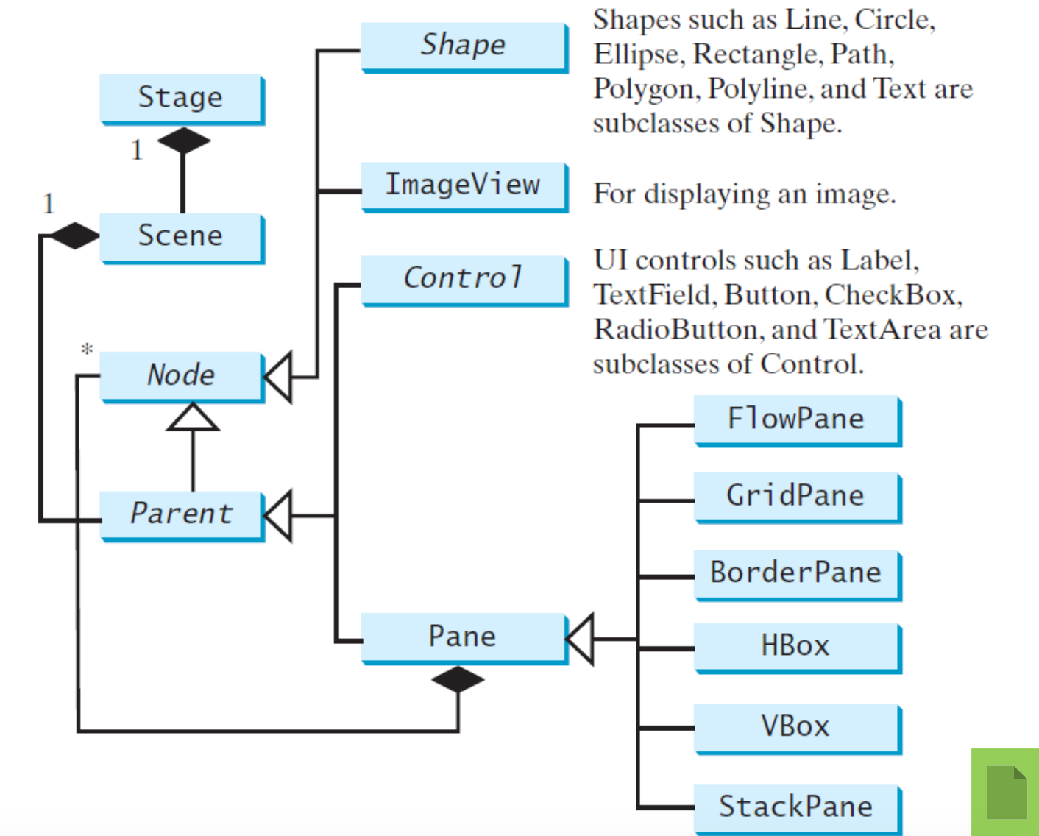

Slide 5
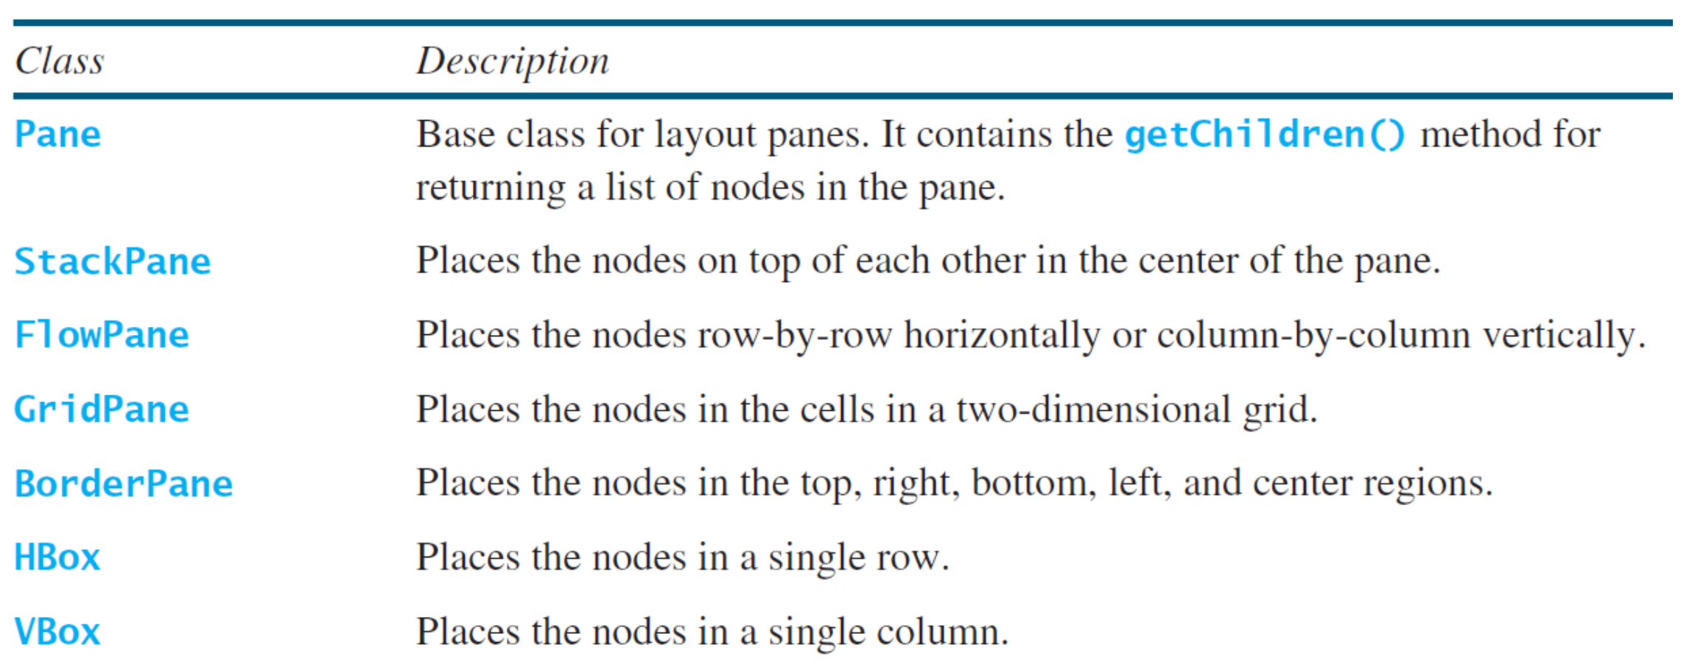

Slide 6
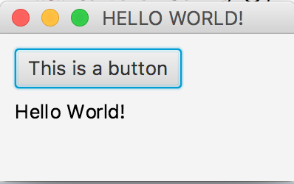
HelloWorld in JavaFX
public class HelloWorld extends Application {
public static void main(String[] args) {
launch(args);
}
@Override
public void start(Stage stage) {
stage.setTitle("HELLO WORLD!");
VBox vbox = new VBox(); //create pane
vbox.setPadding(new Insets(10)); //add space
vbox.setSpacing(8); //vertical space between nodes
// add two nodes
vbox.getChildren().add(new Button("This is a button"));
vbox.getChildren().add(new Text("Hello World!"));
//create scene
Scene scene = new Scene(vbox, 200, 100);
stage.setScene(scene);
stage.show();
}
}

Slide 7
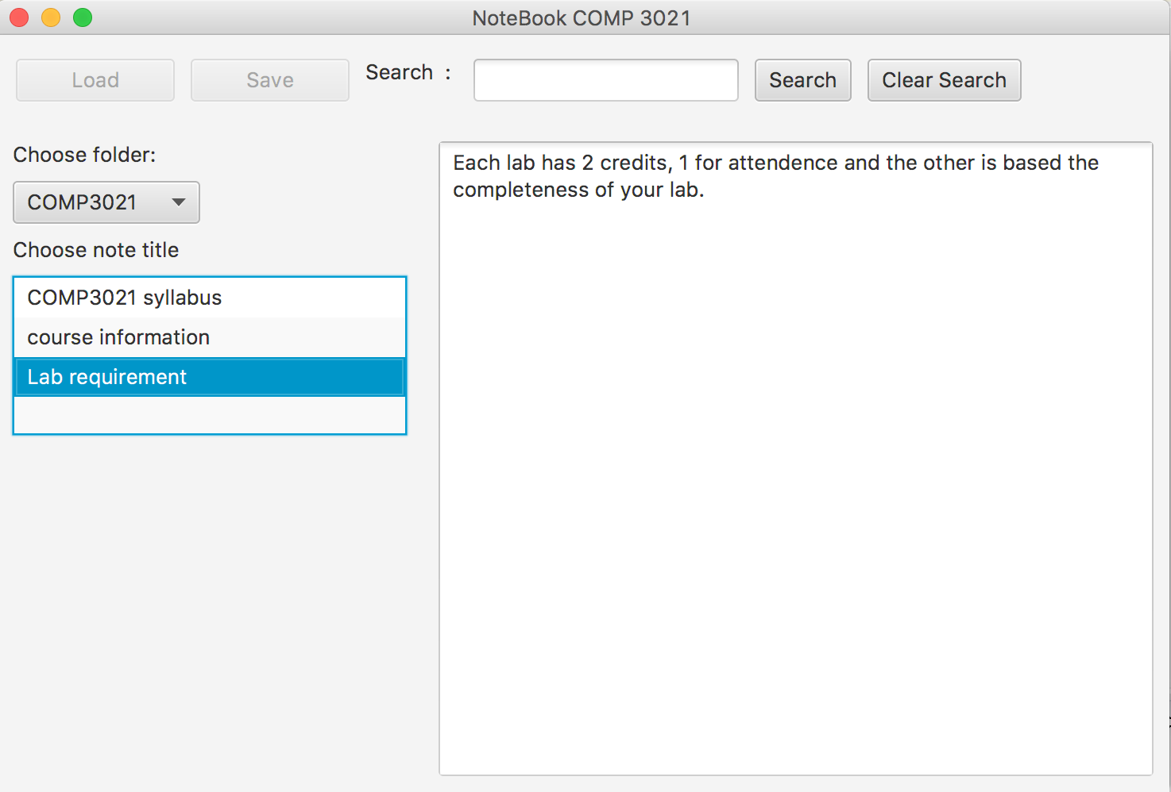
LAB #6 Final Result

Slide 8
TASK 1: Import the initial JavaFX class
Download the NoteBookWindow.java class from Canvas.
Copy this file under base package, where we implemented lab 2 – 4.
Get familiar with the class methods and fields

Slide 9
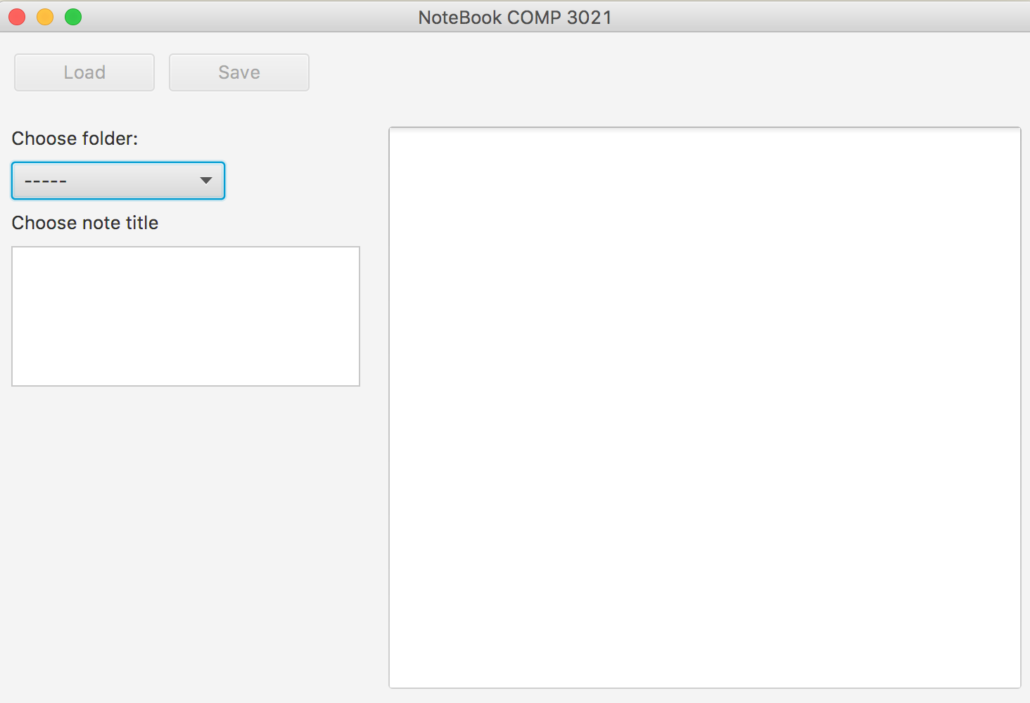
If you run the class you should see this

Slide 10
TOP PANE
CENTER PANE
LEFT PANE

Slide 11
TOP PANE
addGridPane
CENTER PANE
LEFT PANE
addHBox
addVBox

Slide 12
ComboBox<String> foldersComboBox
TextArea textAreaNote
ListView<String> titleslistView

Slide 13
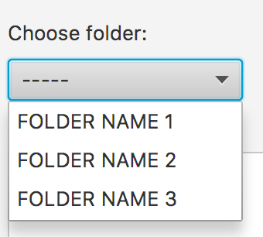
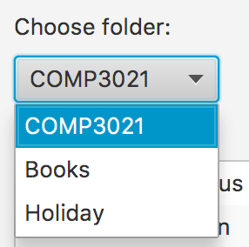
TASK 2: Populate the foldersComboBox
The foldersComboBox shows:
You have to load the folder names from the noteBook object.
Your comboBox should be like this

Slide 14
TASK 2: Populate the foldersComboBox
To achieve this replace this statement in the function addVBox with appropriate code
HINT: access the noteBook object and get all folder names.
foldersComboBox.getItems().addAll("FOLDER NAME 1", "FOLDER NAME 2", "FOLDER NAME 3");

Slide 15
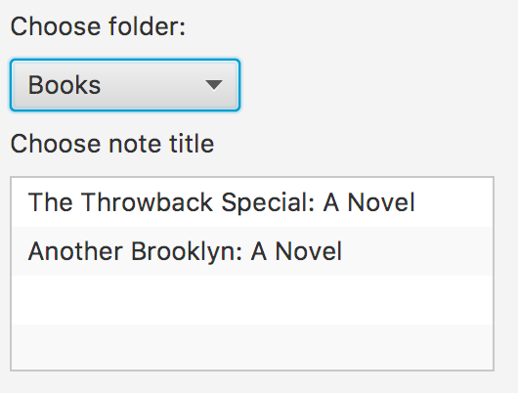
TASK 3: Populate the titlesListView
Once the user selects a folder from the comboBox, the titlesListVIew has to be updated with the titles of ALL TextNote objects in the selected folder

Slide 16
TASK 3: Populate the titlesListView
To achieve this, you have to add code to the function updateListView, invoked from the change listener of the foldersComboBox
This will be called every time the selection of foldersComboBox changes!
foldersComboBox.getSelectionModel().selectedItemProperty().addListener(new ChangeListener<Object>() {
@Override
public void changed(ObservableValue ov, Object t, Object t1) {
currentFolder = t1.toString();
// this contains the name of the folder selected
// TODO updatelistview
updateListView();
}
});

Slide 17
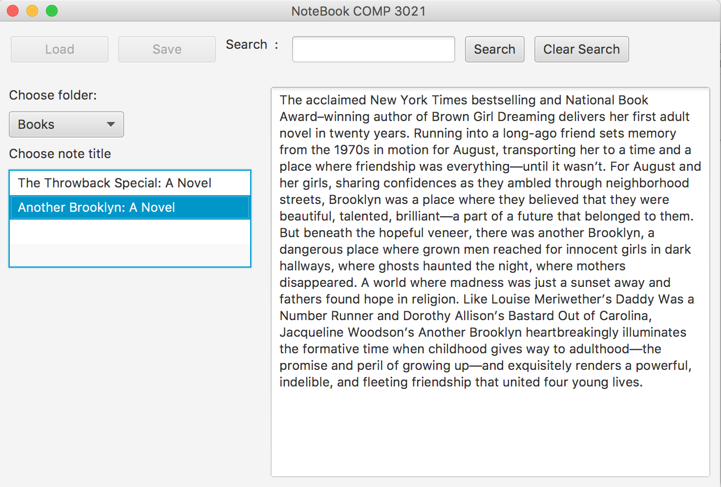
TASK 4: Populate the textAreaNote
Once the user selects a Note title from the titleslistView, the TextArea textAreaNote has to be loaded with the content of the selected note

Slide 18
TASK 4: Populate the textAreaNote
To achieve, this complete the code invoked from the change listener of the titlelistView
This will be called every time the selection of titleslistView changes!
titleslistView.getSelectionModel().selectedItemProperty().addListener(new ChangeListener<Object>() {
@Override
public void changed(ObservableValue ov, Object t, Object t1) {
if (t1 == null)
return;
String title = t1.toString();
// This is the selected title
// TODO load the content of the selected note in
// textAreNote
String content = "";
textAreaNote.setText(content);
}
});

Slide 19
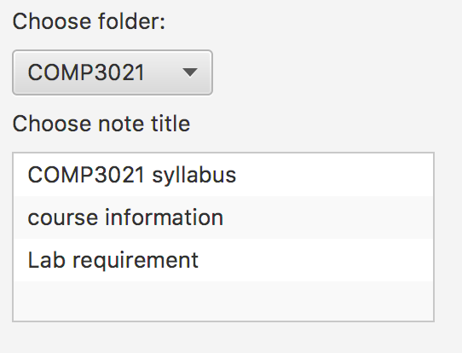
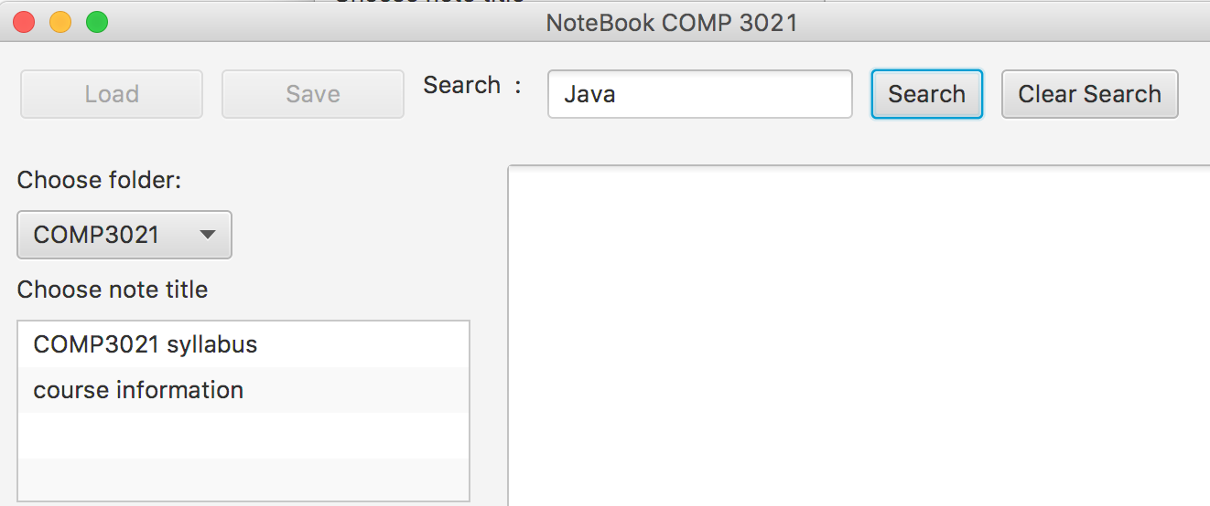
TASK 5: Invoke the search function that you implemented in LAB3
If the user search ”Java” show in titleslistView ONLY those titles in the selected Folder that are returned by the function
List<Note> notes = note.searchNotes(currentSearch);
“Lab requirement” does not contain the word Java

Slide 20
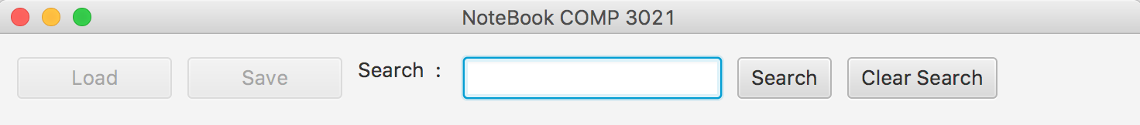
TASK 5: Invoke the search function that you implemented in LAB3
Create one Label, TextField and two Button objects, and add them in the top pane in the function addHBox, as show below
Remember to add them to the hbox object
Label TextField Button Button
hbox.getChildren().addAll(………

Slide 21
TASK 5: Invoke the search function that you implemented in LAB3
Add the listener for the click button of “Search”
HINT can we modify the method updateListView and invoke it?
Button buttonSearch = new Button("Search");
buttonSearch.setOnAction(new EventHandler<ActionEvent>() {
@Override
public void handle(ActionEvent event) {
currentSearch = textSearch.getText();
textAreNote.setText("");
TODO
}
});

Slide 22
TASK 5: Invoke the search function that you implemented in LAB3
Add the listener for the click button of “Clear Search”
If a user clicks the button we want to shows ALL the titles of the selected folder!
Button buttonRemove = new Button("Clear Search");
buttonRemove.setOnAction(new EventHandler<ActionEvent>() {
@Override
public void handle(ActionEvent event) {
currentSearch = "";
textSearch.setText("");
textAreNote.setText("");
TODO
}
});

Slide 23
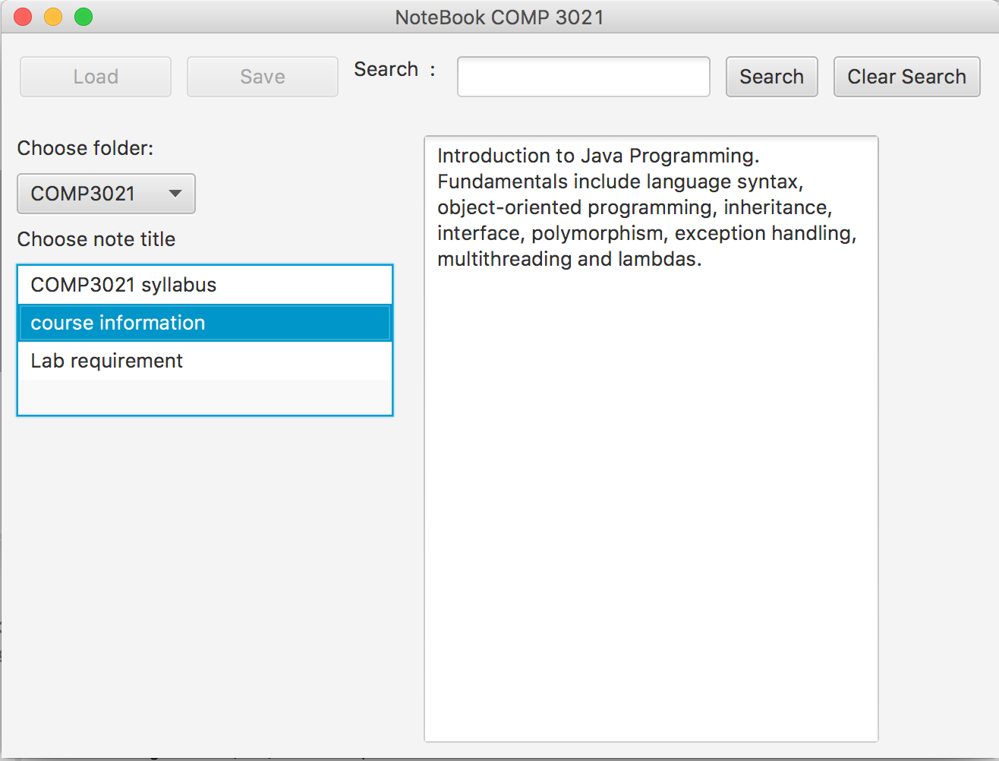
Show a demo of your program to the TAs

Slide 24
END OF LAB #7
Don’t forget to commit and push your code.

