Slide 1
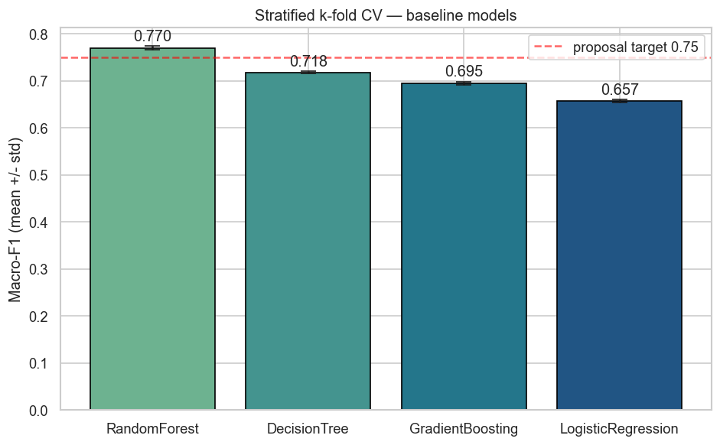
Credit Score
Classification
Customer credit-score classification built on financial behavior data
0.8114
0.8187
0.8122
Final Holdout Macro-F1
Accuracy
Macro-Recall
Data Science Term Project | Team 6
Notes:
프로젝트 목표, 데이터셋, 최종 성능을 한 장에서 먼저 보여준다.

Slide 2
OBJECTIVE
Project goal: multi-class classification for credit-evaluation automation
Credit_Score
28 features
3-class
Evaluated primarily on Macro-F1
Prediction Target
Input Scope
Primary Task
Good / Standard / Poor
personal + financial behavior
multi-class classification
Target distribution is imbalanced, dominated by Standard
Misclassifying Poor as Good inflates default risk
Misclassifying Good as Poor loses business opportunity
Macro-F1 weighs all three classes equally
Goal: Macro-F1 >= 0.75, per-class Recall >= 0.70
Business goals
Objective credit ratings usable for loan approval, credit-limit changes, and interest-rate setting
Provide consistent scoring for identical customer profiles to complement human judgment
Identify Poor-grade customers up front to control non-performing loan risk
Technical goals
Compare Logistic Regression, Random Forest, and Gradient Boosting against a Decision Tree baseline
End-to-end preprocessing that cleans placeholders, impossible outliers, and dirty numeric data
Validate 3 scalers x 3 encoders, imbalance handling, and GridSearchCV in actual code
01 Objective
Team 6 Data Science Term Project
Notes:
제안서의 프로젝트 목표를 기반으로 하되 실제 코드에서 수행한 모델 비교와 평가 방식까지 반영한다. 이 페이지에는 최종 모델 결과를 넣지 않는다.

Slide 3
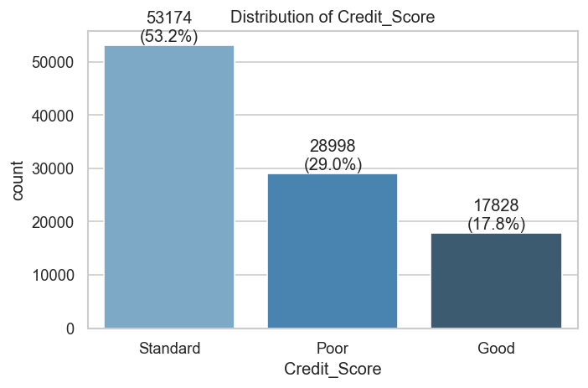
DATASET
Dataset structure and target distribution
Main feature groups
Group
Examples
Customer / profile
Age, Occupation
Income
Annual_Income, Monthly_Inhand_Salary
Credit behavior
Credit_Utilization_Ratio, Outstanding_Debt
Loan history
Num_of_Loan, Type_of_Loan
Payment history
Num_of_Delayed_Payment, Delay_from_due_date
Spending behavior
Payment_Behaviour, Monthly_Balance
02 Data
Team 6 Data Science Term Project
Notes:
타깃 분포와 feature 종류를 소개한다. 이후 전처리와 평가 지표 선택으로 자연스럽게 이어간다.

Slide 4
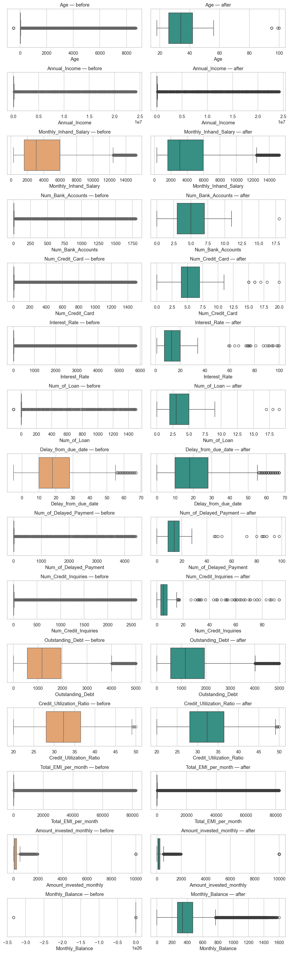
DATA QUALITY
Raw data assessment
Issues identified
Numeric values are stored as object/string
Trailing underscores corrupt numeric-like values
Placeholders (_, _______, !@9#%8) are used to mean missing
Physically impossible extreme outliers in Age, Interest_Rate, Num_of_Loan, etc.
Credit_History_Age is a string like '22 Years and 1 Months'
Each customer has 8 monthly records, enabling per-customer imputation
Preprocessing strategy
Replace obviously invalid values with NaN using domain bounds
Per-Customer_ID ffill/bfill, then a pipeline imputer for remaining gaps
Engineer ratio features that capture financial burden and behavior
03 Preprocessing
Team 6 Data Science Term Project
Notes:
boxplot은 이상치가 많다는 근거로 사용한다. 너무 세부 수치보다 전처리 필요성을 말한다.

Slide 5
PIPELINE
Preprocessing pipeline
1
Placeholder → NaN
2
Numeric coercion
3
History age parsing
Remove _, _______, !@9#%8
Strip underscore and cast to numeric
Years/Months -> total months
4
ID removal
5
Domain cutoff
6
Customer impute
Drop ID, Name, SSN
Replace out-of-range values with NaN
Per-Customer_ID ffill/bfill
7
Loan encoding
8
Feature engineering
9
Model pipeline
Type_of_Loan multi-label binary encoding
Debt/income, EMI/salary, and other ratios
imputer + scaler + encoder
03 Preprocessing
Team 6 Data Science Term Project
Notes:
한 장에서 전체 전처리 흐름을 순서대로 설명한다.

Slide 6
BEFORE → AFTER DATA PREPROPE
Real before/after preprocessing examples
Case
Raw value
After preprocessing
Meaning
Numeric-like string
Age = 28_
Age = 28
Strip trailing underscore from numeric-like string and cast to numeric
Dirty income
Annual_Income = 34847.84_
Annual_Income = 34847.84
Same numeric coercion applied to the income column
Domain outlier
Age = -500 or 7580
Age = NaN
Impossible human age, dropped by domain cutoff
Loan count outlier
Num_of_Loan = 967 or -100
Num_of_Loan = NaN
Only 0-20 loans are treated as valid
Monthly balance error
Monthly_Balance = __-333333...__
Monthly_Balance = NaN
Negative-balance placeholder extreme removed
Customer impute
Monthly_Inhand_Salary = NaN
1824.843333
Filled from another month of the same Customer_ID
03 Preprocessing
Team 6 Data Science Term Project
Notes:
실제 raw data에서 나온 값과 전처리 후 값을 비교한다. 전처리가 왜 필요한지 가장 직관적으로 보여주는 슬라이드다.

Slide 7
TRANSFORMATION
Real data-transformation examples
Type_of_Loan multi-label encoding
Per-Customer_ID missing-value imputation
Raw value
Auto Loan, Credit-Builder Loan, Personal Loan, and Home Equity Loan
Month record
Raw salary
After
1
1824.843333
1824.843333
After
Loan_Auto_Loan=1 | Loan_Credit-Builder_Loan=1 | Loan_Personal_Loan=1 | Loan_Home_Equity_Loan=1
2
NaN
1824.843333
3
NaN
1824.843333
4
NaN
1824.843333
03 Preprocessing
Team 6 Data Science Term Project
Notes:
실제 데이터 하나를 사용해 Type_of_Loan이 여러 binary column으로 바뀌는 것과 ratio feature 계산을 보여준다.

Slide 8
FEATURE ENGINEERING
Real data-transformation examples
Feature
Definition
Meaning
Debt_to_Income
Outstanding_Debt / Annual_Income
Debt burden relative to income
EMI_to_Salary
Total_EMI_per_month / Monthly_Inhand_Salary
Repayment burden relative to monthly salary
Savings_Rate
Amount_invested_monthly / Monthly_Inhand_Salary
Savings / investment behavior
Delay_per_Loan
Num_of_Delayed_Payment / Num_of_Loan
Delay tendency normalized by loan count
New feature
Actual calculation example
Result
Debt_to_Income
809.98 / (19114.12 + 1)
0.0424
EMI_to_Salary
49.574949 / (1824.843333 + 1)
0.0272
Savings_Rate
80.415295 / (1824.843333 + 1)
0.0440
Delay_per_Loan
7 / (4 + 1)
1.4000
03 Preprocessing
Team 6 Data Science Term Project
Notes:
비율형 feature가 왜 중요한지 설명한다. 금액 수준과 부담 수준은 다르다는 점을 강조한다.

Slide 9
COLUMN MAP
Per-column meaning and preprocessing summary
Column group
Key columns
Meaning
Preprocessing
Identifiers
ID, Customer_ID, Name, SSN
Row / customer identifiers
Drop ID, Name, SSN; drop Customer_ID after imputation
Profile
Age, Occupation
Basic customer profile
Numeric coercion of Age, NaN outside 18-100, mode-impute Occupation
Income
Annual_Income, Monthly_Inhand_Salary
Annual income / monthly take-home pay
Strip underscore, cast numeric, median imputation
Credit usage
Outstanding_Debt, Credit_Utilization_Ratio
Debt amount and credit utilization
Numeric coercion, drop negative/unrealistic values, derive ratio features
Loan
Num_of_Loan, Type_of_Loan
Loan count and loan type
Bound loan count, MultiLabelBinarize Type_of_Loan
Payment delay
Delay_from_due_date, Num_of_Delayed_Payment
Days overdue and number of delayed payments
Drop negatives, NaN out-of-range, derive Delay_per_Loan
Credit history
Credit_History_Age
Length of credit history
Convert 'Years and Months' string to total months
Spending
Amount_invested_monthly, Monthly_Balance, Payment_Behaviour
Investment / balance / spending behavior
Numeric coercion, drop negatives, derive Savings_Rate
03 Preprocessing
Team 6 Data Science Term Project
Notes:
컬럼을 하나씩 나열하기보다 발표에서 설명하기 쉬운 컬럼 그룹별 표로 정리했다.

Slide 10
EXPERIMENT DESIGN
Stage-by-stage flow: preprocessing comparison to final evaluation
Step 1
Outlier-handling comparison
none / domain / domain_percentile
Step 2
Imbalance-handling comparison
none / class_weight / SMOTE
Quantify the effect of outlier handling on performance
Test whether imbalance handling actually raises Macro-F1
Step 3
Preprocessing-combination comparison
3 scalers × 3 encoders = 9
Step 4
Model comparison
LR / DT / RF / GB
Compare numeric scaling x categorical encoding combinations
Compare models from a linear baseline to tree ensembles
Step 5
Hyperparameter tuning
GridSearchCV on best model
Step 6
Final hold-out evaluation
20% holdout
Tune n_estimators, max_depth, etc. on the best model
Inspect confusion matrix and per-class precision / recall / F1
04 Experiments
Team 6 Data Science Term Project
Notes:
조건이라는 표현 대신 단계별 실험 흐름으로 설명한다. Step 1~3은 ablation, Step 4~6은 모델 선택과 최종 평가다.

Slide 11
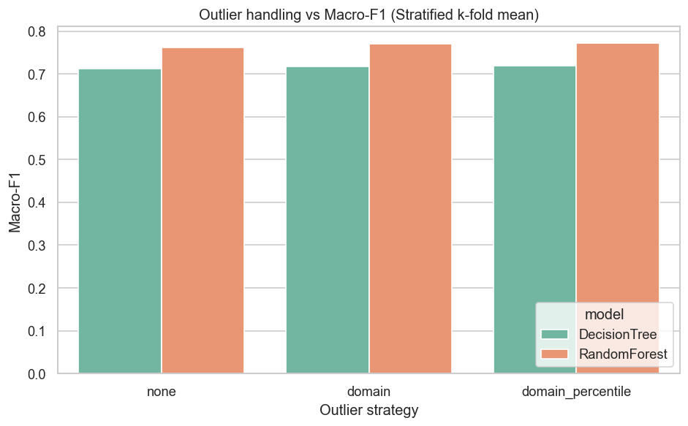
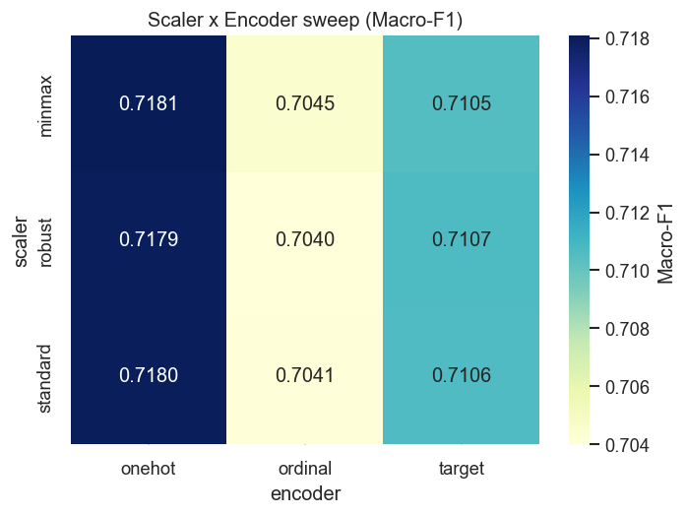
ABLATION
Preprocessing comparison: validating outlier and encoder choices
Outlier mode
Criterion
Treatment
none
No baseline
Use raw values without any outlier handling
domain
Analyst-defined realistic ranges
Age 18-100 | Bank Accounts 0-20 | Credit Card 0-20 | Interest Rate 0-100 | Loan 0-20 | Delayed Payment 0-100 | Credit Inquiries 0-100 | Drop negatives on Due Date / Balance
domain_percentile
domain + statistical extremes
After domain pass, NaN the bottom 0.5% and top 0.5% of every numeric column
Outlier comparison: none / domain / domain_percentile
Preprocessing matrix: 3 scalers (Standard, MinMax, Robust) x 3 encoders (OneHot, Ordinal, Target) = 9 combinations
Domain-based outlier removal is more stable than none, and OneHotEncoder yields the most consistent performance
04 Experiments
Team 6 Data Science Term Project
Notes:
Ablation은 선택한 전처리가 감에 의한 것이 아니라 실험으로 검증되었다는 근거다.

Slide 12
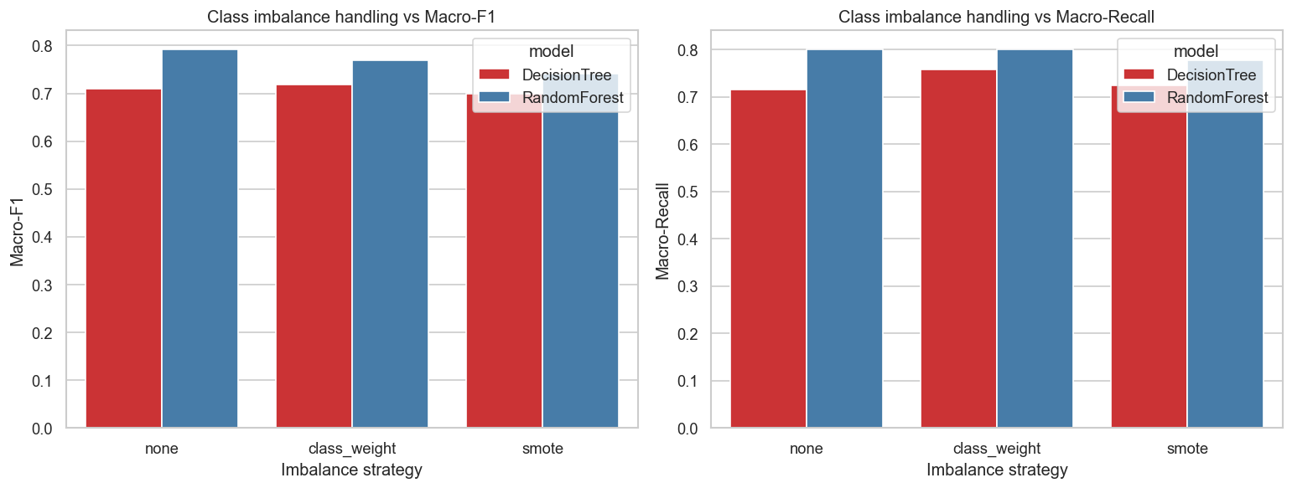
IMBALANCE
Imbalance-handling comparison results
Strategies compared
None: leave class imbalance untouched
class_weight='balanced': stronger weights for minority classes
SMOTE: synthesize minority-class samples
Findings
On Random Forest, the 'None' strategy yields the highest Macro-F1
SMOTE's linear interpolation likely injects noise into financial-behavior distributions
Imbalance handling must be validated empirically
04 Experiments
Team 6 Data Science Term Project
Notes:
불균형 데이터라서 처리 전략을 비교했지만, 결과적으로 모든 imbalance 처리 방법이 좋은 것은 아니었다.

Slide 13
MODELS
Models compared
Logistic Regression
Linear baseline
Decision Tree
Interpretable tree
Fast and interpretable, but limited on non-linear interactions
Rule-based splits; single tree risks overfitting
Random Forest
Bagging ensemble
Gradient Boosting
Boosting ensemble
Voting across trees is robust to noise and non-linear patterns
Iteratively corrects weak learners, but sensitive to settings
05 Modeling
Team 6 Data Science Term Project
Notes:
모델 네 개를 비교한 이유를 설명한다. Random Forest가 왜 후보로 적절했는지 미리 깔아준다.

Slide 14
EVALUATION
Evaluation strategy: CV-based model comparison and tuning
1
Model comparison
2
GridSearchCV
3
Holdout Evaluation
Compare four models via Stratified k-fold CV
Search optimal hyperparameters on the best model
Compute confusion matrix and per-class metrics on a 20% hold-out split
Metric
Why it matters
Accuracy
Check overall prediction accuracy
Macro-F1
Plain arithmetic mean of per-class F1 scores
Macro-Recall
Check that no class is being missed
Confusion Matrix
Diagnose which classes are confused with each other
06 Evaluation
Team 6 Data Science Term Project
Notes:
평가 방식의 타당성을 설명한다. 불균형이 있기 때문에 macro metric을 쓴다는 점이 핵심이다.

Slide 15
MODEL RESULTS
Model-comparison results
Model
Macro-F1
Macro-Recall
Accuracy
Random Forest
0.7697
0.8001
0.7794
Decision Tree
0.7179
0.7584
0.7239
Gradient Boosting
0.6948
0.7038
0.7142
Logistic Regression
0.6567
0.7032
0.6647
Why Random Forest wins
Captures non-linear financial patterns and feature interactions
Voting across trees is more stable than a single tree
Relatively robust to noise and outliers in tabular data
06 Evaluation
Team 6 Data Science Term Project
Notes:
모델 비교의 핵심 결과다. 숫자를 읽고 왜 RF가 좋은지 연결한다.

Slide 16
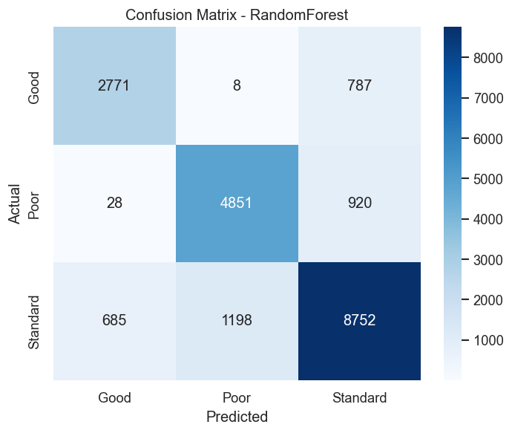
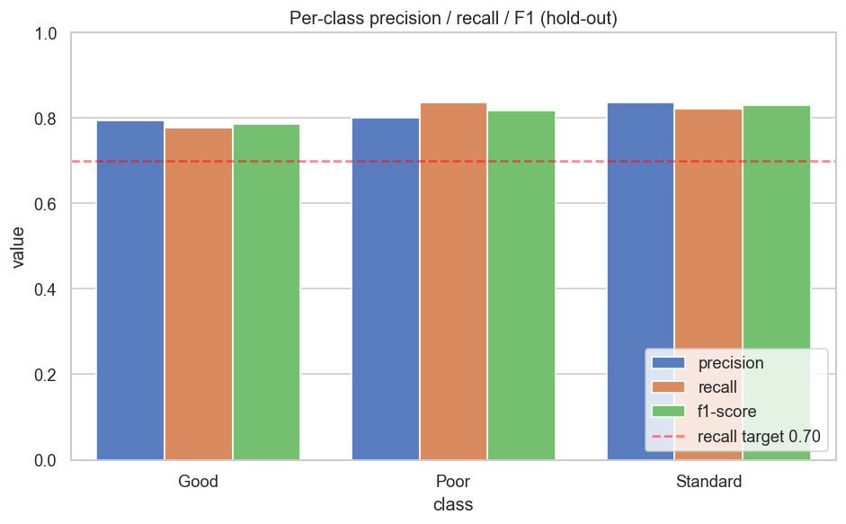
FINAL EVALUATION
Final model: Random Forest
0.8187
0.8114
0.8122
Best parameters
n_estimators=400 | max_depth=None | min_samples_leaf=1
Holdout Accuracy
Holdout Macro-F1
Holdout Macro-Recall
Tuning setup
GridSearchCV: Stratified 5-fold, scoring=f1_macro
Search grid: n_estimators [200, 400]
max_depth [15, 25, None], min_samples_leaf [1, 5]
07 Final Model
Team 6 Data Science Term Project
Notes:
최종 모델의 핵심 지표와 confusion matrix, per-class metric을 보여준다.

Slide 17
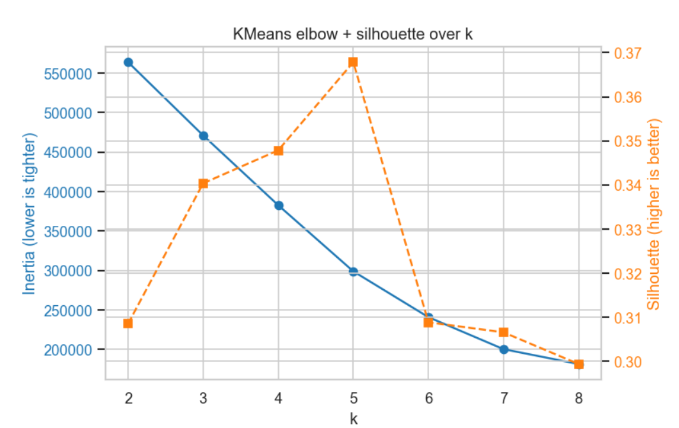
AUXILIARY TASKS
Auxiliary analyses: Regression & Clustering
Regression -- Monthly_Balance prediction
Clustering -- spending-behavior clusters
Regression predicting end-of-month balance from the remaining features
KMeans (k=4) on 7 spending / saving features
Model R^2 MAE
Ridge 0.70 83.18
GradientBoosting 0.92 * 33.14
-> GradientBoosting explains 92% of end-of-month balance variance (R^2 = 0.92)
-> Silhouette peaks at k=5 (0.37); k=4 chosen by the elbow heuristic
Team 6 Data Science Term Project

Slide 18
Learning Experience
Learning Experience
Key insights and improvements gained while running the project
Challenges and resolutions
Lessons learned
01
Windows SMOTE OpenMP DLL conflict
01
SMOTE does not always improve performance
-> Resolved by pinning llvm-openmp / intel-openmp in environment.yml
Tree ensembles already handle imbalance; SMOTE can backfire
02
Complexity of dirty-data preprocessing
02
Encoder choice matters more than scaler choice
-> Systematized into a 9-step placeholder / underscore / domain-cutoff pipeline
Categorical encoding has a more direct impact on performance than numeric scaling
03
From notebook to package
03
Automated artifact persistence
-> Split into 8 src/ modules; reproducible end-to-end via `python -m src.train --all`
Auto-saving every experiment shortened report writing and locked in reproducibility
Team 6 Data Science Term Project
8

Slide 19
Open Source SW
The full source has been published on GitHub; the src/ module layout makes the pipeline fully reproducible.
오픈소스 공개 github.com/Hanharam/DS-credit-score-project
src/ 모듈 구조
— cleaning, imputation, feature engineering
preprocessing.py
— 모델 정의 및 파라미터 그리드
model.py
— CV, holdout, GridSearch, ablations
evaluate.py
— regression, clustering
auxiliary.py
— 시각화, EDA, 전체 파이프라인 CLI
visualize.py / eda.py / train.py
9
Team 6 Data Science Term Project

Slide 20
Open Source SW Contribution -- Full Sweep
Single top-level function run_full_sweep() (src/sweep.py) evaluates every scaler x encoder x model x hyperparameter combination via Stratified k-fold CV and returns the leaderboard, top 5, and best configuration. Executed on an 8,000-row stratified subsample with 3-fold CV (135 configurations, 405 fits, ~33 min).
Rank | Scaler | Encoder | Model | Params | Macro-F1 (mean +/- std)
1 | minmax | ordinal | RandomForest | n_estimators=400, max_depth=15 | 0.6962 +/- 0.0035
2 | standard | ordinal | RandomForest | n_estimators=400, max_depth=15 | 0.6942 +/- 0.0032
3 | robust | ordinal | RandomForest | n_estimators=400, max_depth=15 | 0.6940 +/- 0.0032
4 | standard | onehot | RandomForest | n_estimators=400, max_depth=15 | 0.6938 +/- 0.0043
5 | minmax | onehot | RandomForest | n_estimators=200, max_depth=15 | 0.6938 +/- 0.0050
BEST: RandomForest | minmax + ordinal | n_estimators=400, max_depth=15 | Macro-F1 = 0.6962

