Slide 1

Jar test method
Submitted to Dr Asif by Zulfiqar ali

Slide 2
Introduction
Raw water has impurities (particles) in suspension which can lead to turbidity, odor and taste problems.
These impurities stay suspended in solution due to their small size and because they carry a negative electrostatic charge. This means that they repulse each other and thus stay in suspension. (they do not settle out of solution)
To remove these particles, they must agglomerate and grow in size in order to settle out of solution.
To promote agglomeration of particles, a chemical coagulant (aluminum or iron salts) is used.
The chemical coagulant has positive charges, therefore, it neutralizes the negative electrostatic charges of the particles and brings them together causing them to agglomerate and settle.

Slide 3
COAGULATION PROCESS
Chemical coagulants are added to the raw water and for a brief period rapid mixing is carried out in order to evenly distribute the coagulant throughout the solution.
Having produced the microfloc, the objective is then to produce a floc of adequate size that will settle under gravity.

Slide 4
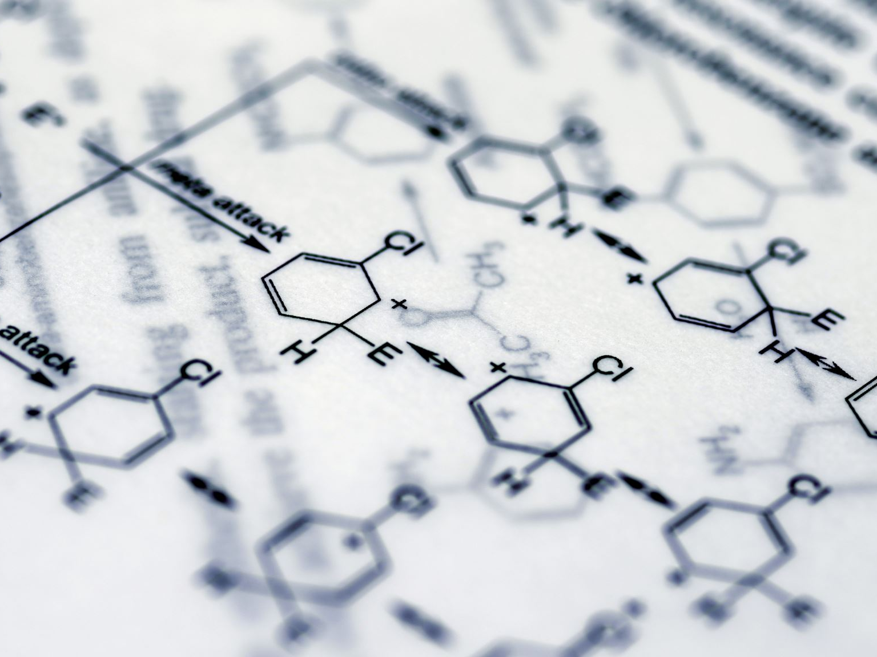
Flocculation Process
Flocculation is a gentle or slow mixing. It causes the microfloc produced by the coagulant to grow in size and form a floc heavy enough to settle out of solution.

Slide 5
Aluminum Sulfate
To produce the hydroxide floc, enough alkalinity should present in the water
If alkalinity is not enough, then it should be added. Usually hydrated lime is used for that purpose (optimum pH is 4.5 – 8)

Slide 6
Ferrous Sulfate
Requires alkalinity in the form of hydroxide to react rapidly [Ca(OH)₂]
The pH should be raised to about 9.5 and excess lime is stabilized
More expensive than alum

Slide 7
Ferric Sulfate
It reacts with alkalinity presents in water
Fe(OH)₃ is dense and settle fast
If alkalinity is not enough, hydrated lime is used
Optimum pH is between 4 and 12

Slide 8
Ferric Chloride
It reacts with natural alkalinity
If alkalinity is insufficient, lime is added
Optimum pH is 4 - 12

Slide 9

What is the Jar Test
The jar test is a common laboratory procedure used to determine the optimum dose of different coagulants, on a small scale in order to predict the functioning of a large scale treatment operating conditions for water or wastewater treatment.

Slide 10
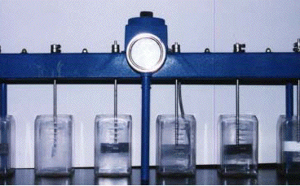

Slide 11
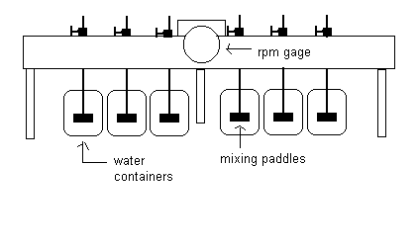

Slide 12
Jar Test Procedure
Fill the jar testing apparatus containers with sample water.
Add the coagulant to each container and stir at approximately 100 rpm for 1 minute.
Reduce the stirring speed to 40 rpm and continue mixing for 40 minutes.
Turn off the mixers and allow the containers to settle for 30 minutes.
Measure the final turbidity in each container.

Slide 13
Thank you…!

