Slide 1
Distance calculator
ITS310
Dr. Berzy
Hani Amer
Dilan Yasin

Slide 2
Criteria
1 - Presentation
2 - Project Demo
3 - Code Review

Slide 3

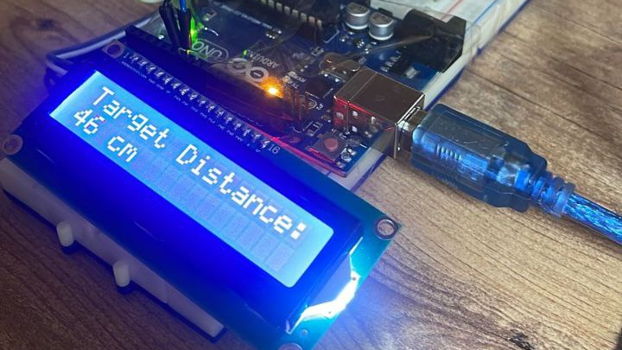

Slide 4
Components
1- Arduino
2 - Bread Board
3 - I2C LCD
4 - Ultra Sonic Sensor
5 - Jumping wires

Slide 5
Why use the Arduino Distance calculator?
1 - Accurate Distance Measurement
2 - Cost-effective Solution
3 - Versatility (Suit your Needs and Applications)
4 - User-friendly Programming (Easy to Debug Any Error Or Problem)
5 - Wide Range of Applications (In Home, In Automation.. etc)

Slide 6
Demonstration

Slide 7
CODE

Slide 8
Any Question?

