Slide 1

Loop Engineering
A new paradigm in AI engineering — where agents don't just respond, they reason, act, observe, and repeat until the task is done.
AGENTIC AI
ENGINEERING PRINCIPLES
PRODUCTION SYSTEMS

Slide 2
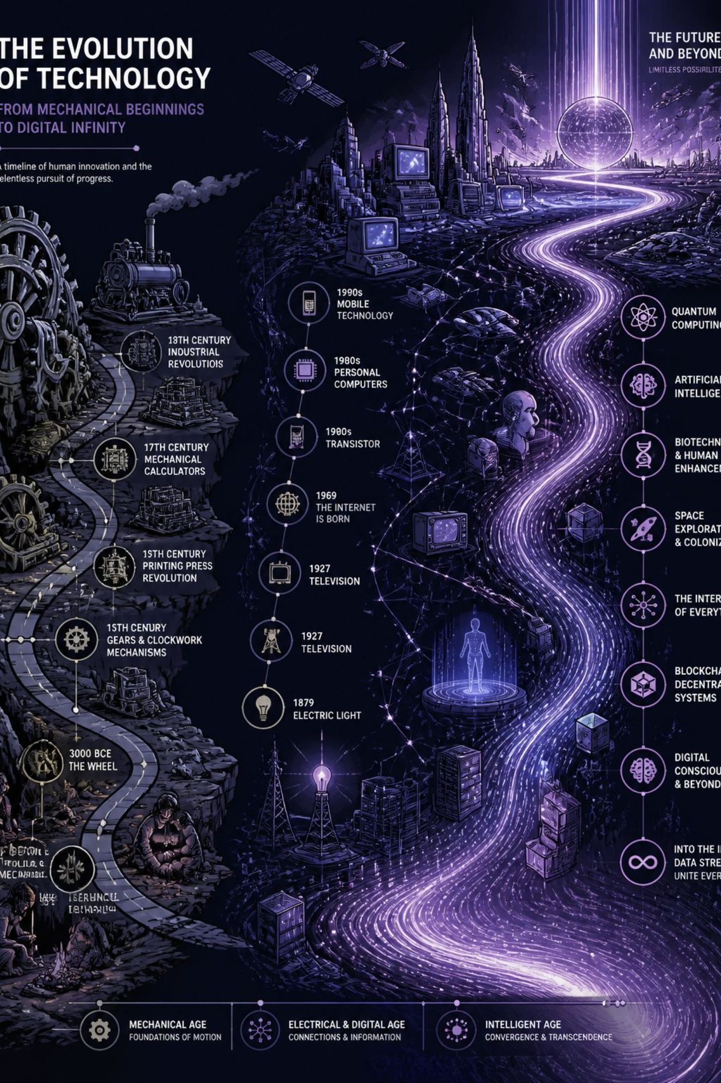



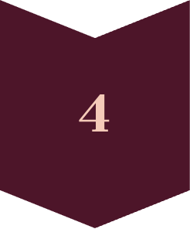
Why Is Everyone Talking About It?
Peter Steinberger (OpenAI) and Boris Cherny (Anthropic) have championed this shift. Modern AI products are no longer just chatbots — they're becoming agents.
Prompt Engineering
Context Engineering
Agent Engineering
Loop Engineering

Slide 3












How Does a Loop Work?
The conceptual lifecycle of an AI agent — from initial discovery through repeated refinement.
Discover
Plan
Understand the task
Devise a strategy
Repeat
Execute
Iterate until done
Take action
Reflect
Observe
Evaluate outcomes
Monitor results
This explains what happens during execution. But production systems require much more than a simple loop.

Slide 4






From Conceptual Loops to Production Loops
Addy Osmani's six primitives for engineering production-ready agent loops.
Automations
Trigger recurring work
Worktrees
Safe parallel execution — each agent gets an isolated workspace sharing the same repository history
Skills
Reusable knowledge
Plugins / MCP
Tool integration
Sub-Agents
Specialized responsibilities
Persistent Memory
Long-term state

Slide 5

What Makes a Good Loop?
Beyond components — these are the design decisions engineers face:
Should I retry? Should I stop?
Should I ask another agent? Should I verify?
Should I use another tool? What should I remember?
Key Metrics to Optimize
Iteration Reality
Success Rate
Cost & Latency
Number of Iterations
Tool Success Rate
Recovery Rate
Many production agents complete tasks in ~3–10 iterations. Frameworks expose configurable limits to balance accuracy, latency, and cost.

Slide 6
Framework Support
"The art of loop engineering is designing how an agent iteratively plans, executes, evaluates, and adapts — not simply prompting it." — LangChain
Feature
LangGraph
OpenAI Agents SDK
AutoGen
Durable Exec.
Checkpoints
✅
Trace-based
Partial
—
Tool Calling
✅
✅
✅
—
Human Approval
✅
Partial
Partial
—
State Management
✅
Session
Agent memory
—

Slide 7




REAL-WORLD APPLICATIONS
Loops in Action
How agentic loops solve real problems across domains.
Software Development
Customer Support
Research Assistant
Cybersecurity
Problem: Refunds require verification.
Loop: Read account → Check purchase → Verify policy → Execute refund
Outcome: Policy-compliant automation
Problem: One search rarely finds sufficient evidence.
Loop: Search → Read → Compare → Search again
Outcome: Evidence-backed synthesis
Problem: One alert isn't enough.
Loop: Collect logs → Correlate → Investigate → Escalate
Outcome: Faster incident response
Problem: One prompt can't reliably fix a bug.
Loop: Analyze → Modify → Test → Observe → Retry
Outcome: Autonomous debugging

Slide 8
Challenges & Best Practices
Key Challenges
Best Practices
Infinite loops — agents stuck in unproductive cycles
Cost explosion — each iteration consumes tokens and money
Debugging complexity — tracing multi-step agent behavior is hard
Human oversight — knowing when to escalate to a human
Set configurable iteration limits (typically 3–10)
Use checkpoints for durable execution and recovery
Design clear stop conditions and success criteria
Implement human approval gates for high-stakes actions
Track tool success rates and recovery metrics

Slide 9

Key Takeaways
Loops ≠ One-Shot
Agents reason, act, observe, and repeat — closing the gap between intent and outcome.
Production Requires Primitives
Worktrees, persistent memory, sub-agents, and skills transform loops from demos to systems.
Design Is the Discipline
Good loop engineering means optimizing success rate, cost, latency, and recovery — not just prompting.
Frameworks Enable, You Architect
LangGraph, OpenAI Agents SDK, and AutoGen provide building blocks — the loop design is yours.

Slide 10



What's Next
Loop engineering is still evolving. Here's where the field is headed.
Human-in-the-Loop UX
Designing interfaces where humans and agents collaborate seamlessly
Cost & Latency Optimization
Reducing token usage and iteration overhead at scale
Multi-Agent Orchestration
Coordinating specialized sub-agents for complex workflows
Observability & Debugging
Tracing, logging, and monitoring agent behavior in production
The best loop engineers don't just build agents — they design systems that learn, adapt, and improve over time.

