Slide 1

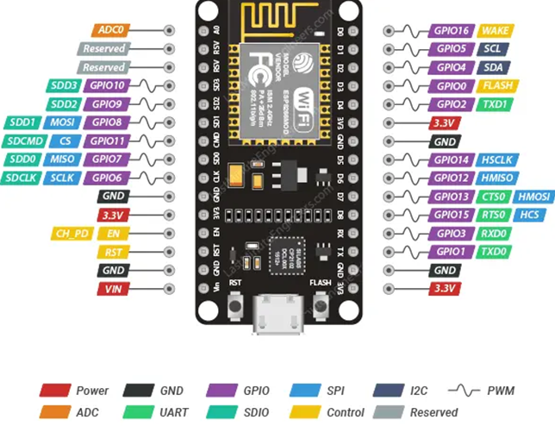
WELCOME
NodeMCU ESP8266
function
operation
services
use
configuration
Notes:
Configuration

Slide 2
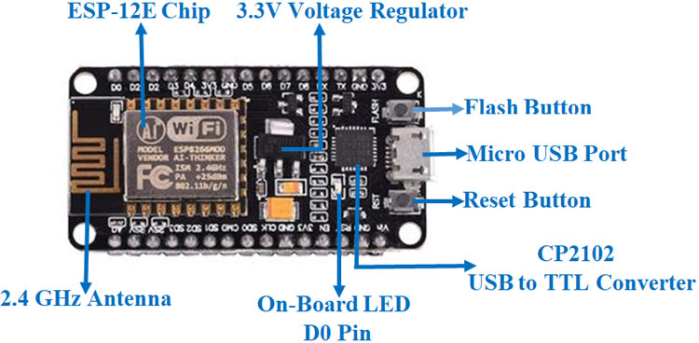
CONFIGURATION
- SRAM: 64 KB
- Clock speed: 80 MHz
- Types of pins include: Power, GND, GPIO, SPI, I2C, PWM, ADC, UART, SDIO, Control, Reserved.
function
operation
use
services
configuration
- Microcontroller: The CPU is a 32-bit Tensilica Xtensa LX106 RISC processor
- Operating voltage: 3.3V
- Input voltage: 7-12V from the VIN pin or 5V from the micro USB port.
- Digital I/O pins (DIO): 16
- Analog input pins (ADC): 1
- Interfaces: UART, SPI, I2C
- Flash memory: 4 MB
Notes:
Operating voltage: 3.3V Types of pins include: Power, GND, GPIO, SPI, I2C, PWM, ADC, UART, SDIO, Control, Reserved.

Slide 3
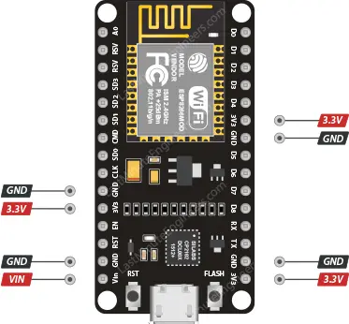
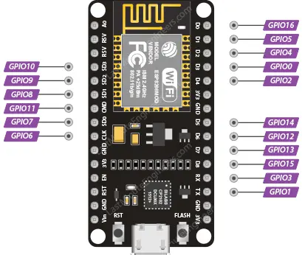
FUNCTION OF THE PINS
2. GPIO pins (General-Purpose Input/Output pins)
1. POWER PIN
operation
function
services
use
configuration
- Total: 17 GPIO pins.
- Each GPIO can be configured internally to the either HIGH or LOW
Notes:
Each GPIO can be configured internally to be either HIGH or LOW.

Slide 4
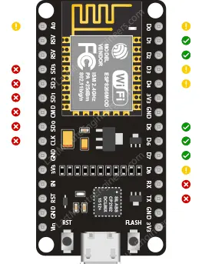
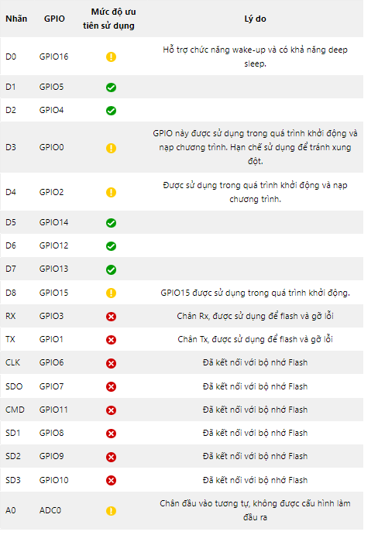
FUNCTION OF THE PINS
Which GPIO pins of ESP8266 are safe to use?
operation
function
services
use
configuration
Notes:
Which GPIO pins of ESP8266 are safe to use?

Slide 5
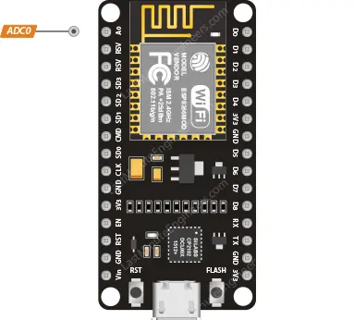
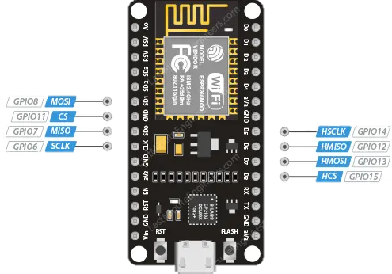
FUNCTION OF THE PINS
3. ADC PIN
4. SPI PIN
operation
function
services
use
configuration
- Read values: 0V → 3.3V
- Two main SPI types: Primary SPI (SPI) and Secondary SPI (HSPI).
- Analog value read from the ADC pin will be converted to a value ranging from 0 to 1023
- 80Hz
- Both support FIFO with a 64-byte buffer
Notes:
Both support FIFO (First-In-First-Out) with a 64-byte buffer.

Slide 6
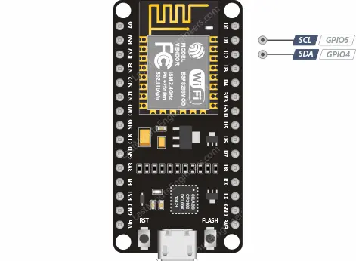
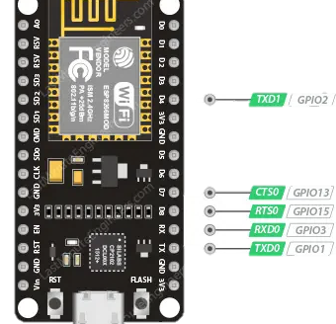
FUNCTION OF THE PINS
5. I2C PIN
6. UART PIN
operation
function
services
use
configuration
- UART0 và UART1
- GPIO4 (SDA) và GPIO5 (SCL)
- TXD0 (Transmit Data 0), RXD0 (Receive Data 0), RST0 (Reset 0) và CTS0 (Clear To Send 0)
- wire.begin(SDA, SCL)
- UART1 communication → TXD1 (Transmit Data 1) pin.
Notes:
Both support FIFO (First-In-First-Out) with a 64-byte buffer.

Slide 7
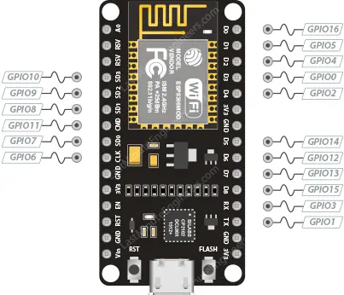
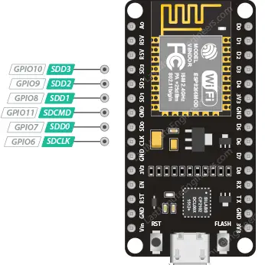
FUNCTION OF THE PINS
7. UART PIN
8. SDIO PIN
operation
function
services
use
configuration
- From GPIO0 to GPIO15
- ESP8266: PWM signals 10-bit resolution
- Supports SDIO v1.1 (4-bit 25 MHz) and SDIO v2.0 (4-bit 50 MHz).
- Frequency range of PWM signal: ~100Hz to 1kHz. Time period: ~1000 μs to 10000 μs.
Notes:
frequency range of the PWM signal is from approximately 100 Hz to 1 kHz.

Slide 8
FUNCTION OF THE PINS
9. INTERRUPT PIN
operation
function
services
use
configuration
All GPIO pins, except GPIO16.
Notes:
Interrupt

Slide 9
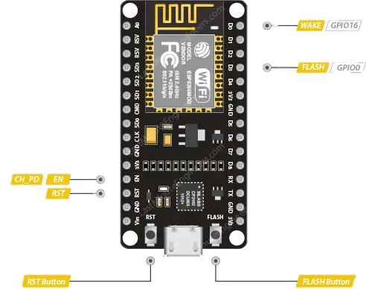
FUNCTION OF THE PINS
10. CONTROL PIN
- EN Pin (CH_PD hoặc Chip Power Down):
+ Default: HIGH level
+ When pulled up to a HIGH level: chip is activated. LOW: chip is disabled
operation
function
services
use
configuration
- RST pin:
+ Default: HIGH level
+ When brought down to a LOW level for a short period: restart.
- FLASH pin:
+ Determines when to enter programming mode during startup.
- WAKE pin:
+ Wake up the ESP8266 from deep sleep mode.
+ LOW level during startup: initiates the programming process.
Notes:
Interrupt

Slide 10
PRINCIPLE OF OPERATION
services
function
use
operation
configuration

Slide 11
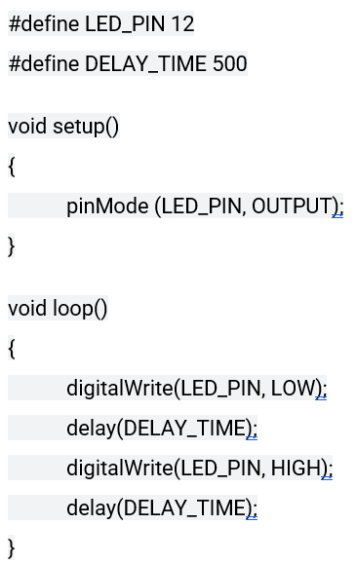
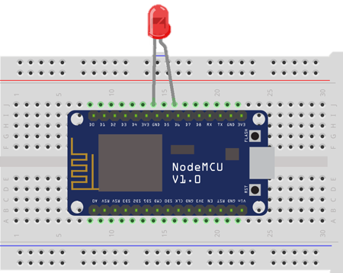
HOW TO USE
Write a program for the ESP to control an LED to blink at a 1-second interval.
Components to prepare include:
- 1 ESP8266 NodeMCU board.
- 1 LED 5mm.
services
use
function
timeline
configuration

Slide 12
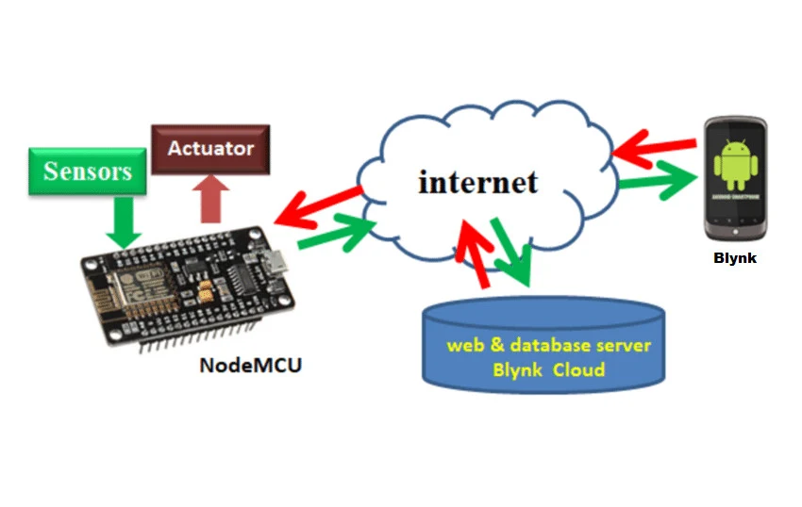
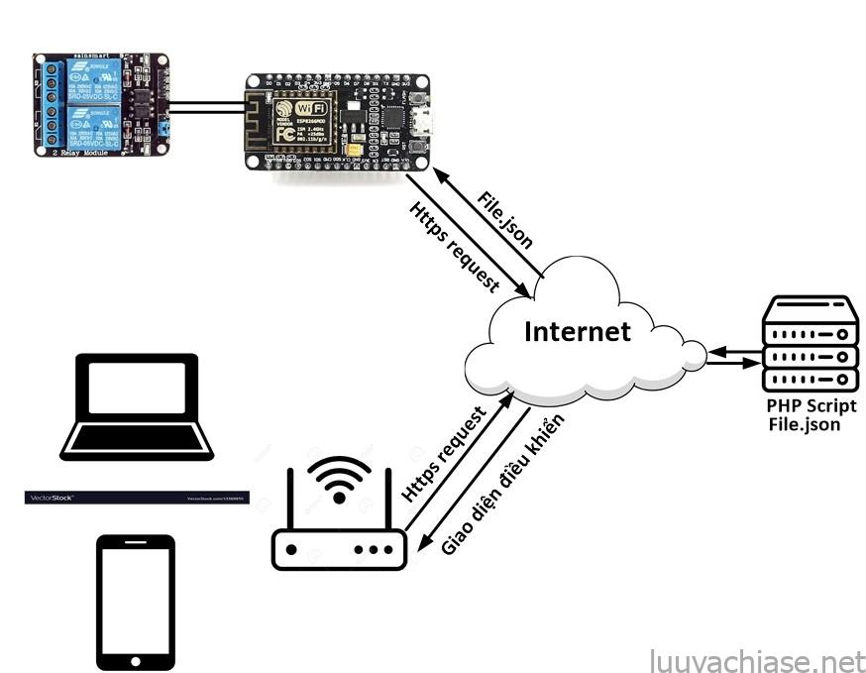



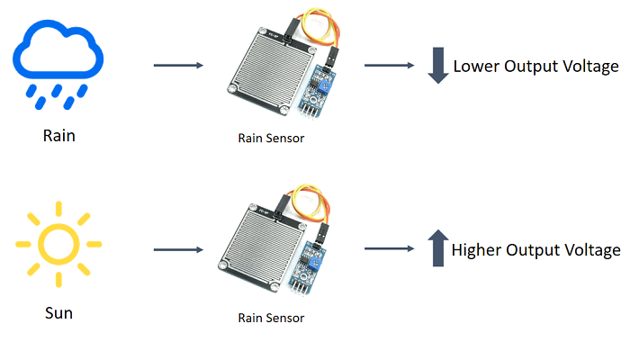



APPLICATION
Home automation.
Collecting data from sensors.
services
function
use
timeline
configuration
Measuring power consumption.
Controlling via Wi-Fi.
Internet Smoked Alarm

