Slide 1
Graphs

Slide 2
Introduction to Graphs
How to describe a complex problem?
Problem | Use | Example
Simple/ Easy | Some data or a list of items | Quadratic equation/ Student management/…
Complex/ Difficult | A graph (draw) | Transportation road map/road network? Relations of airports Drainage net Country’s national electricity grid Computer networks
Graphs are tools for presenting a set of objects in which each object can have relations to others.

Slide 3
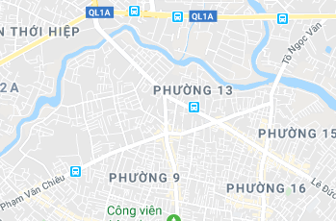

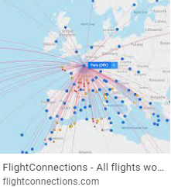
Introduction to Graphs…
Examples:
(From Google map)
Approach 1:
Object: a territory
Relation: Adjacency of 2 territories
Approach 2:
Object: crossroad
Relation: road connecting 2 crossroads
Object: a device
Relation: connection between two devices
Object: an airport
Relation: connection between two airport

Slide 4
Learning Outcomes
LO5.1 Demonstrate graphs and their applications. Define an undirected graph and directed graph.
LO5.2 Explain basic notations about a graph: vertex, edge, adjacent vertices, incident edge,...
LO5.3 Know how to represent a graph using matrix and list
LO5.4 Able to apply BFS and DFS to traverse a graph
LO5.5 Write programs to implement Graph with BFS and DFS traversals using Java
LO5.6 Explain the shortest path problem and Dijkstra’ algorithm.

Slide 5
Learning Outcomes
LO5.7 Write program in Java to implement Dijkstra’s shortest path algorithm.
LO5.8 Define the minimum spanning tree and using the Kruskal’s algorithm to find it.
LO5.9 Define Euler cycle/path and the necessary and sufficient conditions for their existence.
LO5.10 Explain the algorithm to find Euler path / circuit using Stack and implement it in Java language.
LO5.11 Define Halmilton cycle/path and able to determine them using backtracking algorithm.
LO5.12 Demonstrate the graph coloring and can apply Sequential coloring algorithm to color a graph.

Slide 6
Contents
1- Definitions
2- Graph Representation
Basic problems on a graph
3- Graph Traversals
4- Cycle Detection
5- Shortest Paths
6- Spanning Trees – cây phủ
7- Euler Cycles/Paths
8- Halmilton Cycles/Paths
9- Graph coloring
Codes:
Basic codes: 2
Comprehensive codes: 2

Slide 7
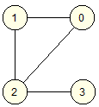
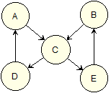
1- Definitions
A graph (G) is a collection of vertices (or nodes, the V set) and the connections (called as edges, the E set between them. G = { V, E }
A vertex is described as a circle.
An edge is described as a link line between two vertices.
Vertex label is information of a vertex which helps to differentiate a vertex with others. In a drawing, the label of a vertex is described using vertex’s key (character/integer).
vertex
vertex’s
label
edge
Graph is applied to manage a group of objects in which one object can link to others.

Slide 8
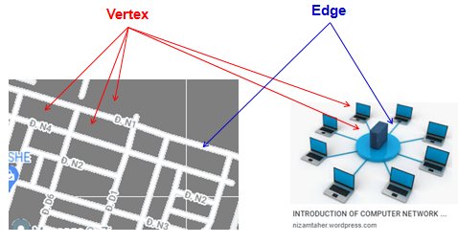
1- Definitions…
Some Real Graphs:
Approach 1: Managing every thing
- Vertex: a territory.
- Edge: Adjacency of 2 territories
Approach 2: Managing roads only
- Vertex: a crossroad.
- Edge: road connecting 2 crossroads

Slide 9
1- Definitions…
Graph Classification:
Based on direction of edges:
Based on number of edges connection two vertices.
Based on whether or not edges are evaluated. An edge may have proper data (a number).
➔ Mix graph: a graph having multiple properties.

Slide 10
1- Definitions…
Classification based on edge’s direction:
Undirected graph / directed graph (digraph)
➔ In a directed graph, each edge has it’s own direction (orientation)

Slide 11
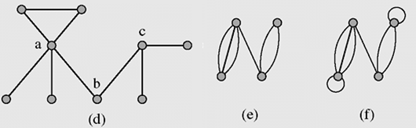
1- Definitions…
Classification based on number of edges between vertices
Simple graph: two distinct vertices in un-directed graph can be join atmost ONE edge
Multigraph is a graph in which two vertices can be joined by multiple edges
Pseudograph is a multigraph which allows for loops at one vertex.

Slide 12
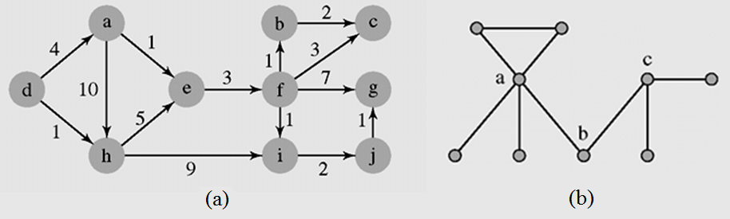
1- Definitions…
Classification based on whether or not edges are evaluated
Weighted graph if each edge has an assigned number (property of each edge)
Un-weighted graph

Slide 13
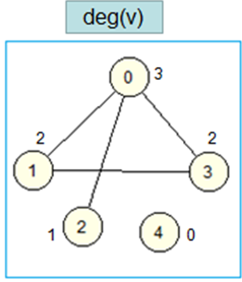
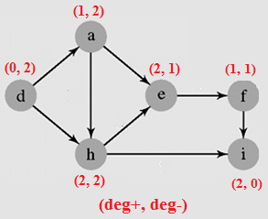
1- Definitions…
Degree of a vertex – Bậc của đỉnh
In undirected graphs: Degree of a vertex, (deg(v), is number of edges connecting with it.
In directed graph:
In-degree (bậc vào), deg⁺(v), is number of edges connected to a vertex.
Out-degree, deg⁻(v), is number of edges connected from a vertex.
deg(v) = deg⁺(v) + deg⁻(v)

Slide 14
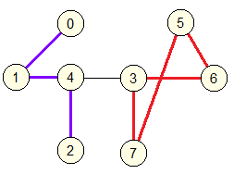
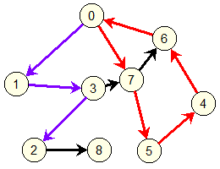
1- Definitions…
Path and circuit/circle
A path is a group of consecutive edges.
A circuit or circle is a closed path.

Slide 15
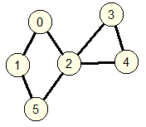
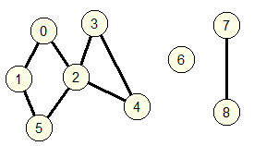
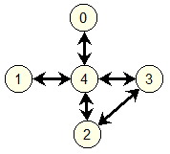
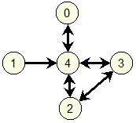
1- Definitions…
Connectivity:
A graph is connected if and only if there exist a path between two arbitrary different vertices.
- If a graph is not connected, it is a combination of at least two connection components.
Connected graph
This graph includes 3 connected components
Connected graph
(Strong connected)
Weak connected
A directed graph is weak connected if it’s associated undirected sub-graph is connected

Slide 16
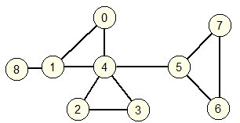
1- Definitions…
Connectivity…
- Articulation point/cut vertex(điểm khớp/đỉnh cắt)
Cut edge (cạnh cắt) / Bridge (cầu)
A special vetex or edge in a graph having special property that when it is removed, it causes the graph unconnected.

Slide 17
2- Graph Representation
2 ways to present data of a graph:
Using matrix:
adjacency matrix(ma trận đỉnh kề) or,
incidence matrix ( ma trận cạnh nối)
It requires huge memory block
Using adjacency list (danh sách kề)
Linked data structure is used to save memory.

Slide 18
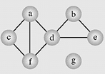
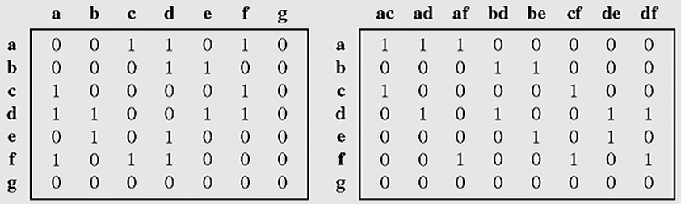
2- Graph Representation…
Representing a graph using a matrix:
Edge label = association of labels of two related vertices
Vertices are sorted based on their labels
Edges are sorted
(a) an adjacency matrix
(b) an incidence matrix

Slide 19
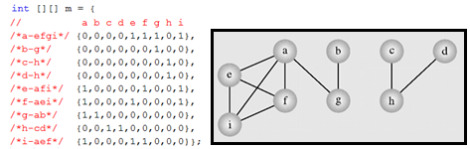
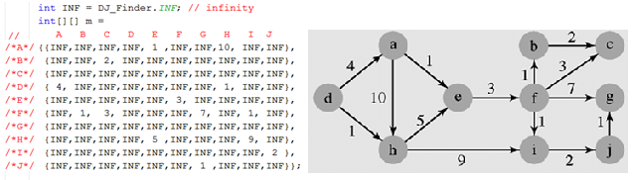
2- Graph Representation…
Some graphs using adjacency matrices:

Slide 20
2- Graph Representation…
Representing a graph using a matrix:
Evaluating on memory efficiency
Situation: Road map of a city has 10000 crossroads, and at most 7 roads connecting each 2 distinct crossroads.
Using adjacency matrix:
Matrix size: 10000 x 10000.
In each row, there is at most 7 non-zero numbers.
➔ Efficiency: (7*10000)/(10000 x 10000) → 7/10000
Using incident matrix: Do yourself

Slide 21
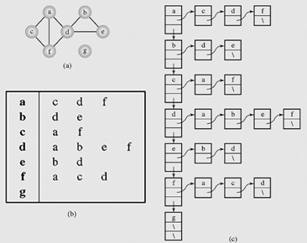
2- Graph Representation…
Representing a graph using an adjacency list:
Adjacency list of a vertex
Vertex list
All lists are sorted.

Slide 22
3- Graph Traversals
Graph traversal:
An operation which will visit all vertices, each vertex will be done only one time → O(n).
Traversals on a graph are similar as those are introduced in the chapter Trees.
Breadth-First Traversal (Breadth-First Search- BFS)
Depth- First Traversal (Depth-First Search- DFS)

Slide 23
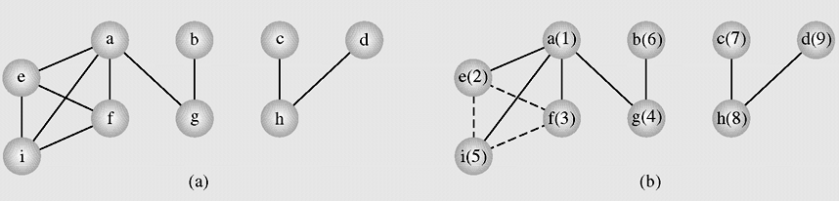
3- Graph Traversals…
Breadth- First Search: Example
1
6
7
9
2
3
4
8
5
Figure 8-5 An example of application of the breadthFirstSearch() algorithm to a graph
a e f g i b c h d

Slide 24
3- Graph Traversals…
num(v) is a positive integer which describes the visited order of the vertex v
breadthFirstSearch() // using a queue
for all vertices v num(v) = 0; // reset visited orders
order = 1; // order begin from 1
while there is a vertex v such that num(v) is 0 // Visiting all vertices
num(v) = order++;
enqueue (v)
while queue is not empty
v=dequeue();
for all vertices u adjacent to v // considering all adjacent vertices of v
if num(u) is 0 {
num(u) = order++;
enqueue(u);
}

Slide 25
3- Graph Traversals…
Breadth First Search: Walking through the algorithm:
Result | Queue
 | (a,1)
(a,1) | (e,2),(f,3),(g,4),(i,5)
(a,1),(e,2) | (f,3),(g,4),(i,5)
(a,1),(e,2),(f3) | (i,5)
(a,1),(e,2),(f3),(g,4), | (i,5),(b,6)
(a,1),(e,2),(f3),(g,4),(i,5) | (b,6)
(a,1),(e,2),(f3),(g,4),(i,5),(b,6) | (c,7)
(a,1),(e,2),(f3),(g,4),(i,5),(b,6),(c,7) | (h,8)
(a,1),(e,2),(f3),(g,4),(i,5),(b,6),(c,7),(h,8) | (d,9)
(a,1),(e,2),(f3),(g,4),(i,5),(b,6),(c,7),(h,8),(d,9)
a b c d e f g h i | e f g i g h h a f i a e i a b c d a e f

Slide 26
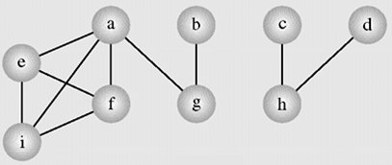
3- Graph Traversals…
Breadth First Search: Walking through the algorithm:
(For taking quiz)
Queue ←
a e f g i
a e f g I
a e f g i
a e f g i b
a e f g i b
a e f g i b c
a e f g i b c h
a e f g i b c h d
a e f g i b c h d
Một đỉnh đã được đưa vào hàng đợi rồi thì gạch ngang (đánh dấu đã xử lý)

Slide 27
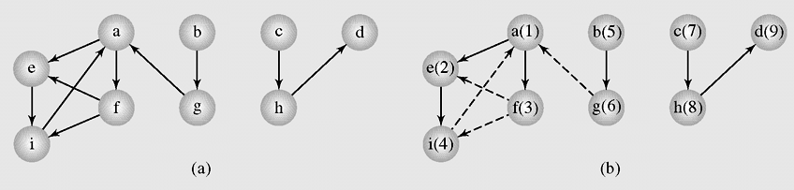
3- Graph Traversals…
Breadth First Search: Check the result.
The breadthFirstSearch() algorithm applied to a digraph. Result: a, e, f, i, b, g, c, h, d

Slide 28
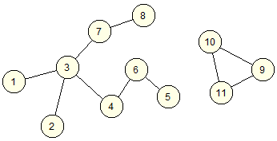
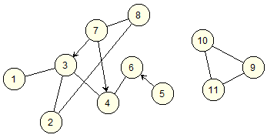
3- Graph Traversals…
Practice: Apply the BFS algorithm to the following graphs
G1
G2
Result:
1, ……..
1, ……..

Slide 29
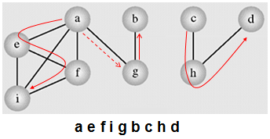
3- Graph Traversals…
Depth-First Search algorithm:
Each vertex v is visited and then each unvisited vertex adjacent to v is visited.
1
6
7
9
2
3
5
8
4

Slide 30
3- Graph Traversals…
Depth-first search algorithm: each vertex v is visited and then each unvisited vertex adjacent to v is visited
DFS (Vertex u) // Recursive algorithm
num(u) = order++; // i: visiting order
for all vertices v adjacent to u
if (num(v) is 0) // v is not traversed yet
attach edge uv to edges; // update result
DFS(v); // recursive traversing down
depthFirstSearch()
for all vertices v num(v) = 0;
edges = null; // Initiate the traverse result
order = 1;
while there is a vertex v such that num(v) is 0 DFS(v);
output edges;

Slide 31
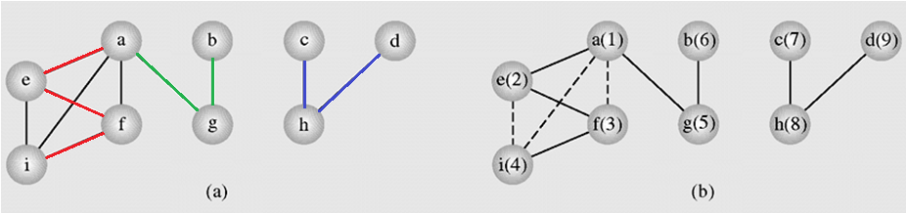
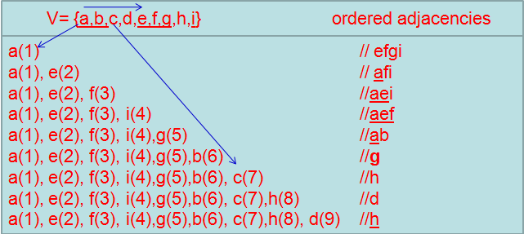
3- Graph Traversals…
An example of application of the depthFirstSearch()

Slide 32
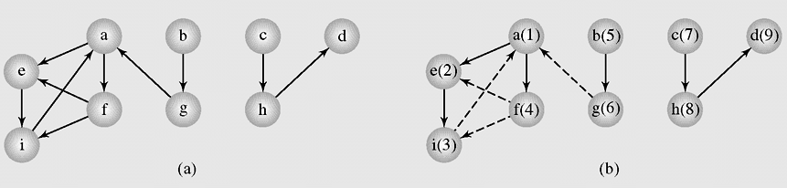
3- Graph Traversals…
Depth First Search guarantees generating a tree (or a forest, a set of trees) that includes or spans over all vertices of the original graph.
The depthFirstSearch() algorithm applied to a digraph

Slide 33
3-Graph Traversals…
Practice: Apply the DFS algorithm to the following graphs:
G1
G2

Slide 34
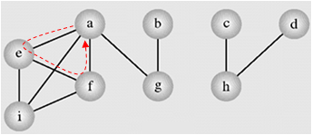
4- Cycle Detection
Depth-First Search → Cycle Detection
DFS (Vertex v)
num(v) = i++;
for all vertices u adjacent to v
if (num(u) is 0)
attach edge uv to edges;
DFS(u);
cycleDetectionDFS (Vertex v)
num(v) = i++;
for all vertices u adjacent to v
if (num(u) is 0) // u is not visited → continue traversing
attach edge uv to edges;
cycleDetectionDFS(u);
else if edge(uv) is not in edges, cycle detected // u is re-visited → cycle
digraphCycleDetectionDFS (Vertex v)
num(v) = i++;
for all vertices u adjacent to v
if (num(u) is 0)
pred (u)= v;
digraphCycleDetectionDFS(u);
else if num(u) is not ∞
pred (u) = v;
cycle detected;
num(v) = ∞;
modify
{ae, ef, fa}
O(n²)

Slide 35
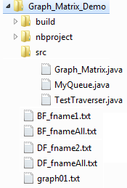
Demo 1: Traversing a Graph (Using Adjacency Matrix)
Objectives:
- Traverse a simple undirected matrix-based graph
- Output traversal results to monitor and files.
Graph_Matrix: class for a graph.
MyQueue: Class for a queue
TestTraverser: Tester
Output files
Input file

Slide 36
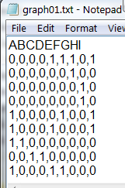
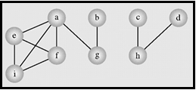
Demo 1: Traversing a Graph
Input:

Slide 37
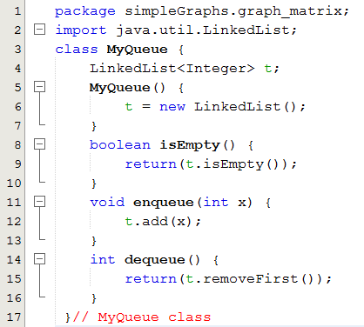
Demo 1: Traversing a Graph
MyQueue.java

Slide 38
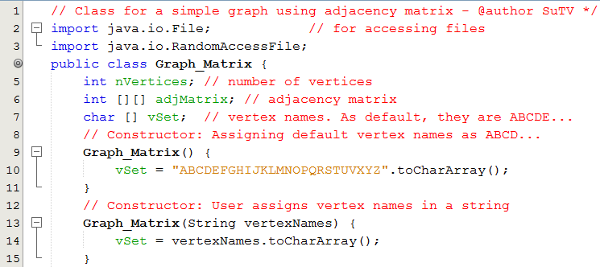
Demo 1: Traversing a Graph
Graph_Matrix.java

Slide 39
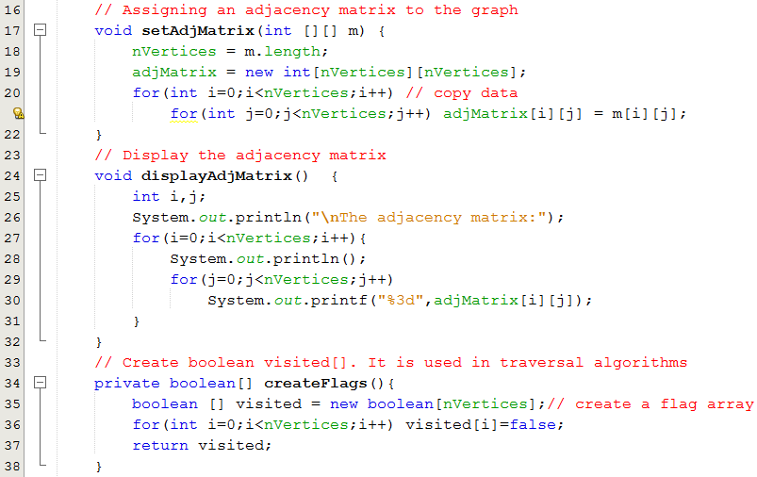
Demo 1: Traversing a Graph
Graph_Matrix.java

Slide 40
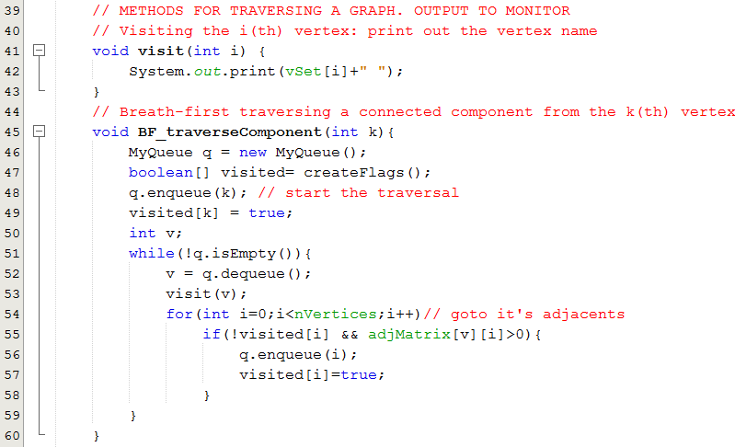
Demo 1: Traversing a Graph
Graph_Matrix.java

Slide 41
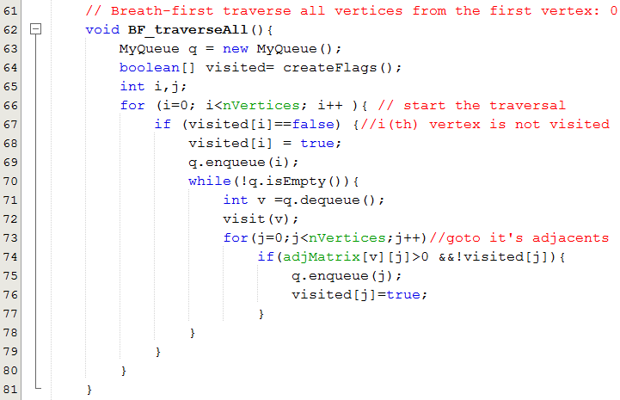
Demo 1: Traversing a Graph
Graph_Matrix.java

Slide 42
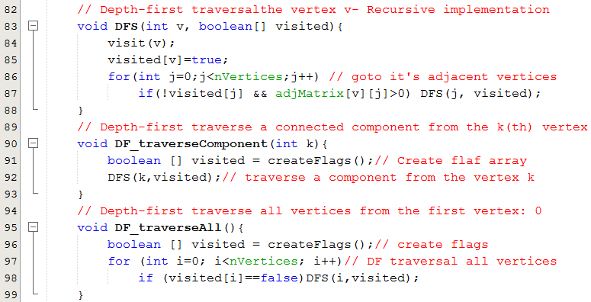
Demo 1: Traversing a Graph
Graph_Matrix.java

Slide 43
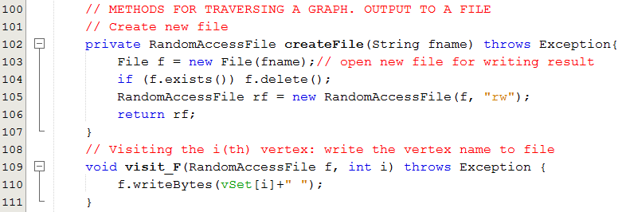
Demo 1: Traversing a Graph
Graph_Matrix.java

Slide 44
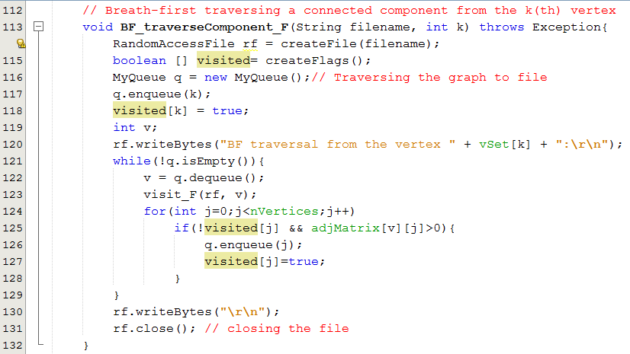
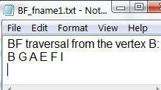
Demo 1: Traversing a Graph
Graph_Matrix.java

Slide 45
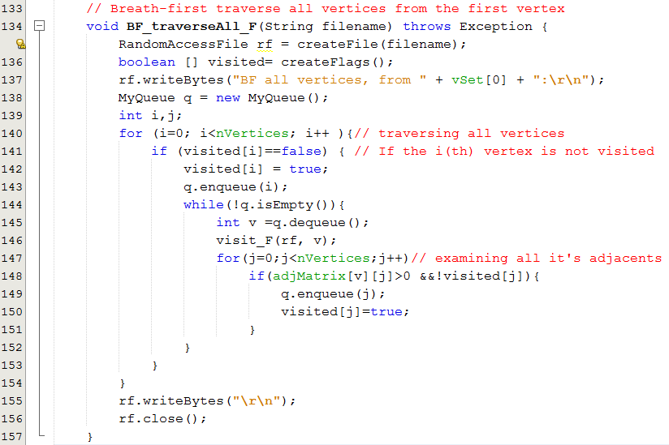
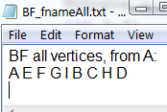
Demo 1: Traversing a Graph
Graph_Matrix.java

Slide 46
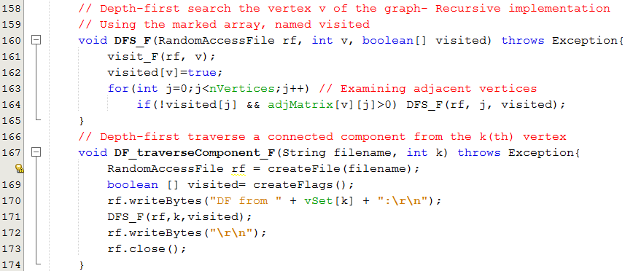
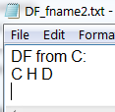
Demo 1: Traversing a Graph
Graph_Matrix.java

Slide 47
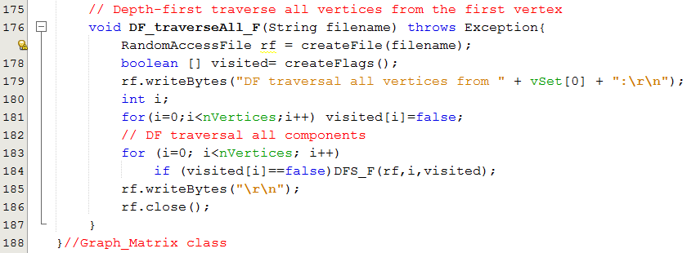
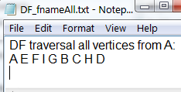
Demo 1: Traversing a Graph
Graph_Matrix.java

Slide 48
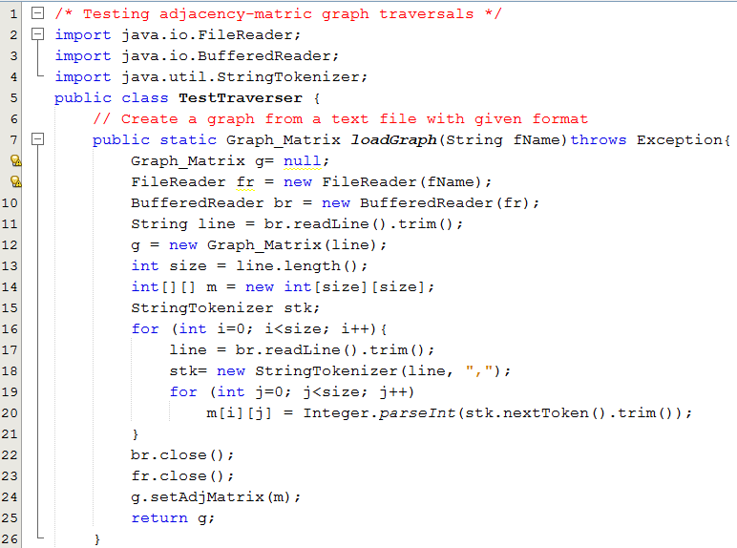

Demo 1: Traversing a Graph
TestTraverser.java

Slide 49



Demo 1: Traversing a Graph
TestTraverser.java

Slide 50


Demo 1: Traversing a Graph
TestTraverser.java

Slide 51
Demo 1: Traversing a Graph
TestTraverser.java

Slide 52
5- Shortest Paths
Weight of an edge:
A real number which depends on specific problem.
It is positive but it may be negative in some cases.
Road map: road length (meter)
Aero map: fly length/ cost ($)
Computer network: bandwidth (bit/sec)
Drainage net: water flow (m³/s)
Electricity grid: load power (watt)
. . . .
It may be a multiple-variable function
Shortest Paths are basic requirement in Graph theory

Slide 53
5- Shortest Paths…
Label: considered values are applied to each vertex. In this Dijkstra, introduced, Label(v) = {cost(v), predecessor(v)}
To get shortest path between two vertices, each vertex must be chosen to scan for evaluating. In each pass, only one vertex is chosen to scan.
Classification:
Label-setting methods: In each pass through the vertices still to be processed, one vertex is set to a value that remains unchanged to the end of the execution, the Dijkstra algorithm is an example.
Label-correcting methods: Allow for the changing of any label during application of the method

Slide 54
5- Shortest Paths…
Algorithms:
Main algorithm:
Dijkstra — weight of edge >=0
Algorithms should be referenced:
Bellman-Ford — weight of edge may be negative.
A*: Using heuristics to improve performance
Floyd-Warshall — Determine shortest path for all pair of vertices.
Johnson — Determine shortest path for all pair of vertices. It can be more efficient than Floyd-Warshall on a sparse graph.
Attention: Each algorithm has it’s own purpose and a specific graph type.

Slide 55

5- Shortest Paths…
GenericShortestPathAlgorithm (weighted simple digraph, vertex first)
for all vertices v cost(v) = ∞
cost(first)=0;
initialize toBeChecked; // set of vertices will be checked
while (toBeChecked is not empty)
v= a vertex in toBeChecked; // depending on specific algorithm
remove v from toBeChecked;
for all vertices u adjacent to v
if cost(u) > cost(v) + weight(v,u))
cost(u) = cost(v) + weight(v,u));
predecessor(u)= v;
Add u to toBeChecked if it is not there;
Dijkstra
toBeChecked= all vertices
Ford
Examine edges instead of vertices
O(|V|²)

Slide 56
5- Shortest Paths…
DJ ShortestPathAlgorithm (weighted simple digraph, vertex first)
for all vertices v {
marked(v) = false; cost(v) = ∞; predecessor (v) = null;
}
cost(first) = 0;
v = first;
while (v != null) {
marked (v) = true;
for all vertices u adjacent to v {
if (marked (u)=false AND (cost(u) > cost(v) + weight(v,u))) {
cost(u) = cost(v) + weight(v, u));
predecessor(u)= v;
}
}
v= the minimum cost vertex in non-marked vertices;
}

Slide 57


5- Shortest Paths…
Finding shortest paths from the vertex d to others
V = infinity
An execution of DijkstraAlgorithm
Độ dài đường đi ngắn nhất từ d sang i =?
Đường đi ngắn nhất từ d sang i là đường nào?
Sau bước lặp thứ 3 của thuật toán DJ, độ dài đường đi ngắn nhất từ d đến i =? → 10

Slide 58

5- Shortest Paths…
Exercise: Use Dijkstra algorithm to find the shortest path from the vertex 5 to the vertex 4

Slide 59





Demo 2: SP Dijkstra Algorithm
Dijkstra Algorithm Impl.
Input
output file

Slide 60

Demo 2: SP Dijkstra Algorithm
DJ_Finder.java

Slide 61

Demo 2: SP Dijkstra Algorithm
DJ_Finder.java

Slide 62

Demo 2: SP Dijkstra Algorithm
DJ_Finder.java

Slide 63

Demo 2: SP Dijkstra Algorithm
DJ_Finder.java

Slide 64

Demo 2: SP Dijkstra Algorithm
DJ_Finder.java

Slide 65

Demo 2: SP Dijkstra Algorithm
DJ_Test.java

Slide 66


Demo 2: SP Dijkstra Algorithm

Slide 67

6- Spanning Trees- Cây phủ
Subgraph: G’ (V’, E’) is called as a subgraph of the graph G(V, E) if and only if V’ is a subset of V and E’ is a subset of E.
Spanning Tree: G’ (V’, E’) is called as a spanning tree of subgraph of the graph G(V, E) if and only if V’=V and E’ is a subset of E and G’ is a tree (connected, having no cycle).
A graph may have some spanning trees.
A graph representing (a) the airline connections between seven cities and (b–d) three possible sets of connections

Slide 68
6- Spanning Trees…
- A graph may have some spanning trees
- In weighted graph, minimum spanning tree is a spanning tree which sum of edge weights is minimum.
How to construct minimum spanning trees?
Algorithms will be introduced:
- Krushkal (written in learning outcome)
- Dijkstra ( Read by yourself)
- Prim-Jarnik ( Read by yourself)

Slide 69
6- Spanning Trees…
Minimum spanning tree- Kruskal algorithm:
Input: weighted connected, undirected graph
Output: minimum spanning tree
tree = null;
edges = sequence of all edges of graph sorted by weight;
for (i=1; i<= |E| and |tree| < |V| -1; i++)
if e_{i} from edges does not form a cycle with edges in tree
add e_{i} to tree.
Edges having small weight are choosen with high priority

Slide 70


6- Spanning Trees…
Minimum spanning tree-Kruskal algorithm:
Lấy cạnh có trọng số bé mà không tạo thành vòng.

Slide 71
6- Spanning Trees…
Read by yourself
Minimum spanning tree- Dijkstra algorithm:
Input: weighted connected, undirected graph
Output: minimum spanning tree
tree = null;
edges = an unsorted sequence of all edges of graph ;
for j=1 to |E|
- add e_{j} to tree;
- if there is a cycle in tree, remove an edge with maximum weight from this only cycle;

Slide 72

6- Spanning Trees…
Read by yourself
Minimum spanning tree- Dijkstra algorithm:
Edges are choosen in natural order of edge abels

Slide 73
6- Spanning Trees…
Read by yourself
Minimum spanning tree- Prim-Jarnik algorithm:
Step 1: Initialize a tree with a single vertex, chosen arbitrarily from the graph.
Step 2: Grow the tree by one edge of the edges that connect the tree to vertices not yet in the tree, find the minimum-weight edge, and transfer it to the tree.
Step 3: Repeat step 2 (until all vertices are in the tree).

Slide 74



6- Spanning Trees…
74
Read by yourself
Prim-Jarnik Algorithm demo
A spanning tree of graph (a) found with Prim’s algorithm starting with the vertex 0. The vertices are selected in the following order:
0, 1, 7, 6, 5, 2, 8, 3, 4
Notes:
|E| = number of edges
|V| = number of vertices
74

Slide 75
7- Euler Cycles
Euler path: a path traversing all the edges of the graph exactly once
Euler cycle: a cycle traversing all the edges of the graph exactly once
No Euler cycle
no Euler path
Has Euler cycle
Has Euler path,
but no Euler cycle

Slide 76
7- Euler Cycles…
C
Is it possible to start at some
location, travel across all the
bridges without crossing any
bridge twice, and return to
the same starting point?
A
D
B
C
A D
B
Kneiphof island on Pregel river and 7 bridges built in 18-th century in Königsberg town (Kaliningrad).
Rephrasing in terms of Euler cycles:

Slide 77

7- Euler Cycles…
Necessary and sufficient conditions for Euler cycles/ Euler path
Undirected graph
Theorem 1: A connected multigraph has an Euler cycle if and only if each of its vertices has even degree.
Theorem 2: A connected multigraph has an Euler path but Euler cycle if and only if it has exactly two odd degree vertices.
Which of graphs have Euler cyles/ Euler path?

Slide 78

7- Euler Cycles…
Directed graph
- A connected directed multigraph has an Euler cycle if and only if deg+(v) = deg-(v) for all vertex v.
- A connected directed multigraph has an Euler path but Euler cycle if and only if it has exactly two vertices u and v in which one vertex having deg+(u) – deg-(u) = +1 and deg+(v) – deg-(v) = -1.
Which of graphs have Euler cyles/ Euler path?
1,2

Slide 79

7- Euler Cycles…
Algorithm Euler for a graph having Euler cycle.
Main Idea:➔ Splicing all sub-cycles
Copy G →cycle
Contruct a cycle (1,2,3) then move others to H
Loop until H having no edge: From a common vertex (ex. 3) of cycle and H, construct a new cycle then splice this to cycle.

Slide 80
7- Euler Cycles…
Algorithm Euler(G)
Input: Connected graph G with all vertices having even degrees
Output: Euler cycle Construct a cycle in G
Remove all the edges of cycle from G to get subgraph H
while H has edges
find a non-isolated vertex v that is both in cycle and in H
//the existence of such a vertex is guaranteed by G’s connectivity
construct subcycle in H
splice subcycle into cycle at v
remove all the edges of subcycle from H
return cycle

Slide 81
7- Euler Cycles…
Algorithm for finding an Euler cycle from the vertex X using stack
Chuyển các chu trình con vào stack, giảm bậc mỗi đỉnh của các chu trình này 2 đơn vị cho đến khi bậc của đỉnh bằng 0.
Algorithm Euler(G, start)
//Input: Connected graph G with all vertices having even degrees
//Output: Euler cycle
declare a stack S of vertices which will be examined
declare empty array E (which will contain Euler cycle)
push the vertex start to S
while(S is not empty) {
u= the vertex on the top of the stack S
if (u is isolated) then remove it from the stack and put it to E
else
v= an arbitrary vertex which is adjacent to u,
push v to S
Remove edges (u, v) and (v,u) from the graph
}
Vertices in E form a Euler cycle of the graph

Slide 82




Demo 3: Euler Cycle
Finding an Euler cycle using stack
A
C
E
G
B
D
F
H
Implementations
Input/
output files

Slide 83

Demo 3: Euler Cycle
Euler_Graph.java
Finding an Euler cycle using stack

Slide 84

Demo 3: Euler Cycle
Euler_Graph.java
Finding an Euler cycle using stack

Slide 85

Demo 3: Euler Cycle
Euler_Graph.java
Finding an Euler cycle using stack

Slide 86

Demo 3: Euler Cycle
Euler_Graph.java
Finding an Euler cycle using stack

Slide 87

Demo 3: Euler Cycle
Euler_Graph.java
Finding an Euler cycle using stack

Slide 88

Demo 3: Euler Cycle
Euler_Graph_Test.java
Finding an Euler cycle using stack

Slide 89

Demo 3: Euler Cycle
Euler_Graph_Test.java
Finding an Euler cycle using stack

Slide 90

8- Hamilton Cycles
Hamilton cycle: visits every vertex of the graph exactly once before returning, as the last step, to the starting vertex.
Examples:
Hamilton path: visits every vertex of the graph exactly once.

Slide 91

8- Hamilton Cycles…
Finding Hamilton’s cycles using Backtracking
(Exhausted Searching – vét cạn- dò tìm cho đến cùng)
Choose 1 in 6 vertices
Choose 1 in 5 vertices
Choose 1 in 4 vertices
Choose 1 in 3 vertices
Choose 1 in 2 vertices
Choose 1 in 1 vertices
7 vertices: 6! options
A
C
B
E
G
F
D
A
A
B
C
D
E
F
G
A
B
C
D
E
F
G
A
B
C
D
E
F
G
A
B
C
D
E
F
G
A
B
C
D
E
F
G
A
B
C
D
E
F
G
O(n!) → AI is needed

Slide 92

8- Hamilton Cycles…
A graph can have some Hamilton cycles.
List all Hamilton’s cycles using Backtracking
The given graph has four Hamilton circles.

Slide 93
8- Hamilton Cycles…
Finding Hamilton’s cycles using Backtracking
(Exhausted Searching – vét cạn- dò tìm cho đến cùng)
Given the graph G = (V,E) and X is a vertex of G. Suppose there exists at least one Hamilton Cycle for the graph. The following is a backtracking algorithm for finding one Hamilton cycle from the vertex X:
declare an empty array H (which will contain Hamilton cycle)
(1) Put the vertex X to H
(2) Check if H is a Hamilton cycle then stop, else go to (3)
(3) Consider the last vertex Y in H, if there is/are vertex(es) adjacent to Y, select an adjacent vertex Z and put it to H. If there no adjacent vertex, remove Y from H and denote it as a bad selection (so you do not select it in the same way again).
Go to (2).
O(n!) → AI is needed

Slide 94

9- Graph Coloring Problem
In graph theory, graph coloring is a way of coloring the vertices of a graph such that no two adjacent vertices share the same color.
The chromatic number (số mầu) of a graph is the minimum number of colors one can use to color the vertices of the graph so that no two adjacent vertices are the same color.
If the chromatic number of the graph G is denoted by χ(G). A graph for which k = χ(G) is called k-colorable. For a complete
graph χ(K_{n})=n, χ(C_{2n})=2, χ(C_{2n+1})=3; and for bipartite graph χ(G)≤ 2.
Determining a chromatic number of a graph G is an NP-complete problem.

Slide 95

9- Graph Coloring Problem…
Sequential coloring:
A graph used for coloring;
Colors assigned to vertices with the sequential coloring algorithm that orders vertices by index number
Vertices are put in the largest first sequence;
Graph coloring obtained with the Brélaz algorithm
Changing order of vertices

Slide 96
9- Graph Coloring Problem…
Sequential coloring establishes the sequence of vertices and a sequence of colors before coloring them, and then color the next vertex with the lowest number possible
sequentialColoringAlgorithm(graph = (V, E))
put vertices in a certain order v_{P1}, v_{P2}, . v_{pi} . . , v_{Pv} ;
put colors in a certain order c₁, c₂, . . . , c_{k};
for i = 1 to |V|
j=the smallest index of color that does not appear in any neighbor of v_{Pi};
color(v_{Pi}) = c_{j};
Complexity: O(|V|²)

Slide 97
Summary

LO5.1 Demonstrate graphs and their applications. Define an undirected graph and directed graph.
LO5.2 Explain basic notions about a graph: vertex, edge, adjacent vertices, incident edge,...
LO5.3 Know how to represent a graph using matrix and list
LO5.4 Able to apply BFS and DFS to traverse a graph
LO5.5 Write programs to implement Graph with BFS and DFS traversals using Java





Slide 98
Summary
LO5.6 Explain the shortest path problem and Dijkstra’ algorithm.
LO5.7 Write program in Java to implement Dijkstra’s shortest path algorithm.
LO5.8 Define the minimum spanning tree and using the Kruskal’s algorithm to find it.
LO5.9 Define Euler cycle/path and the necessary and sufficient conditions for their existence.
LO5.10 Explain the algorithm to find Euler path / circuit using Stack and implement it in Java language.






Slide 99
Summary

LO5.11 Define Halmilton cycle/path and able to determine them using backtracking algorithm.
LO5.12 Demonstrate the graph coloring and can apply Sequential coloring algorithm to color a graph.


