Slide 1


TP558 - Tópicos avançados em Machine Learning
Soft Actor-Critic
Hanieh Memarian
hanieh.memarian@dtel.inatel.br

Slide 2
Outline
Introduction
Definition & Develo- pment of GNN
Challenges
Article
Future work & Conclusion
5
Background
Basic problem
What is Soft Actor Critic
Why is SAC Useful
Development Idea of SAC
Definition of SAC
Deep RL side
RIS-UAV side
Algorithm
Simulation Results
Conclusion
Future Directions
4
3
2
1

Slide 3
Introduction

Slide 4
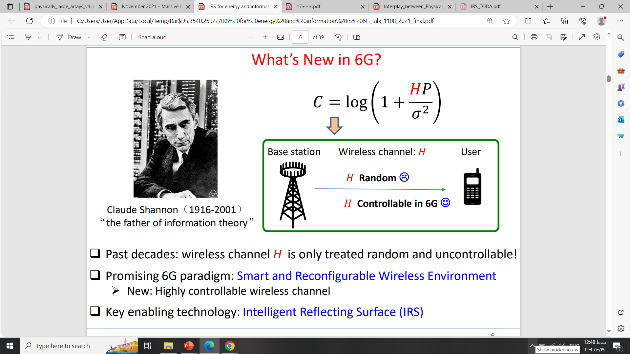
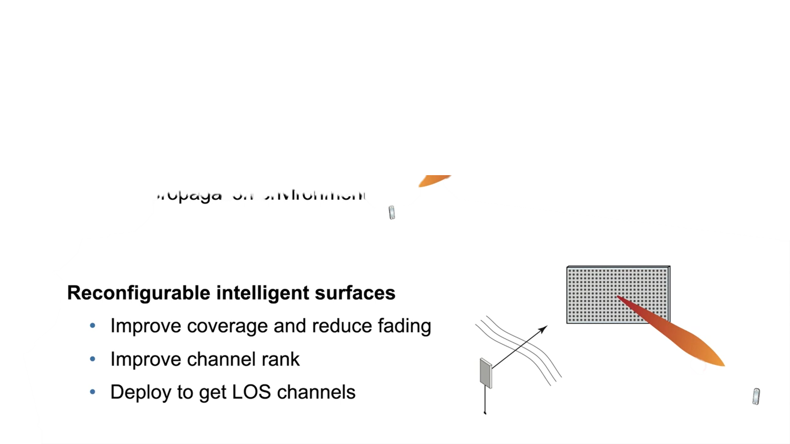
Introduction
Three challenges for 5G operators
Number of 5G Bss
Power consumption
Hardwar cost
Reconfigurable Intelligent Surface (RIS)
Soft Actor-Critic
4/36

Slide 5
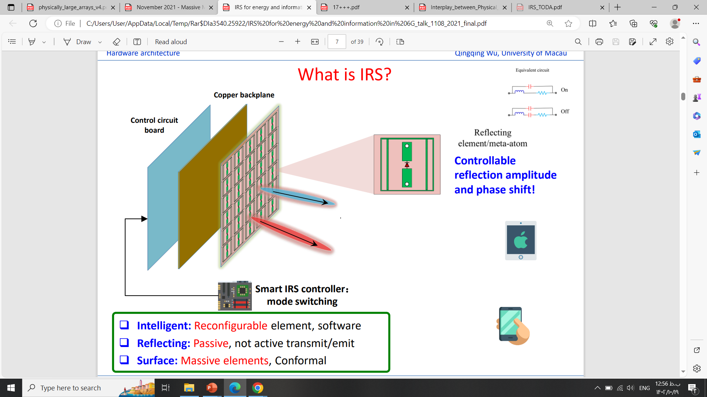
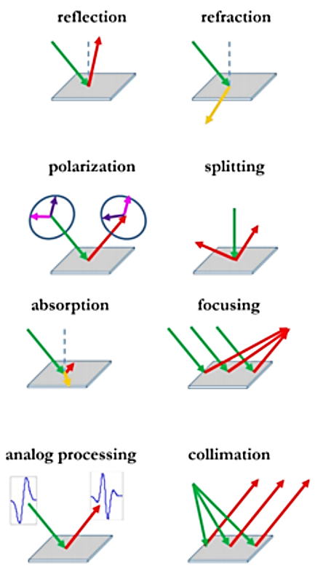
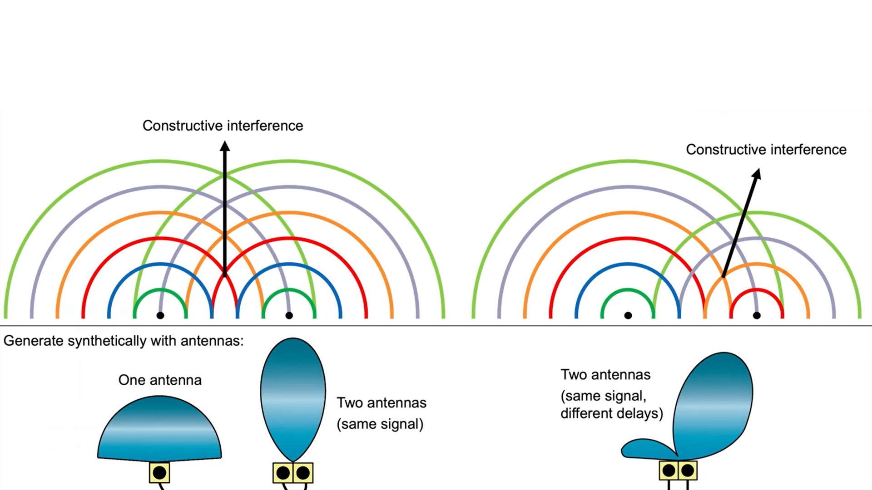
Introduction
Reference : [1] Shimin Gong, Xiao Lu , Dinh Thai Hoang, , Dusit Niyato, , Lei Shu, Dong In Kim, and Ying-Chang Liang , '' Toward Smart Wireless Communications via Intelligent Reflecting Surfaces: A Contemporary Survey '' , IEEE Communications Survays and Tutorials, 2020
Soft Actor-Critic
5/36

Slide 6
Introduction
RIS in 6G networks
Active RIS
Phase and amplitude modulation
Higher system gain with fewer elements; needs extra supply power
Passive RIS
Phase-only reflection, no extra power
Suffers from “multiplicative fading”: cascaded path loss limits capacity gain
Reference : [2] Z. Huang et al., A soft actor–critic reinforcement learning approach for over the air active beamforming with RIS, Physical Communication 66 (2024)
Soft Actor-Critic
6/36

Slide 7
Background: RIS meets the UAV
Introduction
Terrestrial RIS: limits
Serves only terminals on the same side of the surface
In cities, several RIS hops add path loss
Aerial RIS (ARIS)
Flexible deployment, high mobility
Creates line-of-sight links
360° reflection by UAV attitude + phase tuning
Open issues
Buildings and trees weaken LoS to users
Active RIS needs extra power → UAV endurance
Paper’s argument: amplification energy is much lower than the UAV’s mechanical energy, so an active ARIS raises capacity without much cutting hover time.
Reference : [2] Z. Huang et al., A soft actor–critic reinforcement learning approach for over the air active beamforming with RIS, Physical Communication 66 (2024)
Soft Actor-Critic
7/36

Slide 8

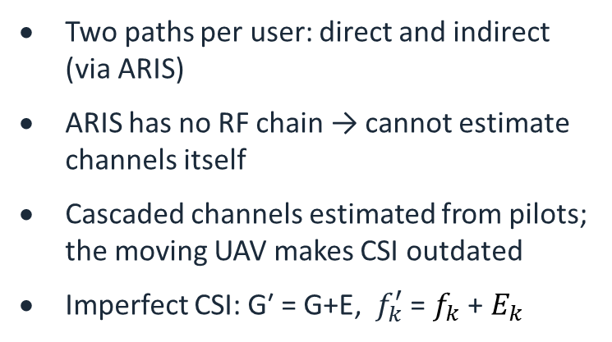

Basic problem: ARIS-aided system
Introduction
ARIS (UAV + RIS)
N elements
Two paths per user: direct and indirect (via ARIS)
ARIS has no RF chain → cannot estimate channels itself
Cascaded channels estimated from pilots; the moving UAV makes CSI outdated
Imperfect CSI: G′ = G+E, $f_{k}^{′}$ = $f_{k}$ + $E_{k}$
G (LoS)
$f_{k}$ (LoS)
BS
M antennas
K users
$h_{k}$ (weak LoS, direct)
Downlink MU-MISO, M > K
Reference : [2] Z. Huang et al., A soft actor–critic reinforcement learning approach for over the air active beamforming with RIS, Physical Communication 66 (2024)
Soft Actor-Critic
8/36

Slide 9
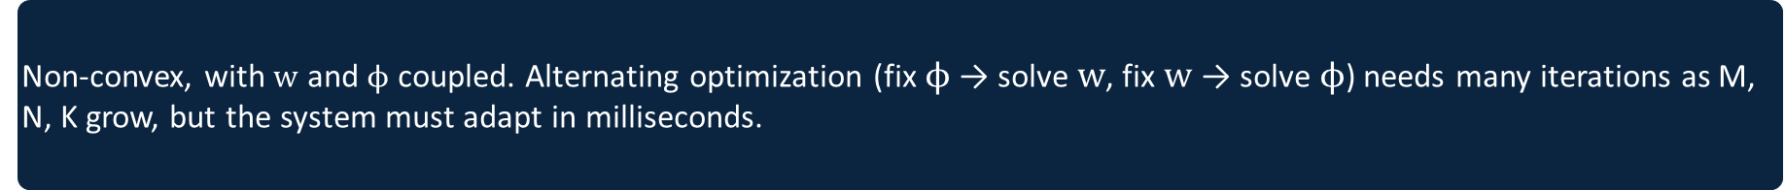

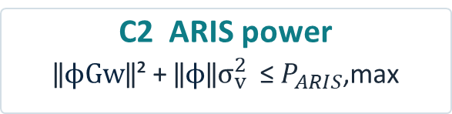

Basic problem: sum-rate maximization
Introduction
$\max_{wφ}$ $\sum_{k=1}^{K}{\log_{2}(1+γ_{k})}$
C1 BS power
‖$w$‖² ≤ $P_{BS}$,max
C2 ARIS power
‖$ϕGw$‖² + ‖$ϕ$‖$σ_{v}^{2}$≤ $P_{ARIS}$,max
C3 Phase shifts
0 ≤ $θ_{n}$< 2π for all n
Non-convex, with $w$ and $ϕ$ coupled. Alternating optimization (fix $ϕ$ → solve $w$, fix $w$→ solve $ϕ$) needs many iterations as M, N, K grow, but the system must adapt in milliseconds.
Reference : [2] Z. Huang et al., A soft actor–critic reinforcement learning approach for over the air active beamforming with RIS, Physical Communication 66 (2024)
Soft Actor-Critic
9/36

Slide 10
Definition and Development
of SAC

Slide 11
What is Soft Actor-Critic?
Definition and Development of SAC
SAC = an off-policy actor-critic deep RL algorithm built on maximum-entropy RL: the actor maximizes expected return and entropy, i.e. it succeeds at the task while acting as randomly as possible.
1
2
3
Actor-critic
Separate policy (actor) and value (critic) networks
Off-policy
Replay buffer reuses past experience → sample efficient
Entropy maximization
Encourages exploration and stability
Version used for continuous action spaces (e.g. beamforming weights)
References: [3] T. Haarnoja et al., Soft Actor-Critic: Off-policy maximum entropy deep RL with a stochastic actor, ICML 2018 (PMLR 80).
[4] T. Haarnoja et al., Soft Actor-Critic Algorithms and Applications, arXiv:1812.05905.
[5] OpenAI Spinning Up, Soft Actor-Critic documentation.
Soft Actor-Critic
11/36

Slide 12
Why is SAC useful?
Definition and Development of SAC
≈ 2 h
3 h vs 7.4 h
5 seeds
real-world quadruped walking learned from 160k steps
dexterous-hand valve task: SAC vs PPO
similar results across random seeds
Sample efficient: off-policy learning from a replay buffer
Stable: stochastic policy + entropy term; far less seed variance than a deterministic variant
Little tuning: automatic temperature adjustment
Matches or beats DDPG, PPO, TD3 and soft Q-learning, most clearly on the 21-D Humanoid
References: [3] T. Haarnoja et al., Soft Actor-Critic: Off-policy maximum entropy deep RL with a stochastic actor, ICML 2018 (PMLR 80).
[4] T. Haarnoja et al., Soft Actor-Critic Algorithms and Applications, arXiv:1812.05905.
Soft Actor-Critic
12/36

Slide 13
How SAC emerged
Definition and Development of SAC
2015–17
2015
2017
2018
2018
1
2
3
4
5
TRPO / PPO
On-policy: stable, but fresh samples for almost every update
DDPG
Off-policy, deterministic actor; brittle to hyperparameters
Soft Q-learning
Max-entropy in deep RL, but sampler-based; not true actor-critic
SAC (ICML)
Off-policy max-entropy actor-critic + convergence proof
SAC v2 (Alg. & Apps)
Twin Q, no V net, auto temperature, real robots
References: [3] T. Haarnoja et al., Soft Actor-Critic: Off-policy maximum entropy deep RL with a stochastic actor, ICML 2018 (PMLR 80).
[4] T. Haarnoja et al., Soft Actor-Critic Algorithms and Applications, arXiv:1812.05905.
[5] OpenAI Spinning Up, Soft Actor-Critic documentation.
Soft Actor-Critic
13/36

Slide 14
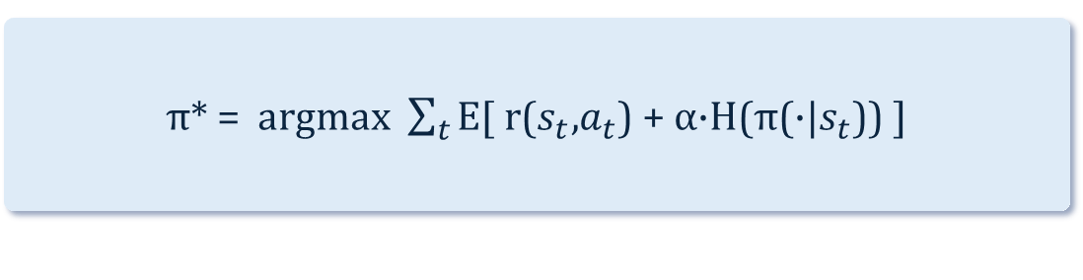


Definition: the maximum-entropy objective
Definition and Development of SAC
π* = argmax $\sum_{t}{\text{E}\text{[ }\text{r}\text{(}s_{t}\text{,}a_{t}\text{) + }\text{α}\text{·}\text{H}\text{(}\text{π}\text{(·|}s_{t}\text{)) ]}}$
Why it helps
Explores widely, gives up on clearly bad options
Keeps several near-optimal behaviours (multi-modal)
Robust to model and estimation errors
Natural fit for uncertain CSI
V(s) = $E_{a}$ ~ π[ Q(s,a) − α log π(a|s) ]
$T^{π}$Q(s,a) = r(s,a) + γ $E_{s^{′}}$[ V(s′) ]
α = temperature; α → 0 recovers standard RL. H = entropy of the policy.
References: [3] T. Haarnoja et al., Soft Actor-Critic: Off-policy maximum entropy deep RL with a stochastic actor, ICML 2018 (PMLR 80).
[4] T. Haarnoja et al., Soft Actor-Critic Algorithms and Applications, arXiv:1812.05905.
[5] OpenAI Spinning Up, Soft Actor-Critic documentation.
Soft Actor-Critic
14/36

Slide 15
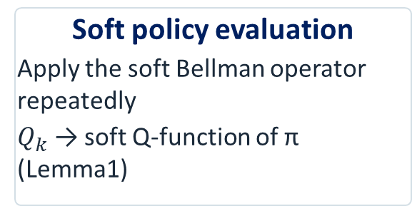
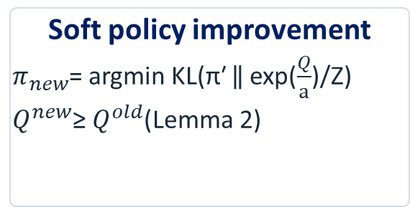
From soft policy iteration to SAC
Definition and Development of SAC
Soft policy evaluation
Apply the soft Bellman operator repeatedly
$Q_{k}$ → soft Q-function of π (Lemma1)
Soft policy improvement
$π_{new}$= argmin KL(π′ ‖ exp($\frac{Q}{a}$)/Z)
$Q^{new}$≥ $Q^{old}$(Lemma 2)
Convergence
Alternating both steps converges to the optimal max-entropy policy in the class Π (Theorem 1)
Practical SAC: replace tabular steps by neural networks and stochastic gradient descent, alternating one gradient step on the critics and one on the actor.
References: [3] T. Haarnoja et al., Soft Actor-Critic: Off-policy maximum entropy deep RL with a stochastic actor, ICML 2018 (PMLR 80).
[4] T. Haarnoja et al., Soft Actor-Critic Algorithms and Applications, arXiv:1812.05905.
Soft Actor-Critic
15/36

Slide 16
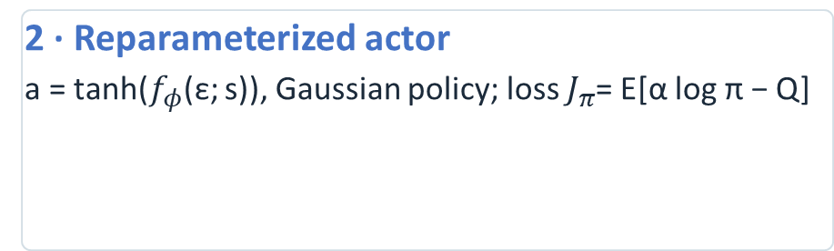
Practical SAC: networks and updates
Definition and Development of SAC
1 · Twin soft Q-critics
Minimize soft Bellman residual with target networks (τ = 0.005); use the min of the two Q values to curb overestimation
2 · Reparameterized actor
a = tanh($f_{φ}$(ε; s)), Gaussian policy; loss $J_{π}$= E[α log π − Q]
3 · Automatic temperature
Learn α by minimizing J(α) = E[−α log π − α·H̄], with target entropy H̄ = −dim(A)
4 · Replay buffer
Store (s, a, r, s′); sample mini-batches; one env step + one gradient step. Typical: lr 3·10⁻⁴, γ = 0.99, batch 256, 2×256 hidden
References: [4] T. Haarnoja et al., Soft Actor-Critic Algorithms and Applications, arXiv:1812.05905.
[5] OpenAI Spinning Up, Soft Actor-Critic documentation.
Soft Actor-Critic
16/36

Slide 17
Evidence: SAC in the real world
Definition and Development of SAC
160k steps
Minitaur walks after ≈ 2 h real-world training
300k steps
valve from raw RGB images, no simulation
Trained on flat ground only, the gait generalized to slopes, blocks and stairs.
References: [4] T. Haarnoja et al., Soft Actor-Critic Algorithms and Applications, arXiv:1812.05905.
Soft Actor-Critic
17/36

Slide 18
Challenges

Slide 19
Challenges: deep RL side
Challenges
1
Sample complexity
Model-free deep RL can need millions of steps; on-policy methods need fresh data
2
Brittleness
Learning rates and exploration constants need per-task tuning (e.g. DDPG)
3
Stability
Off-policy + neural networks + continuous actions make convergence hard
4
Temperature / reward scale
Too small → near-uniform policy; too large → near-deterministic, poor exploration
SAC’s answers: replay buffer, entropy-regularized stochastic actor, twin critics, automatic α.
Soft Actor-Critic
19/36

Slide 20
Challenges: RIS-UAV side and our answer
Challenges
Challenge
Answer in the article
Multiplicative fading limits passive RIS
Active ARIS amplifies the reflected signal
Imperfect CSI from UAV mobility
Max-entropy stochastic policy, trained with noisy G′ and f′
Non-convex, coupled W and Φ; AO cost grows
Trained SAC policy outputs {W, Φ} directly
UAV endurance vs extra power
Few elements (N = 30), 1 % of power at the ARIS
Reference : [2] Z. Huang et al., A soft actor–critic reinforcement learning approach for over the air active beamforming with RIS, Physical Communication 66 (2024)
Soft Actor-Critic
20/36

Slide 21
Article
A soft actor–critic reinforcement learning approach for over the air active beamforming with reconfigurable intelligent surface

Slide 22
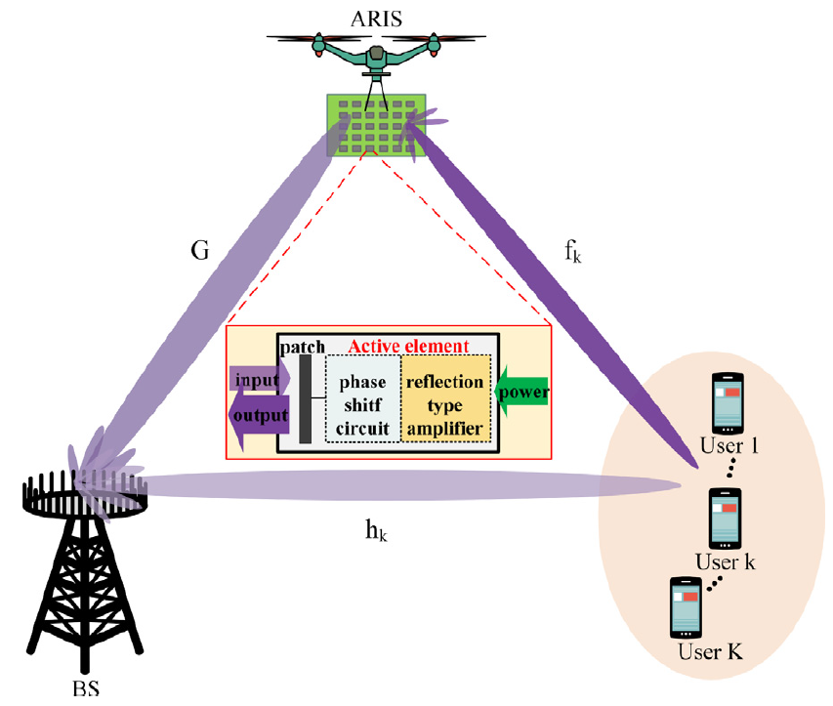
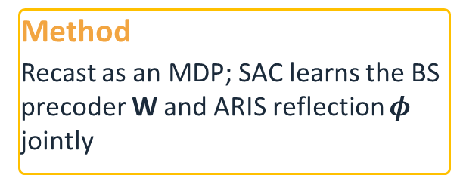
The article at a glance
Article
1
Model
Active ARIS, weak LoS, imperfect CSI; maximize sum rate under power and phase constraints
2
Method
Recast as an MDP; SAC learns the BS precoder W and ARIS reflection $φ$ jointly
3
Results
Similar sum rate with perfect / imperfect CSI; ≈ 71–75 % above passive RIS
Reference : [2] Z. Huang et al., A soft actor–critic reinforcement learning approach for over the air active beamforming with RIS, Physical Communication 66 (2024)
Soft Actor-Critic
22/36

Slide 23
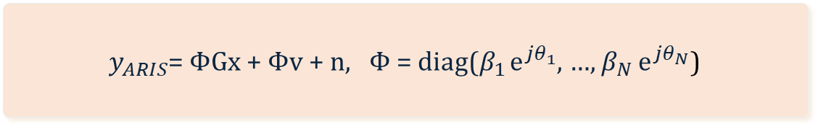
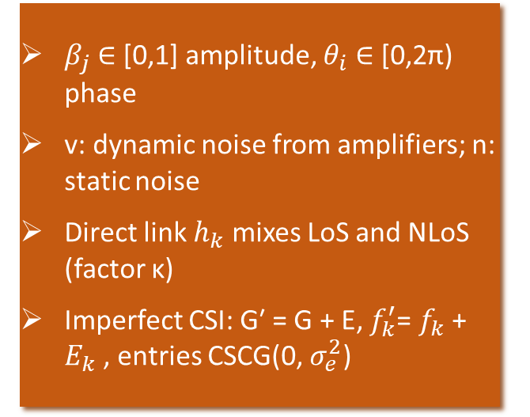
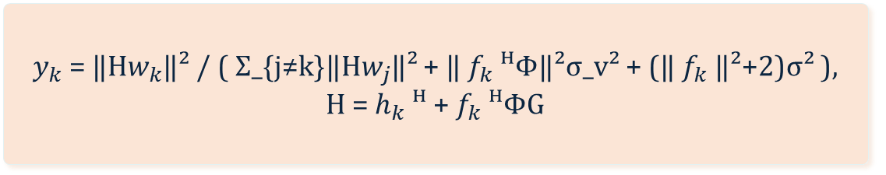

system model
Article
x = W s
$β_{j}$ ∈ [0,1] amplitude, $θ_{i}$ ∈ [0,2π) phase
v: dynamic noise from amplifiers; n: static noise
Direct link $h_{k}$ mixes LoS and NLoS (factor κ)
Imperfect CSI: G′ = G + E, $f_{k}^{′}$= $f_{k}$ + $E_{k}$, entries CSCG(0, $σ_{e}^{2}$)
$y_{ARIS}$= ΦGx + Φv + n, Φ = diag($β_{1}$ $ⅇ^{jθ_{1}}$, …, $β_{N}$ $ⅇ^{jθ_{N}}$)
$y_{k}$= ($h_{k}$ᴴ + $f_{k}$ᴴΦG)Ws + $f_{k}$ᴴΦv + $n_{k}$
$y_{k}$= ‖H$w_{k}$‖² / ( Σ_{j≠k}‖H$w_{j}$‖² + ‖ $f_{k}$ᴴΦ‖²σ_v² + (‖ $f_{k}$‖²+2)σ² ),
H = $h_{k}$ᴴ + $f_{k}$ᴴΦG
Reference : [2] Z. Huang et al., A soft actor–critic reinforcement learning approach for over the air active beamforming with RIS, Physical Communication 66 (2024)
Soft Actor-Critic
23/36

Slide 24
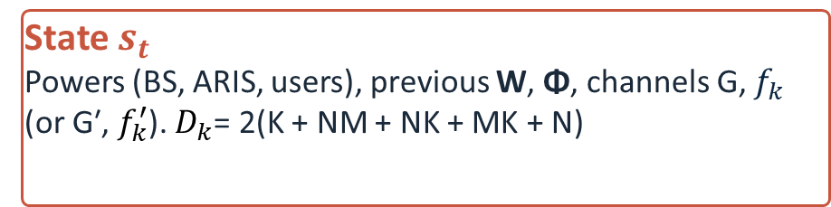
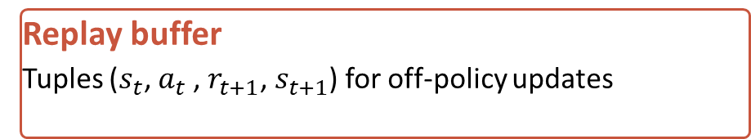
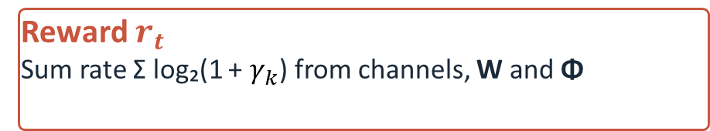
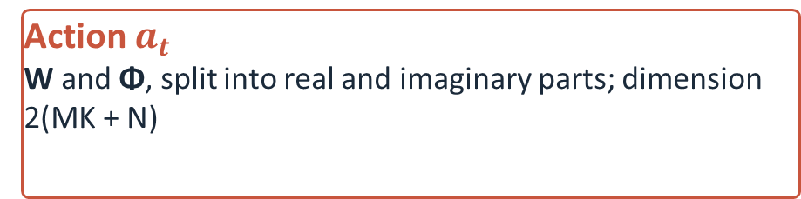
SAC formulation as an MDP
Article
State $s_{t}$
Powers (BS, ARIS, users), previous W, Φ, channels G, $f_{k}$ (or G′, $f_{k}^{′}$). $D_{k}$= 2(K + NM + NK + MK + N)
Action $a_{t}$
W and Φ, split into real and imaginary parts; dimension 2(MK + N)
Reward $r_{t}$
Sum rate Σ log₂(1 + $γ_{k}$) from channels, W and Φ
Replay buffer
Tuples ($s_{t}$, $a_{t}$, $r_{t+1}$, $s_{t+1}$) for off-policy updates
Neural networks cannot take complex values, so all complex matrices are split into real and imaginary parts.
Reference : [2] Z. Huang et al., A soft actor–critic reinforcement learning approach for over the air active beamforming with RIS, Physical Communication 66 (2024)
Soft Actor-Critic
24/36

Slide 25
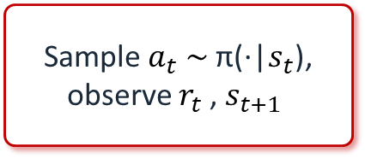
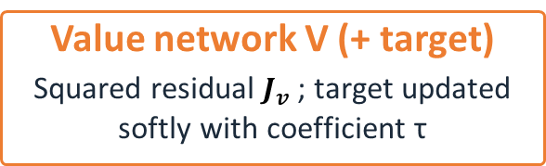
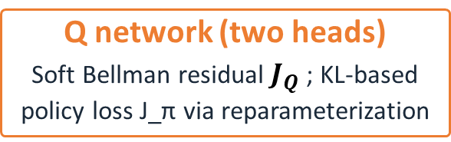
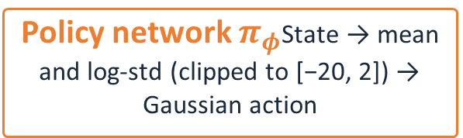
The SAC algorithm
Article
Environment: channels, BS, ARIS
Sample $a_{t}$ $\sim$ π(·|$s_{t}$), observe $r_{t}$, $s_{t+1}$
Store in replay buffer M
Mini-batch B → targets
Policy network $π_{φ}$State → mean and log-std (clipped to [−20, 2]) → Gaussian action
Q network (two heads)
Soft Bellman residual $J_{Q}$; KL-based policy loss J_π via reparameterization
Value network V (+ target)
Squared residual $J_{v}$; target updated softly with coefficient τ
Every few episodes the policy is evaluated. Output: optimal action a = {W, $φ$}.
Reference : [2] Z. Huang et al., A soft actor–critic reinforcement learning approach for over the air active beamforming with RIS, Physical Communication 66 (2024)
Soft Actor-Critic
25/36

Slide 26
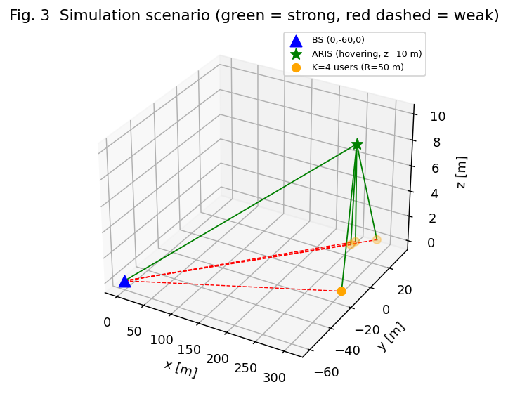
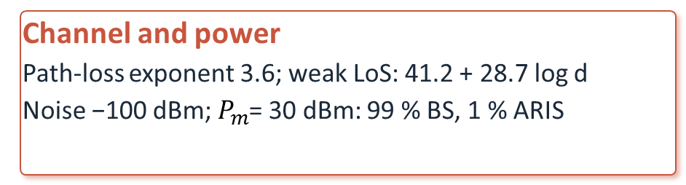
Simulation setup
Article
Geometry
BS at (0, −60, 0) m; user centre at (300, 0, 0) m
K = 4 users within 50 m (also 5 m); ARIS hovers near
(300, 10, 10) m
Channel and power
Path-loss exponent 3.6; weak LoS: 41.2 + 28.7 log d
Noise −100 dBm; $P_{m}$= 30 dBm: 99 % BS, 1 % ARIS
Training
γ = 1, lr = 0.001, τ = 0.001, batch 16
Buffer 40,000; 40,000 steps; log-std clip (−20, 2)
Five schemes compared
SAC perfect CSI · SAC imperfect CSI
Active RIS + AO · Passive RIS · No RIS (WMMSE)
Reference : [2] Z. Huang et al., A soft actor–critic reinforcement learning approach for over the air active beamforming with RIS, Physical Communication 66 (2024)
Soft Actor-Critic
26/36

Slide 27
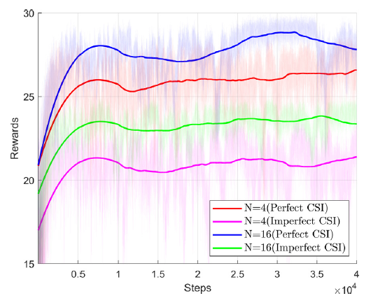
Results 1: training and convergence
Article
10k vs 15k
iterations to converge: lr 0.001 vs 0.0001
+25
reward gain from 30 to 50 dBm (N = 30)
27–29 vs 25–27
reward range, N = 16 vs N = 4 (perfect CSI)
Perfect CSI always above imperfect CSI: outdated channels misalign beams
lr = 0.001 adopted for all later experiments
More reflecting elements and more power → higher sum rate (N from 10 to 130)
Reference : [2] Z. Huang et al., A soft actor–critic reinforcement learning approach for over the air active beamforming with RIS, Physical Communication 66 (2024)
Soft Actor-Critic
27/36

Slide 28
Results 2: sum-rate versus baselines
Article
+37 / +66 / +70 %
over passive RIS: AO / SAC imperfect / SAC perfect
N = 70 elements
Passive 21.95 · AO 32.85 · SAC 37.69 (imperfect) / 38.36 (perfect) bps/Hz
SAC gains grow faster with power: same rate with less power
Reference : [2] Z. Huang et al., A soft actor–critic reinforcement learning approach for over the air active beamforming with RIS, Physical Communication 66 (2024)
Soft Actor-Critic
28/36

Slide 29
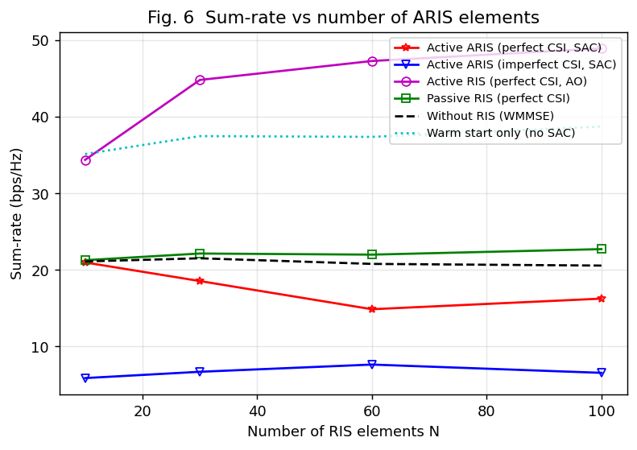
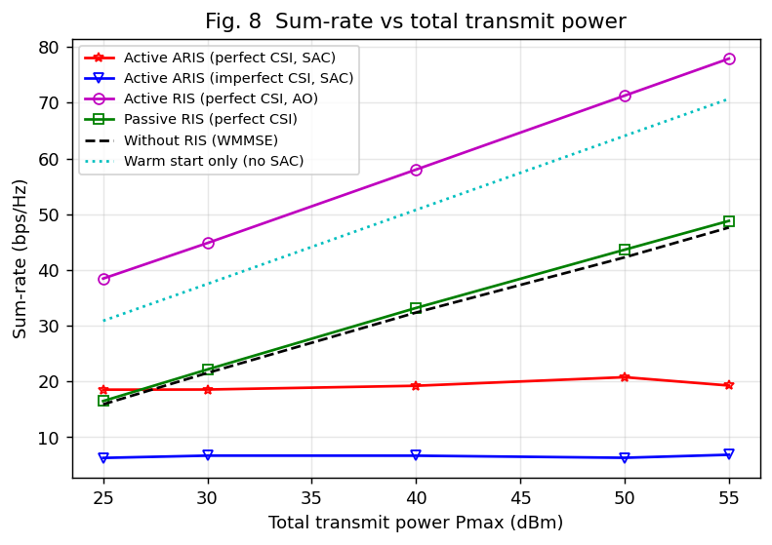
Article
Reference : [2] Z. Huang et al., A soft actor–critic reinforcement learning approach for over the air active beamforming with RIS, Physical Communication 66 (2024)
Soft Actor-Critic
29/36

Slide 30
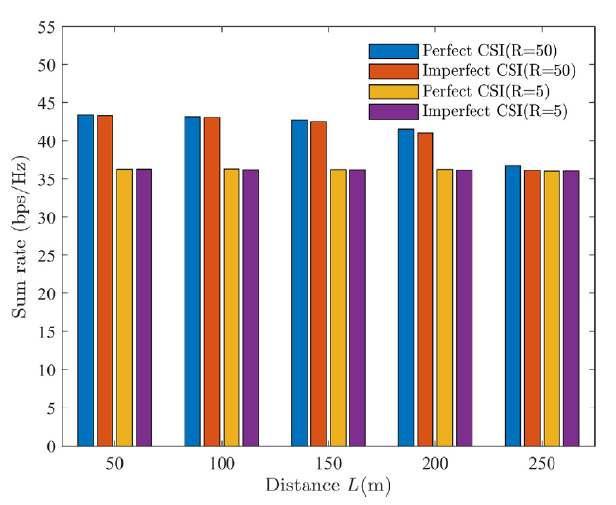
Results 3: robustness to CSI and UAV position
Article
Gap ≤ 0.89 bps/Hz
Perfect vs imperfect CSI, across all experiments
35.70 vs 29.48
SAC with imperfect CSI beats AO with perfect CSI (30 dBm)
R = 50 m > R = 5 m
Users closer to the BS give higher rates; the perfect and imperfect curves nearly overlap
Reference : [2] Z. Huang et al., A soft actor–critic reinforcement learning approach for over the air active beamforming with RIS, Physical Communication 66 (2024)
Soft Actor-Critic
30/36

Slide 31
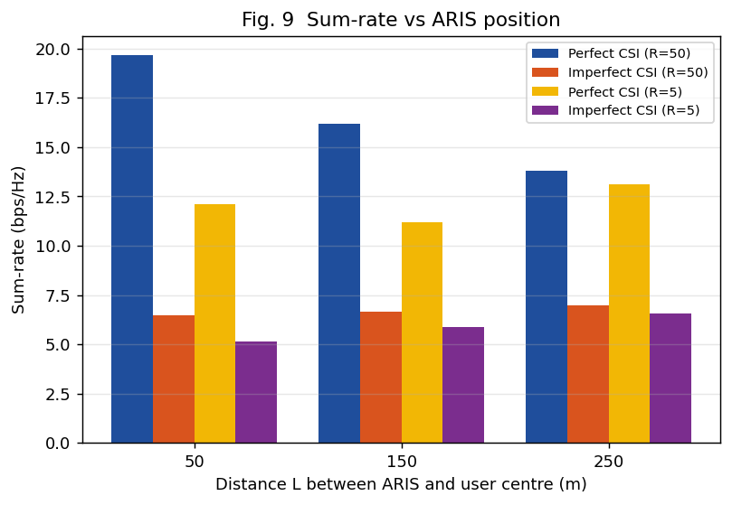
Article
Reference : [2] Z. Huang et al., A soft actor–critic reinforcement learning approach for over the air active beamforming with RIS, Physical Communication 66 (2024)
Soft Actor-Critic
31/36

Slide 32
Future work and Conclusion

Slide 33
Future work and Conclusion
Conclusion
Future Directions
Active ARIS overcomes multiplicative fading
Long-endurance UAV use in active RIS-assisted communication
SAC’s max-entropy policy handles rapidly changing, imperfect CSI
Compare with TD3 / PPO (paper uses only AO baselines)
Jointly designs BS precoder W and ARIS reflection Φ
Use SAC v2: twin critics, automatic α
Beats AO-based active RIS, same rate with less power
Add amplifier energy to the reward; optimize trajectory
Stable as the UAV position changes
Soft Actor-Critic
33/36

Slide 34
References
[1] Shimin Gong et al., '' Toward Smart Wireless Communications via Intelligent Reflecting Surfaces: A Contemporary Survey '' , IEEE Communications Survays and Tutorials, 2020
[2] Z. Huang et al., ‘’A soft actor–critic reinforcement learning approach for over the air active beamforming with RIS’’, Physical Communication 66 (2024) 102474.
[3] T. Haarnoja et al., ‘’Soft Actor-Critic: Off-policy maximum entropy deep RL with a stochastic actor’’, ICML 2018 (PMLR 80).
[4] T. Haarnoja et al., ‘’Soft Actor-Critic Algorithms and Applications’’, arXiv:1812.05905.
[5] OpenAI Spinning Up, Soft Actor-Critic documentation.
Soft Actor-Critic
34/36

Slide 35
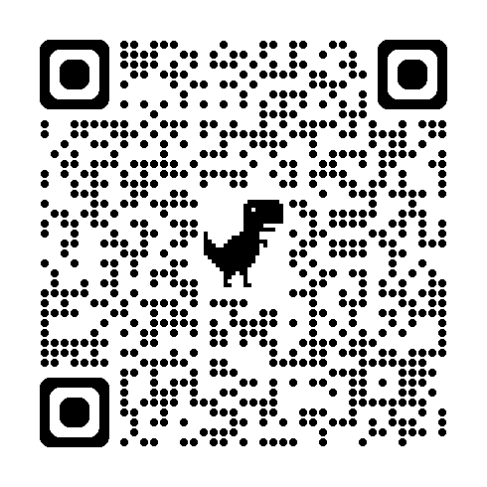
Quiz
https://forms.gle/L4363qJMHKteabUR6
Soft Actor-Critic
35/36

Slide 36

Thank you for your attention

