Slide 1


TP558 - Tópicos avançados em Machine Learning
Genetic Algorithms
Hanieh Memarian
hanieh.memarian@dtel.inatel.br

Slide 2
Outline
Introduction
Definition & Develo- pment of GA
Challenges
Article
Future work & Conclusion
5
Background
Basic problem
What is GA
Why is GA Useful
Definition of GA
Strengths of GA
Limitations of GA
Challenges and design guidance
Algorithm
Simulation Results
Conclusion
Future Directions
4
3
2
1

Slide 3
Introduction

Slide 4
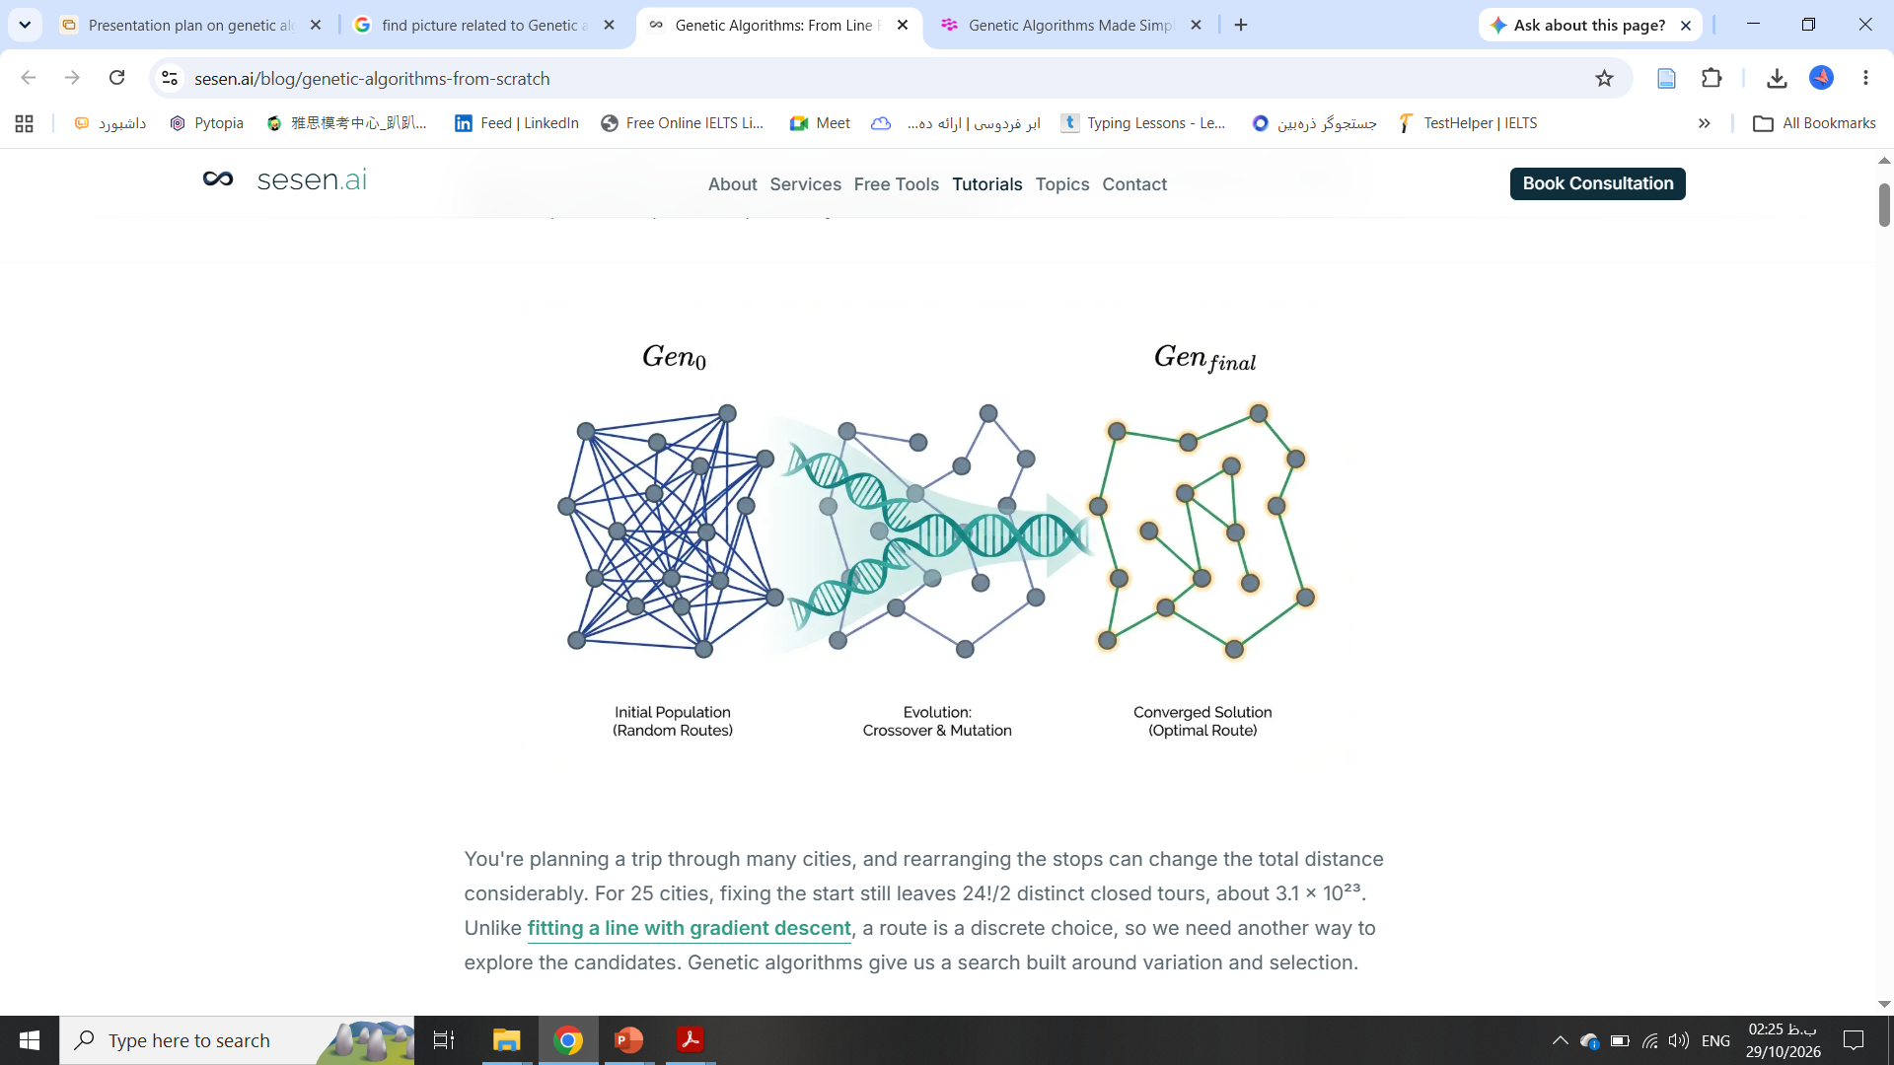
Background of GA
Introduction
Biological inspiration
Origins
Classical GA
A metaheuristic that imitates evolution: chromosomes, mutation, crossover and natural selection.
Turing proposed a learning machine in 1950; Holland developed GAs from the 1960s and published in 1975.
A population of binary strings; a string’s fitness decides its influence on future search.
Genetic Algorithms
4/29

Slide 5
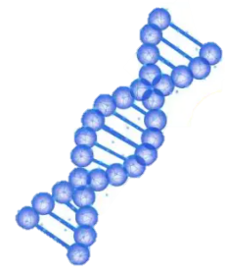
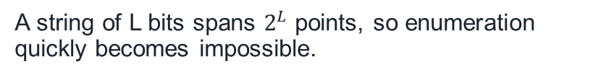
Basic problem search and optimization
Introduction
Huge search spaces
No derivatives needed
A string of L bits spans $2^{L}$ points, so enumeration quickly becomes impossible.
The objective can be a simulator, noisy or discontinuous; only evaluations are required.
Moving targets
Constrained design
In dynamic settings such as wireless, the optimum keeps shifting: “dancing landscapes”.
Network design mixes placement, routing and capacity limits; exact solvers slow down on large instances.
Genetic Algorithms
5/29

Slide 6
Definition and Development
of GA

Slide 7
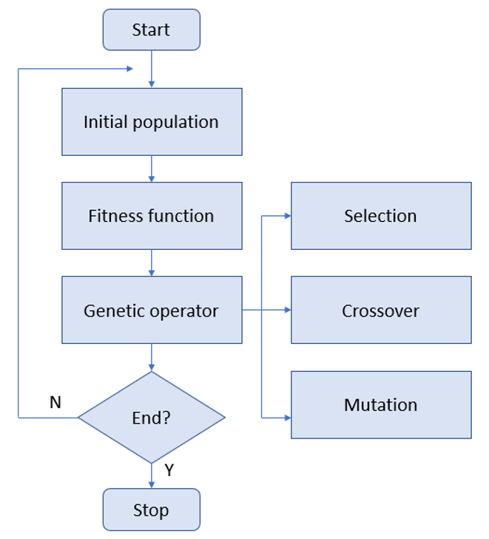
What is a GA?
Definition and Development of GA
1 Initialize
2 Evaluate
Random or seeded population of chromosomes
Compute fitness of every chromosome
3 Select
4 Recombine
Fitter chromosomes are likelier parents
Crossover swaps parent segments
5 Mutate
6 Repeat
Rare random changes keep diversity
Repeat until a termination criterion is met; elitism can keep the best individuals unchanged.
Genetic Algorithms
7/29

Slide 8

Why is a GA useful?
Definition and Development of GA
Rugged landscapes
Interacting parameters
Highly multimodal, discrete or discontinuous functions.
Nonlinear dependencies (epistasis) that defeat simpler methods.
Hard combinatorial problems
Proven real-world use
Good approximations for NP-complete problems.
Antenna, VLSI and scheduling design; telecom network design with 31% and 52.2% cost cuts (A4).
Do not use a GA if a hill-climber works well.
Genetic Algorithms
8/29

Slide 9
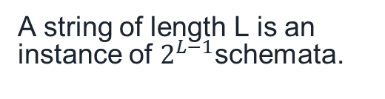
schemata and building blocks
Definition and Development of GA
Schemata
Schema theorem
Building blocks
A string of length L is an instance of $2^{L−1}$schemata.
Short, low-order, above-average schemata receive exponentially more samples.
Crossover recombines good short pieces into better strings; implicit parallelism.
Genetic Algorithms
9/29

Slide 10
Definition of GA
Definition and Development of GA
P(H,t+1) ≥ P(H,t) $\frac{f\left(H,t\right)}{\overline{f}}$ [1 − $P_{c}\frac{Δ\left(H\right)}{L−1}$ − O(H) $P_{m}$]
H: schema; f(H,t): mean fitness of its instances; $\overline{f}$: population mean; Δ(H): defining length; O(H): order;
$P_{c}$, $P_{m}$: crossover and mutation probabilities; L: string length.
A GA is a stochastic, population-based search that applies selection, crossover and mutation to evolve encoded candidate solutions toward higher fitness.
Genetic Algorithms
10/29

Slide 11
Challenges

Slide 12
Strengths of GA
Challenges
Generality
Adaptive, online
Beats exact solvers at scale
Works on a wide range of problems and when the objective is only evaluated.
Mutation explores while selection exploits; suits changing conditions.
On large PON instances a GA outran ILP in run time (A4).
Parallel, scalable
Multi-objective
Easy to implement
Population structure maps to island and master-slave models.
Pareto-front search with NSGA-II and variants.
Swapping and shifting genes; fits DSPs and FPGAs.
Genetic Algorithms
12/29

Slide 13
Limitations of GA
Challenges
No guarantee
Premature convergence
Costly evaluation
No proof of global optimality, even when a GA beats ILP on run time (A4).
Genetic drift with small or uniform populations.
Thousands of fitness calls; evaluation time is the usual bottleneck.
Not real-time safe
Deception, epistasis
No Free Lunch
Stochastic: run time varies and is unbounded.
Hitchhiking and deceptive functions can mislead search.
No method is best across all problems.
Genetic Algorithms
13/29

Slide 14
Challenges and design guidance
Challenges
Premature convergence
Fitness sharing, crowding, mutation; scaled or rank selection
Hamming cliffs (binary integers)
Use Gray codes so neighbours differ by one bit
Parameter tuning
Pop. 50-100; $P_{c}$0.6, $P_{m}$0.001 (pop. ~100); $P_{c}$ 0.9, $P_{m}$ 0.01 (pop. ~30)
Slow fitness evaluation
Fitness approximation, caching, parallel and island GAs
Settings in practice
[4]: pop. 100, 100 generations, tournament 5, 10% elitism; cap generations near 2.5 × pop. ([1])
Genetic Algorithms
14/29

Slide 15
Article
Genetic Algorithms in Wireless Networking

Slide 16
Why use GA in wireless networks?
Article
Dynamic channels
Conflicting objectives
Black-box fitness
Optima keep changing; GAs adapt online and satisfice rather than optimize.
BER, power, SINR and throughput are optimized jointly by multi-objective GAs.
No explicit objective formula is needed, only an evaluation.
Genetic Algorithms
16/29

Slide 17
Application areas surveyed
Article
Routing
Ahn & Ramakrishna [23]; Yang et al. [34]
QoS
Xiao et al. [73] (admission control); Roy et al. [49]
Load balancing
Scully & Brown [70] (WLAN)
Bandwidth allocation
Lin & Labeau [75]
Channel allocation
Ngo & Li [98]; Friend et al. [17]
Localization
Zhang et al. [99]; Tam et al. [101]
Network planning, placement
Pries et al. [120]; Ghosh et al. [122]; Xhafa et al. [105]
Genetic Algorithms
17/29

Slide 18
GA by network type
Article
Sensor networks
Coverage, clustering, sleep scheduling (Jia; Ferentinos)
Mesh networks
Router placement for coverage and connectivity (Xhafa et al.)
Cognitive radio
Cognitive engine with WSGA; island GA for channels
Cellular networks
Relay stations, base-station sleep modes (Chiaraviglio et al.)
Software-defined
Small-cell backhaul resource manager (Bojic et al.)
Genetic Algorithms
18/29

Slide 19
Hybrid GAs
Article
Game theory
Reinforcement learning
Fuzzy logic
Evolutionary games for sensing, power control and routing.
GA as policy-space search over encoded policies.
GA tunes membership functions and rules.
Quantum GA
Memetic
Other metaheuristics
Qubit chromosomes; more effective on larger inputs.
Local search on each member: stronger but costlier; used in A4.
ACO routing, GA-trained neural network weights.
Genetic Algorithms
19/29

Slide 20
Main problem automatic network design
Article
Rising demand
High investment
Slow manual design
Streaming, cloud and gaming push providers to fibre (FTTH, FTTB).
Ducts and cables dominate cost; good design can save about 30%.
Splitters, headend, PDOs, routes, distances and optical budget: days of effort.
Design a GPON / fiber-to-the-home network at equipment level, on an existing physical infrastructure, at minimum cost.
Genetic Algorithms
20/29

Slide 21
Problem formulation
GPON/FTTH design
Article
One OLT feeder fibre feeds a 1:N splitter that serves ONUs (client modems); splitting is centralised or cascaded.
Decisions
Constraints
Objective
Where to place capacitated PDOs (street cabinets), which client connects to which PDO, splitter ratio and level.
12 ports per PDO with 10% spare; drop cable up to 85 m; reach 20 km and optical budget (about 0.35 dB/km); drop cables must not cross distribution cables.
Minimize total cost of PDOs, drop cable and distribution cable, avoid buried routes, serve every client’s demand.
Genetic Algorithms
21/29

Slide 22
Algorithm two-level GA with local search
Article
Two-level representation
Variation operators
Level 1: binary list, 1 = PDO placed on that equipment. Level 2: integer list, client → PDO id, −1 if unassigned.
Bit-flip mutation and uniform crossover act on level 1; level 2 is then repaired for affected homes.
Local search
Selection
Clients first join their closest PDO; hill-climbing swaps of drop links fix the rest, within range and port limits.
Tournament selection (size 5) with 10% elitism, 100 generations on a population of 100.
Genetic Algorithms
22/29

Slide 23
Fitness function and experimental setup
Article
$C_{Mat}$= $C_{Drop}$· $N_{Drop}$+ $C_{Dist}$· $N_{Dist}$+ $C_{PDO}$· $N_{PDO}$
f = $C_{Mat}$+ $H_{Missing}$· P
$H_{Missing}$: homes left unconnected; P: penalty set to the cost of one PDO. Drop cable is ×10 costlier for buildings; Dijkstra paths are cached.
Costs and limits
GA settings
PDO $300; drop cable $2/m; distribution cable $5/m. 12 ports, 10% spare, drop ≤ 85 m, reach 20 km.
Pop. 100; 100 generations; bit-flip 2/len; uniform crossover rate 0.85; tournament 5; 10% elitism.
Genetic Algorithms
23/29

Slide 24
Simulation results
Article
Metric
Map 1 handmade
Map 1 GA best
Map 2 handmade
Map 2 GA best
Number of PDOs
62
17
27
14
Drop cable (km)
2.75
4.18
3.53
3.09
Distribution cable (km)
2.08
1.74
2.76
1.65
Fitness (cost score)
34,505
23,908
50,216
24,828
Cost cut: 31% on Map 1; 52.2% reported for Map 2 (its Table 7 gives about 50.6%). Run time about 30.5 s and 37 s, against hours to days by hand.
Fitness falls fastest in the first 25 generations. Map 1: 103 houses, 5 buildings; Map 2: 76 houses, 11 buildings.
Genetic Algorithms
24/29

Slide 25
Future work and Conclusion

Slide 26
Future work and Conclusion
Conclusion
Future Directions
Distributed multi-objective GAs, wireless-specific knowledge, stronger theory, big-data scaling.
A GA designed GPON networks 31% and 52.2% cheaper than handmade ones in seconds, with no optimality guarantee.
Soft Actor-Critic
26/29

Slide 27
References
[A1] A1 Mehboob, Qadir, Ali, Vasilakos, “Genetic Algorithms in Wireless Networking,” arXiv:1411.5323, 2014.
[A2] E. D. Goodman, “Introduction to Genetic Algorithms,” GECCO 2007 tutorial.
[A3] D. Whitley, “A Genetic Algorithm Tutorial,” Statistics and Computing, 1994.
[A4] Correia et al., “Automatic Design of Telecom Networks with Genetic Algorithms,” arXiv:2304.00637, 2023.
Soft Actor-Critic
27/29

Slide 28

Quiz
https://forms.gle/dT7m8f9vYrYxZ4vy9
Soft Actor-Critic
28/29

Slide 29

Thank you for your attention

