Slide 1
Taxi ordering System
Hanif Adedotun - 191203007
Audu-Ukpoju Peace - 201203008
Abdullahi Magaji Sani - 191203014

Slide 2
INTRODUCTION
The taxi ordering app is a lightweight Java application that helps anyone book a ride online safely and securely
It consists of 5 major screens:
The home screen where the user inputs current location and destination,
The profile screen where the use details and trip history are stored,
The loading screen that comes up after booking a ride,
The Book Ride screen that shows the waiting time and driver details,
The Driving screen that shows the trip time as well a button to share details,
The Finished screen that shows a rating checkbox

Slide 3
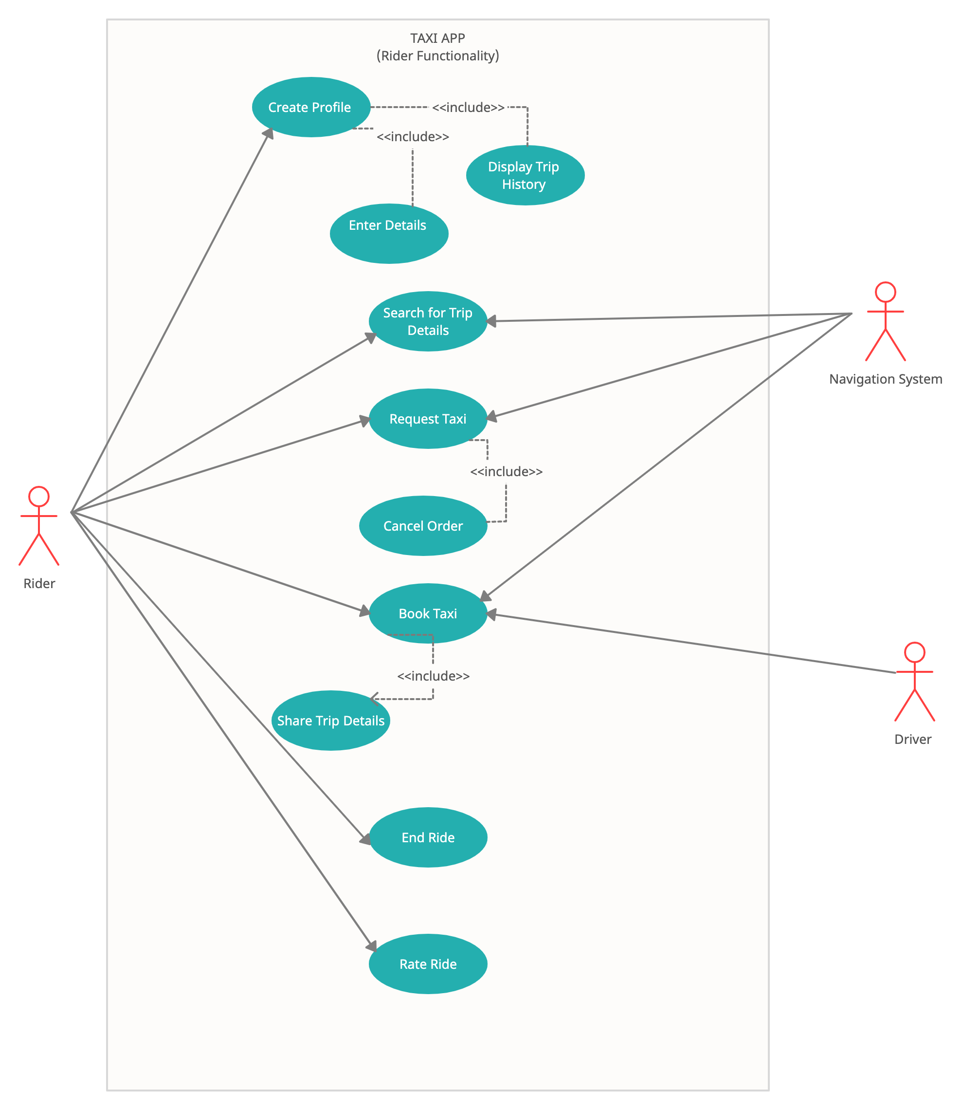
Use-case diagram

Slide 4
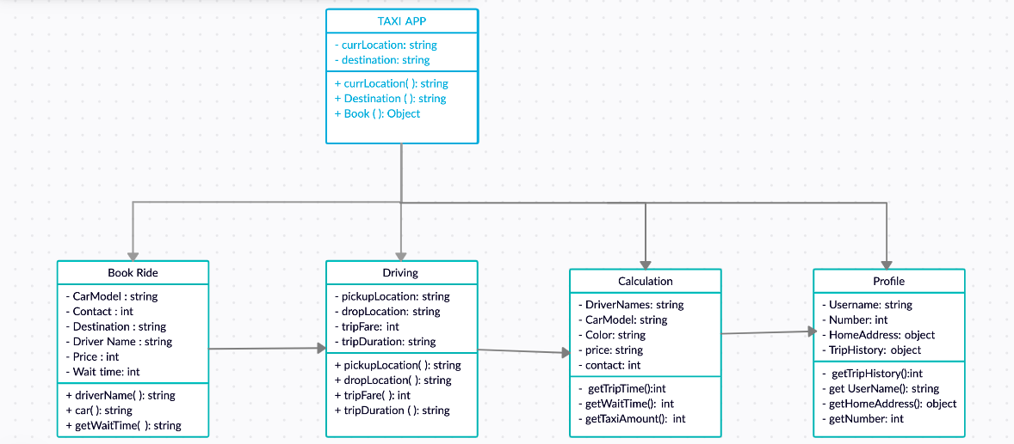
CLASS diagram

Slide 5
IMPLEMENTATION/
CODING

Slide 6
limitations
App is limited to only the Passanger/customer aspect
Cannot do accept debit cards
Limited functionalities in app
Cannot verify user location

Slide 7
CHEERS!
ONTO TO THE DEMO!
Repository
www.github.com/taxiApp

