Slide 1
Predicting Patron Patterns for the San Francisco Public Library System
By Hanif Lumsden
Notes:
Greetings. This is Hanif Lumsden, presenting my research on predicting patron patterns for the San Francisco Public Library System.

Slide 2



Topic Description
This topic centers around the dataset for the San Francisco library circulation system regarding patron data.
Ranging from years 2003 to 2016.
Composed of 420000 records analyzed using data mining classification techniques.
Notes:
The public library system for San Francisco library circulation system is chosen. Data is taken from the library’s website, as it is an open comma-separated-value file for download, and contains bibliographic records of items, patrons, and circulation data from the years 2003 to 2016 and has a total of over 420,000 records. Data mining classification and predictive techniques multiple linear regression and decision tree is used for this project.

Slide 3



Topic Importance
Determining best fit for particular types of data.
Data provides insight into patron behavior.
Best approach for analyzing library circulation data.
Notes:
The importance comes in finding the best model for the library data. Different mining techniques will be more suitable for different types of data. In this report, only two types are executed due to the system constraints, but the results are compared with Ansari et al (2020) and Han et al. (2022). Analysts should consider this report and how applicable different algorithms are when assessing library circulation data in the future. In terms of analytical results use-value, libraries can better suit patrons if they understand them better.

Slide 4
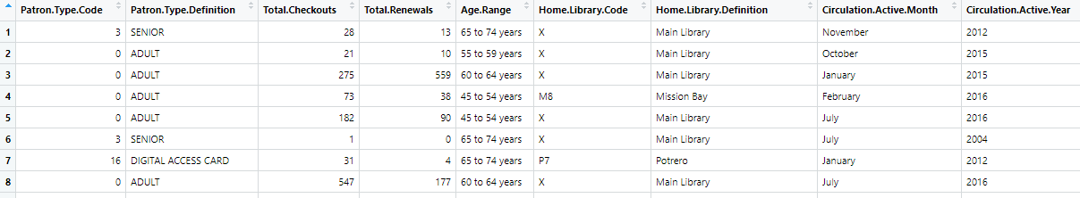
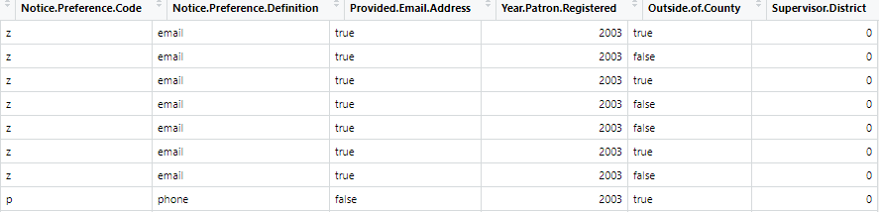
Dataset Selection
Notes:
This library data is provided by the San Francisco publishing department of the public library, representing the use of inventoried items (DataSF, 2019). Columns consist of a patron type code where patrons are assigned a categorical number for records-sake; patron type definition that describes the patron type number; total checkouts and total renewal columns representing a total number of checkouts and renewals made by the patron; age range is a string column of the from 0 to 75 and over but separated by decade or age group; home library code which is an alphanumeric identifier and home library definition which defines said identifier and is based on location; circulation active month and year columns are when the patron was last active; notice preference and definition is the code and preferred contact information; provided email address is a boolean attribute; year patron registered; outside of the county is another boolean attribute; and supervisor district is a number that corresponds with the district number (DataSF, 2019).

Slide 5


Method
MLR model considering registration and checkout by year.
Decision tree for predicting patron behavior by age and supervisor district.
Notes:
Multiple linear model regression will be used for registration and checkout as dependent variable by year and decision tree for predicting patron behavior by age as well as likely patron type and behavior based on location (Ansari et al., 2020)

Slide 6




Data Preprocessing
Deletion of rows containing null values.
Usage of is.na() and na.omit().
Converting to numeric factors.
Shuffling the data.
Notes:
Missing data values from the Supervisor District column are replaced with 0. Any row containing a null value is deleted. Using the is.na() function, the data frame is checked for not applicable values. Values are deleted using the na.omit() function. For multiple linear model regression and decision tree analysis, the data attributes where the data type is a string or non-numeric are converted to a numeric factor. This includes patron type definition, age range, library code and definition, circulation month and year, preference code and definition, email address, and outside of the county. For the decision tree, the data is shuffled using the sample function.

Slide 7
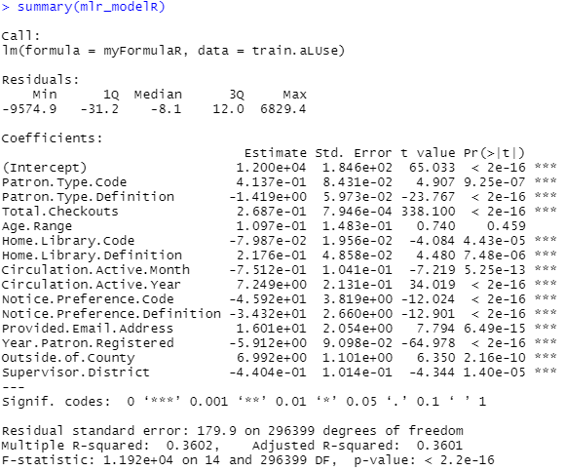
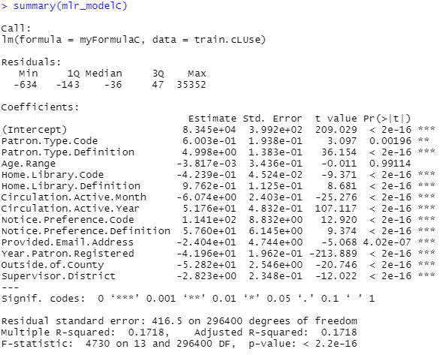
Multiple Linear Regression Model #1
All attributes are dependent values outside of age range in accordance to the p-value.
Considering renewal has accuracy of 36.02 percent and checkouts has accuracy of 17.18 percent.
Notes:
Dependent data variables total checkout and renewals are identified for multiple linear models. The model shows all attributes are dependent variables except age range, such that all dependent variable attributes have a p-value less than 0.05. The dataset has over 400000 attributes, so the model factoring in renewals has an accuracy of 36.02 percent, and the modeling factoring in checkouts has an accuracy of 17.18 percent. These are very low in accuracy in general.

Slide 8
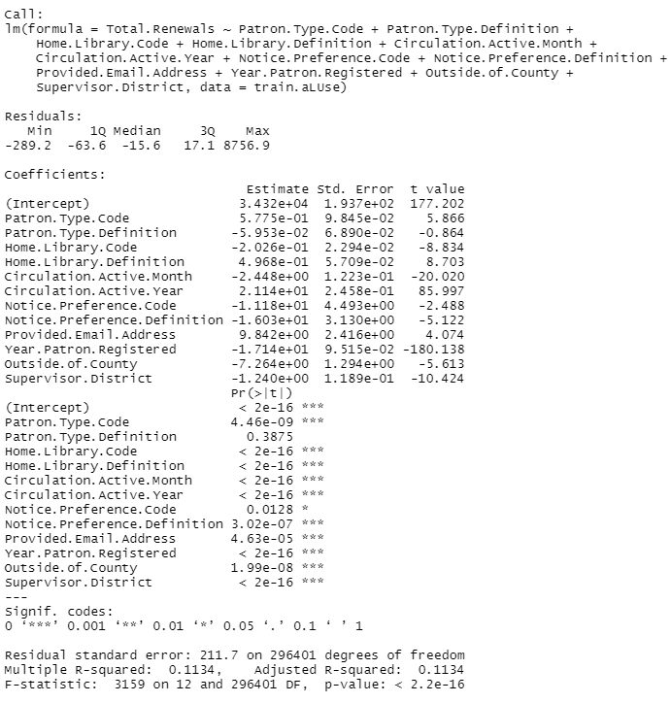


Multiple Linear Regression Model #2
Minimum adequate model amounts to lower accuracy.
Accuracy amounts to 17.22 for renewal consideration and 11.34 for checkout consideration.
Akaike Information Criterion value is useless for this test.
Notes:
Based on practice, p-values less than 0.05 are considered for the minimum adequate model. The only difference between the minimum adequate model and the initial multiple linear regression model is not factoring in the age range this test run. Most attributes are dependent variables, so accuracy does not increase; it decreases. There is a decrease in accuracy due to the contradiction in the purpose

Slide 9
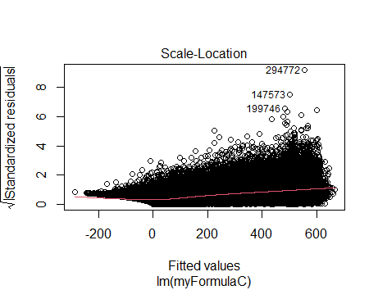
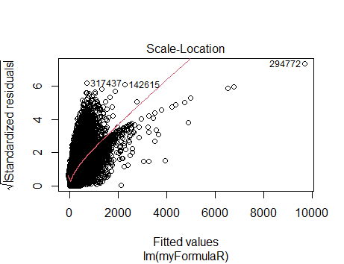
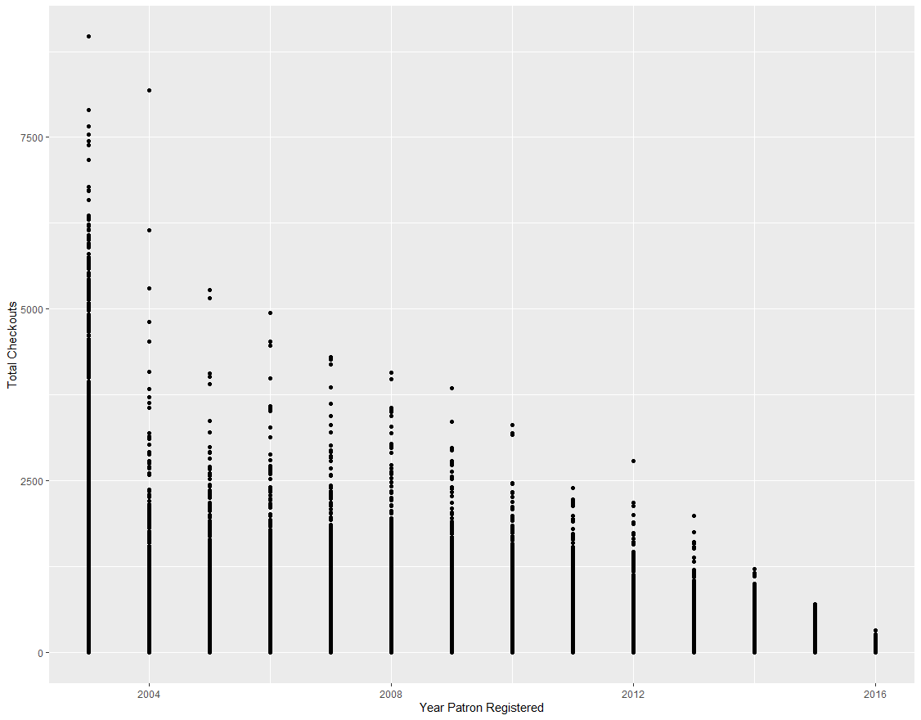
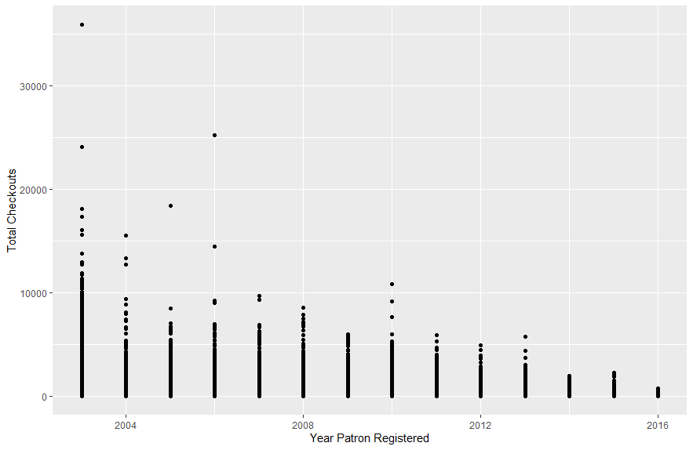
Multiple Linear Regression Model #3
Checkout
Renewal
Using a conventional plot, it is gathered that 2003 had peak activity.
There is large disparities in values along the fit.
Many outliers are seen
Notes:
Clear from these two graphs, the majority of the activity happened during the year 2003 when this particular patron dataset was first gathered. Activity decreases over time. It is assumed that technology is particular a factor in the decrease.
It must be emphasized that the distance between two points. According to the predictive model, the majority of values are clustered along the fit, and both summaries share the same general regression behavior. There are many outliers, however, and this is very indicative of the accuracy model or inaccuracy.

Slide 10
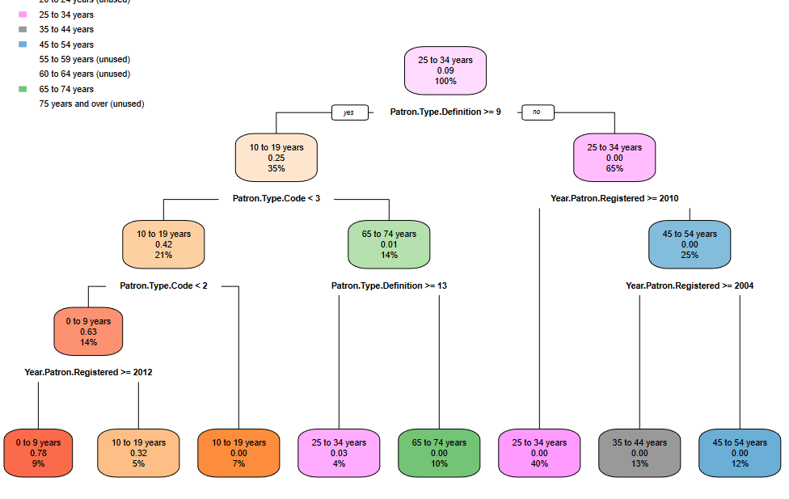
Decision Tree #1
Predicts patron type based on age.
Predicts registration based on age.
Notes:
At the start of the root node, the probability that the patron is 25 to 34 years is 9 percent. If the patron is not labeled as a staff, senior, welcome or young adult, juvenile, or patron definition type less than 9, the node goes to the correct node, where guest and adults are between the ranges 25 to 34, which in turn predicts year patron registered and amounts to a very low value. For confirmed patron definition type over 9, 35 percent of patrons with a type definition over 9 are 25 percent likely between the ages of 10 to 19. The type code is predicted. It is determined that the majority of patrons that were kids that registered past 2012 are between the ages of 0 to 9, and before 2012 were between the ages of 10 to 19. The patron type code being more significant than 3 means that the patron is an adult. It is determined that patron type definition greater than 13 or comprising of staff and young adults are between the ages of 25 to 34 on a scale of 3 percent.

Slide 11
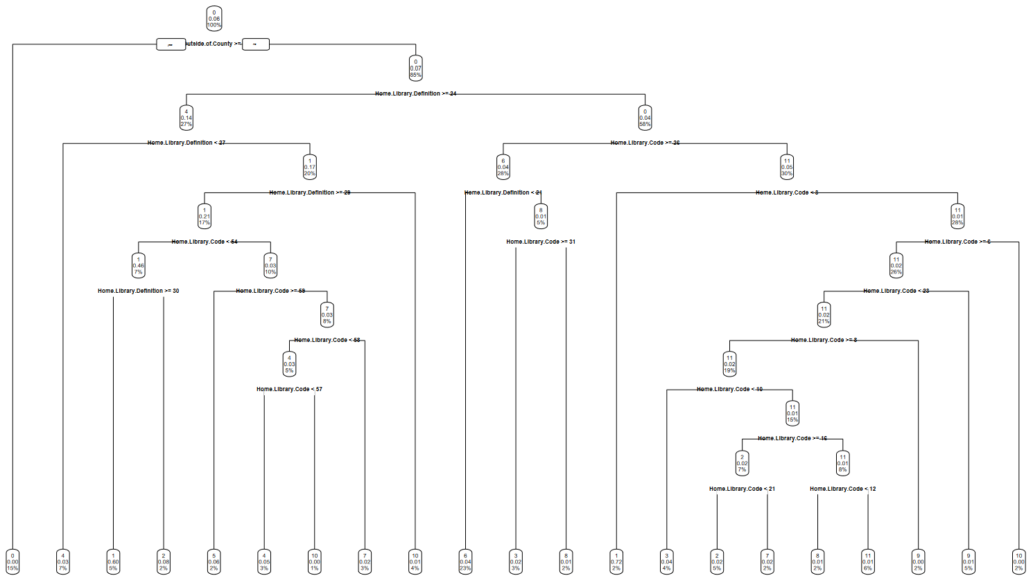
Decision Tree #2
Regarding patron location using supervisor district.
Library definition and code are emphasized.
Notes:
A much more detailed decision tree considering the supervisor district or patrons' location. Initial prediction that 6 percent of patrons will remain outside the county. From then on, home library definition and code are emphasized or the description where the patron is registered originally registered in home library definition, then home library code which can change depending on when the patron wants to adjust their destination library. Essentially, a predictor based on location is displayed with many potential outcomes. The decision tree is a better fit for the library circulation data

Slide 12


Discussions
Decision tree modeling: 48 and 51 percent accurate compared to MLR which was 33 to 11 percent accurate.
Based on literature review by Ansari et al. (2020) and Han et al. (2022), neural networks and fast update algorithms are closer to predicting actual behavior.
Notes:
The decision tree model fits the data better. Consider a dependent and independent variable in supervisor district and age range, respectively. The accuracy amounted to 48.04 percent for the age range decision tree and 51.8 percent for the supervisor district decision tree as opposed to accuracy being below 20 percent for the multiple linear regression model.
The two methods used while analyzing the entire data set amounted to very slow performance on an 8 GB ram computer. When handling this data set, the majority of data should be deleted. Doing this will lead to better performance and potentially better accuracy.
Ansari et al. (2020) predicted behavioral models using neural networks and decision trees among others. For comparison, decision trees are inquired about. Ansari et al. (2020) used the decision tree algorithm to predict loan period, referrals, and user delays, ranging from 59.3 percent to 90 percent. The neural network algorithm produced the greatest accuracy rates, up to 99 percent, close to the actual library behavioral patterns (Ansari et al., 2020). The decision tree model done for the San Francisco library amount to around 50 percent, which is around 10 percent less than the least accurate run for Ansari et al. (2020) though we were modeling different attributes and data. The range of accuracy for Ansari et al. (2020) shows that while a decision tree can be an effective model for library circulation data, neural network algorithms that assess the same data produce a more accurate model and depiction of actual user behavior.
Han et al. (2022) utilize an algorithm entitled ‘fast update’ or FUP. The FUP will scan the database once and produce a computation to increase library operation efficiency (Han et al., 2022). Hans uses association rule mining and, with high accuracy, determines borrowing behavior. The FUP algorithm will likely better fit the borrowing behavior for the San Francisco library circulation data over multiple linear regression analysis.

Slide 13
Conclusion
Cutting down data may lead to more accurate results and better performance
Decision tree determined to be more accurate model for library circulation data.
Notes:
Decision tree fits better for library circulation data. More accurate models will likely be produced if most data is first randomized and deleted. This will have a significant effect on performance as well. Regardless, the decision tree model is a better fit when compared with the multiple linear regression model based on the accuracy produced. It is determined through a literature review that neural networks are a better fit for library circulation data. Analysts should consider this paper and neural network algorithms when dealing with library circulation data.

Slide 14
References
Ansari, N., Vakilimofrad, H., Mansoorizadeh, M., & Amiri, M. R. (2020). Using data mining techniques to predict user’s behavior and create recommender systems in the libraries and information centers. Global Knowledge, Memory and Communication, 70(6/7), 538-557. https://doi.org/10.1108/gkmc-04-2020-0058
DataSF. (2016). San Francisco library usage. Kaggle. https://www.kaggle.com/datasets/datasf/sf-library-usage-data
DataSF. (2019). Library usage. San Francisco Open Data. https://data.sfgov.org/Culture-and-Recreation/Library-Usage/qzz6-2jup
Han, C., Yu, W., Li, X., Lin, H., & Zhao, H. (2022). A new fast algorithm for library circulation data mining based on FUP. Scientific Programming, 2022, 1-8. https://doi.org/10.1155/2022/1683099
San Francisco Public Library. (n.d.). Guidelines for library use. https://sfpl.org/about-us/guidelines-library-use
Wittmann, R., Neatrour, A., Cummings, R., & Myntti, J. (2019). From Digital Library to Open Datasets: Embracing a “Collections as Data” Framework. Information Technology and Libraries, 38(4), 49-61. https://doi.org/10.6017/ital.v38i4.11101
Notes:
The following are the references. Thank you for listening to my presentation.

