Slide 1

CodeBMB
Computational Literacy in Biochemistry and Molecular Biology
Paul Craig
CodeBMB Workshop

Slide 2
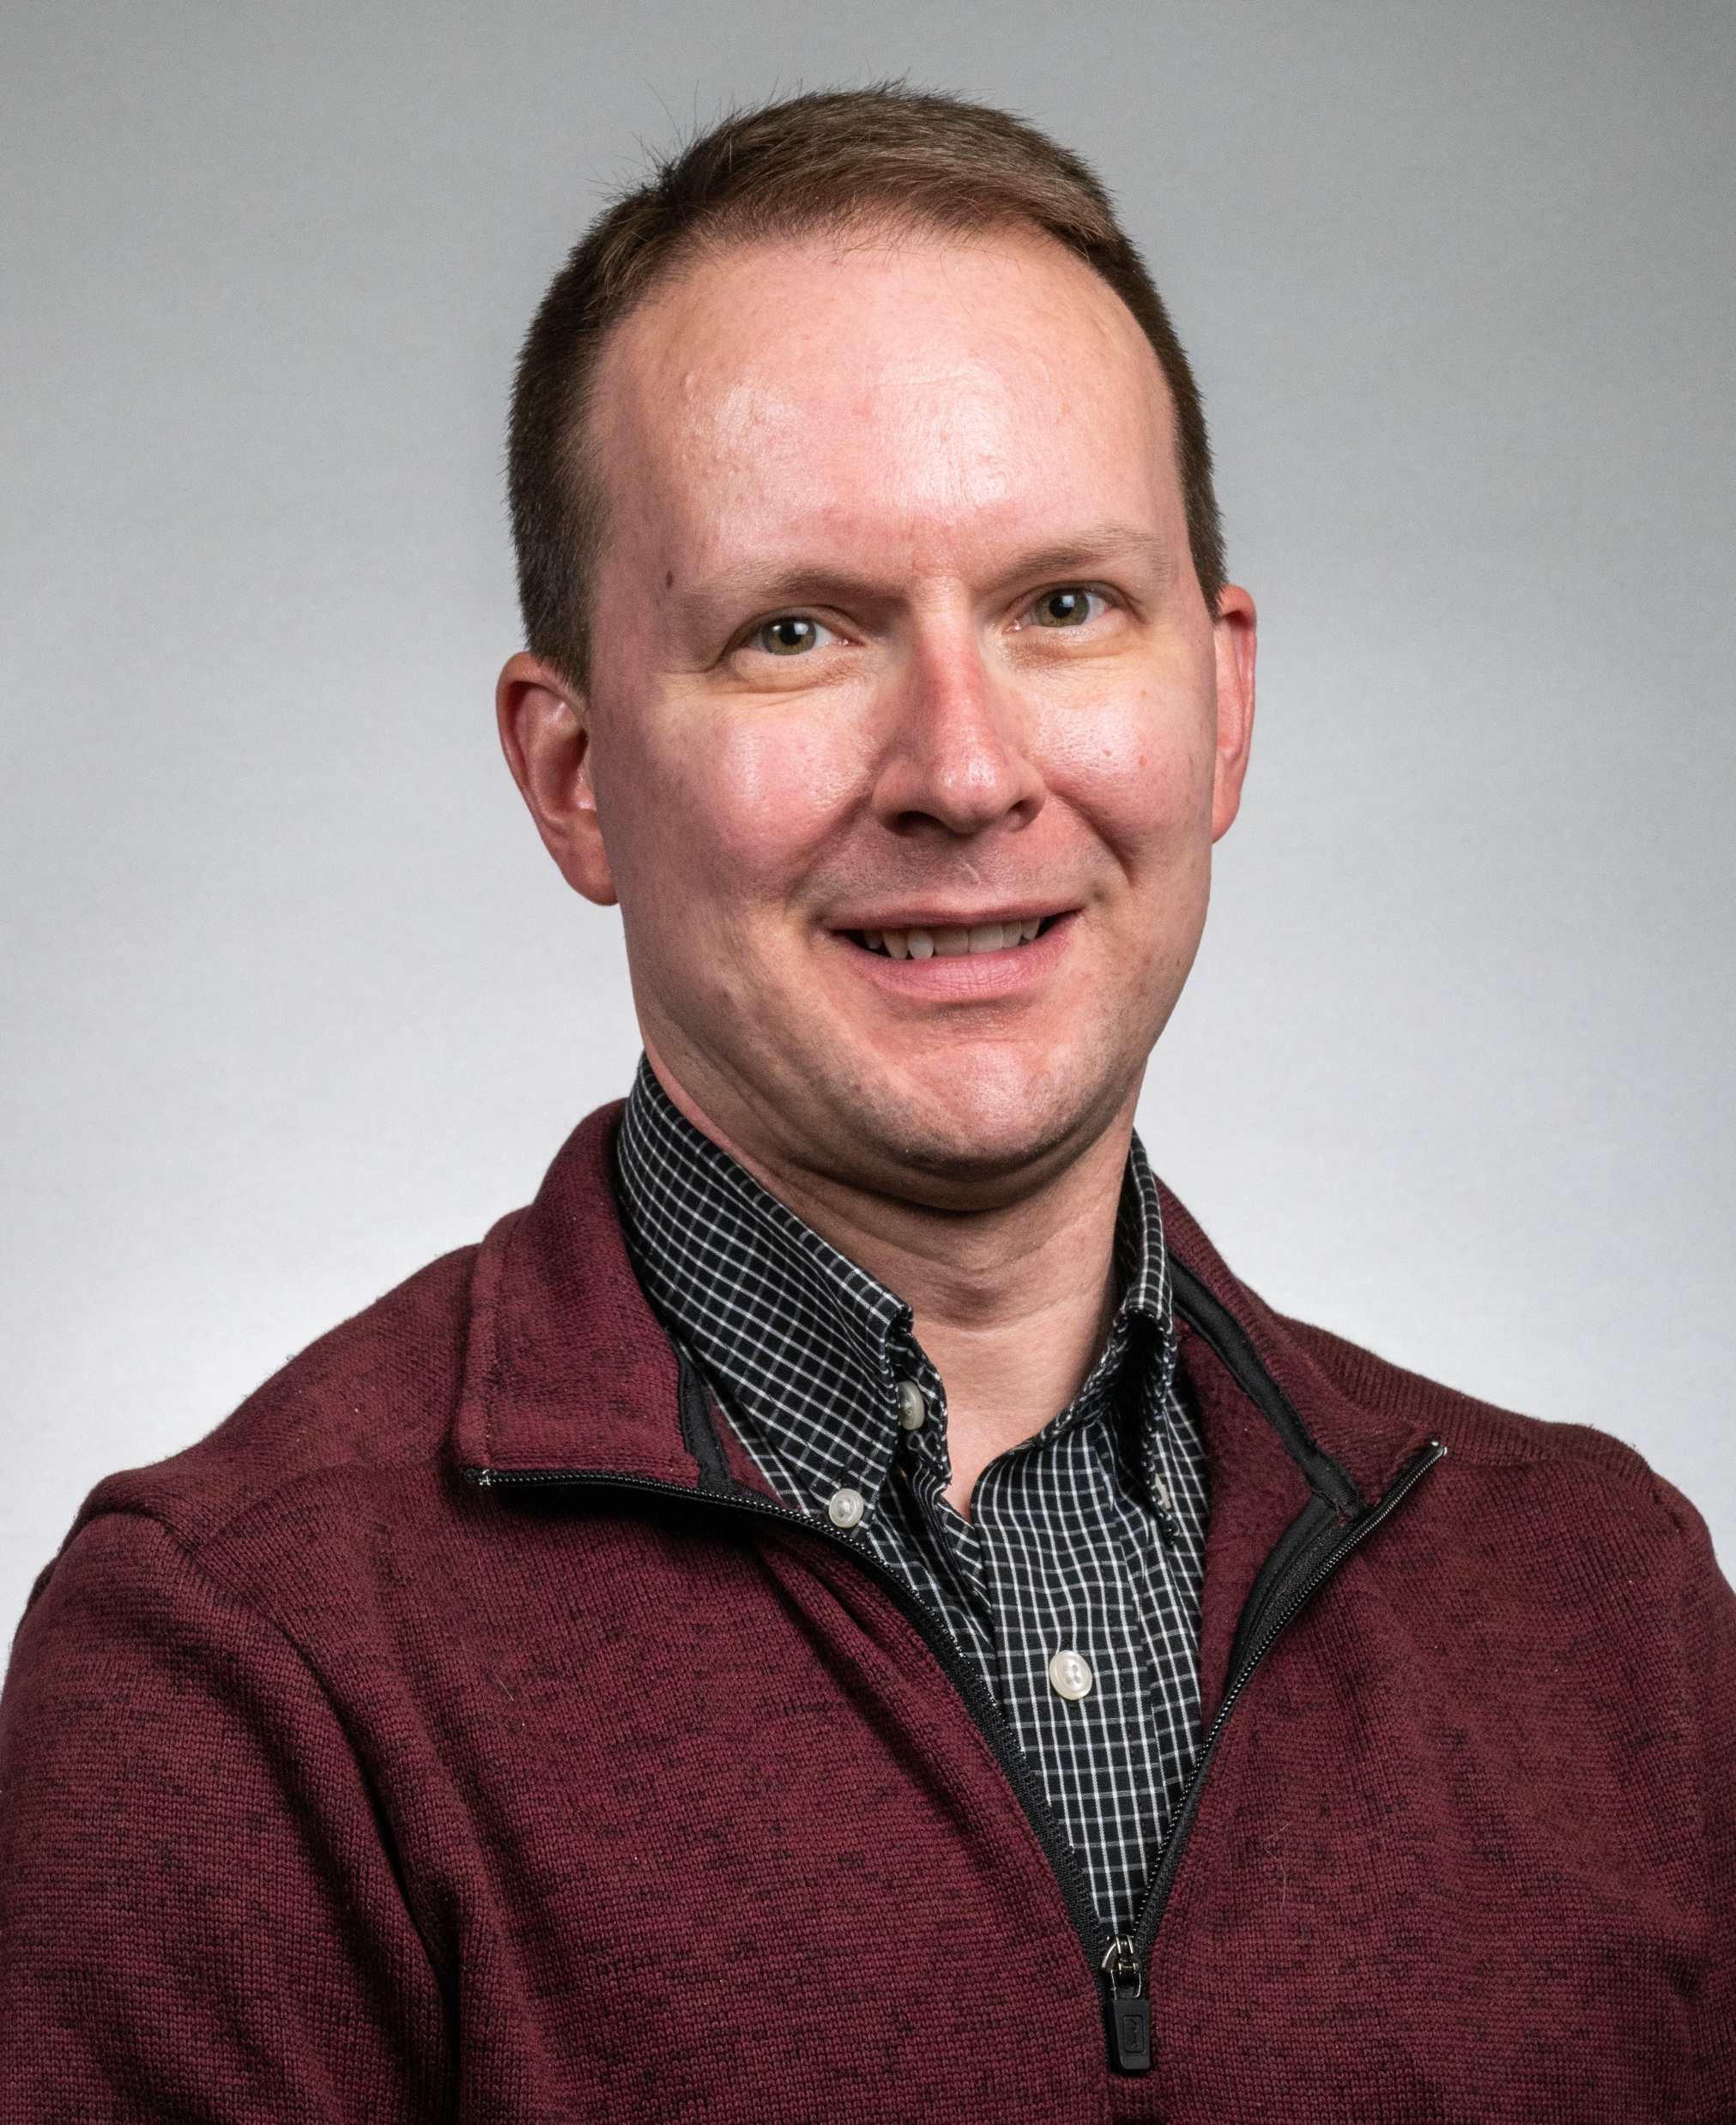
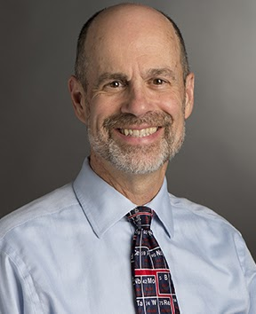
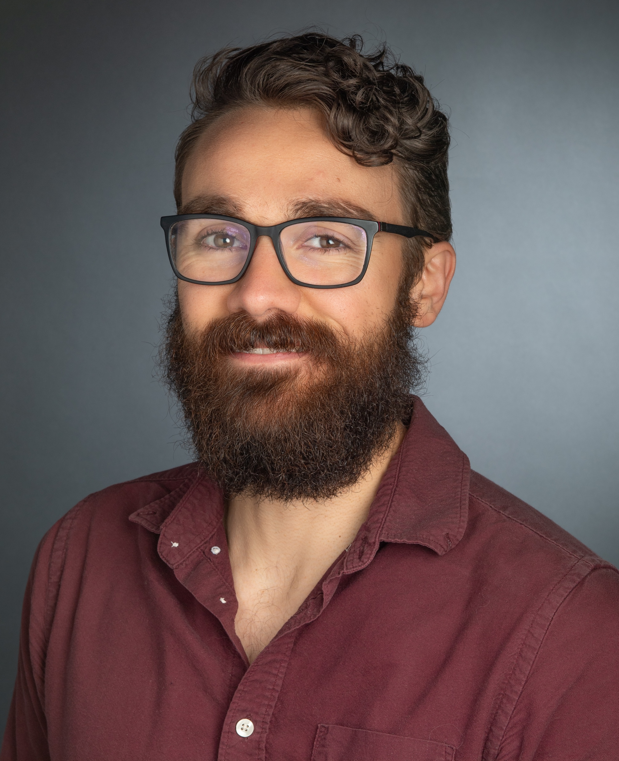
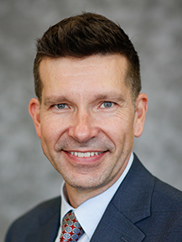
The Team
Chris Berndsen
James Madison University
Paul Craig
RIT
Mike Foster
Penn State
Wally Novak
Wabash College

Slide 3
Who We Are
We are experts at Biochemistry and Molecular Biology.
We are effective instructors in our classrooms.
We work well with our research students.
We care about the success of our students and our peers.
We are not experts at coding.
We are not experts at teaching our students to code.
Learning can be a humbling process.

Slide 4
The Agenda for Tuesday, May 19, 2026
Time | Topic | Presenter | Activity
1:00 | Introduction | Paul Craig
1:10 | Pedagogical Basis of Coding | Mike Foster
1:25 | GitHub Basics– Forking Repositories | Wally Novak | Forked Repository
1:50 | Intro to Colab and Google Drive | Chris Berndsen | Colab Notebook 001
2:10 | Break and Q&A
2:25 | Basics of Python Syntax | Paul Craig | Colab Notebook 002
3:00 | Break
3:15 | Pandas and Plotting | Chris Berndsen | Colab Notebook 003
3:50 | Wrap-Up and Overnight Task

Slide 5
The Agenda for Thursday, May 21, 2026
Time | Topic | Presenter | Activity
1:00 | Recap and Common Questions | Paul Craig
1:10 | Project Possibilities Showcase | Paul Craig
1:20 | Linear Regression | Wally Novak | Colab Notebook 004
1:50 | Break
2:05 | AI Session: Using Gemini to Modify Code | Chris Berndsen
2:50 | Select a Project
 | Colab & Python Basics | Mike Foster
 | Protein Assay/Linear Regression | Chris Berndsen | Colab Notebook 004
 | Enzyme Kinetics/Nonlinear Regression | Paul Craig | Colab Notebook 005
 | Biopython Sequence Analysis | Wally Novak | Colab Notebook 006
3:25 | Project Sharing | Mike Foster
3:50 | Resources, Next Steps, Closing | Paul Craig

Slide 6
We Value Your Feedback
Please take a few minutes to complete our post-workshop survey
Your feedback helps us:
Improve future workshops
Better meet your needs
Deliver more impactful content
Thank you for helping
us make a difference

Slide 7
Staying in Touch
PyBMB Website: https://sites.wabash.edu/pybmb/
CodeBMB GitHub: https://github.com/codeBMB
Our Slack Channel: https://pybmb.slack.com
Email: codingforbmb@gmail.com

Slide 8
Future Workshops
BCCE July 26-30 (details will be posted on our website)
Workshop 2 Learning to Code is planned for Fall 2026
Workshop 3 Teaching with Code is planned for Spring 2027
Processing and Writing Files | More with Pandas | Plotting in Python
Nonlinear Regression | Sequence and Structure | Working with AlphaFold
Principles of Live Coding | Live Coding Discussion | Live Coding Practice
TPACK and Live Coding | Grading Student Work in a Live Coding Setting

Slide 9







Acknowledgements
NSF 2518732, 2518733: Collaborative Research: Promoting Computational Literacy in Biochemistry and Molecular Biology Education

