Slide 1

Why Coding?
The Pedagogical Case for
Computational Literacy in Biochemistry and Molecular Biology
Mike Foster
May 19th Workshop

Slide 2
Who are you?
You all represent the gamut:

Slide 3
Who are you?
Many of you are just beginning your coding journey:

Slide 4
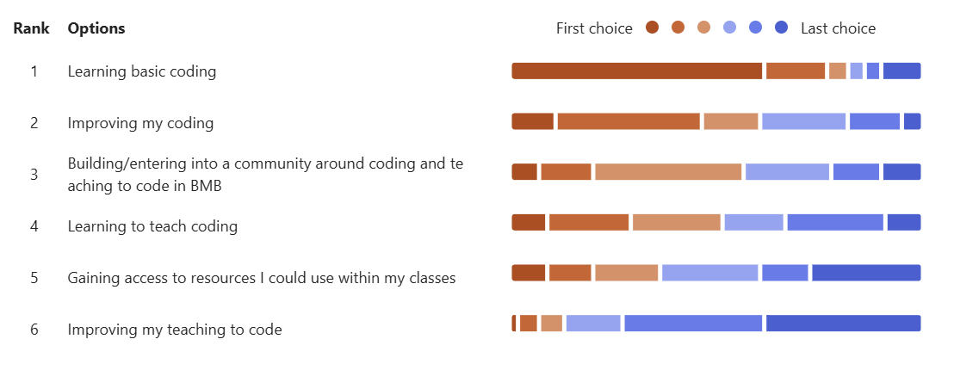
Who are you?
Goals

Slide 5
By the End of This Presentation, You Will Be Able To...
Define computational literacy and describe its three interconnected components — material, cognitive, and social
Articulate why computational skills are essential for the next generation of biochemistry and molecular biology students
Identify three major barriers that prevent faculty from incorporating coding into their BMB courses
Explain how the TPACK framework maps the knowledge faculty need to teach coding effectively in a BMB context
Describe at least two pedagogical strategies — including notebook-based learning and live coding — that make teaching coding accessible to beginners

Slide 6
The Elephant in the Room
Should We Be Teaching Coding to Life Scientists?
• Many of us were trained without coding
• Many of our students will work in fields that require it
• Most BMB faculty believe coding is important — but don't teach it
62% have NEVER run a coding activity in their courses
95%
of faculty survey respondents believe coding is important…
Yet faculty report insufficient preparation to teach it
Training faculty to teach computation is essential for sustaining the research pipeline

Slide 7
Theoretical Grounding
Computational Literacy

Slide 8
What Is Computational Literacy?
It's More Than Just Writing Code
According to diSessa…
a new literacy emerges when there is an adoption of some tool or way of reasoning by a broad cultural group
Material
Cognitive
Social
The ability to read and write code
Applying computation to analyze and solve problems
Communicating through computation — e.g., commenting code, collaborating, visualizing
Training in all three aspects is widely regarded as a 21st-century skill and improves student learning gains.
(diSessa, 2001; Weintrop et al., 2016)

Slide 9
Why You?

Slide 10
Why You?

Slide 11
Why You?
Computational Literacy is grounded in a context
Cognitive Pillar places an emphasis on the application of coding/computation to solving problems
Social Pillar speaks to core scientific practices (e.g., open data, methodological communication, continuation within labs)
You don’t have to be an expert to engage your students
The types of activities we will be working through over the course of this workshop can be a perfect introduction to your students
“Computational notebooks” provide the scaffolding that students need, and any questions that may arise can be handled through online resources and even AI

Slide 12
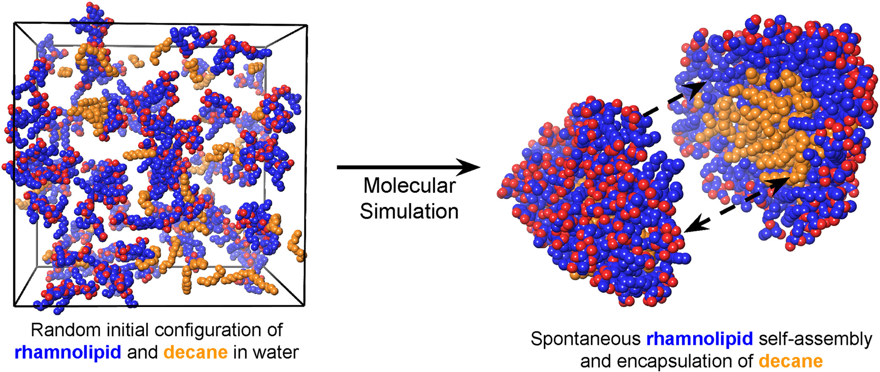
Why Now?
Computational Literacy Is a 21st-Century Requirement
Bioinformatics, computational biology, protein design, and NGS analysis all rely on computational skills
ASBMB recognizes computational skills as necessary for BMB curricula
Computational literacy allows scientists to develop models and test hypotheses rapidly and inexpensively
AlphaFold, AI-driven drug discovery, and large-scale genomics are already the present
Make America AI Ready (DOL) – AI literacy for the workforce
Big Data Moments in BMB
▶ 1990s: BLAST & GenBank
▶ 2000s: Human Genome
▶ 2010s: NGS Revolution
▶ 2020: AlphaFold
▶ Now: AI in drug design
https://doi.org/10.1016/j.cocis.2023.101760
https://www.drugdesign.org/chapters/molecular-docking/

Slide 13
What Our Community Says It Needs
Survey of BMB Faculty (January 2025)

Slide 14

Why Hasn't Coding Made It Into Most BMB Classrooms?
Barriers to coding in the BMB classroom and how we are addressing the issue
Coding is perceived as complex
Access to coding is not inclusive
We are reluctant to teach what we don’t know
https://goeshow.com/the-event-managers-guide-to-diversity-equity-and-inclusivity/
Carbone et al. (faculty barriers), Van Wyngaarden et al., Derus & Ali (computing facilities)

Slide 15
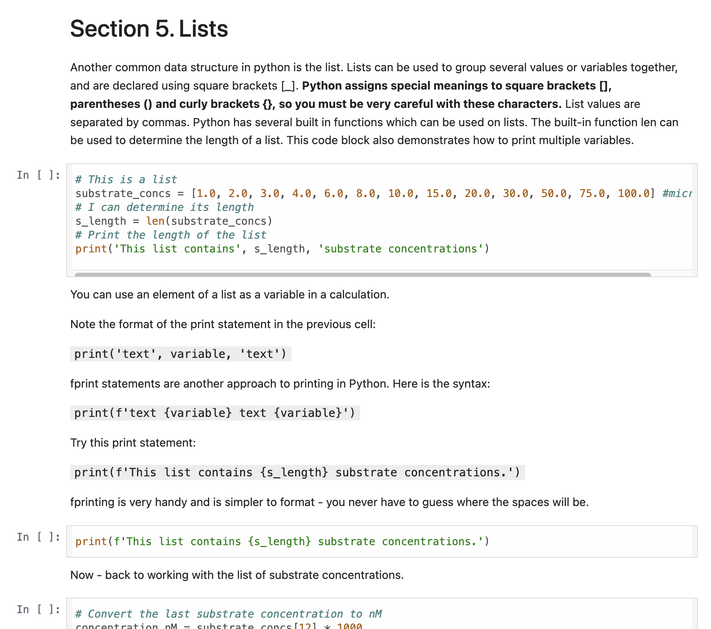
Barrier 1: Coding Feels Hard
"I don't even know where to start"
The challenge:
Students must learn syntax AND how to apply it to specific tasks
Perception of difficulty and complexity remains high
The solution — notebook-based learning:
Colab allows code to be provided in ready-to-run format
Code is run in small sections → incremental progress
Students learn coding while performing contextual BMB tasks
Notebooks are simple to run and modifiable for new problems
McGettrick, The Computer Journal, Laakso, et al. Journal of Information Technology Education. Innovations in Practice, Ochkov, et al. VI International Conference on Information Technologies in Engineering Education

Slide 16
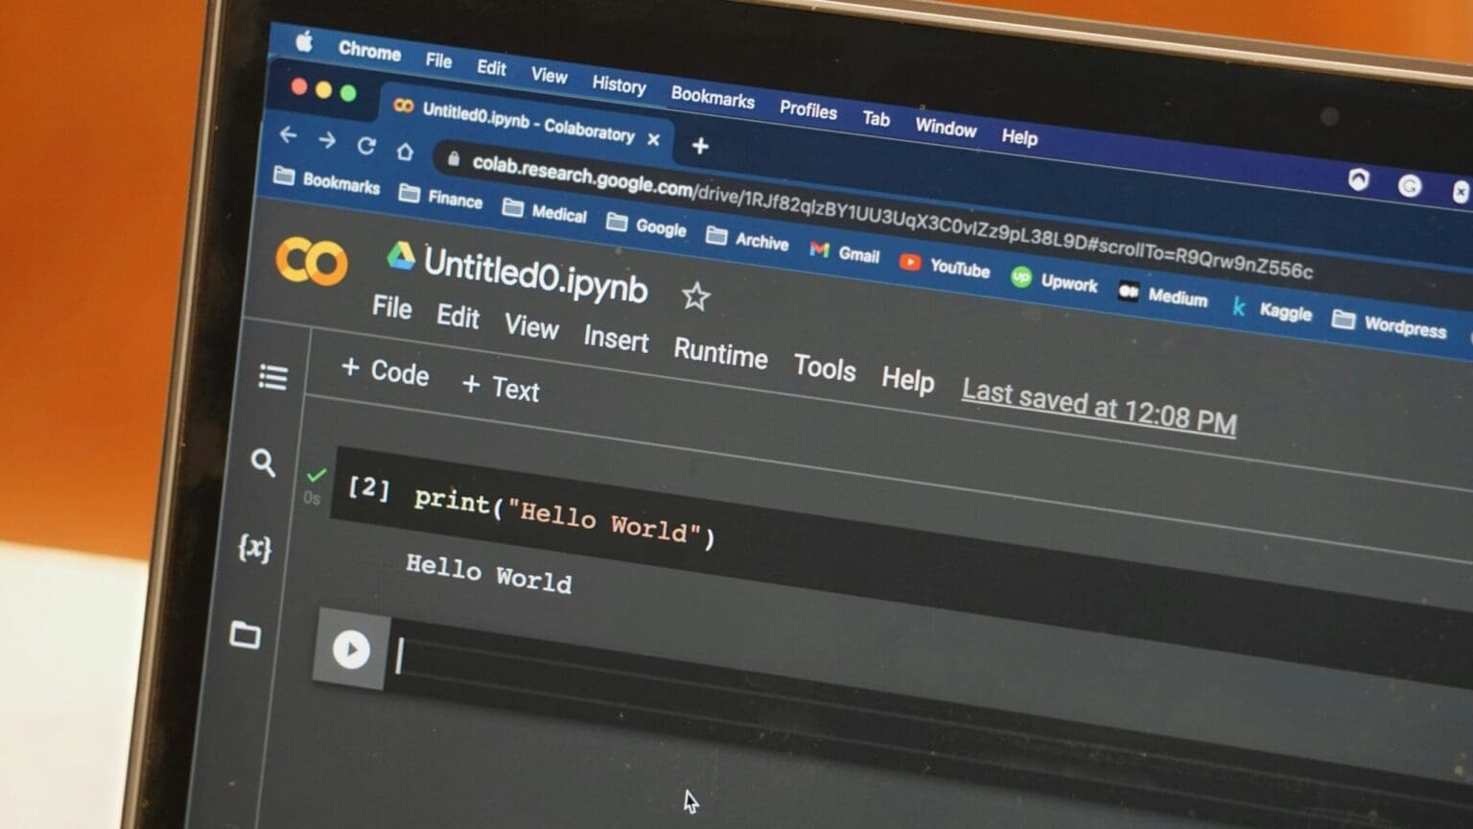
Barrier 2: Access and Equity
"Not everyone has the same resources"
The challenge:
Computer access at higher education institutions varies widely
Some students cannot afford their own device
School labs may use Mac or Windows, disenfranchising some users
Poorly functioning facilities detract from learning to code (Derus & Ali, ICCIE 2012)
The solution — cloud-based coding:
Credit: Zach Graves, Unsplash
Google Colab runs in any browser, so no installation needed
Works on any operating system and most devices
Free! No cost barrier for students or institutions
Students at any institution can solve
interesting biological problems for nearly no cost!

Slide 17
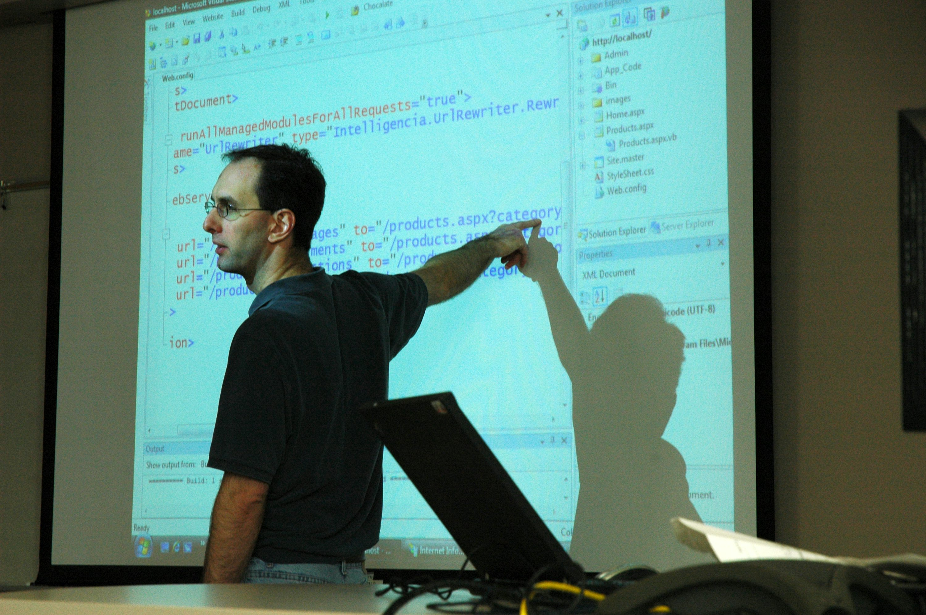
Barrier 3: Faculty Confidence
"I can't teach what I don't know"
The challenge:
Lack of instructor confidence
Lack of time, training, and professional development opportunities
Most BMB faculty have little experience training others to code
The solution — turnkey materials + community:
Pre-built Colab notebooks are simple to run and modifiable
Live coding: instructor writes and runs code step by step
A growing community of BMB faculty facing the same challenges
You don't need to be an expert, you just need to be one step ahead
Credit: Wonderlane, Unsplash
Carbone et al. Higher Education Research & Development, Van Wyngaarden et al. Trends in Higher Education

Slide 18
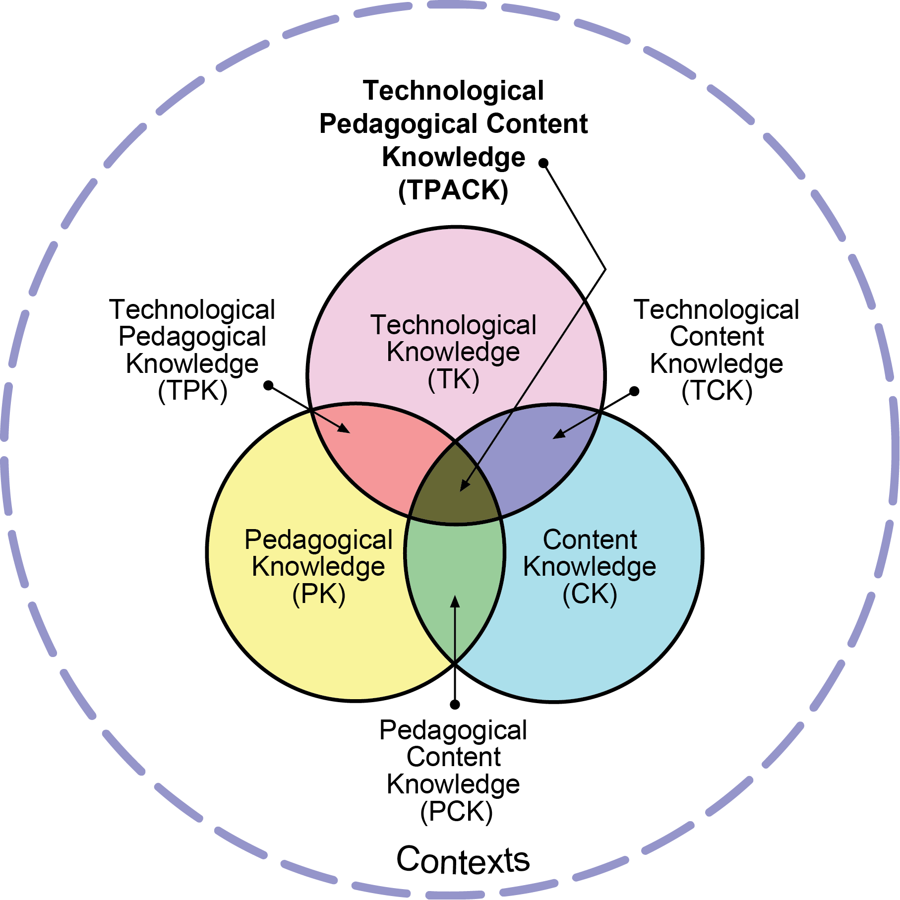
What Do You Actually Need to Know?
The TPACK Framework — Mishra & Koehler (2006)
PK - Expertise in teaching: active learning, flipped classrooms, live coding, scaffolding
CK - Expert BMB knowledge: enzymes, proteins, genomics, biochemical pathways
TK - Knowledge of technology: Colab, GitHub, Python, BLAST, visualization tools
Reproduced by permission of the publisher, © 2012 by tpack.org
Important intersections: TCK = using Colab + Python for BMB tasks | TPK = knowing HOW to use these tools to deepen student learning | TPACK = all three together

Slide 19
Where This Workshop Fits in TPACK
Today and Thursday you will learn...
TPACK Area
How
GitHub + Colab + Python
TK
Introductory Lectures and Demonstrations Notebook 001
Python for BMB data analysis
TK, TCK
Notebooks 002-003
Linear regression workflow
TCK, TPK
Notebook 004
Enzyme Kinetics Analysis
TCK, TPK
Notebook 005
Protein Sequence Analysis with BioPython
TCK, TPK
Notebook 006
Project Showcase, Planning, and Presenting
TPACK
Group Activity
Our goal: provide faculty with the TPACK of BMB coding to increase student learning.

Slide 20
How This Workshop Is Designed
Pedagogy in practice — four guiding principles
1
Context First
2
Incremental Complexity
Concepts taught using BMB examples: Michaelis-Menten kinetics, Bradford assays, protein sequences.
Introduce online resources.
Run code in small sections. Scaffolded notebooks allow modification without starting from scratch. Every participant makes progress.
3
Live Coding
4
You Leave With Something Real
Instructor writes and runs code step by step. Makes the process of coding visible. Demonstrated to make coding easier for novices to understand.
A series of notebooks that can be adapted to your own research or teaching.
More development in future workshops.

Slide 21
What You Will Leave With
✅ A working Google Colab + GitHub setup
✅ Foundational Python skills grounded in BMB examples
✅ Complete notebooks you can use in own research or teaching
✅ Membership in a growing community of BMB coders
You don't need to become an expert coder. You just need to become confident enough to take the first step with your students.
CodeBMB Workshop | codingBMB@gmail.com | github.com/codeBMB

