Slide 1


Heart Disease Prediction Using Machine Learning Algorithms
By : IT-A Batch 08
T. Sri Jyothirmaye Chowdary-17881A1244
S. Rakesh -17881A1227
S. Hanish Rao-17881A1209
Project Supervisor:
E. Ravi Kumar
Assistant professor
Department of IT
Department of Information Technology
VARDHAMAN COLLEGE OF ENGINEERING,HYDERABAD
An autonomous institute, Affiliated to JNTUH

Slide 2
Problem Statement
Heart disease is the leading cause of death worldwide. This system predicts the arising possibilities of heart disease. The outcomes of this system provide the chance of occurring heart disease in terms of Yes/No.

Slide 3
Abstract
Heart disease is the leading cause of death worldwide. This system predicts the arising possibilities of heart disease. The outcomes of this system provide the chance of occurring heart disease in terms of Yes/No. The datasets used are classified in terms of medical parameters. The datasets are processed in python programming using main Machine Learning Algorithms namely Decision Tree Algorithm, SVC, K Neighbors Algorithm, Random Forest Algorithm which shows the best algorithm among the above methods in terms of accuracy level of heart disease.

Slide 4
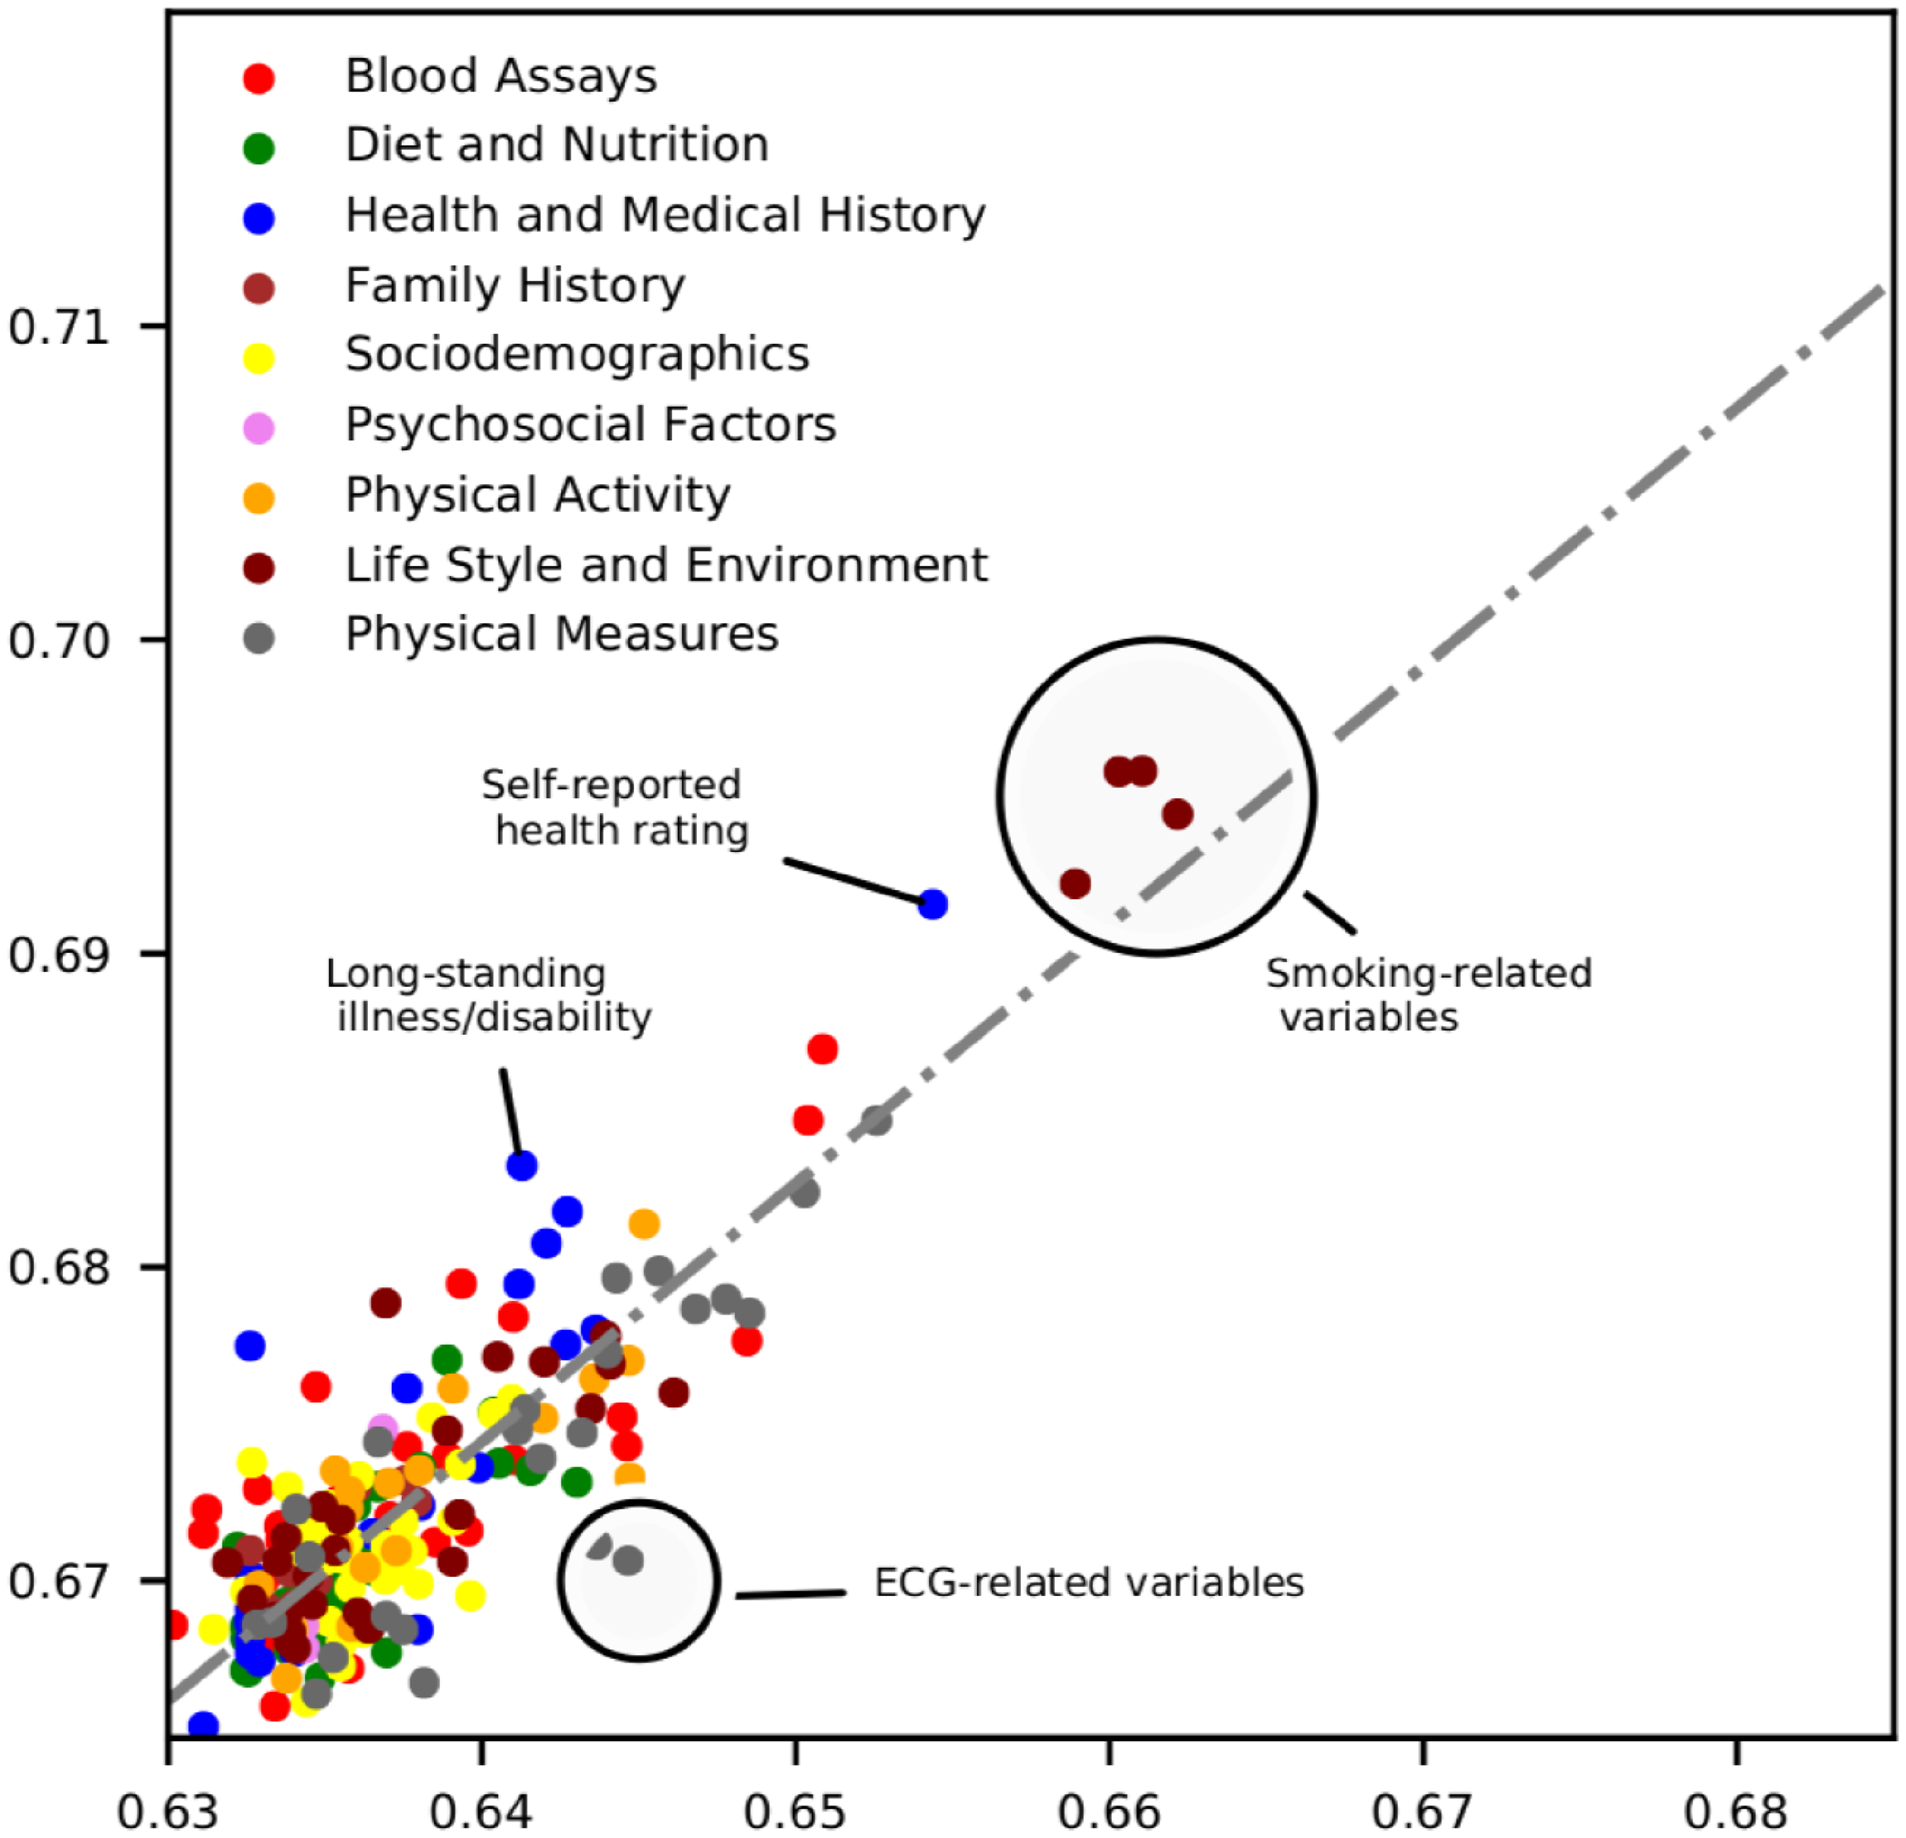
Literature Survey: Existing System
Today medical services have come a long way to treat patients with various diseases.
Diagnosing patients correctly and administering effective treatments have become quite a challenge.
Diagnosis of the condition solely depends upon the doctor's intuition and patient's records.
There is a lack of effective analysis tool to discover hidden relationships in data.
Detection is not possible at an early stage.
In the existing system, practical use of various collected data is time consuming.

Slide 5
Objective
Heart disease is the leading cause of death worldwide. The main objective of this system is to predicts the arising possibilities of heart disease.

Slide 6
Proposed System
Due to lack of certain resources in the medical field, prediction of heart disease occasionally may be a problem.
This issue can be resolved by adopting Machine Learning algorithms.
These algorithms are used to enhance the accuracy level of the prediction.
These are performed using the Python programming language.
The major algorithms used are-
Decision Tree
K Neighbours
Random Forest
SVM

Slide 7
Requirements
Software Requirements:
Python 3
Jupyter Notebook
tkinter

Slide 8
Functional Requirements
Decision Tree
K Neighbours Algorithm
Random Forest
SVM

Slide 9

Data Source
UCI Machine Learning Repository :
Heart Disease data set
Data set used here is a real dataset
This database contains 75 attributes.
The dataset consists of 300 instance of data with the appropriate 14 clinical parameters.
The clinical parameter of dataset is about tests which are taken related to the heart disease as like blood pressure level, chest pain type, electrocardiographic result and etc.

Slide 10
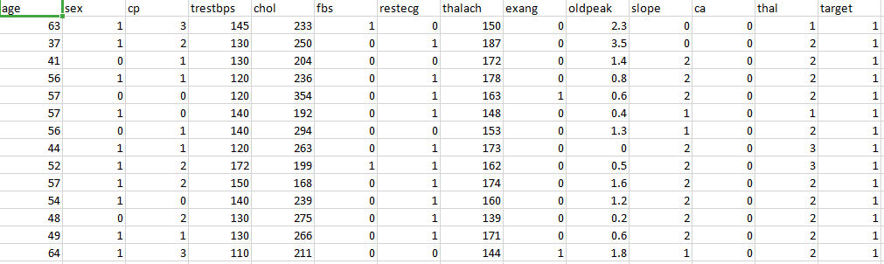

Slide 11
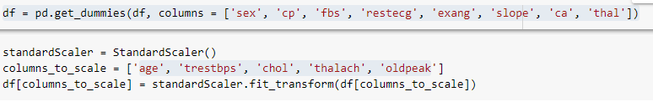
Data Preprocessing

Slide 12
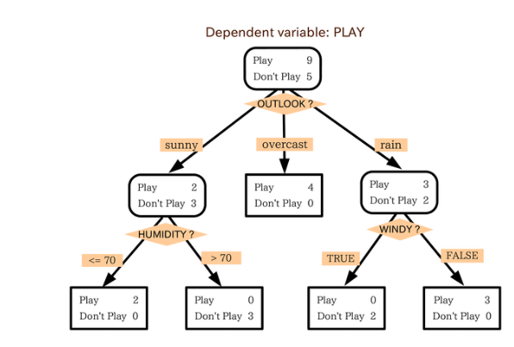
DESIGN OF THE PROJECT
1. Decision Tree:
The decision tree is a supervised machine learning algorithm.
Based on certain conditions it gives a categorical solution such Yes/No, True or false, 1 or 0.
The output consists of horizontal and vertical line splits based on the condition depends on the dependent variables.

Slide 13
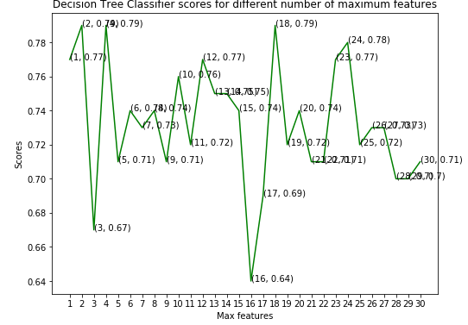
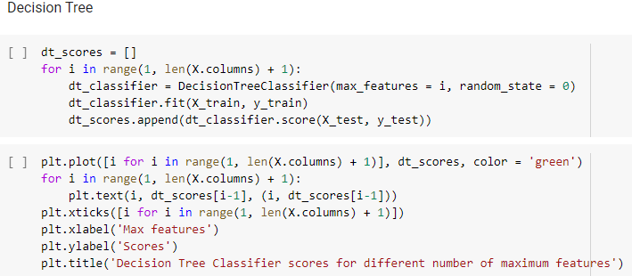

Slide 14
2. K Neighbours Algorithm
It is a supervised learning algorithm.
The working principle is based on assignment of weight to each data point which is called as neighbour.
Distance is computed for every training sample and classified based on majority of class in neighbour.

Slide 15
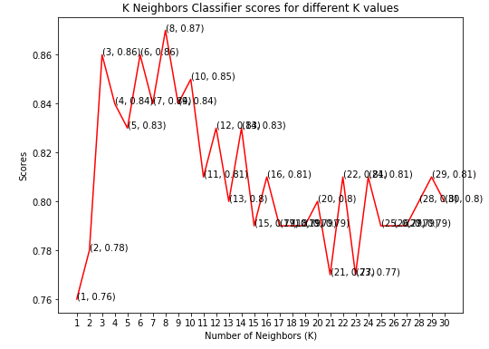
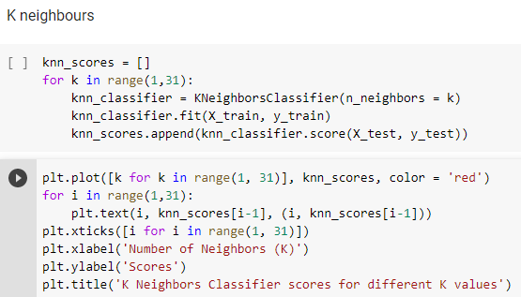

Slide 16
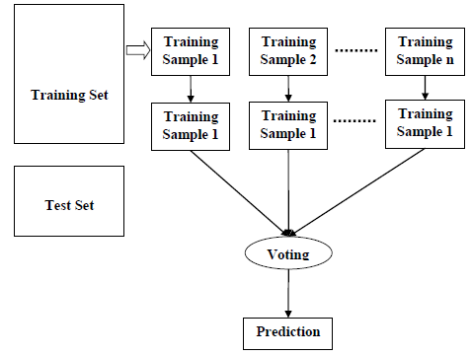
3. Random Forest
Random forest is a supervised learning algorithm.
It is used for both classification as well as regression.
Random forest algorithm creates decision trees on data samples and then gets the prediction from each of them and finally selects the best solution by means of voting.

Slide 17
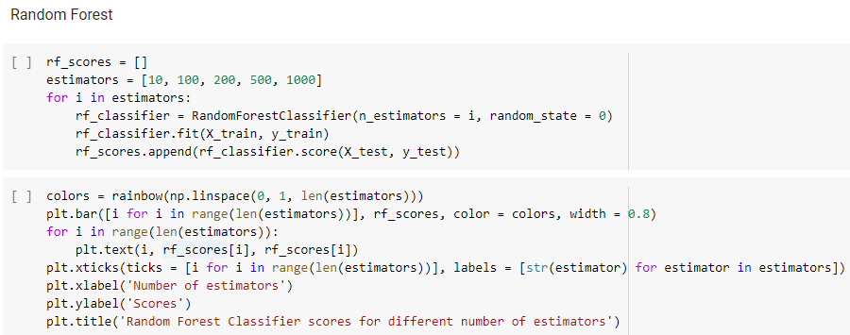
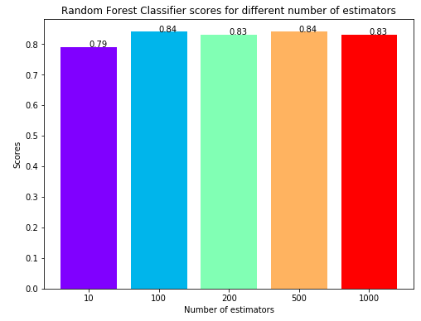

Slide 18
4. Support Vector Machine
Support Vector Machine (SVM) is a relatively simple Supervised Machine Learning Algorithm used for classification and/or regression.
SVM finds a hyper-plane that creates a boundary between the types of data.
SVM can only perform binary classification (i.e., choose between two classes). However, there are various techniques to use for multi-class problems.

Slide 19
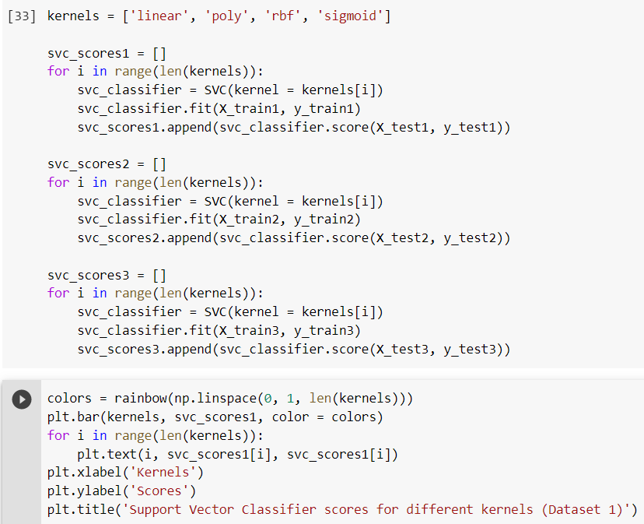
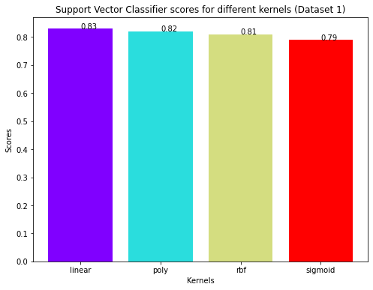

Slide 20
Result

Slide 21
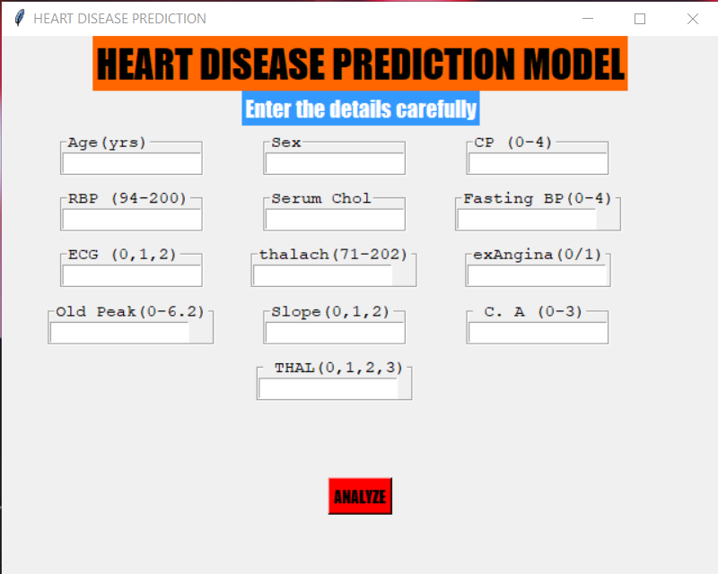
RESULT ANALYSIS
Insert the input values to predict the occurrence of heart disease.

Slide 22
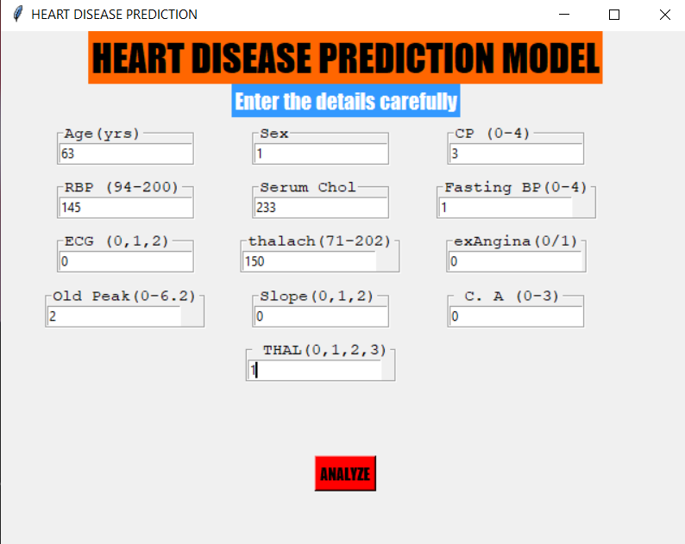
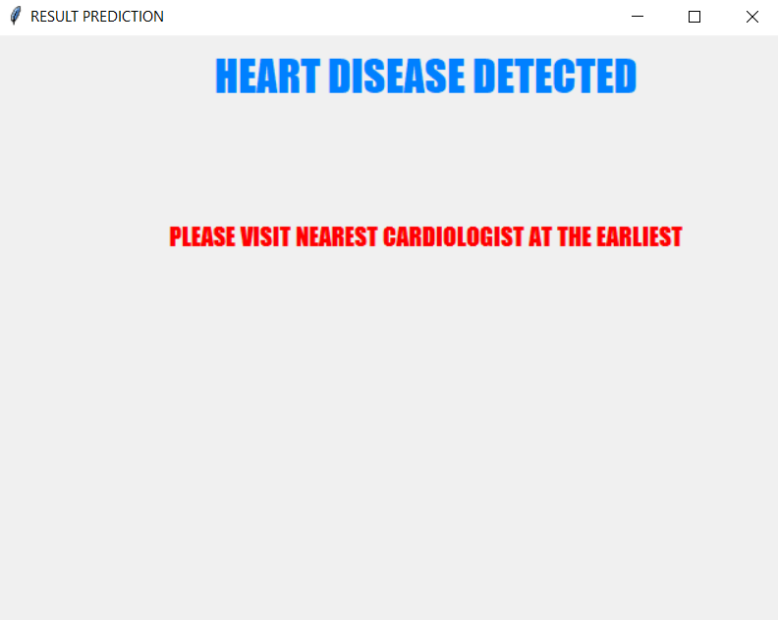
Based on the input values, the GUI displays whether the person has any chance of occurring heart disease or not.

Slide 23
Conclusion
These algorithms are applied to the same dataset in order to analyze the best algorithm in terms of accuracy.
The KNN model has predicted an accuracy level of 87%
Decision Tree classifier has predicted an accuracy level of 79%.
Random Forest classifier has predicted an accuracy level of 84%.
SVM has predicted an accuracy level of 83%.
Thus, the best algorithm for the prediction of heart disease is the KNN model.
In this project, Four Machine learning algorithms were applied on the dataset to predict the best algorithm for Heart Disease and a GUI is built using the best algorithm i.e KNN.

Slide 24
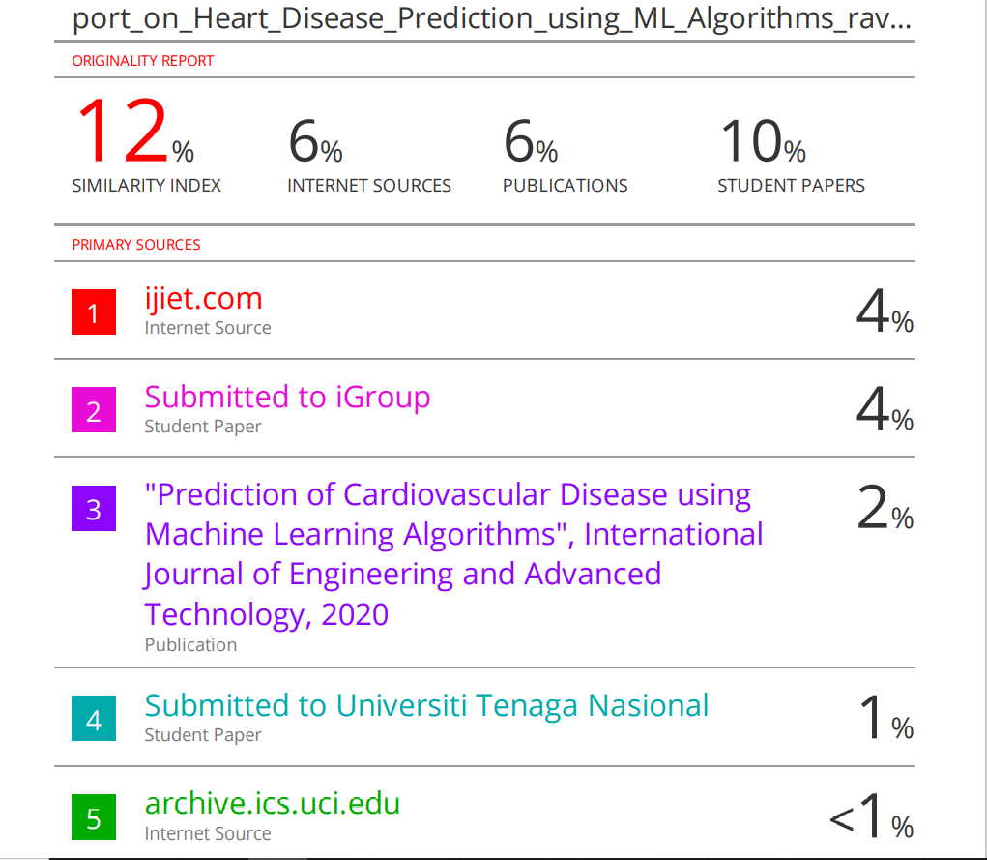
Project Report Details
We have done our project report and research paper in Overleaf.
The Plagiarism report is shown below.

Slide 25
References
https://www.geeksforgeeks.org/introduction-machine-learning-using-python/
https://archive.ics.uci.edu/ml/datasets/Heart+Disease
https://www.kaggle.com/ronitf/heart-disease-uci
https://ieeexplore.ieee.org/

Slide 26


