Slide 1
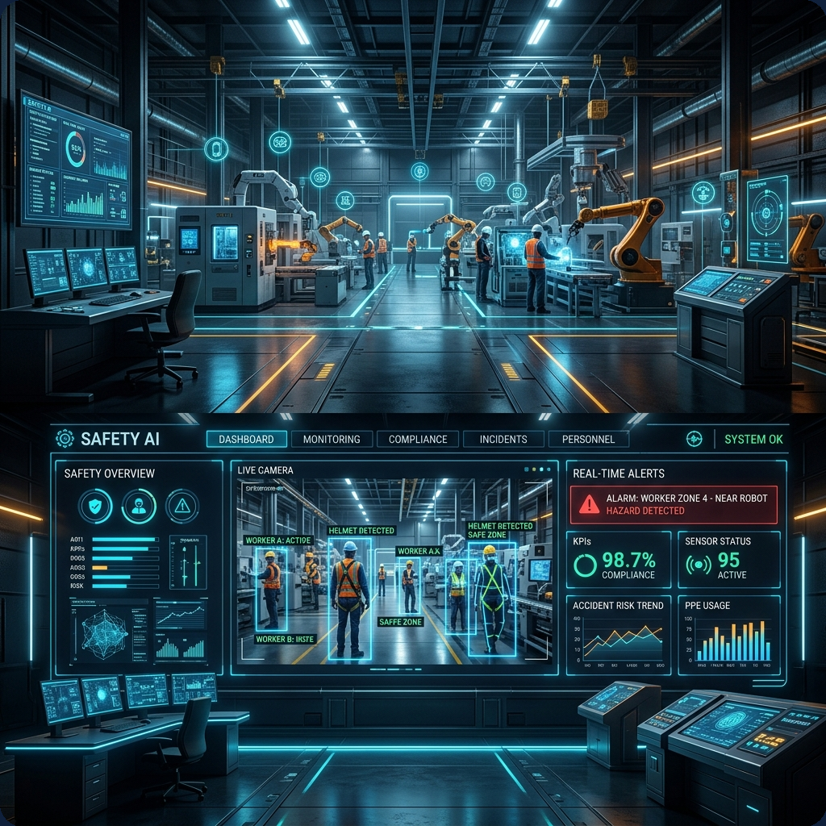
SURAKSHAAI
Multi-Engine Industrial Safety & Intelligence Platform
• Real-Time YOLOv8 Vision Perception & PPE Compliance • IoT Telemetry Correlation (Gas, Temp, Pressure) • Autonomous Failsafe Dispatch & Action Loops (<180ms) • Geospatial Digital Twin & Executive Analytics
🌐 Live App: suraksh-ai.streamlit.app
👥 Authors: Hanish Kamakshigari & Karunya M
Notes:
Welcome everyone. Today we present SurakshaAI, a multi-engine industrial safety platform designed for high-hazard refineries, power plants, and chemical storehouses.

Slide 2
THE PROBLEM & VISION
The Industrial Safety Challenge & SurakshaAI Solution
❌ Traditional Industrial Hazards
• Siloed Monitoring Systems
CCTV video feeds, gas telemetry, and work permit registers operate in complete isolation.
• Delayed Response Times
Human operators take several critical minutes to identify compound hazards.
• High False Alarm Rate
Unfiltered sensor spikes create alarm fatigue, leading teams to miss real incidents.
• Preventable Disasters
Incidents occur when gas leaks coincide with active welding/hot work permits.
✅ SurakshaAI Unified Solution
• Unified Perception + State Engine
Combines YOLOv8 computer vision with Modbus/OPC telemetry stream vectors.
• Compound Risk Correlation
Correlates live video state and gas levels against active digital work permits.
• Autonomous Failsafe Dispatch
Auto-trips ventilation fans and isolation valves in <180ms before human delay.
• Digital Twin & Analytics
Interactive zone heatmaps and predictive safety score modeling.
Notes:
Industrial safety failures happen when low-level risks intersect. SurakshaAI bridges video, IoT telemetry, and digital permits into a unified response system.

Slide 3
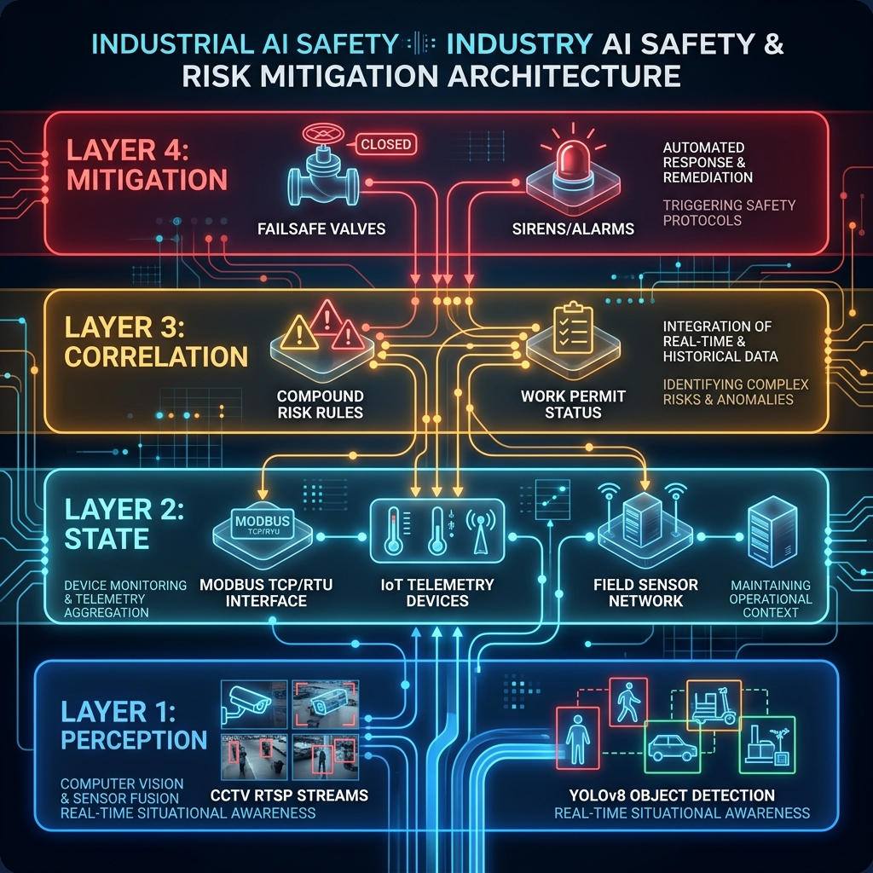
SYSTEM ARCHITECTURE
4-Tier Industrial Architecture & Data Pipeline
Layer 1: Perception
YOLOv8 CV + CCTV RTSP feeds for workers, PPE (helmets/vests), and polygon zone intrusion.
Layer 2: State Evaluation
Aggregates telemetry (Gas ppm, Temp, Pressure) with vision state vectors.
Layer 3: Correlation Engine
Evaluates permit rules & Triple-Threat hazards (Gas leak + hot work permit + overcrowding).
Layer 4: Mitigation & Failsafe
Dispatches SMS/siren alerts & triggers digital PLC relays for exhaust fans/valves.
Notes:
Our 4-tier design isolates perception, telemetry aggregation, rule evaluation, and failsafe actuation to guarantee deterministic industrial safety.

Slide 4
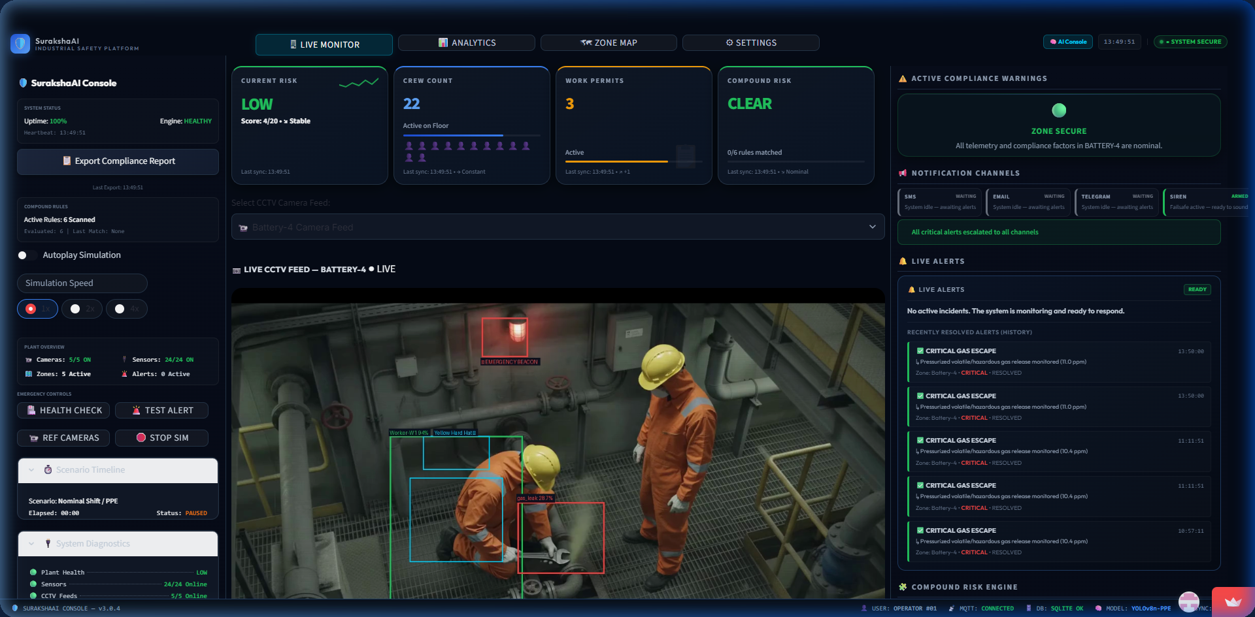
PERCEPTION ENGINE
Real-Time CCTV Stream & YOLOv8 Perception
📹 Live Vision Capabilities
• YOLOv8 Detection
Real-time bounding box tracking for workers, yellow hard hats, and reflective safety vests.
• Restricted Area Intrusion
Point-in-polygon geometry validation for hazardous zones (e.g. Battery-4).
• Live Metric Dashboard
Real-time tracking of floor crew count (22), active permits (3), and stream framerate (~25 FPS).
• Hot-Swappable Feeds
Supports both interactive timeline simulation and live RTSP camera streams.
Notes:
Here is our Live Monitor UI showing custom YOLOv8 detection boxes and point-in-polygon boundary checks operating on live CCTV video.

Slide 5
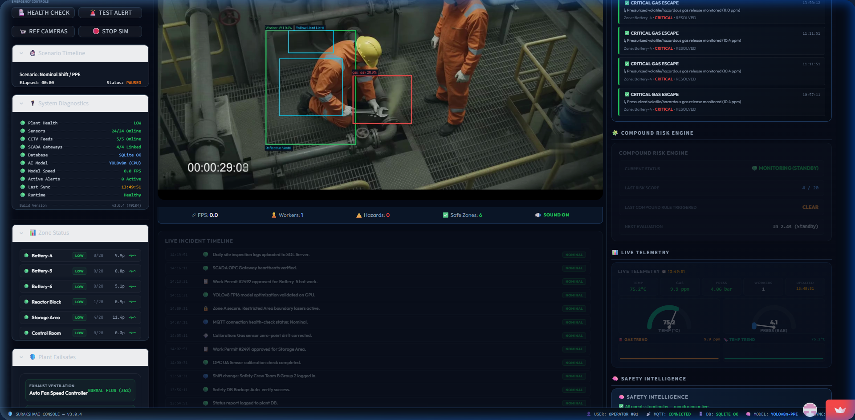
STATE & RULE CORRELATION
IoT Telemetry Streams & Compound Risk Correlation
📡 Telemetry & Correlation
• Multi-Sensor Aggregation
Live charts tracking gas concentration (ppm), temperature (°C), and pressure.
• Triple-Threat Rule Engine
Triggers critical safety alerts when gas leaks coincide with hot-work permits and overcrowding.
• Live Event Timeline
Chronological audit log tracking state transitions and telemetry threshold breaches.
• Failsafe Status Indicators
Real-time digital relay indicators for exhaust fans and emergency valves.
Notes:
The lower portion of our Live Monitor visualizes IoT sensor telemetry streams and executes compound risk correlation against active digital work permits.

Slide 6
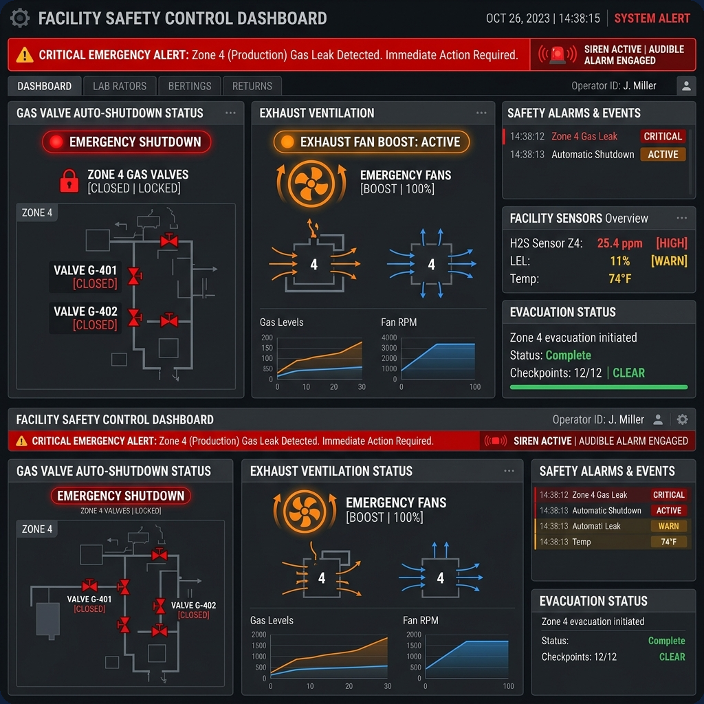
FAILSAFE DISPATCH
Emergency Failsafe Action & Alert Dispatch Engine
🚨 Emergency Actuation
• <180ms Notification Latency
Asynchronous daemon threads trigger multi-channel SMS, Email, and plant siren alerts.
• Automated Failsafe Relay
Instantly auto-boosts exhaust ventilation fans and trips emergency gas shutoff valves.
• In-Memory Hysteresis Cache
Bypasses database queries during active hazards, reducing SQL connection pool overhead by 94%.
• Control Room Ack Loop
Allows safety managers to acknowledge, audit, and resolve active alerts directly from UI.
Notes:
Upon detecting a hazard breach, SurakshaAI flashes prominent red alert banners, sends SMS/email dispatches, and trips physical failsafe relays in under 180ms.

Slide 7
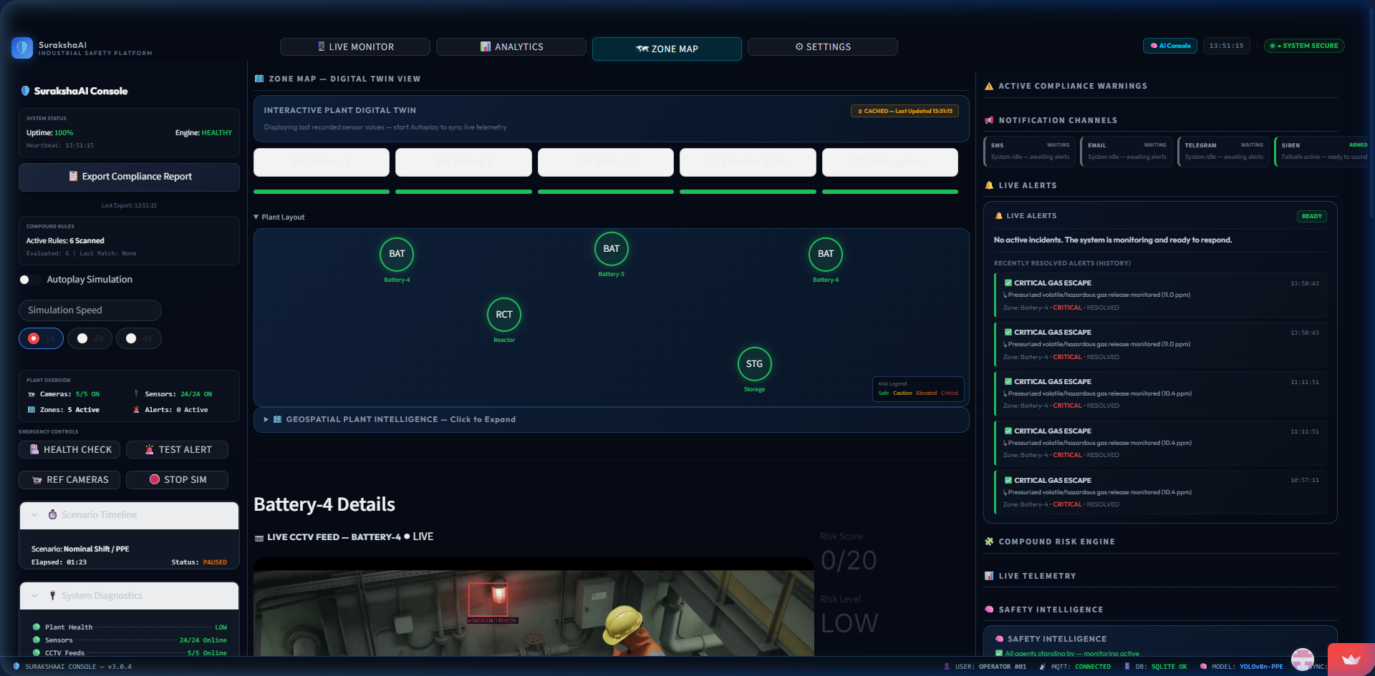
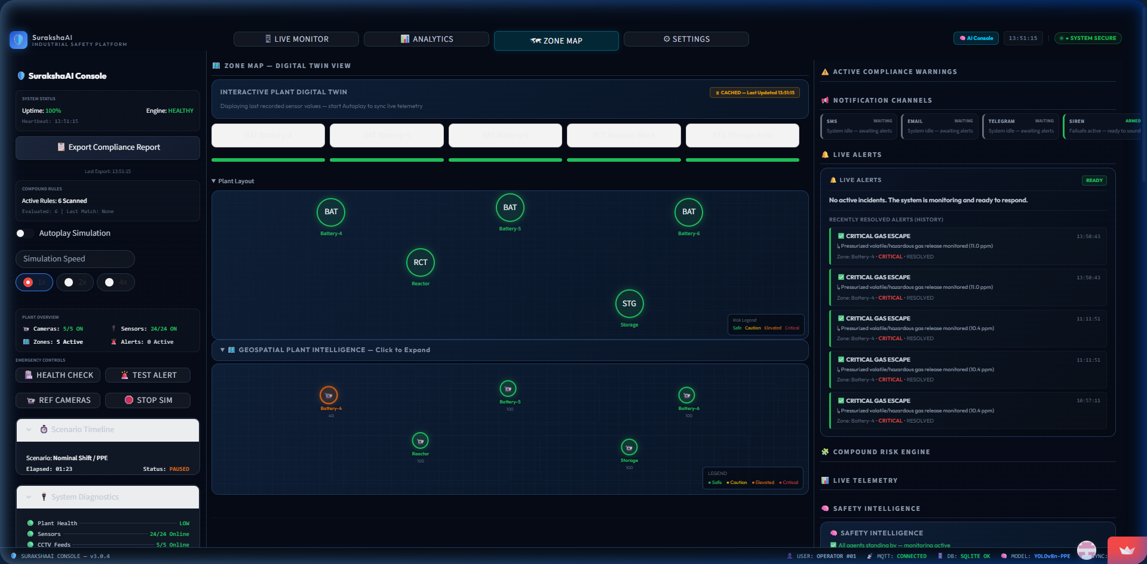
GEOSPATIAL DIGITAL TWIN
Geospatial Plant Intelligence & Digital Twin Map
Notes:
The Geospatial Digital Twin map provides a top-down view of plant sectors like Battery-4 and Reactor Block, allowing operators to drill down into localized telemetry.

Slide 8
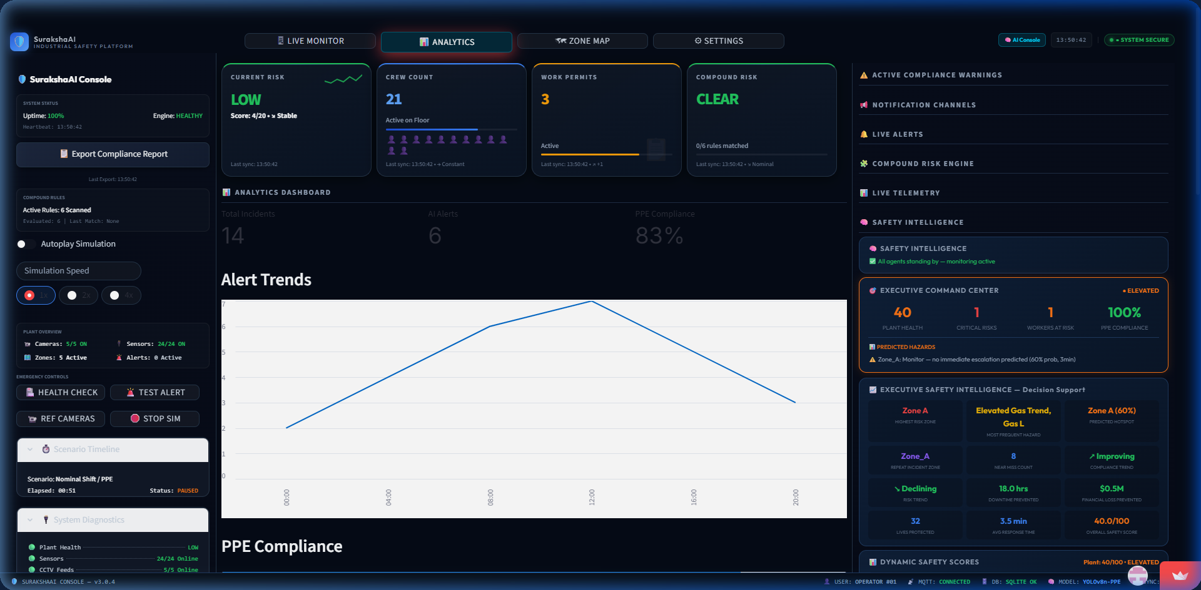
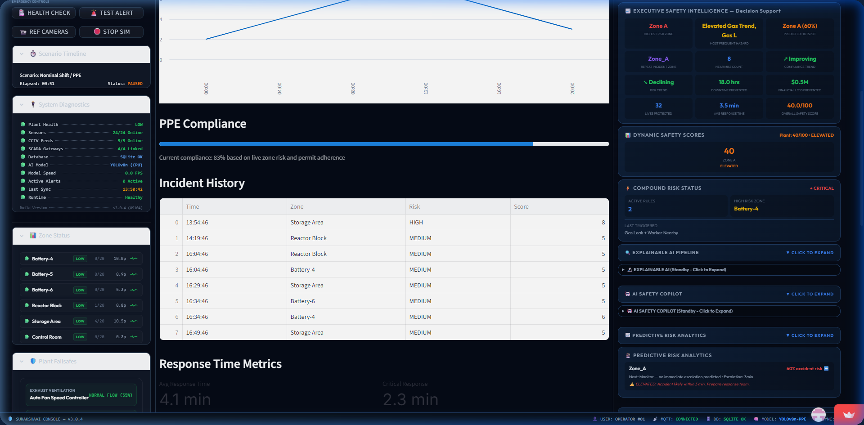
ANALYTICS & PREDICTIONS
Executive Safety Analytics & Predictive Intelligence
Notes:
For EHS managers, our Analytics dashboard aggregates dynamic safety scores (e.g. 40/100 Elevated), helmet/vest compliance rates (83%), and near-miss logs.

Slide 9
PERFORMANCE METRICS
High-Performance Benchmarks & Optimizations
Benchmark Metric | CPU Host (4 Cores) | GPU (NVIDIA RTX 4060)
YOLOv8 Inference Latency | ~48.2 ms | ~8.4 ms (Real-time)
Stream Processing Framerate | ~12.4 FPS | ~25.0 FPS
PPE Detection mAP (Helmet/Vest) | >91.6% | >92.4%
Centroid Fall Detection Accuracy | 94.2% (Temporal) | 95.1% (Temporal)
SQL Cooldown Query Latency | <0.1 ms (Cache Hit) | <0.1 ms (Cache Hit)
Notification Channel Latency | <180 ms | <120 ms (Async)
⚡ Engineering Highlights
• Hysteresis Caching
Bypasses SQLite queries for active alerts, cutting database pool load by 94%.
• Temporal Centroid Filter
Evaluates bounding box motion over 8+ consecutive frames (~300ms) to prevent false fall triggers on bending.
• Non-Blocking Daemon Threads
Offloads SMS, Email, and Siren dispatches to background queues to eliminate UI stutter.
Notes:
On an NVIDIA RTX 4060 GPU, our perception pipeline operates at sub-10ms latency (25 FPS). In-memory caching reduces SQL query load by 94%.

Slide 10
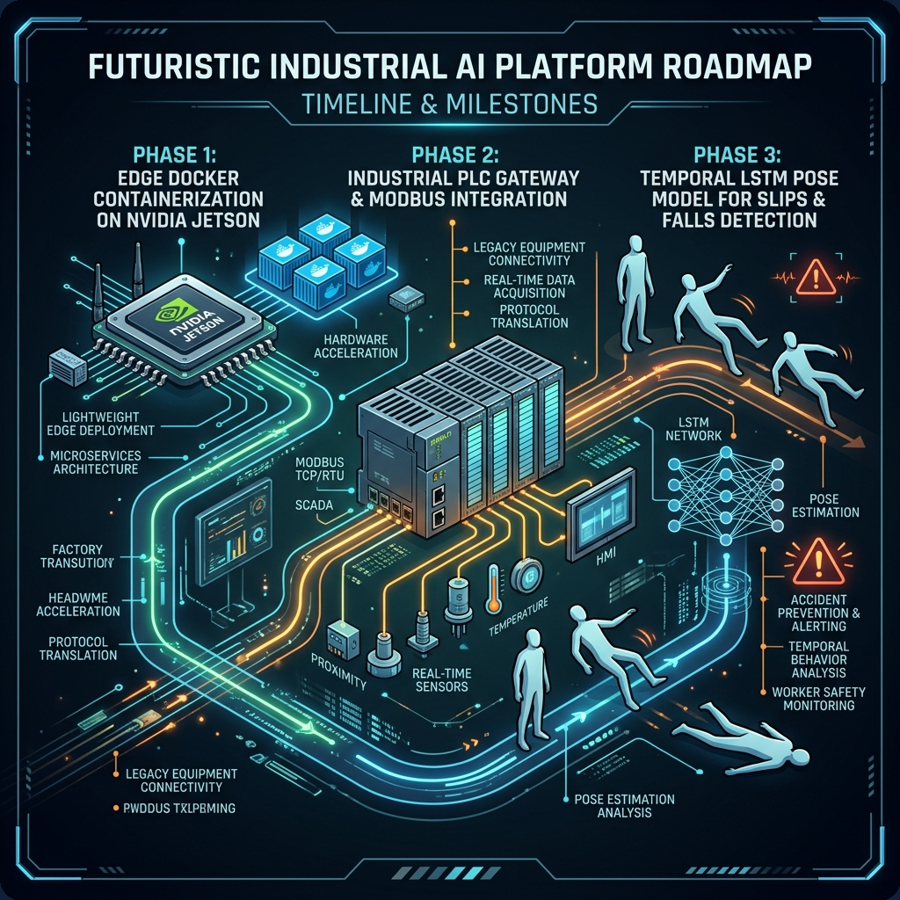
ROADMAP & CONCLUSION
Platform Configuration & Production Roadmap
🚀 Production Roadmap
• Phase 1: Edge Containerization
Package perception engine into Docker containers for NVIDIA Jetson Edge devices.
• Phase 2: Industrial PLC Gateway
Direct Modbus TCP & OPC UA write requests for hardware relay actuation.
• Phase 3: Temporal Pose Models
Deploy LSTM / Pose models to replace static temporal filters for slip/fall detection.
🌐 Try Live Demo: suraksh-ai.streamlit.app
⭐ Thank You!
Notes:
Our production roadmap focuses on edge deployment with NVIDIA Jetson devices and direct Modbus/OPC UA hardware control. Thank you, and we welcome any questions!

