Slide 1
Construction of warehouse concepts on northwind Database as for product supply chain.
BY
Hanish Vasireddy
10402594

Slide 2

INTRODUCTION
When we are dealing with products we know that there exists a life cycle chain of products starting from the manufacturing and ending till it is received by the customers.
Once an order is placed by the customer and the process that occurs till order is received is all maintained as a Supply chain process.
For this we are using data warehousing concepts where we will store all the data related to this process and take only the data from which we can gather important information
Once we apply these concepts we can have reporting and visualisation by using different tools and technology.

Slide 3
Why Northwind
We have selected Northwind database because it provides a very huge and accurate data related to the field we have chosen. We can directly get a sql file for complete installation of the data source in our SQL server. Once we have installed our database source then we can move ahead with warehouse creation.

Slide 4
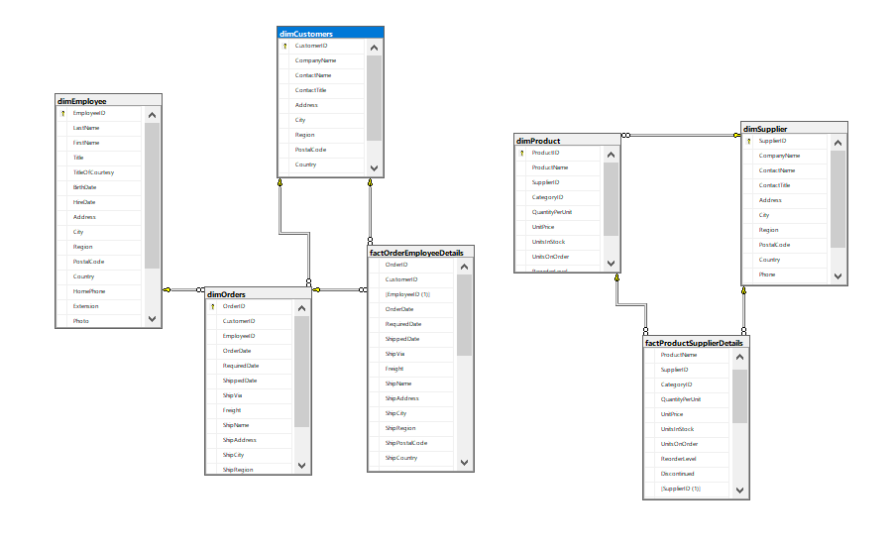
ER-Diagram

Slide 5
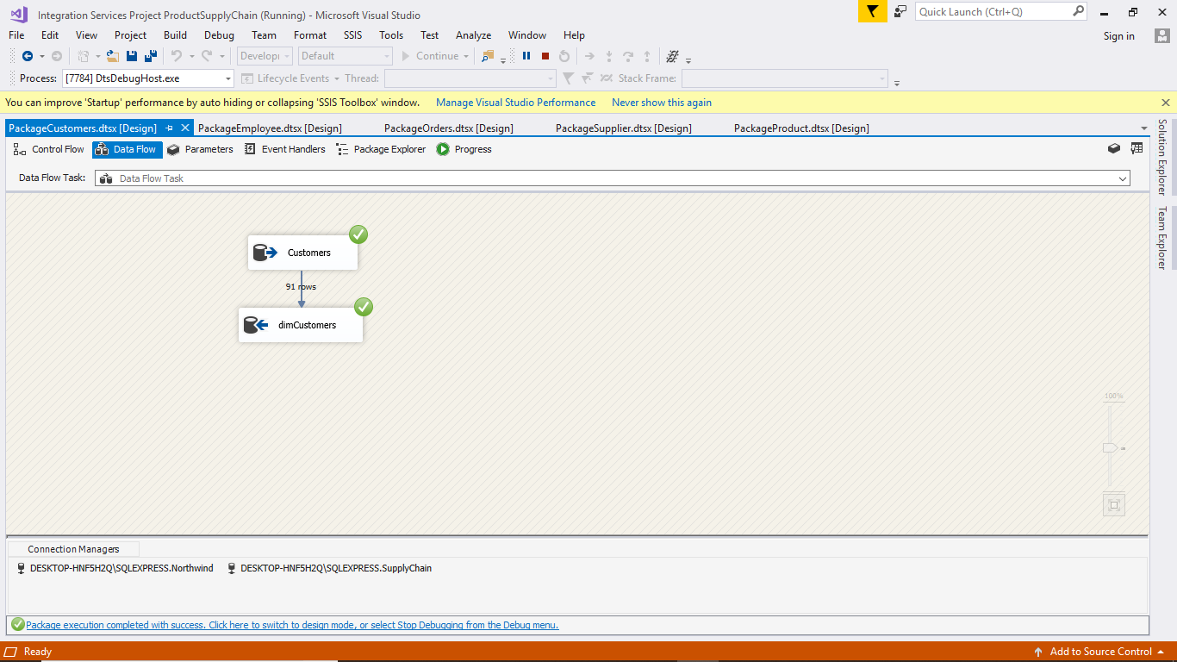
ETL PROCESS
Creating package for dimCustomers
Notes:
hanish

Slide 6
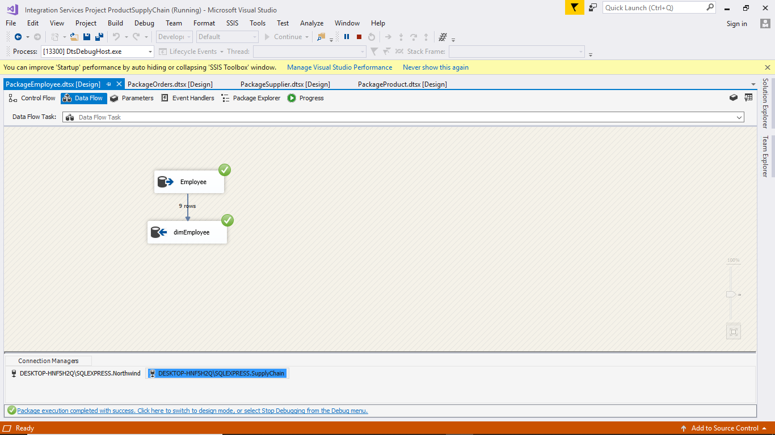
ETL PROCESS
create package for dimEmployee

Slide 7
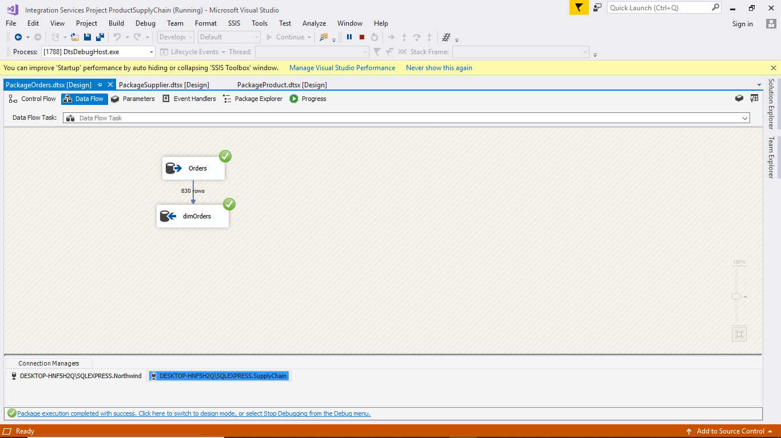
ETL PROCESS
create package for dimOrders

Slide 8
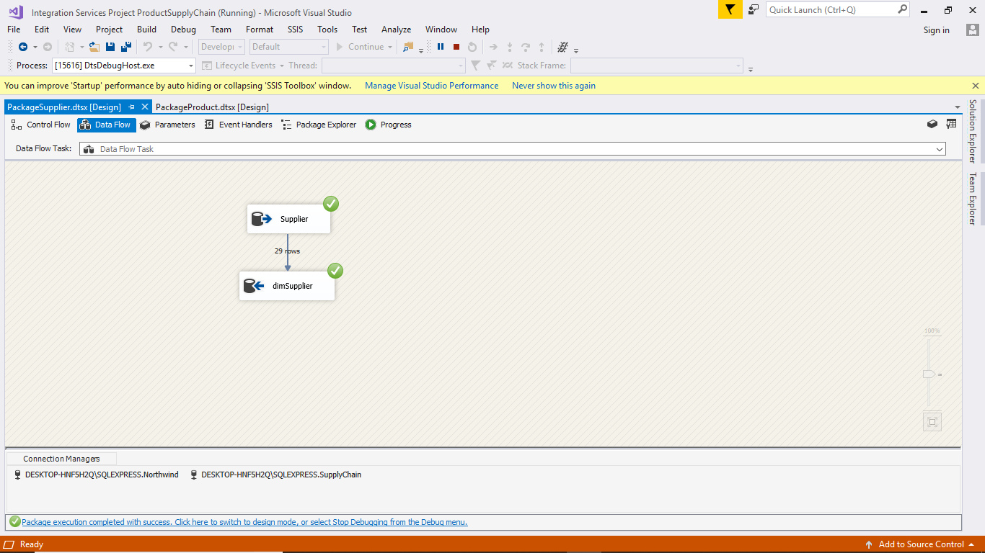
ETL PROCESS
create package for dimSuppliers

Slide 9
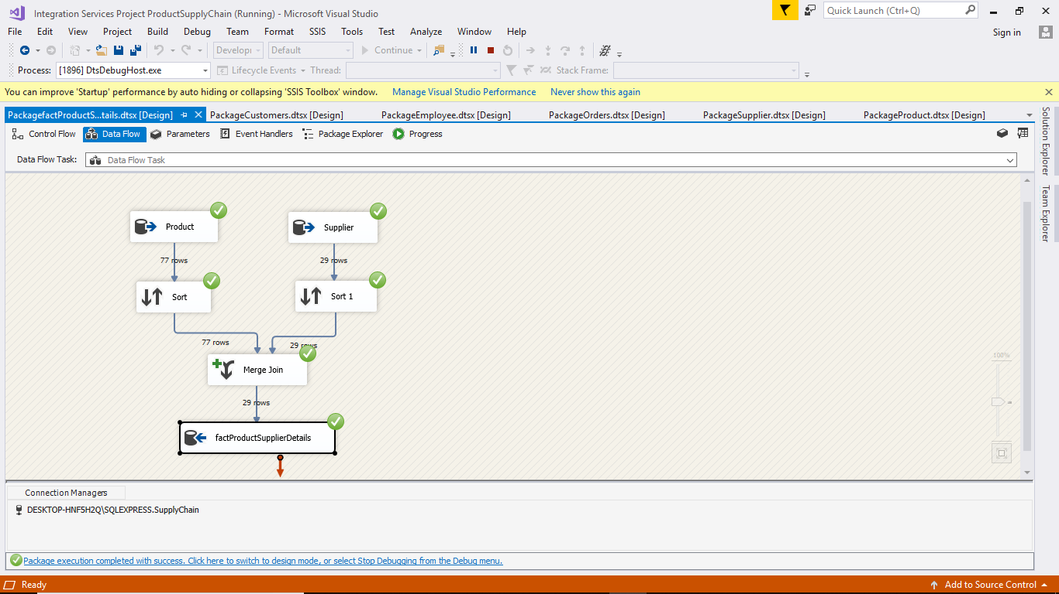
Fact Table 1
create package for fact table FactProductSupplerDetails

Slide 10
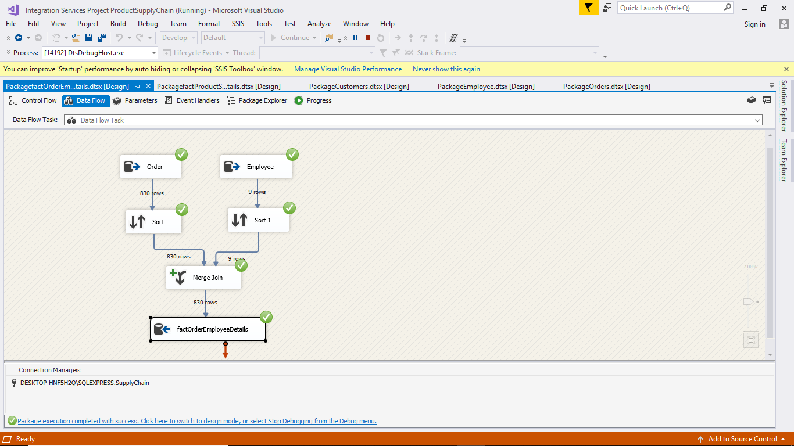
Fact Table 2
create package for fact table factOrderEmployeeDetails

Slide 11
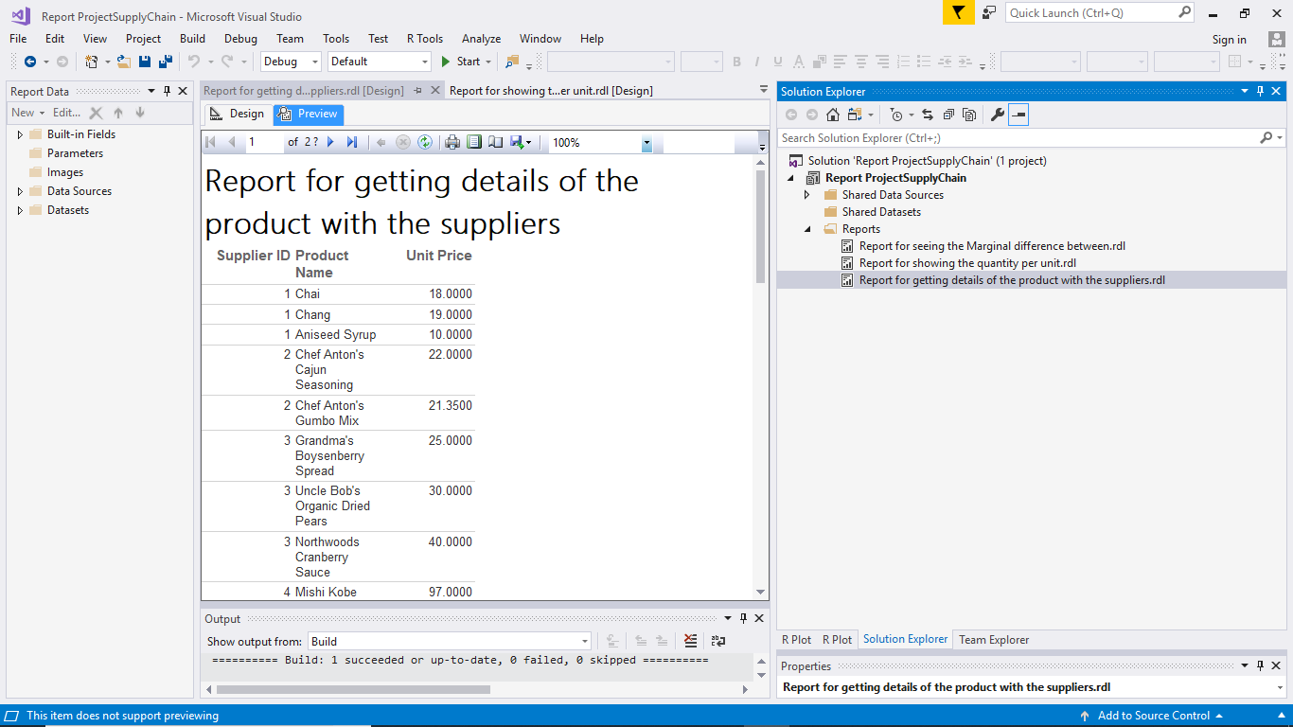
SSRS Reports
Report for getting details of the product with the suppliers-

Slide 12
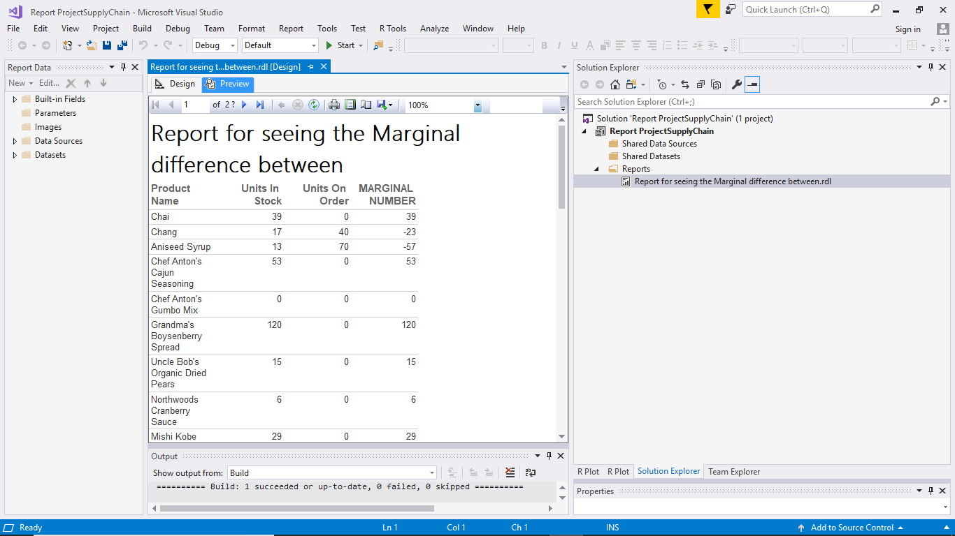
SSRS Reports
Report for seeing the Marginal difference between-

Slide 13
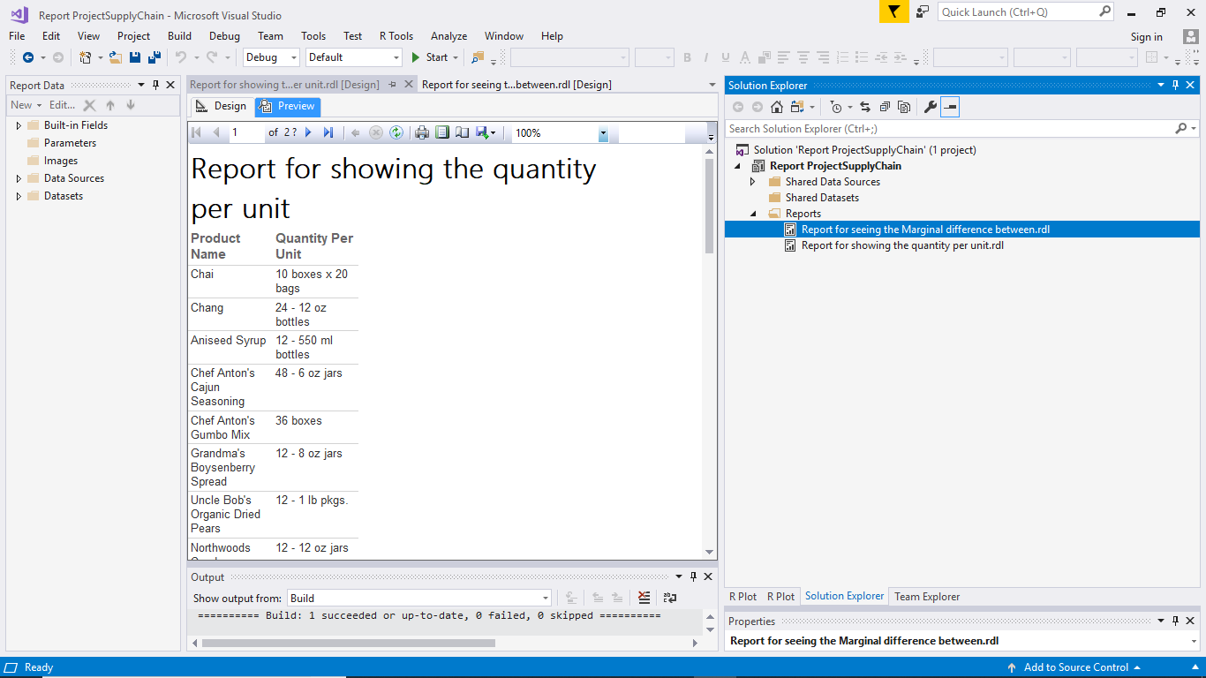
SSRS Reports
Report for showing the quantity per unit:

Slide 14
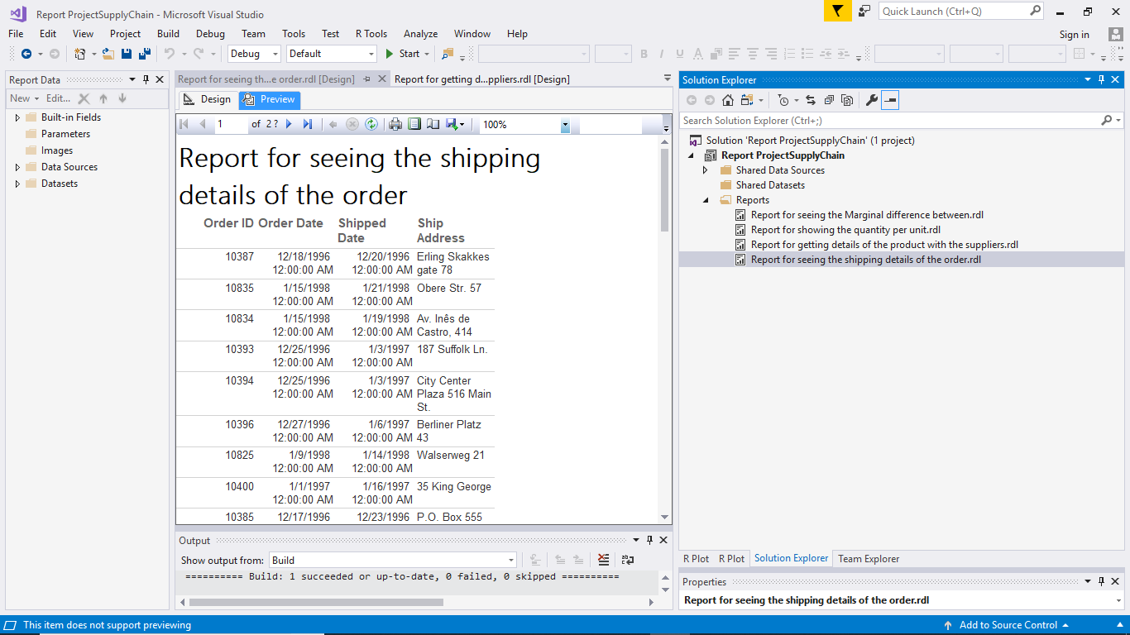
SSRS Reports
Report for seeing the shipping details of the order:

Slide 15
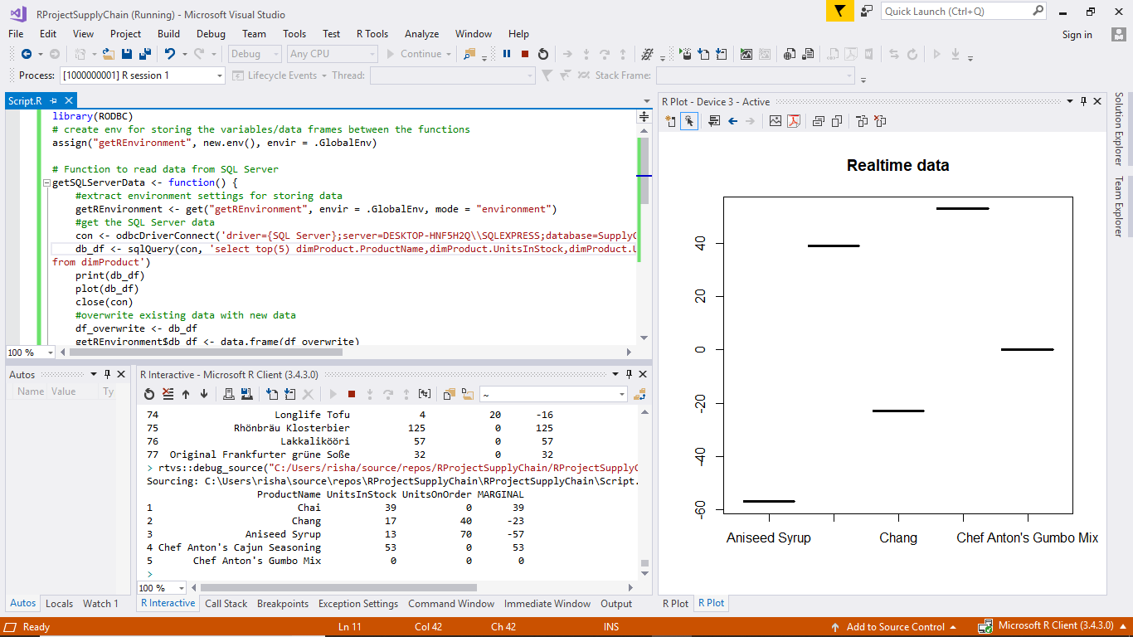
VISUALIZATION
For visualising the Marginal value between ordered and the available stock of the product.

Slide 16
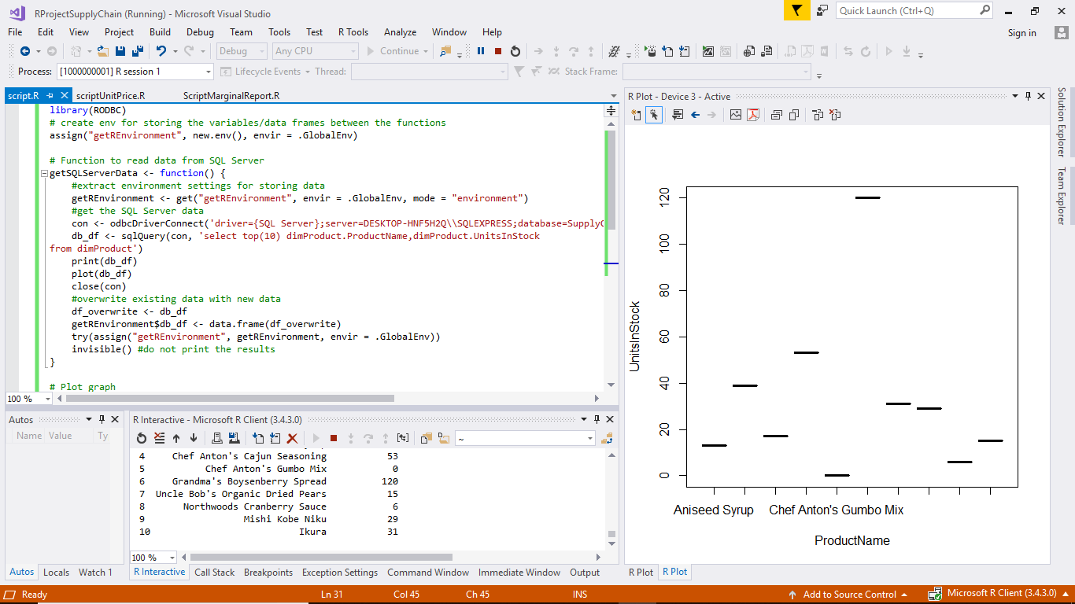
VISUALIZATION
visualising the number of units in stock for each product

Slide 17
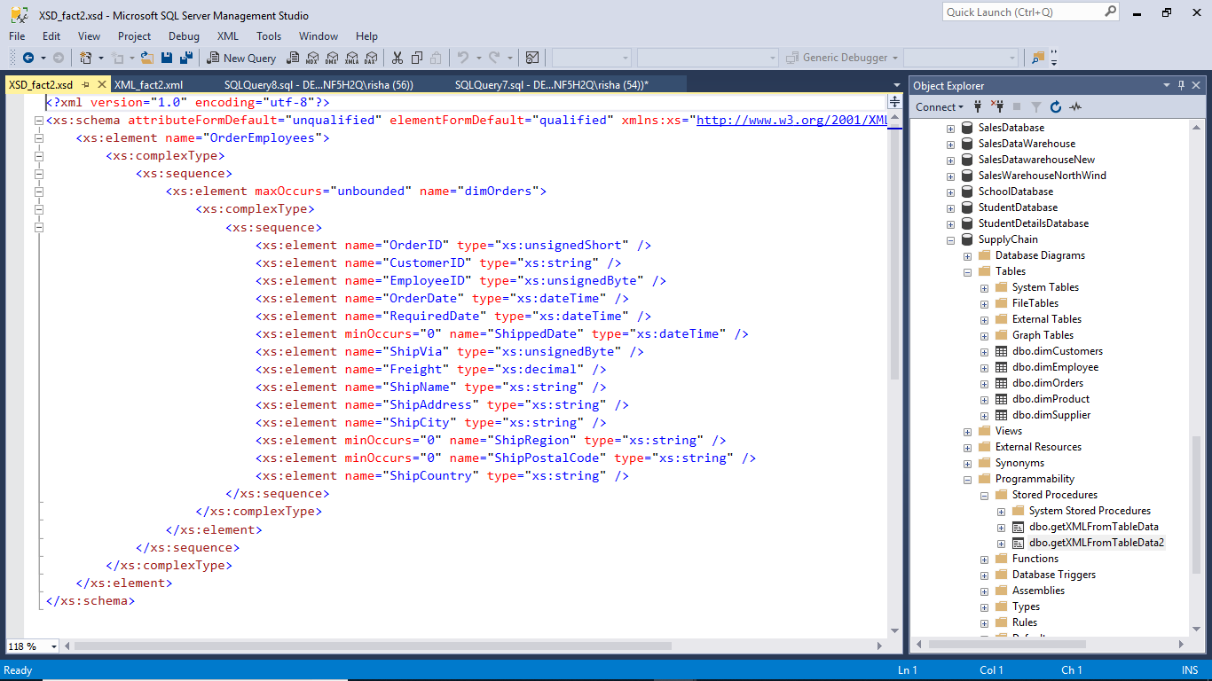
XML and XSD

Slide 18
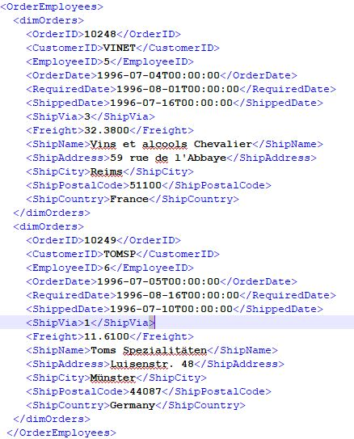
XML schema fact2

Slide 19
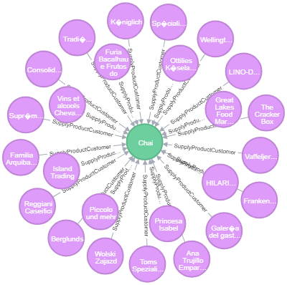
Neo4j
To show relation between customers and the products.
To show relation between customers and the products.
To show relation between customers and the products.
To show relation between customers and the products.
To show relation between customers and the products.
To show relation between customers and the products.
To show relation between customers and the products.

Slide 20
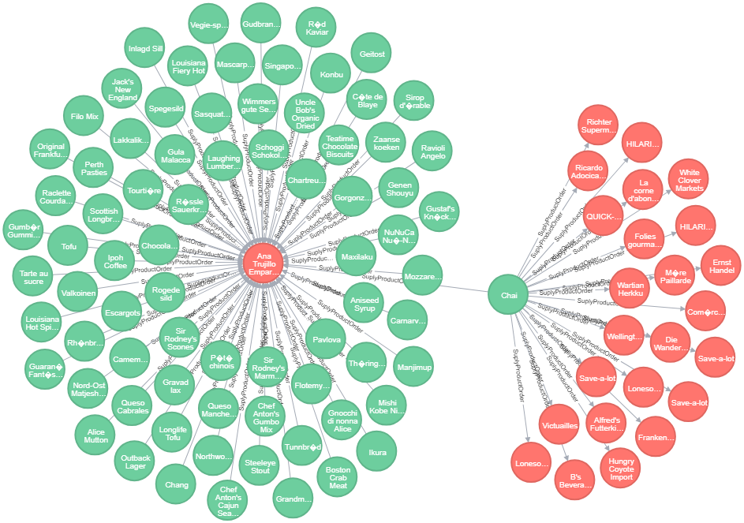
Neo4j
relation between the order and the products in the order.

Slide 21
THANK YOU

