Slide 1
Week-3&4 Report
Class balancing
Baselines - ResNet 50 for classification
Clip finetuning
Literatures on Data Augmentation

Slide 2
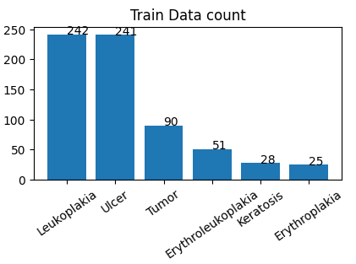
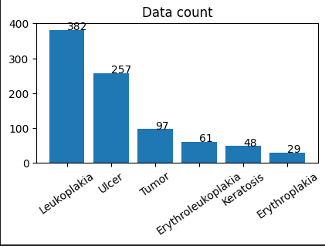
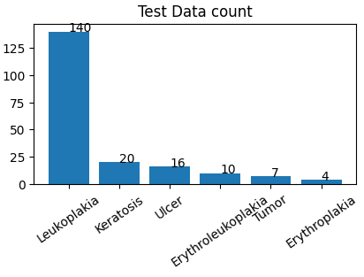
Class Balancing
Original

Slide 3
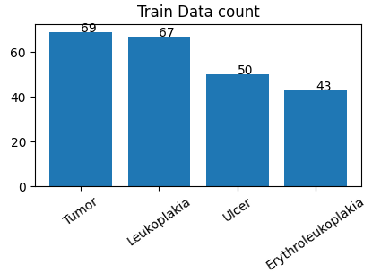
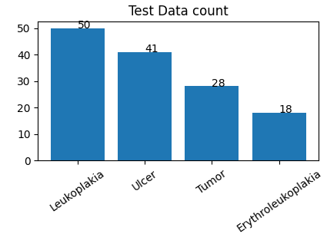
Class Balancing (cont.)
New with class balance (with images of same patients in same split)
Removed Keratosis and Erythroplakia classes (reason: few images)
Total num of images:
Train=229
Test=137

Slide 4
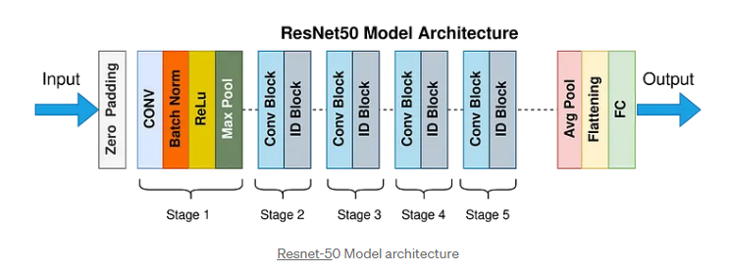
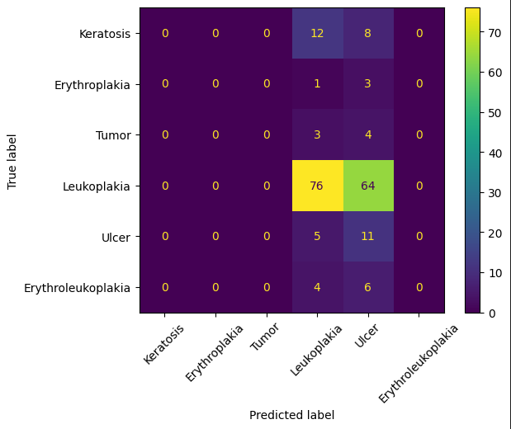
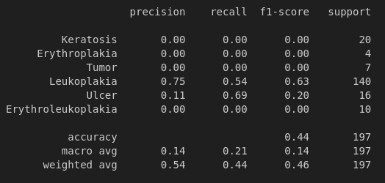
Baselines for Classification
ResNet50 Architecture
Trained on original and class balanced dataset
Original dataset: [for 20 epochs, learning rate=0.1]

Slide 5
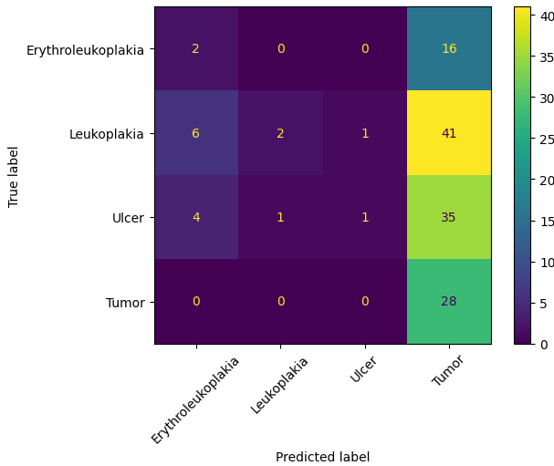
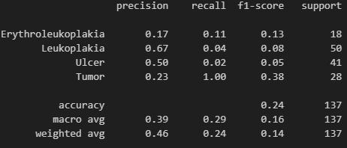
Baselines for Classification
ResNet50 Architecture
Trained on original and class balanced dataset
Class Balanced dataset: [for 20 epochs, learning rate=0.1]

Slide 6
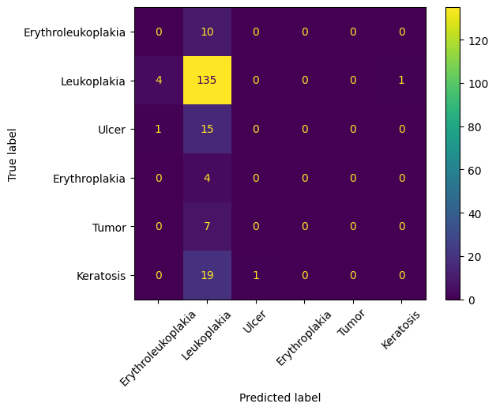
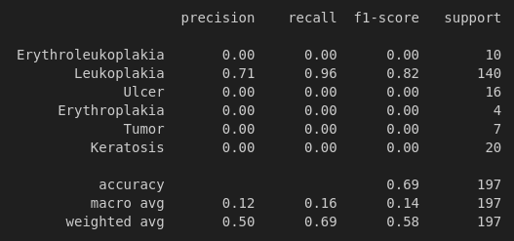
CLIP for classification
Finetuned OpenAI/ViT-32 (https://huggingface.co/openai/clip-vit-base-patch32 )

Slide 7
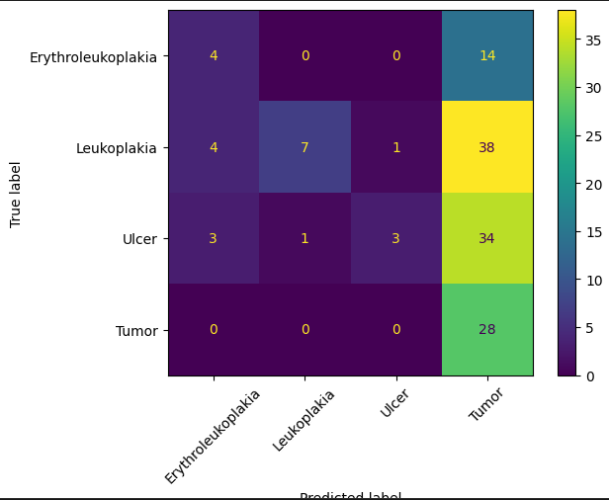
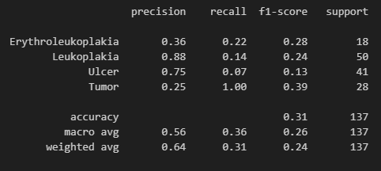
CLIP for classification
Finetuned OpenAI/ViT-32

Slide 8
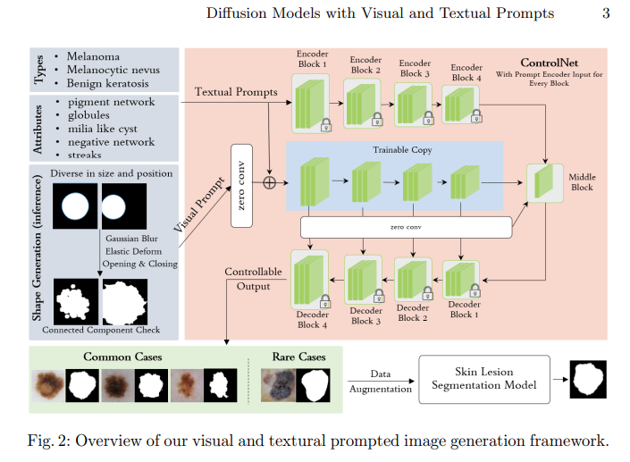
Literature for data augmentation
Boosting Dermatoscopic Lesion Segmentation via Diffusion Models with Visual and Textual Prompts [https://arxiv.org/abs/2310.02906]
Summary:
Generates synthetic samples for Dermatoscopic lesions using diffusion models given segmentation
Lesion types, attributes, and masks are used as prompts in the training and inference.

