Slide 1
ME 346: Heat Transfer
Lecture: Conduction-Introduction
Date:
Instructor: Ankit Jain

Slide 2
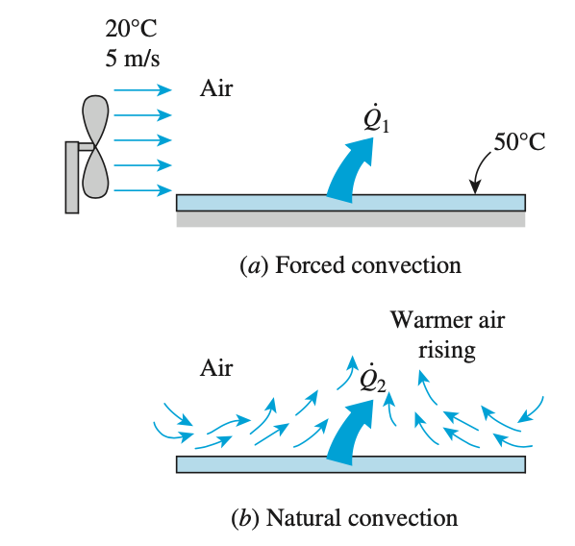
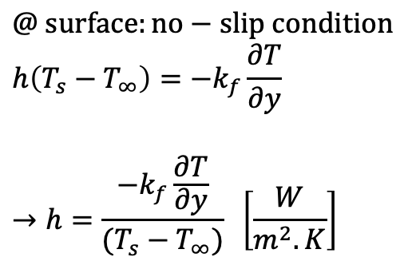
Convective Heat Transfer
Convection: involves fluid motion on top of heat conduction
Thought: is heat transfer via convection more than that by conduction?
Types of convection
Convective Heat Transfer Coeff.
$$q^{”}=h \left(T_{s}−T_{∞}\right) [Newton^{′}s law of cooling]$$
$$@ surface:no−slip condition$$
$$h\left(T_{s}−T_{∞}\right)=−k_{f}\frac{∂T}{∂y}$$
$$→h=\frac{−k_{f}\frac{∂T}{∂y}}{(T_{s}−T_{∞})} \left[\frac{W}{m^{2}.K}\right]$$
Note: This is how we
measure/compute h

Slide 3
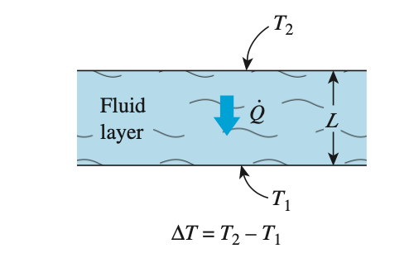

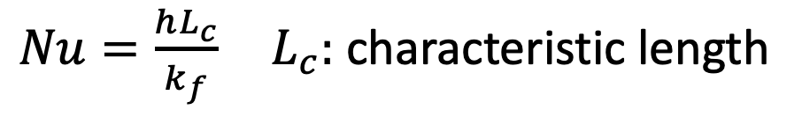
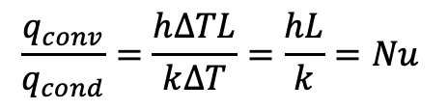

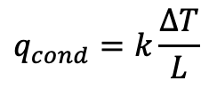
Non-dimensional h: Nusselt Number
$Nu=\frac{hL_{c}}{k_{f}} L_{c}:$characteristic length
$$q_{cond}=k\frac{∆T}{L}$$
$$\frac{q_{conv}}{q_{cond}}=\frac{h∆TL}{k∆T}=\frac{hL}{k}=Nu$$
$$q_{conv}=h ∆T$$
Nu: enhancement in heat transfer across a fluid layer due to
convection compared to conduction
$$Nu=1?$$

Slide 4
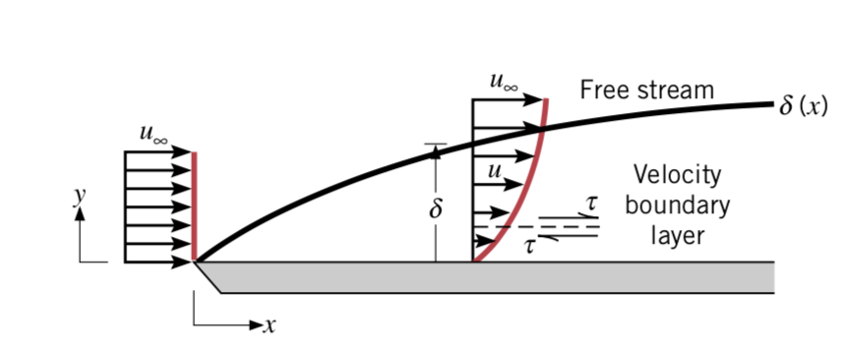
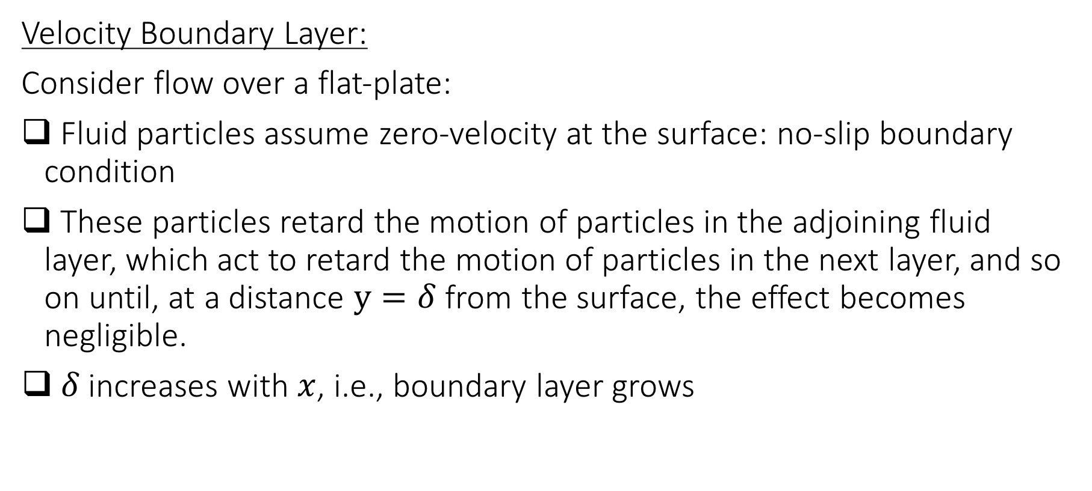
Boundary Layers
Velocity Boundary Layer:
Consider flow over a flat-plate:
Fluid particles assume zero-velocity at the surface: no-slip boundary condition
These particles retard the motion of particles in the adjoining fluid layer, which act to retard the motion of particles in the next layer, and so on until, at a distance $y=δ$ from the surface, the effect becomes negligible.
$δ$increases with $x$, i.e., boundary layer grows

Slide 5
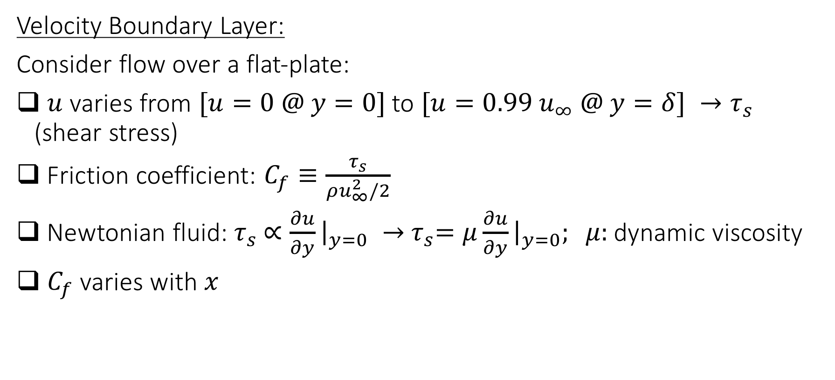
Boundary Layers
Velocity Boundary Layer:
Consider flow over a flat-plate:
$u$ varies from $[u=0 @ y=0]$to $[u={0.99 u}_{∞} @ y=δ] →τ_{s}$ (shear stress)
Friction coefficient: $C_{f}≡\frac{τ_{s}}{ρu_{∞}^{2}/2}$
Newtonian fluid:${ τ}_{s} ∝\frac{∂u}{∂y}{\left.​\right|}_{y=0} →{ τ}_{s}=μ\frac{∂u}{∂y}{\left.​\right|}_{y=0}; μ:$dynamic viscosity
$C_{f}$ varies with $x$

Slide 6
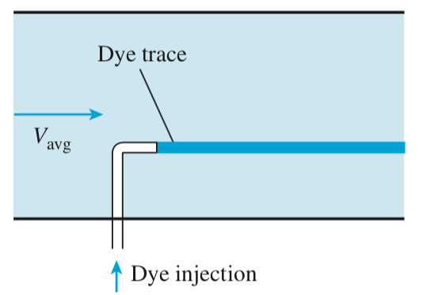
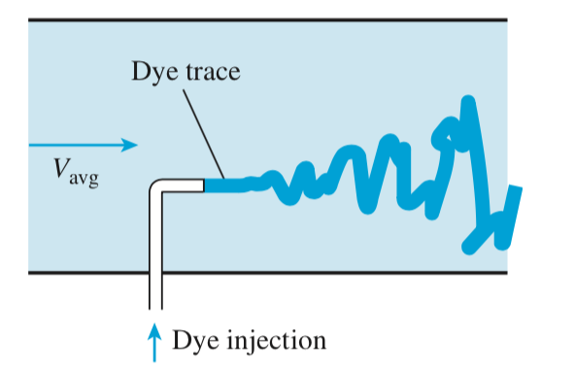
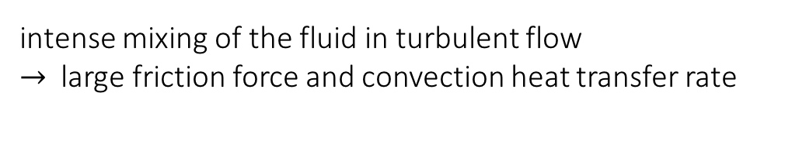
Laminar and Turbulent Flow
Laminar Flow: highly-ordered flow with smooth streamlines
Turbulent Flow: Chaotic, highly irregular flow
intense mixing of the fluid in turbulent flow
$→$large friction force and convection heat transfer rate

Slide 7
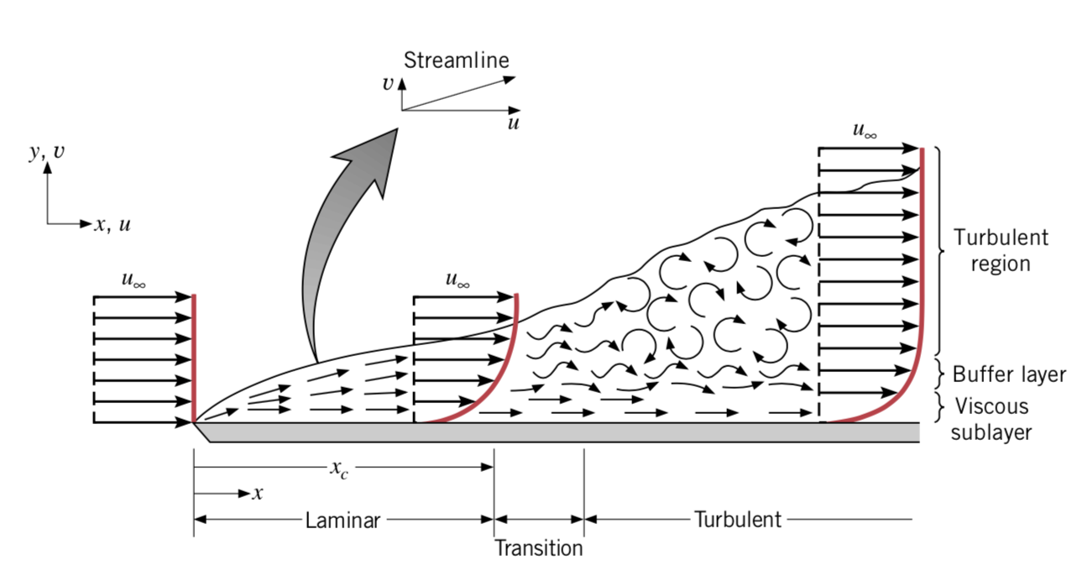
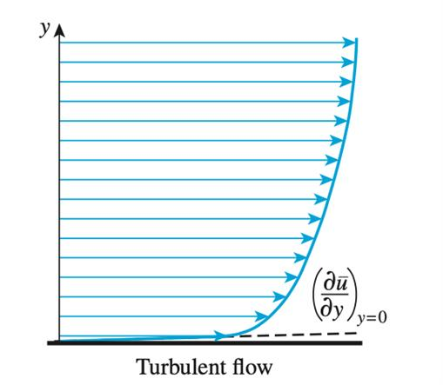
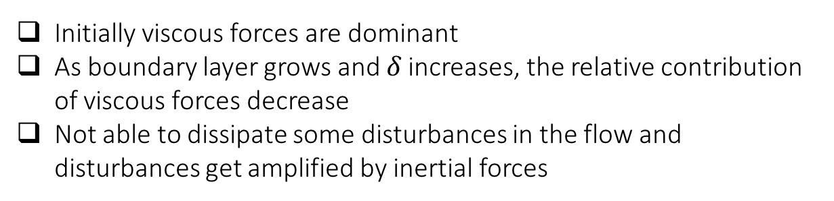
Laminar and Turbulent Flow
Turbulent Flow:
Viscous sublayer: viscous effects dominates and velocity profile is almost linear
Buffer sublayer: viscous and turbulent effects are comparable
Turbulent sublayer: dominated by turbulent effects and velocity profile is flat
Initially viscous forces are dominant
As boundary layer grows and $δ$increases, the relative contribution of viscous forces decrease
Not able to dissipate some disturbances in the flow and disturbances get amplified by inertial forces

Slide 8
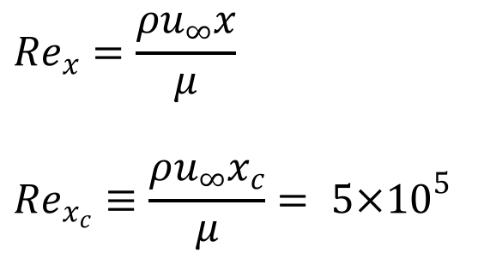
Laminar and Turbulent Flow
$$Re_{x}=\frac{ρu_{∞}x}{μ}$$
$$Re_{x_{c}}≡\frac{ρu_{∞}x_{c}}{μ}= 5×{10}^{5}$$
For flow over a flat plate
Transition from laminar to turbulent flow depends on fluid-type, flow velocity, and surface geometry and roughness, among other things

Slide 9
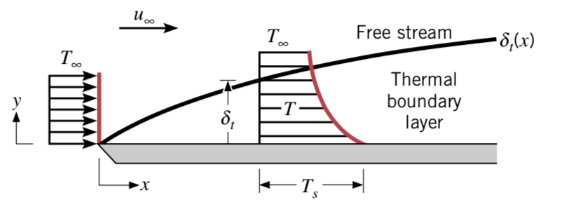
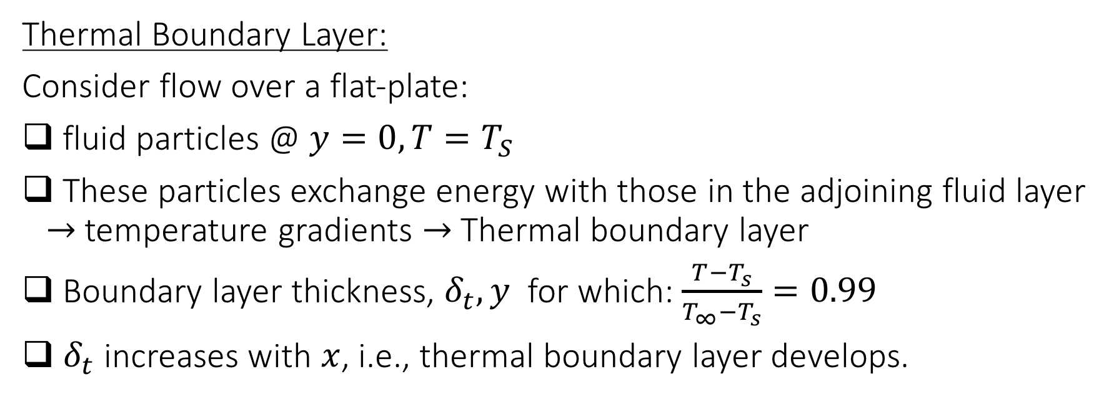
Boundary Layers
Thermal Boundary Layer:
Consider flow over a flat-plate:
fluid particles @$y=0, T=T_{S}$
These particles exchange energy with those in the adjoining fluid layer $→$temperature gradients $→$ Thermal boundary layer
Boundary layer thickness, $δ_{t}, y$ for which: $\frac{T−T_{s}}{T_{∞}−T_{s}}=0.99$
$δ_{t}$ increases with $x$, i.e., thermal boundary layer develops.

Slide 10
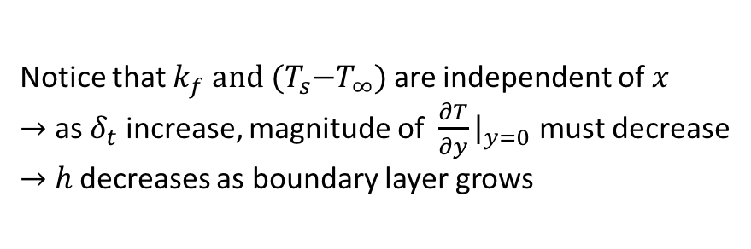
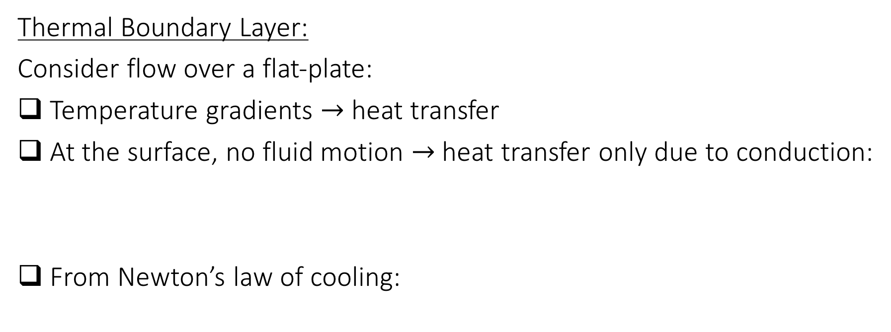
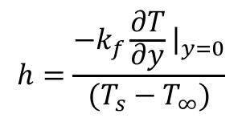


Boundary Layers
Thermal Boundary Layer:
Consider flow over a flat-plate:
Temperature gradients $→$ heat transfer
At the surface, no fluid motion $→$ heat transfer only due to conduction:
From Newton’s law of cooling:
$$q_{s}^{”}=−k_{f}\frac{∂T}{∂y}{\left.​\right|}_{y=0}$$
Notice that $k_{f}$ $and {(T}_{s}−T_{∞})$ are independent of $x$
$→$ as $δ_{t}$ increase, magnitude of $\frac{∂T}{∂y}{\left.​\right|}_{y=0}$ must decrease
$→$ $h$ decreases as boundary layer grows
$$q_{s}^{”}=h(T_{s}−T_{∞})$$
$$h=\frac{{−k}_{f}\frac{∂T}{∂y}{\left.​\right|}_{y=0}}{(T_{s}−T_{∞})}$$

Slide 11
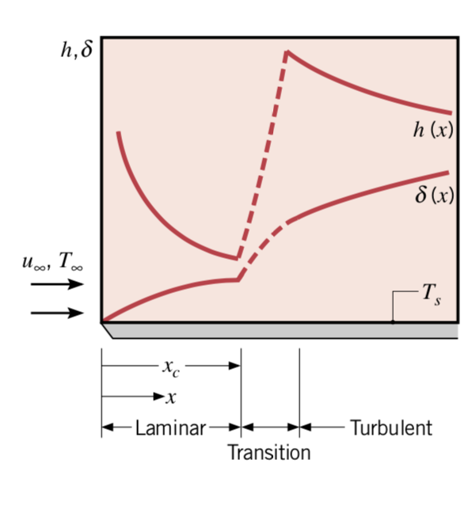
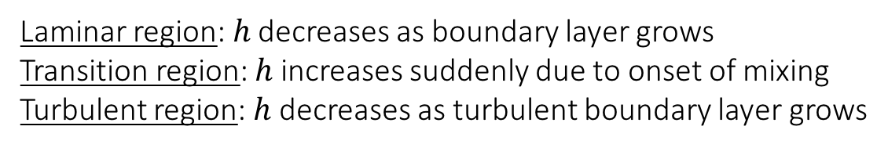
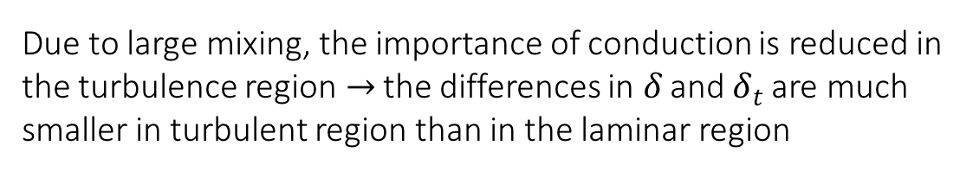
Thermal Boundary Layer
Laminar region: $h$ decreases as boundary layer grows
Transition region: $h$ increases suddenly due to onset of mixing
Turbulent region: $h$ decreases as turbulent boundary layer grows
Due to large mixing, the importance of conduction is reduced in the turbulence region$→$ the differences in $δ$ and $δ_{t}$ are much smaller in turbulent region than in the laminar region

Slide 12
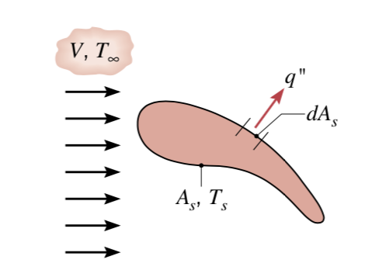

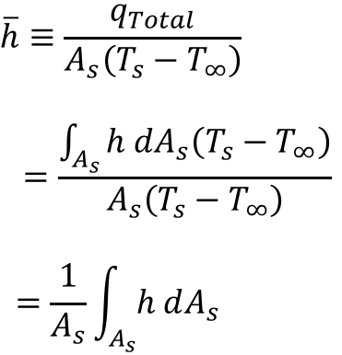
Local and average coefficients
Total heat transfer rate:
$$q_{Total}=\int_{A_{s}}^{ }{h dA_{s}(T_{s}−T_{∞})}$$
$$\overline{h}≡\frac{q_{Total}}{A_{s}\left(T_{s}−T_{∞}\right)}$$
$$=\frac{\int_{A_{s}}^{ }{h dA_{s}\left(T_{s}−T_{∞}\right)}}{A_{s}\left(T_{s}−T_{∞}\right)}$$
$$=\frac{1}{A_{s}}\int_{A_{s}}^{ }{h dA_{s}}$$

Slide 13
Governing Equations for Boundary Layers
Conservation of Mass: Continuity Equation
Conservation of Momentum: Momentum Equation
Conservation of Energy: Energy Equation

Slide 14
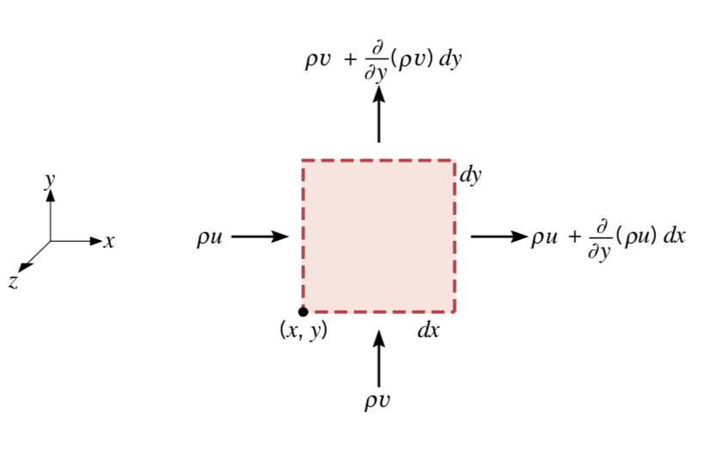
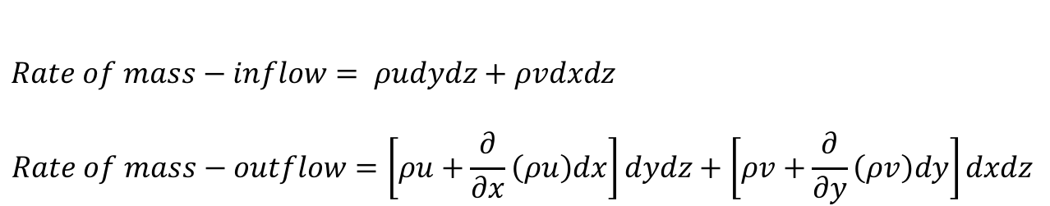
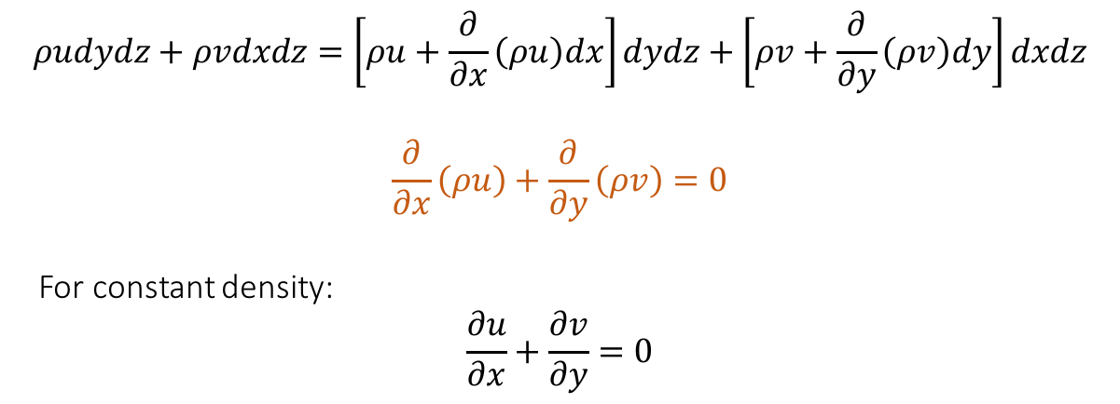
Continuity Equation
unit size in the z-direction, two-dimensional, steady flow
for steady flow, the net rate at which mass enters the control volume (inflow - outflow) must equal zero
$$Rate of mass−inflow= ρudydz+ρvdxdz$$
$$Rate of mass−outflow=\left[ρu+\frac{∂}{∂x}\left(ρu\right)dx\right]dydz+\left[ρv+\frac{∂}{∂y}\left(ρv\right)dy\right]dxdz$$
$$ρudydz+ρvdxdz=\left[ρu+\frac{∂}{∂x}\left(ρu\right)dx\right]dydz+\left[ρv+\frac{∂}{∂y}\left(ρv\right)dy\right]dxdz$$
$$\frac{∂}{∂x}\left(ρu\right)+\frac{∂}{∂y}\left(ρv\right)=0$$
For constant density:
$$\frac{∂u}{∂x}+\frac{∂v}{∂y}=0$$

Slide 15
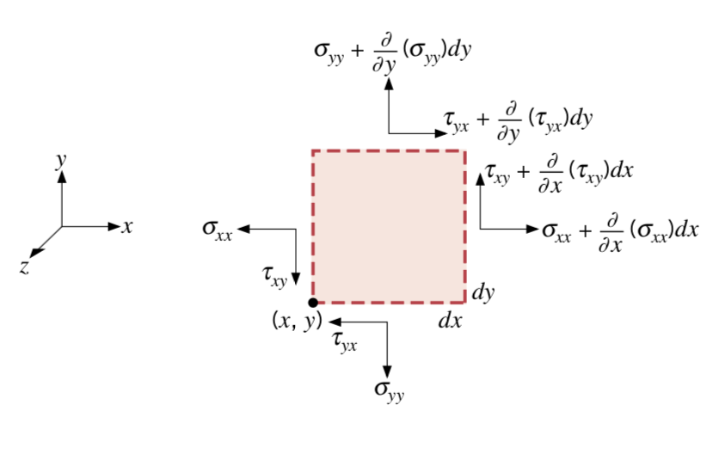
Momentum Equation
Newton’s Second Law: the sum of all forces must equal the rate of momentum change
Body forces: proportional to the volume of the body [such as gravity, electric, and magnetic forces]
Surface forces: proportional to the surface area [such as pressure forces due to hydrostatic pressure and shear stresses due to viscous effects]
Surface forces: Pressure and viscous
Viscous forces: decomposed into two perpendicular comp: Normal and Shear stress
Note: Pressure and normal stress are different! Forces due to normal stress are arising from viscous effects related to velocity gradient and are zero for uniform velocity profile. While pressure forces are related to hydrostatic pressure and are non-zero even for uniform velocity profiles.

Slide 16
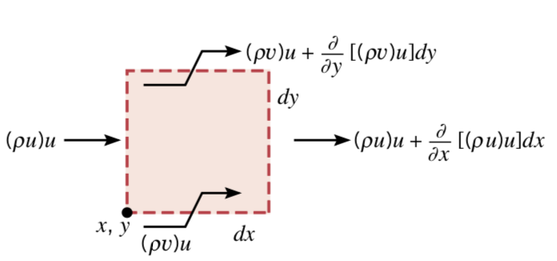
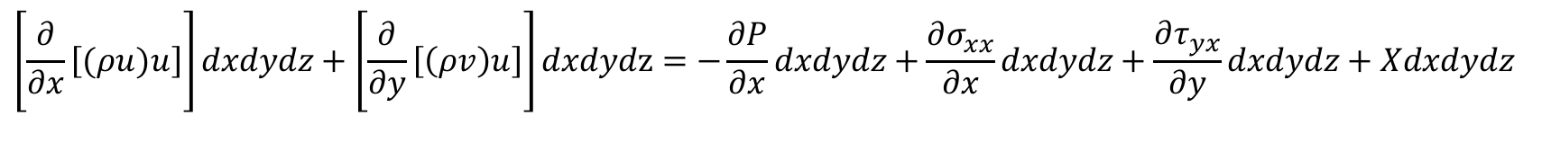
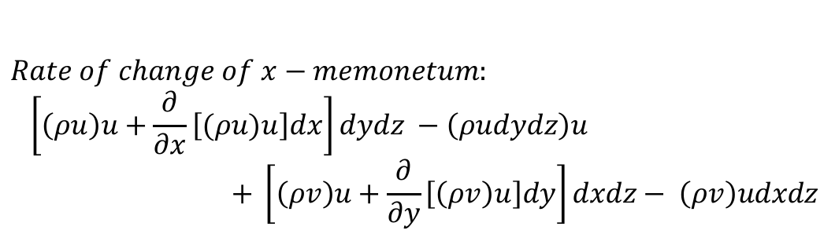


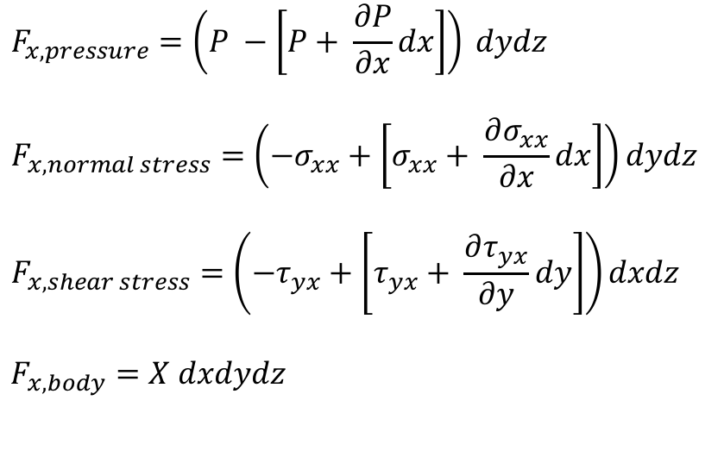
Momentum Equation
$$F_{x, pressure}=\left(P −\left[P+ \frac{∂P}{∂x}dx\right]\right) dydz$$
$$F_{x, normal stress}=\left(−σ_{xx}+\left[σ_{xx}+ \frac{∂σ_{xx}}{∂x}dx\right]\right)dydz$$
$$F_{x, shear stress}=\left(−τ_{yx}+\left[τ_{yx}+ \frac{∂τ_{yx}}{∂y}dy\right]\right)dxdz$$
$$F_{x, body}=X dxdydz$$
$$P$$
$$P+\frac{∂P}{∂x}dx$$
$$Rate of change of x−memonetum:$$
$$\left[\left(ρu\right)u+\frac{∂}{∂x}\left[(ρu)u\right]dx\right]dydz −\left(ρudydz\right)u$$
$$+ \left[\left(ρv\right)u+\frac{∂}{∂y}\left[\left(ρv\right)u\right]dy\right]dxdz− \left(ρv\right)udxdz$$
$$\left[\frac{∂}{∂x}\left[(ρu)u\right]\right]dxdydz+\left[\frac{∂}{∂y}\left[\left(ρv\right)u\right]\right]dxdydz=−\frac{∂P}{∂x}dxdydz+\frac{∂σ_{xx}}{∂x}dxdydz+\frac{∂τ_{yx}}{∂y}dxdydz+Xdxdydz$$

Slide 17
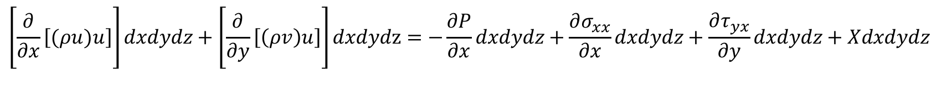
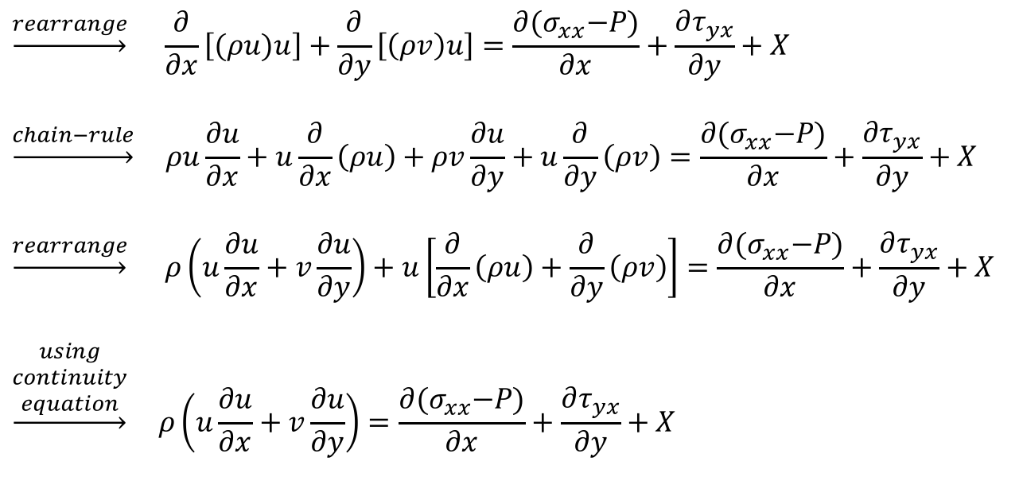
Momentum Equation
$$\left[\frac{∂}{∂x}\left[(ρu)u\right]\right]dxdydz+\left[\frac{∂}{∂y}\left[\left(ρv\right)u\right]\right]dxdydz=−\frac{∂P}{∂x}dxdydz+\frac{∂σ_{xx}}{∂x}dxdydz+\frac{∂τ_{yx}}{∂y}dxdydz+Xdxdydz$$
$$\underset{→}{rearrange} \frac{∂}{∂x}\left[(ρu)u\right]+\frac{∂}{∂y}\left[\left(ρv\right)u\right]=\frac{∂{(σ}_{xx}−P)}{∂x}+\frac{∂τ_{yx}}{∂y}+X$$
$$\underset{→}{chain−rule} ρu\frac{∂u}{∂x}+u\frac{∂}{∂x}\left(ρu\right)+ρv\frac{∂u}{∂y}+u\frac{∂}{∂y}\left(ρv\right)=\frac{∂{(σ}_{xx}−P)}{∂x}+\frac{∂τ_{yx}}{∂y}+X$$
$$\underset{→}{rearrange} ρ\left(u\frac{∂u}{∂x}+v\frac{∂u}{∂y}\right)+u\left[\frac{∂}{∂x}\left(ρu\right)+\frac{∂}{∂y}\left(ρv\right)\right]=\frac{∂{(σ}_{xx}−P)}{∂x}+\frac{∂τ_{yx}}{∂y}+X$$
$$\underset{→}{\begin{aligned}using \\ continuity \\ equation\end{aligned}} ρ\left(u\frac{∂u}{∂x}+v\frac{∂u}{∂y}\right)=\frac{∂{(σ}_{xx}−P)}{∂x}+\frac{∂τ_{yx}}{∂y}+X$$

Slide 18
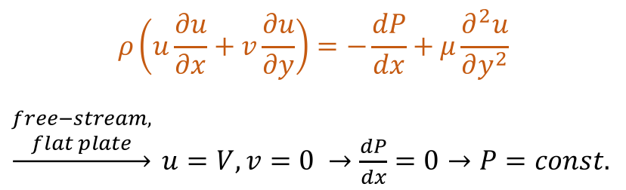
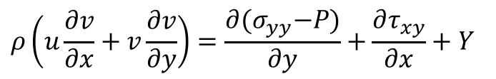

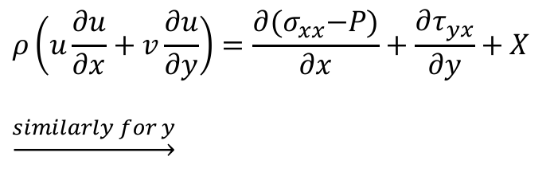
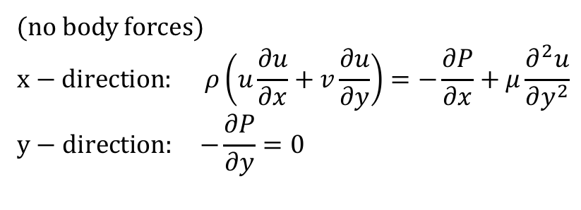

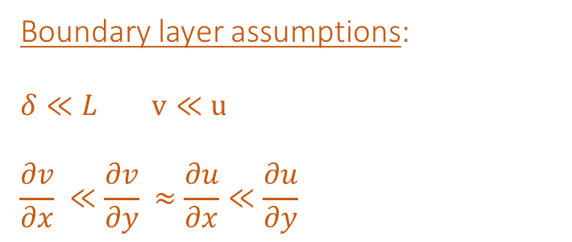
Momentum Equation
$$ρ\left(u\frac{∂u}{∂x}+v\frac{∂u}{∂y}\right)=\frac{∂{(σ}_{xx}−P)}{∂x}+\frac{∂τ_{yx}}{∂y}+X$$
$$\underset{→}{similarly for y}$$
Boundary layer assumptions:
$$δ≪L v≪u$$
$$\frac{∂v}{∂x} ≪\frac{∂v}{∂y} ≈\frac{∂u}{∂x}≪\frac{∂u}{∂y}$$
$$ρ\left(u\frac{∂v}{∂x}+v\frac{∂v}{∂y}\right)=\frac{∂{(σ}_{yy}−P)}{∂y}+\frac{∂τ_{xy}}{∂x}+Y$$
$$σ_{xx}∝\frac{∂u}{∂x}{ σ}_{yy}∝\frac{∂v}{∂y} τ_{yx}=μ\frac{∂u}{∂y} τ_{xy}=μ\frac{∂v}{∂x}$$
(no body forces)
$$x−direction: ρ\left(u\frac{∂u}{∂x}+v\frac{∂u}{∂y}\right)=−\frac{∂P}{∂x}+μ\frac{∂^{2}u}{∂y^{2}}$$
$$y−direction: −\frac{∂P}{∂y}=0$$
$$ρ\left(u\frac{∂u}{∂x}+v\frac{∂u}{∂y}\right)=−\frac{dP}{dx}+μ\frac{∂^{2}u}{∂y^{2}}$$
$\underset{→}{\begin{aligned}free−stream, \\ flat plate\end{aligned}} u=V, v=0$ $→\frac{dP}{dx}=0→P=const.$
$$→P=P(x)$$

Slide 19
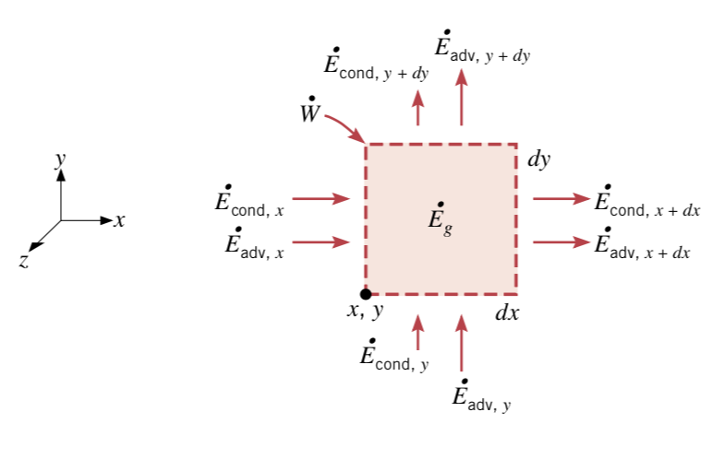

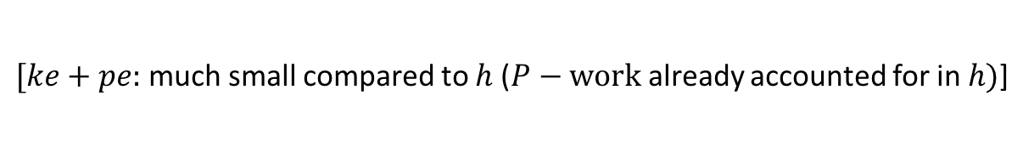
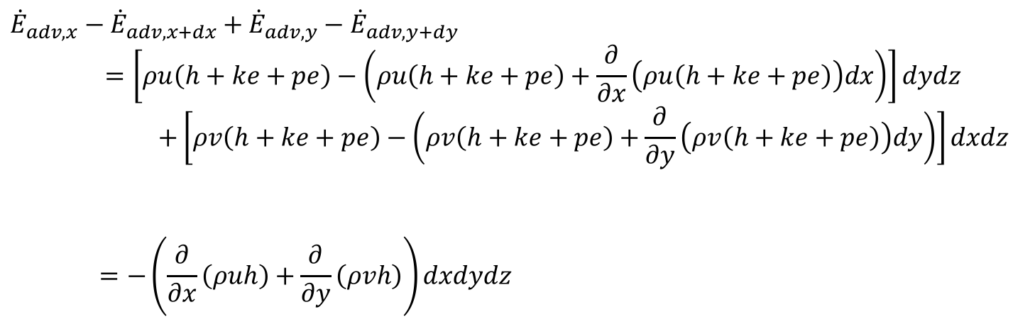
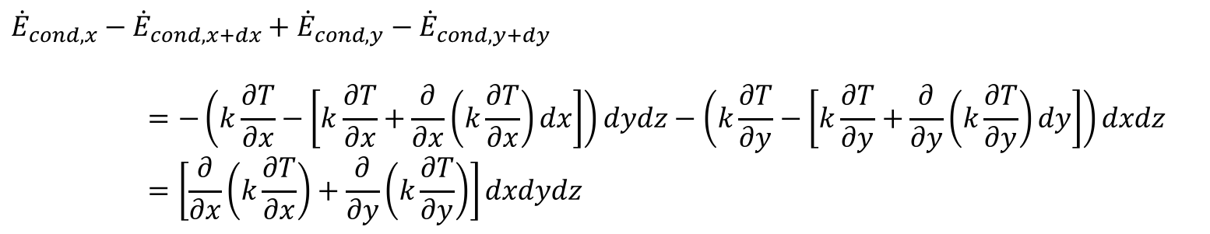
Energy Equation
$${\dot{E}}_{in}+\dot{W}={\dot{E}}_{out}$$
$${\dot{E}}_{cond,x}−{\dot{E}}_{cond,x+dx}+{\dot{E}}_{cond,y}−{\dot{E}}_{cond,y+dy}$$
$$=−\left(k\frac{∂T}{∂x}−\left[k\frac{∂T}{∂x}+\frac{∂}{∂x}\left(k\frac{∂T}{∂x}\right)dx\right]\right)dydz−\left(k\frac{∂T}{∂y}−\left[k\frac{∂T}{∂y}+\frac{∂}{∂y}\left(k\frac{∂T}{∂y}\right)dy\right]\right)dxdz$$
$$=\left[\frac{∂}{∂x}\left(k\frac{∂T}{∂x}\right)+\frac{∂}{∂y}\left(k\frac{∂T}{∂y}\right)\right]dxdydz$$
$${\dot{E}}_{adv,x}−{\dot{E}}_{adv,x+dx}+{\dot{E}}_{adv,y}−{\dot{E}}_{adv,y+dy}$$
$$=\left[ρu\left(h+ke+pe\right)−\left(ρu\left(h+ke+pe\right)+\frac{∂}{∂x}\left(ρu\left(h+ke+pe\right)\right)dx\right)\right]dydz$$
$$+\left[ρv\left(h+ke+pe\right)−\left(ρv\left(h+ke+pe\right)+\frac{∂}{∂y}\left(ρv\left(h+ke+pe\right)\right)dy\right)\right]dxdz$$
$$=−\left(\frac{∂}{∂x}\left(ρuh\right)+\frac{∂}{∂y}\left(ρvh\right)\right)dxdydz$$
$[ke+pe:$ much small compared to $h$ ($P−work$already accounted for in $h)$]

Slide 20

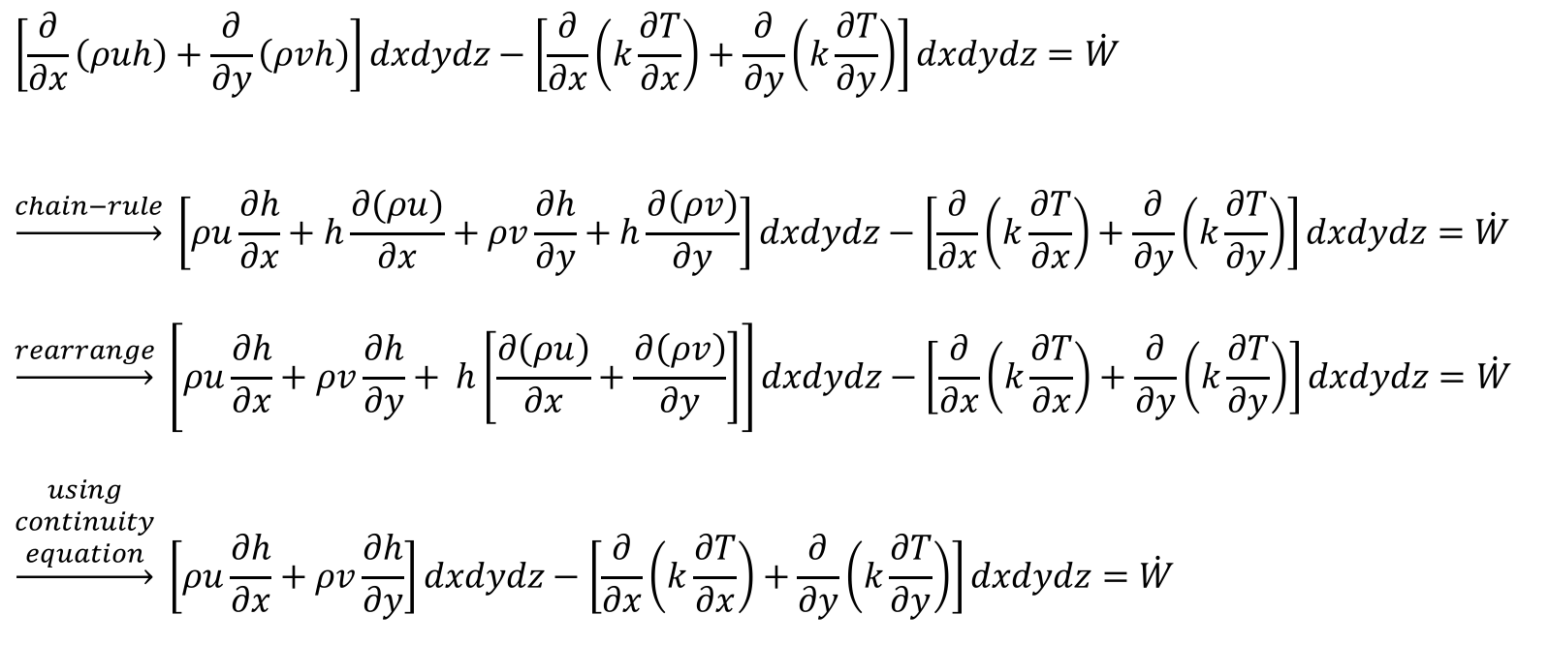
Energy Equation
$${\dot{E}}_{in}+\dot{W}={\dot{E}}_{out}$$
$$\left[\frac{∂}{∂x}\left(ρuh\right)+\frac{∂}{∂y}\left(ρvh\right)\right]dxdydz−\left[\frac{∂}{∂x}\left(k\frac{∂T}{∂x}\right)+\frac{∂}{∂y}\left(k\frac{∂T}{∂y}\right)\right]dxdydz=\dot{W}$$
$$\underset{→}{chain−rule} \left[ρu\frac{∂h}{∂x}+h\frac{∂(ρu)}{∂x}+ρv\frac{∂h}{∂y}+h\frac{∂(ρv)}{∂y}\right]dxdydz−\left[\frac{∂}{∂x}\left(k\frac{∂T}{∂x}\right)+\frac{∂}{∂y}\left(k\frac{∂T}{∂y}\right)\right]dxdydz=\dot{W}$$
$$\underset{→}{rearrange} \left[ρu\frac{∂h}{∂x}+ρv\frac{∂h}{∂y}+ h\left[\frac{∂\left(ρu\right)}{∂x}+\frac{∂\left(ρv\right)}{∂y}\right]\right]dxdydz−\left[\frac{∂}{∂x}\left(k\frac{∂T}{∂x}\right)+\frac{∂}{∂y}\left(k\frac{∂T}{∂y}\right)\right]dxdydz=\dot{W}$$
$$\underset{→}{\begin{aligned}using \\ continuity \\ equation\end{aligned}} \left[ρu\frac{∂h}{∂x}+ρv\frac{∂h}{∂y}\right]dxdydz−\left[\frac{∂}{∂x}\left(k\frac{∂T}{∂x}\right)+\frac{∂}{∂y}\left(k\frac{∂T}{∂y}\right)\right]dxdydz=\dot{W}$$

Slide 21
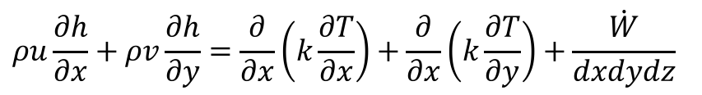
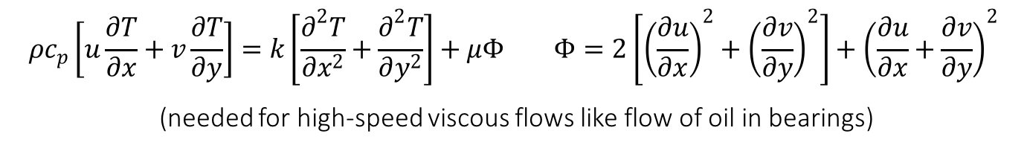



Energy Equation
$$ρu\frac{∂h}{∂x}+ρv\frac{∂h}{∂y}=\frac{∂}{∂x}\left(k\frac{∂T}{∂x}\right)+\frac{∂}{∂x}\left(k\frac{∂T}{∂y}\right)+\dot{\frac{W}{dxdydz}}$$
$\dot{W}:$ accounts for work done by body and viscous forces
(work done by pressure forces is already accounted for)
Viscous work: typically negligible compared to other terms
$$\underset{→}{\begin{aligned}constant properties, \\ incompressible flow, \\ negligible body forces\end{aligned}} ρc_{p}\left[u\frac{∂T}{∂x}+v\frac{∂T}{∂y}\right]=k\left[\frac{∂^{2}T}{∂x^{2}}+\frac{∂^{2}T}{∂y^{2}}\right]$$
Using $h=c_{p}T,$where
$$c_{p}: heat capacity$$
$$ρc_{p}\left[u\frac{∂T}{∂x}+v\frac{∂T}{∂y}\right]=k\left[\frac{∂^{2}T}{∂x^{2}}+\frac{∂^{2}T}{∂y^{2}}\right]+μΦ Φ=2\left[{\left(\frac{∂u}{∂x}\right)}^{2}+{\left(\frac{∂v}{∂y}\right)}^{2}\right]+{\left(\frac{∂u}{∂x}+\frac{∂v}{∂y}\right)}^{2}$$
(needed for high-speed viscous flows like flow of oil in bearings)

Slide 22



Functional/Non-dimensional Solutions
$$x^{∗}=\frac{x}{L} y^{∗}=\frac{y}{L} u^{∗}=\frac{u}{V} v^{∗}=\frac{v}{L} T^{∗}=\frac{T−T_{s}}{T_{∞}−T_{s}} P^{∗}=\frac{P}{ρV^{2}}$$
$$Continuity: \frac{∂u^{∗}}{∂x^{∗}}+\frac{∂v^{∗}}{∂y^{∗}}=0$$
$$Momentum: \left(u^{∗}\frac{∂u^{∗}}{∂x^{∗}}+v^{∗}\frac{∂u^{∗}}{∂y^{∗}}\right)=−\frac{dP^{∗}}{dx^{∗}}+\frac{1}{Re_{L}}\frac{∂^{2}u^{∗} }{∂{y^{∗}}^{2}}$$
$$Energy: \left[u^{∗}\frac{∂T^{∗}}{∂x^{∗}}+v^{∗}\frac{∂T^{∗}}{∂y^{∗}}\right]=\frac{1}{Re_{L}Pr}\frac{∂^{2}T^{∗}}{∂{y^{∗}}^{2}}$$
$$Re_{L}=\frac{VL}{ν};Reynolds Number$$
$$Pr=\frac{ν}{α};Prandtl Number$$
$Boundary Conditions:$ $u^{∗}\left(0,y^{∗}\right)=1; u^{∗}\left(x^{∗},0\right)=0; u^{∗}\left(x^{∗},∞\right)=1;$
$v^{∗}\left(0,y^{∗}\right)=0; { v}^{∗}\left(x^{∗},0\right)=0; v^{∗}\left(x^{∗}, ∞\right)=0;$
${ T}^{∗}\left(0,y^{∗}\right)=1; { T}^{∗}\left(x^{∗},0\right)=0; T^{∗}\left(x^{∗}, ∞\right)=1;$

Slide 23














Functional/Non-dimensional Solutions
$$Re_{L}=\frac{VL}{ν};Reynolds Number$$
$$Pr=\frac{ν}{α};Prandtl Number$$
$$u^{∗}=f_{1}\left(x^{∗}, y^{∗}, \frac{dP^{∗}}{dx^{∗}}, Re_{L}\right)$$
$$T^{∗}=g_{1}\left(x^{∗}, y^{∗}, \frac{dP^{∗}}{dx^{∗}}, Re_{L},Pr\right)$$
$$=\frac{\frac{μV}{L}\frac{∂u^{∗}}{∂y^{∗}}{\left.​\right|}_{y^{∗}=0}}{\frac{ρV^{2}}{2}}$$
$$=\frac{μ\frac{∂u}{∂y}{\left.​\right|}_{y=0}}{\frac{ρV^{2}}{2}}$$
$$C_{f}≡\frac{τ_{s}}{\frac{ρV^{2}}{2}}$$
$$=\frac{2}{Re_{L}}\frac{∂u^{∗}}{∂y^{∗}}{\left.​\right|}_{y^{∗}=0}$$
$$=f\left(x^{∗}, y^{∗},\frac{dP^{∗}}{dx^{∗}}, Re_{L}\right)$$
$$h=\frac{{−k}_{f}\frac{∂T}{∂y}{\left.​\right|}_{y=0}}{(T_{s}−T_{∞})}$$
$$=−\frac{\frac{k_{f}\left(T_{∞}−T_{s}\right)}{L}\frac{∂T^{∗}}{∂y^{∗}}{\left.​\right|}_{y^{∗}=0}}{\left(T_{s}−T_{∞}\right)}$$
$$=\frac{k_{f}}{L}\frac{∂T^{∗}}{∂y^{∗}}{\left.​\right|}_{y^{∗}=0}$$
$Nu:$Non-dimensional T-gradient at surface
$Nu$ to thermal boundary layer is what $C_{f}$to velocity boundary layer
$$Nu ≡\frac{hL}{k_{f}}$$
$$=\frac{∂T^{∗}}{∂y^{∗}}{\left.​\right|}_{y^{∗}=0}$$
$$=g\left(x^{∗}, y^{∗}, \frac{dP^{∗}}{dx^{∗}}, Re_{L},Pr\right)$$

Slide 24






Significance of non-dimensional Parameters
$$Re=\frac{inertial forces}{viscous forces}$$
$$=\frac{change in momentum offluid}{viscous forces}$$
$$\overset{→}{\begin{aligned}order of magnitue \\ analysis\end{aligned}} ≈ \frac{ρV^{2}A}{μ\frac{V}{L}A}$$
$$=\frac{ρVL}{μ}$$
L$arge Re→$ viscous forces less dominant $→$ inertial forces amplify fluid disturbances $→$ turbulent flow
At a fixed location on surface, if $Re$ increase $→$ viscous forces less dominant
$Pr \left(=ν/α\right):$ $\text{measure} \text{of} \text{the} \text{relative} \text{effectiveness} \text{of} \text{momentum} \text{and} \text{energy} \text{transport} \text{by} \text{diffusion} \text{in} \text{the} \text{velocity} \text{and} \text{thermal} \text{boundary} \text{layers}\text{, }\text{respectively}\text{. }$
For laminar flow: $\frac{δ}{δ_{t}}∝{Pr}^{n}, n>0⁡$

Slide 25
© Ankit Jain
All rights reserved.
You may not make copies or disseminate this material in any form without my express permission.

