Slide 1
ME 346: Heat Transfer
Lecture: Introduction
Date: Aug 1, 2023
Instructor: Ankit Jain

Slide 2
Class Policies
Assignment copy/plagiarism: zero tolerance!
  zero grade for entire assignment/project!
  no exceptions!
  http://www.iitb.ac.in/newacadhome/punishments201521July.pdf
FR for total score < 40%

Slide 3
Grading
Assignments: 20%
Quizzes: 20%
MidSem: 20%
EndSem: 40%
Class Participation: *01%

Slide 4
Syllabus
Introduction
Introduction to conduction
One-Dimensional, Steady-State Conduction
Two-Dimensional, Steady-State Conduction
Transient Conduction
Introduction to Convection
Forced External Flow
Forced Internal Flow
Natural Convection
Boiling and Condensation
Heat Exchangers
Radiation: Processes and Properties
Radiation Exchange Between Surfaces

Slide 5
References
Incropera FP, Dewitt DP, Bergman TL, Lavine AS, Principles of Heat and Mass transfer, 7th Ed, Wiley, 2017
Cengel YA, Ghajar AJ, Heat and Mass Transfer : Fundamentals and Applications, 5th Ed, McGraw Hill, 2018
Sukhatme SP, A text book on Heat transfer, 4th Ed, Universities Press, 2005

Slide 6
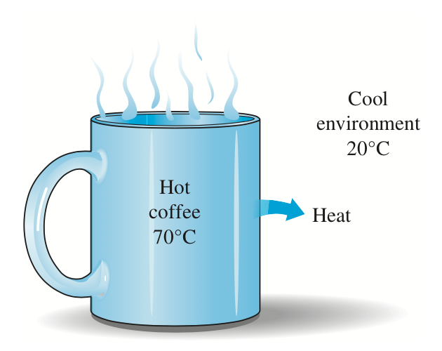
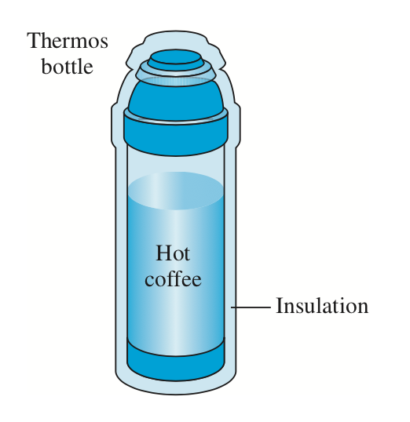
Heat Transfer
Refs:
Incropera, Dewitt, Bergman, Lavine
Cengel & Ghajar
What is Heat?
What are some examples of Heat Transfer?
Why we need to study Heat Transfer?

Slide 7
Relation to Thermodynamics
Thermodynamics:
Energy can be transferred by interactions of system with surroundings in the form of heat and work
Deals with the end states
No mechanism/method for computing the rate of heat flow
equilibrium states of matter
Heat Transfer:
quantify rate at which heat transfer occurs under thermal non-equilibrium

Slide 8
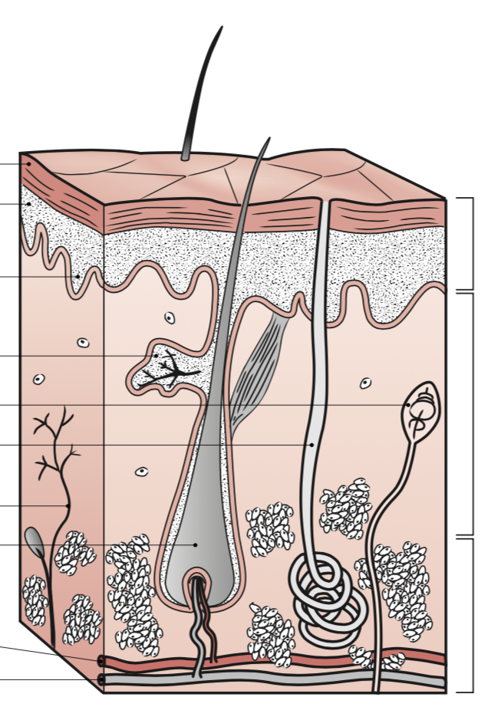
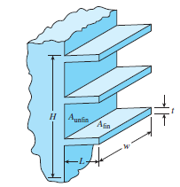
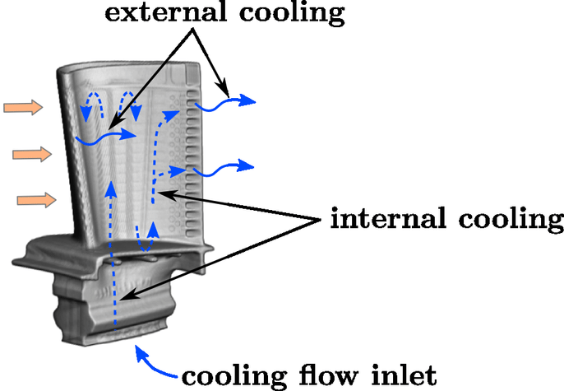
Why Study Heat Transfer?
Heat transfer is commonly encountered in engineering systems and other aspects of life and we can see that many ordinary household appliances are designed, in whole or in part, by using the principles of heat transfer
Turbine cooling
Fin designs in microprocessors
Selective Tissue Heating
Refs:
Incropera, Dewitt, Bergman, Lavine
Cengel & Ghajar

Slide 9
Heat Transfer Application: Data Recording
https://blog.seagate.com/craftsman-ship/hamr-next-leap-forward-now/

Slide 10



Job Scenario

Slide 11
Thermodynamics: 0th law
“if two systems are both in thermal equilibrium with a third system then they are in thermal equilibrium with each other”
A
Thermal
equilibrium
Thermal
equilibrium
0th law
B
C

Slide 12
Thermodynamics: 1st law
“total energy of an isolated system is constant; energy can transformed from one form to another, but can be neither created nor destroyed”

Slide 13
Thermodynamics: 2nd law
“it is impossible for any device that operates in a cycle to receive heat from a single reservoir and produce a net amount of work”
Hot
Cold

Slide 14
Thermodynamics: 3rd law
“The entropy of a perfect crystal of any pure substance approaches zero as the temperature approaches absolute zero”

Slide 15
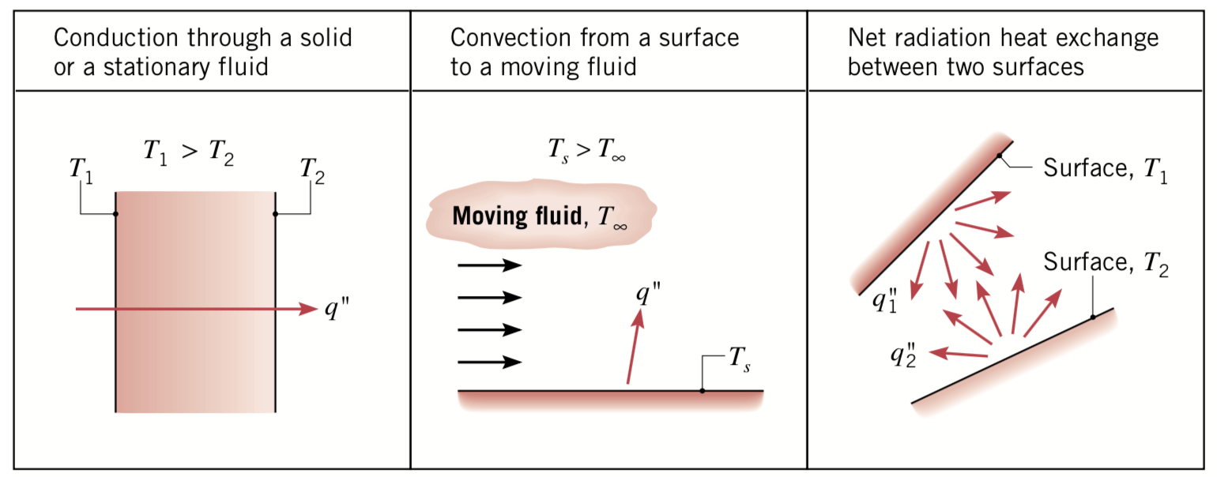
Heat Transfer: modes
Refs:
Incropera, Dewitt, Bergman, Lavine
Cengel & Ghajar
Heat: energy in transit due to a temperature difference

Slide 16
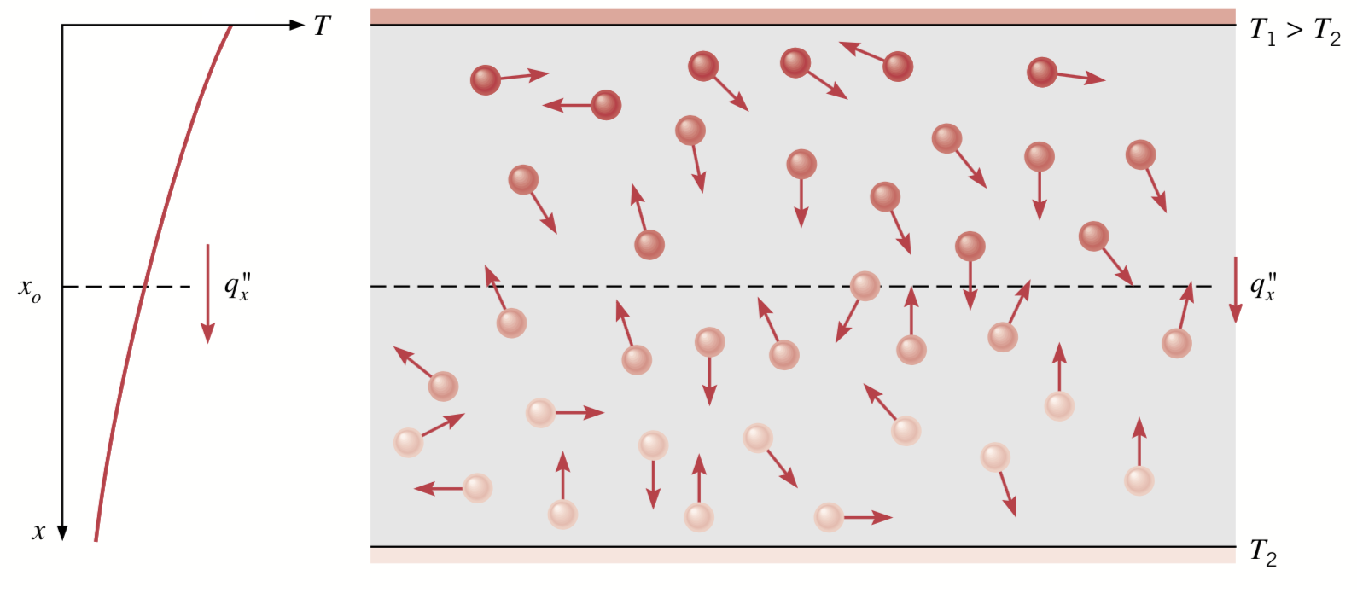
Conduction
Refs:
Incropera, Dewitt, Bergman, Lavine
Cengel & Ghajar
the transfer of energy from the more energetic to the less energetic particles of a substance due to interactions between the particles

Slide 17
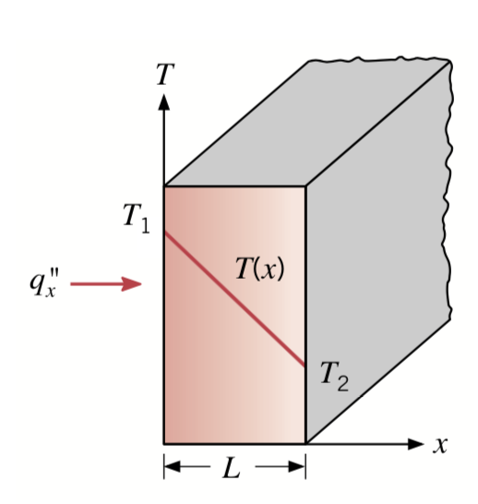
Refs:
Incropera, Dewitt, Bergman, Lavine
Cengel & Ghajar
Conduction: Fourier’s Law
Fourier’s Law:

Slide 18
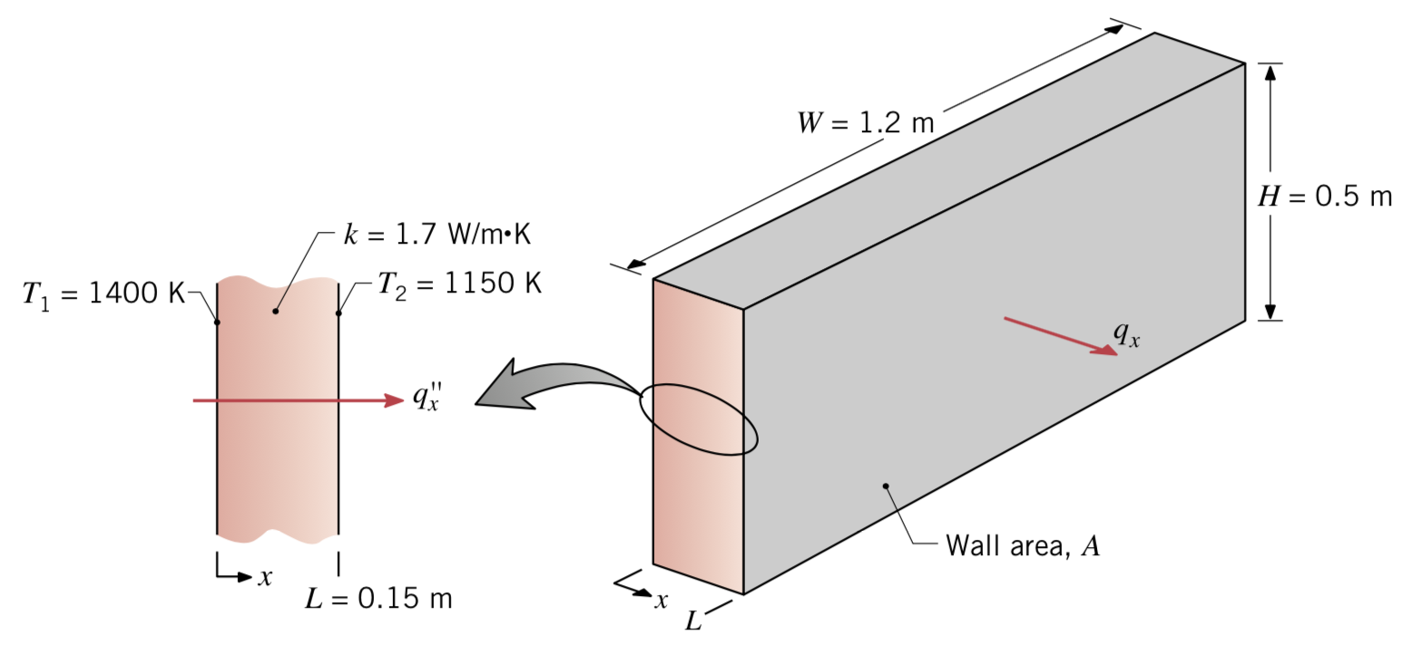
Conduction: Example
Example: The wall of an industrial furnace is constructed from 0.15-m-thick fireclay brick having a thermal conductivity of 1.7 W/mK. Measurements made during steady-state operation reveal temperatures of 1400 and 1150 K at the inner and outer surfaces, respectively. What is the rate of heat loss through a wall that is 0.5 m by 1.2 m on a side?
Schematic:
Refs:
Incropera, Dewitt, Bergman, Lavine
Cengel & Ghajar

Slide 19
Conduction: Example
Known: Wall thickness, area, surface temperatures, and material thermal conductivity
Unknown: Heat loss through wall, i.e.,
Assumptions:
  Steady-state conditions
  One-dimensional heat transfer
  Constant material thermal conductivity
Analysis:
Using Fourier’s law:

Slide 20
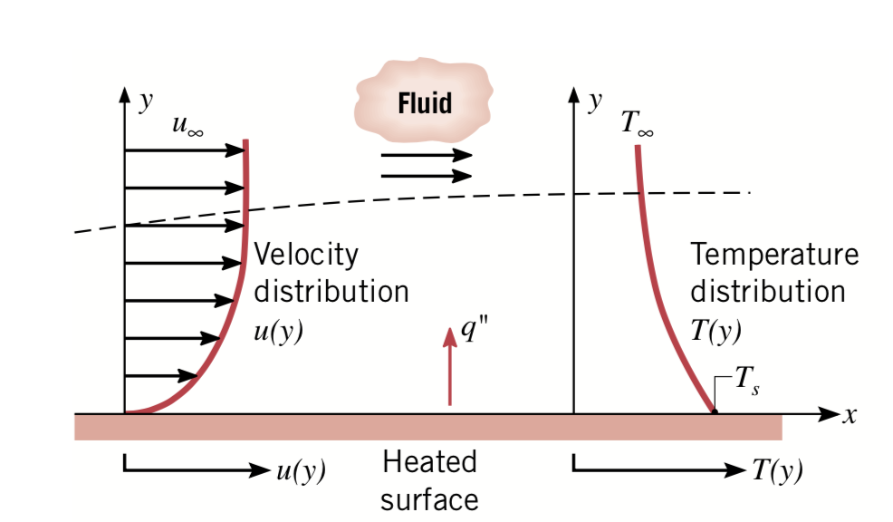
Convection
Diffusion: random molecular motion
Advection: bulk macroscopic motion
Convection: Diffusion + Advection
Close to surface: diffusion only
Refs:
Incropera, Dewitt, Bergman, Lavine
Cengel & Ghajar

Slide 21
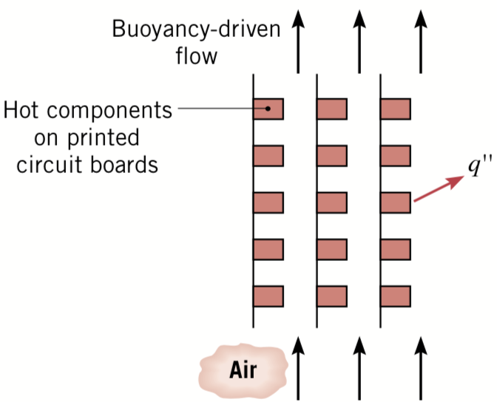
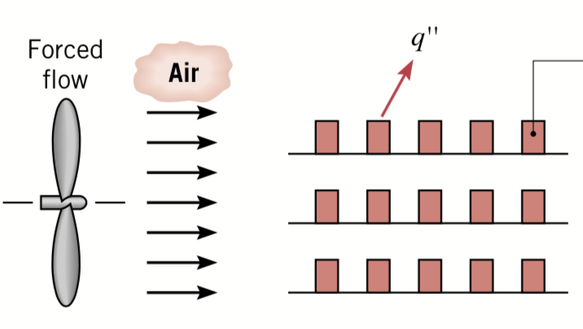
Convection: modes
Natural Convection
Forced Convection
Refs:
Incropera, Dewitt, Bergman, Lavine
Cengel & Ghajar

Slide 22
Convection: Newton’s law of cooling
Refs:
Incropera, Dewitt, Bergman, Lavine
Cengel & Ghajar

Slide 23
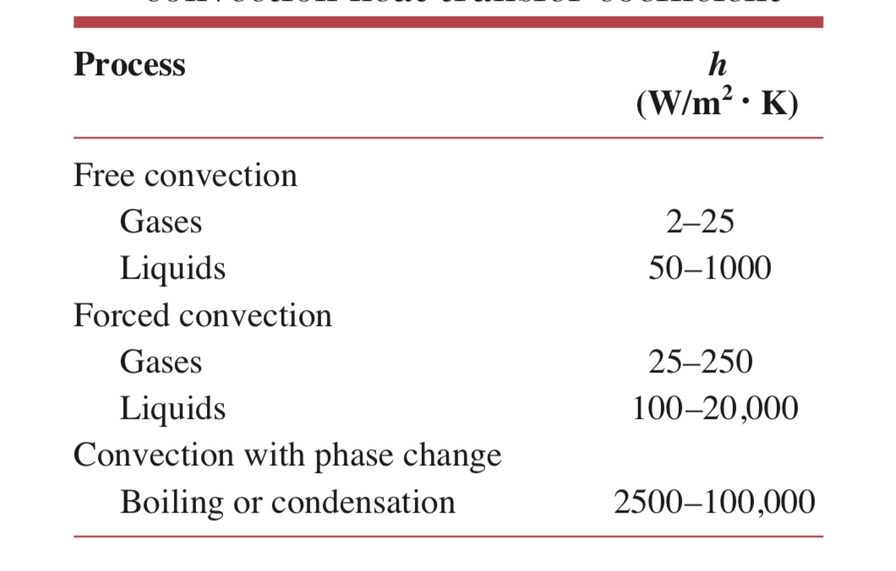
Convection: Convective Heat Transfer Coefficient
Refs:
Incropera, Dewitt, Bergman, Lavine
Cengel & Ghajar

Slide 24
Refs:
Incropera, Dewitt, Bergman, lavine
Cengel & Ghajar
Radiation: Black Surface
All forms of matter emit thermal radiations at non-zero temperature
Energy emitted by these radiations transported as electromagnetic radiations:
photons
No need for a media: vacuum is preferred.
Emissive power, E, rate at which energy is released per unit area
Stefan-Boltzmann’s Law:

Slide 25
Refs:
Incropera, Dewitt, Bergman, lavine
Cengel & Ghajar
Radiation: Real Surface

Slide 26
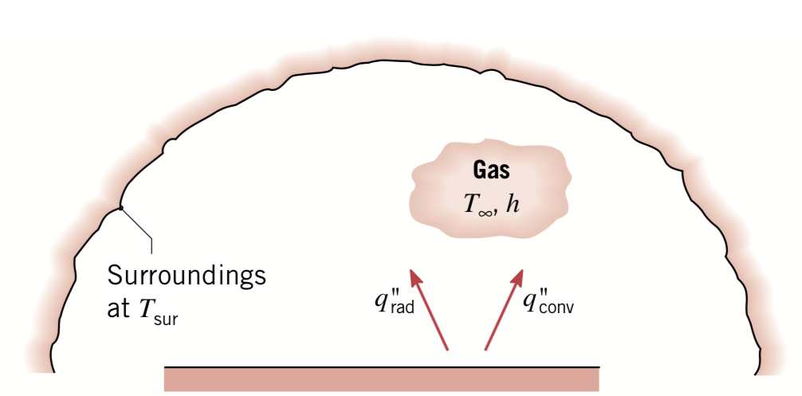
Refs:
Incropera, Dewitt, Bergman, lavine
Cengel & Ghajar
Radiation: Net Heat Exchange with Surrounding
Net rate of radiation heat transfer from the surface:

Slide 27
fraction of radiations leaving surface and striking surface (geometrical)
Under steady-state:
Both and are geometrical properties, independent of and other thermal conditions
for all conditions [reciprocity relation]

Slide 28
Refs:
Incropera, Dewitt, Bergman, lavine
Cengel & Ghajar
Summary
Mode | Mechanism | Rate Equation
Conduction | Diffusion of energy due to random molecular motion
Convection | Diffusion of energy due to random molecular motion plus energy transfer due to bulk motion
Radiation | Energy transfer by electromagnetic waves

Slide 29
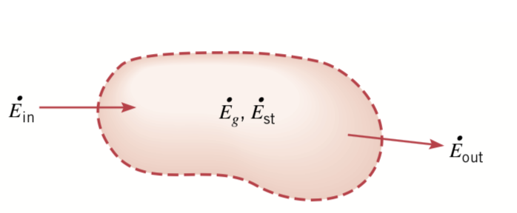
Energy Conservation
Refs:
Incropera, Dewitt, Bergman, lavine
Cengel & Ghajar
Mechanical energy is often small compared to thermal energy and is neglected
→ → (no phase change) →

Slide 30
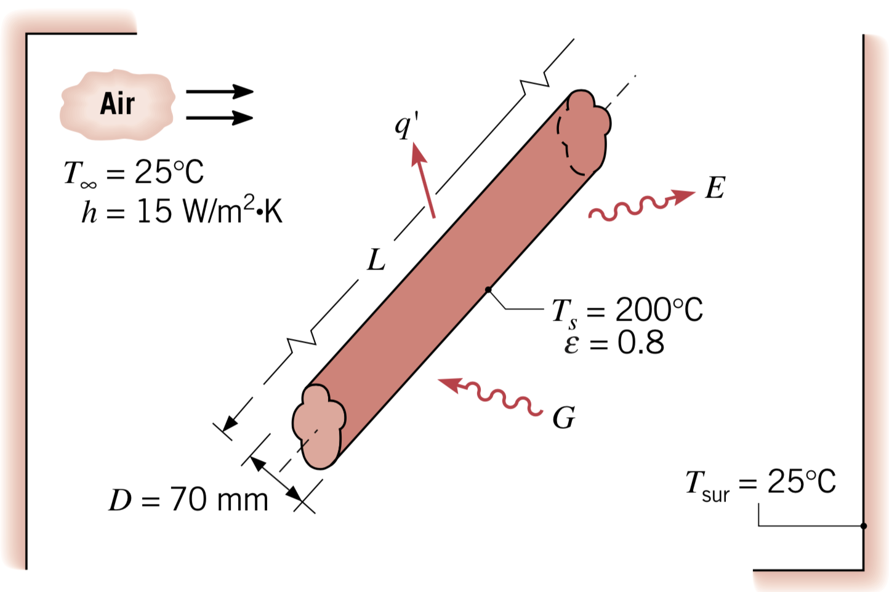
Refs:
Incropera, Dewitt, Bergman, lavine
Cengel & Ghajar
Radiation: Example
Problem: An uninsulated steam pipe passes through a room in which the air and walls are at 25°C. The outside diameter of the pipe is 70 mm, and its surface temperature and emissivity are 200°C and 0.8, respectively. If the coefficient associated with free convection heat transfer from the surface to the air is 15 W/m2.K, what is the rate of heat loss from the surface per unit length of pipe?
Schematic:

Slide 31
Radiation: Example
Known: pipe diameter, emissivity, convective heat transfer coefficient, pipe, air, and
wall temperatures
Unknown:
  Heat loss per unit length from pipe
Assumptions:
  Steady-state conditions

Slide 32
Radiation: Example
Analysis:
Heat loss from pipe (per unit length) is due to convective and radiative losses:

Slide 33
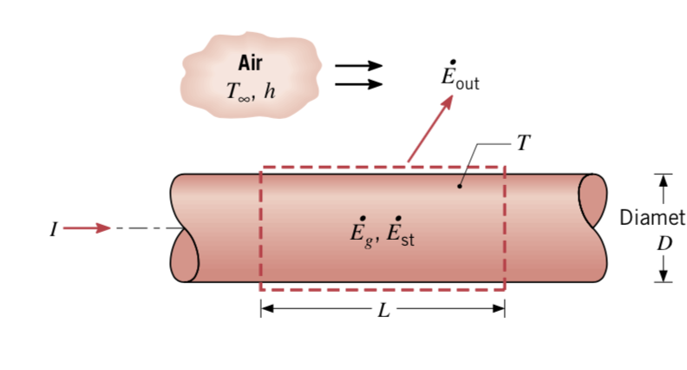
Energy Conservation: example
Refs:
Incropera, Dewitt, Bergman, lavine
Cengel & Ghajar
Problem: A long conducting rod of diameter and electrical resistance per unit length is initially in thermal equilibrium with the ambient air. This equilibrium is disturbed when an electrical current is passed through the rod. Develop an equation that could be used to compute the variation of the rod temperature with time during passage of the current.
Schematic:

Slide 34
Energy Conservation: example
Known: Rod dimensions, ambient conditions, rod electrical-resistance
Unknown: Temperature change of rod with time
Assumptions:
  uniform heat generation
  temperature of rod is uniform at any time t
Analysis:

Slide 35
© Ankit Jain
All rights reserved.
You may not make copies or disseminate this material in any form without my express permission.

