Slide 1
ME 346: Heat Transfer
Lecture: Conduction-Introduction
Date: 3 Aug
Instructor: Ankit Jain

Slide 2
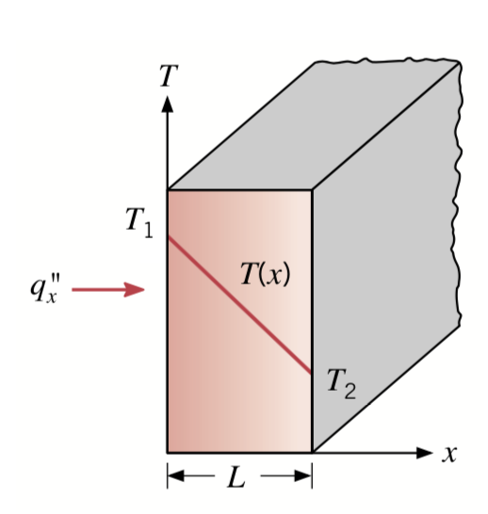
Recap from Previous Lecture
Refs:
Incropera, Dewitt, Bergman, lavine
Cengel & Ghajar
Transport of energy due to temperature gradient in material
Due to random atomic/molecular motion
Fourier’s law: phenomenological [cannot be derived; from observations]

Slide 3
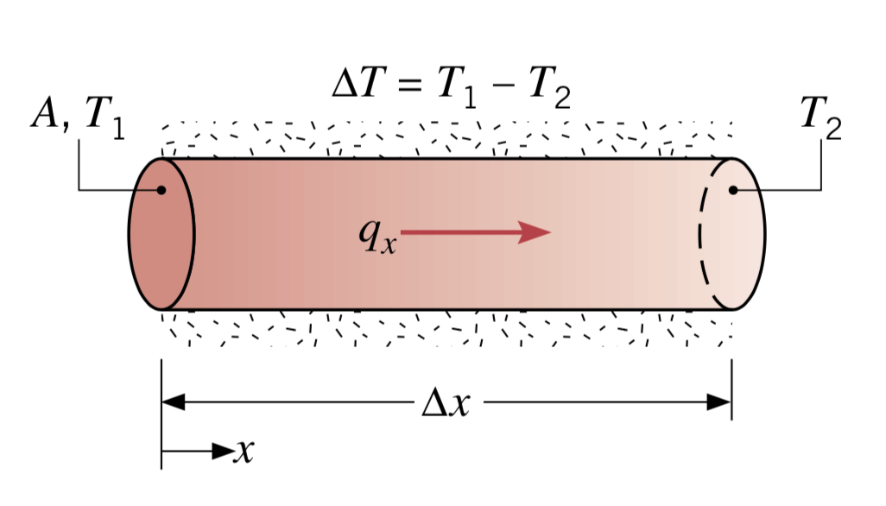
Fourier Law: From Observations
Refs:
Incropera, Dewitt, Bergman, lavine
Cengel & Ghajar
because heat-flows in the direction of decreasing temperature

Slide 4
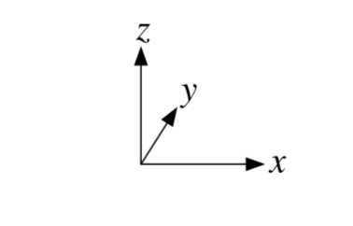
Fourier Law: Generalized Form
Refs:
Incropera, Dewitt, Bergman, lavine
Cengel & Ghajar
T is a temperature field: T(x,y,z)
gradient operator
Cartesian Coordinates:
Isotropic material:

Slide 5
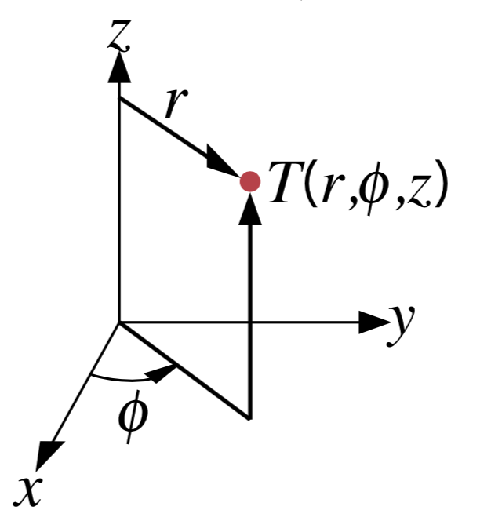
Fourier Law: Generalized Form
Refs:
Incropera, Dewitt, Bergman, lavine
Cengel & Ghajar
T is a temperature field: T(x,y,z)
gradient operator
Cylindrical Coordinates:

Slide 6
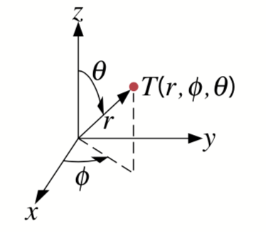
Fourier Law: Generalized Form
Refs:
Incropera, Dewitt, Bergman, lavine
Cengel & Ghajar
T is a temperature field: T(x,y,z)
gradient operator
Spherical Coordinates:

Slide 7
Thermal Conductivity
Thermal Conductivity: Measure of how fast heat will flow in a material
Isotropic Material:

Slide 8
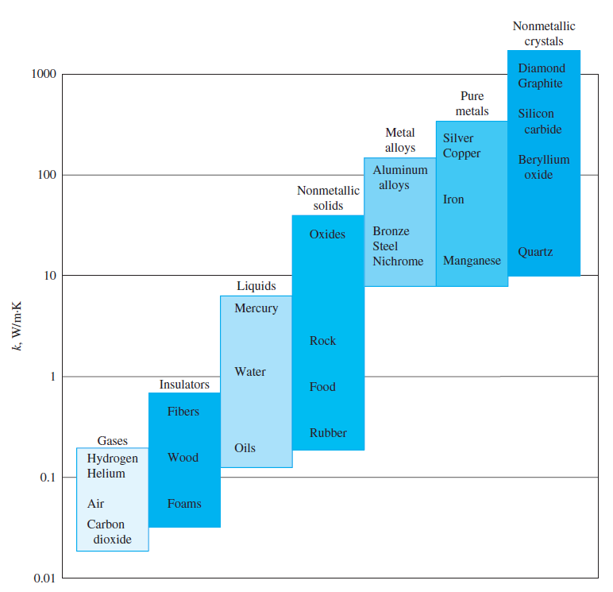
Thermal Conductivity: Solids
Refs:
Incropera, Dewitt, Bergman, lavine
Cengel & Ghajar
Solids:
electronic contribution (metals/semi-metals)
lattice/atomic-vibrations (phonons) contribution
heat capacity
mean velocity
mean free path

Slide 9
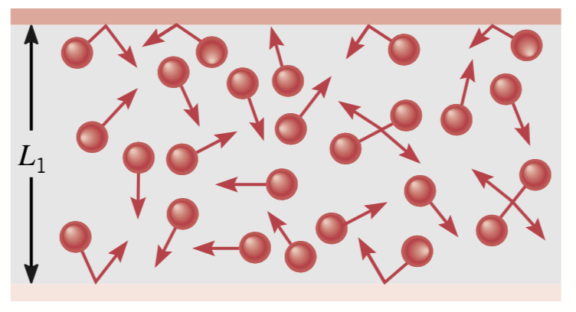
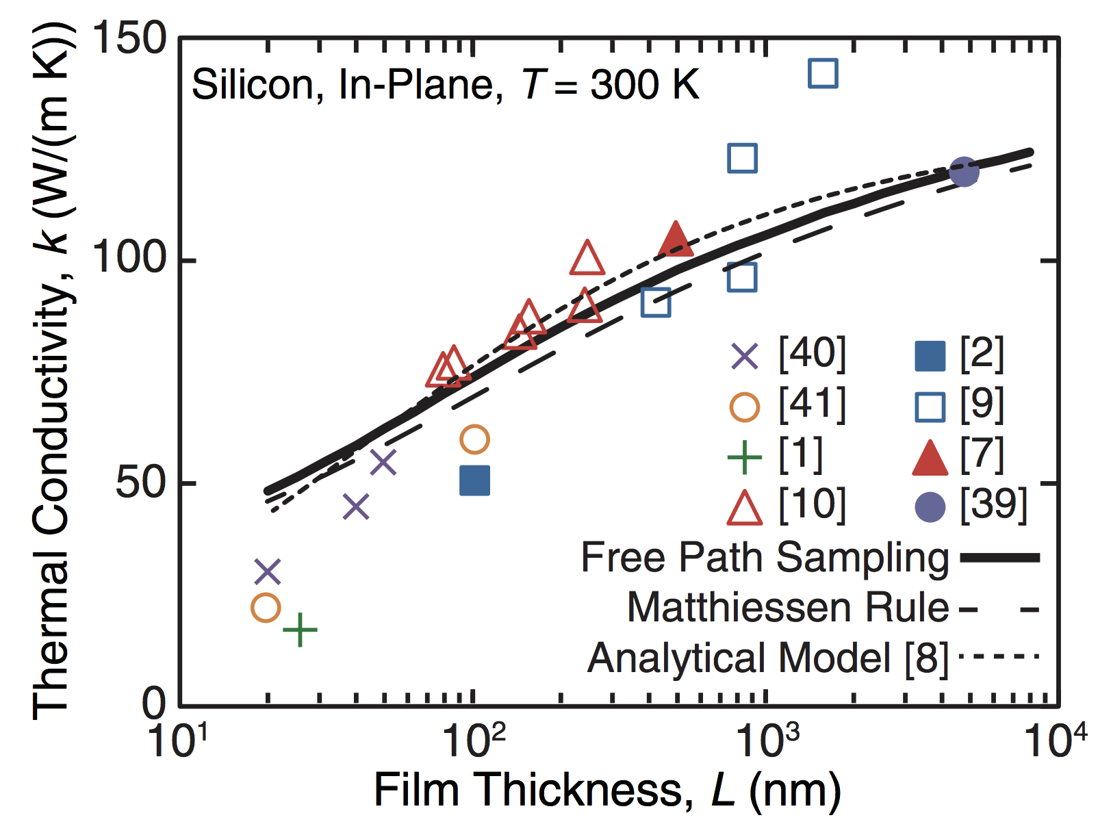
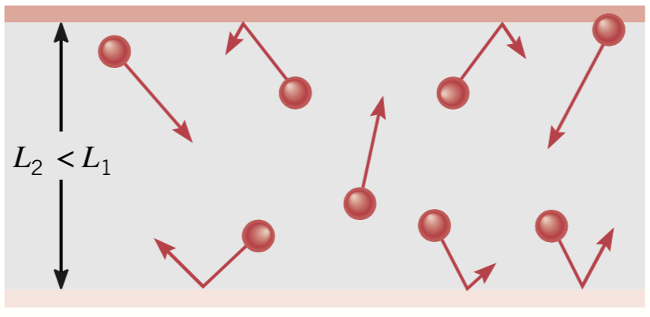
Thermal Conductivity: Solids-Boundary Effects
Jain, Yu, and McGaughey, PRB 87 195301 (2013)
Refs:
Incropera, Dewitt, Bergman, lavine
Cengel & Ghajar

Slide 10
Thermal Conductivity: Fluids and Insulating Systems
Fluids:
Large interatomic spacing than solid inefficient heat transfer compared to solid
Insulating Systems:
  Composites with voids (often with reflecting coatings)
  Voids often evacuated to reduce the conduction part
  Thermal k depends on pressure and can reach as little as 0.004 W/mK.

Slide 11
Other Thermal Properties
specific heat capacity, ()
density, ()
Volumetric heat capacity [, : ability of material to store thermal energy
Thermal Diffusivity:
[],
ability of material to conduct thermal energy relative to its ability to store thermal energy.

Slide 12
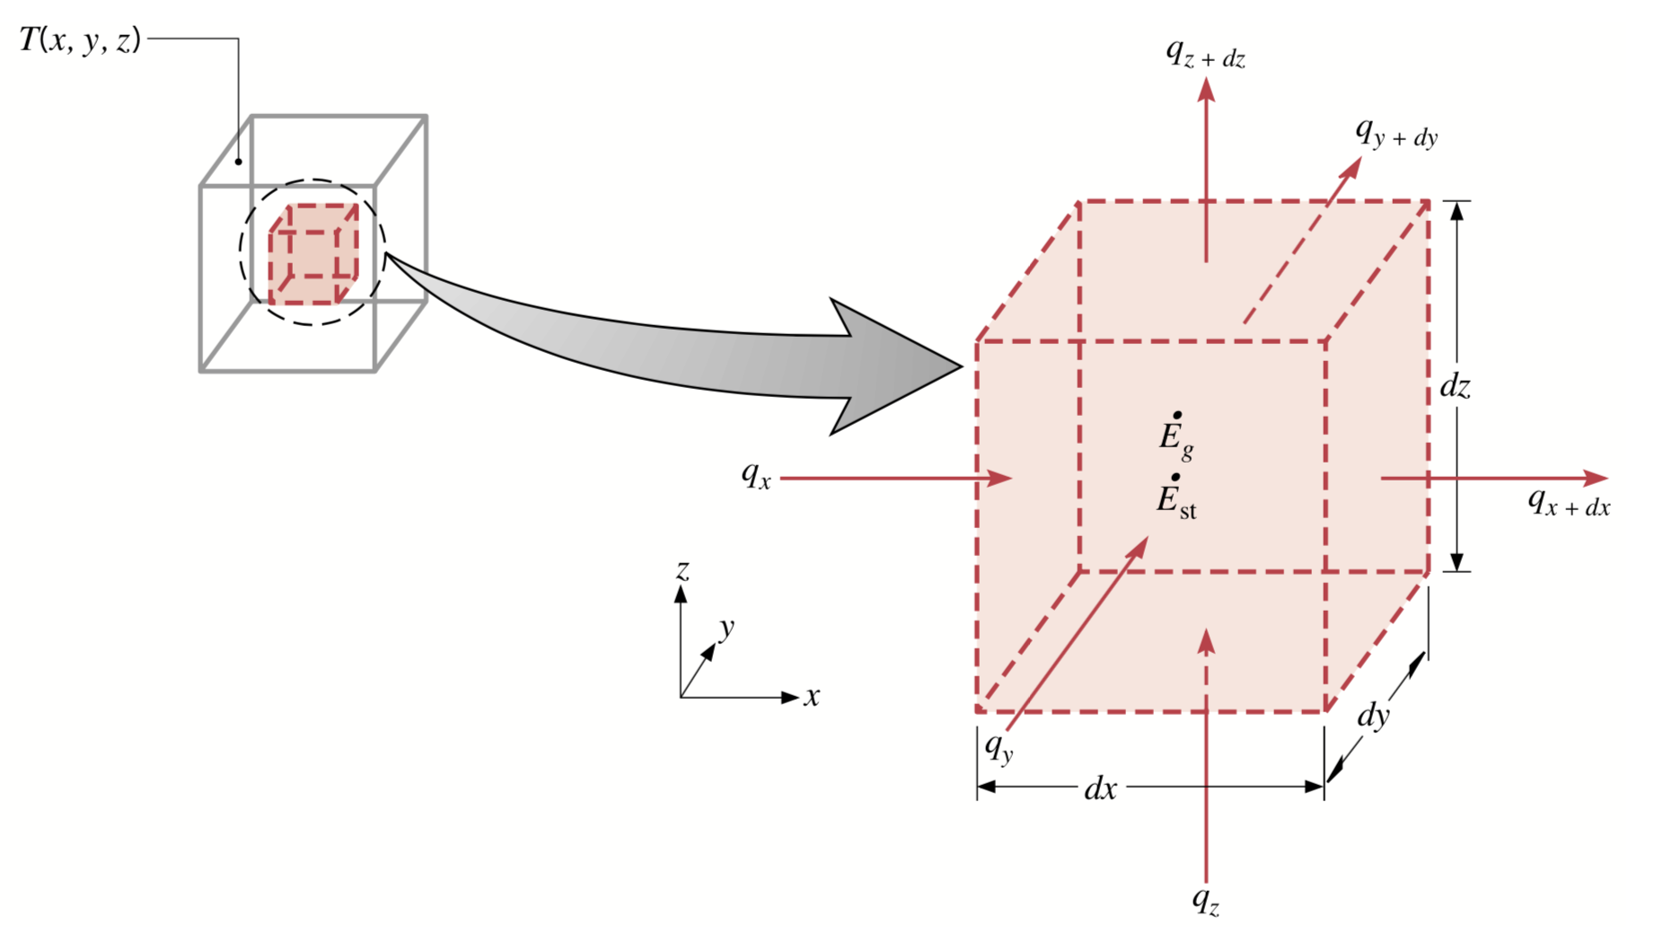
Heat Diffusion Equation
Refs:
Incropera, Dewitt, Bergman, lavine
Cengel & Ghajar
Given initial and boundary conditions, identify temperature distribution inside the material domain
  determine structural integrity under thermal stress, expansion, etc.
  determine the material thickness for insulating materials
Consider:
Homogenous medium
No-bulk motion
Temperature distribution
Differential volume

Slide 13
Heat Diffusion Equation
Refs:
Incropera, Dewitt, Bergman, lavine
Cengel & Ghajar
Heat flux perpendicular to faces , ,
Heat fluxes on the opposite surfaces [using Taylor series]:
Net rate at which heat is entering the control volume:

Slide 14
Heat Diffusion Equation
Refs:
Incropera, Dewitt, Bergman, lavine
Cengel & Ghajar
Energy Balance for control volume for time :
volumetric energy generation rate

Slide 15
Heat Diffusion Equation
Refs:
Incropera, Dewitt, Bergman, lavine
Cengel & Ghajar
Using Fourier’s law:

Slide 16
Heat Diffusion Equation
Special Cases:
Constant
Steady-state:
Steady-state, no-heat generation, one-dimensional conduction:

Slide 17
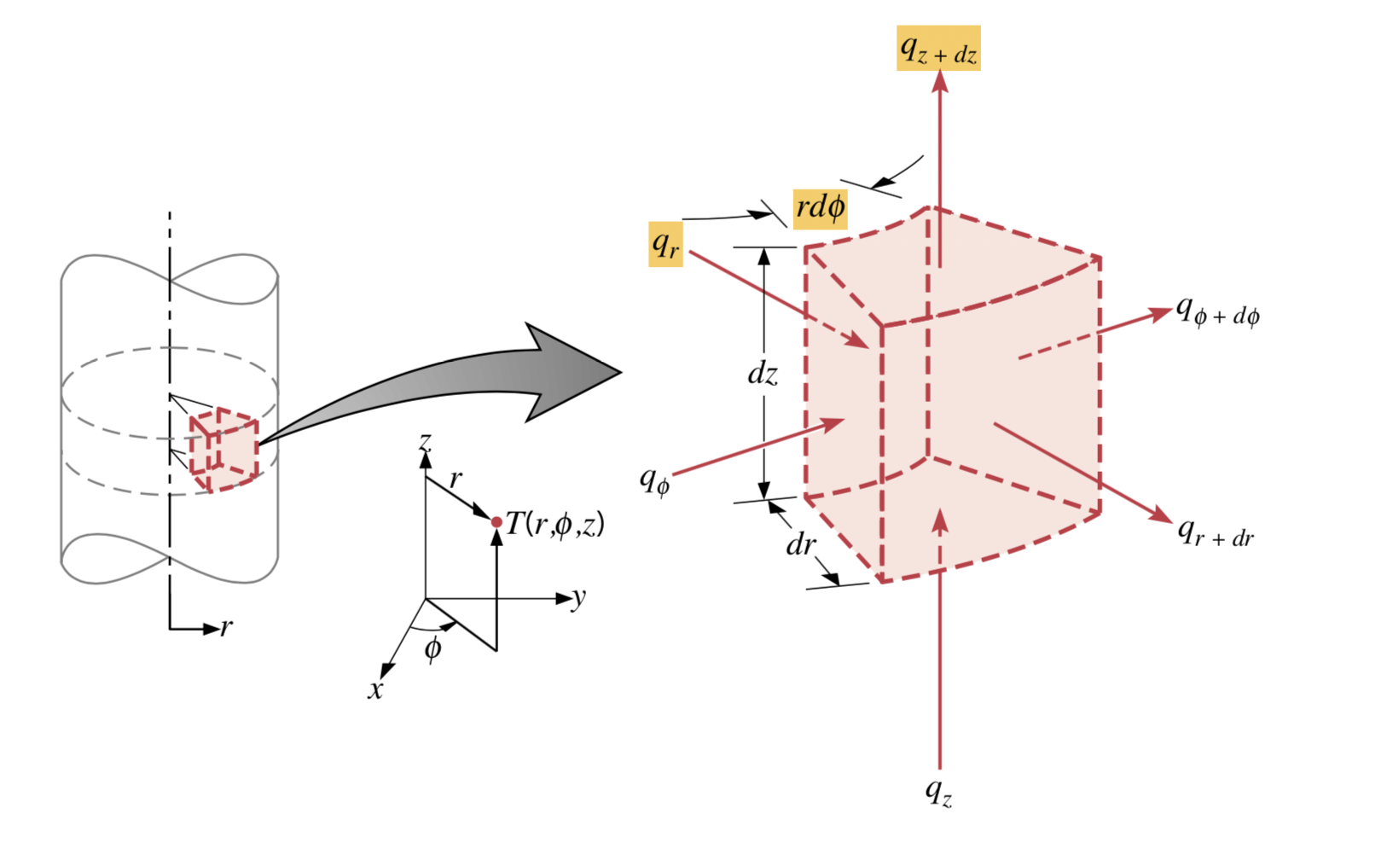
Heat Diffusion Equation: Cylindrical Coordinates
Refs:
Incropera, Dewitt, Bergman, lavine
Cengel & Ghajar
Consider:
Homogenous medium
No-bulk motion
Temperature distribution
Differential volume
Heat entering on the opposite surfaces [using Taylor series]:
Net rate at which heat is entering the control volume:
ME 346: Heat Transfer, Ankit Jain

Slide 18
Heat Diffusion Equation: Cylindrical Coordinates
Refs:
Incropera, Dewitt, Bergman, lavine
Cengel & Ghajar
Energy Balance for control volume for time :
ME 346: Heat Transfer, Ankit Jain

Slide 19
Heat Diffusion Equation: Cylindrical Coordinates
Refs:
Incropera, Dewitt, Bergman, lavine
Cengel & Ghajar
Using Fourier’s law:
ME 346: Heat Transfer, Ankit Jain

Slide 20
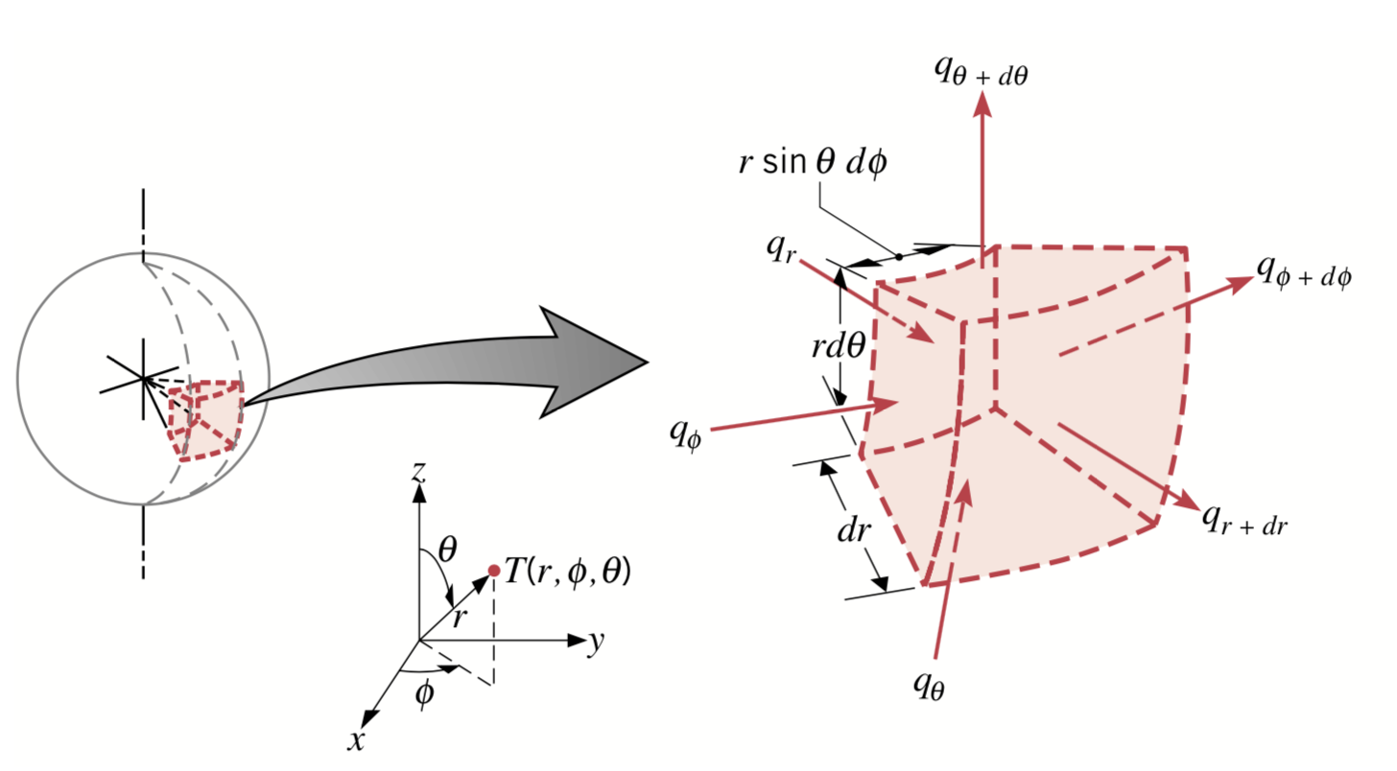
Heat Diffusion Equation: Spherical Coordinates
Refs:
Incropera, Dewitt, Bergman, lavine
Cengel & Ghajar
ME 346: Heat Transfer, Ankit Jain

Slide 21
Boundary Conditions
Second order in spatial coordinates two boundary conditions for each spatial coordinate
first order in time one boundary condition in time [known as initial condition]

Slide 22
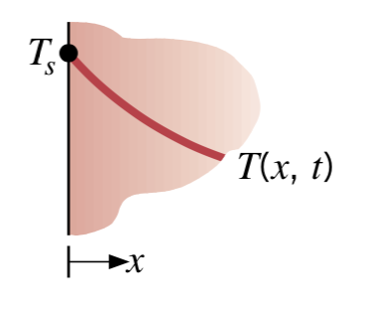
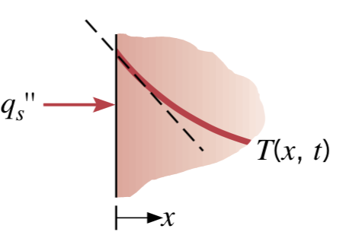
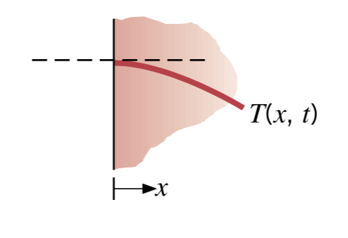
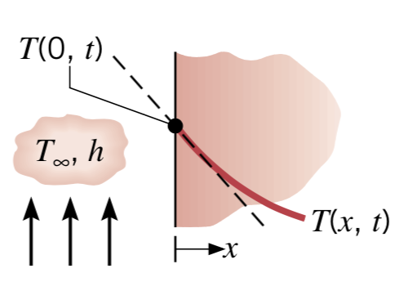
Boundary Conditions
Refs:
Incropera, Dewitt, Bergman, lavine
Cengel & Ghajar
Constant Temperature/ Dirichlet/ Type-I
Constant heat-flux/ Neumann/ Type-II
melting solid/
boiling liquid
bonding with heater
Convection heat flux/ Type-III
Special Case:
adiabatic

Slide 23
Problem: Consider a large plane wall of thickness , thermal conductivity and surface area . The two sides of the wall are maintained at constant temperatures and Determine the variation of temperature within the wall under the steady-state conditions.
Schematic:

Slide 24
Known: Surface temperatures, , wall-thickness.
Unknown: distribution inside the wall
Assumptions:
Constant material properties
One-dimensional heat transport
No heat-generation
Steady-state conditions
Analysis:
Heat Diffusion Equation:

Slide 25
Boundary Conditions:
Q: Could we get to this linear profile without starting with the Diffusion Eqn.?
Q: What if is a function of ?

Slide 26
Q: What if surface are equal but there is a heat generation inside the wall?
Heat Diffusion Equation:
Boundary Conditions:
Q: What about heat flux Could we something about it?
Q: Where is inside the wall?

Slide 27
Q: What if we have a long hollow cylinder without any internal heat generation and surfaces maintained at a constant . Under steady-state, would temperature profile be linear?
For sphere?

Slide 28
© Ankit Jain
All rights reserved.
You may not make copies or disseminate this material in any form without my express permission.

