Slide 1
ME 346: Heat Transfer
Lecture: Conduction-Introduction
Date:
Instructor: Ankit Jain

Slide 2
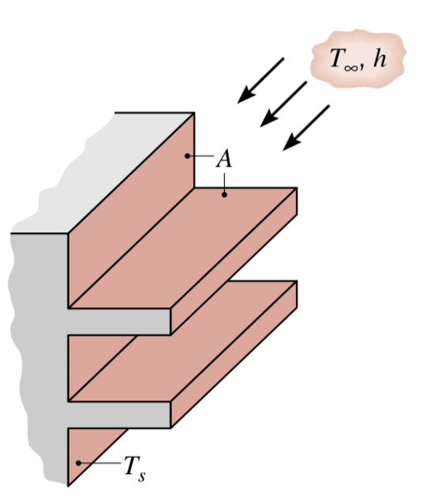
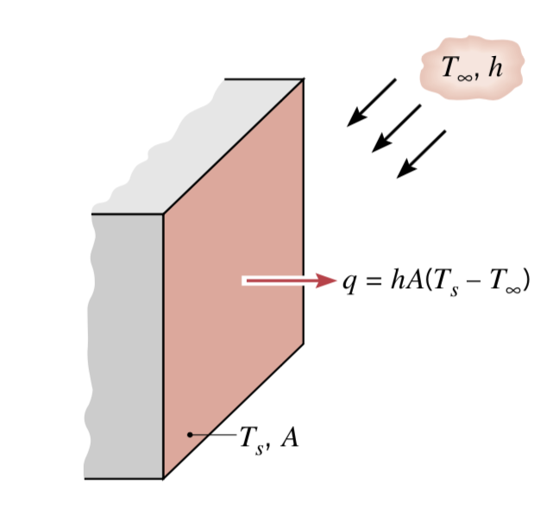

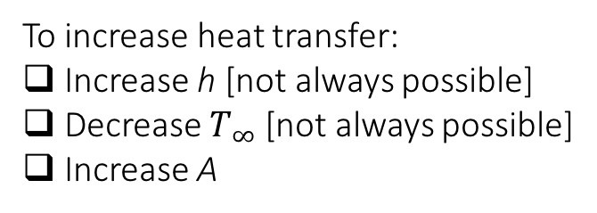
Objective
Refs:
Incropera, Dewitt, Bergman, Lavine
Cengel & Ghajar
Extended Surface: to enhance heat transfer between a solid and an adjoining fluid $→$fin
To increase heat transfer:
Increase h [not always possible]
Decrease $T_{∞}$ [not always possible]
Increase A

Slide 3
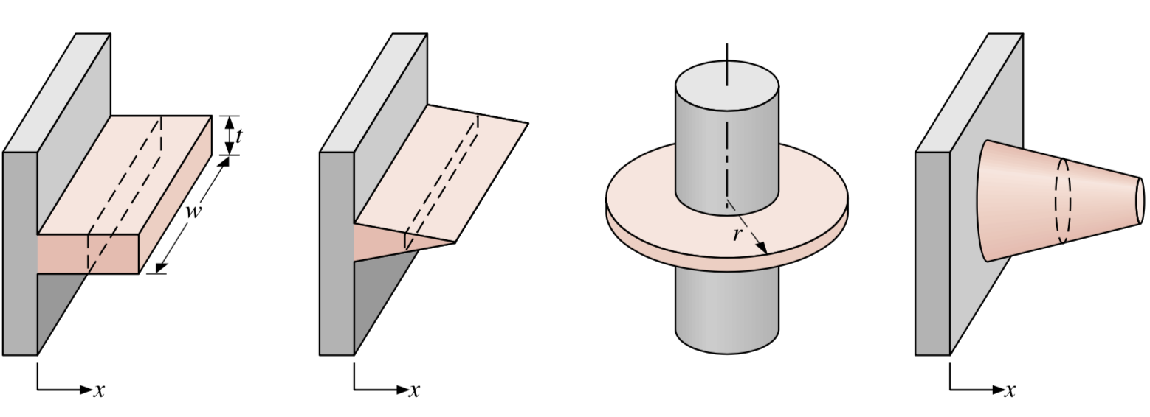
Fin Types:
Straight fin with
const. cross-section
Straight fin with
varying cross-section
Annular fin
Pin fin
Refs:
Incropera, Dewitt, Bergman, Lavine
Cengel & Ghajar

Slide 4
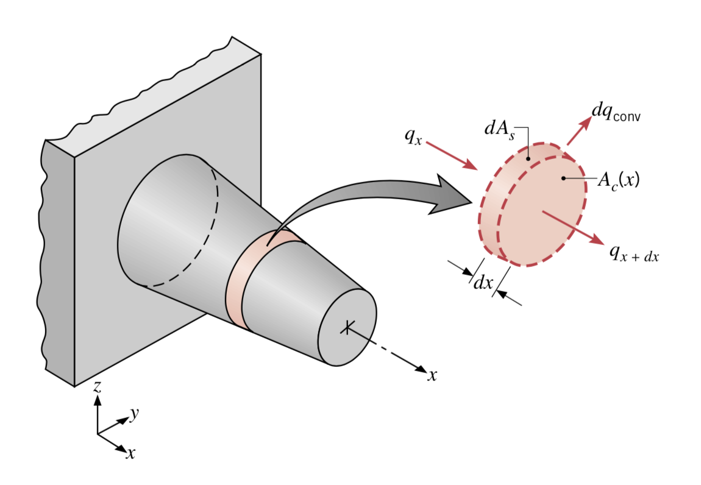
General Considerations:
Assumptions:
one-dimensional heat conduction inside fin
T is only a function of x
steady-state analysis
h is constant across fin
no radiation losses
constant-k
Refs:
Incropera, Dewitt, Bergman, Lavine
Cengel & Ghajar

Slide 5
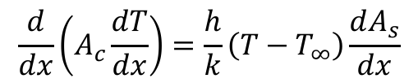
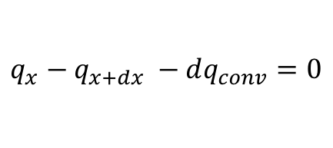

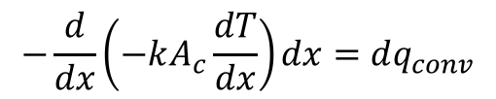

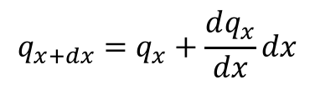
General Considerations:
Refs:
Incropera, Dewitt, Bergman, Lavine
Cengel & Ghajar
Conservation of Energy over a differential element:
$$q_{x}−q_{x+dx} −dq_{conv}=0$$
$$q_{x+dx}=q_{x}+\frac{dq_{x}}{dx}dx$$
$$q_{x}=−kA_{c}\frac{dT}{dx}$$
$$−\frac{d}{dx}\left(−kA_{c}\frac{dT}{dx}\right)dx=dq_{conv}$$
$$dq_{conv}=h(T−T_{∞})dA_{s}$$
$$\frac{d}{dx}\left(A_{c}\frac{dT}{dx}\right)=\frac{h}{k}\left(T−T_{∞}\right)\frac{dA_{s}}{dx}$$

Slide 6
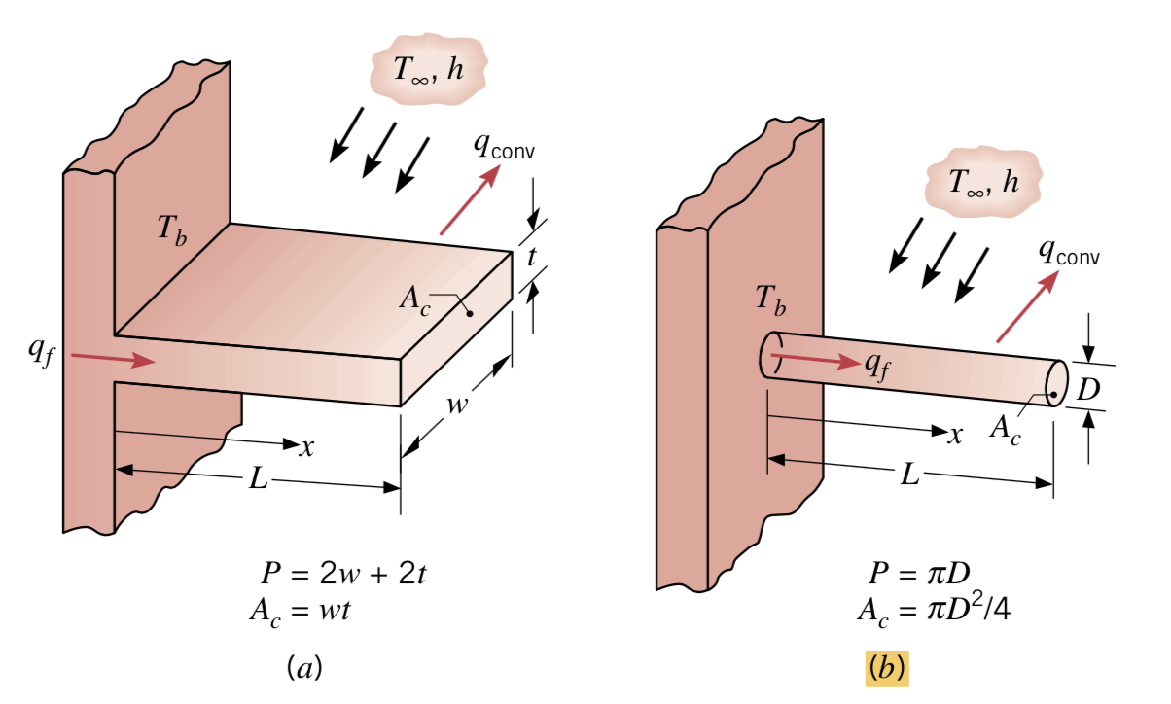
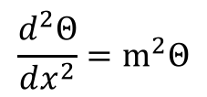

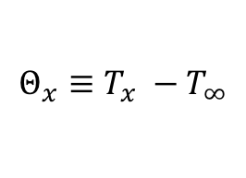
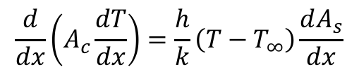
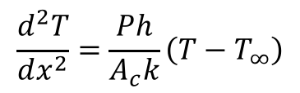
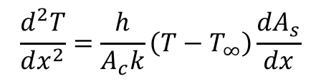
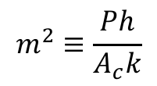
Uniform Cross Section Fin
$$\frac{d}{dx}\left(A_{c}\frac{dT}{dx}\right)=\frac{h}{k}\left(T−T_{∞}\right)\frac{dA_{s}}{dx}$$
$$\frac{d^{2}T}{dx^{2}}=\frac{h}{A_{c}k}\left(T−T_{∞}\right)\frac{dA_{s}}{dx}$$
$${dA}_{s}=Pdx$$
$$\frac{d^{2}T}{dx^{2}}=\frac{Ph}{A_{c}k}\left(T−T_{∞}\right)$$
$$Θ_{x}≡T_{x} −T_{∞}$$
$$\frac{d^{2}Θ}{dx^{2}}=m^{2}Θ$$
$$m^{2}≡\frac{Ph}{A_{c}k}$$
Refs:
Incropera, Dewitt, Bergman, Lavine
Cengel & Ghajar

Slide 7
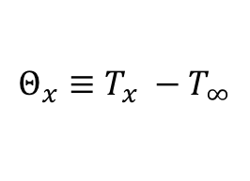

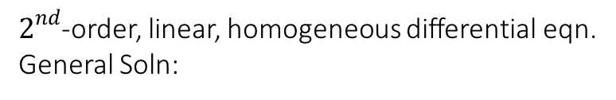
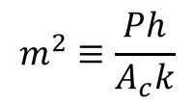
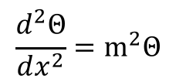
Uniform Cross Section Fin
$$\frac{d^{2}Θ}{dx^{2}}=m^{2}Θ$$
$$m^{2}≡\frac{Ph}{A_{c}k}$$
$$Θ_{x}≡T_{x} −T_{∞}$$
$2^{nd}$-order, linear, homogeneous differential eqn.
General Soln:
$$Θ\left(x\right)=C_{1}e^{mx}+C_{2}e^{−mx}$$
Refs:
Incropera, Dewitt, Bergman, Lavine
Cengel & Ghajar

Slide 8

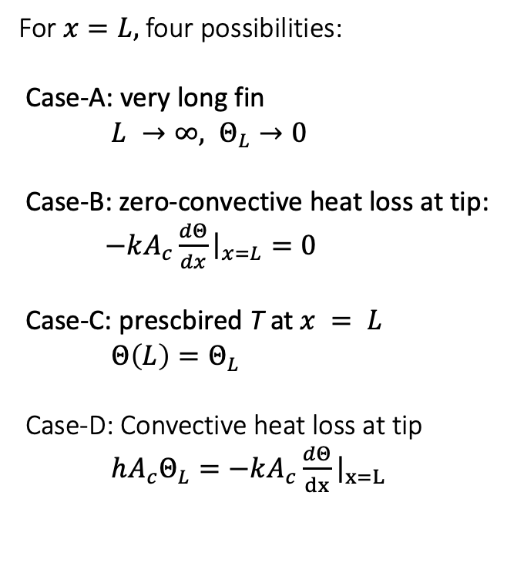
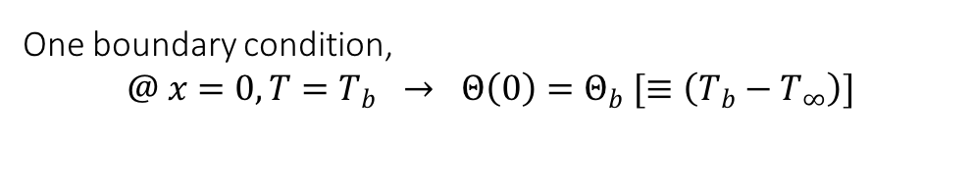
Uniform Cross Section Fin
$$Θ\left(x\right)=C_{1}e^{mx}+C_{2}e^{−mx}$$
One boundary condition,
$$@ x=0, T=T_{b} → Θ\left(0\right)=Θ_{b} [≡\left(T_{b}−T_{∞}\right)]$$
For $x=L,$four possibilities:
Case-A: very long fin
$L →∞, Θ_{L}→0$
Case-B: zero-convective heat loss at tip:
$−kA_{c}\frac{dΘ}{dx}{\left.​\right|}_{x=L}=0$
Case-C: prescbired T at $x = L$
$Θ\left(L\right)=Θ_{L}$
Case-D: Convective heat loss at tip
$hA_{c}Θ_{L}=−kA_{c}\frac{dΘ}{dx}{\left.​\right|}_{x=L}$
Refs:
Incropera, Dewitt, Bergman, Lavine
Cengel & Ghajar

Slide 9
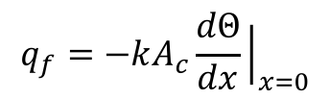
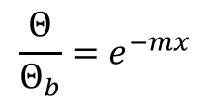
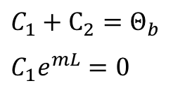
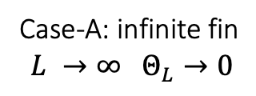
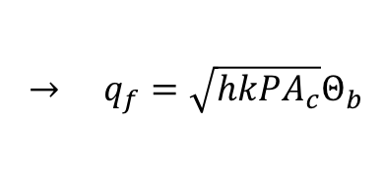
Uniform Cross Section Fin: Case-A
Refs:
Incropera, Dewitt, Bergman, Lavine
Cengel & Ghajar
$$Θ\left(x\right)=C_{1}e^{mx}+C_{2}e^{−mx}$$
One boundary condition,
$$@ x=0, T=T_{b} → Θ\left(0\right)=Θ_{b} [≡\left(T_{b}−T_{∞}\right)]$$
Case-A: infinite fin
$$L →∞ Θ_{L}→0$$
$$C_{1}+C_{2}=Θ_{b}$$
$$C_{1}e^{mL}=0$$
$$\frac{Θ}{Θ_{b}}=e^{−mx}$$
Total heat transferred from the entire-fin:
$$q_{f}=−kA_{c}\frac{dΘ}{dx}{\left.​\right|}_{x=0}$$
$$→ q_{f}=\sqrt{hk{PA}_{c}}Θ_{b}$$

Slide 10
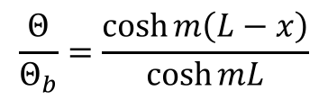
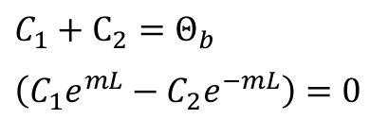
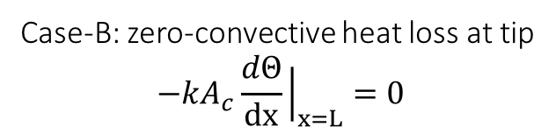
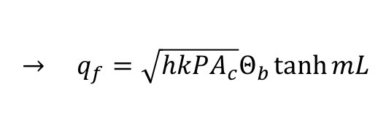
Uniform Cross Section Fin: Case-B
Refs:
Incropera, Dewitt, Bergman, Lavine
Cengel & Ghajar
$$Θ\left(x\right)=C_{1}e^{mx}+C_{2}e^{−mx}$$
One boundary condition,
$$@ x=0, T=T_{b} → Θ\left(0\right)=Θ_{b} [≡\left(T_{b}−T_{∞}\right)]$$
Case-B: zero-convective heat loss at tip
$$−kA_{c}\frac{dΘ}{dx}{\left.​\right|}_{x=L}=0$$
$$C_{1}+C_{2}=Θ_{b}$$
$$\left(C_{1}e^{mL}−C_{2}e^{−mL}\right)=0$$
$$\frac{Θ}{Θ_{b}}=\frac{\cosh{m\left(L−x\right)}}{\cosh{mL}}$$
Total heat transferred from the entire-fin:
$$q_{f}=−kA_{c}\frac{dΘ}{dx}{\left.​\right|}_{x=0}$$
$$→ q_{f}=\sqrt{hk{PA}_{c}}Θ_{b}\tanh{mL}$$

Slide 11
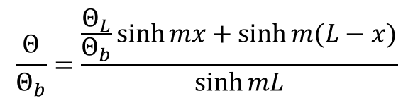
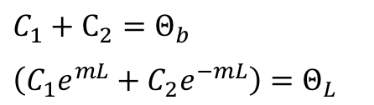
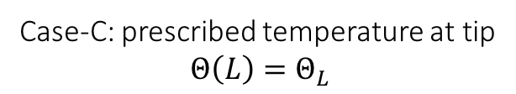
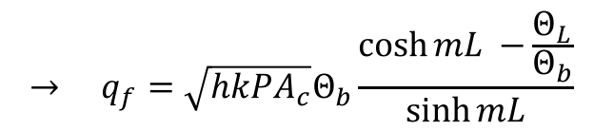
Uniform Cross Section Fin: Case-C
Refs:
Incropera, Dewitt, Bergman, Lavine
Cengel & Ghajar
$$Θ\left(x\right)=C_{1}e^{mx}+C_{2}e^{−mx}$$
One boundary condition,
$$@ x=0, T=T_{b} → Θ\left(0\right)=Θ_{b} [≡\left(T_{b}−T_{∞}\right)]$$
Case-C: prescribed temperature at tip
$$Θ\left(L\right)=Θ_{L}$$
$$C_{1}+C_{2}=Θ_{b}$$
$$\left(C_{1}e^{mL}+C_{2}e^{−mL}\right)=Θ_{L}$$
$$\frac{Θ}{Θ_{b}}=\frac{\frac{Θ_{L}}{Θ_{b}}sinh{mx}+\sinh{m(L−x)}}{\sinh{mL}}$$
Total heat transferred from the entire-fin:
$$→ q_{f}=\sqrt{hk{PA}_{c}}Θ_{b}\frac{\cosh{mL −}\frac{Θ_{L}}{Θ_{b}}}{\sinh{mL}}$$
$$q_{f}=−kA_{c}\frac{dΘ}{dx}{\left.​\right|}_{x=0}$$

Slide 12
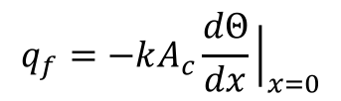
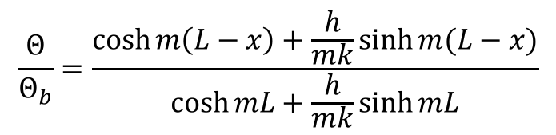
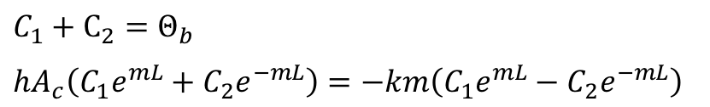
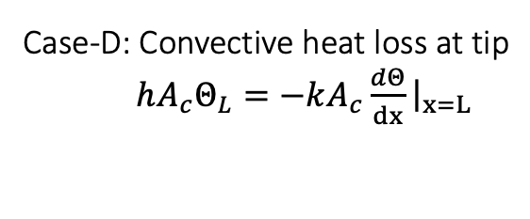
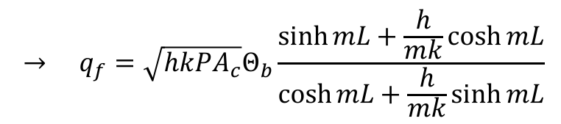
Uniform Cross Section Fin: Case-D
Refs:
Incropera, Dewitt, Bergman, Lavine
Cengel & Ghajar
$$Θ\left(x\right)=C_{1}e^{mx}+C_{2}e^{−mx}$$
One boundary condition,
$$@ x=0, T=T_{b} → Θ\left(0\right)=Θ_{b} [≡\left(T_{b}−T_{∞}\right)]$$
Case-D: Convective heat loss at tip
$hA_{c}Θ_{L}=−kA_{c}\frac{dΘ}{dx}{\left.​\right|}_{x=L}$
$$C_{1}+C_{2}=Θ_{b}$$
$$hA_{c}\left(C_{1}e^{mL}+C_{2}e^{−mL}\right)=−km\left(C_{1}e^{mL}−C_{2}e^{−mL}\right)$$
$$\frac{Θ}{Θ_{b}}=\frac{\cosh{m\left(L−x\right)}+\frac{h}{mk}\sinh{m(L−x)}}{\cosh{mL}+\frac{h}{mk}\sinh{mL}}$$
Total heat transferred from the entire-fin:
$$→ q_{f}=\sqrt{hk{PA}_{c}}Θ_{b}\frac{\sinh{mL}+\frac{h}{mk}\cosh{mL}}{\cosh{mL}+\frac{h}{mk}\sinh{mL}}$$
$$q_{f}=−kA_{c}\frac{dΘ}{dx}{\left.​\right|}_{x=0}$$

Slide 13
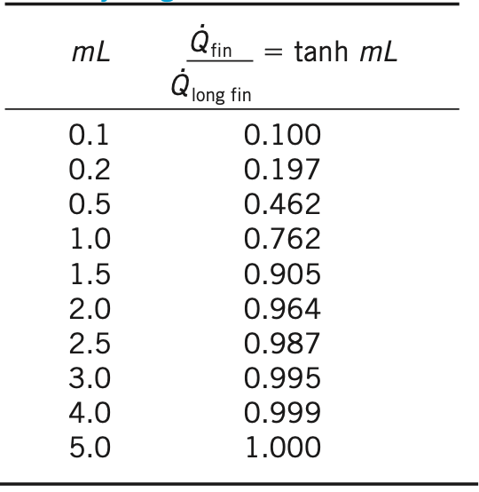



Thoughts:
What should be the length of fin?
$$q_{f}^{inf}=\sqrt{hk{PA}_{c}}Θ_{b}$$
$$q_{f}^{adiabatic}=\sqrt{hk{PA}_{c}}Θ_{b}\tanh{mL}$$
$$\frac{q_{f}^{adiabatic}}{q_{f}^{inf}}=\tanh{mL}$$
Refs:
Incropera, Dewitt, Bergman, Lavine
Cengel & Ghajar

Slide 14
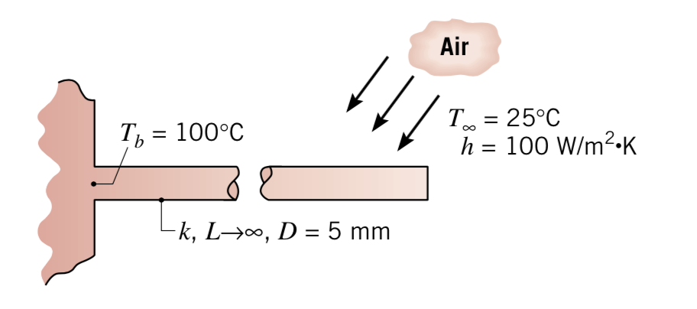
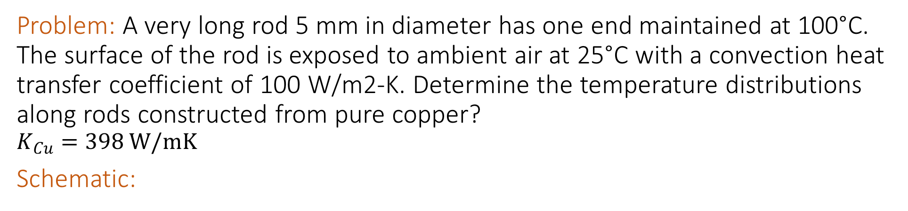
Problem: A very long rod 5 mm in diameter has one end maintained at 100°C. The surface of the rod is exposed to ambient air at 25°C with a convection heat transfer coefficient of 100 W/m2-K. Determine the temperature distributions along rods constructed from pure copper?
$$K_{Cu}=398 W/mK$$
Schematic:
Refs:
Incropera, Dewitt, Bergman, Lavine
Cengel & Ghajar

Slide 15
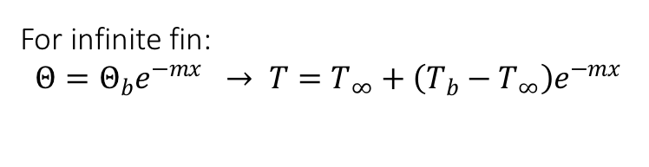
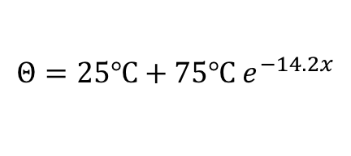
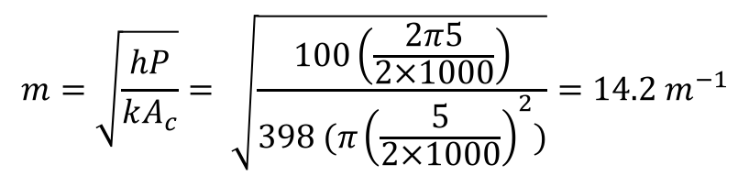
Known: A long circular rod exposed to ambient air
Unknown: Temperature distribution and heat loss from rod?
Assumptions: Steady-state, One-dimensional conduction, constant-k, uniform-h, no radiation losses, very-long rod
Solution:
For infinite fin:
$$Θ=Θ_{b}e^{−mx} → T=T_{∞}+\left(T_{b}−T_{∞}\right)e^{−mx}$$
$$m=\sqrt{\frac{hP}{kA_{c}}}= \sqrt{\frac{100\left(\frac{2π5}{2×1000}\right)}{398 (π{\left(\frac{5}{2×1000}\right)}^{2})}}=14.2 m^{−1}$$
$q_{f}= \sqrt{hpkA_{c}}Θ_{b}=\sqrt{100\left(\frac{2π5}{2×1000}\right)398 (π{\left(\frac{5}{2×1000}\right)}^{2})} 75=8.3 W$
$$Θ=25℃+75℃ e^{−14.2x}$$
Refs:
Incropera, Dewitt, Bergman, Lavine
Cengel & Ghajar

Slide 16
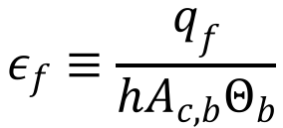
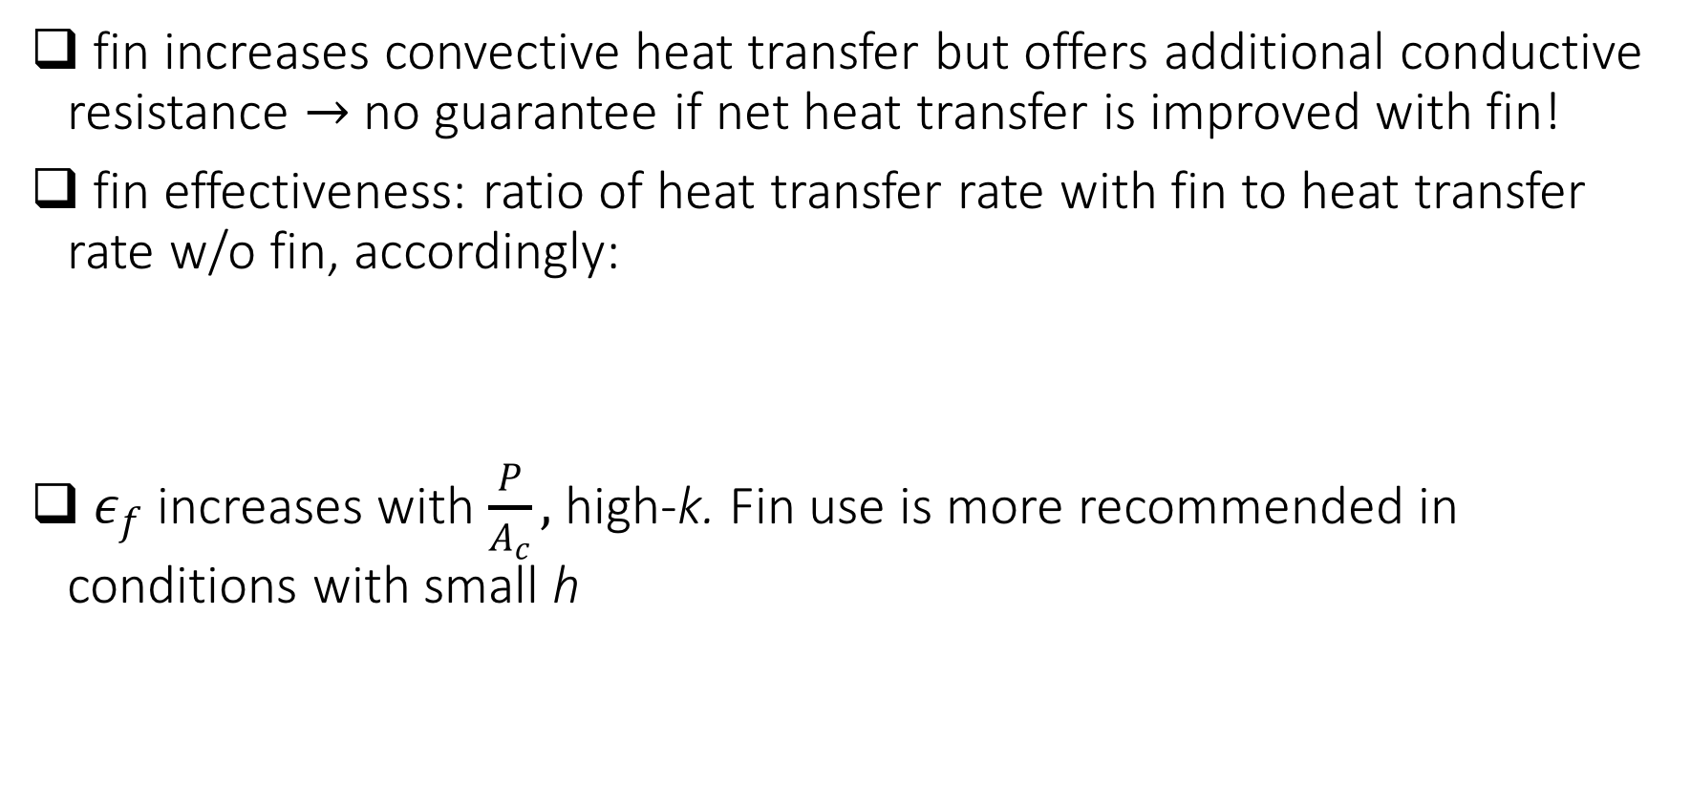

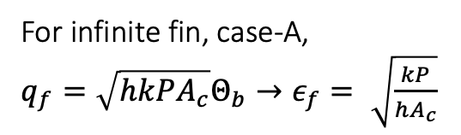
Fin Performance
Refs:
Incropera, Dewitt, Bergman, Lavine
Cengel & Ghajar
fin increases convective heat transfer but offers additional conductive resistance $→$no guarantee if net heat transfer is improved with fin!
fin effectiveness: ratio of heat transfer rate with fin to heat transfer rate w/o fin, accordingly:
$ε_{f}$ increases with $\frac{P}{A_{c}},$ high-k. Fin use is more recommended in conditions with small h
For infinite fin, case-A,
$q_{f}=\sqrt{hk{PA}_{c}}Θ_{b}→ε_{f}= \sqrt{\frac{kP}{hA_{c}}}$
$$ε_{f}≡\frac{q_{f}}{hA_{c,b}Θ_{b}}$$
Question: When is more recommended? Gas vs Liquid? Free vs forced convection?
Fin resistance, $R_{f}≡Θ_{b}/q_{f}$

Slide 17





Fin Performance
Refs:
Incropera, Dewitt, Bergman, Lavine
Cengel & Ghajar
fin efficiency: ratio of heat transfer rate with fin to maximum heat transfer possible through fin (with 0 conduction resistance of fin), accordingly:
Results of adiabatic-tip can be used for convective tip with corrected lengths:
$${ L}_{c}=L+t/2 \left(rectangular fin\right)$$
$${ L}_{c}=L+r/2 (pin fin)$$
$$η_{f}≡\frac{q_{f}}{hA_{f}Θ_{b}}$$
For very-long fin, case-A,
$q_{f}=\sqrt{hk{PA}_{c}}Θ_{b}→η_{f}=\frac{1}{L}\sqrt{\frac{kA_{c}}{hP}}=\frac{1}{mL}$
$$A_{f}=PL$$
For adiabatic fin-tip, case-B,
$$q_{f}=\sqrt{hk{PA}_{c}}Θ_{b}\tanh{mL}→η_{f}=\frac{\tanh{mL}}{mL}$$
$η_{f}$ decreases with increasing $L.$Typically $η_{f}≥90\%$

Slide 18


Refs:
Incropera, Dewitt, Bergman, Lavine
Cengel & Ghajar

Slide 19

Problem: A 15-cm x 20-cm integrated circuit board is to be cooled by attaching 4-cm- long aluminum (k = 237 W/m∙K) fins on one side of it. Each fin has a 2-mm x 2-mm square cross section. The surrounding ambient temperature is 25°C and the convection heat transfer coefficient on each fin surface is 20 W/m2∙K. To prevent the circuit board from overheating, the upper surface of the circuit board needs to be at 85°C or cooler. Design a finned surface having the appropriate number of fins, with an overall effectiveness of 3 that can keep the circuit board surface from overheating.
Schematic:

Slide 20

Known: Fin geometry, base, ambient conditions and heat transfer coefficients
Unknown: Number of fins needed to maintain the base surface $T<T_{critical}$.
Assumptions:
Steady-state operating conditions
One-dimensional heat conduction
Negligible radiation heat transfer
Uniform $h$
Constant thermal properties
Negligible heat transfer from fin tip
Analysis:

Slide 21













$$Heat transfer will take place both from finned and unfinned surface:$$
$$For N fins:$$
$$q_{finned}=N η q_{fin}^{ideal}$$
$$=Nη{hA}_{fin}θ_{b}$$
$$=NηhLPθ_{b}$$
$$A_{fin}=LP$$
$$q_{unfinned}={h(A}_{Total}−{NA}_{c})θ_{b}$$
$$q_{no−fin}=hA_{Total}θ_{b}$$
$$Effectiveness, ε=\frac{q_{fin}}{q_{no−fin}}$$
$$=\frac{NηhLPθ_{b}+{h(A}_{Total}−{NA}_{c})θ_{b}}{hA_{Total}θ_{b}}$$
$$= \frac{NηLP+{(A}_{Total}−{NA}_{c}) }{A_{Total}}$$
$$=Nη\frac{LP}{A_{Total}}+\left(1−N\frac{A_{c}}{A_{Total}}\right)$$
$$=1+ N\frac{1}{A_{Total}}\left(ηLP−A_{c}\right)$$
$$→ N=\frac{ε−1}{ηLP−A_{c}}A_{Total}$$

Slide 22





$$N=\frac{ε−1}{ηLP−A_{c}}A_{Total}$$
$$Fin is with constant cross−sectional area with adiabiatic tip$$
$$→η=\frac{\tanh{mL}}{mL}$$
$$=\frac{\tanh\left(13 \left[m^{−1}\right]×4 \left[cm\right]\right)}{13 \left[m^{−1}\right]×4 \left[cm\right]}=0.92$$
$$m=\sqrt{\frac{hP}{kA_{c}}}=\sqrt{\frac{20 \left[\frac{W}{m^{2}K}\right] 4×2 [mm]}{237 \left[\frac{W}{mK}\right] × 4 [mm^{2}]}}=13 \left[m^{−1}\right]$$
$$N=\frac{(3−1)}{0.92×0.04 \left[m\right]×\left(4×0.002\right)\left[m\right]−0.002×0.002 [m^{2}]} × 0.15×0.20 \left[m^{2}\right]$$
$$=206.7$$
$$=207$$

Slide 23
Problem: A metal rod of length 2L, diameter D, and thermal conductivity k is inserted into a insulating wall, exposing one-half of its length to an air stream with convectrive heat transfer coefficient of h. A volumetric energy generation at a uniform rate is occuring within the mebedded portion of the rod. Determine the steady-state temperature at the end of the embedded half of the rod.
Schematic:

Slide 24

Problem: A metal rod of length 2L, diameter D, and thermal conductivity k is inserted into a insulating wall, exposing one-half of its length to an air stream with convectrive heat transfer coefficient of h. A volumetric energy generation at a uniform rate is occuring within the mebedded portion of the rod. Determine the steady-state temperature at the end of the embedded half of the rod.
Schematic:

Slide 25




Assumptions: Steady-state, one-dimensional heat transfer, no radiation, constant properties, exposed portion is sufficiently long to use the infinite fin assumption.
Solution:
For exposed surface:
$q_{f}=\sqrt{khPA_{c}}θ_{b}$ (infinite fin)
Energy balance at the base:
$$\dot{q}LA_{c}=q_{f}=\sqrt{khPA_{c}}\left(T_{b}−T_{∞}\right)$$
$$→T_{b}=T_{∞}+\frac{\dot{q}LA_{c}}{\sqrt{khPA_{c}}}$$
For embedded portion:
$$T=−\frac{\dot{q}}{k}\frac{x^{2}}{2}+C_{1} x+C_{2} with$$
$$T\left(0\right)=T_{b}$$
$$−kA_{c} \frac{dT}{dx}{\left.​\right|}_{x=0}=\dot{q}LA_{c}$$
$$C_{1}=−\frac{\dot{q}L}{k}, C_{2}=T_{b} → T\left(−L\right)=T_{b}+\frac{\dot{q}}{k}\frac{L^{2}}{2}=T_{∞}+\frac{\dot{q}LA_{c}}{\sqrt{khPA_{c}}}+\frac{\dot{q}}{k}\frac{L^{2}}{2}$$

Slide 26
© Ankit Jain
All rights reserved.
You may not make copies or disseminate this material in any form without my express permission.

