Slide 1

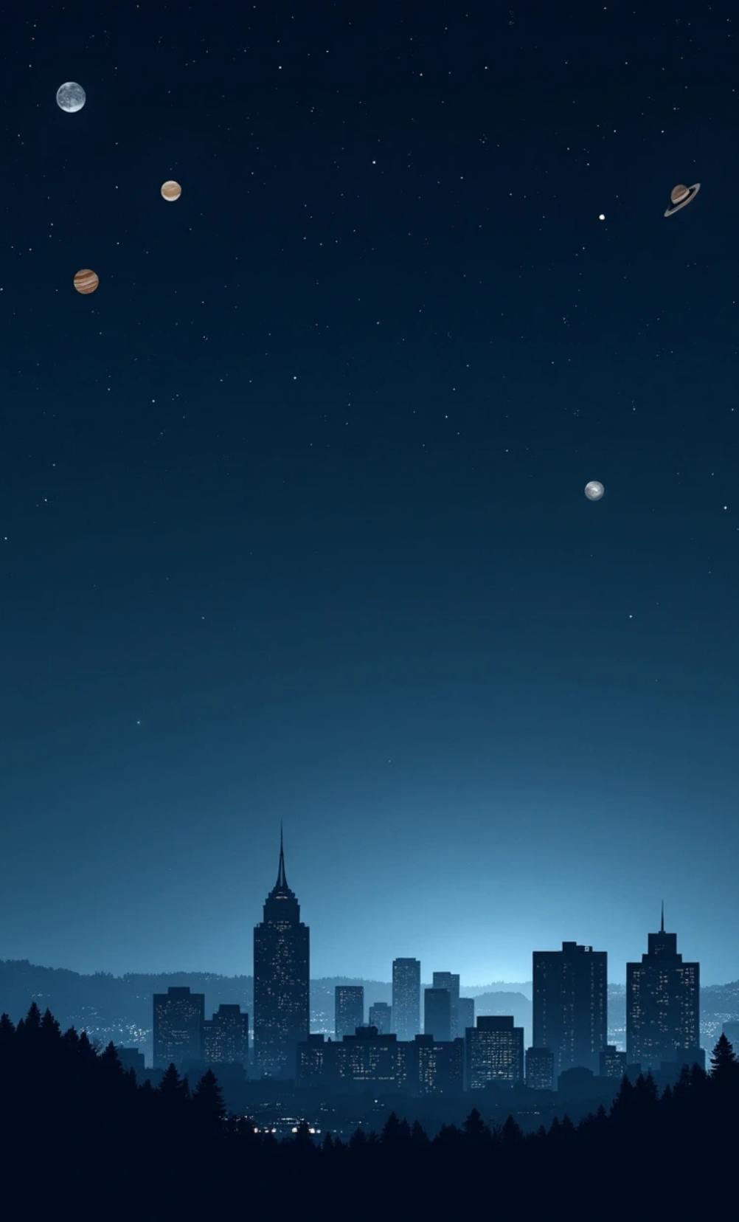
Identifying Today's Visible Planets
This presentation delves into a Python project designed to assist stargazers in identifying visible planets from their urban locations. By utilizing astronomical data and programming techniques, it aims to connect individuals with the mesmerizing wonders of the night sky, enhancing their stargazing experience.

Slide 2
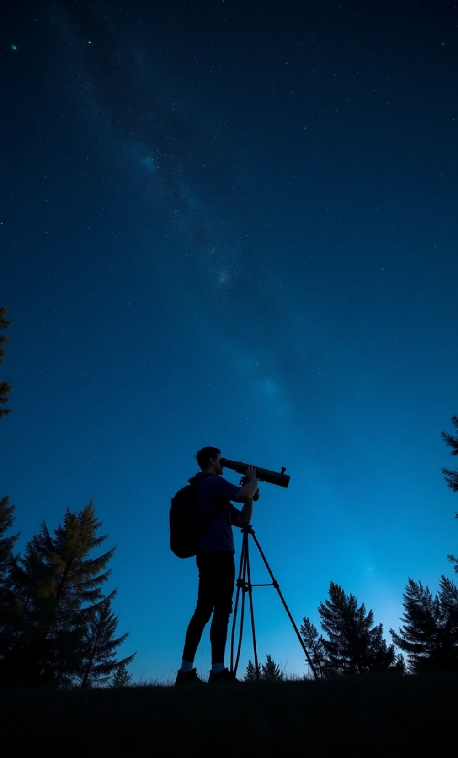
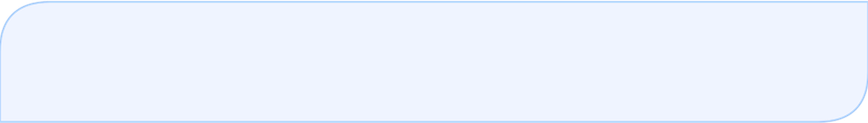
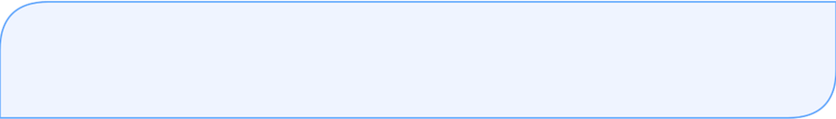
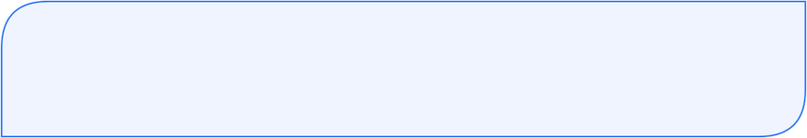
Visibility of Planets for Stargazers
Knowledge Gaps
Many stargazers lack knowledge about which planets are visible from their location.
Daily Shifts
Planet positions shift daily, affecting visibility based on time and location.
Python Application
The project aims to create a Python application to provide current visibility status for planets.

Slide 3





Importance of Astronomy Promotion
Easy Planning
Public Interest
Simplifies the process of planning night sky viewing for beginners and enthusiasts.
Promotes interest in astronomy and space science among the public.
2
1
Real-time Data
3
Utilizes real-time astronomical calculations, ensuring accurate and reliable information.
5
Bridging Skills
4
Bridges the gap between real-world astronomical data and programming skills.
Coding Project
Offers a straightforward coding project with advanced technical implications.

Slide 4

Tools & Technologies
Programming Language
Library Usage
Python serves as the primary programming language for the project.
The Skyfield library is used for precise calculations of planetary positions.
Time Management
Mathematical Operations
Datetime module helps keep track of the current date and time.
Math operations are applied for elevation angle calculations to determine visibility.
Coordinate Acquisition
Geopy or manual input is utilized for obtaining latitude and longitude coordinates.

Slide 5
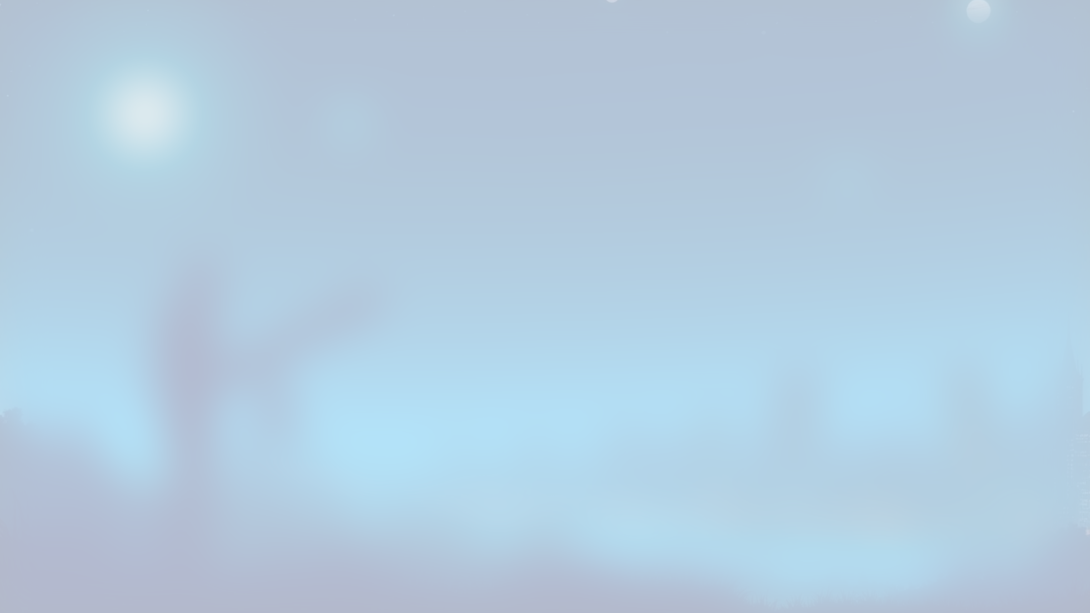




How It Works
1
2
3
4
5
User Input
Retrieving Data
Loading Planetary Data
Evaluating Visibility
Output Results
Users input their city's latitude and longitude to tailor the program.
The application retrieves the current date and time for accurate calculations.
Finally, the program outputs a list of currently visible planets for the user.
Skyfield library loads necessary planetary data for the specified location.
It evaluates which planets are positioned above the horizon, indicating visibility.

Slide 6




Python Code Snapshot
Load Planetary Data
User Location Definition
The project utilizes Skyfield to gather planetary information.
1
2
Users set their location for accurate celestial observations.
Code Demonstration
Altitude and Visibility
4
3
The code shows clear correlation between elevation and visibility.
Visible planets have altitudes above 0°.

Slide 7



Visible Planets Tonight
Location
Visible Planets
Program Effectiveness
Bengaluru
Venus, Mars, Jupiter

Slide 8

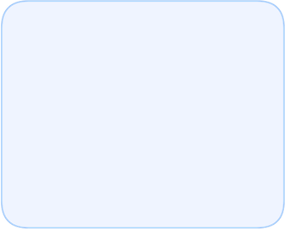
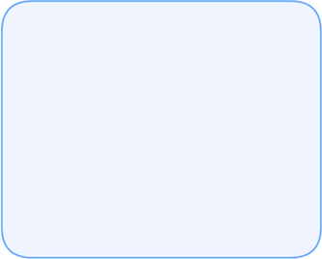
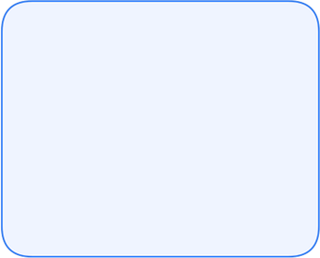
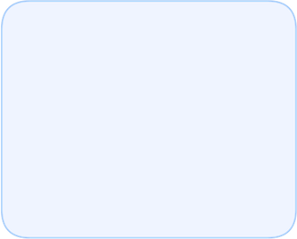




Future Enhancements in Stargazing
1
2
3
4
Visibility Predictions
App Development
Weather Integration
Real-time API Integrations
Future enhancements may include predictions for moons and star constellations.
Developing a web or mobile app could allow for broader accessibility.
Incorporating weather data or cloud cover information would increase realism and functionality.
Real-time API integrations could provide users with live sky map features.

Slide 9
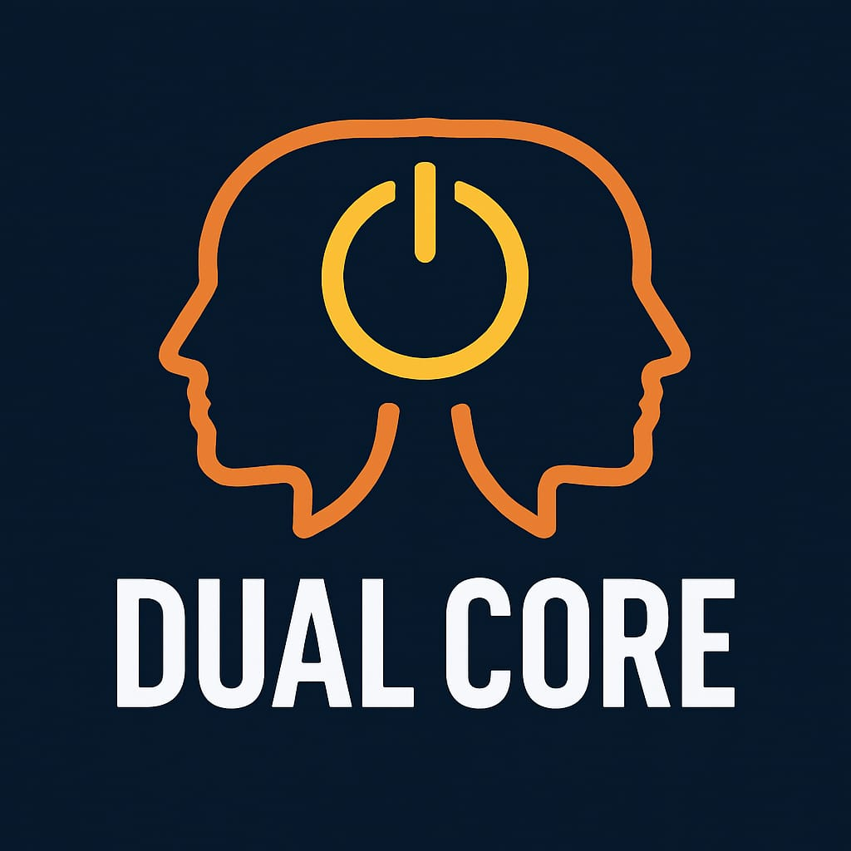
By Hanishka.P.A
Disha.S

Slide 10
THANK YOU

