Slide 1




A fiery approach to r web services
Exposing your models as web services in R...
@quintindk
https://github.com/quintindk
https://linkedin.com/in/quintindk

Slide 2

About me...

Slide 3

About me...
I’m a proud father and husband.
I’ve been in the technology industry for 20 years.
Of that 20 years, almost 11 years have been at Netstar.
My background is software development; .NET, JS, Python, R, Scala, Java.
My interests outside of Technology are reading of which I enjoy mostly psychology, philosophy and anthropology.

Slide 4
Fiery Web Services
ProjectTemplate - http://projecttemplate.net/
Fiery - https://github.com/thomasp85/fiery
Docker - https://www.docker.com

Slide 5
ProjectTemplate
is a system for automating the thoughtless parts of a data analysis project...
Organizing the files in your project.
Loading all the R packages you’ll use.
Loading all of your data sets into memory.
Munging and preprocessing your data into a form that’s suitable for analysis.
http://projecttemplate.net

Slide 6
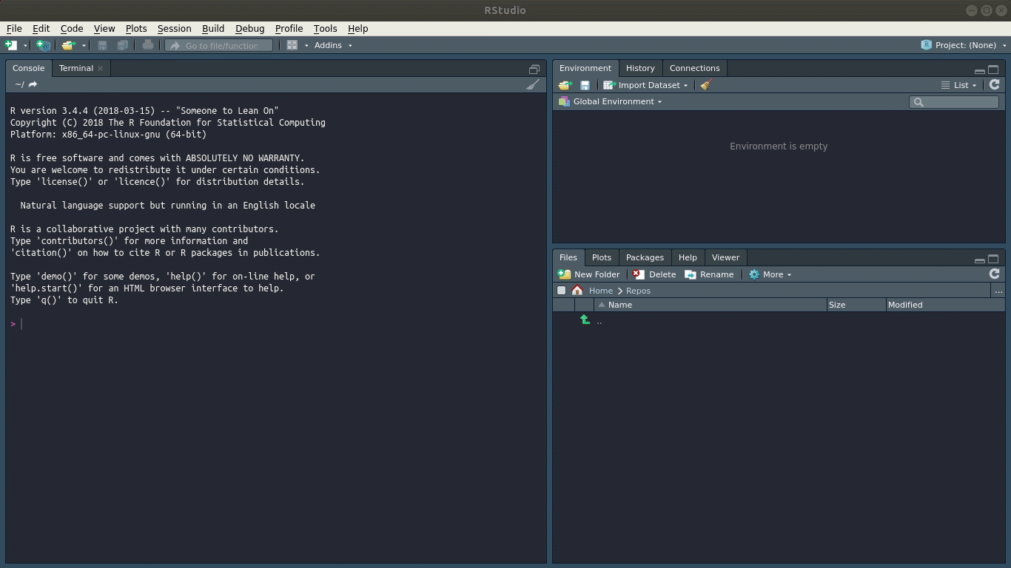
Demo...

Slide 7

Folder structure (Minimal)
project
cache
config
data
munge
src

Slide 8
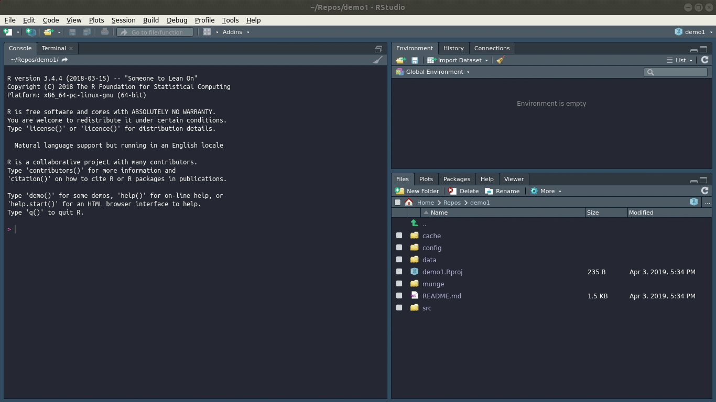
Demo...

Slide 9

Fiery
This package maintained by the infamous Thomas Lin Pedersen @thomasp85 (think gganimate) is a framework for web servers in R.
Fiery is a flexible and lightweight framework for building web servers in R. It is relatively unopinionated about how you chose to build your server logic and supports many use cases, from serving static files to being used as a base for a model-view-controller based setup.
https://github.com/thomasp85/fiery

Slide 10
Demo...

Slide 11
Routr and stacked routes...

Slide 12
Demo...

Slide 13
ProjectTemplate and Fiery
Model View Controller pattern...

Slide 14
Demo...

Slide 15

Docker
https://www.docker.com/

Slide 16
Dockerfile

Slide 17
Install.R

Slide 18
Demo...

Slide 19
THANK YOU
@quintindk
https://github.com/quintindk
https://linkedin.com/in/quintindk

Slide 20
@quintindk
https://github.com/quintindk
https://linkedin.com/in/quintindk

