Slide 1


MAC
Hank Chen

Slide 2
Outline
Cryptographic Hash Function Criteria
Collision Theorem
Merkle–Damgård Construction
Message Authentication Code (MAC)

Slide 3
Outline
One Way Function & Requirement (Pre-image resistance, Second pre-image resistence, Collision resistence)
Merkle–Damgård construction
MD5 & SHA1 & SHA2 & SHA3 (SHA Family)
Collision (eg. SHA1, MD5) ,Birthday paradox
MAC (CBC-MAC, simple MAC, HMAC)
Length Extension Attack & Padding

Slide 4
Cryptographic Hash Function Criteria

Slide 5
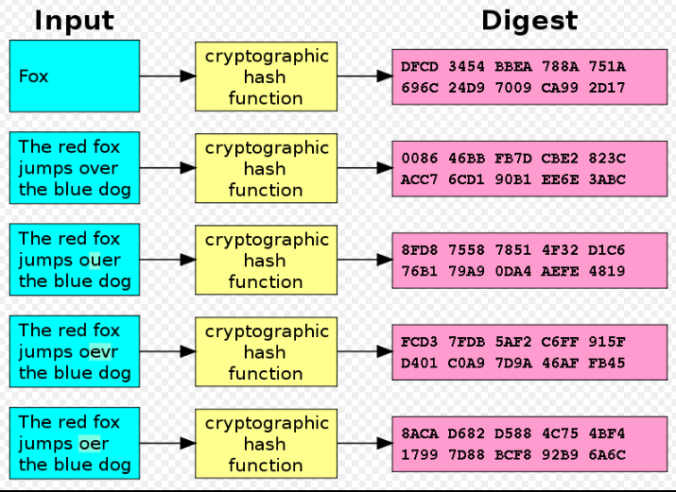
Cryptographic hash function
variant input size
fixed output size (digest)

Slide 6
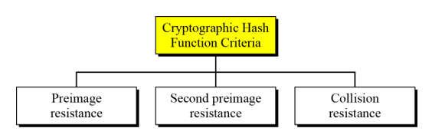
Cryptographic Hash Function Criteria

Slide 7
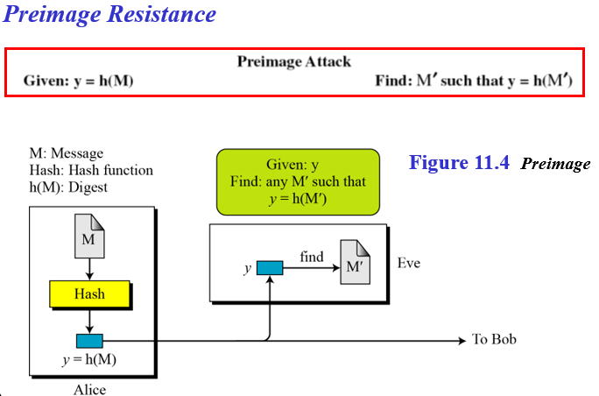

Slide 8
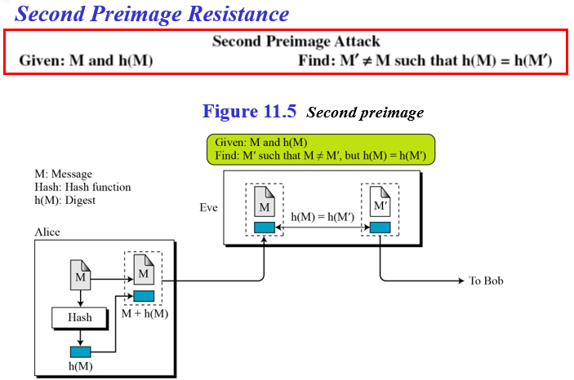

Slide 9
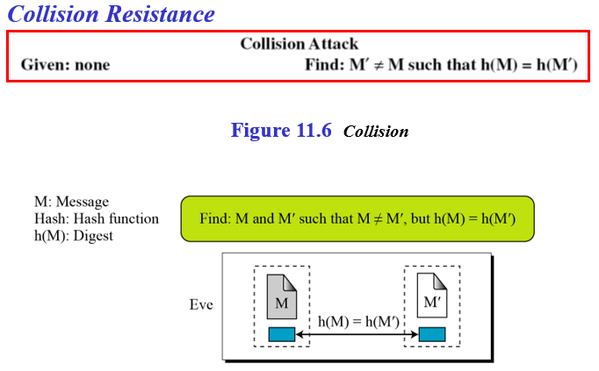

Slide 10
Collision Theorem

Slide 11
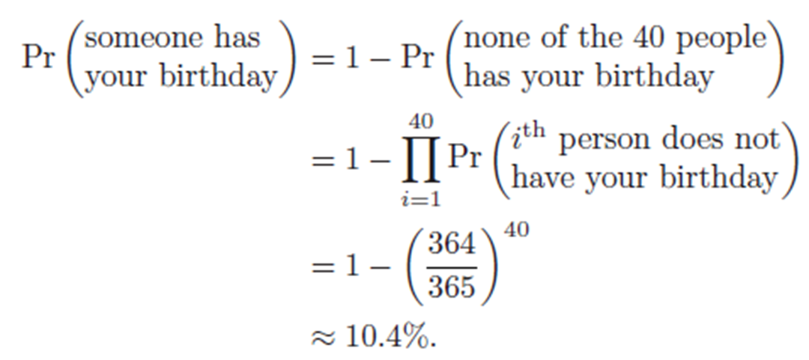
Birthday Paradox
In a group of 40 people
What is the probability that someone has the same birthday as you? (弱碰撞)
Notes:
40人都跟你不同天生日

Slide 12
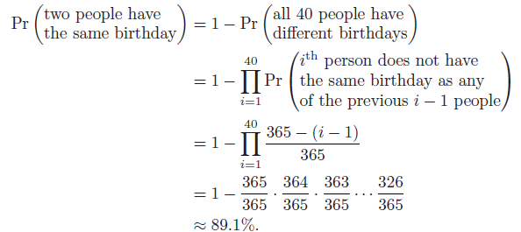
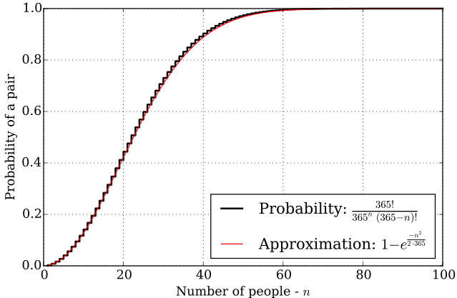
Birthday Paradox
In a group of 40 people
2. What is the probability that at least two people share the same birthday? (強碰撞)
Notes:
40人都在不同天生日

Slide 13


Birthday Attack
Given f, find f(x1) == f(x2), for distinct x1 and x2
For example
A hash with 32 bits digest size
probability of collision is $2^{−20}$
Notes:
N-位長度的雜湊表可能發生碰撞測試次數不是2^{N}次而是只有2^{N/2}次

Slide 14
Merkle–Damgård Construction

Slide 15
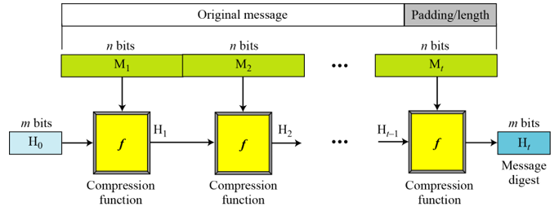
Merkle–Damgård Construction
Suffer from Length Extension Attack
Padding

Slide 16
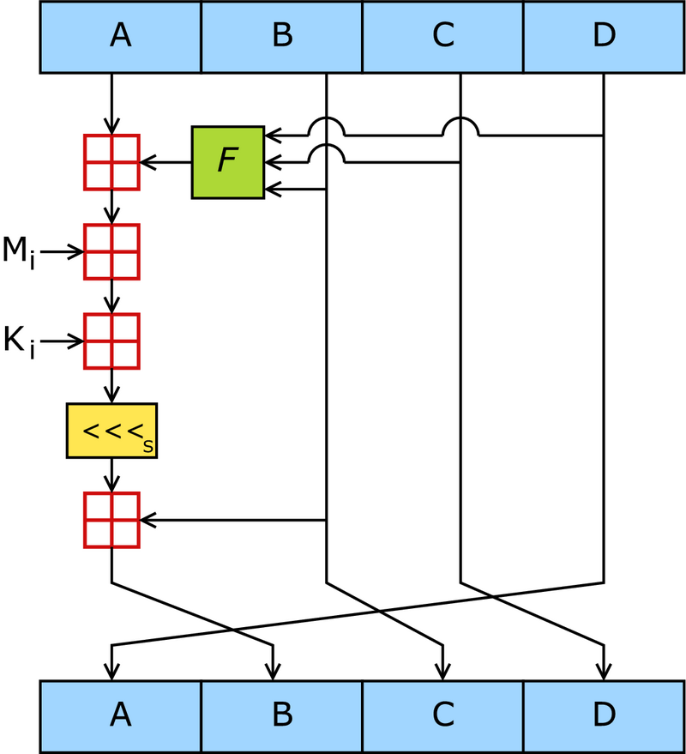
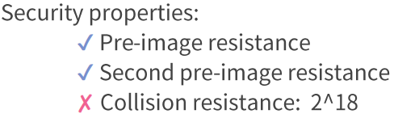
MD5
digest size: 128 bits (16 bytes)
Much faster than SHA-family
Notes:
一個MD5運算— 由類似的64次迴圈構成，分成4組16次。F 一個非線性函式；一個函式運算一次。M_{i} 表示一個 32-bits 的輸入資料，K_{i} 表示一個 32-bits 常數，用來完成每次不同的計算。

Slide 17
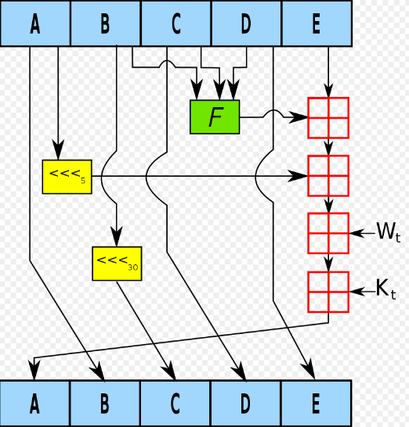
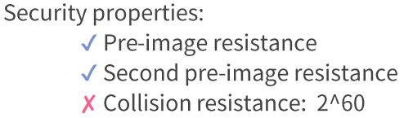
SHA1
digest size: 160 bits (20 bytes)

Slide 18
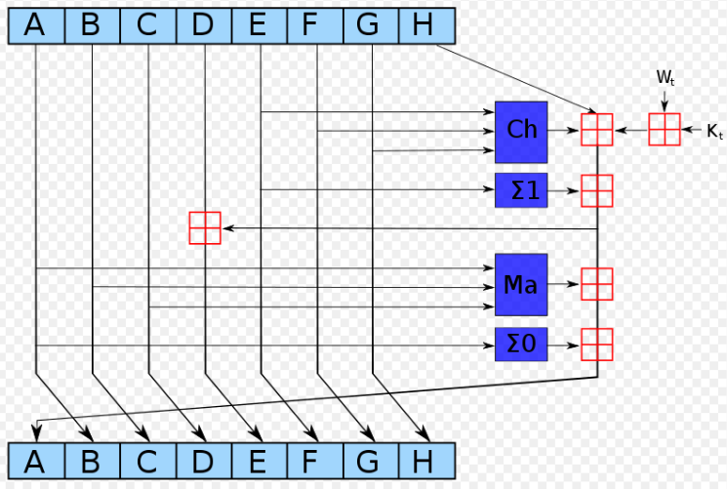
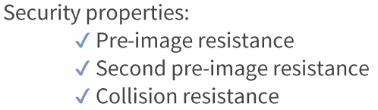
SHA2
digest size:
224, 256, 384, 512 bits

Slide 19
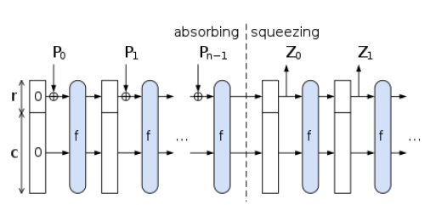
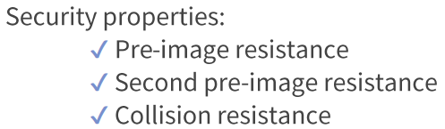
SHA3
Sponge construction
arbitary digest size

Slide 20
Lab1 – SHA256LEA
Length Extension Attack

Slide 21
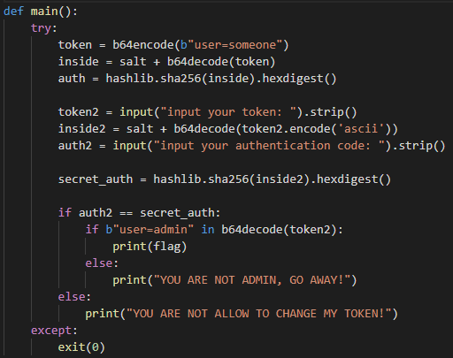

Slide 22
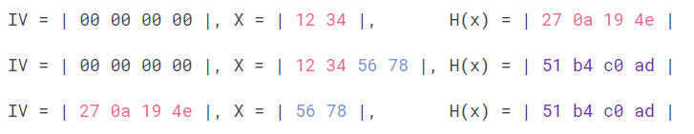
Length Extension Attack
nc 140.114.77.172 60004
HashPump

Slide 23
Lab2 – SHA1 is dead

Slide 24
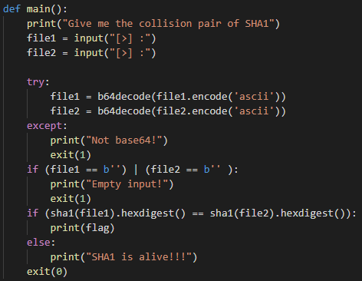

Slide 25
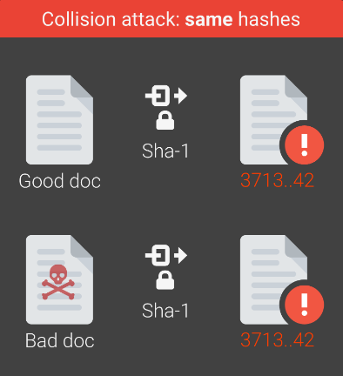
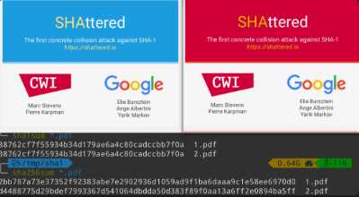
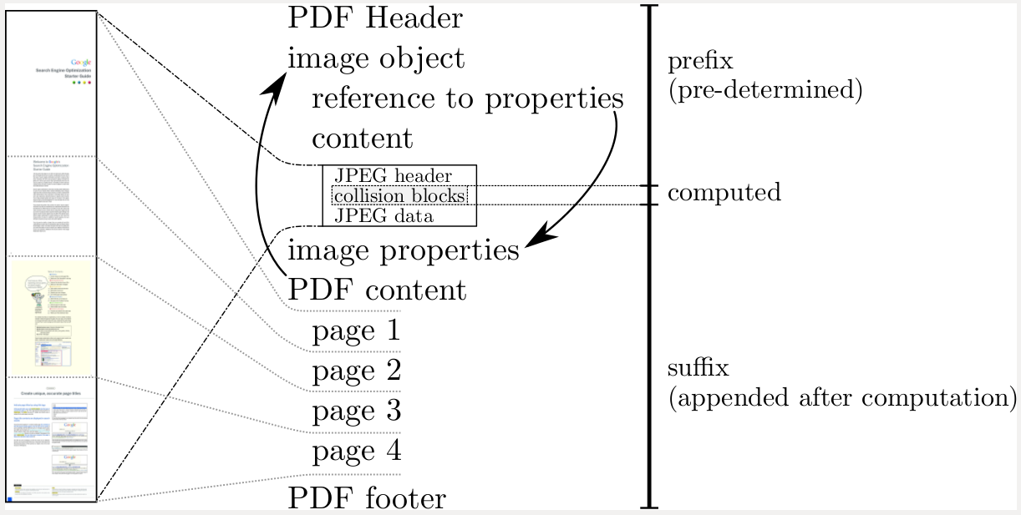
SHA1 Collision
nc 140.114.77.172 60005
https://shattered.io/

Slide 26
Lab3 – MD5 c011isi0n

Slide 27
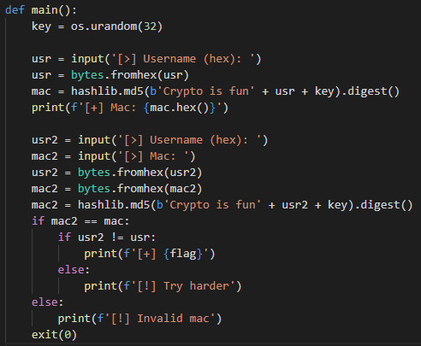

Slide 28

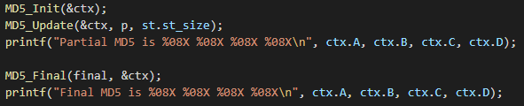
MD5 tunneling
nc 140.114.77.172 60006
md5-tunneling
hashclash
partial_md5.c
/usr/include/openssl/md5.h

Slide 29
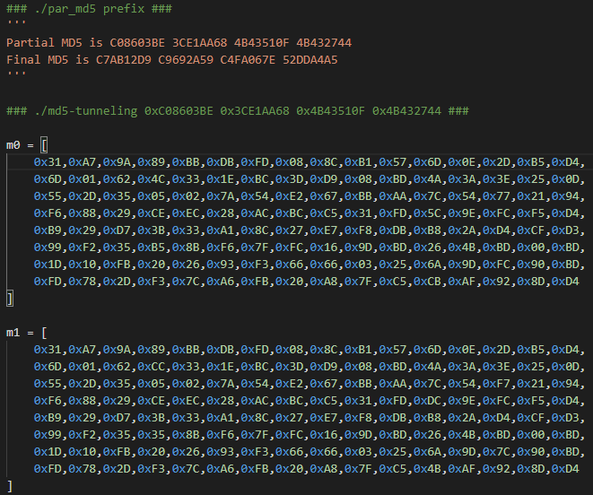
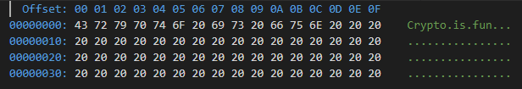

Prefix
Found Collision!!

Slide 30
Message Authentication Code (MAC)

Slide 31
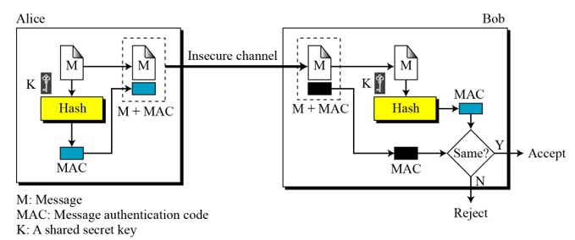
MAC
A cryptographic checksum on data that uses a symmetric key to detect both accidental and intentional modifications of the data.

Slide 32
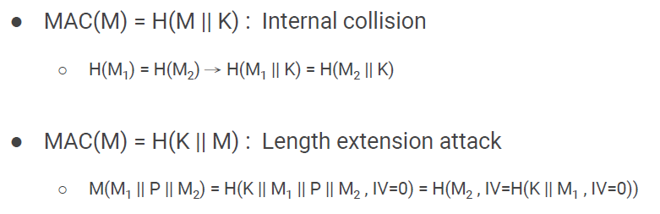
Simple MAC

Slide 33
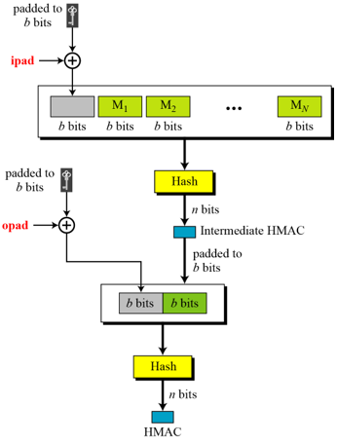

HMAC
opad: the block-sized padding of repeated bytes “0x5c5c5c….”
ipad: the block-sized padding of repeated bytes “0x363636….”

Slide 34
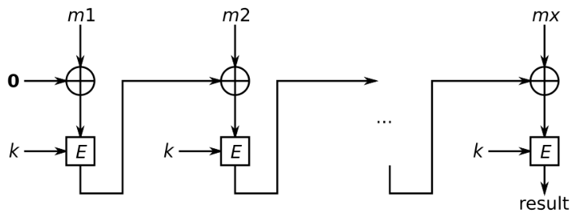
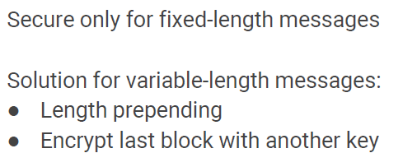
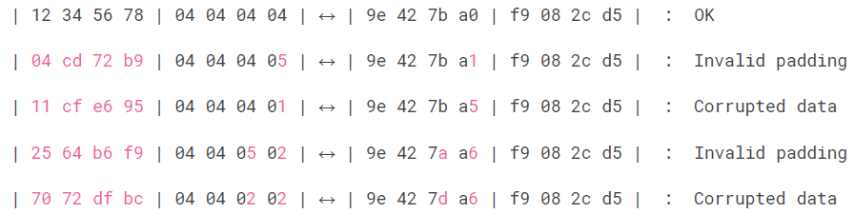
CBC-MAC
Suffer from padding oracle
IV

Slide 35
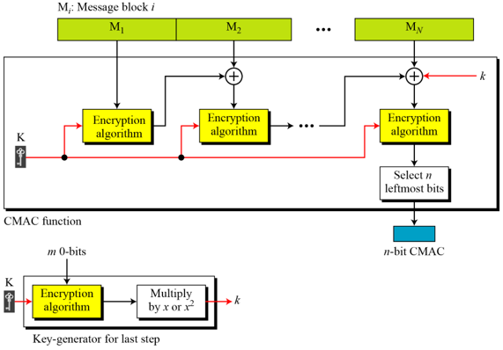
CMAC
One-key CBC-MAC

Slide 36
HW2 Hint
https://quipqiup.com/

Slide 37
Hill Climbing

Slide 38
Genetic Algorithm

Slide 39
ngram-score

Slide 40
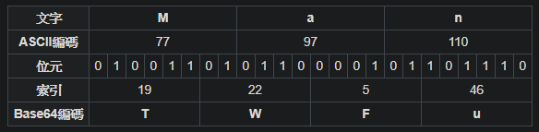
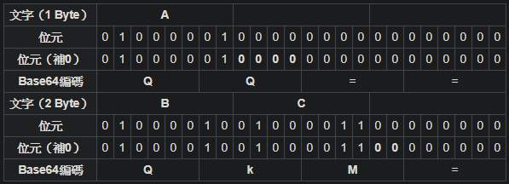
Base 64
ASCII printable
[=A-Za-z0-9+/]

Slide 41
More Topic in Future
PWN – bufferoverflow
PWN – heapoverflow
PWN – FILE Structure
CRYPTO – DLP(RSA, Rabin, …, baby step giant step, oracle attack)
CRYPTO – SPN(AES, …, linear & differential cryptoanalysis)
CRYPTO – Shamir secret sharing, blockchain
CRYPTO – Elliptic Curve & Supersingular Isogeny Key Exchange
CRYPTO – Lattice (LLL, SIS, LWE, RLWE), PQC
WEB …

Slide 42
Reference
Forouzan, Behrouz A. ,Cryptography and Network Security, McGraw-Hall International Edition, 2008.
Jeffrey Hoffstein, Jill Pipher, Joseph H. Silverman, An Introduction to Mathematical Cryptography

Slide 43
Thanks For Your Listening!

