Slide 1
How 2 Random
Hank Chen

Slide 2
Outline
What Is PRNG?
Is Random Enough?
How 2 Random?

Slide 3
What Is PRNG?

Slide 4
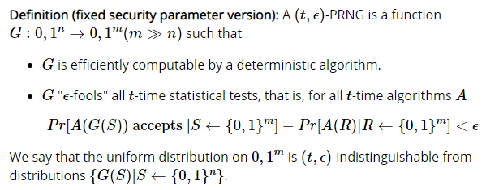
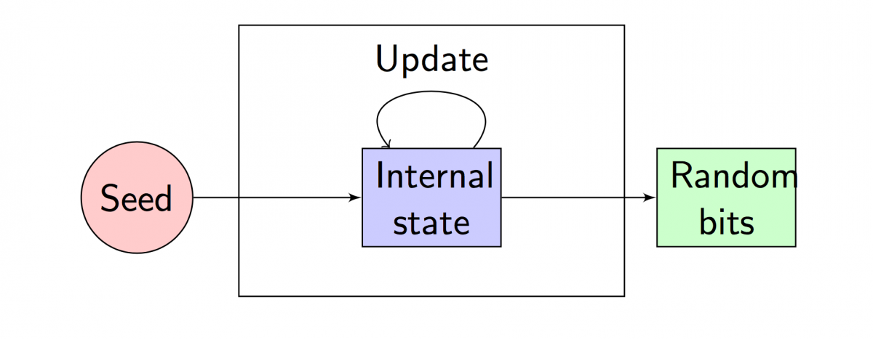
PRNG (亂數產生器)

Slide 5
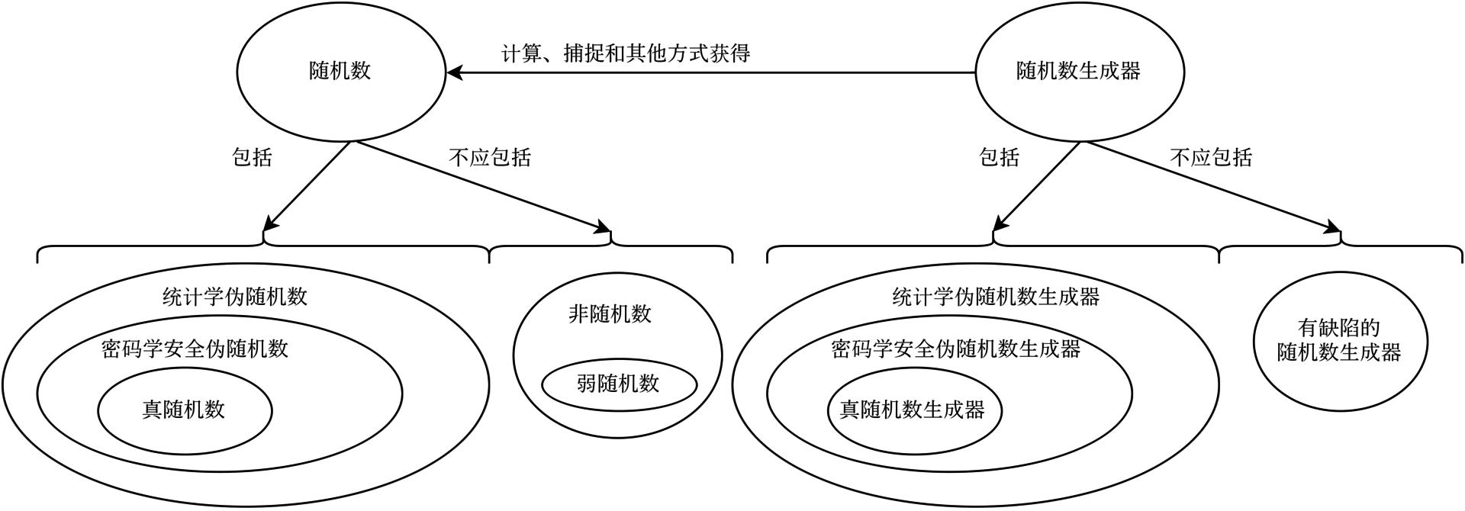
Classification
CSPRNG (Cryptographic Secure Pseudo Random Number Generator)
TRNG (True Random Number Generator)

Slide 6
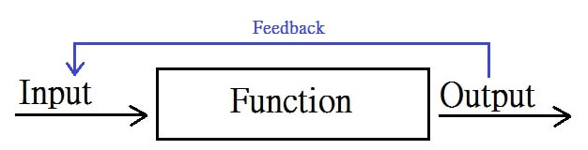

CSPRNG (密碼學安全亂數產生器)
One way function
過去簡單，反推很難
Eg. Discrete Logrithm Problem
Cipher based
CTR mode, IV = seed
Stream cipher, IV = seed
Hash based
$x_{i+1}$=$x_{i}$+1; $o_{i+1}$=𝐻($x_{i}$)

Slide 7
TRNG (真•亂數產生器)
Definition
不是電腦程式來生成亂數的裝置
eg. 石英共振、噪音
用來生成PRNG的seed
Product
TPM (Trusted Platform module)

Slide 8
System Random
Application (Linux)
/dev/urandom
/dev/random
system call getrandom()
/dev/random : 512 bytes
/dev/urandom : 33554431 bytes
/dev/hwrng

Slide 9
Is Random Enough?

Slide 10
Algorithm
LCG
XOR shift
LFSR
MT19937

Slide 11
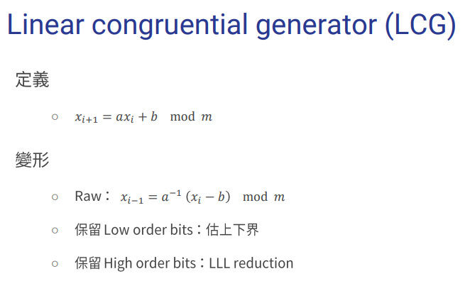

Slide 12
Lab1 – Crack LCG

Slide 13
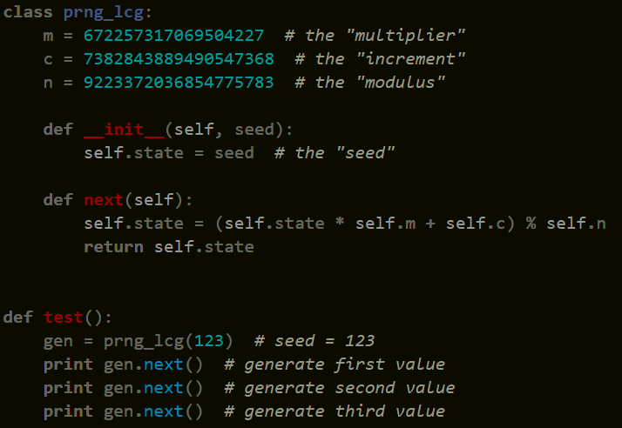
Crack LCG

Slide 14
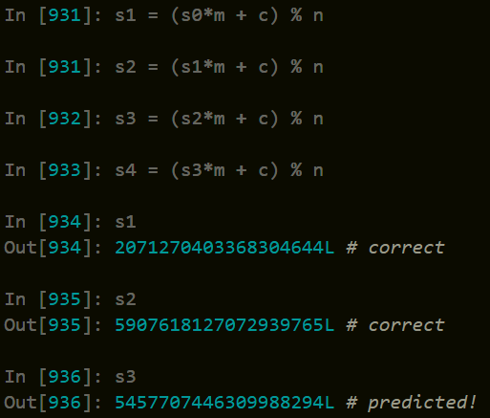
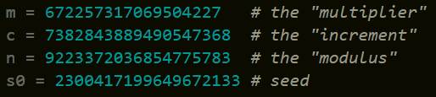
Crack LCG – Level 1
Everything Known

Slide 15
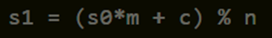



Crack LCG – Level 2
Unknown increment

Slide 16

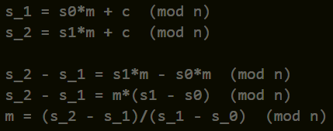

Crack LCG – Level 3
unknown increment and multiplier

Slide 17
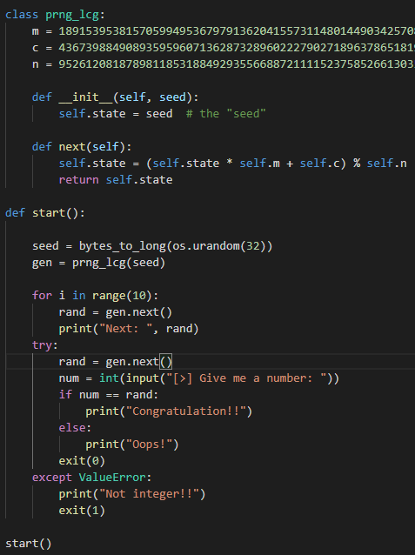

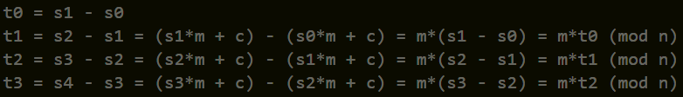
Crack LCG – Level 4
nc 140.114.77.172 60001

Slide 18
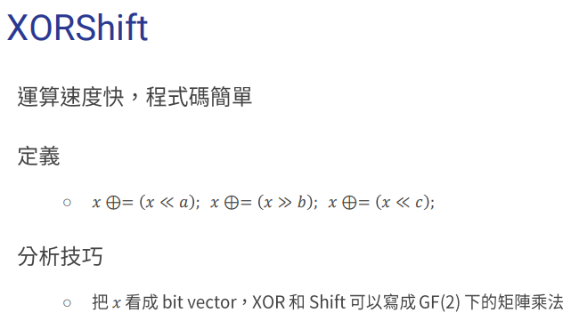

Slide 19
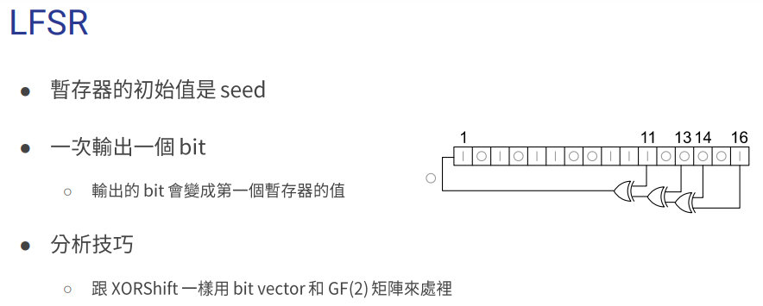

Slide 20
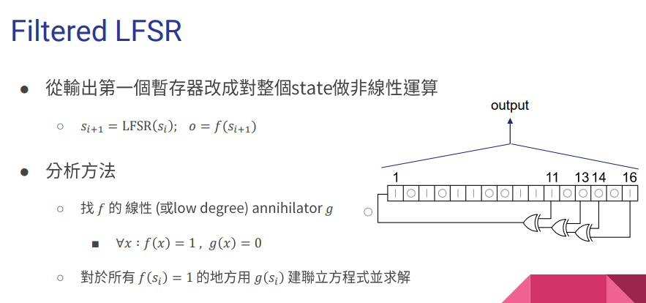

Slide 21
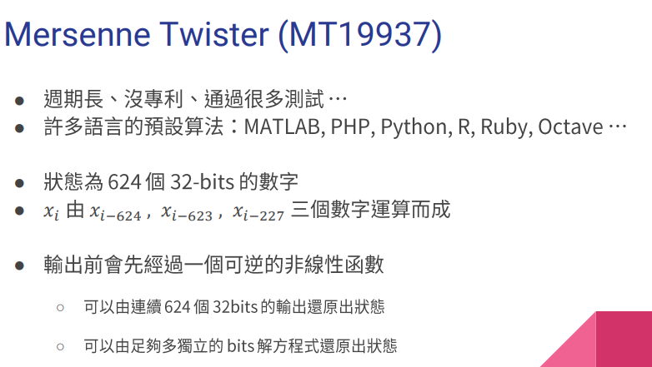

Slide 22
Lab2 – Crack MT19937

Slide 23
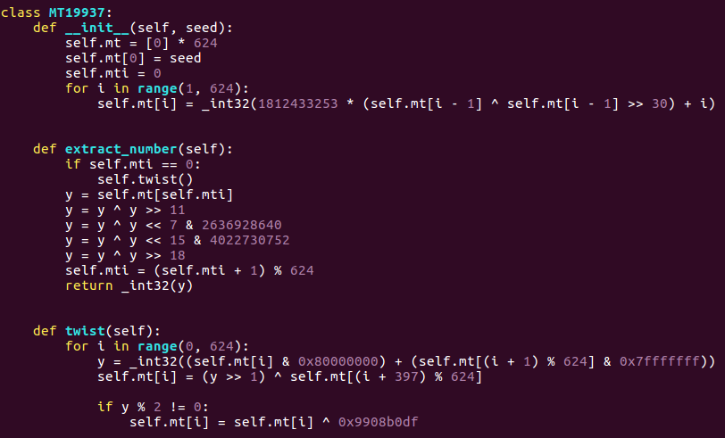
Crack MT19937

Slide 24
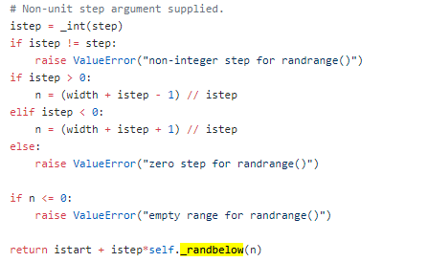
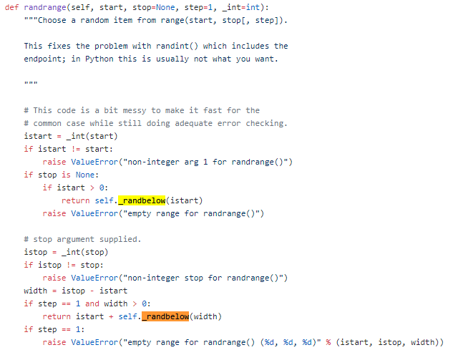
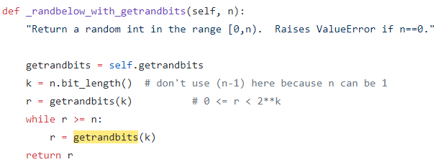
https://github.com/python/cpython/blob/master/Lib/random.py
1

Slide 25
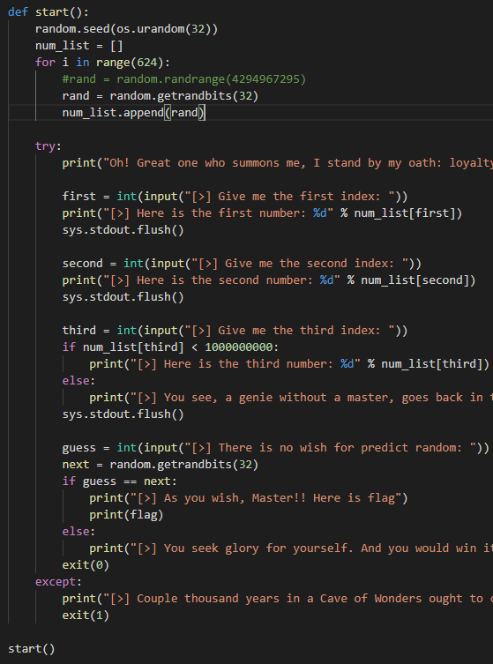
Crack MT19937 – Level 1
nc 140.114.77.172 60002
Choose 2 or 3 numbers from 624 “continuous” random number
Each number in range(0, 4294967295)

Slide 26
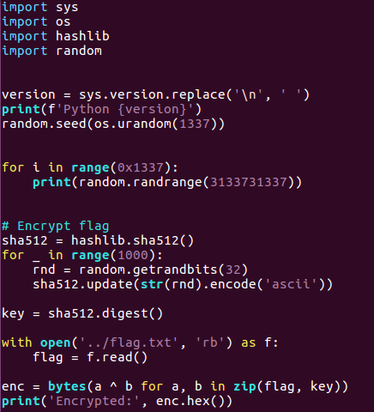
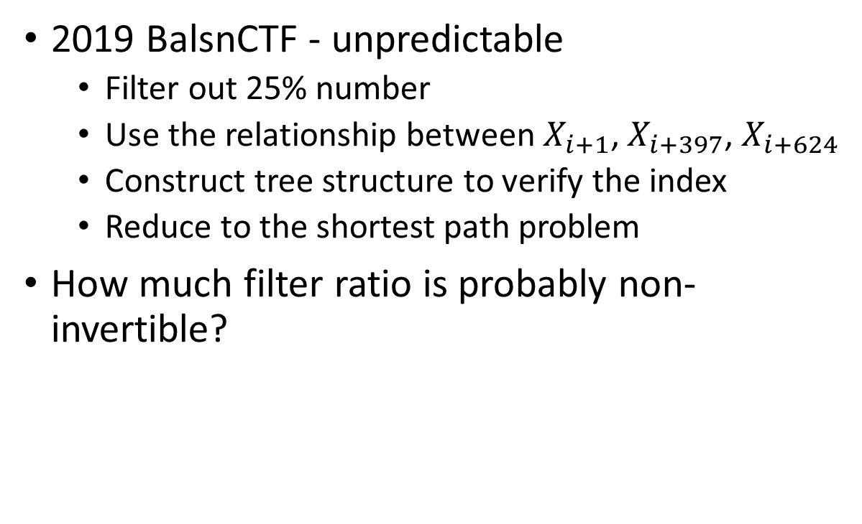
Crack MT19937 – Level 2
2019 BalsnCTF - unpredictable
Filter out 25% number
Use the relationship between $X_{i+1}$, $X_{i+397}$, $X_{i+624}$
Construct tree structure to verify the index
Reduce to the shortest path problem
How much filter ratio is probably non-invertible?

Slide 27
Cryptographic Backdoor

Slide 28
Trapdoor V.S. Backdoor
Trapdoor
One way function
不知道密鑰的人要算很久
Backdoor
定義:
A feature or defect that allows surreptitious access to data
特色:
NOBUS (No One But Us)
Deniable
Reusable (optional)
Unmalleable (hard to replicate)
Forward-secure (previous exploits aren’t compromised)

Slide 29

Why random number is important?
Most of Cryptosystems need random number
RSA: p,q
AES: iv, key
DSA: private key
ECC: points on curve
If we enable to predict PRNG
We know everything!!!

Slide 30
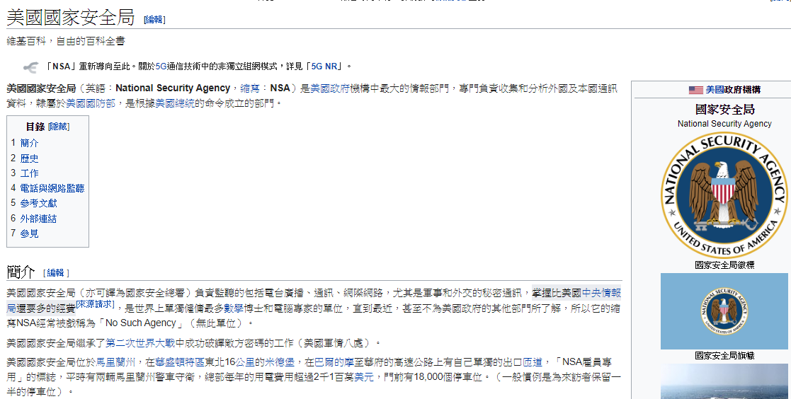
NSA

Slide 31
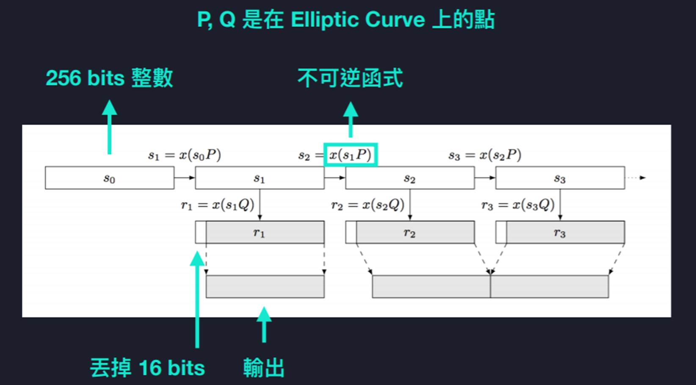
NSA – EC DRBG

Slide 32
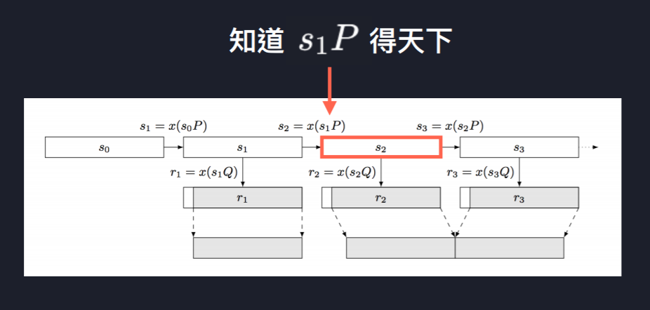
https://blog.0xbadc0de.be/archives/155

Slide 33
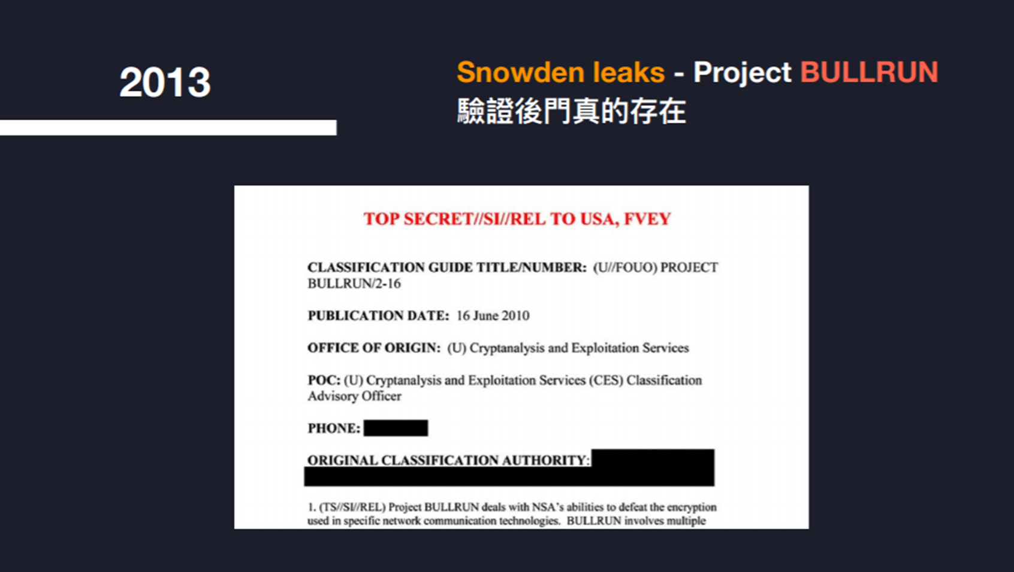

Slide 34
How 2 Random?

Slide 35
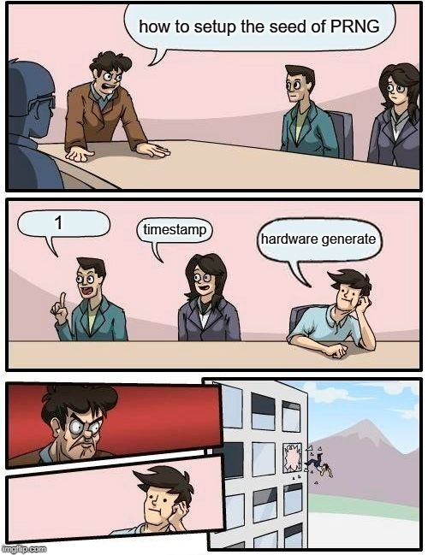
The Correct Way
Understand algorithms of PRNG
Change your seed periodically
Make sure your seed is from hardware
Also make sure you have enough entropy

Slide 36
Reference
https://oalieno.github.io/security/crypto/classic/dual-ec/
Sasdf slides from NCTU CTF

Slide 37

Thanks for Your Listening!

