Slide 1
Stepdown PSU
POE 8
Johan Paul

Slide 2


$$V_{in}=14V−19V$$
$$V_{ref}=1.25V$$
$$f_{s}=33kHz$$
$$V_{o}=9V$$
$$I_{o}=0.5A$$
$$V_{opp\left(ripple\right)}<60mV_{pp}$$

Slide 3


$$T=t_{on}+t_{off}=\frac{1}{f_{s}}=\frac{1}{33kHz}=30.303μS$$
Period time
$$\frac{t_{on}}{t_{off}}=\frac{V_{out}+V_{F}}{V_{in\left(min\right)}−V_{sat}−V_{out}}=\frac{9+0.3}{14−1.3−9}=2.5135$$
Ratio between on and off time
$$t_{off}=\frac{t_{on}+t_{off}}{\frac{t_{on}}{t_{off}}+1}=\frac{30.303}{2.5135+1}=8.624μS$$
Off time
$$t_{on}=\left(t_{on}+t_{off}\right)−t_{off}=30.303−8.624=21.679μS$$
On time
$$D=\frac{t_{on}}{t_{on}+t_{off}}=\frac{21.679}{30.303}=0.715$$
Duty cycle
$$I_{pk\left(switch\right)}=I_{o}∗2=1A$$
Peak current during switching
$$C_{T}=4∗{10}^{−5}∗t_{on}=8.67∗{10}^{−10}⇒1νF$$
Value of a capacitor
$$R_{sc}=\frac{V_{f}}{I_{pk\left(switch\right)}}=\frac{0.3V}{1}=0.333Ω$$
Value of a source transistor

Slide 4


$$L_{min}=\frac{V_{in\left(min\right)}−V_{sat}−V_{out}}{I_{pk\left(switch\right)}}∗t_{on}=\frac{14−1.3−9}{1}∗21∗{10}^{−}6=77μH$$
Minimal value of the inductor
$$C_{0}=\frac{I_{pk\left(switch\right)}+\left(t_{on}+t_{off}\right)}{8∗V_{ripple\left(pp\right)}}=\frac{1A∗30.303μS}{8∗10.8mV}=350μF$$
Value of the capacitor
$$C_{inpp}=\frac{I_{out}\left(D−D^{2}\right)}{V_{inpp\left(c\right)}∗F_{sw}}=\frac{0.5\left(0.715∗{0.715}^{2}\right)}{2.5∗33kHz}=1.2μF$$
Value of the input capacitor
$$R_{1}=1.2kΩ$$
Diagram resistor
$$R_{2}=\left(\frac{V_{out}}{1.25}−1\right)∗R_{1}=\left(\frac{9}{1.25}−1\right)∗1.2k=7.44kΩ$$
Value of the second resistor
$$R_{Load}=\frac{V}{I}=\frac{9}{0.5}=18 Ω$$
Value of the load resistor for maximum load

Slide 5
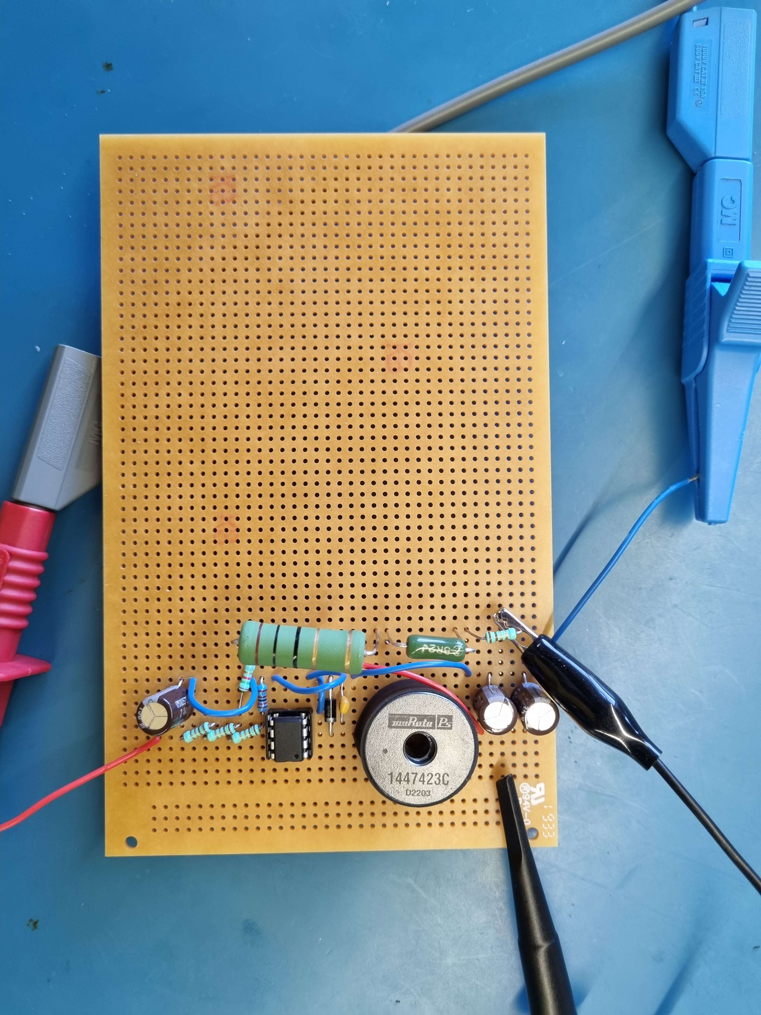
Setup

Slide 6
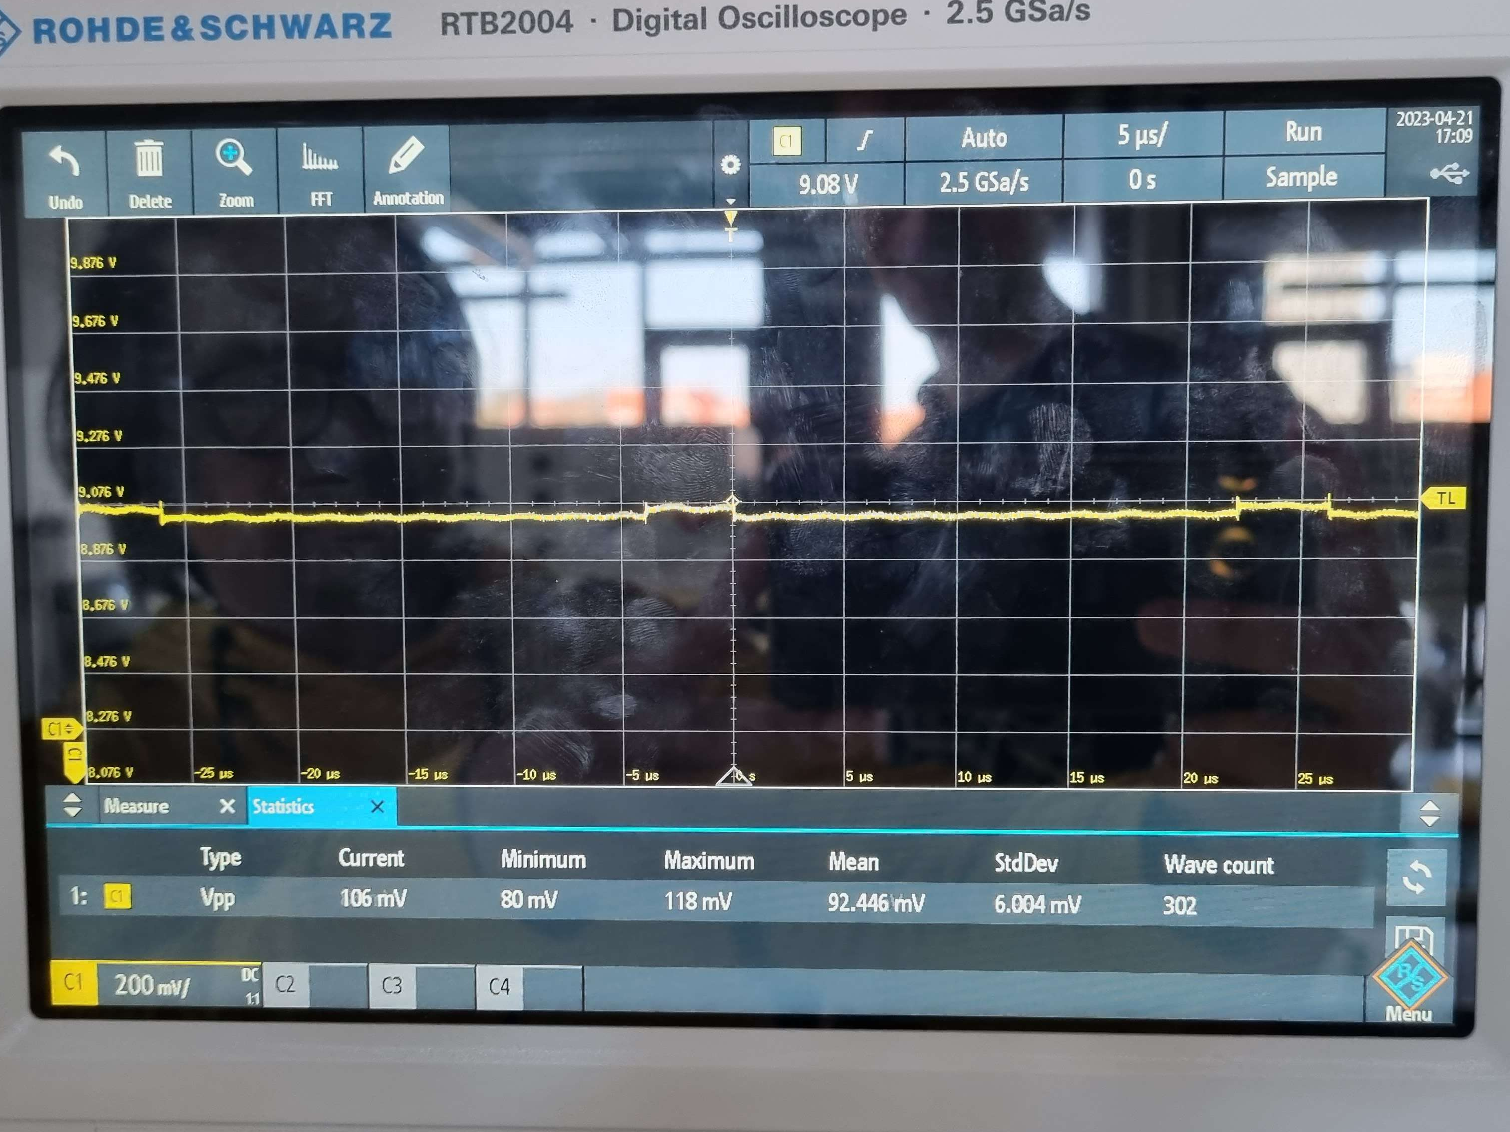
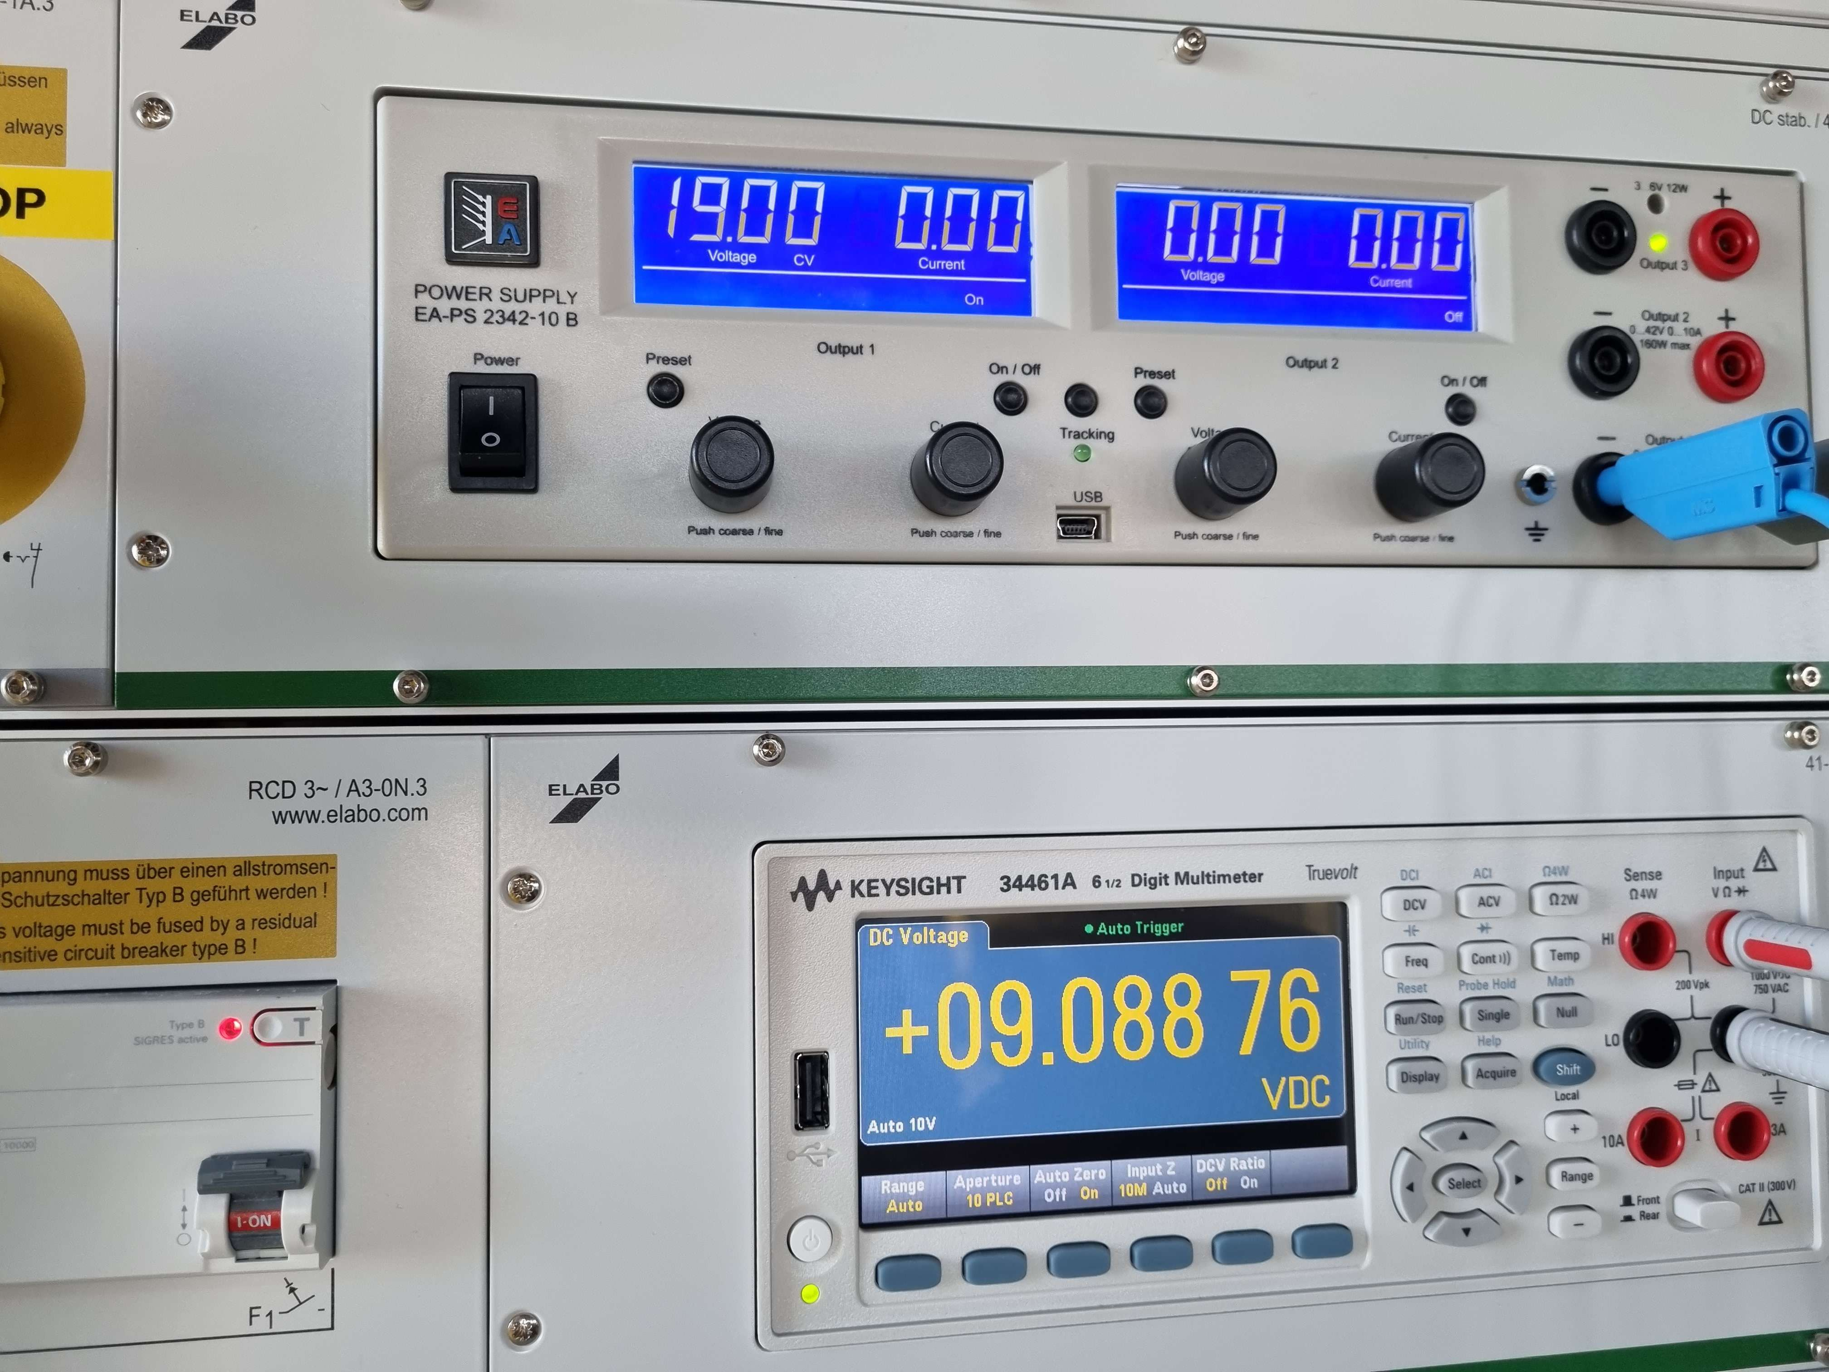
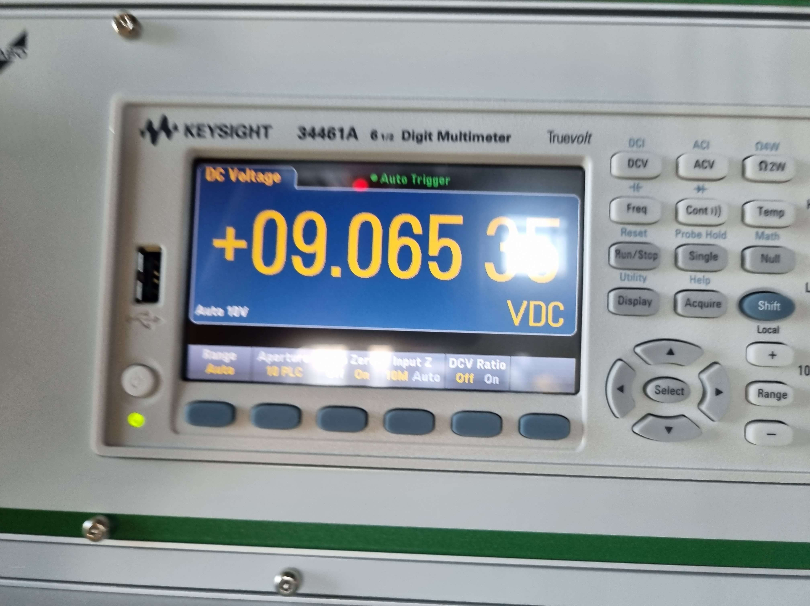
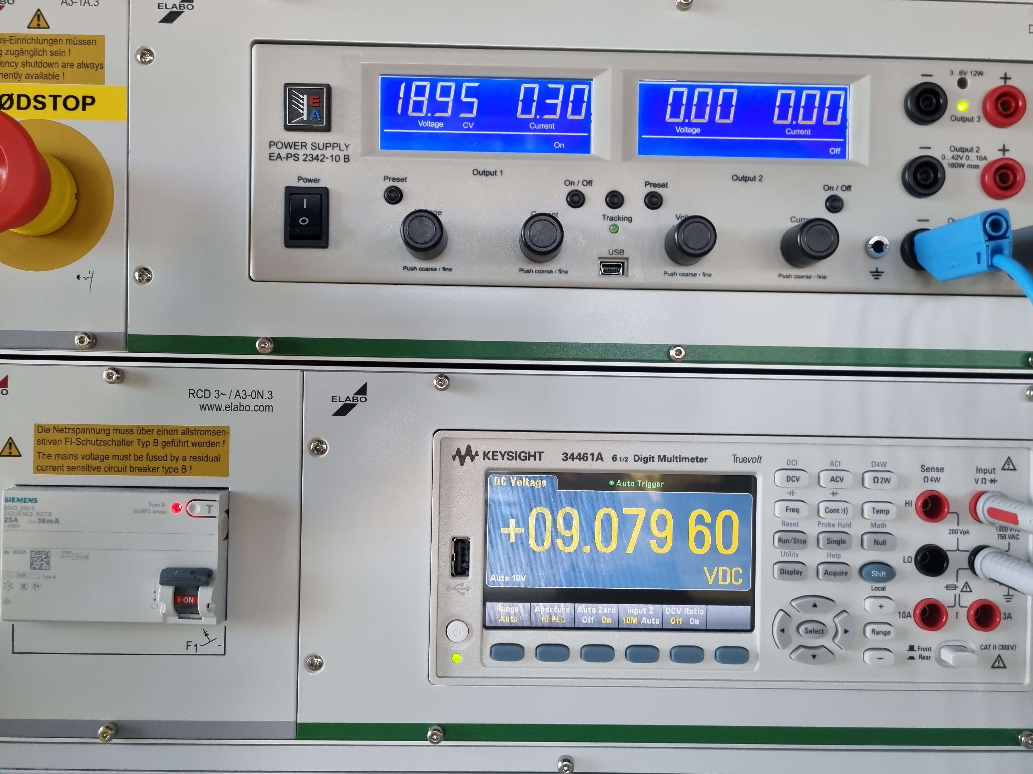
Results

