Slide 1
Learning Stable Graphs from Multiple Environments with Selection Bias
Yue He, Peng Cui, Jianxin Ma, Hao Zou, Xiaowei Wang, Hongxia Yang, and Philip S. Yu. 2020. Learning Stable Graphs from Multiple Environments with Selection Bias. In Proceedings ofthe 26th ACM SIGKDD Conference on Knowledge Discovery and Data Mining (KDD ’20)
Zekun Cai 20200821

Slide 2
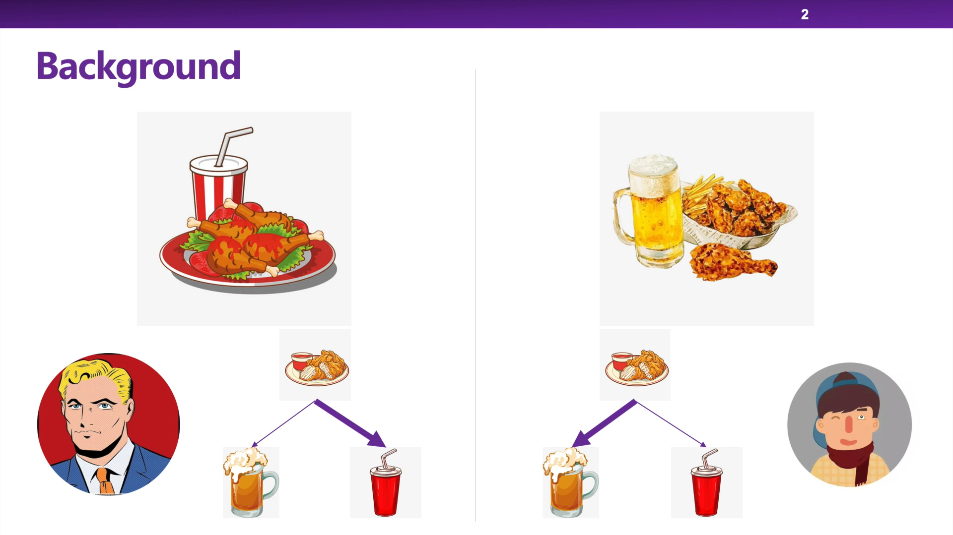
Introduction

Slide 3
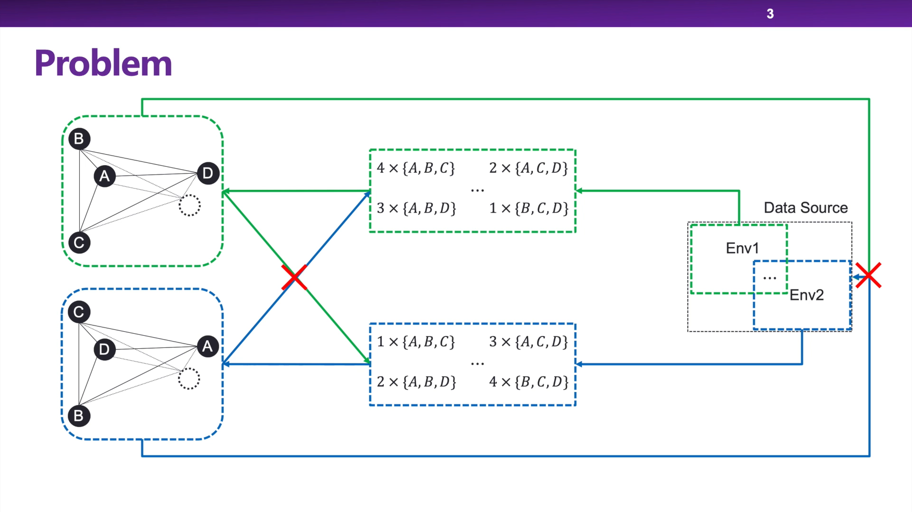
Problem
The data collection process is usually full of known or unknown sample selection biases, leading to spurious correlations among entities. (product purchasing graph: female and male; different geographical regions; long time-span)
→We need stable graph across different environments with selection bias.
The learned graph can be applied into multiple, even unknown environments and help to produce stable performances with subsequent tasks.

Slide 4
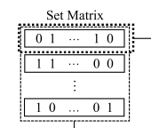
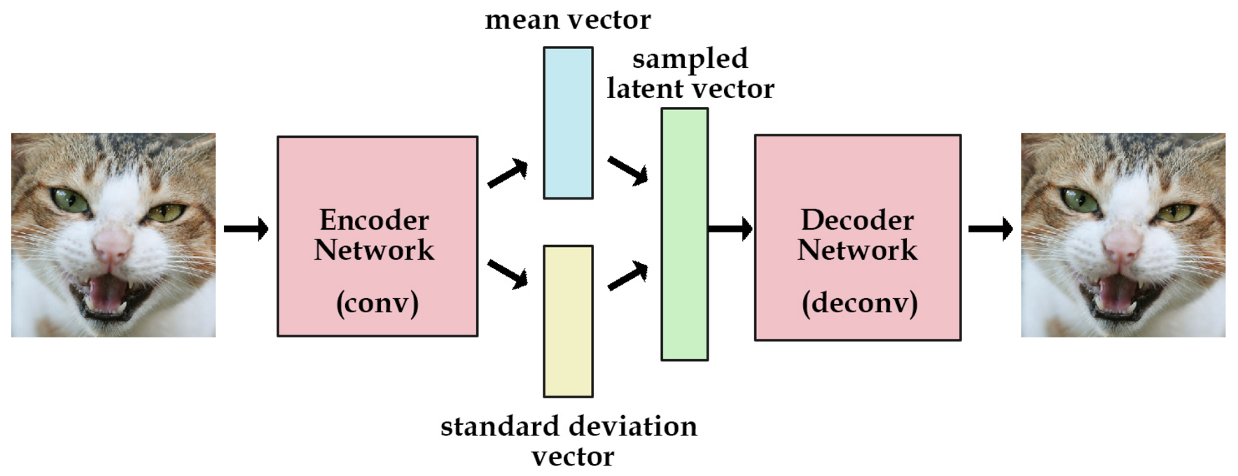
Concept
Set data
a data sample is represented by a set (e.g. a shopping basket in recommendation systems)
Elements
Graph nodes(e.g. products in recommendation systems)
Environments
different environments are with different selection bias
VAE（变分自编码器）
Deep Generative Model
重建 loss+KL散度

Slide 5



Notations and Problem
给出M个不同环境的graph和set data , 我们的任务是在其之上学习出一个稳定的图结构（如图的邻接矩阵），可以在不同的环境中都有良好的效果。
Method
由于环境的不同，不同环境的图结构以及节点的条件概率分布也不同
没有数据偏见的图结构和概率分布，应该是所有环境的随机选择。
因此，若一个图结构满足稳定图结构，应该满足上面的非偏见条件概率分布
→我们需要把图结构原始的参数空间(邻接矩阵)变为概率空间，然后在概率空间优化。

Slide 6



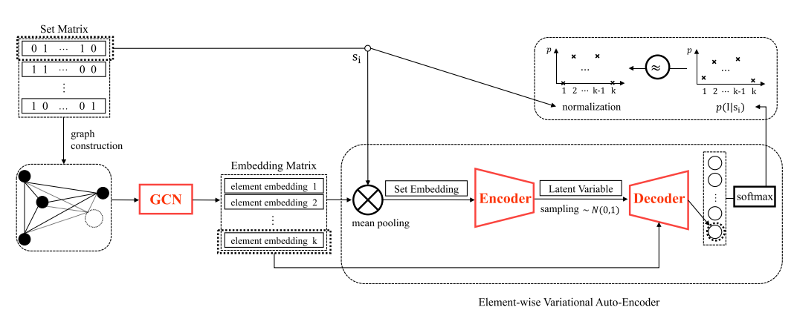
METHOD
1. Graph Based Set Generation
Model the function h()
GCN学习node的表示得到node的embedding matrix
使用embedding matrix对set编码得到set embedding
将set embedding输入到VAE，得到条件概率分布

Slide 7



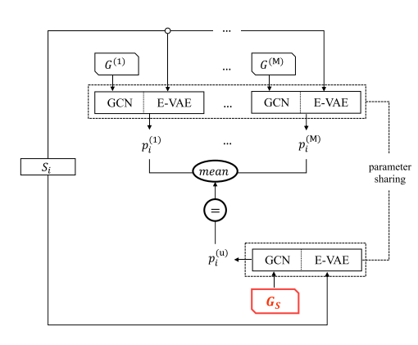

METHOD
2. Stable Graph Learning
使用训练好的GCN和VAE得到set在每个环境的条件概率分布
初始化稳定图结构$G_{s}$，将set输入得到稳定图中的条件概率分布
优化$G_{s}$使得稳定图条件概率等于每个环境的概率分布的均值

Slide 8


EXPERIMENT
Baselines and Data
由每个环境生成自己的图结构
将上面所有的图求平均
将所有环境的数据拼接到一起生成图结构
本研究提出的稳定图结构
Cloud Theme Click Dataset
淘宝APP中云主题场景的用户点击日志
more than 4 million purchase histories of users for one month

Slide 9
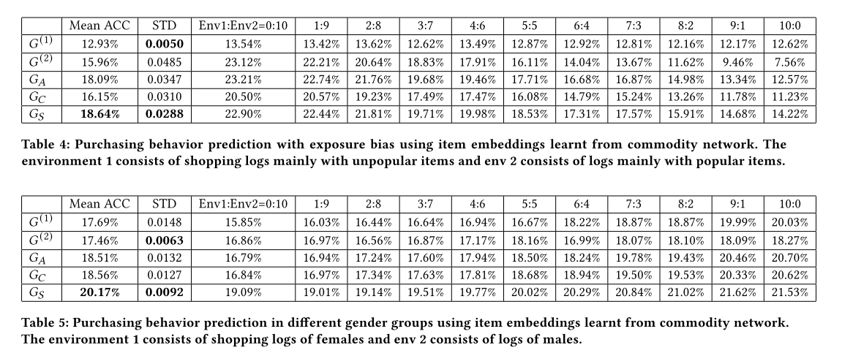
EXPERIMENT
Real Data Experiment
根据purchasing behavior prediction判断不同图结构的好坏
依据是否经常购买流行商品/用户性别换把整个数据集划分成两个不同的环境

