Slide 1
Paper Reading Sharing
NCF: A Neural Context Fusion Approach to Raw Mobility Annotation
李永康 2020/08/21

Slide 2
Motivation
most studies simply utilize POI check-ins to mine the concerned mobility patterns, the effectiveness of which is usually hindered due to data sparsity.
To obtain better POI-based human mobility for mining, in this paper, we strive to directly annotate the POIs associated with raw user-generated mobility records.

Slide 3
Introduction
Human mobility
location-based(focuses on the space and time aspects)
activity-based(explains the purposes behind people’s moves)
point-of-interest (POI) based(people’s movements between POIs)
source of POI-based human mobility
Check-in records (they are sparse by nature / experimentally verifies that temporally sparse mobility may not exhibit any significant transitional relationships)
raw mobility annotation(proactive acquisition of POI-based human mobility from user-generated timestamped locations can provide both densely-sampled trajectories and reliable semantics to support numerous potential applications)

Slide 4
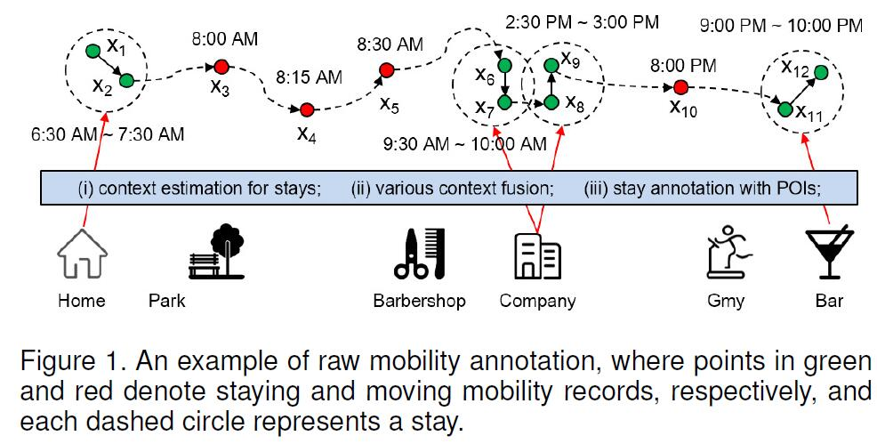
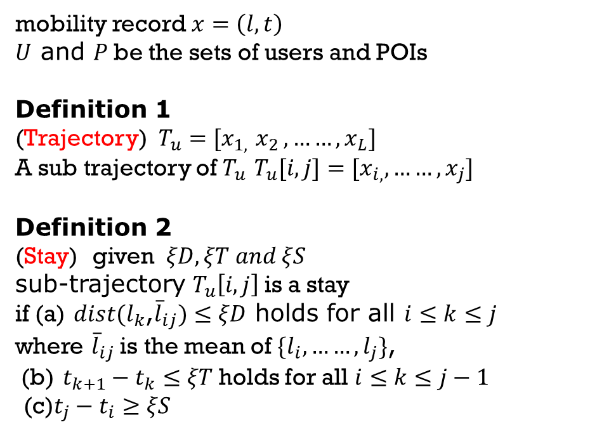
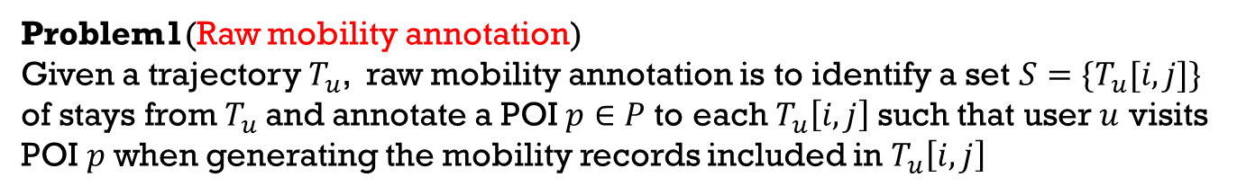
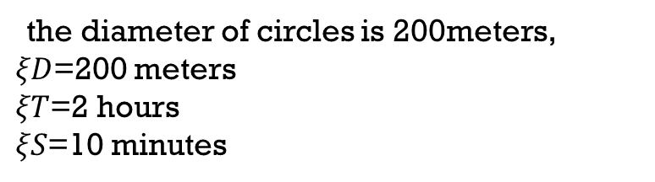
Raw mobility preprocessing
mobility record$x=\left(l,t\right)$
$U$ and $P$be the sets of users and POIs
Definition 1
(Trajectory) $T_{u}=[x_{1,}$ $x_{2 },……,x_{L}]$
A sub trajectory of $T_{u}$ $T_{u}[i,j]=[x_{i,},……,x_{j}]$
Definition 2
(Stay) given $ξD,ξT and ξS$
sub-trajectory $T_{u}\left[i,j\right]$is a stay
if (a) $dist(l_{k}$,${\overline{l}}_{ij})≤ξD$ holds for all $ⅈ≤k≤j$
where ${\overline{l}}_{ij}$is the mean of $\{l_{i},……,l_{j}\}$,
(b) $t_{k+1}−t_{k}≤ξT$holds for all $ⅈ≤k≤j−1$
(c)$t_{j}−t_{i}≥ξS$
the diameter of circles is 200meters,
$ξD$=200 meters
$ξT$=2 hours
$ξS$=10 minutes
Problem1(Raw mobility annotation)
Given a trajectory $T_{u}$, raw mobility annotation is to identify a set $S=\{T_{u}[i,j]\}$
of stays from $T_{u}$and annotate a POI $p∈P$to each $T_{u}\left[i,j\right]$such that user $u$ visits POI $p$when generating the mobility records included in $T_{u}\left[i,j\right]$

Slide 5
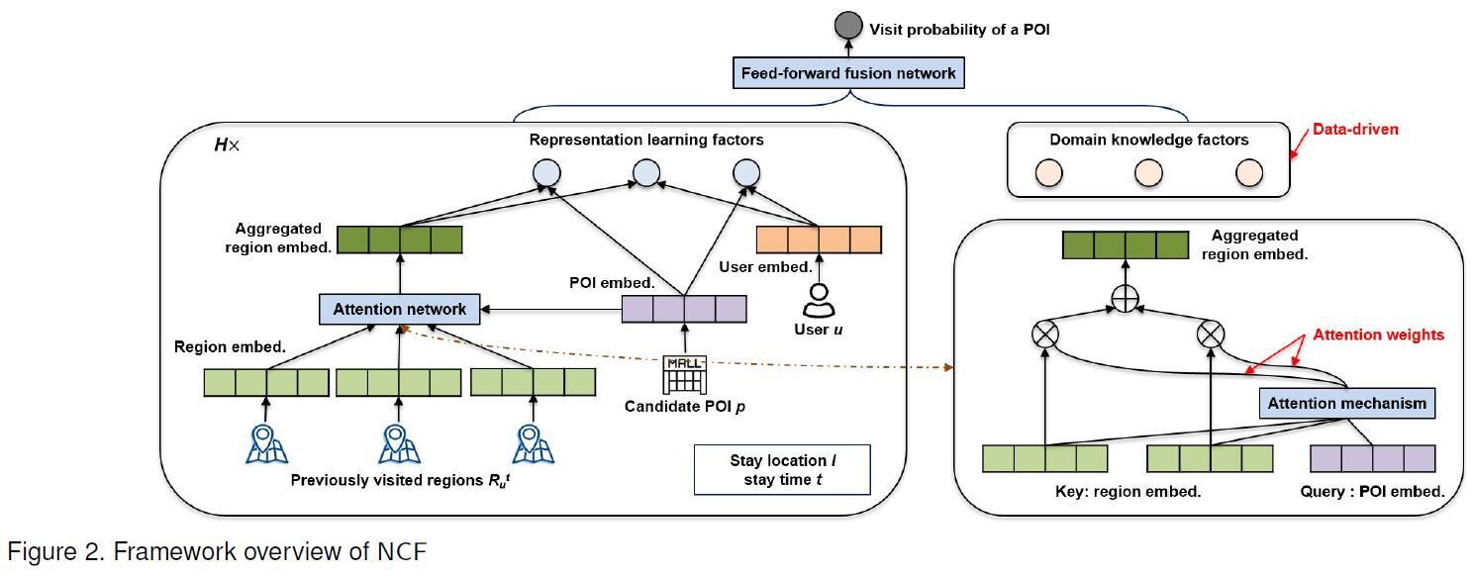
A neural context fusion approach
Input (a) a user $u ∈ U$ (b) location$l$and time stamp $t$of a stay $T_{u}\left[i,j\right]$
(c) a set $R_{u}^{t}$regions where user $u$ stays before time stamp $t$ (d) a candidate POI $p ∈ P$
Output the probability that $u$ is visiting $p$ when staying at location $l$and time stamp $t$

Slide 6
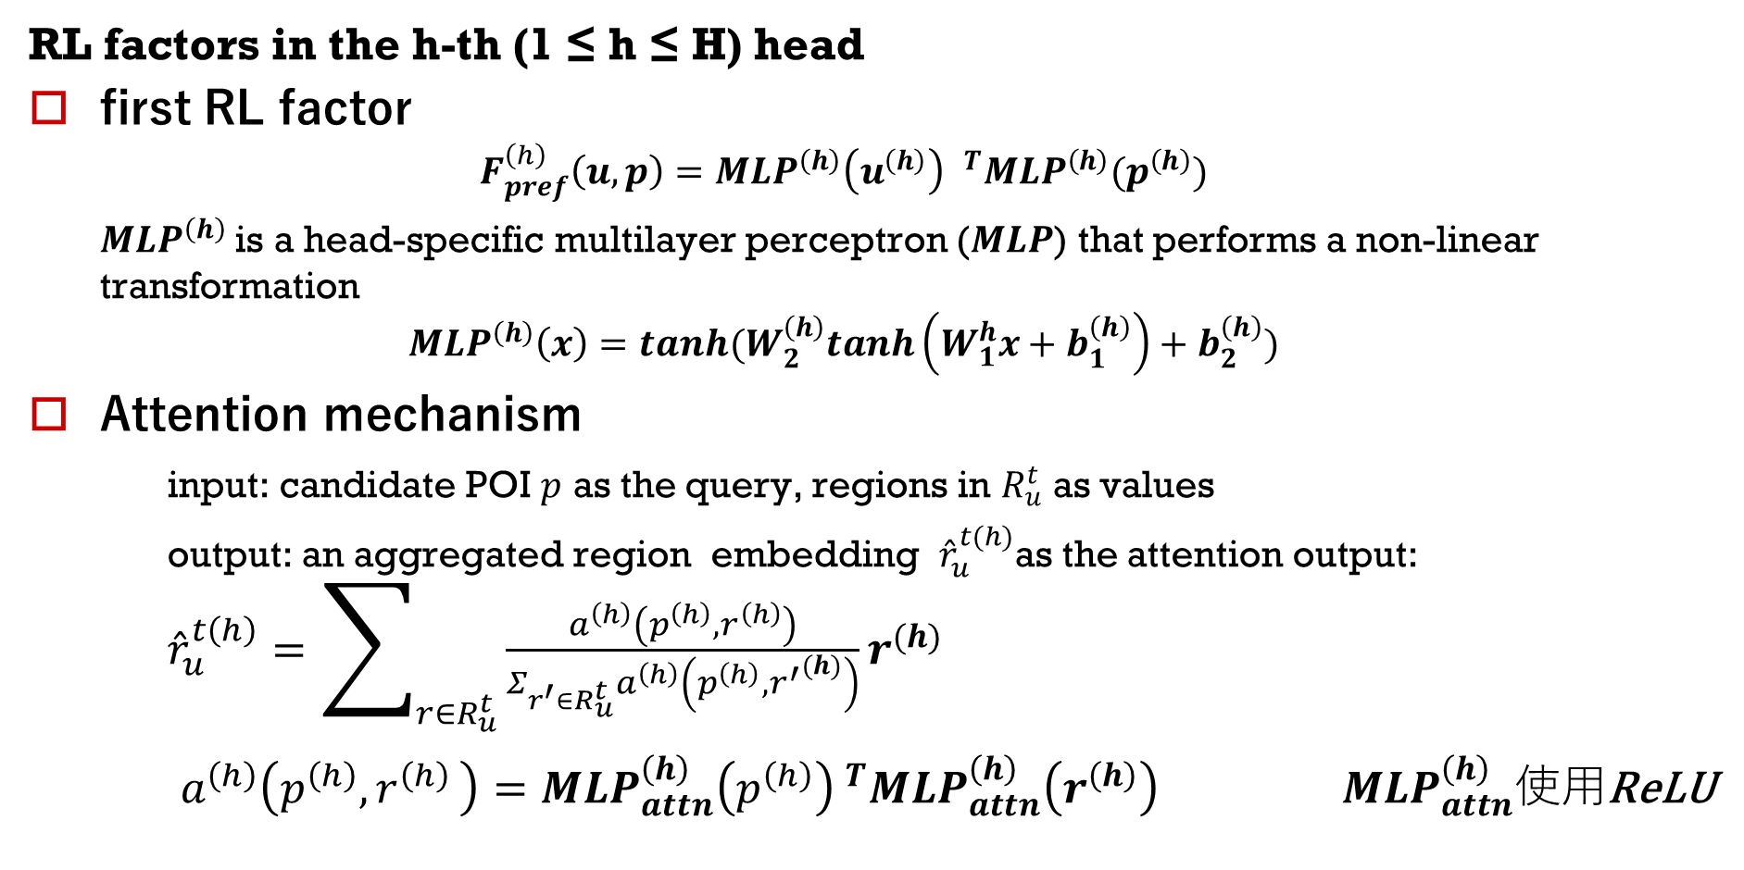
A neural context fusion approach
RL factors in the h-th (1 ≤ h ≤ H) head
first RL factor
$$F_{pref}^{\left(h\right)}\left(u,p\right)={{MLP}^{\left(h\right)}\left(u^{\left(h\right)}\right) }^{T}{MLP}^{\left(h\right)}(p^{\left(h\right)})$$
${MLP}^{\left(h\right)}$is a head-specific multilayer perceptron ($MLP$) that performs a non-linear transformation
$${MLP}^{\left(h\right)}\left(x\right)=tanh(W_{2}^{\left(h\right)}tanh\left(W_{1}^{h}x+b_{1}^{\left(h\right)}\right)+b_{2}^{\left(h\right)})$$
Attention mechanism
input: candidate POI $p$ as the query, regions in $R_{u}^{t}$ as values
output: an aggregated region embedding ${\hat{r}}_{u}^{t(h)}$as the attention output: ${\hat{r}}_{u}^{t\left(h\right)}=\sum_{r∈R_{u}^{t}}{\frac{a^{\left(h\right)}\left(p^{\left(h\right)}{,r}^{\left(h\right)}\right)}{Σ_{r^{′}∈R_{u}^{t}}a^{\left(h\right)}\left(p^{\left(h\right)},{r^{′}}^{(h)}\right)}r^{(h)}}$
$a^{\left(h\right)}\left(p^{\left(h\right)}{,r}^{\left(h\right)}\right)={MLP}_{attn}^{\left(h\right)}{\left(p^{\left(h\right)}\right) }^{T}{MLP}_{attn}^{\left(h\right)}\left(r^{\left(h\right)}\right)$ ${ MLP}_{attn}^{\left(h\right)}使用$ReLU

Slide 7


A neural context fusion approach
RL factors in the h-th (1 ≤ h ≤ H) head
Second RL factor (POI-based transition context factor)
Third RL factor （user-based transition context factor）

Slide 8
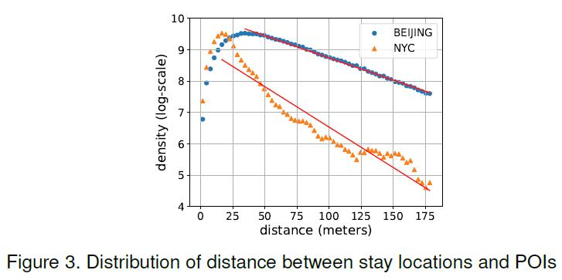


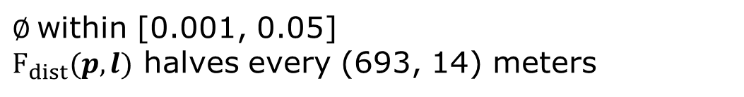
A neural context fusion approach
Domain knowledge factors （ three context factors）
distance context factor${ F}_{dist}(p,l)$
$∅$within [0.001, 0.05]
$F_{dist}(p,l)$ halves every (693, 14) meters

Slide 9
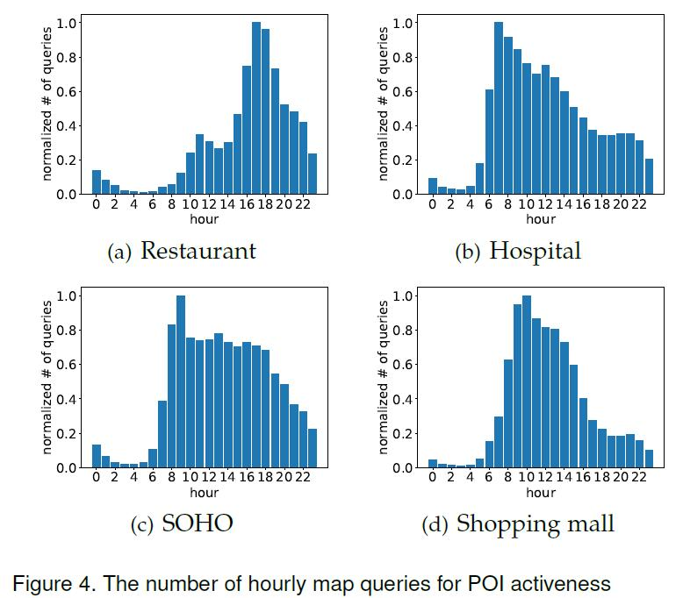



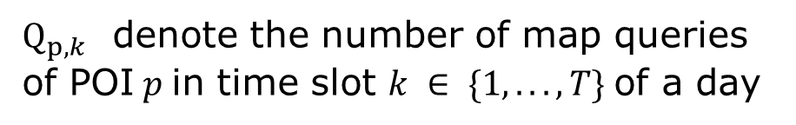
A neural context fusion approach
The time factor $F_{time}(p,t)$
$Q_{p,k}$ denote the number of map queries of POI$p$in time slot $k ∈ \{1, . . . , T\}$of a day
In this study, we consider two-hour time slots, T = 12. Note that two hours is a reasonable length of time for most POI visit purposes.
The popularity context factor $F_{popu}\left(p\right)$
$$F_{popu}\left(p\right)=log(\sum_{k}{Q_{p,k}}+1)$$
their candidate POIs (the top-100
nearest POIs around the stay location)

Slide 10
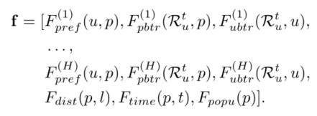

A neural context fusion approach
Training and Inference with Context Fusion
For each candidate POI $p$ of a stay of
user $u$ at location $l$ and time stamp $t$
$\hat{y}是$所有候选POI的访问概率组成的向量，$y是真实$POI对应的索引的one-hot 向量
损失函数为 $y$和$softmax\left(\hat{y}\right)的$交叉熵损失

Slide 11
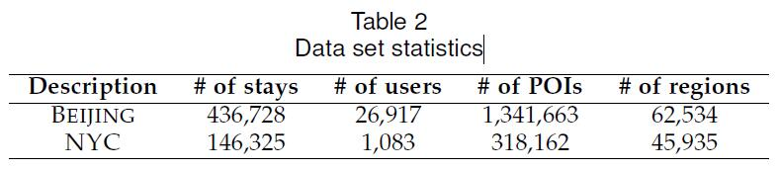
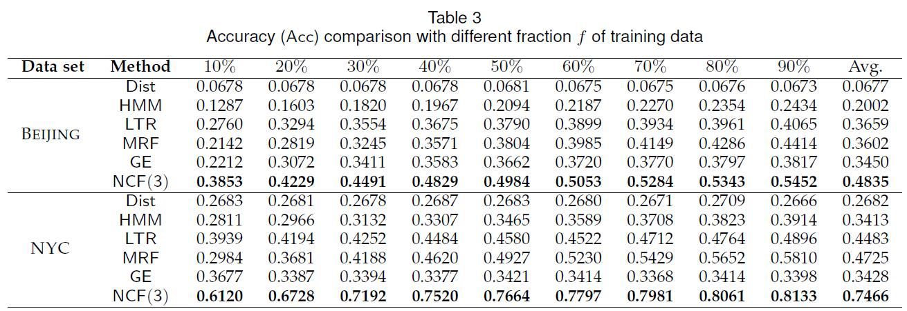
Experimental Setups

Slide 12
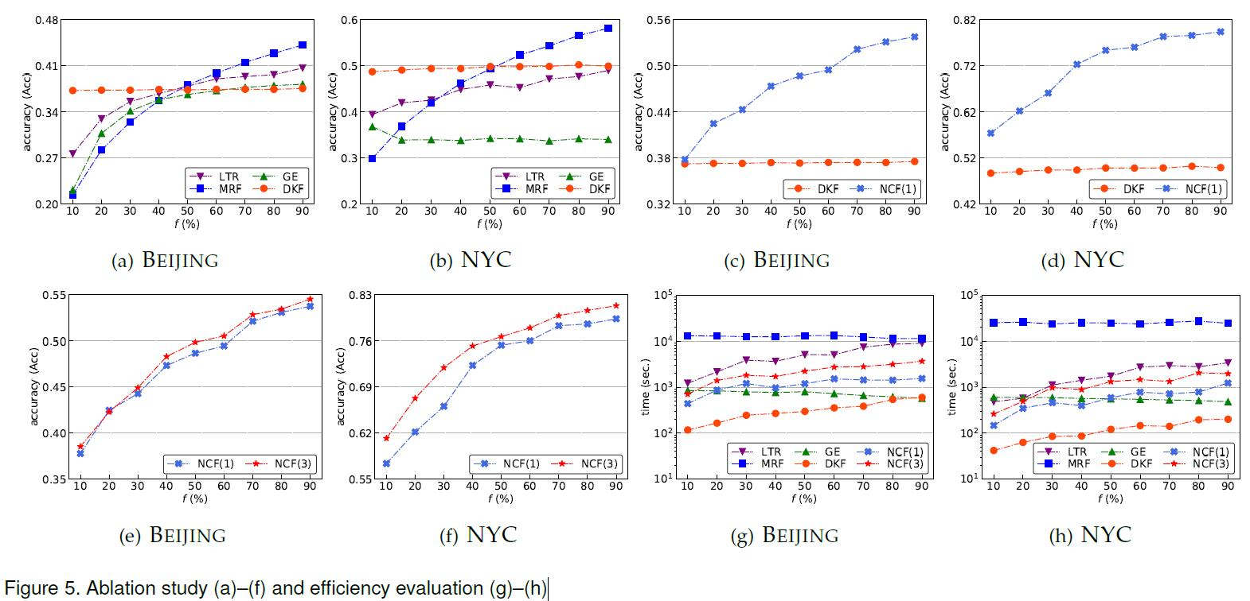
Experimental Setups
5(a) & 5(b) Domain knowledge factors
5(c) & 5(d). Representation learning factors.
5(e) & 5(f) Multi-head architecture
5(g) & 5(h) Efficiency comparison

Slide 13
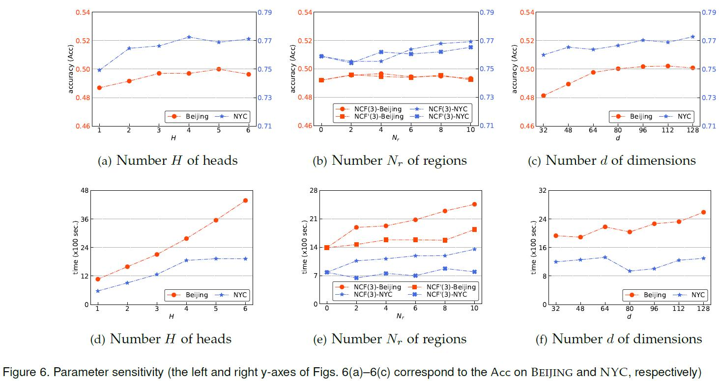
Experimental Setups

Slide 14
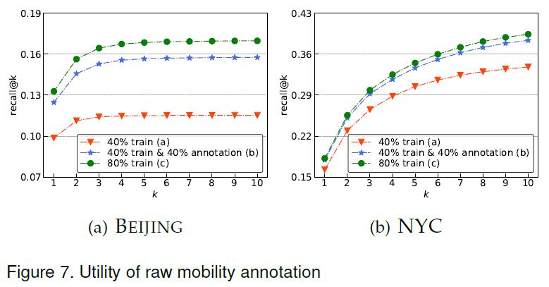
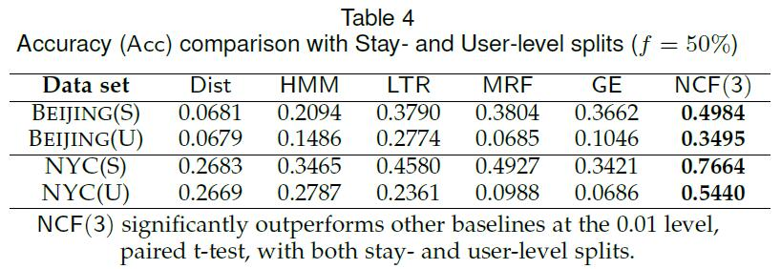
Experimental Setups

