Slide 1
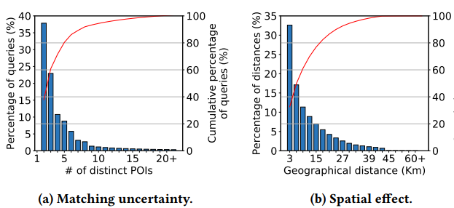
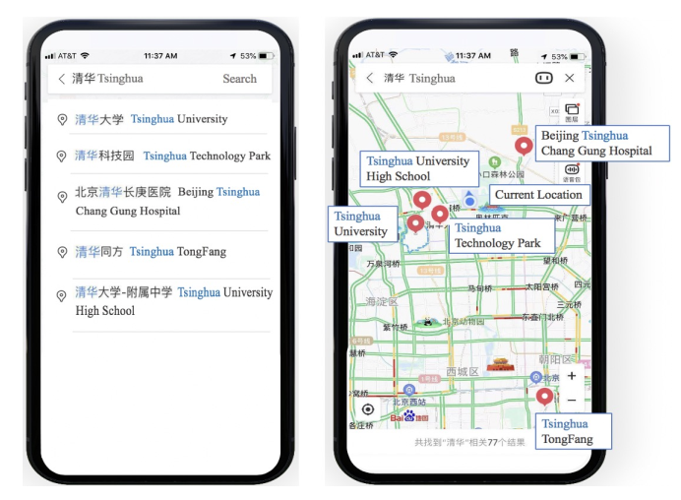
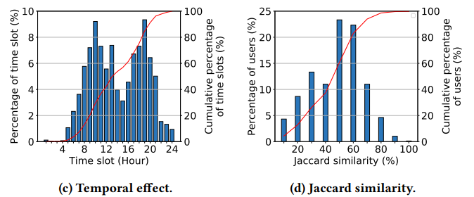
Spatio-Temporal Dual Graph Attention Network for query-POI Matching
POI: Point Of Interest

Slide 2
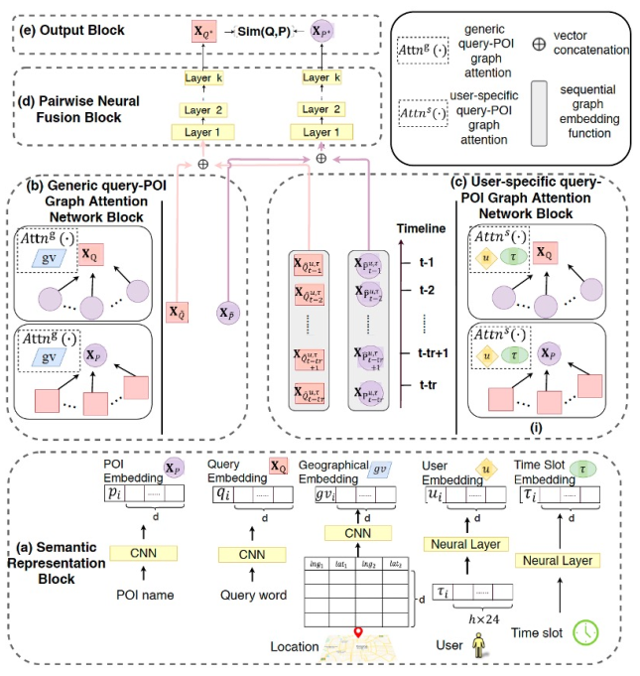
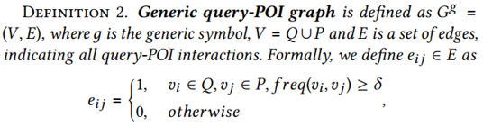

Definition 1. Map query event. A map query event is dened as a 4-tuple 𝑚𝑞 = {𝑢, 𝜏, 𝑞, 𝑝},
u user 𝜏 time slot q query p clicked POI

Slide 3
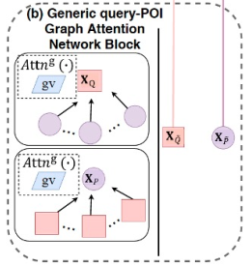
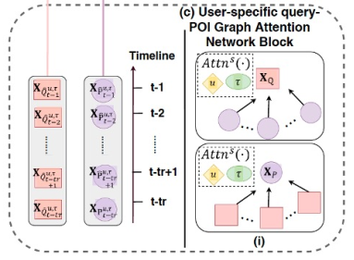

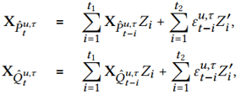
Generic query-POI graph attention
User-specific query-POI graph attention
ARMA
Attention weights are determined by both static semantic similarities and geographical correlations.

Slide 4




Generic query-POI graph attention
User-specific query-POI graph attention
Attention weights are determined by both static semantic similarities and geographical correlations.

Slide 5

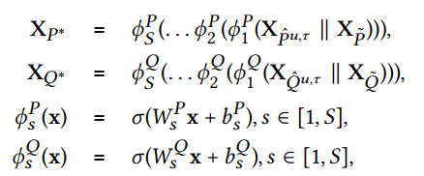
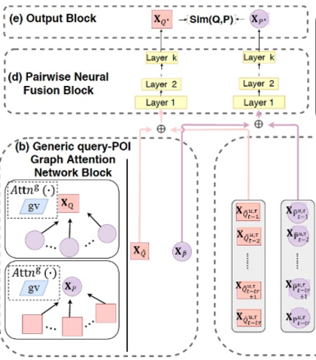

Fusion Block

Slide 6


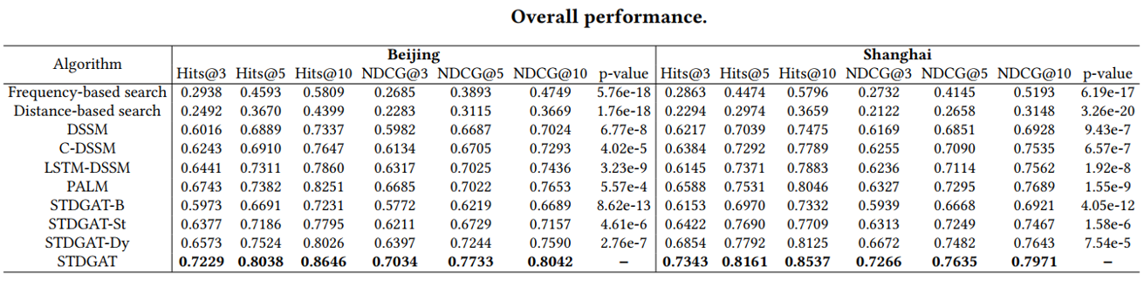
Evaluation Matrics

