Slide 1
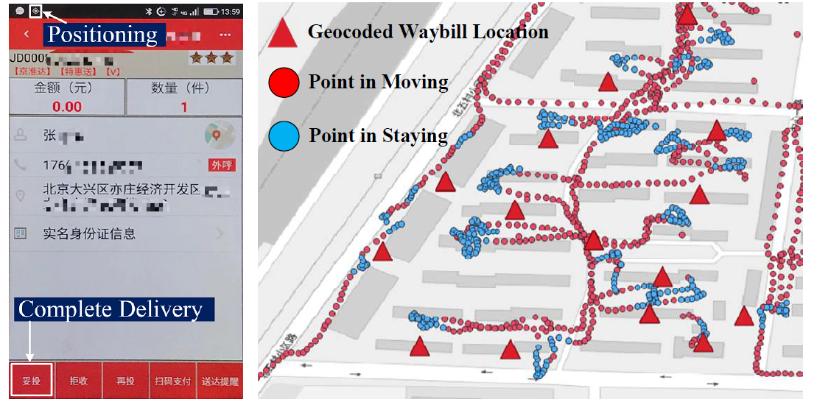
Doing in One Go: Delivery Time Inference Based on Couriers’ Trajectories
Geocoded Waybill Location: parsed from the plain text shipping addresses via Geocoding services

Slide 2


Definition
Waybill | parcel delivery task, 𝑤 = (𝑙_{a}, F_{𝑝}, 𝑡_{𝑟} , 𝑡_{𝑑} ).
Delivery Location | where a courier gives the parcel to the corresponding customer,𝑙_{𝑑} = (𝑥,𝑦),
Trajectory | A trajectory is a sequence of spatiotemporal points, denoted as 𝑡𝑟 =< 𝑝₁, 𝑝₂, ..., 𝑝_{𝑛} >, 𝑝 = (𝑥,𝑦,𝑡)
Stay Point | < 𝑝_{𝑖} , 𝑝_{𝑖+1}, ..., 𝑝_{𝑗} > is called a stay point 𝑠𝑝 if 𝑑𝑖𝑠𝑡𝑎𝑛𝑐𝑒 (𝑝_{𝑖} , 𝑝_{𝑘} ) ≤ 𝐷_{𝑚𝑎𝑥} (∀𝑘 ∈ [𝑖 + 1, 𝑗 ]), 𝑑𝑖𝑠𝑡𝑎𝑛𝑐𝑒 (𝑝_{𝑖} , 𝑝_{𝑗+1}) > 𝐷_{𝑚𝑎𝑥} and |𝑝_{𝑗} _{.𝑡} − 𝑝_{𝑖 .𝑡} | ≥ 𝑇_{𝑚𝑖𝑛}.
Delivery Trip | process that a courier delivers a batch of parcels to customers.
Location of a 𝑠𝑝

Slide 3
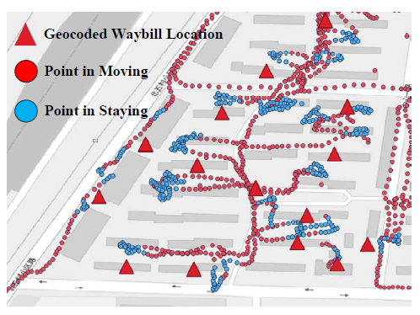
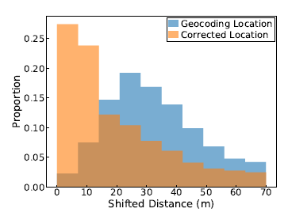
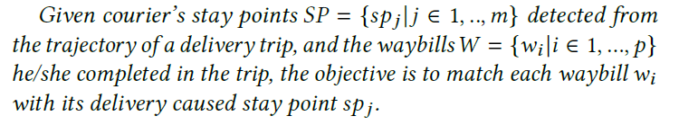
Extract the delivery time based on the stay points of the trajectories

Slide 4
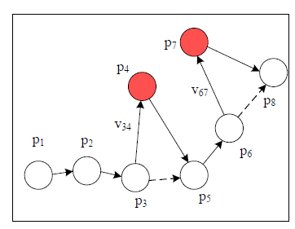
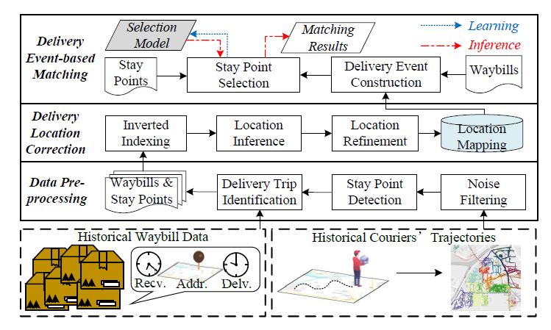
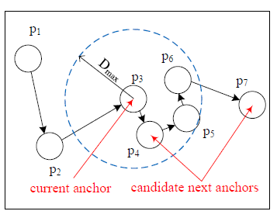
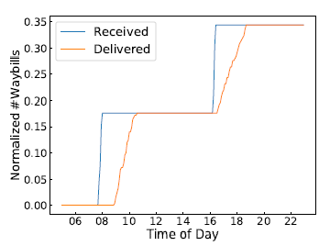
1)Noise Filtering
System framework of DTInf
Speed threshold
2)Stay PointDetection
𝐷_{𝑚𝑎𝑥} =20m
𝑇_{𝑚𝑖𝑛} =30s
3)Delivery Trip Identification

Slide 5
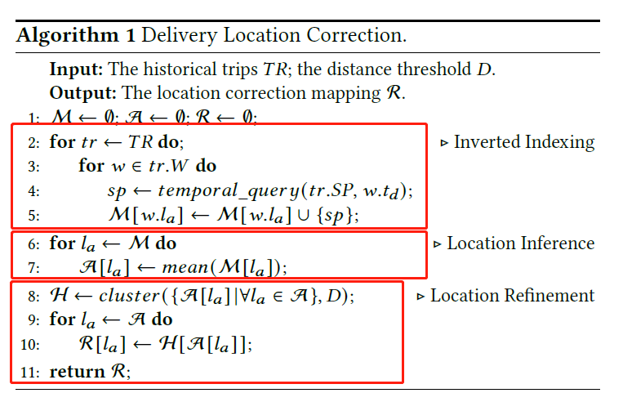
Delivery Location Correction
Inverted index M
Raw delivery location hashmap A
Hierarchical clustering algorithm
Clustering result H

Slide 6
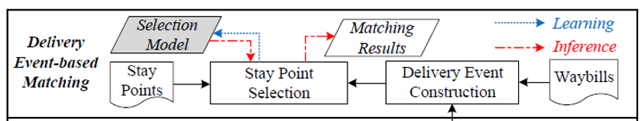

1) Delivery Event Construction
Delivery Event-based Matching
Group waybills into several delivery events according to their corrected delivery locations.
Assign that stay point to all waybills in that event
2) Stay Point Selection
MLP
cross entropy loss
Location features
Delivery event features
Stay point features
Matching feature

Slide 7
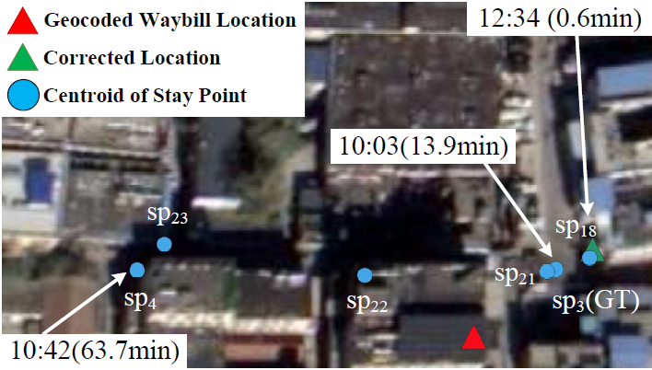
Case Study

Slide 8
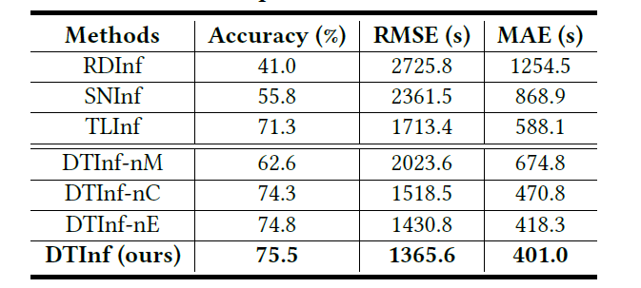
Evaluation Metrics
selects the stay point that is the closest
to the corrected location
does not correct the delivery locations
does not construct delivery events

