Slide 1
Flow Prediction in Spatio-Temporal Networks
Based on Multitask Deep Learning
邓婕文
2020年6月24日

Slide 2
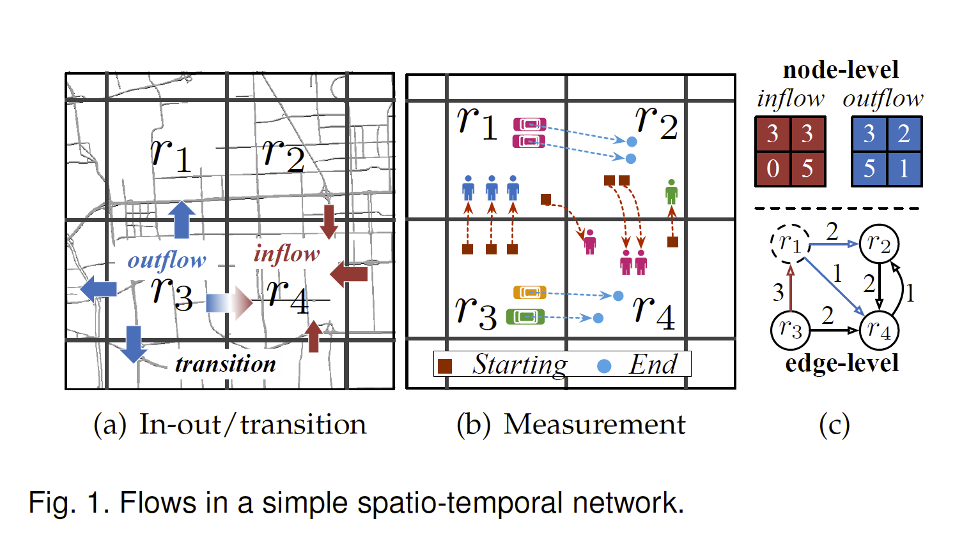
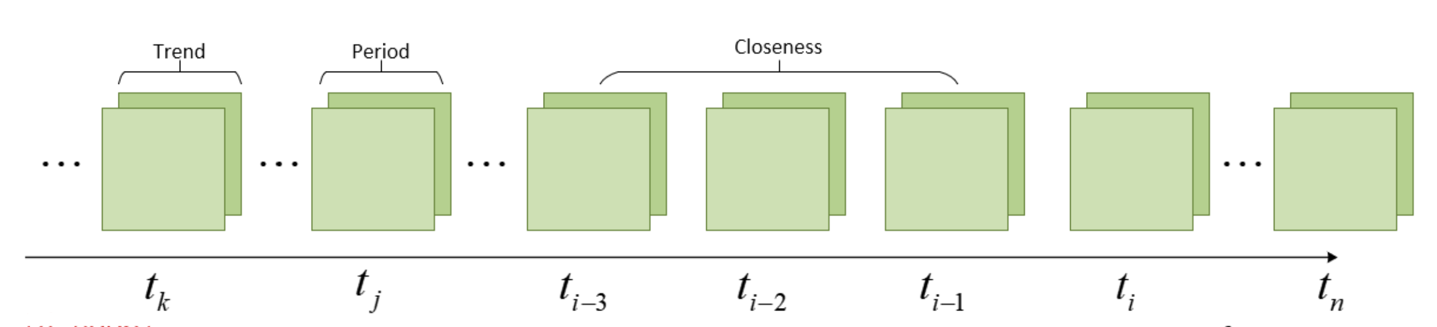
MDL
Node Level

Slide 3
MDL
Edge Level

Slide 4
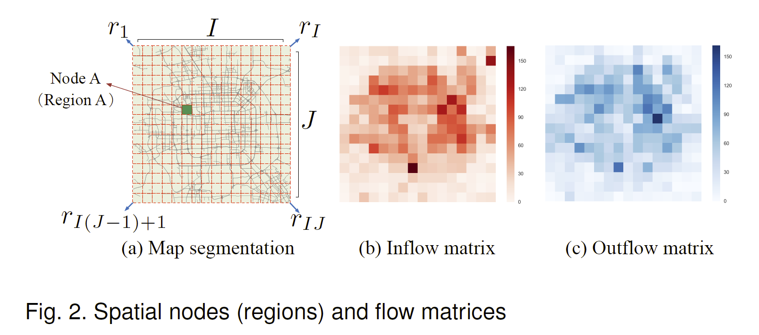

MDL
In/Out Flows
the point $(x, y)$ lies within the node $r_{ij}$.
Outflow:
Inflow:
the timestamp $τ_{e}$ is in the time interval t.

Slide 5
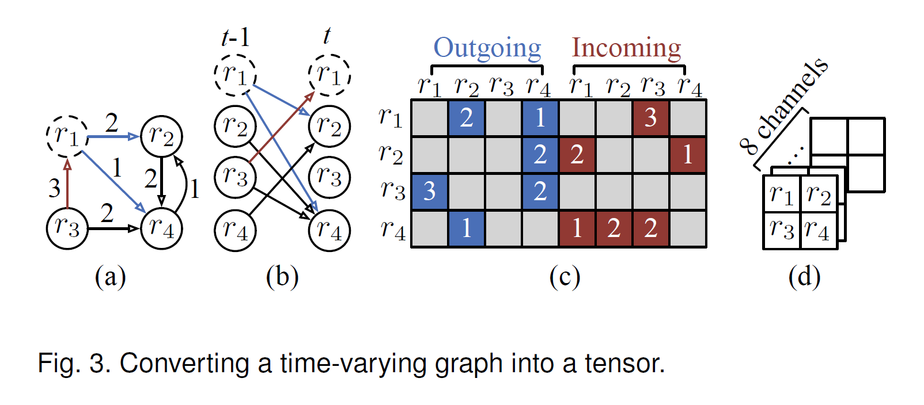
MDL
How to apply deep neural networks to time-varying graphs?
We propose converting each graph at time t into a tensor first.
(a) Given a graph consisting of 4 nodes and 6 edges at time t.
(b) Unroll it that is a directed graph.
(a) For each node, there are incoming and outgoing transitions, represented by a vector (dimension= 8).
(a) Finally, we can reshape the matrix into a tensor.

Slide 6
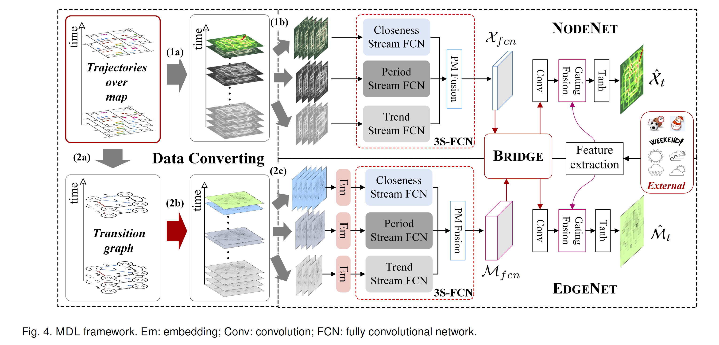
MDL
Framework
Embed very large information networks into low-dimensional vector spaces.

Slide 7
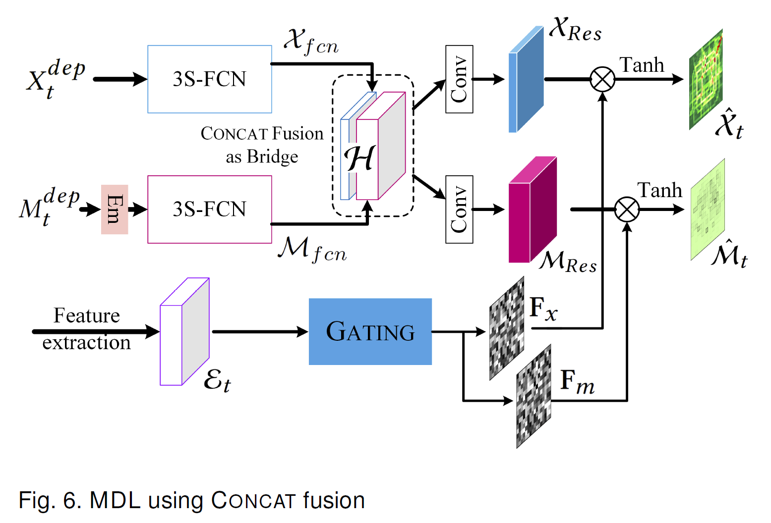
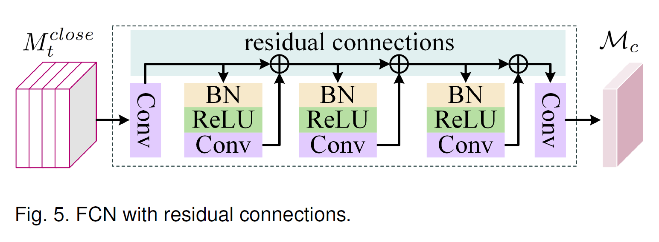
MDL
3S-FCN
Fusing External Factors
Where propose a three-stream FCN (3S-FCN) to capture
temporal closeness, period, and trend dependencies.
We here develop a gating-mechanism-based fusion.
Each stream is a FCN.

Slide 8
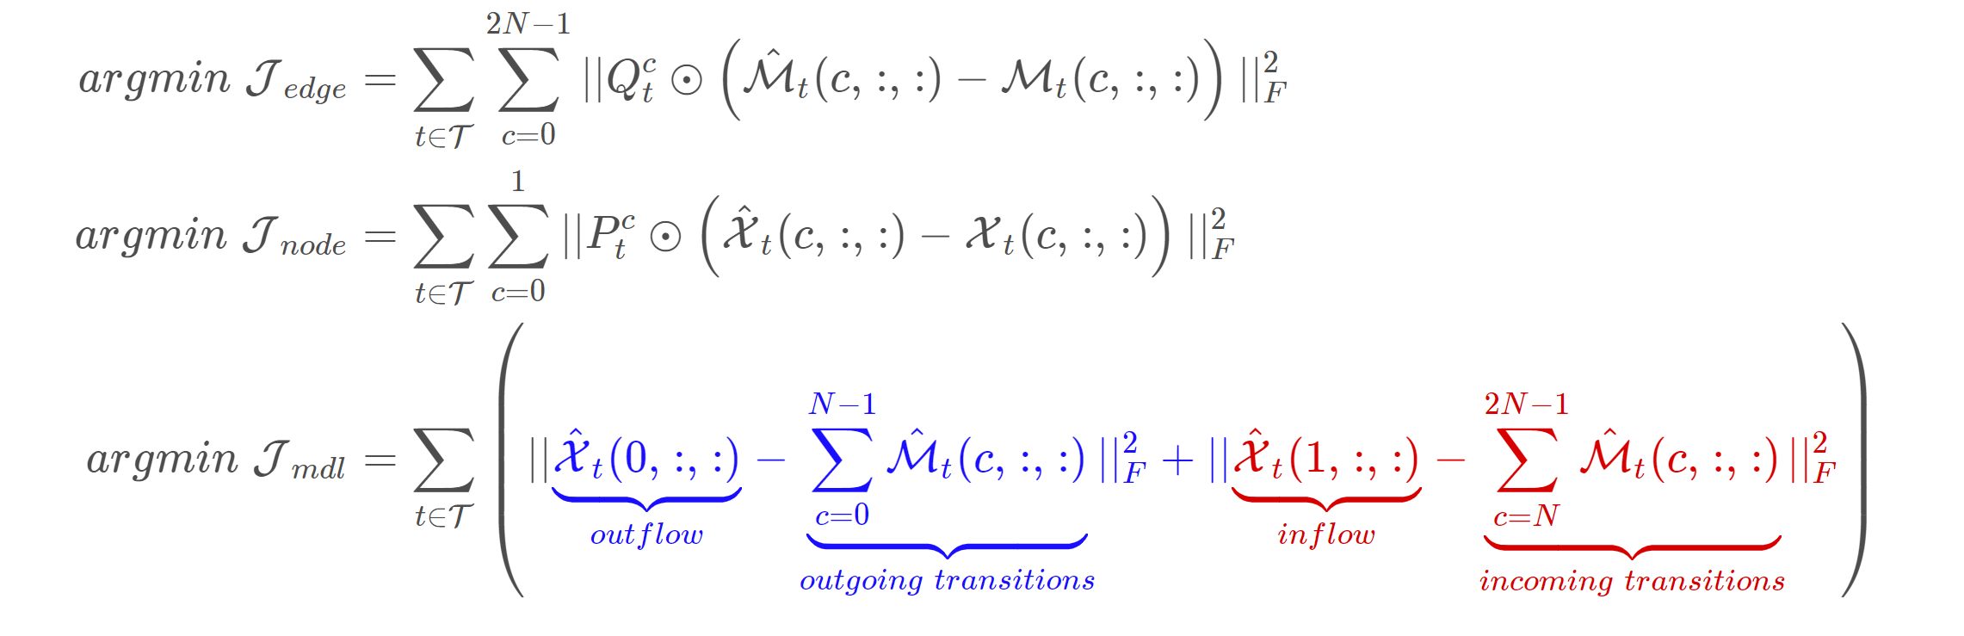
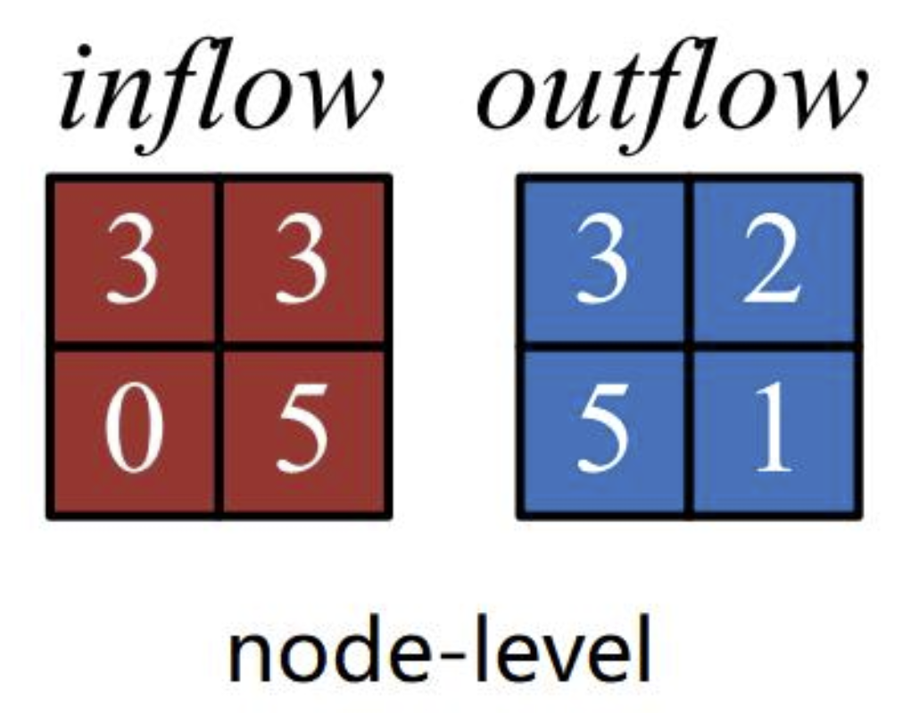
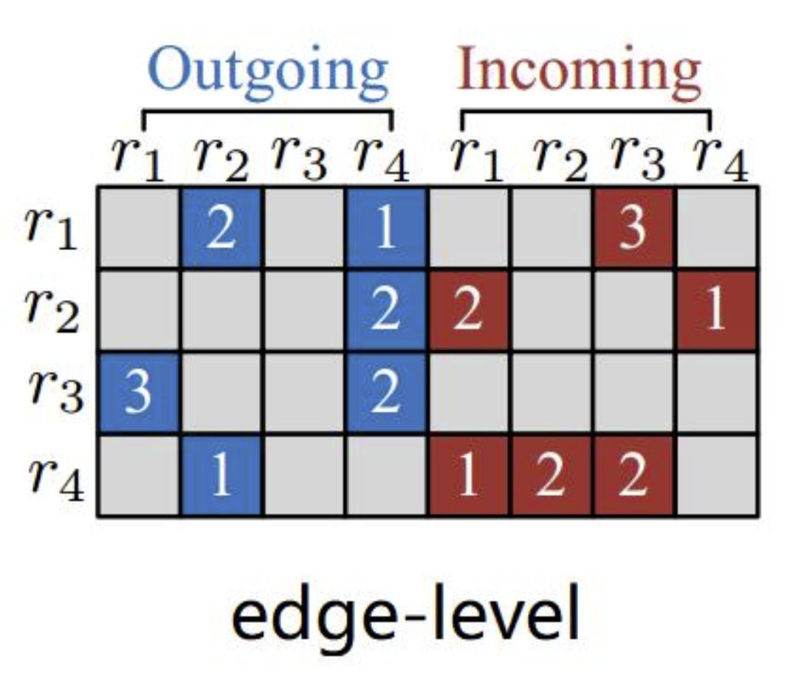
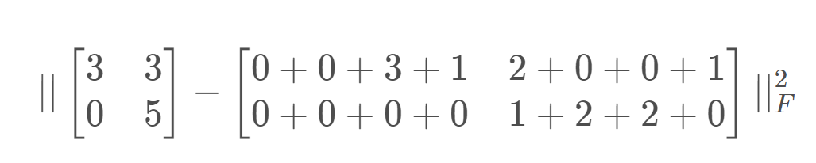
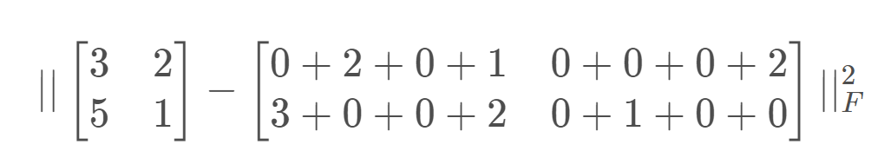
MDL
Losses
Inflow:
Outflow:

