Slide 1
AM-GCN: Adaptive Multi-channel Graph Convolutional Networks
(KDD2020)
邓婕文
2020年9月4日

Slide 2
AM-GCN
Problem
The capability of the state-of-the-art GCN in fusing node features and topological structures is distant from optimal or even satisfactory.
GCN may not be able to adaptively learn some deep correlation information between topological structures and node features.
Solution
Extract the specific and common embeddings from node features, topological structures, and their combinations simultaneously;
Use the attention mechanism to learn adaptive importance weights of the embeddings.

Slide 3
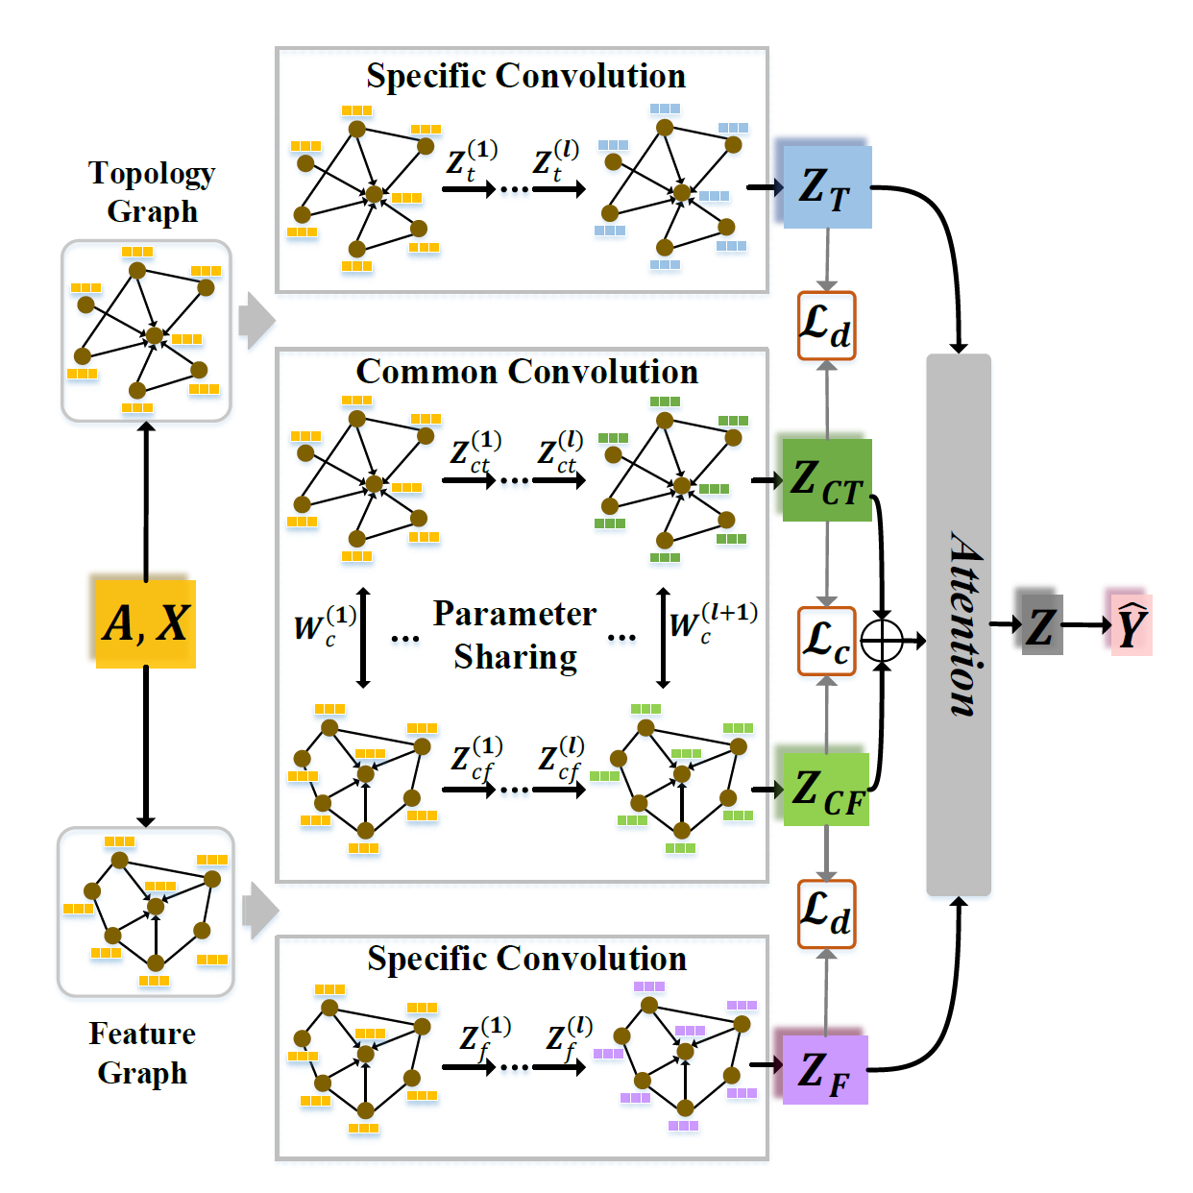






AM-GCN
AM-GCN Model Architecture
Specific Convolution Module
Feature space:
Common Convolution Module
Topology graph
Feature graph
Attention Mechanism

Slide 4
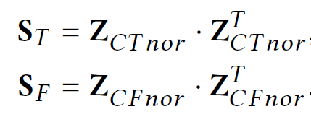

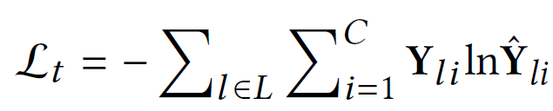

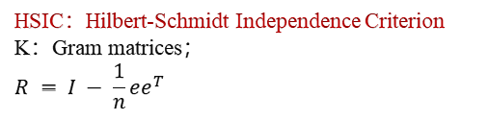
AM-GCN
Objective Function
Consistency Constraint: Enhance the commonality
Disparity Constraint: Enhance the disparity
HSIC：Hilbert-Schmidt Independence Criterion
K：Gram matrices；
$$R = I − \frac{1}{n}ee^{T}$$
Optimization Objective: Cross-entropy Loss

Slide 5
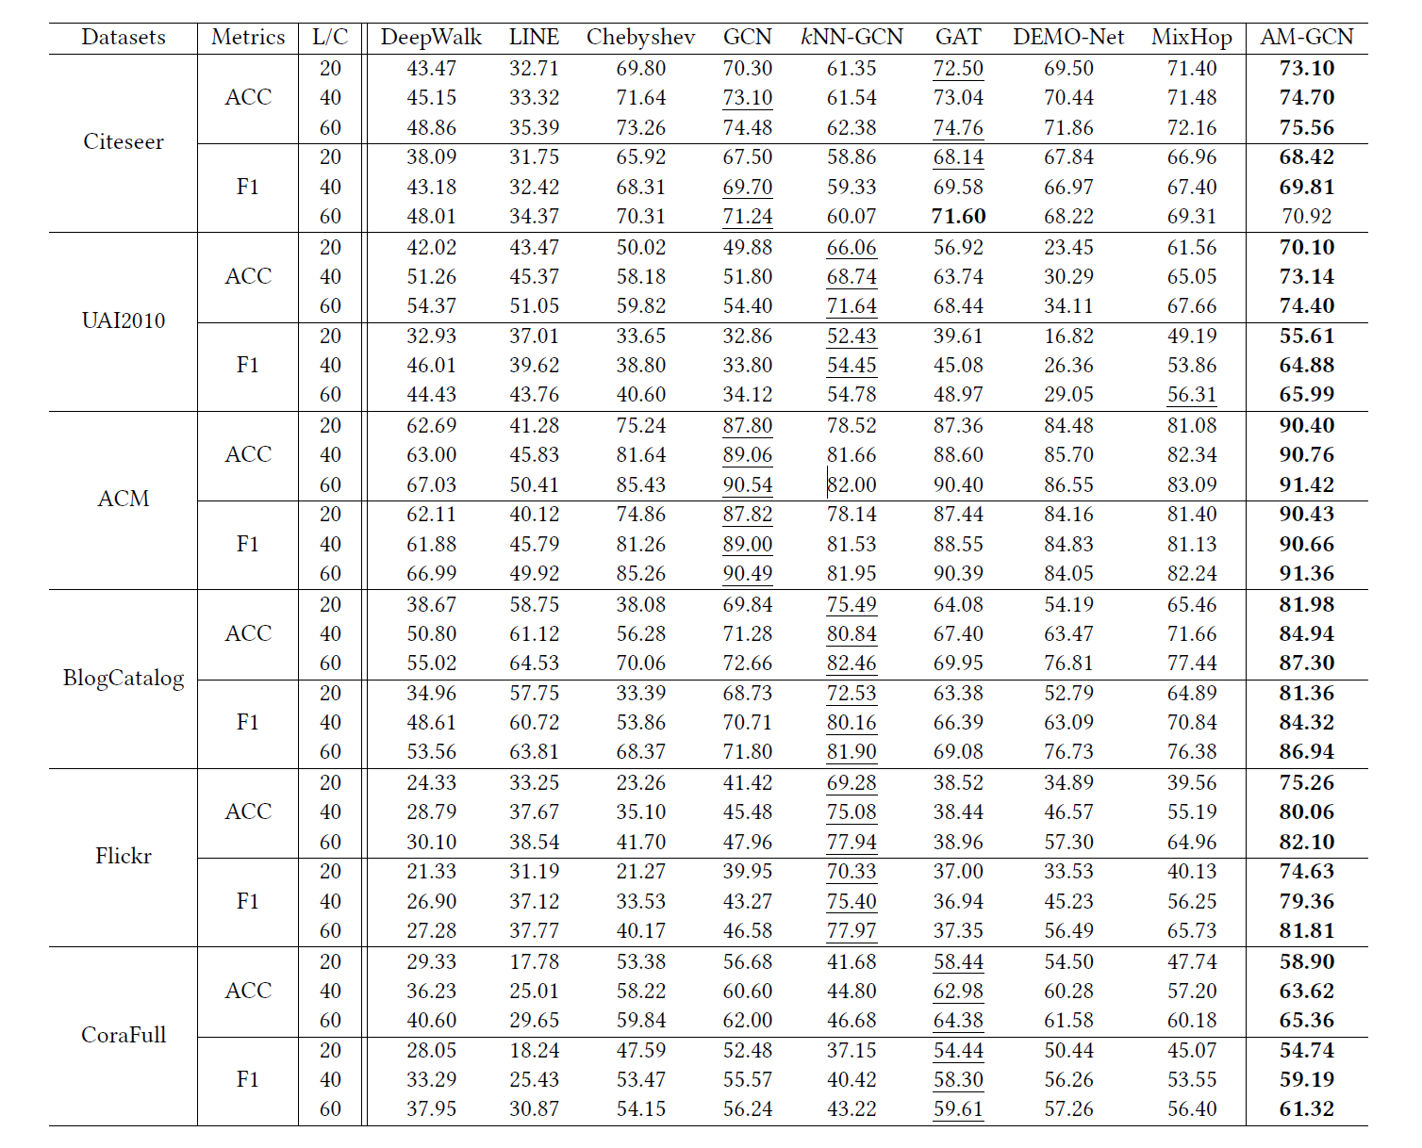
AM-GCN
Experiment

Slide 6
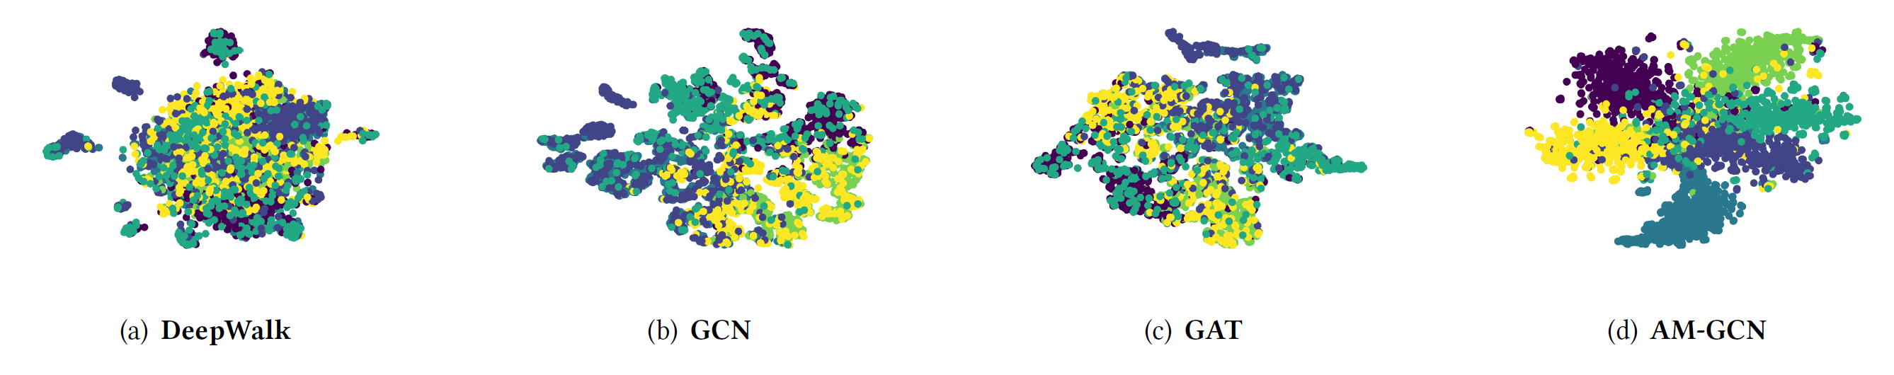
AM-GCN
Visualization of the learned node embeddings

