Slide 1

NCKU Programming Contest Training Course
2013/05/18
Pinchieh Huang (free999)
Pinchieh.huang@gmail.com
http://myweb.ncku.edu.tw/~p76014143/20130508.rar
Department of Computer Science and Information Engineering
National Cheng Kung University
Tainan, Taiwan

Slide 2
Outline
Chinese Postman Problem
Difference Constraint

Slide 3
Chinese Postman Problem
Problem Definition
Given a (weighted) graph G(V, E). Start from a given vertex, finding the shortest route that cover each at least once and back to the origin vertex.
source
source

Slide 4
Chinese Postman Problem
Euler Path (Circuit)
Eulerian trail (or Eulerian path) is a trail in a graph which visits every edge exactly once. Similarly, an Eulerian circuit or Eulerian cycle is an Eulerian trail which starts and ends on the same vertex.

Slide 5
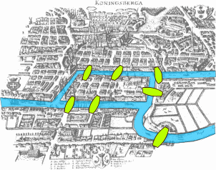
Chinese Postman Problem
How to determine whether a Euler Path (Circuit) can be found?
Seven Bridges of Königsberg

Slide 6
Chinese Postman Problem
Lemma
A Euler Path can be found in a graph if the number of vertexes with odd degree are less or equal than two. A Euler Circuit can be found in a graph if the number of vertexes with odd degree is equal to 0.
number of V_{odd} =
number of V_{odd} =
number of V_{odd} =

Slide 7
Chinese Postman Problem
Lets return the original problem..
If we can found an Euler circuit in the given graph, the answer is obvious the summation of all edges’ weight.
If we can’t…. ??

Slide 8
Chinese Postman Problem
3
4
5
8
2
4
10
3
6
1
source

Slide 9
Chinese Postman Problem
3
4
5
2
4
3
6
1
source

Slide 10
Chinese Postman Problem
3
4
5
2
4
10
3
6
1
source

Slide 11
Chinese Postman Problem
3
4
5
?
2
4
10
3
6
1
source

Slide 12
Chinese Postman Problem
3
4
5
最短路徑 (9)
2
4
10
3
6
1
source

Slide 13
Chinese Postman Problem
奇
奇
奇
奇

Slide 14
Chinese Postman Problem
奇
奇
奇
奇

Slide 15
Chinese Postman Problem
奇
奇
奇
奇

Slide 16
Chinese Postman Problem
奇
奇
奇
奇

Slide 17
Chinese Postman Problem
3
4
5
7
8
9
2
4
10
3
6
1
source

Slide 18
Chinese Postman Problem
3
4
5
7
8
9
2
4
10
3
6
1
source

Slide 19
Chinese Postman Problem
3
4
5
8
2
4
10
3
6
1
source

Slide 20
Chinese Postman Problem
3
4
5
8
2
4
10
3
6
1
source

Slide 21
Chinese Postman Problem
3
4
5
8
2
4
10
3
6
1
source

Slide 22
match
dp[bit] = 走過 bit 上的點的最短距離
求 dp[ (1<<N) -1 ]
枚舉任兩個拜訪過的點
3
2
4
1

Slide 23
Example
UVa 10296

Slide 24
Outline
Chinese Postman Problem
Difference Constraint

Slide 25
Difference Constraint
Given :
X1 - X2 <= 0 X1 - X5 <= -1 X2 - X5 <= 1 X3 - X1 <= 5 X4 - X1 <= 4 X4 - X3 <= -1 X5 - X3 <= -3 X5 - X4 <= -3
Find :
A feasible solution of X1, X2, …,X5

Slide 26
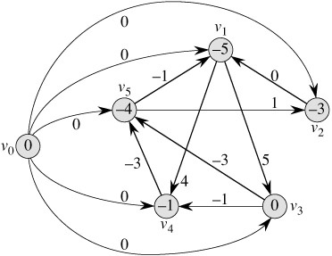
Difference Constraint

Slide 27
example
Uva 515

Slide 28
K-shortest Path

Slide 29
Homework
Uva
515,
POJ
1201, 2983, 1364, 1275

