Slide 1

NCKU Programming Contest Training Course
2013/05/22
Pin-Chieh Huang (free999)
Pinchieh.huang@gmail.com
http://myweb.ncku.edu.tw/~P76014143/20130522_Flow.rar
Department of Computer Science and Information Engineering
National Cheng Kung University
Tainan, Taiwan

Slide 2
Outline
Maximum Network Flow

Slide 3
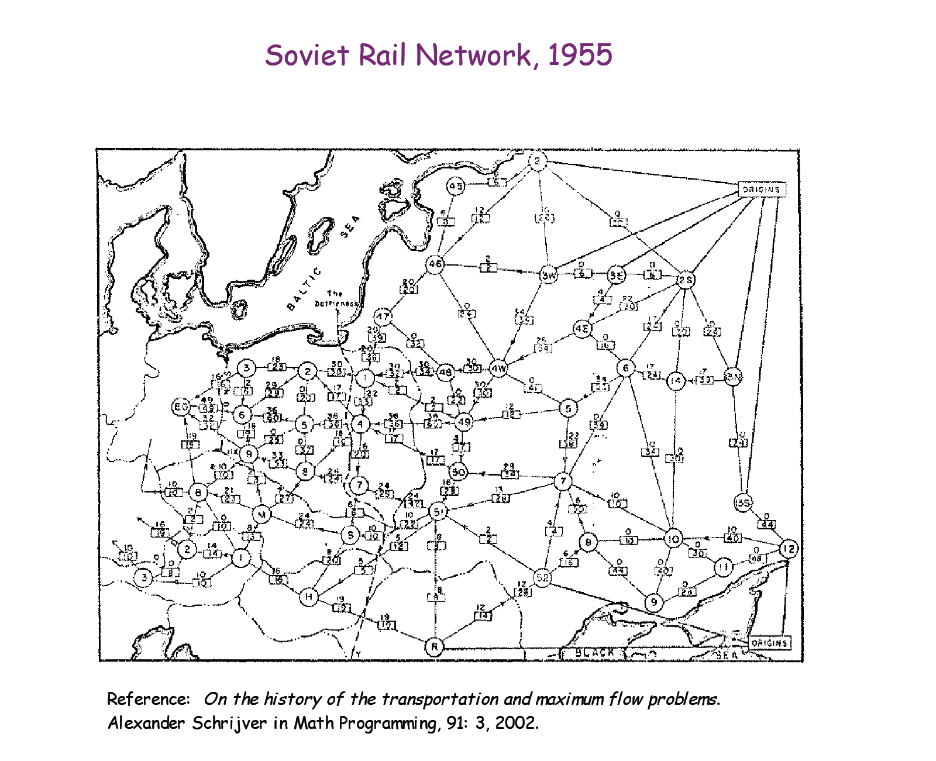
Maximum Flow
Network flow problem

Slide 4
Maximum Flow
Network flow problem
A flow network G=(V,E): a directed graph, where each edge (u,v)∈E has a nonnegative capacity c(u,v)>=0.
If (u,v)∉E, we assume that c(u,v)=0.
two distinct vertices :a source s and a sink t.
12
16
20
s
10
9
7
t
4
13
4
14

Slide 5
Maximum Flow
G=(V,E): a flow network with capacity function c.
s -- the source and t -- the sink.
A flow in G: a real-valued function f:V*V → R satisfying the following two properties:
Capacity constraint: For all u,v ∈V,
we require f(u,v) ≤ c( u,v).
Flow conservation: For all u ∈V-{s,t}, we require

Slide 6
Maximum Flow
The quantity f (u,v) is called the net flow from vertex u to vertex v.
The value of a flow is defined as
The total flow from source to any other vertices.
The same as the total flow from any vertices to the sink.

Slide 7
Maximum Flow
12/12
11/16
15/20
s
10
t
1/4
4/9
7/7
8/13
4/4
11/14
A flow f in G with value .

Slide 8
Maximum Flow
Given a flow network G with source s and sink t
Find a flow of maximum value from s to t.
How to solve it efficiently ?

Slide 9
Maximum Flow
This section presents the Ford-Fulkerson method for solving the maximum-flow problem. We call it a “method” rather than an “algorithm” because it encompasses several implementations with different running time. The Ford-Fulkerson method depends on three important ideas that transcend the method and are relevant to many flow algorithms and problems: residual networks, augmenting paths, and cuts. These ideas are essential to the important max-flow min-cut theorem, which characterizes the value of maximum flow in terms of cuts of the flow network.

Slide 10
Maximum Flow
FORD-FULKERSON-METHOD(G,s,t)
initialize flow f to 0
while there exists an augmenting path p
do augment flow f along p
return f

Slide 11
Maximum Flow
Given a flow network and a flow, the residual network consists of edges that can admit more net flow.
G=(V,E) --a flow network with source s and sink t
f: a flow in G.
The amount of additional net flow from u to v before exceeding the capacity c(u,v) is the residual capacity of (u,v), given by:
In the regular direction: c_{f}(u,v)=c(u,v)-f(u,v)
in the other direction: c_{f}(v, u)=c(v, u)+f(u, v).

Slide 12
Maximum Flow
12
12
v₁
v₃
v₁
v₃
16
20
16
20
s
10
4
7
t
s
7
9
10
4
t
9
13
4
13
v₂
v₄
v₂
v₄
4
14
14
4/12
8
4/16
v₁
v₃
20
12
v₁
v₃
20
4
s
7
s
4
4
10
4
t
10
4
t
4/9
7
5
13
4/4
13
10
4
v₂
v₄
v₂
v₄
4/14
4

Slide 13
Maximum Flow
1
1
1
1
1
1
1

Slide 14
Maximum Flow
1
1
1
1
1
1
1

Slide 15
Maximum Flow
1
1
1
1

Slide 16
Maximum Flow
1
1
1
1

Slide 17
Maximum Flow
1
1
1
1
1
1

Slide 18
12
v₁
v₃
16
20
s
10
4
7
t
9
13
4
v₂
v₄
14
Initial

Slide 19
12
4/12
v₁
v₃
v₁
v₃
16
20
4/16
20
s
10
4
7
t
s
7
9
10
4
t
4/9
13
4
13
4/4
v₂
v₄
v₂
v₄
14
4/14
(a)

Slide 20
8
12
4/12
v₁
v₃
v₁
v₃
20
7/20
4
11/16
s
4
4
10
4
t
s
4
7/7
t
7
7/10
4/9
5
13
10
4
13
4/4
v₂
v₄
v₂
v₄
4
11/14
(b)

Slide 21
8
12/12
5
v₁
v₃
13
v₁
v₃
4
11/16
15/20
11
4
s
3
11
7
7
t
s
7/7
10
1/4
t
5
4/9
13
3
8/13
4/4
v₂
v₄
4
v₂
v₄
11
11/14
(c)

Slide 22
Example
Uva 820

Slide 23
Outline
Bipartite Matching

Slide 24
Bipartite Matching
L
R
L
R
(a)
(b)

Slide 25
Bipartite Matching
1
1
2
2
3
3
4
4
5
L
R

Slide 26
Bipartite Matching
1
1
2
2
3
3
4
4
5
L
R

Slide 27
Bipartite Matching
1
1
2
2
3
3
4
4
5
L
R

Slide 28
Bipartite Matching
1
1
2
2
2
3
3
3
4
4
4
5
L
R

Slide 29
Bipartite Matching
1
1
2
2
2
2
1
3
3
3
4
4
4
5
L
R

Slide 30
Bipartite Matching
1
1
2
2
2
2
1
1
3
3
3
4
4
4
5
L
R

Slide 31
Bipartite Matching
1
1
2
2
2
2
1
1
3
3
3
4
4
4
5
L
R

Slide 32
Bipartite Matching
1
1
2
2
2
2
1
1
3
3
3
4
4
4
5
L
R

Slide 33
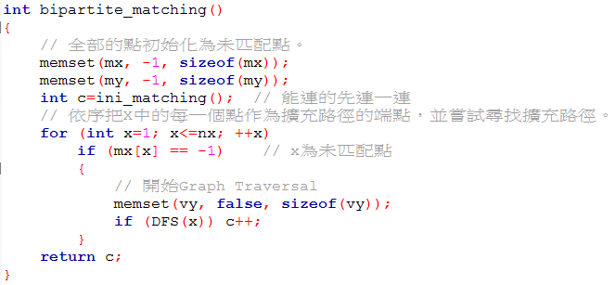
Bipartite Matching

Slide 34
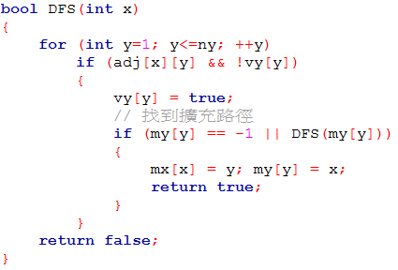
Bipartite Matching

Slide 35
Example
POJ 1274

Slide 36
Bipartite Matching
s
t
L
R
L
R
(a)
(b)

Slide 37
Homework
POJ:
Flow: 1149, 1459, 2112, 2289, 2396, 2455, 2584, 3189, 3228
Matching: 1274, 1325, 1422, 1466, 1469, 2060, 2226, 2239, 2446, 2536, 2594, 2724, 3020, 3041, 3207, 3216, 3343, 3692
UVa:
Flow: 820, 10330, 10779, 563, 10511, 10983, 10806, 10380
Matching: 259, 670, 753, 10080, 10092, 10243, 10418, 10984, 663

