Slide 1

NCKU Programming Contest Training Course
2013/07/17
Pin-chieh Huang (free999)
pinchieh.huang@gmail.com
http://myweb.ncku.edu.tw/~p76014143/20130717.rar
Department of Computer Science and Information Engineering
National Cheng Kung University
Tainan, Taiwan

Slide 2
Outline
Tree - diameter
Cut vertex and Cut edge
Strongly-connected component

Slide 3
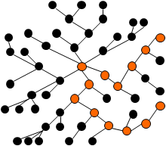
Diameter
一棵無根樹的「直徑」，就是相離最遠的兩個點的距離。

Slide 4
Diameter
任選一樹根
Two method
找出最長和次長的DFS路徑
找出最長的DFS路徑終點 V,
以 V 為 root 找出最長的DFS路徑

Slide 5
Example
Uva 10308

Slide 6
Outline
Tree - diameter
Cut vertex and Cut edge
Strongly-connected component

Slide 7
Cut Vertex and Edge
Cut Vertex
In mathematics and computer science, a cut vertex or articulation point is a vertex of a graph such that removal of the vertex causes an increase in the number of connected components. If the graph was connected before the removal of the vertex, it will be disconnected afterwards. Any connected graph with a cut vertex has a connectivity of 1.
While well-defined even for directed graphs, cut vertices are primarily used in undirected graphs. In general, a connected, undirected graph with n vertices can have no more than n-2 cut vertices. Naturally, a graph may have no cut vertices at all.

Slide 8
Cut Vertex
Cut Vertex
and

Slide 9
Cut Vertex
DFS trace by Root
- Directed and Back (cross) edge
1
3
2
6
4
5
5
9
10
0
8
9
0
8
9
3
7
4
2
6
1
7
1
7
8
3
1
6
4
8
2
3
5
2
3
5
1
7
4
6
7
4
6
10
5
9
2
0
8
9

Slide 10
Cut Vertex
Observation
If root has two child, => the root is an articulation point
If a vertex u has a child w, so that w and w can’t back to u’s parent => u is articulation point
Define
low(u): the minimum dfn value can obtain by u
low(u)
(1) Directed Edge: min{ dfn(u), min{low(w)|w是u的child},
(2) Back (cross) edge: min{dfn(w)|(u,w)是back edge}}

Slide 11
Cut Vertex
5
9
10
1
0
8
9
3
2
6
4
4
5
1
7
8
3
7
3
1
6
2
6
2
3
5
4
8
1
7
7
4
6
5
9
10
2
0
8
9

Slide 12
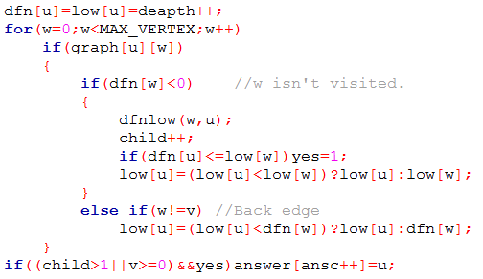
Cut Vertex
5
9
10
0
8
9
4
1
7
8
3
1
6
2
3
5
7
4
6
2

Slide 13
Cut Edge
Observation
Similar to cut vertex
Given an edge (u, v), if now is tracing u -> v and low[v] > dfn[u] => cut edge
5
9
10
0
8
9
4
1
7
8
3
1
6
2
3
5
7
4
6
2

Slide 14
Example
Uva 315

Slide 15
Outline
Tree - diameter
Cut vertex and Cut edge
Strongly-connected component

Slide 16
SCC
SCC
Strongly-connected component

Slide 17
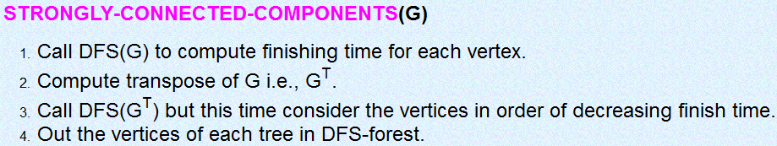
SCC
Algorithm

Slide 18
SCC
Algorithm
a
b
c
d
e
f
g
h

Slide 19
SCC
Algorithm
a
b
c
d
e
f
g
h

Slide 20
SCC
Algorithm
a
b
c
d
e
f
g
h

Slide 21
SCC
Algorithm
a
b
c
d
e
f
g
h

Slide 22
SCC
Algorithm
a
b
c
d
e
f
g
h

Slide 23
SCC
Algorithm
a
b
c
d
e
f
g
h

Slide 24
SCC
Algorithm
a
b
c
d
e
f
g
h
h

Slide 25
SCC
Algorithm
a
b
c
d
e
f
g
h
h | d

Slide 26
SCC
Algorithm
a
b
c
d
e
f
g
h
h | d

Slide 27
SCC
Algorithm
a
b
c
d
e
f
g
h
h | d

Slide 28
SCC
Algorithm
a
b
c
d
e
f
g
h
h | d | f

Slide 29
SCC
Algorithm
a
b
c
d
e
f
g
h
h | d | f | g

Slide 30
SCC
Algorithm
a
b
c
d
e
f
g
h
h | d | f | g | c

Slide 31
SCC
Algorithm
a
b
c
d
e
f
g
h
h | d | f | g | c

Slide 32
SCC
Algorithm
a
b
c
d
e
f
g
h
h | d | f | g | c | e

Slide 33
SCC
Algorithm
a
b
c
d
e
f
g
h
h | d | f | g | c | e | b

Slide 34
SCC
Algorithm
a
b
c
d
e
f
g
h
h | d | f | g | c | e | b | a

Slide 35
SCC
Algorithm
Reverse the graph
a
b
c
d
e
f
g
h
h | d | f | g | c | e | b | a

Slide 36
SCC
Algorithm
Reverse the graph
a
b
c
d
e
f
g
h
h | d | f | g | c | e | b | a

Slide 37
SCC
Algorithm
Reverse the graph
Re-search by the ending time
a
b
c
d
e
f
g
h
h | d | f | g | c | e | b | a

Slide 38
SCC
Algorithm
Reverse the graph
Re-search by the ending time
a
b
c
d
e
f
g
h
h | d | f | g | c | e | b | a

Slide 39
SCC
Algorithm
Reverse the graph
Re-search by the ending time
a
b
c
d
e
f
g
h
h | d | f | g | c | e | b | a

Slide 40
SCC
Algorithm
Reverse the graph
Re-search by the ending time
a
b
c
d
e
f
g
h
h | d | f | g | c | e | b | a

Slide 41
SCC
Algorithm
Reverse the graph
Re-search by the ending time
a
b
c
d
e
f
g
h
h | d | f | g | c | e | b | a

Slide 42
SCC
Algorithm
Reverse the graph
Re-search by the ending time
a
b
c
d
e
f
g
h
h | d | f | g | c | e | b | a

Slide 43
SCC
Algorithm
Reverse the graph
Re-search by the ending time
a
b
c
d
e
f
g
h
h | d | f | g | c | e | b | a

Slide 44
SCC
Algorithm
Reverse the graph
Re-search by the ending time
a
b
c
d
e
f
g
h
h | d | f | g | c | e | b | a

Slide 45
SCC
Algorithm
Reverse the graph
Re-search by the ending time
a
b
c
d
e
f
g
h
h | d | f | g | c | e | b | a

Slide 46
SCC
Algorithm
Reverse the graph
Re-search by the ending time
a
b
c
d
4 components
e
f
g
h
h | d | f | g | c | e | b | a

Slide 47
Example
ICPC 4262
http://goo.gl/WctgJ

Slide 48
Homework
Cut vertex and edge:
315, 352, 610, 793, 796, 10178, 10199, 10301, 10607, 10685, 10707,
11503, 11600, 11665, 11690
SCC
ICPC 4262, 4272
POJ 2186
Uva 111504 , 11709, 11710, 11838

