Slide 1

NCKU Programming Contest Training Course
2013/07/19
Pin-chieh Huang (free999)
pinchieh.huang@gmail.com
http://myweb.ncku.edu.tw/~p76014143/20130719_Trie.rar
Department of Computer Science and Information Engineering
National Cheng Kung University
Tainan, Taiwan

Slide 2
Problem
Store this collection of words in a memory efficient way :
{abacus, abode, dreaded, dust, dusty, planar, east}
How to proceed?

Slide 3
Idea
Avoid the Duplicate Part
Can we find a way to avoid search the same part?
Draw a trie corresponding to the collection of words:
{abacus, abode, dreaded, dust, dusty, planar, east}

Slide 4
Example
g
s
t
o
i
h
u
go
e
n
m
she
Make sure the word
“she” is not found…
…unless it has been
explicitly inserted!
sun
d
l
e
shed
time
l
shell

Slide 5
T.insert(“tick”)
g
s
t
o
i
h
u
go
e
n
c
m
sun
d
l
e
k
shed
tick
time
l
place a marker
shell

Slide 6
T.insert(“tick”)
g
s
t
o
i
h
u
go
e
n
c
m
sun
d
l
e
k
shed
tick
time
l
shell

Slide 7
T.search(“group”)
g
s
t
o
null
i
h
u
Failure
return false
go
e
n
c
m
sun
d
l
e
k
shed
tick
time
l
shell

Slide 8
T.search(“timer”)
g
s
t
o
i
h
u
go
e
n
c
m
sun
d
l
e
k
shed
tick
time
l
Failure
return false
shell
null

Slide 9
T.search(“she”)
g
s
t
o
i
h
u
go
e
n
c
m
String found.
But no marker!
sun
Failure
return false
d
l
e
k
shed
tick
time
l
shell

Slide 10
T.search(“shed”)
g
s
t
o
i
h
u
go
e
n
c
m
sun
String found.
Marker found!
d
l
k
e
shed
tick
time
Success
return true
l
shell

Slide 11
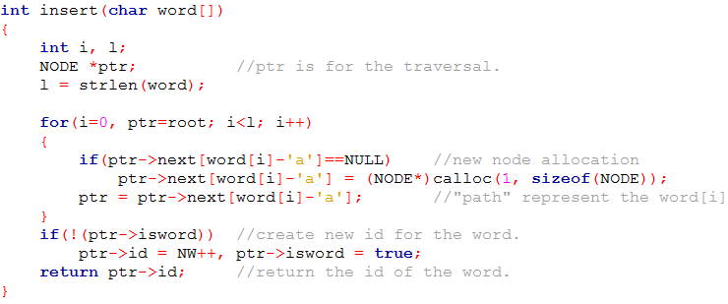
Trie

Slide 12
Example
PkU 3630

Slide 13
Homework
Total 7 Problems
POJ
2503
2513
3630
UVa
902
10226
10391
10745

Slide 14
Thank You For Attention!

