Slide 1

NCKU Programming Contest Training Course
2013/07/21
Pin-chieh Huang (free999)
Pinchieh.huang@gmail.com
Department of Computer Science and Information Engineering
National Cheng Kung University
Tainan, Taiwan

Slide 2
Outline
Line Intersection

Slide 3
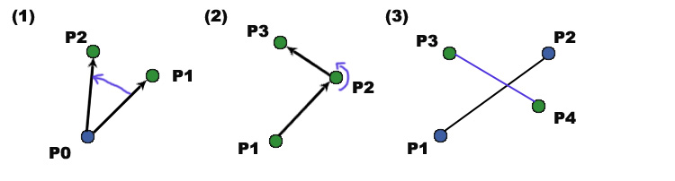
Intersection
Direction
Problem: Is vector pi → pj clockwise from vector pi → pk
How to solve it efficiently?

Slide 4
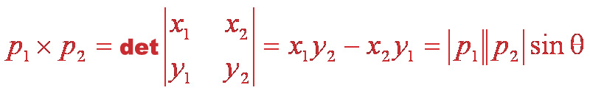
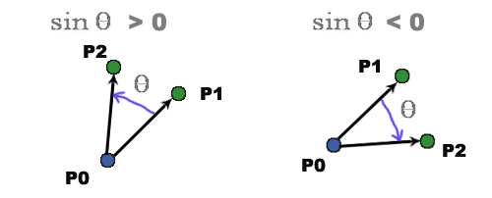
Cross Product
Cross Product
P1 X P2 > 0
P1 X P2 < 0

Slide 5
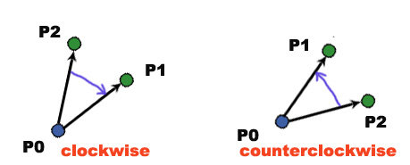
Cross Product
The cross products of PP to PP can be represented as:
(P₁ – P₀)X(P₂ – P₀)=(x₁ – x₀)(y₂ – y₀)-(x₂ – x₀)(y₁ – y₀)
(P₁ – P₀)X(P₂ – P₀)> 0
(P₁ – P₀)X(P₂ – P₀)< 0

Slide 6
Cross Product
P₂(2,4)
P1 (4,2)
P₀ (0,0)
(P1-P0)X(P2-P0)=(x1 – x0)(y2 – y0)-(x2 – x0)(y1 – y0) = 4*4 – 2*2 =12 > 0
P₀P₂ is counterclockwise from P₀P₁

Slide 7
Cross Product
If we traverse from p1 to p2 and then p3, should we make a turn left or turn right at point p2?

Slide 8
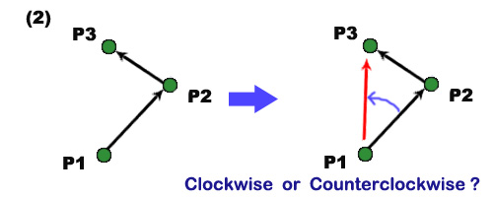
Cross Product
Judge it by cross product
Cross product d of p1p2 to p1p3:
d > 0 ; Counterclockwise : left turn
d < 0 ; Clockwise : right turn

Slide 9
Cross Product
P₃(2,4)
P₂ (4,2)
P₁ (0,0)
(P2-P1)X(P3-P1)=(x1 – x0)(y2 – y0)-(x2 – x0)(y1 – y0)
= 4*4 – 2*2 =12 > 0
P₁P₃在P₁P₂逆時針方向
: Left turn

Slide 10
Cross Product
Line/Segment intersection problem
Is the segment p1p2 crossing with segment p3p4?

Slide 11
Cross Product
Two situation
(1) Proper: the ending point of the segment cannot be the intersected
point
(2) Non-proper: intersected iff any intersection
p₁
p₁
p₄
p₄
p₃
p₃
p₂
p₂

Slide 12
Cross Product
Example

Slide 13
Cross Product
If is intersected, p4 and p3 will be opposite with respect to p1p2
p₁
⋅
< 0
p₂
< 0
> 0
p₄
OR
p₃
> 0
< 0

Slide 14
Cross Product
Is this Judgment enough?
p₁
⋅
< 0
p₂
< 0
> 0
p₄
OR
p₃
> 0
< 0

Slide 15
Cross Product
We should change the based line and judge it again…
p₁
(P₃P₂ X P₃P₄) ⋅ (P₃P₁ X P₃P₄) > 0
False
p₂
p₄
p₃

Slide 16
Cross Product
Example

Slide 17
Cross Product
Until now, we have solved the proper intersection problem…
What about the non-proper (general) situation?
p₁
Cross product = 0
(P₃P₂ X P₃P₄) ⋅ (P₃P₂ X P₃P₄) = 0
p₄
p₃
p₂

Slide 18
Cross Product
Example

Slide 19
Cross Product
p_{i} (5,8)
On-Segment(p_{i}, p_{j}, p_{k})
1 if min(x_{i}, x_{j}) ≤ x_{k} ≤ max(x_{i}, x_{j})
and min(y_{i}, y_{j}) ≤ y_{k} ≤ max(y_{i}, y_{j})
2 then return TRUE
3 else return FALSE
P_{k} (7,7)
P_{j} (10,5)
X : 5 ≤ 7 ≤ 10
Y : 5 ≤ 7 ≤ 5 TRUE

Slide 20
Cross Product
Segments-Intersect(p₁, p₂, p₃, p₄)
1 d₁ ← (p₁ − p₃) × (p₄ − p₃)
2 d₂ ← (p₂ − p₃) × (p₄ − p₃)
3 d₃ ← (p₃ − p₁) × (p₂ − p₁)
4 d₄ ← (p₄ − p₁) × (p₂ − p₁)
5 if d₁d₂ < 0 and d₃d₄ < 0 then return TRUE
6 if d₁=0 and On-Segment(p₃, p₄, p₁) then return TRUE
7 if d₂=0 and On-Segment(p₃, p₄, p₂) then return TRUE
8 if d₃=0 and On-Segment(p₁, p₂, p₃) then return TRUE
9 if d₄=0 and On-Segment(p₁, p₂, p₄) then return TRUE
10 return FALSE
Straddle each other
Judge if one of the ending point in a line is on the other line

Slide 21
Cross Product
Example
POJ 1269
POJ 2653

Slide 22
Homework
PKU: 2318
PKU: 2398
PKU: 3304
PKU: 1269
PKU: 1556
PKU: 2653
PKU: 1066
PKU: 1410
PKU: 1696
PKU: 3347
PKU: 2826
PKU: 1039
UVa
152
10514
10709
191
273
378
527
866
10902

