Slide 1

NCKU Programming Contest Training Course
2013/08/11
Pin-Chieh Huang (free999)
http://myweb.ncku.edu.tw/~p76014143/20130811_KMP.rar
Department of Computer Science and Information Engineering
National Cheng Kung University
Tainan, Taiwan

Slide 2
Outline
Rabin-Karp Algorithm
KMP Algorithm

Slide 3
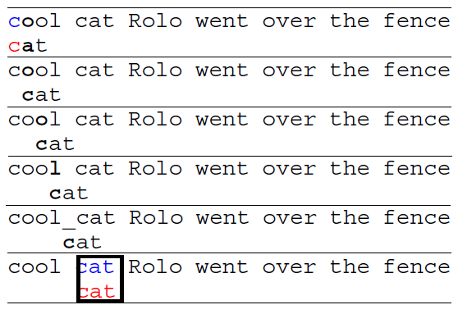
String Matching
Judge if a given string is the substring of another string
“abcde” is the substring of “reabcdeef”
“abcde” is not the substring of “aibeckdle”
“abcde” is the subsequence of “aibeckdle”
Brute Force Method
For loop with O(?)

Slide 4
Rabin-Karp Algorithm
Rabin-Karp Algorithm
Hash a pattern
{A, B, C, …, Z} = {0, 1, 2, …, 25}
Hash Technique
Choose two prime p and q
ABC = {0, 1, 2} → 0*(p^2) + 1*(p^1) + 2*(p^0)
ABCDE → 0*(p^4) + 1*(p^3) + 2*(p^2) + 3*(p^1) + 4*(p^0)
If too large
Mod q

Slide 5
Rabin-Karp Algorithm
So…Given a string and matching pattern, how to efficiently find the matching?
string = “ABCDEFGHIJ”
pattern = “EFG”
A | B | C | D | E | F | G | H | I | J
Design complexity ?

Slide 6
Rabin-Karp Algorithm
Matching pattern: EFG = 4(p^2) + 5(p^1) + 6(p^0)
A | B | C | D | E | F | G | H | I | J
X | X
HASH: ABC = 0(p^2) + 1(p^1) + 2(p^0)

Slide 7
Rabin-Karp Algorithm
Matching pattern: EFG = 4(p^2) + 5(p^1) + 6(p^0)
A | B | C | D | E | F | G | H | I | J
X | X
HASH: BCD = 1(p^2) + 2(p^1) + 3(p^0)

Slide 8
Rabin-Karp Algorithm
Matching pattern: EFG = 4(p^2) + 5(p^1) + 6(p^0)
A | B | C | D | E | F | G | H | I | J
X | X
HASH: CDE= 2(p^2) + 3(p^1) + 4(p^0)

Slide 9
Rabin-Karp Algorithm
Matching pattern: EFG = 4(p^2) + 5(p^1) + 6(p^0)
A | B | C | D | E | F | G | H | I | J
X | X
HASH: DEF= 3(p^2) + 4(p^1) + 5(p^0)

Slide 10
Rabin-Karp Algorithm
HASH: ABC = 0(p^2) + 1(p^1) + 2(p^0)
Step 1. k = 0(p^2) + 1(p^1) + 2(p^0) – 0(p^2)
Step 2. k*p
Step 3. k*p + D*(p^0)
Get: 1(p^2) + 2(p^1) + 3(p^0)
HASH: BCD = 1(p^2) + 2(p^1) + 3(p^0)
Design Complexity: O(?)
HASH: CDE= 2(p^2) + 3(p^1) + 4(p^0)
HASH: DEF= 3(p^2) + 4(p^1) + 5(p^0)

Slide 11
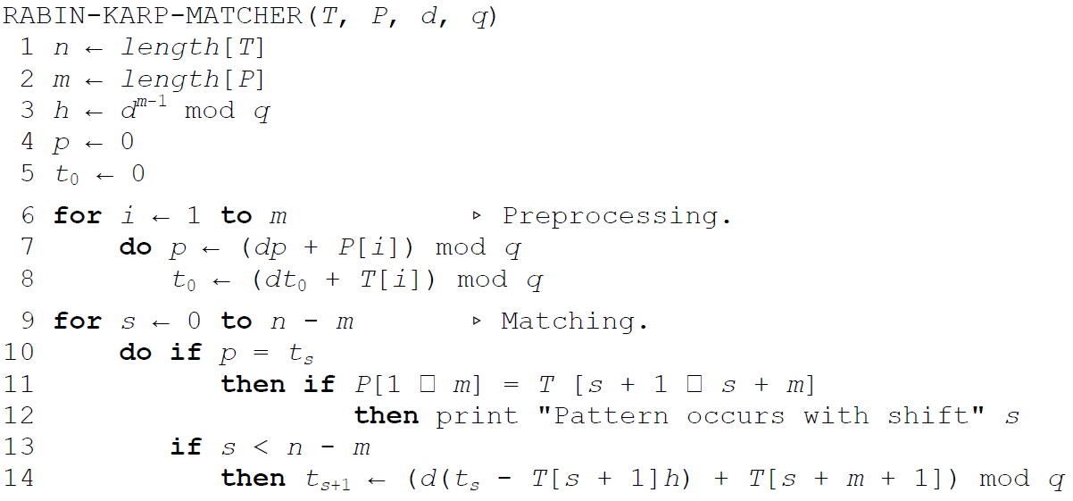
Rabin-Karp Algorithm
Main Algorithm
How to choose the two primes ?

Slide 12
Example
POJ 1200

Slide 13
2D Rabin-Karp
2D extension (ural 1486)
Text:
abcde
edcba
dcbea
abcde
edeca
Pattern:
dc
cb

Slide 14
2D Rabin-Karp
Extend to 2D
a
×p²
q³
b
×p²
a
a
q²
×p²
q
×p²
c
×p
q³
b
×p
q²
b
×p
c
q
×p
a
×q³
b
×q²
a
×q
c

Slide 15
2D Rabin-Karp
Extend to 2D
×
×
×
×
×
×
×
×
×
p³
p⁴
p³
p²
p
p²
1
p
1

Slide 16
Outline
Rabin-Karp Algorithm
KMP Algorithm

Slide 17
KMP Algorithm
KMP Algorithm
Two-Stage Technique
differs from the brute-force algorithm by keeping track of information gained from previous comparisons
Shifting idea: avoid non-necessary moving and comparison
First Stage
Prefix function
Second Stage
Matching

Slide 18
KMP Algorithm
First Stage
Prefix Function pi[i]
The longest prefix of the current suffix
i | 1 | 2 | 3 | 4 | 5 | 6 | 7
pattern | a | b | a | b | a | c | a
Pi[i] | 0 | 0 | 1 | 2 | 3 | 0 | 1

Slide 19
KMP Algorithm
First Stage
Prefix Function pi[i]
The longest prefix of the current suffix
i | 1 | 2 | 3 | 4 | 5 | 6 | 7
pattern | a | b | a | b | a | c | a
Pi[i] | 0 | 0 | 1 | 2 | 3 | 0 | 1
Pi[4] = 2 means: ab (1~2) = ab (3~4)
Pi[4] = 2 means: prefix = suffix

Slide 20
KMP Algorithm
Shift technique
i
b | a | c | b | a | b | a | b | a | a | b | c | b | a | b
s
1 | 2 | 3 | 4 | 5 | 6 | 7
a | b | a | b | a | c | a
0 | 0 | 1 | 2 | 3 | 0 | 1
q

Slide 21
KMP Algorithm
Shift technique
i
b | a | c | b | a | b | a | b | a | a | b | c | b | a | b
s
s’
1 | 2 | 3 | 4 | 5 | 6 | 7
a | b | a | b | a | c | a
0 | 0 | 1 | 2 | 3 | 0 | 1
q

Slide 22
KMP Algorithm
text
b | a | c | b | a | b | a | b | a | c | a | c | b | a | b
1 | 2 | 3 | 4 | 5 | 6 | 7
a | b | a | b | a | c | a
0 | 0 | 1 | 2 | 3 | 0 | 1

Slide 23
KMP Algorithm
i
text
b | a | c | b | a | b | a | b | a | c | a | c | b | a | b
1 | 2 | 3 | 4 | 5 | 6 | 7
a | b | a | b | a | c | a
0 | 0 | 1 | 2 | 3 | 0 | 1
q
Pattern[q+1] != text[i] → Tune the prefix function

Slide 24
KMP Algorithm
i
text
b | a | c | b | a | b | a | b | a | c | a | c | b | a | b
1 | 2 | 3 | 4 | 5 | 6 | 7
a | b | a | b | a | c | a
0 | 0 | 1 | 2 | 3 | 0 | 1
q

Slide 25
KMP Algorithm
i
text
b | a | c | b | a | b | a | b | a | c | a | c | b | a | b
1 | 2 | 3 | 4 | 5 | 6 | 7
a | b | a | b | a | c | a
0 | 0 | 1 | 2 | 3 | 0 | 1
q
Pattern[q+1] = text[i] → increase q

Slide 26
KMP Algorithm
i
text
b | a | c | b | a | b | a | b | a | c | a | c | b | a | b
1 | 2 | 3 | 4 | 5 | 6 | 7
a | b | a | b | a | c | a
0 | 0 | 1 | 2 | 3 | 0 | 1
q

Slide 27
KMP Algorithm
i
text
b | a | c | b | a | b | a | b | a | c | a | c | b | a | b
1 | 2 | 3 | 4 | 5 | 6 | 7
a | b | a | b | a | c | a
0 | 0 | 1 | 2 | 3 | 0 | 1
q

Slide 28
KMP Algorithm
i
text
b | a | c | b | a | b | a | b | a | c | a | c | b | a | b
1 | 2 | 3 | 4 | 5 | 6 | 7
a | b | a | b | a | c | a
0 | 0 | 1 | 2 | 3 | 0 | 1
q
Pattern[q+1] != text[i] → tune the prefix function

Slide 29
KMP Algorithm
i
text
b | a | c | b | a | b | a | b | a | c | a | c | b | a | b
1 | 2 | 3 | 4 | 5 | 6 | 7
a | b | a | b | a | c | a
0 | 0 | 1 | 2 | 3 | 0 | 1
q

Slide 30
KMP Algorithm
i
text
b | a | c | b | a | b | a | b | a | c | a | c | b | a | b
1 | 2 | 3 | 4 | 5 | 6 | 7
a | b | a | b | a | c | a
0 | 0 | 1 | 2 | 3 | 0 | 1
q

Slide 31
KMP Algorithm
i
text
b | a | c | b | a | b | a | b | a | c | a | c | b | a | b
1 | 2 | 3 | 4 | 5 | 6 | 7
a | b | a | b | a | c | a
0 | 0 | 1 | 2 | 3 | 0 | 1
q
Pattern[q+1] != text[i] → tune the prefix function

Slide 32
KMP Algorithm
i
text
b | a | c | b | a | b | a | b | a | c | a | c | b | a | b
1 | 2 | 3 | 4 | 5 | 6 | 7
a | b | a | b | a | c | a
0 | 0 | 1 | 2 | 3 | 0 | 1
q

Slide 33
KMP Algorithm
i
text
b | a | c | b | a | b | a | b | a | c | a | c | b | a | b
1 | 2 | 3 | 4 | 5 | 6 | 7
a | b | a | b | a | c | a
0 | 0 | 1 | 2 | 3 | 0 | 1
q

Slide 34
KMP Algorithm
i
text
b | a | c | b | a | b | a | b | a | c | a | c | b | a | b
1 | 2 | 3 | 4 | 5 | 6 | 7
a | b | a | b | a | c | a
0 | 0 | 1 | 2 | 3 | 0 | 1
q
Pattern[q+1] = text[i] → increase q

Slide 35
KMP Algorithm
i
text
b | a | c | b | a | b | a | b | a | c | a | c | b | a | b
1 | 2 | 3 | 4 | 5 | 6 | 7
a | b | a | b | a | c | a
0 | 0 | 1 | 2 | 3 | 0 | 1
q

Slide 36
KMP Algorithm
i
text
b | a | c | b | a | b | a | b | a | c | a | c | b | a | b
1 | 2 | 3 | 4 | 5 | 6 | 7
a | b | a | b | a | c | a
0 | 0 | 1 | 2 | 3 | 0 | 1
q

Slide 37
KMP Algorithm
i
text
b | a | c | b | a | b | a | b | a | c | a | c | b | a | b
1 | 2 | 3 | 4 | 5 | 6 | 7
a | b | a | b | a | c | a
0 | 0 | 1 | 2 | 3 | 0 | 1
q

Slide 38
KMP Algorithm
i
text
b | a | c | b | a | b | a | b | a | c | a | c | b | a | b
1 | 2 | 3 | 4 | 5 | 6 | 7
a | b | a | b | a | c | a
0 | 0 | 1 | 2 | 3 | 0 | 1
q

Slide 39
KMP Algorithm
i
text
b | a | c | b | a | b | a | b | a | c | a | c | b | a | b
1 | 2 | 3 | 4 | 5 | 6 | 7
a | b | a | b | a | c | a
0 | 0 | 1 | 2 | 3 | 0 | 1
q

Slide 40
KMP Algorithm
i
text
b | a | c | b | a | b | a | b | a | c | a | c | b | a | b
1 | 2 | 3 | 4 | 5 | 6 | 7
a | b | a | b | a | c | a
0 | 0 | 1 | 2 | 3 | 0 | 1
q

Slide 41
KMP Algorithm
i
text
b | a | c | b | a | b | a | b | a | c | a | c | b | a | b
1 | 2 | 3 | 4 | 5 | 6 | 7
a | b | a | b | a | c | a
0 | 0 | 1 | 2 | 3 | 0 | 1
q

Slide 42
KMP Algorithm
i
text
b | a | c | b | a | b | a | b | a | c | a | c | b | a | b
1 | 2 | 3 | 4 | 5 | 6 | 7
a | b | a | b | a | c | a
0 | 0 | 1 | 2 | 3 | 0 | 1
q

Slide 43
KMP Algorithm
i
text
b | a | c | b | a | b | a | b | a | c | a | c | b | a | b
1 | 2 | 3 | 4 | 5 | 6 | 7
a | b | a | b | a | c | a
0 | 0 | 1 | 2 | 3 | 0 | 1
q

Slide 44
KMP Algorithm
i
text
b | a | c | b | a | b | a | b | a | c | a | c | b | a | b
1 | 2 | 3 | 4 | 5 | 6 | 7
a | b | a | b | a | c | a
0 | 0 | 1 | 2 | 3 | 0 | 1
q

Slide 45
KMP Algorithm
i
text
b | a | c | b | a | b | a | b | a | c | a | c | b | a | b
1 | 2 | 3 | 4 | 5 | 6 | 7
a | b | a | b | a | c | a
0 | 0 | 1 | 2 | 3 | 0 | 1
q

Slide 46
KMP Algorithm
i
text
b | a | c | b | a | b | a | b | a | c | a | c | b | a | b
1 | 2 | 3 | 4 | 5 | 6 | 7
a | b | a | b | a | c | a
0 | 0 | 1 | 2 | 3 | 0 | 1
q

Slide 47
KMP Algorithm
i
text
b | a | c | b | a | b | a | b | a | c | a | c | b | a | b
1 | 2 | 3 | 4 | 5 | 6 | 7
a | b | a | b | a | c | a
0 | 0 | 1 | 2 | 3 | 0 | 1
q

Slide 48
KMP Algorithm
i
text
b | a | c | b | a | b | a | b | a | c | a | c | b | a | b
1 | 2 | 3 | 4 | 5 | 6 | 7
a | b | a | b | a | c | a
0 | 0 | 1 | 2 | 3 | 0 | 1
q
Got a matching → tune the prefix function

Slide 49
KMP Algorithm
i
text
b | a | c | b | a | b | a | b | a | c | a | c | b | a | b
1 | 2 | 3 | 4 | 5 | 6 | 7
a | b | a | b | a | c | a
0 | 0 | 1 | 2 | 3 | 0 | 1
q

Slide 50
KMP Algorithm
i
text
b | a | c | b | a | b | a | b | a | c | a | c | b | a | b
1 | 2 | 3 | 4 | 5 | 6 | 7
a | b | a | b | a | c | a
0 | 0 | 1 | 2 | 3 | 0 | 1
q

Slide 51
KMP Algorithm
i
text
b | a | c | b | a | b | a | b | a | c | a | c | b | a | b
1 | 2 | 3 | 4 | 5 | 6 | 7
a | b | a | b | a | c | a
0 | 0 | 1 | 2 | 3 | 0 | 1
q
Pattern[q+1] != text[i] → tune the prefix function

Slide 52
KMP Algorithm
i
text
b | a | c | b | a | b | a | b | a | c | a | c | b | a | b
1 | 2 | 3 | 4 | 5 | 6 | 7
a | b | a | b | a | c | a
0 | 0 | 1 | 2 | 3 | 0 | 1
q

Slide 53
KMP Algorithm
i
text
b | a | c | b | a | b | a | b | a | c | a | c | b | a | b
1 | 2 | 3 | 4 | 5 | 6 | 7
a | b | a | b | a | c | a
0 | 0 | 1 | 2 | 3 | 0 | 1
q

Slide 54
KMP Algorithm
i
text
b | a | c | b | a | b | a | b | a | c | a | c | b | a | b
1 | 2 | 3 | 4 | 5 | 6 | 7
a | b | a | b | a | c | a
0 | 0 | 1 | 2 | 3 | 0 | 1
q
Pattern[q+1] != text[i] → tune the prefix function

Slide 55
KMP Algorithm
i
text
b | a | c | b | a | b | a | b | a | c | a | c | b | a | b
1 | 2 | 3 | 4 | 5 | 6 | 7
a | b | a | b | a | c | a
0 | 0 | 1 | 2 | 3 | 0 | 1
q

Slide 56
KMP Algorithm
i
text
b | a | c | b | a | b | a | b | a | c | a | c | b | a | b
1 | 2 | 3 | 4 | 5 | 6 | 7
a | b | a | b | a | c | a
0 | 0 | 1 | 2 | 3 | 0 | 1
q

Slide 57
KMP Algorithm
i
text
b | a | c | b | a | b | a | b | a | c | a | c | b | a | b
1 | 2 | 3 | 4 | 5 | 6 | 7
a | b | a | b | a | c | a
0 | 0 | 1 | 2 | 3 | 0 | 1
q

Slide 58
KMP Algorithm
i
text
b | a | c | b | a | b | a | b | a | c | a | c | b | a | b
1 | 2 | 3 | 4 | 5 | 6 | 7
a | b | a | b | a | c | a
0 | 0 | 1 | 2 | 3 | 0 | 1
q

Slide 59
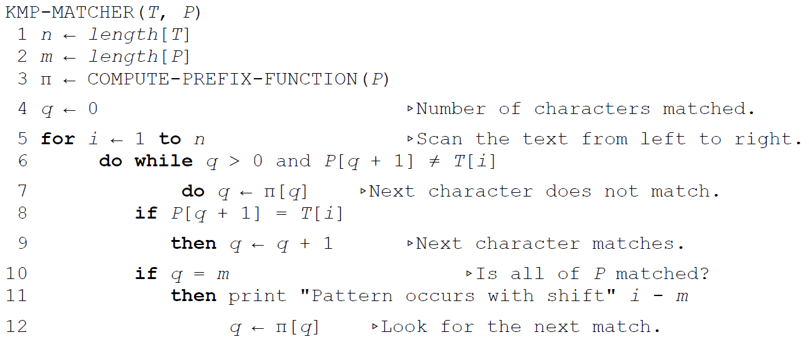
KMP Algorithm

Slide 60
KMP Algorithm
How to compute the prefix function?
i | 1 | 2 | 3 | 4 | 5 | 6 | 7
pattern | a | b | a | b | a | c | a
Pi[i] | 0 | 0 | 1 | 2 | 3 | 0 | 1

Slide 61
KMP Algorithm
Example
i | 1 | 2 | 3 | 4 | 5 | 6 | 7
pattern | a | b | a | b | a | c | a
Pi[i] | 0
Pattern[0+1] = Pattern[2] ?

Slide 62
KMP Algorithm
Example
i | 1 | 2 | 3 | 4 | 5 | 6 | 7
pattern | a | b | a | b | a | c | a
Pi[i] | 0 | 0
Pattern[0+1] = Pattern[3] ?

Slide 63
KMP Algorithm
Example
i | 1 | 2 | 3 | 4 | 5 | 6 | 7
pattern | a | b | a | b | a | c | a
Pi[i] | 0 | 0 | 1
Pattern[1+1] = Pattern[4] ?

Slide 64
KMP Algorithm
Example
i | 1 | 2 | 3 | 4 | 5 | 6 | 7
pattern | a | b | a | b | a | c | a
Pi[i] | 0 | 0 | 1 | 2
Pattern[2+1] = Pattern[5] ?

Slide 65
KMP Algorithm
Example
i | 1 | 2 | 3 | 4 | 5 | 6 | 7
pattern | a | b | a | b | a | c | a
Pi[i] | 0 | 0 | 1 | 2 | 3
Pattern[3+1] = Pattern[6] ?

Slide 66
KMP Algorithm
Example
i | 1 | 2 | 3 | 4 | 5 | 6 | 7
pattern | a | b | a | b | a | c | a
Pi[i] | 0 | 0 | 1 | 2 | 3
Pattern[3+1] = Pattern[6] ?
Pattern[1+1] = Pattern[6] ?

Slide 67
KMP Algorithm
Example
i | 1 | 2 | 3 | 4 | 5 | 6 | 7
pattern | a | b | a | b | a | c | a
Pi[i] | 0 | 0 | 1 | 2 | 3
Pattern[3+1] = Pattern[6] ?
Pattern[1+1] = Pattern[6] ?
Pattern[0+1] = Pattern[6] ?

Slide 68
KMP Algorithm
Example
i | 1 | 2 | 3 | 4 | 5 | 6 | 7
pattern | a | b | a | b | a | c | a
Pi[i] | 0 | 0 | 1 | 2 | 3 | 0
Pattern[3+1] = Pattern[6] ?
Pattern[1+1] = Pattern[6] ?
Pattern[0+1] = Pattern[6] ?

Slide 69
KMP Algorithm
Example
i | 1 | 2 | 3 | 4 | 5 | 6 | 7
pattern | a | b | a | b | a | c | a
Pi[i] | 0 | 0 | 1 | 2 | 3 | 0
Pattern[0+1] = Pattern[7] ?

Slide 70
KMP Algorithm
Example
i | 1 | 2 | 3 | 4 | 5 | 6 | 7
pattern | a | b | a | b | a | c | a
Pi[i] | 0 | 0 | 1 | 2 | 3 | 0 | 1
Pattern[0+1] = Pattern[7] ?

Slide 71
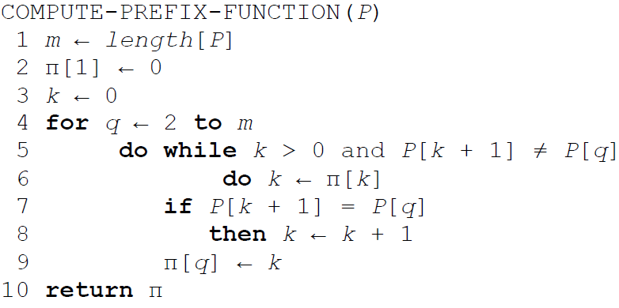
KMP Algorithm

Slide 72
Example
POJ 2406
POJ 3461

Slide 73
Homework
POJ-1961
POJ-2406
POJ-2752
POJ-2185
POJ-1200
POJ-3461
UVA -10298
UVA -11475

