Slide 1

NCKU Programming Contest Training Course
Course 8
2013/03/06
Sheng-Chi You(rabbit125)
Jay_s6215@hotmail.com
http://myweb.ncku.edu.tw/~f74986133/Course_8.rar
Department of Computer Science and Information Engineering
National Cheng Kung University
Tainan, Taiwan

Slide 2
Outline
Dynamic Programming
Longest Increase Sequence(LIS)
Longest Common Subsequence(LCS)

Slide 3
Dynamic Programming
Dynamic Programming (DP)
Dynamic programming is a general algorithm design technique for solving problems defined by or formulated by recursion structure with overlapping substructure.
Purpose
Optimization
Avoid duplicate search and calculation
Two categories
Minimization (maximization) problem
Combinatorial problem
Notes:
動態規劃技巧有三個主要部份
遞迴關係（recurrence relation）
列表式運算（tabular computation）
路徑迴溯（traceback）

Slide 4
Recall for Fib-Seq
Fibonacci sequence: 0 , 1 , 1 , 2 , 3 , 5 , 8 , 13 , 21 , …
F_{i} = i if i ≤ 1
F_{i} = F_{i-1} + F_{i-2} if i ≥ 2
Solved by a recursive program:
Much replicated computation is done.
It should be solved by a simple loop.

Slide 5
Solving Method
Solving the Fib-Sequence
Bottom up design
Using the for loop or while loop without recursive stack
Top-down design
Using the recursive design with memorization for computation
Top-Down design
(1) basic condition
(2) if memorized
(3) recurrence
(4) return the value
Take a problem for example
PKU: 1579 Function Run Fun

Slide 6
Function Run Fun
How to figure out this is a DP problem ?
We want to find out what value w(a, b, c) is
w(a, b, c) can be generated by the functions at last slide
ex, if we want to know w(50, 50, 50), we have to know w(20, 20, 20) at first
The final answer is consist of lots of subproblems
ex, w(a, b, c) = w(a-1, b, c) + w(a-1, b-1, c) + w(a-1, b, c-1) - w(a-1, b-1, c-1)
subproblems

Slide 7
Function Run Fun
if (a <= 0 or b <= 0 or c <= 0)
w(a, b, c) = 1
if (a > 20 or b > 20 or c > 20)
w(a, b, c) = w(20, 20, 20)
if (a < b and b < c)
w(a, b, c) = w(a, b, c-1) + w(a, b-1, c-1) - w(a, b-1, c)
otherwise
w(a, b, c) = w(a-1, b, c) + w(a-1, b-1, c) + w(a-1, b, c-1) - w(a-1, b-1, c-1)

Slide 8
Just Practice
Practice
PKU: 1579 Function Run Fun
Notes:
這裡要用兩個題目放在OJ給學弟妹練習

Slide 9
Programming Steps
Programming Strategy
(1) Check the category, min-max problem or combination problem?
(2) Check if there is a order( the optimal order )
This is a very important step!!!
Ordered -> optimization with dp
In-ordered -> bitmask dp, memorized dp or non-dp problems
(3) Think the recurrence formulation
(4) Write a program to solve it
Top-down
Bottom-up
(5) Backtrack the optimal path
Memory Strategy
Set up the recorded table
Notes:
什麼樣的問題適合用動態規劃技巧來解呢
符合最佳化準則，亦即若將最佳答案解構，解構後的子答案仍為對應子問題的最佳解
解題過程中，有許多重複的子問題

Slide 10
Outline
Dynamic Programming
Longest Increase Sequence(LIS)
Longest Common Subsequence(LCS)

Slide 11
LIS Problem
Longest Increasing Subsequence
The longest increasing subsequence problem is to find a subsequence of a given sequence in which the elements in this subsequence are in sorted order (lowest to highest), and in which the length of the subsequence is as long as possible.
The elements in the subsequence are not necessarily to be continuous.
Two well-known method to solve this problem are followings:
(1) DP by O(N²)
(2) Greedy with binary search by O(NlogN)

Slide 12
LIS Example
Example
0, 8, 4, 12, 2, 10, 6, 14, 1, 9, 5, 13, 3, 11, 7, 15
A increasing subsequence is 0, 4, 14, 15
The longest increasing subsequence is 0, 2, 6, 9, 13, 15 wit he length six
Question
Is the longest increasing subsequence unique?
How should we deal with this problem in different situation by which method?

Slide 13
DP method
Dynamic programming approach
Recall the design strategy
(1) Check the category
(2) Check the order property
(3) Think the recurrence
(4) Write and problem with two methods
(5) Backtrack the optimal path

Slide 14
DP method
Rule 1
Order?
Rule 2
Category
Rule 3
Given a sequence with n elements stored in an array seq[i] where 1<=i<=n.
Define dp[i] for representing that the longest length of the increasing subsequence that ended by seq[i] from seq[1] to seq[i].
So that the recurrence can be formulated as the following:
Initialized the dp[i] by 1
dp[i] = max(dp[j]+1), where 1<=j<i and seq[i]>seq[i]
Also define a pi array pi[i] that represent the previous element of the element i in the increasing subsequence.

Slide 15
DP method
Rule 3
Example
seq[9] = {9, 5, 2, 8, 7, 3, 1, 6, 4}
Find the dp[i] and pi[i].
seq | 9 (1) | 5 (2) | 2 (3) | 8 (4) | 7 (5) | 3 (6) | 1 (7) | 6 (8) | 4 (9)
dp | 1 | 1 | 1 | 1 | 1 | 1 | 1 | 1 | 1
pi | -1 | -1 | -1 | -1 | -1 | -1 | -1 | -1 | -1
initial
seq | 9 (1) | 5 (2) | 2 (3) | 8 (4) | 7 (5) | 3 (6) | 1 (7) | 6 (8) | 4 (9)
dp | 1 | 1 | 1 | 2 | 2 | 2 | 1 | 3 | 3
pi | -1 | -1 | -1 | 2 | 2 | 3 | -1 | 6 | 6
result
Notes:
n^2各種掃描方向皆可 - 說明

Slide 16
DP method
Rule 4
Write the program
Rule 5
Trace the result
Exercise
Write a program that find the length of the LIS for a given sequence.
Note:
Please use the dynamic programming as the practice.
The number of the element in the given sequence will not exceed 1000.
Review
Time complexity O( ? )
Space complexity O( ? )
Compare with the brute force method.
Notes:
這裡要用OJ給學弟妹練習，練習完之後要檢討一下時間空間複雜度

Slide 17
Greedy Method
Greedy Method
An efficient algorithm based on binary search.
Given the sequence seq[9] = {9, 5, 2, 8, 7, 3, 1, 6, 4}
http://www.csie.ntnu.edu.tw/~u91029/LongestIncreasingSubsequence.html
9
5
2
8
2
7
2
3
2
3
1
6
3
1
4
3
1
Notes:
此圖表為個數值恰當位置
之後由最後一個位置向前讀出序列

Slide 18
Greedy Method
Exercise
Write a program that find the length of the LIS for a given sequence.
Note:
Please use the dynamic programming as the practice.
The number of the element in the given sequence will exceed 1000.
Review
Time complexity O( ? )
Space complexity O( ? )
Notes:
這裡要用OJ給學弟妹練習，練習完之後要檢討一下時間空間複雜度

Slide 19
Just Practice
Practice
NOJ 30 LIS Problem
Notes:
這裡要用兩個題目放在OJ給學弟妹練習

Slide 20
Outline
Dynamic Programming
Longest Increase Sequence(LIS)
Longest Common Subsequence(LCS)

Slide 21
LCS Problem
Longest Common Subsequence
The longest increasing subsequence problem is to find a common subsequence of two given sequences in which the elements in this common subsequence are appear in both original sequences, and in which the length of the subsequence is as long as possible.
The elements in the subsequence are not necessarily to be continuous.
Two well-known method to solve this problem are followings:
(1) DP by O(N²)
(2) Greedy with binary search by O(NlogN)

Slide 22
Example
Common Subsequence Example
Longest Common Subsequence
president
providence
president
providence
president
providence

Slide 23
DP method
Dynamic programming approach
Recall the design strategy
(1) Check the category
(2) Check the order property
(3) Think the recurrence
(4) Write and problem with two methods
(5) Backtrack the optimal path

Slide 24
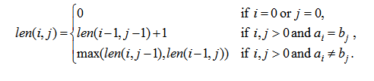
DP method
Rule 1
Order?
Rule 2
Category
Rule 3
Let A=a₁a₂…a_{m} and B=b₁b₂…b_{n} .
len(i, j): the length of an LCS between a₁a₂…a_{i} and b₁b₂…b_{j}
With proper initializations, len(i, j) can be computed as follows.

Slide 25
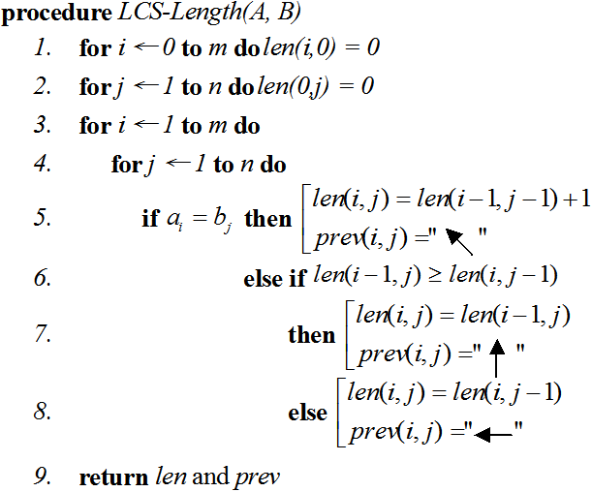
DP method
Rule 4

Slide 26
DP method
Rule 4
The dp result of the two string, “providence”and “president”

Slide 27
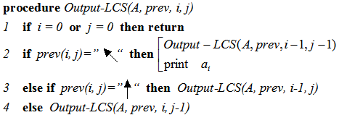
DP method
Rule 5
Trace the path

Slide 28
DP method
Rule 5
The result “priden”of the two string, “providence”and “president”

Slide 29
DP method
More Example
Given string A = bacad, string B = accbadcb
The dp table can be optimized as the following figure and the longest common string can be backtraced by the table.

Slide 30
DP method
Exercise
Write a program that find the length of the LCS for two given sequences.
Note:
Please use the dynamic programming as the practice.
The number of the element in the given sequence will not exceed 1000.
Review
Time complexity O( ? )
Space complexity O( ? )
Compare with the brute force method.
Notes:
這裡要用OJ給學弟妹練習，練習完之後要檢討一下時間空間複雜度

Slide 31
Just Practice
Practice
NOJ 31 LCS Problem
Notes:
這裡要用兩個題目放在OJ給學弟妹練習

Slide 32
Homework 8
UVA (total 23 problems)
103, 108, 111, 231, 437, 481, 497, 507, 531, 836, 10066, 10131, 10192, 10252, 10405, 10534, 10635, 10684, 10723, 10755, 10827, 10949, 11582

Slide 33
Thank You For Attention!

