Slide 1

NCKU Programming Contest Training Course
Course 7
2013/02/20
http://myweb.ncku.edu.tw/~p76014143/Course7.rar
Department of Computer Science and Information Engineering
National Cheng Kung University
Tainan, Taiwan

Slide 2
Outline
backtracking
prune technique
more example

Slide 3
Backtracking
Backtracking
a general algorithm for finding all (or some) solutions to some computational problem, that incrementally builds candidates to the solutions, and abandons each partial candidate c ("backtracks") as soon as it determines that c cannot possibly be completed to a valid solution
Design Method
DFS based recursion
constraint setting

Slide 4
Backtracking
Example of enumerating 3-bits gray codes
0 _ _
1 _ _
0 0 _
0 1 _
1 0 _
1 1 _
0 0 0
0 0 1
0 1 0
0 1 1
1 0 0
1 0 1
1 1 0
1 1 1

Slide 5
Backtracking
General pseudo code
backtrack( [v1,...,vn] ) // [v1,...,vn] is multiple dimension vector
{
/* a solution candidate */
if ( [v1,...,vn] is well-generated ){
if ( [v1,...,vn] is a solution ) process solution;
return;
}
/* set constraints and recursion */
for ( x = possible values of vn+1 ){
set up constraints;
backtrack( [v1,...,vn, x] );
back up the constraints
}
}
call backtrack( [] ); // call function

Slide 6
Backtracking
Permutation
a permutation of a finite set S is a bi-jective map from S to itself; in other words, the any ordering of its element in a list
S={1, 2, 3}, the permutation are as follows:
{1, 2, 3} {1, 3, 2} {2, 1, 3} {2, 3, 1}, {3, 1, 2}, {3, 2, 1}
Algorithm
backtracking

Slide 7
Backtracking
Pseudo code
int solution[MAX]; // a candidate
bool used[MAX]; // constraint
void permutation(int k, int n) //the kth dimension
{
if (k == n) // it's a solution
{
for (int i=0; i<n; i++)
cout << solution[i] << " "; cout << endl;
}
else {
for (int i=0; i<n; i++) // try to enumerate all possible number
if (!used[i])
{
used[i] = true; // set constraint
solution[k] = i; // set solution
permutation(k+1, n); // recursive
used[i] = false; // back up the constraint
}
}
}

Slide 8
Backtracking
Subset enumeration
s is the subset of S means that all elements in s belong to S
S={1, 2, 3}
s can be {1}, {2, 3}, {1, 3}, ….
total 2^{n}
Algorithm
backtracking

Slide 9
Backtracking
Pseudo code
void backtrack(int n) // n is the dimension
{
// it's a solution
if (n == 3)
{
print_solution();
return;
}
// take n and set constraint
solution[n] = true;
backtrack(n+1);
// back up the constraint and take nothing
solution[n] = false;
backtrack(n+1);
}

Slide 10
Example - 1
uva 441: lotto
Sample Input
7 1 2 3 4 5 6 7
Sample Output
1 2 3 4 5 6
1 2 3 4 5 7
1 2 3 4 6 7
1 2 3 5 6 7
1 2 4 5 6 7
1 3 4 5 6 7
2 3 4 5 6 7

Slide 11
Exercise
Problem 1: Permutation
input: N (1~10)
output: All permutation of 1~N lexically
example:
N=3
{1, 2, 3} {1, 3, 2} {2, 1, 3} {2, 3, 1} {3, 1, 2} {3, 2, 1}
Problem 2: Partition of string
input: string (length <=10)
output: all possible partition
example:
string = “123”
(123) (1,23) (12,3) (1,2,3)

Slide 12
Outline
backtracking
prune technique
more example
Heap

Slide 13
Prune Technique
Prune
if can’t be, return
cut the solution search tree
also referred to as branch and bound

Slide 14
Outline
backtracking
prune technique
more example

Slide 15
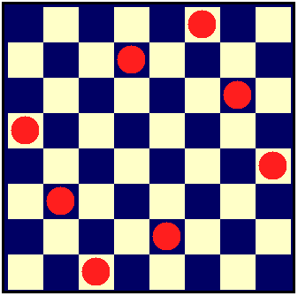
Queen Problem
8 Queen Problem (Uva 750)

Slide 16
Queen Problem
Pseudo code
void backtrack(int x) // each row
{
if (x == 8) //find a solution
{
print_solution();
return;
}
for (int y=0; y<8; ++y) // try and recursion
{
int d1 = (x+y) % 15, d2 = (x-y+15) % 15;
if (!my[y] && !md1[d1] && !md2[d2]) {
// set up the constraint
my[y] = md1[d1] = md2[d2] = true;
solution[x] = y;
backtrack(x+1);
// back up the constraint
my[y] = md1[d1] = md2[d2] = false;
}
}
}

Slide 17
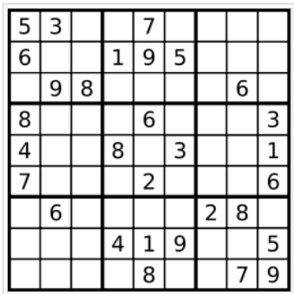
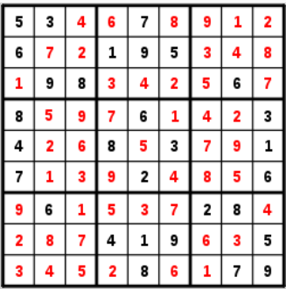
Sudoku Problem
Sudoku Problem (ZJ2d060)

Slide 18
Sudoku Problem
Pseudo code
void backtrack(int x, int y)
{
if (y == 9) x++, y = 0; // next row
if (x == 9) // a solution
{
print_solution();
return;
}
// try and recursion
for (int n=1; n<=9; ++n)
if (!mx[x][n] && !my[y][n] && !mg[x/3][y/3][n])
{
mx[x][n] = my[y][n] = mg[x/3][y/3][n] = true;
solution[x][y] = n;
backtrack(x, y+1);
mx[x][n] = my[y][n] = mg[x/3][y/3][n] = false;
}
}

Slide 19
Homework 7
Queen Problem
Uva 167 750 10513 639 750
UVA (total 40 problems)
861 10181 10128 10160 10032 10001 704 10270
140 165 193 222 259 291 301 399 435 524 539 565 574 598 628 656 732 10624
zero judge 2
d060(NCPC)

Slide 20
Thank You For Attention!

