Slide 1
Midterm Review
Grab Your Time
106598024 鍾承翰 106598054 楊子冊
106598060 吳彥銘

Slide 2
Outline
Problem Statement
System Context Diagram
Use Case Diagram
Demonstration
Significant Use Case_1
Significant Use Case_2
Domain Model
Use Case Realizations with GRASP Patterns
Design Class Diagram
Implementation Class Diagram
Significant Functionality
Unit Tests
Significant Test Case
Project Information

Slide 3
Problem Statement
在人生中，我們往往不知道該如何有效運用時間，而最根本的原因就是不確定將時間花在哪裡，而渾渾噩噩地過著日復一日的生活。因此我們需要有一個軟體能夠幫我們紀錄，除了上工時間之外，還做了哪些事情，並且可以用簡單的圖表來呈現讓使用者可以知道時間都花在甚麼事情上，進一步去調整每件事情時間的分配。
對於使用者來說，可以藉由此軟體記錄下自己做的事情及時間。如果想知道每段時間做了什麼，花了多少時間，只要設定日期範圍，即可產生相對應的圖表。圖表顯示出這段時間內每項事情及其所花費的時數，藉此思考事情的規劃到底是不是有效率的。

Slide 4
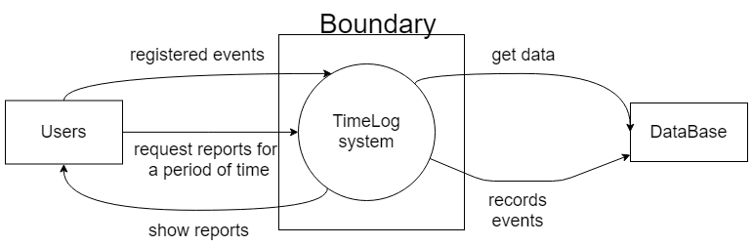
System Context Diagram

Slide 5
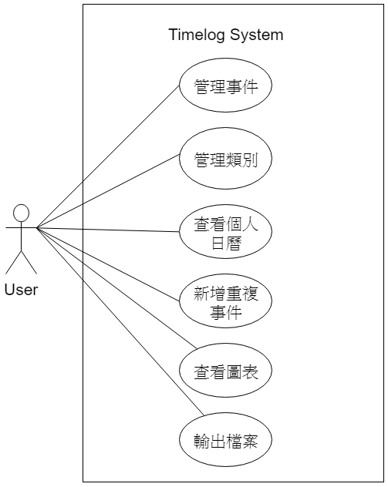
Use Case Diagram

Slide 6
Demonstration
DEMO

Slide 7
Significant Use Cases 1
Use Case ID
Use Case Name | 管理事件
Scope | Timelog System.
Level | User goal.
Primary Actor | User.
Stakeholders and Interests | User：使用者想管理事件。
Preconditions | 登入系統。 修改與刪除至少一筆事件。
Success Guarantee | 系統成功紀錄在事件清單中。

Slide 8
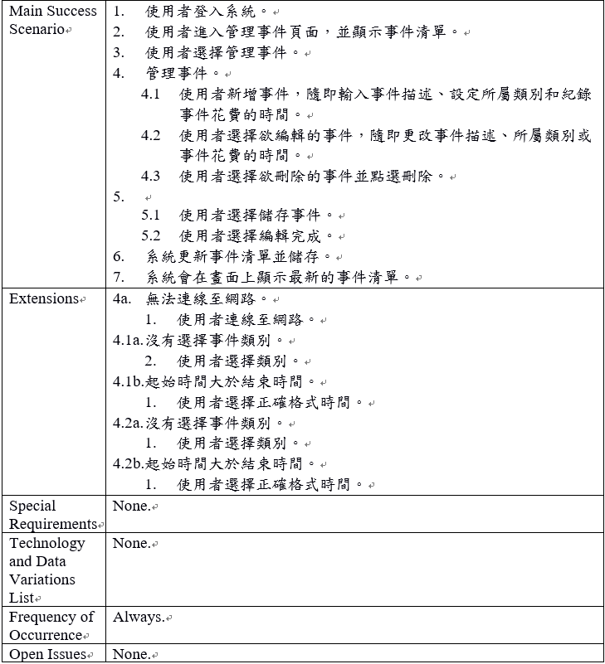
Significant Use Cases 1

Slide 9
Significant Use Cases 2
Use Case ID | 2.
Use Case Name | 管理類別。
Scope | Timelog System.
Level | User goal.
Primary Actor | User.
Stakeholders and Interests | User：使用者想管理類別。
Preconditions | 1. 登入系統。 2. 修改與刪除至少一筆事件。
Success Guarantee | 系統成功更新類別清單。

Slide 10
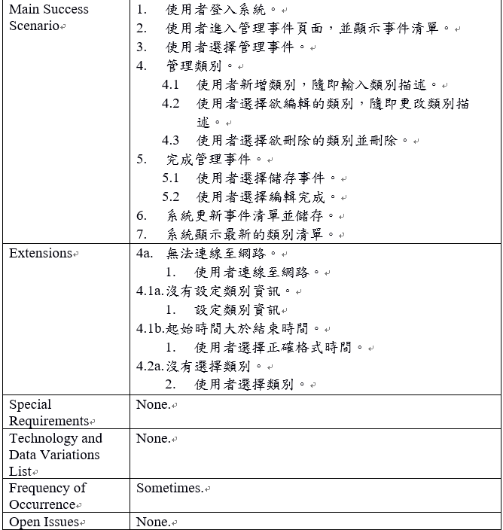
Significant Use Cases 2

Slide 11
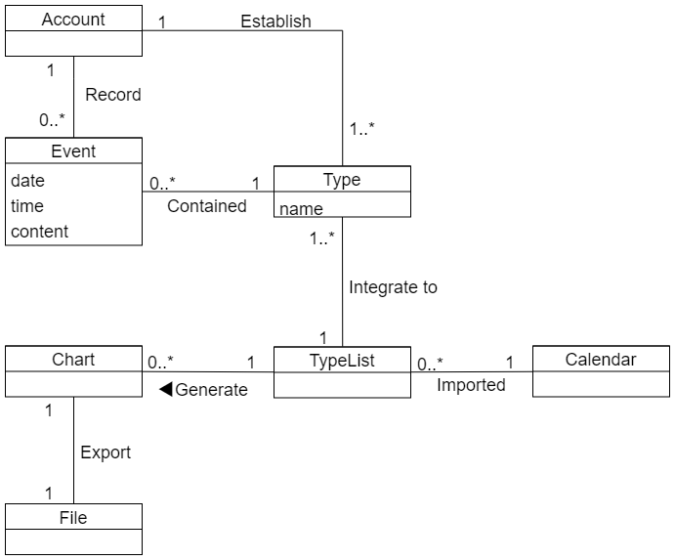
Domain Model

Slide 12
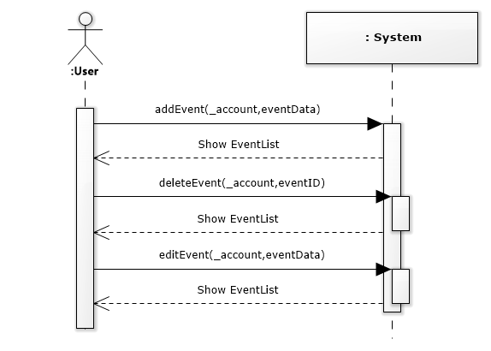
Use Case Realizations with GRASP Patterns
SSD-Manage Event

Slide 13
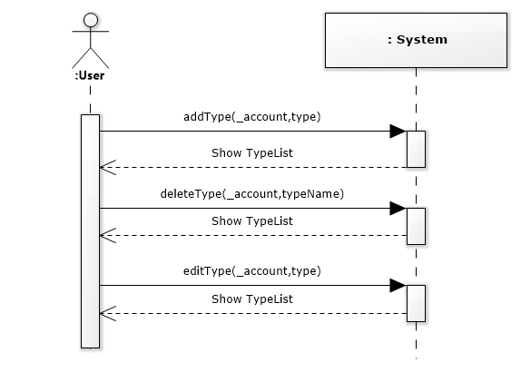
Use Case Realizations with GRASP Patterns
SSD-Manage Type

Slide 14
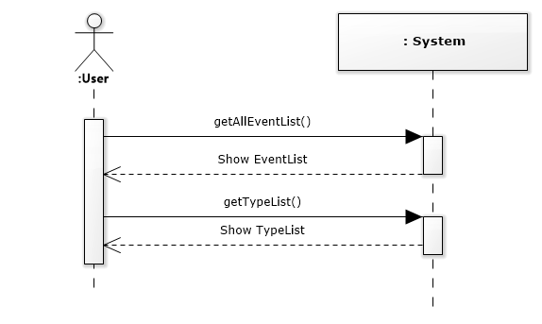
Use Case Realizations with GRASP Patterns
SSD-Present Calendar

Slide 15
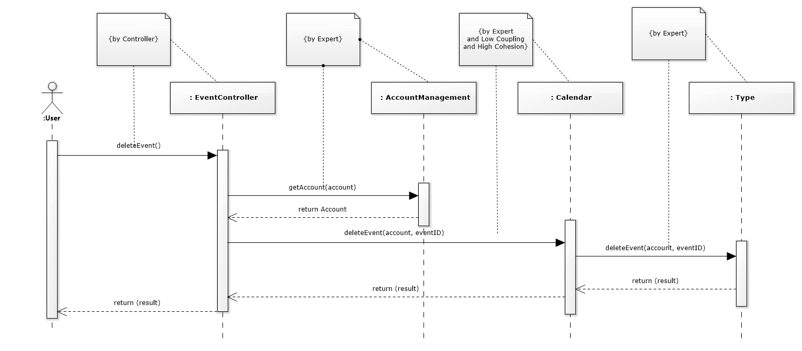
Use Case Realizations with GRASP Patterns
SD-Delete Event

Slide 16
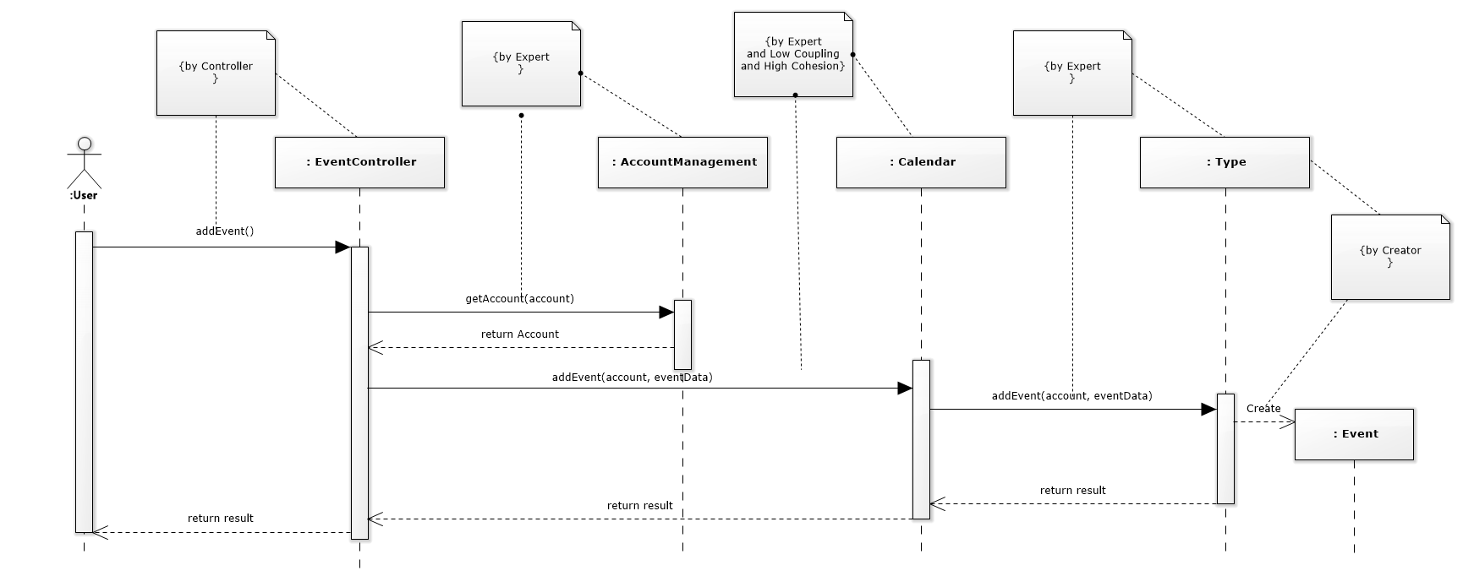
Use Case Realizations with GRASP Patterns
SD-Add Event

Slide 17
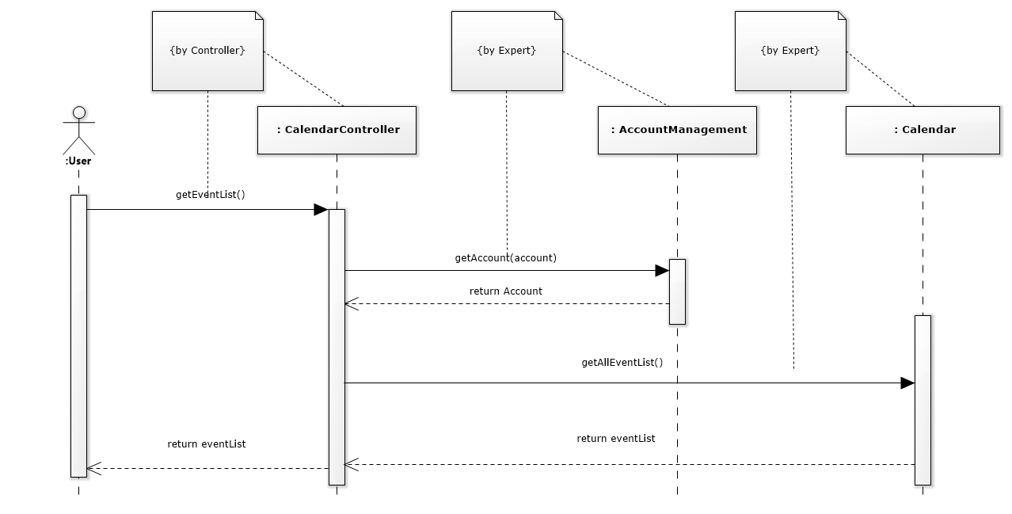
Use Case Realizations with GRASP Patterns
SD-Get EventList

Slide 18
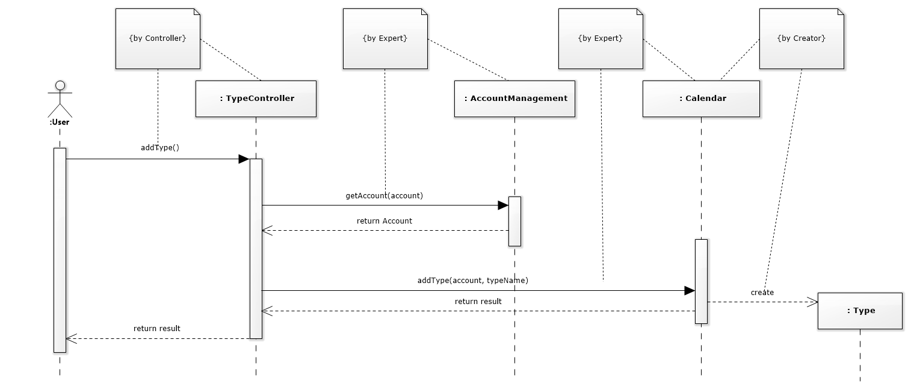
Use Case Realizations with GRASP Patterns
SD-Add Type

Slide 19
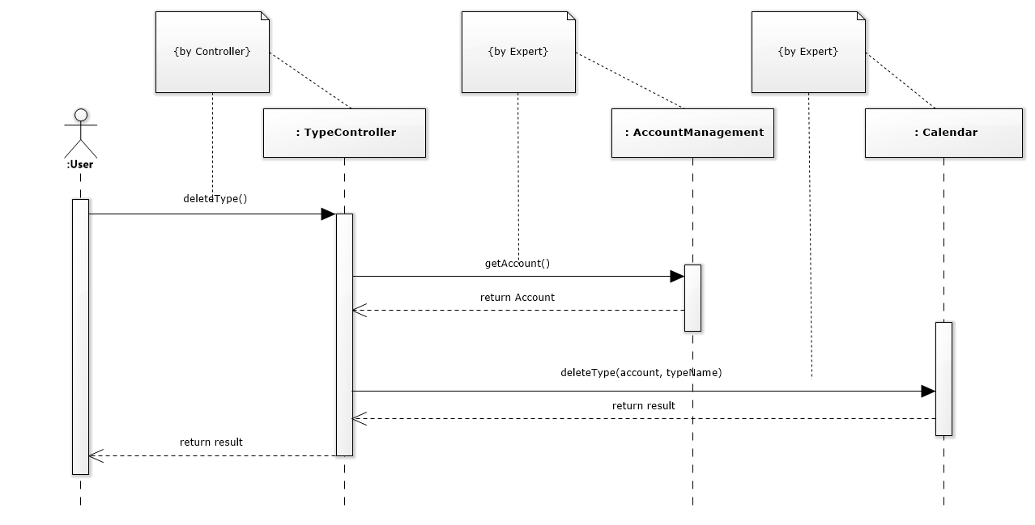
Use Case Realizations with GRASP Patterns
SD-Delete Type

Slide 20

Use Case Realizations with GRASP Patterns
SD-Get TypeList

Slide 21
Design Class Diagram
Next

Slide 22
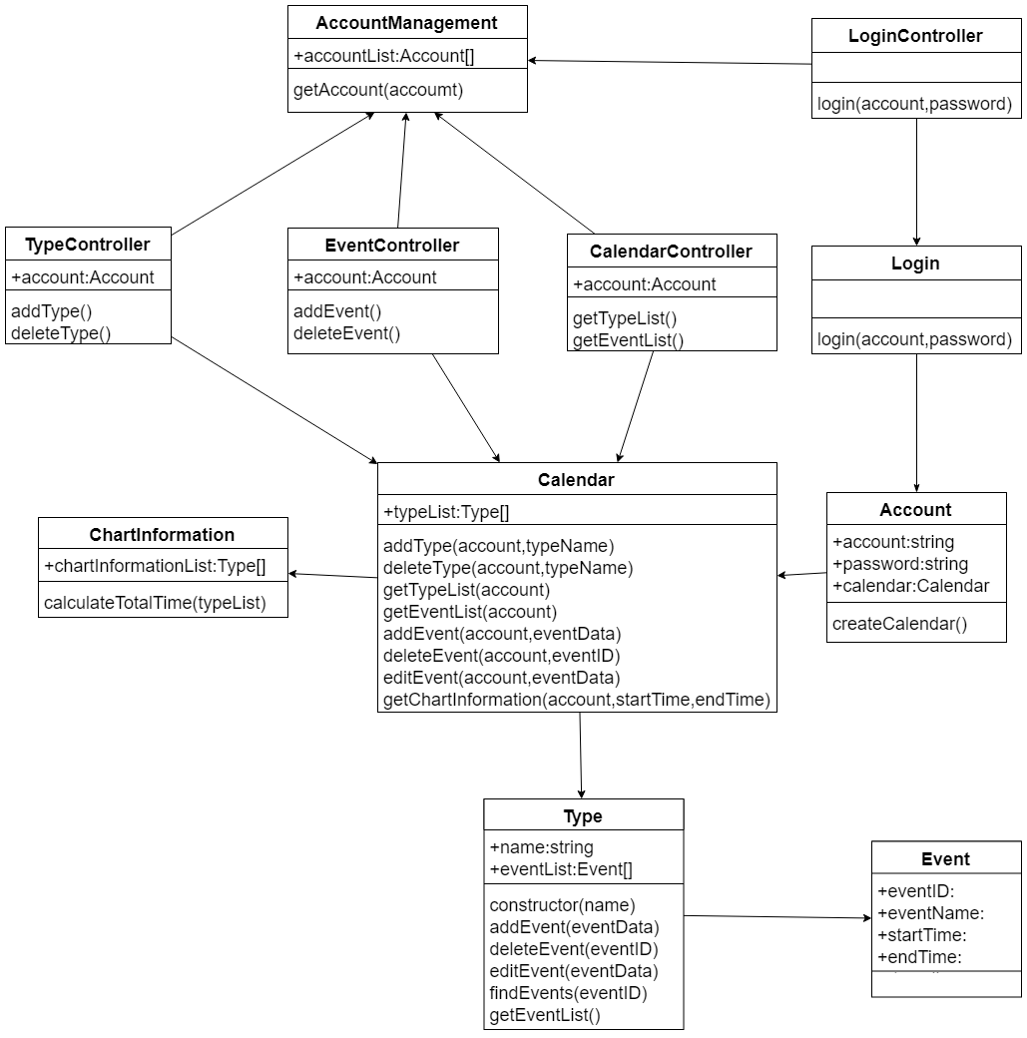

Slide 23
Implementation Class Diagram
Next

Slide 25
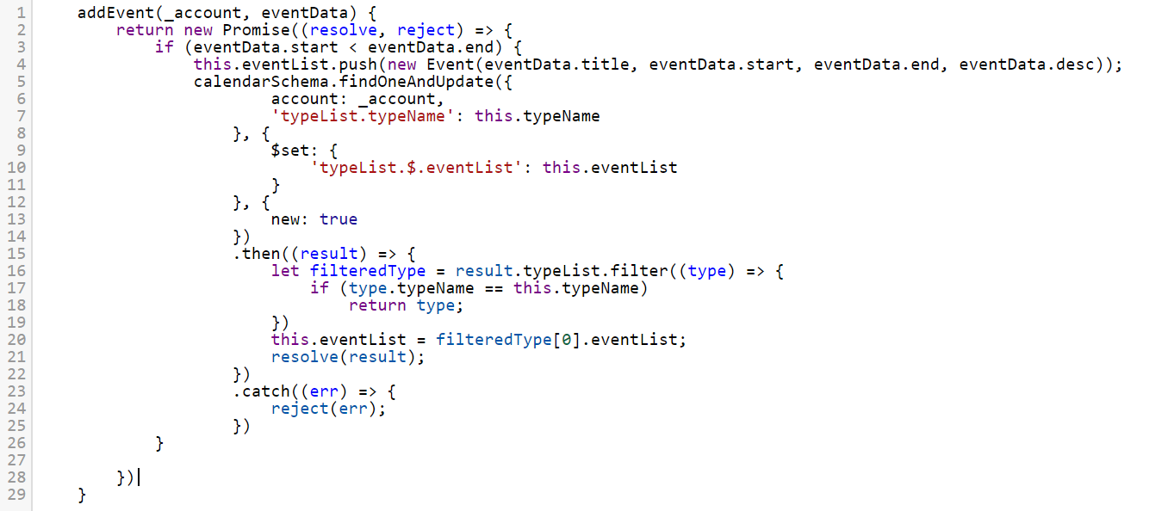
Significant Functionality

Slide 26
Unit Test
DEMO Unit Test

Slide 27
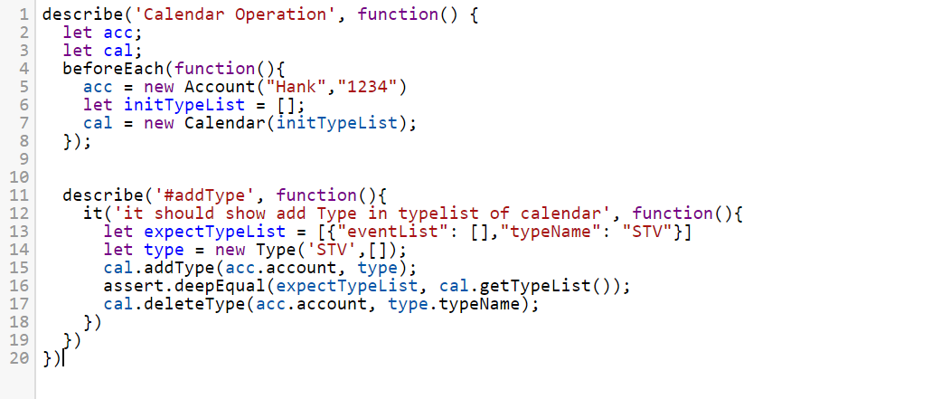
Significant Test Case

Slide 28
Project Information
Project Information
LOC of production code | 931
The number classes of production code | 13
The number of methods of production code | 15
The number of unit tests | 6
LOC of test code | 93
Team member Hank time efforts | 98 hr.
Team member Andy time efforts | 84 hr.
Team member Johnson time efforts | 75 hr.
Total time efforts | 257 hr.

Slide 29
Thank You

