Slide 1
CHAPTER 1
How Does AI Reshape Information Acquisition and Belief Formation in Human Groups?

Slide 2
Research Background
Search engines typically present users with multiple sources, links, and evidentiary cues.
Generative AI increasingly organizes information as “direct answer → integrated explanation → follow-up questions.”
Research problem: At the group level, if many members rely on the same model, similar training data, the same retrieval system, and similar answer-generation logic, their seemingly independent judgments may contain the same omissions, narrative frames, and errors. The number of judgments continues to grow, but the number of independent information samples does not grow proportionally.
Real-world examples include AI search assistants embedded in Weibo and WeChat.

Slide 3
Research Background
DIRECT EVIDENCE ON AI-ASSISTED WISDOM OF CROWDS
• Pal, Palley & Satopää (2026), “Enhancing Crowd Accuracy in AI-Assisted Judgmental Forecasting.” The same AI advice is shared information that can be counted repeatedly and overrepresented when judgments are averaged. Across three experiments (N = 3,188), the authors propose correcting shared AI signals with participants’ pre-AI judgments.
• Schoenegger et al. (2024), “AI-Augmented Predictions: LLM Assistants Improve Human Forecasting Accuracy.” Among 991 participants answering six forecasting questions, access to an assigned LLM improved individual accuracy by 24%–28%. The study also tests whether lower judgment diversity harms the wisdom of crowds.
BOUNDARY
AI may have only a small average effect on each member, yet a shared model can expose members to similar evidence, frames, and arguments. This raises error correlation and weakens collective intelligence based on independent judgment. This boundary is consistent with Artificial Hivemind: repeated outputs from the same model and outputs across models were homogeneous, but the study measured model responses—not human political attitudes or organizational decisions.
Notes:
此处要介绍一下wisdom of crowds

Slide 4
Research Gaps
GAP 1 — Existing work largely stops at the model-output layer
Artificial Hivemind and related error studies show that LLM responses may be similar, but not how this similarity becomes human information selection, belief updating, and group-level judgment.
GAP 2 — Individual and group accuracy are often conflated
Studies commonly ask whether AI improves individual judgment, but rarely whether higher judgment correlation reduces aggregation gains even when average individual quality is unchanged or improved.
GAP 3 — Traditional opinion dynamics lacks an interactive generative source
Traditional models focus on interpersonal averaging, imitation, and selective exposure. An LLM combines a shared model prior with user-conditioned output: it may repeat similar content to everyone or generate different content by user position. This shared-base/personalized-output structure remains under-modeled.
GAP 4 — A testable micro–macro bridge is missing
Real-world experiments are usually too small to observe the long-run system effects of thousands or tens of thousands of people using a shared LLM.

Slide 5
Theoretical Framework
WISDOM OF CROWDS AND THE DIVERSITY PREDICTION THEOREM
Wisdom of crowds (Surowiecki, 2004)
Collective judgment outperforms individual judgment under three necessary conditions: diverse views, independent decisions, and dispersed private information. A common AI reference signal directly weakens independence and diversity.
Diversity prediction theorem (Page, 2007)
Group error = average individual error − predictive diversity.
AI can improve individual accuracy while reducing predictive diversity. These forces work in opposite directions. As group size grows, the weight of diversity rises; eventually, the loss of diversity may outweigh the gain in individual accuracy.
Social influence and diversity (Lorenz et al., 2011)
A common external signal makes individual judgments converge and can weaken group forecasting. This study treats uniform AI advice as a global external signal and tests whether it actually reduces collective predictive performance.

Slide 6
Research Question: Do LLMs Undermine the Wisdom of Crowds?
When individuals with heterogeneous initial positions independently and repeatedly interact with an LLM about the same public-policy issue, how does output homogeneity change the correlation structure of group judgment?
“Correlation structure” includes three possible outcomes:
• convergence in information samples;
• higher correlation in judgment errors;
• convergence, persistent division, or further polarization of opinions.
When information quality and average individual accuracy are broadly comparable, does a shared LLM increase error correlation across members, thereby reducing the group’s effective amount of independent information and the quality of collective judgment?
MODEL-OUTPUT HOMOGENEITY → CORRELATED INFORMATION EXPOSURE → BELIEF UPDATING → GROUP JUDGMENT STRUCTURE

Slide 7
Research Hypotheses
H1. A shared LLM increases the similarity of information obtained by members.
H2. A shared LLM increases correlation in members’ judgment errors.
H3. A shared LLM reduces the accuracy gain produced by judgment aggregation.
H4. Model diversity mitigates the loss of crowd wisdom caused by a shared LLM.
H4 also serves as a mechanism test. If model diversity first reduces error correlation and then restores aggregation gains, the core mechanism is supported. If it only increases linguistic variation without changing error correlation or aggregation outcomes, the mechanism is not validated.

Slide 8
Modeling Foundation
OPINION DYNAMICS: WHEN DOES A SHARED MODEL PRODUCE CONVERGENCE OR DIVERGENCE?
Traditional opinion dynamics studies how people update judgments from others’ opinions. DeGroot models convergence through weighted averaging; Friedkin–Johnsen allows attachment to initial positions; Hegselmann–Krause bounded confidence assumes that people accept only information sufficiently close to their current view, allowing multiple opinion clusters.
Here, opinion dynamics is not mainly used to simulate interpersonal diffusion. It describes how members with different initial positions update sequentially in response to shared—but potentially personalized—LLM information.

Slide 9
Method: Hybrid ABM–Dynamics Modeling
ABM connects three levels:
MODEL RESPONSE → INDIVIDUAL UPDATING → GROUP DISTRIBUTION
It can accommodate heterogeneous agents, repeated follow-up questions, nonlinear updating, personalized outputs, and large-scale group outcomes. The theoretical contribution comes from the mechanism relationships above; ABM provides mechanism tracing and counterfactual comparison.

Slide 10
Opinion Dynamics Models Human Group Behavior
Opinion dynamics explains how users update their positions after receiving an LLM response.
Agent i’s opinion in round t is xᵢ,ₜ, and the policy position implied by the LLM response is sᵢ,ₜ. The basic update rule is:
xᵢ,ₜ₊₁ = (1 − λᵢ)xᵢ,ₜ + λᵢsᵢ,ₜ
where λᵢ is the agent’s reliance on the LLM.
With bounded confidence, the agent accepts only information within a threshold of its current view:
|sᵢ,ₜ − xᵢ,ₜ| ≤ τᵢ
This structure can produce two outcomes:
• similar answers from a shared model generate convergence;
• evidence selected by initial position gives opposing camps directionally different answers, generating division or polarization.
Sycophancy and personalization are therefore boundary conditions on the homogenizing effect of a shared model.
Notes:
group size。

Slide 11
Overall Model
Layer | Input | Output | Function
LLM information layer | User question; model configuration | Natural-language response Rᵢₖₜ | Generate the information received by each member
Text-measurement layer | Response Rᵢₖₜ | Position signal sᵢₖₜ; information vector zᵢₖₜ | Convert text into computable variables
Opinion-updating layer | Prior position xᵢₖₜ; position signal sᵢₖₜ | New position xᵢₖ,ₜ₊₁ | Simulate how members adopt the response
Notation
i: member
k: policy issue
t: interaction round
xᵢₖₜ ∈ [−1, 1]: member’s current position
sᵢₖₜ ∈ [−1, 1]: policy position implied by the LLM response
zᵢₖₜ: arguments, facts, and policy frames contained in the response
Chuang et al. use a similar procedure: an LLM agent first generates a natural-language opinion, then an independent FLAN-T5-XXL classifier encodes the text as −2, −1, 0, 1, or 2. They manually validate 100 responses. Krippendorff’s α among three annotators is 0.81, and automatic classification agrees with the human majority vote in 84% of cases.

Slide 12
Revision Plan
In the previous version, I focused the research objective on AI’s effect on individuals’ information acquisition.
The instructor identified the following problem:
The theoretical background was insufficient.

Slide 13
Paper 1: Theoretical Framework
OPTIMAL STOPPING THEORY
Theory type
Normative decision theory and a mathematical decision framework.
Disciplinary homes
• Information economics and search theory
• Microeconomic theory
• Operations research and management science
• Statistical decision theory
• Behavioral decision research
Representative journals
Econometrica; Journal of Economic Theory; Economic Theory; Operations Research; Management Science; Decision Analysis.
DETAILED EXPLANATION
Optimal stopping theory asks when a decision maker should stop when information or options arrive sequentially, continued observation is costly, and future gains are uncertain. Its core is not “more search is always better,” but a comparison between the expected marginal benefit and marginal cost of one more search.
Weitzman’s classic model converts search objects into reservation values. Search continues while an unchecked option still offers sufficient expected gain; it stops when the best observed outcome exceeds the reservation value of every unchecked option. Paper 1 is not exactly the same “find the best option” task, but it can use the central criterion: Is the expected information value of the next piece of evidence greater than the cost of obtaining it?

Slide 14
AI Improves Current Task Performance, Yet May Not Build the Capability Needed to Perform the Task—Paper 1’s Tension
Broadly, we aim to examine the following phenomenon:
Domain | Surface gain from AI | Capability gap that may be hidden | Disciplinary home
Academic research | Rapid reviews, hypotheses, paper explanation, and drafting | Cannot evaluate evidence, detect errors, identify theoretical boundaries, or formulate questions independently | Science studies; research policy; higher education; JDM
Organizational knowledge work | Rapid reports, plans, and analysis | Assumptions remain unexamined; counterexamples are hard to handle; knowledge does not accumulate | Information systems; organizational behavior; knowledge management
Professional learning and training | Novices achieve high immediate performance with AI | Cannot transfer, diagnose, or solve problems independently without AI | Learning sciences; professional education; skill formation
Management and strategy | Rapid, well-structured recommendations | Managers cannot judge applicability boundaries or detect false premises | Management; strategy; JDM
Medical decisions | Diagnostic advice and case explanation | Clinicians cannot independently validate or explain anomalous cases | Medical decision making; professional judgment
Domain | Surface gain from AI | Capability gap that may be hidden | Disciplinary home
Law and compliance | Rapid regulatory explanation and legal opinions | Cannot identify exceptions, jurisdictional differences, or reasoning flaws | Law and society; professional services
News and public information | Rapid summaries of complex events | Cannot verify sources or separate evidence from inference | Communication; information behavior; misinformation
Citizen decisions | Rapid understanding of health, finance, or policy information | Subjective understanding improves, but actual judgment and questioning do not | Behavioral public policy; risk communication; consumer decision making
Public administration | Rapid policy explanation and case processing | Officials cannot independently explain, review, and apply rules | Public administration; administrative discretion; accountability

Slide 15
More Specifically, Paper 1 Focuses on the Information-Collection Stage
WHY DOES THIS MATTER?
Information collection is one of the tasks most widely delegated to AI, so the affected audience is broad.
WHERE IS THE THEORETICAL GAP?
Existing theories cannot clearly explain the consequences AI creates for people.

Slide 16
CHAPTER 2
How Can AI Governance Promote Trust Calibration, Aligning Individual Reliance with AI’s Actual Performance?
Notes:
更像一个章节题目，不像是一个研究问题。

Slide 17
Candidate Theoretical Frameworks
The theoretical core remains:
• trust in automation;
• human adoption of machine advice;
• algorithm aversion and algorithm appreciation.
JUDGMENT AND DECISION MAKING (JDM)
The Journal of Behavioral Decision Making is a leading journal in this field, and the foundational roots of all these terms lie here:
Algorithm aversion
A signature JDM concept formally named in 2015, describing the cognitive bias of deliberately rejecting algorithmic advice that performs better.
Expectations and expertise
From cognitive psychology and behavioral decision research: expectation bias, overconfidence, and domain-expert bias are classic JDM variables.
Decision autonomy / decisional agency
A core decision-psychology concept linked to locus of control and the psychological need to retain control over decisions.
Incentivization
A classic behavioral-decision and behavioral-economics variable distinguishing material incentives from social-reputation incentives.
Cognitive compatibility
A cognitive-psychology and information-processing term comparing intuitive human processing with algorithmic logic.
Divergent rationalities
A term derived from the contrast between the heuristics-and-biases paradigm and fast-and-frugal ecological rationality, asking what counts as rational decision making.

Slide 18
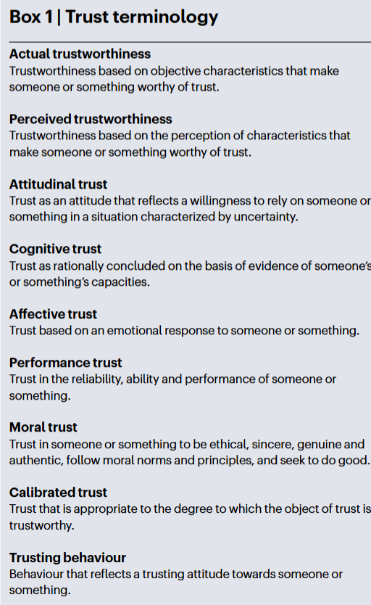
AI Trust Is Highly Interdisciplinary
Research on trust in AI is highly interdisciplinary, involving psychology, philosophy, computer science, and other fields. Its theoretical foundations are correspondingly complex.
The literature covers general trust in artificial intelligence, human resistance to AI, AI in moral decision making, AI in managerial decisions, and trust in autonomous driving.

Slide 19
Defining Trust
The classic three-factor model of interpersonal trust proposes that trust and trustworthiness derive not only from perceived ability, but also from integrity and benevolence.
Trust in AI likewise has two dimensions: performance/capability (can it complete the task?) and morality (is the system directed toward good, and are its processes and purposes legitimate?). Research has not consistently separated performance trust from moral trust, and many studies conflate them. People care about both AI performance and its design intent, operating logic, benevolence, and fairness. An AI system can be highly capable but deceptive, stable but unethical, or morally aligned but inaccurate.

Slide 20
Algorithm Appreciation and Algorithm Aversion
At present, these theories remain largely descriptive accounts of phenomena and objectively have limitations.
Placing both preference for and aversion to AI within one theoretical framework nevertheless has practical relevance and theoretical value.
2. A few early errors determine whether an entire system continues to use AI
Real-world AI applications often begin as pilots:
• an organization deploys on a small scale;
• users observe early performance;
• the organization decides whether to expand, restrict, or terminate use.
This directly affects monitoring, correction, and exit mechanisms for the AI system.
Why does this topic matter in objective terms?
In the past, evaluating an algorithm was relatively simple: accuracy could represent everything. AI, however, crosses the boundary between algorithms and humans. It already displays part of human intelligence while remaining nonhuman. Its monitoring, correction, and exit mechanisms therefore need a scientific basis.

Slide 21
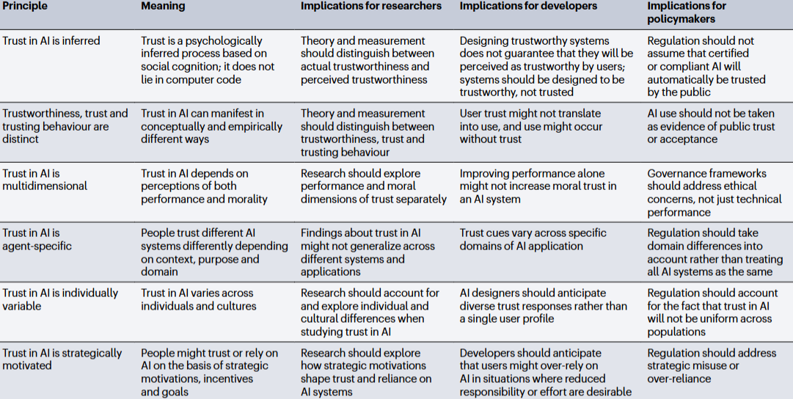
The Complex Nature of Trust in AI

Slide 22
Research Gaps
• AI-governance research analyzes institutions but rarely measures individuals’ actual reliance.
• AI-trust research measures individual reliance, but often treats interface prompts, explanations, or labels as “governance,” without a real institutional basis.
• Research is scarce on person–context fit as a moderator of AI-system features. The effect of the same AI feature—explainability, anthropomorphism, or high accuracy—depends on whether users perceive the AI as fitting themselves and the task, yet this moderation is rarely examined directly.
• Much of the literature is cross-sectional and static rather than longitudinal. AI changes rapidly, so findings about conventional automation and early algorithms may lack temporal validity for current large models. Almost no work tracks how public trust changes over time with technological diffusion and social events.

Slide 23
The Goal of Trust Governance Is Not More Trust, but Reliance That Matches the System’s Real Capability
Governance objective: align actual reliance with the system’s real capability.
Mechanism objective: examine the relationships among actual trustworthiness, perceived trustworthiness, trust attitude, and reliance behavior—and identify which link is easiest to change so that final reliance moves toward actual trustworthiness.
Meaning of trust calibration
ACTUAL TRUSTWORTHINESS → PERCEIVED TRUSTWORTHINESS → TRUST ATTITUDE → ACTUAL RELIANCE

Slide 24
Trust Calibration Bias
Perceptual calibration bias = subjectively judged AI reliability − actual reliability
Behavioral calibration bias = actual degree of reliance − the degree of reliance warranted by relative capability
Algorithm aversion and algorithm appreciation are therefore no longer isolated phenomena:
• underestimating AI capability is a negative perceptual bias;
• knowing AI is better but not adopting it is under-reliance;
• knowing AI is unreliable but continuing to use it is over-reliance.
Regulators should test different intervention combinations for different conditions so that user reliance approaches a reasonable level.

Slide 25
Practical Relevance
For example, when will people think AI should be introduced into a particular stage?
In the past, this was simple: once an algorithm’s accuracy was high enough, including it in the decision process seemed natural. AI is different.
AI enters more complex human settings—not only settings where accuracy is measurable, but also consultation, emotional decisions, and others.
The framework must therefore expand and first clarify questions that past theories could not resolve:
How should traditional algorithms, AI, and humans be distinguished? How are these actors perceived differently?

Slide 26
CHAPTER 3
Responsibility Attribution

Slide 27
Responsibility Attribution
Current theory has reached the claim that people believe AI clearly changes where responsibility is assigned.
The next question is whether responsibility assigned to AI resembles shifting blame to another human or the traditional shifting of blame to an algorithm.
Both types of responsibility transfer are theoretically mature. Yet many studies still treat AI as a conventional algorithm, which clearly cannot explain the emotional dependence that people sometimes develop toward AI.
Practical relevance: If we can show that responsibility transfer to AI follows a genuinely new path, the result will influence future ethics, law, and regulation.

Slide 28
The Work Does Not Identify Which Assumption in Existing Theory Is Wrong or Incomplete
The work does not derive a counterintuitive, falsifiable prediction.
It does not explain why an AI environment would cause classic responsibility theories to fail.

Slide 29
When AI Has Substantively Participated in a Decision, Does Requiring a Human to “Confirm and Take Responsibility” Restore Human Agency—or Merely Push Responsibility Back onto Someone Without Adequate Control?
Accountability theory argues that being observed, evaluated, and required to explain increases a person’s sense of accountability.
Responsibility/control theory argues that responsibility should be grounded in actual control, causal contribution, and decision authority.
AI systems can separate the two: a person may be required to sign, explain, and bear the consequences without genuinely forming or controlling the decision.
Work on meaningful human control explicitly argues that responsibility should be proportionate to actual control and authority. The “moral crumple zone” identifies how automated systems can concentrate failure responsibility on human operators with limited control.
Meaningful Human Control · Moral Crumple Zones

