Slide 1
DOCTORAL PROJECT
The Puzzle That Motivates the Work
REAL SETTINGS
Where AI is entering
Crisis judgment, organizational governance, public administration, healthcare, and other high-risk settings.
AI is entering more real decision settings, and the key question is how human judgment changes once AI becomes part of the decision process
WHAT CHANGES
Embedded decision chains
AI is no longer only a lab system or a stand-alone tool. It is becoming part of real organizational and institutional processes.
Xu | Doctoral Project Intro | July 2026
WHY THIS MATTERS
Why study the human side
Once AI enters consequential decision chains, we need to understand what happens to people as they interpret, rely on, and act with AI.
The dissertation starts from that broader shift.
01
Notes:
Good afternoon, everyone.
Today I'd like to introduce my doctoral research.
Let me begin with a simple observation.
AI is becoming part of many important decisions that we make every day.
We can already see it in healthcare, public administration, financial investment, and many other high-risk settings.
It is becoming part of real decision-making systems.
Because of this change, AI research or governance can no longer focus only on model performance or safety.
We also need to understand what happens to people once AI becomes part of the decision process.
This is the starting point of my dissertation.

Slide 2
CURRENT RESEARCH
Existing research usually asks three separate questions
-
The first question is whether AI improves human judgment quality or performance.
THREE STREAMS
What they ask
Judgment quality
-
The second is whether people trust, adopt, or rely on AI advice.
Trust / reliance
-
The third is how responsibility should be allocated once AI is involved in decision-making.
Responsibility
These questions are important, but they still tend to treat AI as an external tool.
Does AI improve judgment quality? Do people trust and rely on AI? How is responsibility assigned after AI-assisted decisions?
02
Notes:
So what do we already know?
Existing research mainly studies AI from three perspectives.
The first asks whether AI improves human judgment.
The second asks whether people trust and rely on AI.
The third asks who should be responsible after AI-assisted decisions.
These are all important questions.
However, they share one common assumption.
They all treat AI as an external tool.

Slide 3
RESEARCH GAP
These literatures are important, but they still leave the process itself underexplained
Decision quality / calibration
Trust / reliance
Zhang et al., 2020; Ma et al., 2023; Vaccaro et al., 2024
Lee & See, 2004; Dietvorst et al., 2015; Logg et al., 2019
Research here asks whether AI improves joint judgment quality and calibration.
This stream studies appropriate reliance, algorithm aversion, and algorithm appreciation.
Responsibility / ownership
What is still missing
Kirchkamp & Strobel, 2019; Kobis et al., 2025; Chevrier & Teixeira, 2024
Kidd & Birhane, 2023; Harvey & Fischer, 1997; Lee & See, 2004
This stream studies how AI participation redistributes ownership, moral cost, and blame, mostly in delegation or ex post attribution settings.
What is still missing is a process-level account of how these stages connect.
They are analytically useful, but they rarely show how belief formation, reliance calibration, and responsibility unfold inside one connected decision process.
03
Notes:
Much of this literature still treats AI as a traditional algorithm.
For example, it often explains human-AI interaction through ideas such as algorithm aversion, algorithm appreciation, or advice-taking.
However, it is clear that this cannot explain why people sometimes over trust in AIs while at other times distrust them overly
Another limitation is that many studies still focus too much on the AI side.
They ask whether AI improves performance, whether the model is accurate.
The more important question is what happens on the human side.
we need a different way to understand AI-assisted decision-making.
We need to move from seeing AI as an external algorithmic tool, to seeing AI as part of the human decision process itself.

Slide 4
WHY GENERATIVE AI
People increasingly treat AI as a source of judgment, not just a tool
Using AI as a tool
Using AI as a judgment source
Search, calculate,
or automate
Consult, discuss,
or confirm
SHIFT
From tool use
to judgment
interaction
Interpret the
result yourself
Use AI to interpret
complex situations
The tool stays
outside the judgment
Rely on its explanation
and framing
More and more users do not use AI only to search, calculate, or automate. They consult it, discuss with it, confirm with it, and sometimes rely on it.
In these interactions, AI does not simply give an answer. It shapes how people understand the problem itself.
04
Notes:
Why is this make sense?
Because large language models communicate through language rather than simple numerical outputs.
They explain,
summarize,
persuade,
reassure,
and organize information.
As a result,
they influence how people understand problems before making decisions.

Slide 5
WHY LLMs FEEL DIFFERENT
Large language models change interaction through language, explanation, and narrative
-
This means the difference is not only more accurate output.
WHAT THIS ENABLES
Why it matters
Context integration
-
The form of output and the mode of interaction also change.
Continuous explanation
-
LLMs enter the cognitive process through natural language, explanation, and narrative framing.
Narrative influence
That is why people can be influenced not only by answers, but by the way answers are framed.
Their Transformer architecture supports contextual integration, and later tuning makes them able to explain, respond, and interact continuously with users.
05
Notes:
moreover,Large language models are built to work with context.
They can take a question, connect it with surrounding information, and generate a response in natural language.
They give a narrative.
Because of this, they enter the human decision process in a much more direct way.
And they can make a suggestion sound more convincing.
So users are not only influenced by what the AI says.
They are also influenced by how the AI says it.

Slide 6
ONE CONNECTED PROCESS
The three papers study different stages of one connected human-AI decision process
STAGE 1
STAGE 2
STAGE 3
Belief formation
Reliance /
action
Responsibility
-
information -> belief
-
belief / feedback
-> action
-
action -> consequence
-
How is a belief formed before people decide what to do?
-
How does feedback reshape reliance and the threshold for action?
-
How is responsibility understood once action produces consequences?
-
AI can shape what feels sufficient, relevant, or already processed.
-
People may rely, defer, or act differently once AI enters the process.
-
AI can also reshape ownership and responsibility after outcomes occur.
This is the belief-formation stage.
This is the reliance-and-action stage.
This is the responsibility stage.
Belief Formation -> Reliance Calibration / Action Threshold -> Responsibility Attribution
06
Notes:
So at this point, I want to move from the background to the core structure of my research.
My argument is that AI does not only affect one single decision.
Before people make a decision, AI may shape how they form beliefs.
Then, after people form a belief, AI may change how they judge risk.
It may also change how much they rely on the system, and when they decide to take action.
Finally, after the action leads to an outcome, AI may also change how responsibility is understood.
So the process is not just:
AI gives advice, and humans accept or reject it.
The process is closer to this:
AI shapes belief formation.
Then it affects reliance and action.
And finally, it influences responsibility attribution.
This is the shared process behind the three papers in my dissertation.

Slide 7
THE THREE PAPERS
The dissertation isolates different stages of that same decision process
PAPER 1
PAPER 2
evidence -> belief
belief / feedback
-> action threshold
How answer-first AI changes evidence search, belief updating, and subjective information mastery.
How AI error and repeated feedback recalibrate later reliance and action thresholds.
PAPER 3
NEXT
action -> responsibility
Why begin with Paper 1
How AI decision systems reshape the mechanism of responsibility allocation.
I begin with Paper 1 because later reliance and responsibility already depend on a belief base that AI may have reshaped.
Each paper studies a different mapping, mechanism, and outcome within one connected human-AI decision sequence.
07
Notes:
This is where the dissertation separates into the three papers. The three papers are connected because they examine one continuous human-AI decision process. But they are also independent because each one isolates a different mapping, mechanism, and outcome. Paper 1 studies evidence to belief. It asks how answer-first AI changes evidence search, belief updating, and subjective information mastery. Paper 2 studies feedback to reliance and action threshold. It asks how AI error and repeated feedback recalibrate later reliance. Paper 3 studies action to responsibility. It asks how AI-assisted action reshapes ownership and responsibility attribution. I begin with Paper 1 because later reliance and responsibility already depend on a belief base that AI may have reshaped.

Slide 8
PAPER 1
Algorithmic Authority and Information Calibration
How generative AI changes additional search and belief updating under uncertainty
Problem shift
Dissertation position
The question is not only what answer AI gives. The question is whether AI changes when people feel ready to stop looking for more evidence.
Paper 1 studies the first link in the broader chain: how AI reshapes the move from evidence to belief.
Belief formation -> reliance calibration -> responsibility
Notes:
Now I will move to the first paper of my dissertation.
This paper focuses how people move from evidence to belief.
The basic idea is simple.
Generative AI does not only give people an answer faster.
It may also change when people feel they have already seen enough evidence.

Slide 9
CONCRETE EXAMPLE
Search engines ask for evidence first, but AI assistants answer first
The basic reversal is not only about speed. It changes the user's sense of whether more search is still worth doing.
Search engine logic
AI assistant logic
Source 1
Source 2
Source 3
Source 4
The user opens links, compares sources, notices conflict, and then forms a judgment.
Evidence first -> interpretation later
A summarized definition
A coherent explanation
A worked example
A ready-made conclusion
The user first receives an interpreted answer and only later decides whether to verify it.
Interpreted answer first -> optional verification later
The reversal matters because the user may now judge the value of additional evidence through the AI's summary rather than through raw search alone.
Notes:
Let me start with a simple contrast.
When we use a search engine, we usually see evidence first.
We open different links.
We compare sources.
We notice disagreement.
Then we slowly form our own judgment.
But when we use an AI assistant, the order is often reversed.
We first receive a summarized answer.
The answer may already include an explanation, an example, and a conclusion.
Only after that do we decide whether we want to verify it.
So the difference is not only speed.
The deeper difference is the order of the process.
This reversal is the starting intuition of the paper.

Slide 10
CORE PROBLEM
Less search can mean efficiency or harmful under-search
The key is not whether search declines. The key is whether judgment quality declines once search declines.
Efficient compression
Harmful under-search
Users search less because the summary has already compressed informative evidence.
Later posterior quality does not deteriorate.
Users search less because they overestimate how complete the summary already is.
Later judgment moves further away from the full-information benchmark.
vs
Notes:
This creates an important problem.
If people search less after seeing an AI answer, should we worry?
Not necessarily.
Less search can mean two very different things.
In the first case, AI has already compressed useful evidence well.
Then the user searches less, but the final judgment does not become worse.
But in the second case, the user searches less because the AI answer makes the evidence feel more complete than it really is.
Then the user may stop too early, and the final judgment may become worse.
That is harmful under-search.
we should asks whether reduced search is justified.

Slide 11
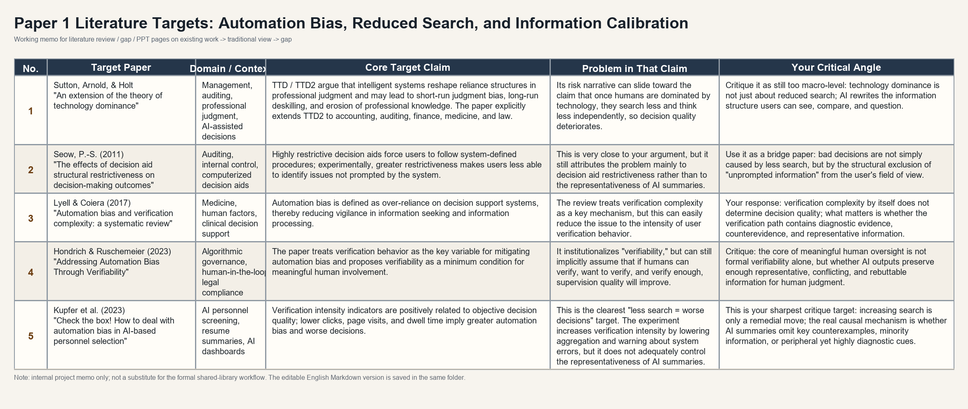
EXISTING WORK
The literature gives us reduced search and automation bias, but not a direct account of information calibration
This literature map shows the closest targets and clarifies why the paper must distinguish search behavior from evidentiary sufficiency and posterior quality.
Notes:
The image summarizes the closest literature targets on automation bias, reduced search, and verification. These papers are valuable, but they often move too quickly from less search to worse judgment, or they treat verification intensity as the key mechanism.
So my paper separates three things.
How much people search.
Whether their final belief is close to the evidence.
And how much they feel they understand the issue.
This is why I frame the paper

Slide 12
CORE QUESTION
Core question: How do generative AI answers change users' stopping thresholds, Bayesian posterior quality, and subjective information mastery?
The paper does not treat reduced raw-evidence viewing as search laziness. It reevaluates that behavior inside a Bayesian belief-updating framework.
Framing
Mechanism in one line
• Reduced raw-evidence viewing is not assumed to be lazy by default.
• The key question is whether AI changes how sufficient the current evidence feels.
• Information calibration asks whether perceived sufficiency stays aligned with the real value of further evidence.
AI answer / AI label
↓
inferred hidden search-and-integration process
↓
perceived evidentiary sufficiency rises
↓
the value of additional evidence falls
↓
the stopping threshold shifts forward
The paper therefore studies whether AI shifts the stopping rule by changing perceived evidentiary sufficiency.
Notes:
The core question is simple.
After people see an AI answer, do they still look for more evidence?
Or do they feel they already know enough?
This is not only about trust.
It is about information calibration.
People may feel they understand the issue, but their belief may not be fully supported by evidence.
A strong AI explanation can make this feeling stronger.
It sounds complete.
It gives a clear story.
So users may assume that AI has already done the search and comparison for them.
Then more evidence feels less necessary.
And they stop earlier.
That is the mechanism I want to test.

Slide 13
RESEARCH QUESTIONS
The study asks three linked questions
The sequence runs from behavior, to normative evaluation, to metacognitive calibration.
RQ1
RQ2
RQ3
Does an AI-labeled summary lower the stopping threshold for additional search?
When search falls, is that rational information compression or harmful information-acquisition deviation?
Does perceived understanding match actual judgment accuracy?

Slide 14
TASK PROTOTYPE
An AI summary-assisted evidence search task in a company-risk judgment setting
The task adapts a classic urn-drawing / bookbag-and-poker-chip belief-updating paradigm to a company-risk setting. Participants either enter the full evidence pool directly or begin with a summary-first answer, then decide whether to inspect additional evidence under the same search cost.
Classical Bayesian prototype
Company-risk contextualization
A fixed evidence environment allows posterior judgments to be benchmarked against a normative updating rule.
The abstract belief-updating task is reframed as judging whether a focal company faces substantial hidden risk.
Summary-first presentation
Common follow-on search
Some participants receive an initial answer before they see raw evidence, recreating a generative-AI interaction sequence.
All groups can inspect additional evidence from the same full pool at the same marginal search cost.
Notes:
Now I move to the task.
I use a controlled belief-updating task.
The logic comes from classic Bayesian tasks, but I put it into a company-risk setting.
Participants judge whether a company has hidden risk.
Some people start with raw evidence.
Others first receive a summary.
But the key point is this:
the summary content is the same.
What changes is the presentation.
One group sees it as an AI-generated answer.The search cost is the same for all groups.
So the task allows me to see when people stop searching, and whether their final belief matches the evidence they actually saw.

Slide 15
DESIGN
The experiment has five groups built on one shared evidence pool
One baseline enters the full evidence pool directly, and four summary groups vary completeness and source label.
Baseline
Complete
No label
Complete
AI label
Incomplete summary
No label
Incomplete
AI label
No summary
Direct entry to the evidence pool
Representative summary
Representative summary
Summary omits key counterevidence
Summary omits key counterevidence
Why five groups instead of a full six-cell matrix
The no-summary baseline does not need a representative versus incomplete split because everyone in that condition enters the same full evidence pool directly.
Notes:
This slide summarizes the five-group design.
all groups are built on the same evidence pool.
The baseline group enters the pool directly.
The summary groups enter through different summary presentations.
But after that, everyone faces the same follow-on search environment.
They can inspect the same additional evidence, with the same search cost.
So if their later search or belief updating differs, the difference comes from the entry condition, not from different evidence environments.

Slide 16
IDENTIFICATION
The same summary text isolates the AI label effect
The content stays the same while the label changes, and every participant then moves through the same additional-search sequence.
Unlabeled summary
AI-labeled summary
The participant sees a summary of the exact same initial evidence, but the source is not identified as AI.
The participant sees the very same summary text, but now the system explicitly says the summary was generated by AI.
Participant sequence
See prior
Read summary
Choose search
Report posterior
Rate mastery
Start from the same prior
Or skip summary in baseline
Open more evidence or stop
Give the final probability
Report confidence and ownership
Notes:
This slide shows the main identification logic.
Participants in the two summary conditions see the same summary text.
The only difference is the label.
One group sees it without an AI label.
The other group sees it as AI-generated.
So if they search differently later, it is not because the content is different.
It is because the AI label changes how the summary is understood.
The label may make the answer feel more complete, more processed, or more authoritative.
After that, everyone goes through the same sequence:
same prior, same search option, same posterior report, and same mastery rating.
That is how I isolate the AI label effect.

Slide 17
BAYESIAN BENCHMARK
Bayesian updating provides the normative benchmark
The design can distinguish under-search from under-updating because each posterior report can be compared with a calculable benchmark.
Classical updating rule
Observed information set
logit(p_Bayes) = logit(p_prior) + sum log(LR_j)
Each evidence item contributes its directional likelihood ratio to the posterior benchmark.
Summary-mentioned evidence and later clicked evidence both enter the participant's observed information set.
Conditional Bayesian deviation
Full-information deviation
abs(logit(p_reported) - logit(p_Bayes observed))
Did the participant use the evidence actually seen correctly?
abs(logit(p_reported) - logit(p_Bayes full))
How far is the final judgment from the full-evidence benchmark?
Notes:
This slide explains the Bayesian benchmark in my design.
I do not only count how many evidence items people open.
I also ask whether their final belief is close to the Bayesian answer.
There are two benchmarks here.
The first one is based on what the participant actually saw.
This includes the evidence in the summary, and the extra evidence they clicked later.
So I calculate what their posterior should be, given only this information.
Then I compare this Bayesian posterior with their reported posterior.
If the gap is large, it means they did not use the evidence well.
So this is a belief-updating problem.
The second benchmark is based on the full evidence pool.
This means all the evidence that was available in the task.
I compare the participant’s reported posterior with this full-information Bayesian posterior.
If this gap is large, it means their final judgment is far from the answer they would reach with all evidence.
So this is more about stopping too early, or seeing too little evidence.
So the key distinction is this:
Did people update badly based on the evidence they had?
Or did they update reasonably, but simply miss important evidence?
That is why Bayesian updating is useful here.
The first error is: people see the evidence, but they do not update enough.
The second error is: people may update enough based on what they saw, but they stop searching too early and miss important evidence.

Slide 18
RESULT PATTERNS
Different result patterns would support different hypotheses
Once the experiment is in place, the key issue is how the observed result pattern maps onto the three research questions.
RQ1: stopping-threshold effect
RQ2: efficient compression
If the AI-labeled summary group searches less, stops earlier, or is willing to pay less for extra evidence than the unlabeled-summary group, that supports the claim that the AI label shifts the search stopping threshold.
If search falls under representative summaries without worse full-information performance, the reduction in search is consistent with efficient information compression rather than harmful under-search.
RQ2: harmful under-search
RQ3: calibration mismatch
If search still falls under incomplete summaries and full-information deviation grows, the result supports harmful information-acquisition deviation caused by overestimated sufficiency.
If AI-summary users show better posterior quality but lower subjective mastery or epistemic ownership, the result supports a mismatch between objective updating quality and subjective information mastery.
Notes:
This slide explains how I read the results.
If the AI-labeled group searches less, that supports the stopping-threshold effect.
But less search is not automatically bad.
If the summary is complete, and judgment quality does not get worse, then less search may be efficient compression.
People save effort without losing quality.
But if the summary is incomplete, and people still search less, then it becomes harmful under-search.
They stop too early, and their final judgment moves away from the full-information benchmark.
The third pattern is calibration mismatch.
People’s feeling of understanding may not match their actual judgment quality.
So the real question is: after people search less, are they still making good judgments?

Slide 19
EXPECTED CONTRIBUTIONS
Expected contributions
The paper contributes by identifying where AI changes additional search, posterior updating, and subjective information mastery.
Theoretical move
Method contribution
Substantive contribution
The paper shifts the focus from generic trust and automation bias to an evidence-to-belief mechanism: how AI changes users' judgments of evidentiary sufficiency and the stopping rule for further search.
It extends a classic Bayesian belief-updating paradigm into a company-risk task with summary-first presentation, follow-on evidence search, and same-summary source-label identification.
The paper distinguishes efficient compression from harmful under-search and shows how objective posterior quality can separate from subjective mastery and epistemic ownership.
Taken together, the paper asks not only whether AI reduces search, but whether it changes when users feel they have already seen enough.
Notes:
The contribution of Paper 1 is threefold.
First, I move from generic AI trust to information calibration.
I ask whether AI changes when people feel they have enough evidence.
Second, I use a controlled Bayesian updating task.
This lets me compare people’s final beliefs with the evidence they actually saw.
Third, I separate efficient compression from harmful under-search.
Less search is not always bad.
But it becomes a problem when people stop too early.
So the main point is simple:
AI may not only reduce search.
It may change when users feel they already know enough.

Slide 20
PAPER 2
AI Error Shocks and Dynamic Reliance
Repeated feedback, matched performance, and path-dependent under-reliance
Dissertation link
Decision-process position
This paper studies how feedback reshapes reliance calibration after local AI failures.
Belief and feedback -> reliance calibration -> later action thresholds
Section deck for dissertation defense
Notes:
Now I will move to the second paper of my dissertation.
The question here is not whether people trust AI in general.
The question is how their reliance changes over time, especially after they see AI make a mistake.
So this paper studies dynamic reliance.
It asks what happens after a local AI failure enters a repeated decision process.

Slide 21
CONCRETE ENTRY POINT
The puzzle is not whether people dislike errors, but how later reliance recovers
A single miss can matter differently when it is read as a problem of source quality rather than a temporary local mistake.
Asymmetric Reliance Dynamics
Why AI may be different
when using the same AI system, such as Doubao or ChatGPT, our level of trust changes depending on the task. We may fully trust AI to help write emails, but become much more cautious when asking for medical advice, investment recommendations, or research support. In other words, trust in AI is not static—it continuously evolves according to task risk, AI performance, and users' previous experiences.
A single AI mistake may not feel like just one mistake. People may start to think the AI itself is unreliable.
And once that impression is formed, it can carry over to later rounds. Even if the AI performs well afterward, people may still remember the earlier failure.
So the key question is not simply whether people dislike AI errors. is how people's trust in AI changes over time during repeated interactions.
Puzzle: when later performance is matched again, does reliance return symmetrically, or does an early AI miss leave a longer shadow?
Notes:
When we use the same AI system, our trust is not always the same.
For example, we may trust AI to help write an email.
But we may become much more cautious when asking about medical advice, investment decisions, or research support.
So trust in AI is not fixed.
The puzzle in this paper is more specific.
If AI makes an early mistake, and later performs well again, do people come back?
So the key issue is not whether people dislike errors.
The key issue is whether reliance recovers.

Slide 22
EXISTING WORK
Existing Work Explains Adoption Better Than Reliance Paths
The literature already explains trust, advice use, and algorithm error reactions. The unresolved question is how feedback history reshapes later self-versus-AI reliance.
Automation trust and appropriate reliance
Advice taking and egocentric discounting
What remains missing
The key issue is not blind trust, but calibrated reliance on automation when its capabilities and limits are understood.
People often discount external advice and overweight their own judgment, even when advice could improve decisions.
1
Multi-round learning
(Lee & See, 2004)
(Yaniv & Kleinberger, 2000; Bonaccio & Dalal, 2006)
Most evidence is still closer to one-shot adoption or short-term calibration.
Algorithm aversion and appreciation
Repeated feedback and attraction updating
Source-specific shock
2
Algorithmic sources can be punished after visible errors, but algorithmic advice can also be preferred in some judgment tasks.
EWA gives a language for repeated choices: past feedback changes the attraction of later options.
Less is known about whether comparable AI errors carry extra diagnostic weight.
(Dietvorst et al., 2015; Logg et al., 2019)
(Camerer & Ho, 1999)
Paper 2 therefore studies dynamic reliance after localized AI error shocks under performance parity.
the gap is not that AI trust is unstudied; it is that error reactions are rarely tracked as path-dependent reliance updating.
Notes:
Existing research already tells us a lot about AI trust.
But many of them focus on one-shot decisions.
They can explain what people do right after an AI error.
But they tell us less about what happens later.
In real human-AI interaction, people do not use AI only once.
They interact with it repeatedly.
Anothor gap is existing models often treat AI preference or aversion as relatively static rather than dynamically evolving.
People’s reliance on the same AI is not fixed.
So this paper asks how reliance evolves across rounds.

Slide 23
GAP
The gap has two parts: most work is not multi-round, and most work does not isolate AI-specific diagnostic asymmetry
The paper therefore targets a dynamic asymmetry problem under repeated feedback rather than a broad statement about distrust.
Gap 1: multi-round updating
In the real world, people rarely interact with AI only once. Human–AI collaboration is an ongoing process. However, most previous studies have relied on one-shot experiments to measure trust and collaboration between humans and AI.
Gap 2: source-specific asymmetry
Without matched-performance comparisons, we cannot tell whether AI misses are treated as more diagnostic than comparable non-AI misses.
Punchline
Dennis, A. R., et al. (2023) and Turel & Kalhan (2023) in MIS Quarterly explicitly argues that prior research on algorithm aversion has been too static. In real work settings, humans do not simply remain either averse to or appreciative of algorithms; rather, they dynamically alternate between algorithm aversion and algorithm appreciation over time.
Notes:
The gap has two parts.
First, most existing studies are not truly multi-round.
They do not show whether early AI failures change later reliance paths.
Second, many studies do not isolate AI-specific asymmetry.
If AI performs worse, people rely on it less. That is not surprising.
The harder question is different.
When AI and human performance are matched overall, do people still punish AI errors more?
So this paper is not saying simply that people dislike algorithms.
It studies dynamic asymmetry under repeated feedback.

Slide 24
RQ AND FRAMING
These gaps lead to one framing: dynamic reliance after source-specific error shocks
The paper asks how local AI failures alter search-free learning about whether AI should be relied on later.
Research questions
Analytical framing
How do participants dynamically calibrate reliance on self vs. AI in repeated human-AI decisions, and how does a localized AI error shock reshape that reliance path?
Reliance is learned over repeated feedback,
not fixed after one AI suggestion.
AI errors are treated as calibration shocks,
not simply as lower accuracy.
Performance parity makes the comparison identifiable:
the AI and the human/self baseline are equally capable.
We first identify path-level reliance changes,
then use an EWA-inspired model to interpret the updating mechanism.
Framing sentence: the dependent object is the reliance path, not the first post-error attitude.
Notes:
in short The paper is about how reliance changes over repeated interactions.
In details, I ask what happens when AI makes a local mistake in one stage.
Does reliance drop only for a short time?
Or does that mistake change the later path of reliance?
So the main object here is the reliance path.
I first look at the path directly.念PPT
Then I use a learning model to help explain why the path changes.

Slide 25
PAPER 2 · REPLACEMENT SLIDE
Research Questions and Hypotheses
The design compares how reliance changes after matched feedback, local AI shocks, and later recovery.
Overall RQ
How do participants dynamically calibrate reliance on self vs. AI in repeated human-AI decisions, and how does a localized AI error shock reshape that reliance path?
H1
Dynamic calibration
H2
AI shock penalty
H3
Post-shock recovery
Reliance should follow repeated feedback about relative self-AI performance.
Concentrated AI errors should reduce later AI adoption compared with balanced errors.
After AI performance recovers, reliance may rebound or remain persistently low.
H4
Shock timing heterogeneity
H5
AI-self asymmetric recovery
Early shocks affect initial calibration; mid shocks disrupt reliance after experience has formed.
After comparable errors, AI reliance recovers more slowly than self reliance: AI is forgiven more slowly than self.
Central test
Do equal performance histories produce equal reliance recovery, or do AI errors leave a longer shadow?
Notes:
Here are the hypotheses of this research.
H1 is about basic learning.
If AI does better, people should rely on it more.
If self does better, people should rely on AI less.
H2 is about AI error shocks.
If AI makes several mistakes in early period, people may reduce AI adoption more than when the same mistakes are spread out.
H3 is about recovery.
After the shock, does reliance come back?Or does it stay low?
H4 is about timing
An early shock may shape first impressions.
A mid shock may break trust after it has already formed.
H5 is about asymmetry.
After similar mistakes, people may forgive themselves faster than they forgive AI.
So the central test is this:
With the same overall performance, does AI reliance recover in the same way?
Or do AI mistakes leave a longer shadow?

Slide 26
EXPERIMENTAL PROTOTYPE
The experimental prototype must satisfy five identification requirements
The design has to isolate path updating rather than domain labels, fixed expertise priors, or simple quality differences.
1. Multi-round learning
2. Learning that stays alive
3.Meaningful AI use
The task must generate repeated opportunities to update reliance after local errors.
The task should require learning, but should not be solved after a few rounds.
Each round should feel similar, but the environment should keep changing.
Participants should feel that AI can actually help.
The AI should not feel like a simple rule or ordinary calculator.
4. Clean individual setting
5.Self–AI counterfactual feedback
Each participant should face the same standardized environment.
The opponent agent is only used to control difficulty, win rate, and AI error timing.
Participants must see both outcomes:
what happened if they followed themselves, and what would have happened if they followed AI.
Prototype summary: repeated decisions + full feedback + matched average quality let us study path effects rather than fixed source stereotypes.
Notes:
Here I want to explain what the task must do.
I need a setting that can show reliance over time.
So first, it must have multiple rounds.
Otherwise, I cannot observe decline, recovery, or path dependence.
Second, it must have some learning cost.
If it is too easy, people learn it quickly and AI no longer matters.
If it is too hard, people may just give up and fully rely on AI.
Third, AI use must feel meaningful.
Participants should feel that AI can actually help.
Fourth, the environment must be clean.
Each participant faces the same standardized setting.
The opponent agent is only used to control difficulty and AI error timing.
Finally, I need counterfactual feedback.
Participants should see both self performance and AI performance after each round.
So the summary is simple:
all this desigin allow me to study reliance paths, not just fixed attitudes toward AI.

Slide 27
EXPERIMENTAL TASK
A Slot-Machine-Like Allocation Task
Participants repeatedly allocate 100 points across three abstract channels, then choose between their own allocation and Agent-AI's allocation.
Mock participant screen: Round t
No real-world label
What the task is
A repeated, abstract, slot-machine-like allocation problem with three channels: alpha, beta, and gamma.
α
recent payoff
β
recent payoff
γ
recent payoff
40 points
35 points
25 points
Why history matters
Self allocation
Agent-AI recommendation
Payoffs are noisy but structured: short trends, state shifts, mean reversion, and random shocks all matter.
Self: 40 / 35 / 25
AI: 25 / 50 / 25
Full feedback
Both chosen and unchosen payoffs are shown after each round.
What is manipulated
Submit self plan
Submit AI plan
The interface stays the same. Treatments change when AI errors cluster and whether performance later recovers.
Repeated loop: history -> self allocation -> AI recommendation -> final choice -> full feedback -> next-round reliance.
Notes:
The experiment is simple.
Participants face three abstract channels. There are no real-world labels,
In each round, each channel generates a different payoff. Participants have 100 points, and they need to allocate these points across the three channels.
they see the AI’s recommendation. Then they choose whether to submit their own decision or follow the AI.
But The payoff sequence is fixed in advance. So every participant faces the same 20 rounds. But we do not tell them this.
Instead, we tell them that the current payoff may be related to the previous round. This makes participants believe there may be an underlying pattern to learn.
The goal is to make the task difficult, but not impossible. Participants should feel uncertain enough to seek help from the AI, but the task should not be so simple that they can fully learn it after a few rounds.

Slide 28
DESIGN AND FLOW
Now the design becomes simple: vary timing, match performance, observe later reliance
The top layer shows condition logic; the bottom layer shows what one participant actually experiences inside each round.
Condition logic
error cluster
recovery block
matched block
Balanced Error
B1
B2
B3
B4
B5
B6
Early Shock
B1
B2
B3
B4
B5
B6
Mid Shock
B1
B2
B3
B4
B5
B6
Performance parity
same total payoff
same error count
same average AI quality
same recovery level
One participant's round
see task
>
make self judgment
>
observe AI output
>
choose final submission
>
receive full feedback
>
update next-round reliance
Notes:
This is the visual simplification of the experiment. At the top, I only vary the timing structure of AI errors;The important point is that overall performance is matched.
The total AI payoff is matched.
The number of errors is matched.
Average AI quality is matched.
So the main manipulated factor is error timing.
That lets me test whether the timing of AI failure changes later reliance.

Slide 29
RQ TABLE
Hypotheses, manipulations, comparisons, and parity standards align cleanly
This is the identification map of the paper: each row ties one question to one manipulation, one comparison, and one parity condition.
RQ / H
Experimental Manipulation
Key Comparison
Parity Standard
What It Identifies
H1
Dynamic updating
Show both self and AI payoffs after each round
AI adoption after AI outperforms self vs after self outperforms AI
Same information within round
Whether reliance responds to relative performance
H2
Shock penalty
Place the same number of AI errors either in one concentrated block or across the task
Later AI adoption after clustered AI errors vs after spread-out AI errors
Same total AI payoff; same error count
Whether local AI failures push reliance below a matched benchmark
H3
Incomplete recovery
Let AI performance return to the matched level after the shock block
AI adoption during recovery rounds in Shock vs Balanced Error conditions
Same later recovery quality
Whether under-reliance persists after performance normalizes
H4
Timing heterogeneity
Place the same AI error shock either early or midway through the task
Later AI adoption after early AI shock vs after mid-task AI shock
Same shock size; same overall AI quality
Whether early misses carry more path-setting weight
H5
AI-self asymmetric recovery
Compare recovery after AI errors with recovery after self errors
AI reliance recovery after AI errors vs self reliance recovery after self errors
Matched error magnitude; same feedback frame; comparable later performance
Whether AI is forgiven more slowly than self
Notes:
This table is the identification map of the paper.
First, I test whether reliance responds to relative performance.
Second, I test whether clustered AI errors create a larger penalty than balanced errors.
Third, I test whether reliance fully recovers after AI performance improves.
Fourth, I test whether early errors matter more than mid-stage errors.
Fifth, I test whether AI misses are punished more than comparable self misses.
They show how reliance falls, whether it recovers, and whether AI errors leave a stronger effect.

Slide 30
EWA MECHANISM
Why an Experience-Weighted-Attraction Model Fits This Study
EWA basically predicts what you'll do next by looking at your actual results and your "what-if" regrets from past choices.
What EWA captures
Which RQ/H can EWA help test?
The importance of EWA in this paper lies in its role as a dynamic updating framework: it allows us to translate AI errors, self-errors, successful feedback, and initial AI preference into changes in attraction, thereby explaining how participants adjust their reliance on AI and their preferred decision architecture across repeated feedback.
Paper 2 RQ / H
EWA model readout
H1 Dynamic updating
Do AI and self attractions track relative performance?
H2 Shock penalty
Does clustered AI failure create extra AI-attraction loss?
H3 Recovery
Does attraction remain below the balanced path after recovery?
H4 Timing
Is early shock harder to repair than mid shock?
Use EWA to model learning, not to replace the experimental comparison.
H5 Source asymmetry
Is negative updating stronger after AI misses than self misses?
Minimal model intuition
Reduced-form comparisons show whether reliance paths differ. EWA-inspired estimation tests whether the difference comes from asymmetric updating of source attraction.
P(choose AI)t = f(AI attractiont - Self attractiont)
Notes:
I use an EWA-inspired model to interpret the learning process.
But it is not the main identification strategy.
The main evidence comes from the experimental comparisons.
The model helps explain why the path changes.
This model is useful because participants repeatedly choose between their own judgment and AI judgment.
They also observe both actual and counterfactual feedback.
So we can think of people as updating the attraction of each source over time.
The key question is whether AI attraction drops more sharply after AI errors.
And whether that drop is harder to repair after early shocks.

Slide 31
EXPECTED RESULTS AND CONTRIBUTION
We first expect a visible path effect and then explain why it persists
The expected contribution is to identify path-dependent under-reliance after AI errors under matched average quality.
Expected reliance path
Contribution
Moves beyond one-shot algorithm aversion toward repeated dynamic reliance.
Uses timing variation plus parity control to identify path effects rather than simple quality differences.
Links visible path divergence to asymmetric learning without letting the EWA layer dominate the story.
Takeaway: under matched average performance, early AI misses may generate a more persistent under-reliance path than later or distributed misses.
Notes:
In conclusion, the paper studies how people adjust their reliance on AI in dynamic task.
The broader point is this:
Many failures in human-AI systems may not come only from poor model performance.
They may come from the wrong reliance path that users develop during interaction.
So this experiment tries to identify three things.
How does this path form?
Can reliance recover after AI performance improves?
And how does this path affect later human use of AI?
That is the main content of Paper 2.

Slide 32
PAPER 3
Paper 3: AI Responsibility Design and Escalatory Risk
AI-supported decisions can change not only what people know, but whether they still feel accountable for the final move.
Belief formation
Reliance calibration
Responsibility design
Paper 1
Paper 2
Paper 3
Action → responsibility
PAPER 3
1
Notes:
Now I move to the third paper in the dissertation.
If the first paper studies belief formation and the second studies reliance , this paper asks what happens once a action has to be owned.
The core question is AI-supported decisions can change not only what people know, but whether they still feel accountable for the final move.

Slide 33
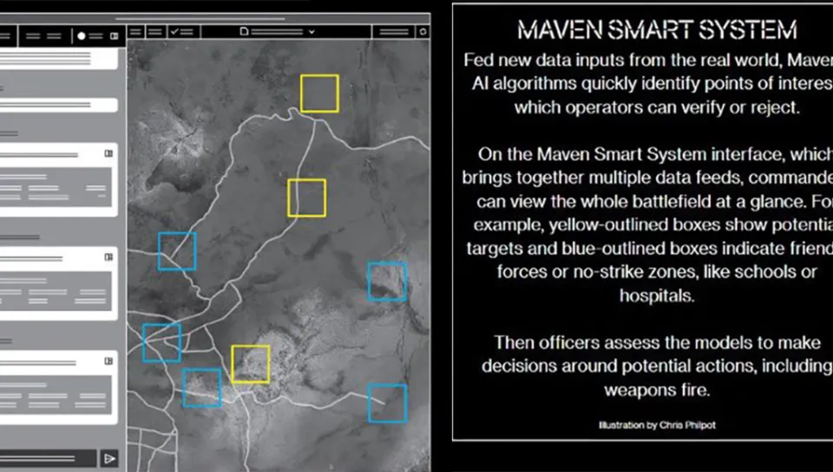
PAPER 3 · CONCRETE ENTRY POINT
Claude has reportedly been used in U.S. military operations related to Iran.
AI may not choose the final action. It can still analyze intelligence, simulate options, and structure what a human sees as actionable.
REPORTED CASE
AI analyzes
Human approves
Ownership shifts
CBS: Claude was reportedly used during the Iran operation; the exact role was not publicly disclosed.
Anthropic: Claude is described in intelligence analysis, simulation, operational planning, and cyber operations.
intelligence
simulation
→
verify
reject
→
feels
shared
Paper 3 asks whether AI role proximity changes decisional ownership and felt accountability before a high-risk action is taken.
Sources: CBS News; Anthropic public statements and DoD agreement. Image: user-provided Maven Smart System illustration; visual entry point only.
PAPER 3
2
Notes:
Let us start with a concrete case.
Claude has reportedly been used in U.S. military operations related to Iran.
For me, the key question is not who should take the respondsibility for the escalate action.
I care more about what happens before the action.
When humans work with AI in these settings, does their sense of responsibility change?
Most of time the human may still approve the final action.
But the decision may feel less personal.
The moral burden may become lighter.
Responsibility may start to shared between the human and the AI system.
These high-risk human-AI interactions will become more common.
So we need to understand how people think, feel, and act with AI before we design future rules and governance.

Slide 34
EXISTING WORK
Responsibility Depends on How AI Enters the Decision Process
Three literatures motivate Paper 3: AI workflow design, delegation as responsibility management, and the gap between external accountability and felt accountability.
1
AI workflow position is a design variable
2
Delegation can shift blame and moral cost
3
Accountability design is not felt accountability
AI does not merely improve or replace prediction. It can enter before, during, or after human judgment, changing roles, authority, and process control.
Delegating difficult choices can reduce personal responsibility and redistribute blame across users, systems, programmers, and machine intermediaries.
Disclosure, approval, audit trails, and justification requirements create external accountability, but they may not automatically make people feel responsible.
(Shrestha et al., 2019; Raisch & Krakowski, 2021; Yin et al., 2025; Krakowski et al., 2026)
(Steffel et al., 2016; Kirchkamp & Strobel, 2019; Chevrier & Teixeira, 2024; Kobis et al., 2025)
(Lerner & Tetlock, 1999; Hall et al., 2017; Aleksovska et al., 2019)
Paper 3 treats AI role position as responsibility architecture.
The question is when AI support weakens decision ownership before action.
The experiment asks whether justification re-anchors responsibility to the human.
Paper 3's move
AI role proximity + justification requirement -> decisional ownership, felt accountability, responsibility sharing, and escalatory choice.
Notes:
This paper builds on three lines of literature.
The first is about AI workflow design.
AI can enter the decision process in different places.
It can analyze, advise, recommend, or support approval.
So AI’s position in the process matters.
The second line is about delegation.
When a decision may create negative consequences, people may involve another agent to manage responsibility.
With AI support, the human may start to feel less like the full decision owner, and more like a supervisor.
The third line is accountability.
A system can require disclosure, approval, or justification.
But formal accountability does not always mean people actually feel responsible.
One important point is that responsibility here is not legal responsibility.
It is subjective responsibility.

Slide 35
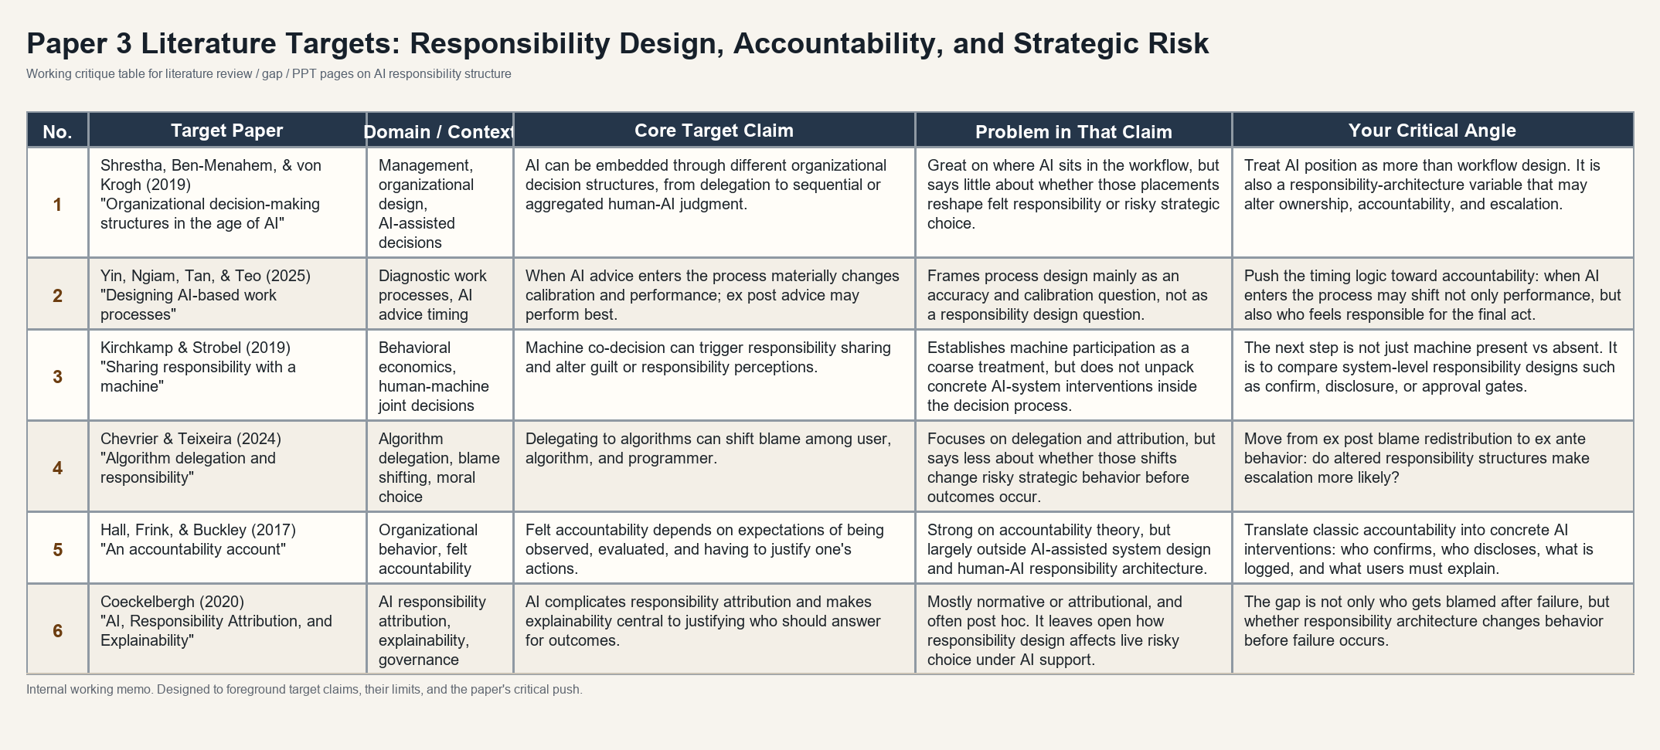
RESEARCH GAP
What is still missing: responsibility design inside AI-supported decisions
The gap is not simply whether AI affects responsibility. It is how visibility, traceability, attribution, and evaluability shape felt accountability before action.
PAPER 3
5
Notes:
This slide states the gap more directly.
a lot of that work focuses on what happens after the outcome.
Who gets blamed?
Who is accountable?
How is responsibility assigned?
My paper moves the question earlier.
Before the outcome happens, how does the AI-supported process change the person’s sense of ownership?
And does that change affect risky action?
So the gap is clear: We still do not fully understand the mechanism of responsibility distribution in human-AI interaction.
I want to know how visibility, traceability, attribution, and evaluability shape felt accountability before action.

Slide 36
TRADITIONAL THEORIES
Traditional theories usually treat responsibility cost as given
Rationalist conflict theories
Behavioral risk theories
• Conflict escalates because of bargaining failure, information asymmetry, or commitment problems.
• The decision maker is still assumed to bear the consequences of the choice.
• Loss aversion, framing, and affect can change whether people escalate or restrain.
• But responsibility structure itself is rarely modeled as the variable that shifts choice.
Fearon (1995); Powell (2006)
Kahneman & Tversky (1979); Loewenstein et al. (2001)
The missing variable is not only belief or payoff perception, but the structure of accountability itself.
PAPER 3
4
Notes:
This paper also connects to theories of strategic risk.
Rationalist theories explain escalation through bargaining failure, information problems, or commitment problems.
Behavioral theories explain risk-taking through framing, loss aversion, and emotion.
These theories are useful.
But they usually treat responsibility as already given.
The decision maker is assumed to carry the cost of the final choice.
AI may change exactly this condition.
When AI becomes part of the process, accountability may no longer feel fixed.
So we need to think about AI within conflict situations. Conflict settings have their own logic, and AI also has its own features. My point is that we need to study how these two things interact.

Slide 37
RESEARCH QUESTIONS
The paper asks how AI intervention and accountability design reshape high-risk choice
RQ1. Does AI decision support itself change high-risk strategic choice?
Overall Research Question
RQ2.Does process confirmation increase ownership and felt accountability?
How do accountability interventions in AI-supported high-risk strategic decision systems reshape felt accountability, decisional ownership, responsibility attribution, and escalatory choice?
RQ3. Can external accountability requirements increase felt accountability and decisional ownership?
RQ4. Do different accountability designs lead to different patterns of escalation behavior?
The question is not who gets blamed after failure. It is how responsibility design changes choices before the outcome is known.
PAPER 3
6
Notes:
The paper has four research questions.
First, does AI decision support itself change high-risk strategic choice?
Second, when AI moves closer to the final action, does it change ownership and responsibility attribution?
Third, can accountability requirements increase felt accountability?
For example, does confirmation or justification make the human feel more responsible?
Fourth, do these accountability requirements change escalation behavior?
So the paper moves from AI presence to responsibility mechanism.

Slide 38
DESIGN
From Research Questions to Experimental Conditions
The experiment holds the strategic environment and AI analysis constant, while varying the responsibility architecture around AI support.
Four experimental conditions
1. Human-only
2. AI-baseline
3. AI-confirm
4. AI-disclosure
No AI support
AI analytical support
Explicit human passage
Visible AI use
Participants make the high-risk choice based only on the payoff structure.
Participants see AI-generated analysis before choosing, with no additional accountability intervention.
Participants see the same AI analysis and must confirm they have reviewed it before acting.
Participants see the same AI analysis and must disclose AI use and its influence.
Identification logic
Comparison
What it identifies
Human-only vs AI-baseline
Effect of AI analytical support
AI-baseline vs AI-confirm
Effect of explicit human passage and decisional ownership
AI-baseline vs AI-disclosure
Effect of AI-use visibility and traceability
AI-confirm vs AI-disclosure
Different accountability designs and responsibility mechanisms
Same game. Same AI analysis. Different responsibility architecture.
PAPER 3
7
Notes:
This slide turns the research questions into experimental conditions.
The key design is to keep two things constant.
First, everyone faces the same Hawk-Dove game.
Second, in all AI conditions, the AI analysis is the same.
What changes is the responsibility structure around the decision.
There are four conditions.
In the Human-only condition, participants make the choice without AI.
This gives the baseline for escalation and responsibility
In the AI-baseline condition, participants see AI analysis before choosing.
This tells us whether AI support itself changes high-risk choice.
In the AI-confirm condition, participants see the same AI analysis.
But before acting, they must clearly confirm that they have reviewed it.
This tests whether explicit human confirmation increases decision ownership and felt accountability.
In the AI-disclosure condition, participants again see the same AI analysis.
But this time, they must disclose AI use and its influence.
This tests whether visibility and traceability increase accountability.
It also tests whether disclosure makes responsibility feel more shared with the AI system.
So the identification logic is simple.
Human-only versus AI-baseline shows the effect of AI analytical support.
AI-baseline versus AI-confirm shows the effect of explicit confirmation.
AI-baseline versus AI-disclosure shows the effect of AI-use visibility.
AI-confirm versus AI-disclosure compares two different accountability designs.
The goal is to isolate whether responsibility architecture matters.
Same game.
Same AI analysis.
Different responsibility architecture.

Slide 39
EXPERIMENTAL PROTOTYPE
Why a repeated Hawk-Dove game is the right prototype
Condition logic
Why this prototype
• Escalation can deliver a unilateral gain.
• Mutual escalation generates shared loss.
• The choice is both risky and consequential for another party.
• That makes responsibility structure behaviorally meaningful.
Human-only
AI-baseline
AI-confirm
AI-disclosure
Two participant, mutilple round
See payoff matrix
See AI analysis if assigned
Confirm or disclose if assigned
Choose escalate or restrain
Observe round outcome
→
→
→
→
Illustrative payoff logic
R
E
R
50, 50
20, 80
The prototype holds the strategic environment fixed and varies the responsibility architecture inside the same risky choice structure.
E
80, 20
10, 10
PAPER 3
8
Notes:
To test this, I use a repeated Hawk-Dove environment.
This task is useful because escalation is meaningful.
If one side escalates and the other restrains, escalation can bring a gain.
But if both sides escalate, both suffer a loss.
So the choice is not just risky for the participant.
It can also create harm for another party.
That makes responsibility visible.
Participants see the same strategic environment.
Some decide alone.What changes is the responsibility structure around the decision.
The experiment is intentionally minimal: the strategic game and AI analysis are held constant, while the responsibility architecture is varied.

Slide 40
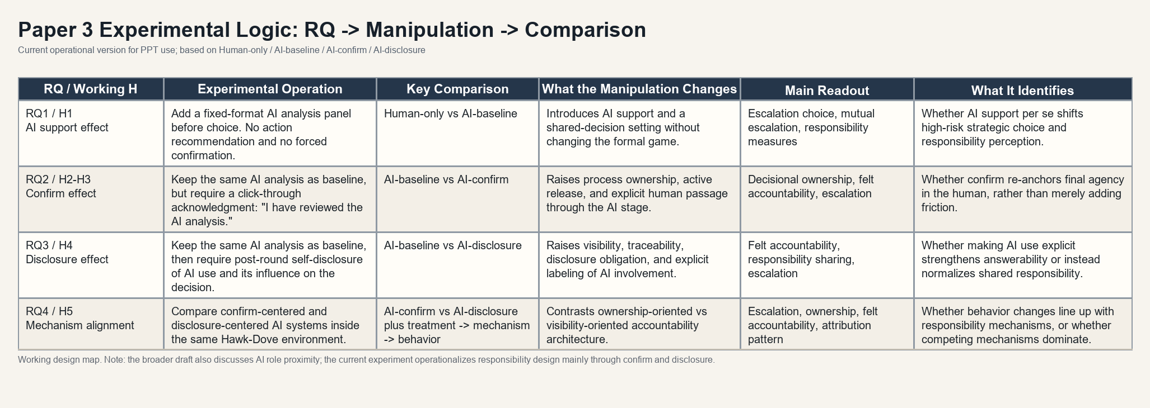
METHOD MAP
RQ -> manipulation -> comparison -> what each contrast identifies
The method page should make the four conditions readable: Human-only, AI-baseline, AI-confirm, and AI-disclosure.
PAPER 3
9
Notes:
This is the key method slide.
Each condition has a specific role.
The human-only condition gives the baseline.
The AI-baseline condition shows what AI support itself changes.
The AI-confirm condition tests whether explicit human confirmation increases ownership.
The AI-disclosure condition tests whether visibility and traceability increase answerability.
So each comparison identifies a different part of responsibility design.
This is what keeps the design focused.
It is not a generic AI treatment.
It is a test of how different accountability structures shape ownership and risky behavior.

Slide 41
CONTRIBUTION
The contribution is to identify where AI changes responsibility before outcomes occur
Expected pattern
Mechanism interpretation
Dissertation role
• AI support may already shift escalation and responsibility perception.
• Confirm may raise ownership by making human passage explicit.
• Disclosure may strengthen answerability or normalize responsibility sharing.
• Structural accountability and felt accountability do not have to move together.
• If behavior changes move with ownership and answerability, the responsibility mechanism is more credible.
• If not, competing mechanisms remain on the table.
• Paper 1 studies how AI changes evidence and belief formation.
• Paper 2 studies how repeated feedback reshapes reliance calibration.
• Paper 3 studies how AI-supported action reorganizes responsibility.
The key question is not only whether people use AI, but how AI system design reorganizes responsibility before action is taken.
PAPER 3
10
Notes:
The contribution of Paper 3 is to study responsibility before outcomes occur.
AI support may change escalation by itself.
Confirmation may raise ownership because the human has to actively pass through the final decision point.
Disclosure may increase answerability.
But it may also make responsibility feel shared between the human and the AI system.
So structural accountability and felt accountability may not move together.
That is why the experiment measures both perception and behavior.
This paper completes the dissertation chain.
Paper 1 studies belief formation.
Paper 2 studies reliance calibration.
Paper 3 studies responsibility design.
The central point is simple:
What matters is not only whether people use AI.
What matters is how AI system design reorganizes responsibility before action is taken.

