Slide 1
DISSERTATION SECTION III
Paper 3: AI Responsibility Design and Escalatory Risk
The paper studies how AI-supported decision systems reshape felt accountability, decisional ownership, and escalatory choice before outcomes occur.
Belief formation
Reliance calibration
Responsibility design
Paper 1
Paper 2
Paper 3
Action → responsibility
PAPER 3
1
Notes:
Now I move to the third paper in the dissertation.
If the first paper studies belief formation and the second studies reliance calibration, this paper asks what happens once a consequential action has to be owned.
The core question is not simply whether AI is used.
It is whether AI system design changes who feels accountable for the final move before the outcome is even known.

Slide 2
A motivating example
When AI enters the decision room, who still owns the risk?
Crisis room
Hospital triage
Public agency
Human-only room
AI-embedded decision room
• A person reviews the strategic situation, the trade-offs, and the possible downside.
• The final move is still experienced as clearly personal.
• Information, action, and responsibility remain tightly bundled.
• The decision maker now sees an AI analysis before acting.
• The system may also require confirmation or disclosure of AI use.
• The final move can start to feel shared, staged, or partially offloaded.
Ownership and accountability stay inside one human decision point.
The key shift is not only informational. It is also about who feels accountable for the final act.
PAPER 3
2
Notes:
I want to begin with a concrete decision scene rather than with theory.
In more and more high-risk settings, people do not decide alone anymore. They see an AI analysis before they act, and sometimes they must confirm or disclose how they used it.
That means the key shift is not only what information enters the room.
It is also whether the final choice still feels fully like my own decision.

Slide 3
What current research already explains
Existing work studies trust, delegation, and blame mostly in separate literatures
Trust in AI
Delegation
Blame after outcomes
When do people rely on algorithmic advice, and when do they resist it?
Will people pass difficult choices to another agent to avoid responsibility?
Once harm occurs, how is blame redistributed across the user, the system, and the developer?
Dietvorst et al. (2015); Logg et al. (2019)
Steffel et al. (2016); Chevrier & Teixeira (2024)
Kirchkamp & Strobel (2019); Coeckelbergh (2020)
These literatures are valuable, but they rarely connect AI system design to the full path from decision structure to risky behavior.
PAPER 3
3
Notes:
The literature is not empty. In fact, it is already quite rich.
But most studies isolate one piece at a time: trust in AI, delegation to another decision agent, or blame once the outcome is already known.
What remains underdeveloped is the process question.
How does responsibility design inside an AI-supported system change risky choice before the outcome arrives?

Slide 4
The benchmark most theories start from
Traditional theories explain strategic risk well, but they usually treat responsibility cost as fixed
Rationalist conflict theories
Behavioral risk theories
• Conflict escalates because of bargaining failure, information asymmetry, or commitment problems.
• The decision maker is still assumed to bear the consequences of the choice.
• Loss aversion, framing, and affect can change whether people escalate or restrain.
• But responsibility structure itself is rarely modeled as the variable that shifts choice.
Fearon (1995); Powell (2006)
Kahneman & Tversky (1979); Loewenstein et al. (2001)
Paper 3 adds the missing variable: in AI-supported systems, accountability can become part of the choice architecture itself.
PAPER 3
4
Notes:
The point here is not to reject traditional theory.
Rationalist conflict theory and behavioral risk theory both help us understand escalation.
But they usually start from the assumption that responsibility cost is already given in the environment.
What AI support may change is exactly that background condition: the accountability structure itself.

Slide 5
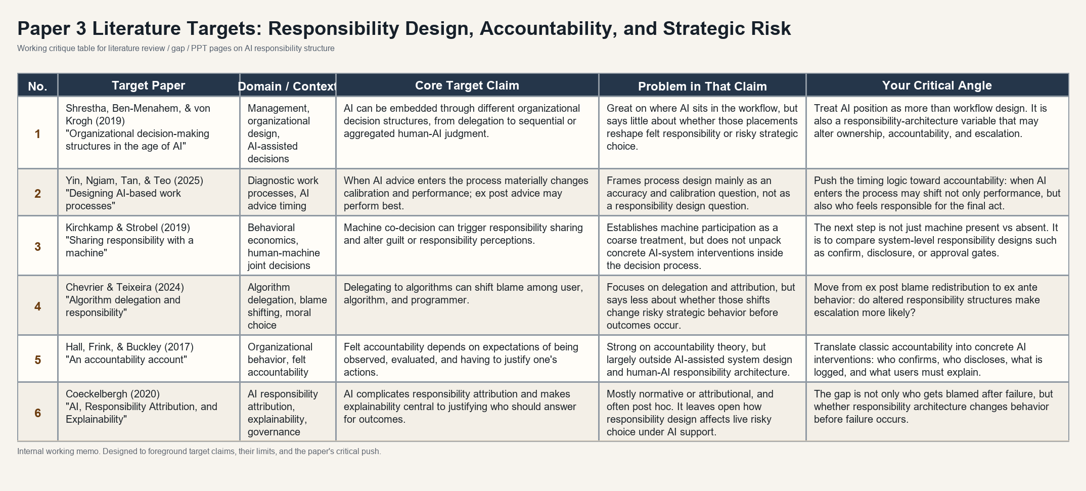
What is still missing
The literature points to a design-level gap inside AI-supported decisions
The gap is not whether AI responsibility matters. It is whether specific AI-system interventions change high-risk behavior before outcomes occur.
PAPER 3
5
Notes:
This slide condenses the literature critique into one visual field.
The problem is not that nobody studies AI responsibility.
The problem is that most work stays at the level of attribution after the outcome, or treats AI participation as one coarse condition.
My question is more design-specific: which interventions inside an AI-supported process actually change ownership, accountability, and risky action before the outcome is known?

Slide 6
Research questions
How AI accountability design reshapes high-risk choice
RQ1. Does AI support itself change strategic escalation?
The move is from AI presence to responsibility design.
RQ2. Does confirmation strengthen decisional ownership and felt accountability?
The paper distinguishes structural accountability from felt accountability, then asks whether both change behavior.
RQ3. Does AI-use disclosure strengthen answerability or normalize shared responsibility?
RQ4. Do these responsibility changes line up with observable escalation behavior?
The question is not who gets blamed after failure. It is how AI-supported systems reshape responsibility before action is taken.
PAPER 3
6
Notes:
These questions all push in the same direction.
Instead of treating AI support as one broad treatment, I ask whether different responsibility designs change how the human actor experiences final agency.
That is why the questions move from AI support itself, to ownership and felt accountability, and then back to behavior.

Slide 7
Framing and alignment
Role proximity motivates the theory, but confirm and disclosure are the current tests
Broader analytical motivation
Current operational test
• AI can enter as analysis, advice, or delegated action.
• As AI moves closer to the final act, ownership may weaken.
• That broader map motivates the paper.
• Human-only vs AI-baseline identifies AI support per se.
• AI-confirm tests whether explicit human passage re-anchors final agency.
• AI-disclosure tests whether visibility and traceability change answerability.
Role proximity remains the conceptual backdrop.
The current experiment operationalizes responsibility design through confirm and disclosure.
So the theory is broader than the experiment, but the current test still identifies two design moves.
PAPER 3
7
Notes:
This slide prevents an obvious misunderstanding.
The broader theory does speak in terms of AI moving closer to action, but the present experiment does not claim to operationalize every role position at once.
Instead, it focuses on two concrete interventions inside the same AI-supported decision process: confirm and disclosure.

Slide 8
Experimental prototype and participant flow
A repeated Hawk-Dove environment makes responsibility design testable
Condition logic
Why this prototype
• Escalation can deliver a unilateral gain.
• Mutual escalation generates shared loss.
• The choice is both risky and consequential for another party.
• That makes responsibility structure behaviorally meaningful.
Human-only
AI-baseline
AI-confirm
AI-disclosure
One participant, one round
See payoff matrix
See AI analysis if assigned
Confirm or disclose if assigned
Choose escalate or restrain
Observe round outcome
→
→
→
→
Illustrative payoff logic
R
E
R
50, 50
20, 80
The prototype holds the strategic environment fixed and varies the responsibility architecture inside the same risky choice structure.
E
80, 20
10, 10
PAPER 3
8
Notes:
This slide explains why the experimental environment is appropriate before we get lost in design detail.
Hawk-Dove is useful because escalation is not just a generic risk preference. It is a consequential move with external loss if both sides escalate.
The flow on the right then makes the design transparent: keep the strategic environment fixed, vary the responsibility architecture inside the process, and observe behavior.

Slide 9
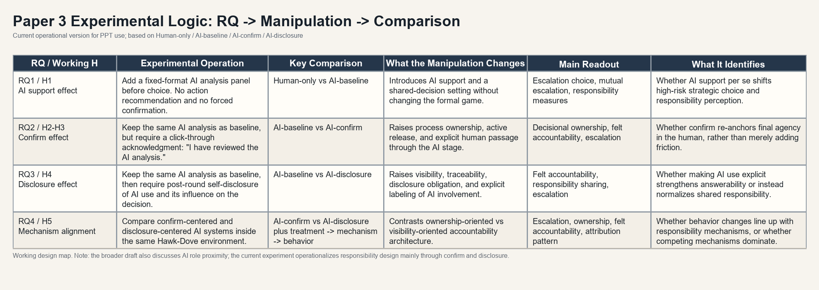
Core method table
Each manipulation is tied to a distinct comparison and identification claim
This is the key method page: the design is not just AI versus no AI, but a set of contrasts about responsibility architecture.
PAPER 3
9
Notes:
This is the most valuable method page in the deck.
The point is to let the committee see, in one field, how each research question maps onto a manipulation, what comparison identifies it, and what mechanism that contrast is supposed to isolate.
That is what keeps the experiment from collapsing into a vague AI-versus-no-AI design.

Slide 10
Expected contrasts
The paper identifies where AI changes responsibility before outcomes occur
Expected pattern
Mechanism interpretation
Dissertation role
• AI support may already shift escalation and responsibility perception.
• Confirm may raise ownership by making human passage explicit.
• Disclosure may strengthen answerability or normalize responsibility sharing.
• Structural accountability and felt accountability do not have to move together.
• If behavior changes move with ownership and answerability, the responsibility mechanism is more credible.
• If not, competing mechanisms remain on the table.
• Paper 1 studies how AI changes evidence and belief formation.
• Paper 2 studies how repeated feedback reshapes reliance calibration.
• Paper 3 studies how AI-supported action reorganizes responsibility.
The central claim is simple: what matters is not only whether people use AI, but how AI system design reorganizes responsibility before action is taken.
PAPER 3
10
Notes:
I end by emphasizing that the contribution is not another generic claim about trust in AI.
The contribution is to identify where responsibility changes inside an AI-supported decision process, and to test whether those changes can be seen in behavior before outcomes arrive.
That is what makes Paper 3 the responsibility link in the larger dissertation architecture.

