Slide 1
PAPER 3
Paper 3: AI Responsibility Design and Escalatory Risk
AI-supported decisions can change not only what people know, but whether they still feel accountable for the final move.
Belief formation
Reliance calibration
Responsibility design
Paper 1
Paper 2
Paper 3
Action → responsibility
PAPER 3
1
Notes:
Now I move to the third paper in the dissertation.
If the first paper studies belief formation and the second studies reliance calibration, this paper asks what happens once a consequential action has to be owned.
The core question is not simply whether AI is used.
It is whether AI system design changes who feels accountable for the final move before the outcome is even known.

Slide 2
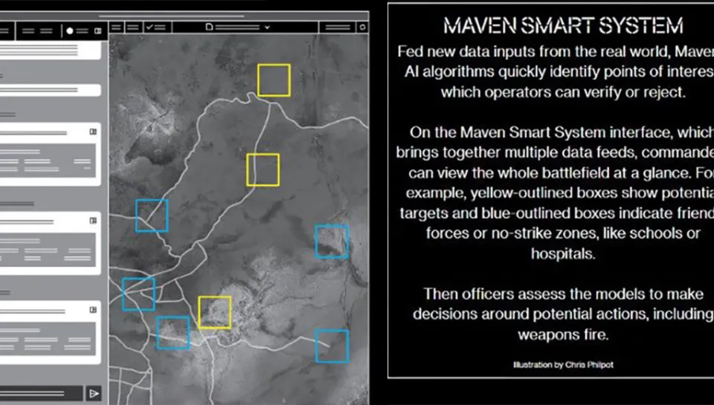
PAPER 3 · CONCRETE ENTRY POINT
Claude has reportedly been used in U.S. military operations related to Iran.
AI may not choose the final action. It can still analyze intelligence, simulate options, and structure what a human sees as actionable.
REPORTED CASE
AI analyzes
Human approves
Ownership shifts
CBS: Claude was reportedly used during the Iran operation; the exact role was not publicly disclosed.
Anthropic: Claude is described in intelligence analysis, simulation, operational planning, and cyber operations.
intelligence
simulation
→
verify
reject
→
feels
shared
Paper 3 asks whether AI role proximity changes decisional ownership and felt accountability before a high-risk action is taken.
Sources: CBS News; Anthropic public statements and DoD agreement. Image: user-provided Maven Smart System illustration; visual entry point only.
PAPER 3
2
Notes:
Let me start with a concrete case.
Claude has reportedly been used in U.S. military operations related to Iran.
For me, the key question is not only who should be blamed after something goes wrong.
I care more about what happens before the action.
When humans work with AI in these settings, does their sense of responsibility change?
If AI helps analyze intelligence or simulate options, the human may still approve the final action.
But the decision may feel less personal.
The moral burden may become lighter.
Responsibility may start to feel shared between the human and the AI system.
This is why we need controlled experiments.
These high-risk human-AI interactions will become more common.
So we need to understand how people think, feel, and act with AI before we design future rules and governance.

Slide 3
EXISTING WORK
Responsibility Depends on How AI Enters the Decision Process
Three literatures motivate Paper 3: AI workflow design, delegation as responsibility management, and the gap between external accountability and felt accountability.
1
AI workflow position is a design variable
2
Delegation can shift blame and moral cost
3
Accountability design is not felt accountability
AI does not merely improve or replace prediction. It can enter before, during, or after human judgment, changing roles, authority, and process control.
Delegating difficult choices can reduce personal responsibility and redistribute blame across users, systems, programmers, and machine intermediaries.
Disclosure, approval, audit trails, and justification requirements create external accountability, but they may not automatically make people feel responsible.
(Shrestha et al., 2019; Raisch & Krakowski, 2021; Yin et al., 2025; Krakowski et al., 2026)
(Steffel et al., 2016; Kirchkamp & Strobel, 2019; Chevrier & Teixeira, 2024; Kobis et al., 2025)
(Lerner & Tetlock, 1999; Hall et al., 2017; Aleksovska et al., 2019)
Paper 3 treats AI role position as responsibility architecture.
The question is when AI support weakens decision ownership before action.
The experiment asks whether justification re-anchors responsibility to the human.
Paper 3's move
AI role proximity + justification requirement -> decisional ownership, felt accountability, responsibility sharing, and escalatory choice.
Notes:
This paper builds on three lines of literature.
The first is about AI workflow design.
AI can enter the decision process in different places.
It can analyze, advise, recommend, or support approval.
So AI’s position in the process matters.
The second line is about delegation.
When a decision may create negative consequences, people may involve another agent to manage responsibility.
With AI support, the human may start to feel less like the full decision owner, and more like a supervisor.
The third line is accountability.
A system can require disclosure, approval, or justification.
But formal accountability does not always mean people actually feel responsible.
So the gap is clear:
We still need to know whether these designs change felt accountability before high-risk action is taken.

Slide 4
TRADITIONAL THEORIES
Traditional theories usually treat responsibility cost as given
Rationalist conflict theories
Behavioral risk theories
• Conflict escalates because of bargaining failure, information asymmetry, or commitment problems.
• The decision maker is still assumed to bear the consequences of the choice.
• Loss aversion, framing, and affect can change whether people escalate or restrain.
• But responsibility structure itself is rarely modeled as the variable that shifts choice.
Fearon (1995); Powell (2006)
Kahneman & Tversky (1979); Loewenstein et al. (2001)
The missing variable is not only belief or payoff perception, but the structure of accountability itself.
PAPER 3
4
Notes:
This paper also connects to theories of strategic risk.
Rationalist theories explain escalation through bargaining failure, information problems, or commitment problems.
Behavioral theories explain risk-taking through framing, loss aversion, and emotion.
These theories are useful.
But they usually treat responsibility as already given.
The decision maker is assumed to carry the cost of the final choice.
AI may change exactly this condition.
When AI becomes part of the process, accountability may no longer feel fixed.
It may become part of the decision architecture itself.
So the missing variable here is not only belief or payoff.
It is the structure of accountability.

Slide 5
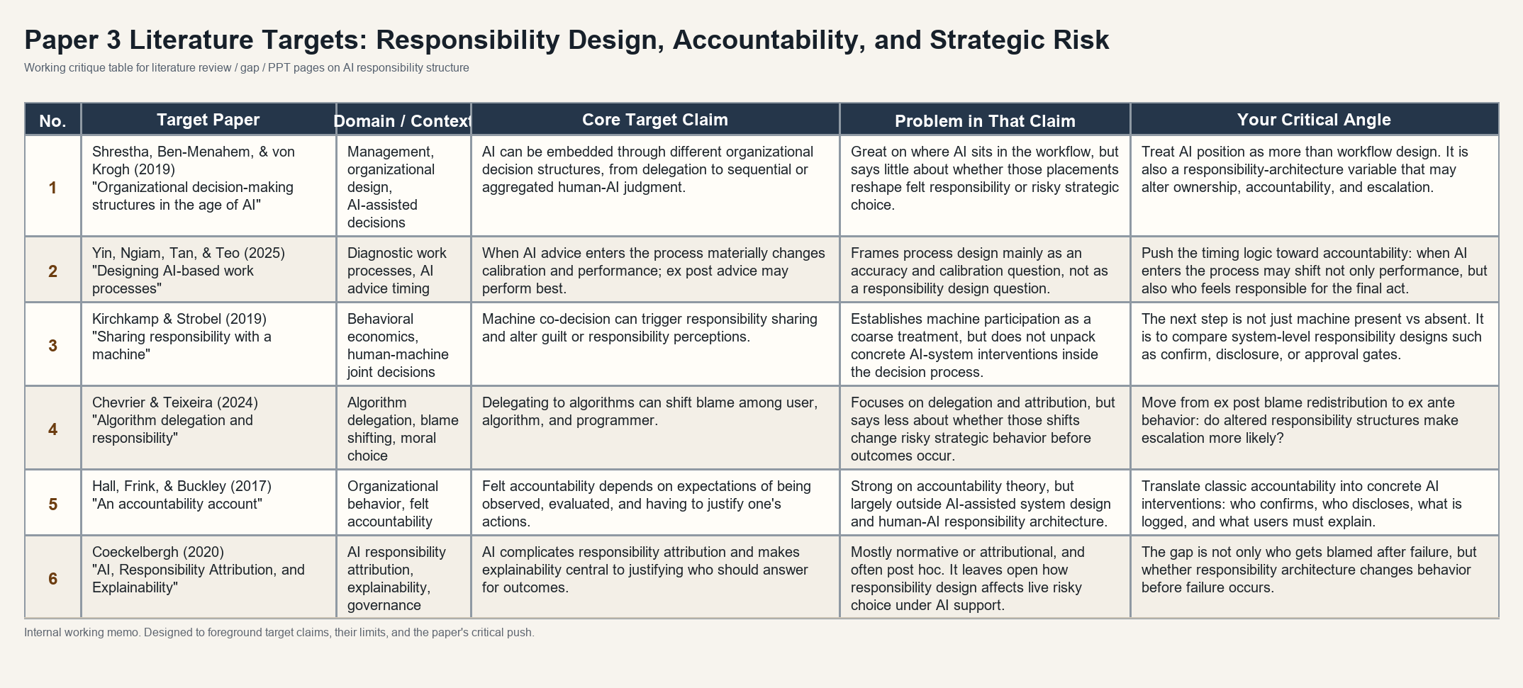
RESEARCH GAP
What is still missing: responsibility design inside AI-supported decisions
The gap is not simply whether AI affects responsibility. It is how visibility, traceability, attribution, and evaluability shape felt accountability before action.
PAPER 3
5
Notes:
This slide states the gap more directly.
a lot of that work focuses on what happens after the outcome.
Who gets blamed?
Who is accountable?
How is responsibility assigned?
My paper moves the question earlier.
Before the outcome happens, how does the AI-supported process change the person’s sense of ownership?
And does that change affect risky action?
So the gap is about responsibility design.
I want to know how visibility, traceability, attribution, and evaluability shape felt accountability before action.

Slide 6
RESEARCH QUESTIONS
The paper asks how AI intervention and accountability design reshape high-risk choice
RQ1. Does AI decision support itself change high-risk strategic choice?
Overall Research Question
RQ2.Does process confirmation increase ownership and felt accountability?
How do accountability interventions in AI-supported high-risk strategic decision systems reshape felt accountability, decisional ownership, responsibility attribution, and escalatory choice?
RQ3. Can external accountability requirements increase felt accountability and decisional ownership?
RQ4. Do different accountability designs lead to different patterns of escalation behavior?
The question is not who gets blamed after failure. It is how responsibility design changes choices before the outcome is known.
PAPER 3
6
Notes:
The paper has four research questions.
First, does AI decision support itself change high-risk strategic choice?
Second, when AI moves closer to the final action, does it change ownership, felt accountability, and responsibility attribution?
Third, can accountability requirements increase felt accountability?
For example, does confirmation or justification make the human feel more responsible?
Fourth, do these accountability requirements change escalation behavior?
So the paper moves from AI presence to responsibility design.
The key point is:
I am not asking who gets blamed after failure.
I am asking how responsibility design changes choices before the outcome is known.

Slide 7
DESIGN
From Research Questions to Experimental Conditions
The experiment holds the strategic environment and AI analysis constant, while varying the responsibility architecture around AI support.
Four experimental conditions
1. Human-only
2. AI-baseline
3. AI-confirm
4. AI-disclosure
No AI support
AI analytical support
Explicit human passage
Visible AI use
Participants make the high-risk choice based only on the payoff structure.
Participants see AI-generated analysis before choosing, with no additional accountability intervention.
Participants see the same AI analysis and must confirm they have reviewed it before acting.
Participants see the same AI analysis and must disclose AI use and its influence.
Identification logic
Comparison
What it identifies
Human-only vs AI-baseline
Effect of AI analytical support
AI-baseline vs AI-confirm
Effect of explicit human passage and decisional ownership
AI-baseline vs AI-disclosure
Effect of AI-use visibility and traceability
AI-confirm vs AI-disclosure
Different accountability designs and responsibility mechanisms
Same game. Same AI analysis. Different responsibility architecture.
PAPER 3
7
Notes:
This slide translates the research questions into the experimental design. The key design choice is to hold the strategic environment fixed. Within the AI conditions, the AI analysis is also held constant. What changes is the responsibility architecture around the same AI support. Human-only provides the no-AI benchmark. AI-baseline adds analytical support. AI-confirm tests whether explicit human passage increases ownership and felt accountability. AI-disclosure tests whether making AI use visible and reportable increases accountability or instead promotes responsibility sharing. So the experiment is intentionally minimal: same game, same AI content, different accountability design.

Slide 8
EXPERIMENTAL PROTOTYPE
Why a repeated Hawk-Dove game is the right prototype
Condition logic
Why this prototype
• Escalation can deliver a unilateral gain.
• Mutual escalation generates shared loss.
• The choice is both risky and consequential for another party.
• That makes responsibility structure behaviorally meaningful.
Human-only
AI-baseline
AI-confirm
AI-disclosure
One participant, one round
See payoff matrix
See AI analysis if assigned
Confirm or disclose if assigned
Choose escalate or restrain
Observe round outcome
→
→
→
→
Illustrative payoff logic
R
E
R
50, 50
20, 80
The prototype holds the strategic environment fixed and varies the responsibility architecture inside the same risky choice structure.
E
80, 20
10, 10
PAPER 3
8
Notes:
To test this, I use a repeated Hawk-Dove environment.
This task is useful because escalation is meaningful.
If one side escalates and the other restrains, escalation can bring a gain.
But if both sides escalate, both suffer a loss.
So the choice is not just risky for the participant.
It can also create harm for another party.
That makes responsibility visible.
Participants see the same strategic environment.
Some decide alone.What changes is the responsibility structure around the decision.
The experiment is intentionally minimal: the strategic game and AI analysis are held constant, while the responsibility architecture is varied.

Slide 9
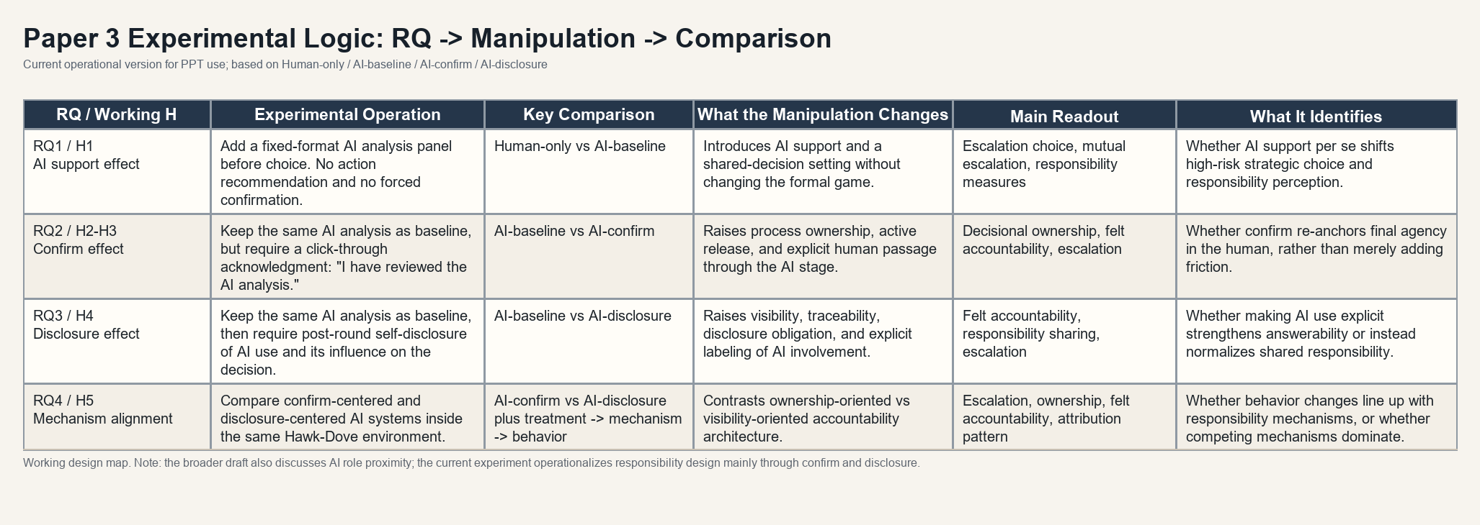
METHOD MAP
RQ -> manipulation -> comparison -> what each contrast identifies
The method page should make the four conditions readable: Human-only, AI-baseline, AI-confirm, and AI-disclosure.
PAPER 3
9
Notes:
This is the key method slide.
The experiment is not just AI versus no AI.
That comparison would be too broad.
Each condition has a specific role.
The human-only condition gives the baseline.
The AI-baseline condition shows what AI support itself changes.
The AI-confirm condition tests whether explicit human confirmation increases ownership.
The AI-disclosure condition tests whether visibility and traceability increase answerability.
So each comparison identifies a different part of responsibility design.
This is what keeps the design focused.
It is not a generic AI treatment.
It is a test of how different accountability structures shape ownership and risky behavior.

Slide 10
CONTRIBUTION
The contribution is to identify where AI changes responsibility before outcomes occur
Expected pattern
Mechanism interpretation
Dissertation role
• AI support may already shift escalation and responsibility perception.
• Confirm may raise ownership by making human passage explicit.
• Disclosure may strengthen answerability or normalize responsibility sharing.
• Structural accountability and felt accountability do not have to move together.
• If behavior changes move with ownership and answerability, the responsibility mechanism is more credible.
• If not, competing mechanisms remain on the table.
• Paper 1 studies how AI changes evidence and belief formation.
• Paper 2 studies how repeated feedback reshapes reliance calibration.
• Paper 3 studies how AI-supported action reorganizes responsibility.
The key question is not only whether people use AI, but how AI system design reorganizes responsibility before action is taken.
PAPER 3
10
Notes:
The contribution of Paper 3 is to study responsibility before outcomes occur.
AI support may change escalation by itself.
Confirmation may raise ownership because the human has to actively pass through the final decision point.
Disclosure may increase answerability.
But it may also make responsibility feel shared between the human and the AI system.
So structural accountability and felt accountability may not move together.
That is why the experiment measures both perception and behavior.
This paper completes the dissertation chain.
Paper 1 studies belief formation.
Paper 2 studies reliance calibration.
Paper 3 studies responsibility design.
The central point is simple:
What matters is not only whether people use AI.
What matters is how AI system design reorganizes responsibility before action is taken.

