Slide 1
DISSERTATION SECTION III
Paper 3: AI Responsibility Design and Escalatory Risk
The paper studies how AI-supported decision systems reshape accountability, ownership, and risky strategic choice before outcomes occur.
Belief formation
Reliance calibration
Responsibility design
Paper 1
Paper 2
Paper 3
Action → responsibility
PAPER 3
1
Notes:
Now I will move to the third paper of my dissertation.
Once a consequential action has to be taken, who feels responsible for that action?
So the question here is not simply whether AI is used.
The question is whether the design of an AI-supported system changes who feels accountable for the final decision.
That is why this paper focuses on responsibility design.

Slide 2
A concrete opening example
AI can change not only the information people see, but who owns the final risk
Crisis room
Hospital triage
Public agency
Human-only decision room
AI-embedded decision room
• A decision maker reviews evidence, trade-offs, and possible consequences.
• The final choice is still experienced as clearly personal.
• Risk and responsibility remain bundled inside one human decision point.
• The decision maker now sees an AI analysis panel before acting.
• The system may also require confirmation, disclosure, or explanation.
• The final move can start to feel shared, staged, or partially offloaded.
Information, ownership, and accountability stay tightly coupled.
The key shift is not only informational. It is also about who feels accountable for the final act.
PAPER 3
2
Notes:
I want to begin with a familiar transition rather than with theory.
In more and more high-risk settings, people no longer decide alone. They see an AI analysis panel, and sometimes they also have to confirm or disclose how they used it.
That means the key shift is not only what information enters the room, but whether the final choice is still felt as fully one’s own.

Slide 3
What current research already explains
Existing work studies trust, delegation, and blame mostly in separate literatures
Trust in AI
Delegation
Blame after outcomes
When do people rely on algorithmic advice, and when do they resist it?
Will people pass difficult choices to another agent to avoid responsibility?
Once harm occurs, how is blame redistributed across the user, the system, and the developer?
Dietvorst et al. (2015); Logg et al. (2019)
Steffel et al. (2016); Chevrier & Teixeira (2024)
Kirchkamp & Strobel (2019); Coeckelbergh (2020)
These literatures are valuable, but they rarely track how AI system design shapes the whole path from decision structure to risky behavior.
PAPER 3
3
Notes:
The literature is not empty. In fact, it is already quite rich.
But most studies focus on one piece at a time: trust in AI, delegation to another decision agent, or blame once the outcome is already known.
What is still relatively underdeveloped is the full process question: how responsibility design inside an AI-supported decision system changes risky choice before the outcome arrives.

Slide 4
The benchmark that Paper 3 tries to move beyond
Traditional theories explain risk choice well, but they usually treat responsibility cost as fixed
Rationalist conflict theories
Behavioral risk theories
• Conflict escalates because of bargaining failure, information asymmetry, or commitment problems.
• The decision maker is still assumed to bear the consequences of the choice.
• Loss aversion, framing, and affect can change whether people escalate or restrain.
• But responsibility structure itself is rarely modeled as the variable that shifts choice.
Fearon (1995); Powell (2006)
Kahneman & Tversky (1979); Loewenstein et al. (2001)
Paper 3 adds the missing variable: accountability is not just a consequence of risky choice. In AI-supported systems, it can become part of the choice architecture itself.
PAPER 3
4
Notes:
The point here is not to reject traditional theory.
Those theories are extremely useful for understanding strategic risk and escalation, but they generally treat responsibility cost as already given in the environment.
What AI support potentially changes is exactly that background condition: the accountability structure itself.

Slide 5
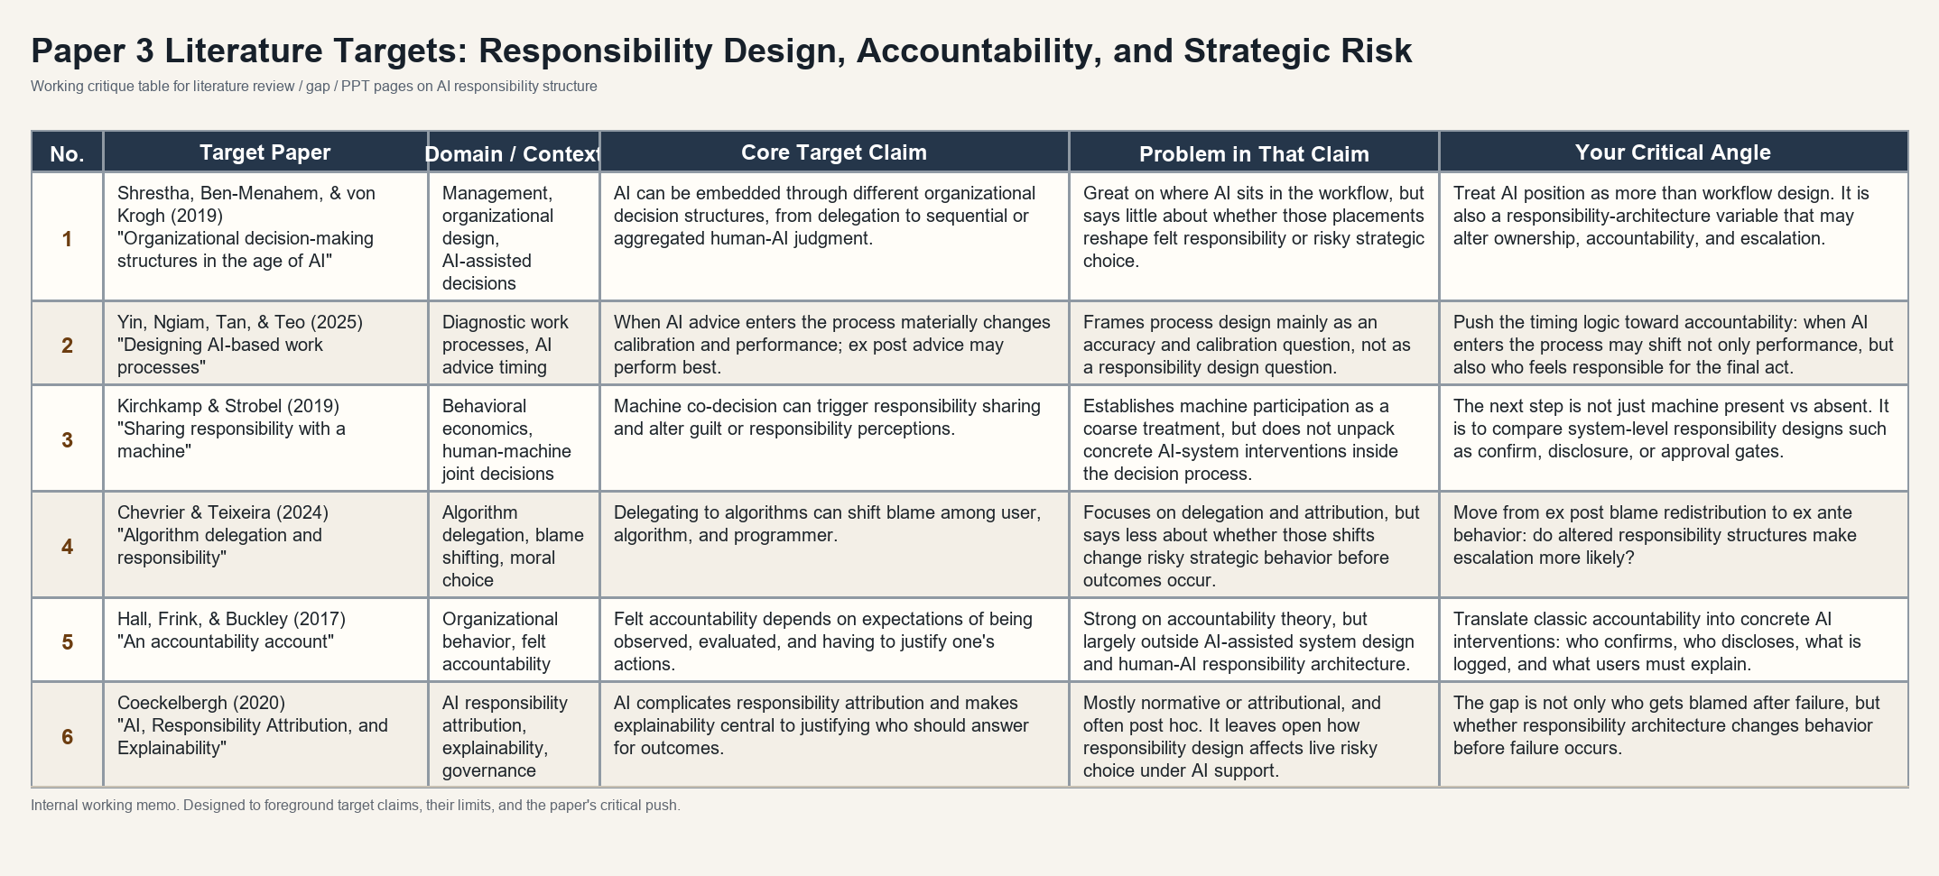
Gap slide built from targeted literature critiques
The literature points to a missing design-level question inside AI-supported decisions
The gap is not that AI responsibility has never been studied. The gap is that responsibility design is rarely linked to live high-risk behavior before outcomes occur.
PAPER 3
5
Notes:
This slide summarizes the gap.
The problem is not that AI responsibility has never been studied.
But much of the work focuses on what happens after the outcome.
Who gets blamed?
Who should be accountable?
How should responsibility be distributed?
Before the outcome occurs, how does the design of the AI-supported decision process change the person’s sense of ownership and accountability?
And does that change affect risky behavior?
So the gap is a mechanism-level question: what kinds of interventions actually change how people perceive responsibility?
How does responsibility design shape high-risk action before we even know the outcome?

Slide 6
Research questions
The paper asks how responsibility design changes high-risk choice
RQ1. Does AI support itself change strategic escalation?
The move is from AI presence to responsibility design.
RQ2. Does stronger human final agency raise decisional ownership and felt accountability?
The paper asks whether different AI-system interventions change ownership, felt accountability, and escalation.
RQ3. Does AI-use traceability strengthen answerability, or does it normalize shared responsibility?
RQ4. Do these responsibility changes line up with observable behavior?
The paper is not asking who gets blamed after failure. It asks how AI-supported systems shape responsibility before action is taken.
PAPER 3
6
Notes:
These research questions all push in the same direction.
Instead of treating AI support as a single treatment, I want to know whether responsibility design changes behavior by changing how the human actor experiences final agency.
That is why the questions move from AI support itself to ownership, felt accountability, and then back to behavior.

Slide 7
Framing and alignment
The broader theory is about AI proximity, but the current test focuses on confirm and disclosure
Broader analytical motivation
Current operational test
• As AI moves closer to the final action, ownership may weaken.
• Analysis, advice, and delegation may create different responsibility architectures.
• This is the broader map behind the paper.
• Human-only vs AI-baseline identifies AI support per se.
• AI-confirm tests whether active human passage re-anchors final agency.
• AI-disclosure tests whether explicit visibility and traceability change answerability.
Role proximity remains the conceptual backdrop.
So the present experiment operationalizes responsibility design through confirm and disclosure.
The deck should therefore present role proximity as the motivation, and confirm / disclosure as the current identifiable design test.
PAPER 3
7
Notes:
This is the alignment slide that prevents a predictable misunderstanding.
The broader theory does speak in terms of AI moving closer to action, but the current experiment does not claim to fully operationalize every role position at once.
Instead, it focuses on two concrete responsibility-design interventions: confirm and disclosure.

Slide 8
Experimental prototype and participant flow
A repeated Hawk-Dove task makes responsibility design behaviorally visible
Condition logic
Why this prototype
• Escalation can deliver a unilateral gain.
• Mutual escalation generates shared loss.
• The choice is both risky and consequential for another party.
• That makes responsibility structure behaviorally meaningful.
Human-only
AI-baseline
AI-confirm
AI-disclosure
One participant, one round
See payoff matrix
See AI analysis if assigned
Confirm or disclose if required
Choose escalate or restrain
Observe outcome and continue
→
→
→
→
Illustrative payoff logic
R
E
R
50, 50
20, 80
The prototype is deliberately simple: it holds the strategic environment fixed and lets responsibility design vary inside the same risky choice structure.
E
80, 20
10, 10
PAPER 3
8
Notes:
This slide explains why the experimental environment is appropriate before getting lost in design detail.
Hawk-Dove is useful because escalation is not just a risk preference. It is a consequential move with external loss if both sides escalate.
The flow on the right then makes the design transparent: hold the strategic environment constant, vary the responsibility architecture inside the decision process, and observe behavior.

Slide 9
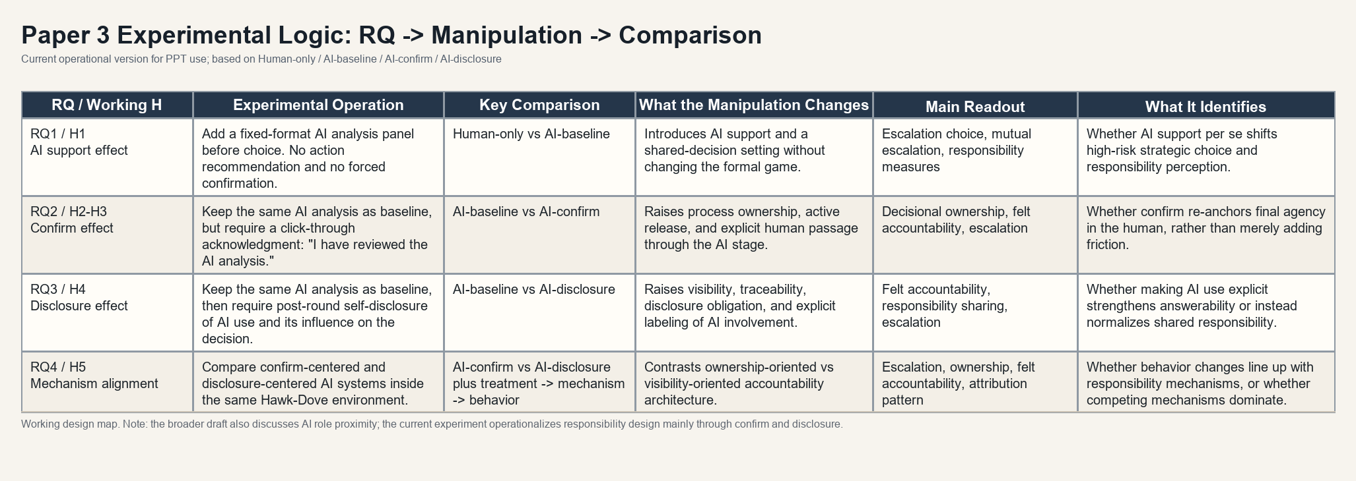
Core method table
The experimental logic cleanly aligns each manipulation with a comparison and an identification claim
This is the key method page: each contrast is tied to a distinct responsibility-design question rather than to a generic AI treatment.
PAPER 3
9
Notes:
This is the most valuable method slide in the deck.
The point is to let the committee see, in one field, how each research question maps onto a manipulation, what comparison identifies it, and what mechanism that contrast is supposed to isolate.
That is what keeps the design from collapsing into a vague 'AI versus no AI' experiment.

Slide 10
Expected patterns and dissertation contribution
The contribution is to identify where AI changes responsibility before outcomes occur
Expected pattern
Mechanism claim
Dissertation role
• AI support may already shift escalation and responsibility perception.
• Confirm may strengthen ownership by making human passage explicit.
• Disclosure may either raise answerability or normalize responsibility sharing.
• Structural accountability and felt accountability do not have to move together.
• Behavioral change matters most when it lines up with ownership and answerability measures.
• If not, competing mechanisms must be taken seriously.
• Paper 1: how AI changes evidence and belief formation.
• Paper 2: how feedback reshapes reliance calibration over time.
• Paper 3: how AI-supported action reorganizes responsibility.
The central claim is simple: what matters is not only whether people use AI, but how AI system design reorganizes responsibility before action is taken.
PAPER 3
10
Notes:
I end by emphasizing that the contribution is not another generic claim about trust in AI.
The contribution is to identify where responsibility changes inside an AI-supported decision process, and to test whether those changes can be seen in behavior before outcomes arrive.
That is what makes Paper 3 the responsibility link in the larger dissertation architecture.

