Slide 1
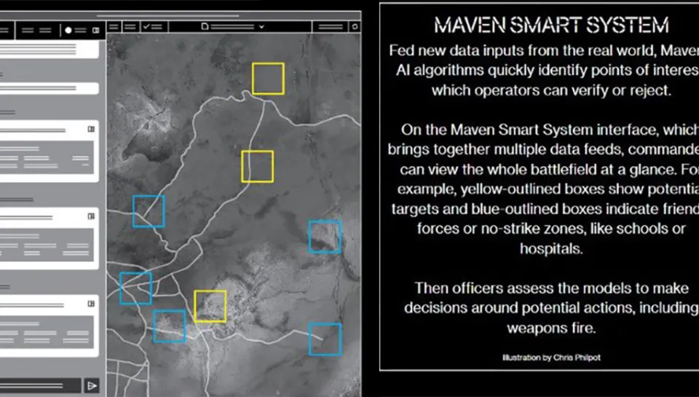
PAPER 3 · CONCRETE ENTRY POINT
Claude has reportedly been used in U.S. military operations related to Iran.
AI may not choose the final action. It can still analyze intelligence, simulate options, and structure what a human sees as actionable.
REPORTED CASE
AI analyzes
Human approves
Ownership shifts
CBS: Claude was reportedly used during the Iran operation; the exact role was not publicly disclosed.
Anthropic: Claude is described in intelligence analysis, simulation, operational planning, and cyber operations.
intelligence
simulation
→
verify
reject
→
feels
shared
Paper 3 asks whether AI role proximity changes decisional ownership and felt accountability before a high-risk action is taken.
Sources: CBS News; Anthropic public statements and DoD agreement. Image: user-provided Maven Smart System illustration; visual entry point only.
PAPER 3
2
Notes:
Let me start with a concrete example rather than an abstract responsibility theory. Recent reporting said that Claude was used by the U.S. military during the Iran operation, although the exact deployment was not publicly disclosed. Anthropic's own public statement is also useful here: it describes Claude in national-security workflows such as intelligence analysis, modeling and simulation, operational planning, and cyber operations.
So I am not claiming that Claude autonomously made a strike decision. The point is more subtle and more important for this paper. AI can enter the decision process before the final human approval. It can analyze information, simulate options, prioritize what looks actionable, and shape the choice environment that a human later approves or rejects.
Once that happens, human in the loop no longer fully answers the responsibility question. If the final action produces harm or escalation, does the human still experience the choice as fully theirs? Or does responsibility feel shared with the system, the organization, and the workflow? That is the question Paper 3 turns into an experiment.

