Slide 1
Chapter 2. Investigating the
Mechanism of Bias Formation
Misalignment Between Human Trust and
Actual AI Trustworthiness
Paper 2 · Research Design Chapter
Notes:
This chapter examines how economic incentives for AI use may alter trust calibration. The presentation moves from the real-world tension to the theoretical conflict, hypotheses, experimental design, model, and expected contribution.
[Sources]
• User-provided source deck: F:\第二章节 偏差形成机制的探究.pptx

Slide 2
Research Entry Point: A Real-World Tension
Many enterprises and government agencies use incentive policies to encourage
employees to use AI tools. Do such rewards alter employees’ judgments of AI
capability? Could they create blind trust in AI within the system?
Intended goal
Possible actual outcome
Improve productivity and use
Employees over-rely on AI, creating
AI capability appropriately.
extensive uncontrollable risks in
frontline operations.
02
Notes:
Organizations increasingly use economic incentives to encourage employees and users to adopt AI. These incentives can increase use while also weakening the informational link between actual AI capability and observed reliance.
[Sources]
• User-provided source deck, slide 2.

Slide 3
Real-World Incentives for AI Use
Existing policies reduce AI-use costs or reward adoption at different organizational levels.
CASE
ACTUAL POLICY
TARGET AND LEVEL
LINK TO EXPERIMENT
Shanghai “Model Coupon
Subsidizes enterprises’ costs of calling
(Token Coupon)”
third-party large-model APIs and privately
Government →
Closest to an “AI-use
deploying models.
enterprise
cost subsidy”.
Provides up to 50% grant support for GenAI
Singapore GenAI
solutions; a new national programme plans
Government →
Reduces organizational
Support Programme
to support 10,000 enterprises and 100,000
enterprises and workers
procurement and adoption costs.
workers in deepening AI adoption.
Makes “reflexive AI usage” a baseline employee
The enterprise bears tool costs
Shopify
expectation; provides unlimited advanced-model
Enterprise → employees
and imposes a usage expectation.
access and extensive Cursor licenses.
Links business-value-generating AI adoption to
Closest to the positive bonus
Omnisend
performance and compensation discussions and
Enterprise → employees
in the experiment.
offers cash bonuses for effective AI use.
03
Notes:
The four cases show that AI-use incentives can take several economic forms, including subsidies, reimbursements, bonuses, and performance-linked rewards. The empirical tension is that more adoption does not by itself reveal whether users believe the AI is more capable.
[Sources]
• User-provided source deck, slide 2.

Slide 4
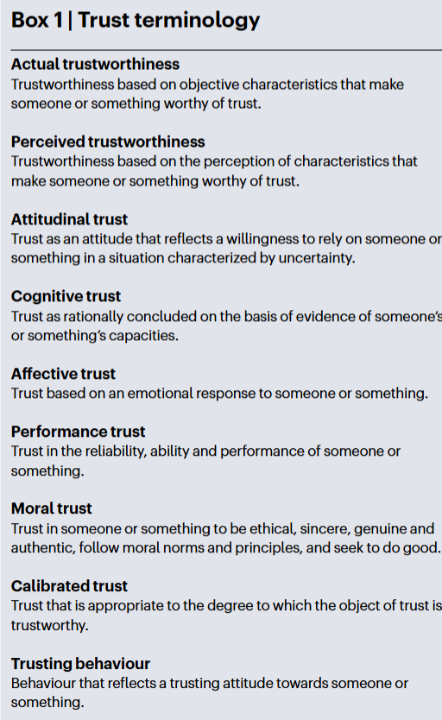
“Actual Trustworthiness” and “Actual Reliance” Are Different Questions
“Trustworthiness, trust and trusting behaviour are connected but distinct constructs”
Source excerpt: Everett et al. (2026)
(Everett et al., 2026, p. 390).
Actual trustworthiness
Whether the AI is in fact worthy of trust.
Perceived trustworthiness
Whether the user judges the AI to be worthy of trust.
Attitudinal trust
Whether the user is willing to rely on the AI.
Trusting behaviour
Whether the user actually relies on the AI.
04
Notes:
This slide separates actual trustworthiness, perceived trustworthiness, attitudinal trust, performance trust, and adoption behaviour. The distinction is essential because adoption under an incentive may be a payoff response rather than evidence of trust.
[Sources]
• User-provided source deck, slide 3.
• Terminology specification: E:\Info_AI\主Agent\文章项目\02_AI授权_EWA\第二篇_AI信任与经济激励_术语规范_2026-08-06.md

Slide 5
Theoretical Background
Limitations
Greiner et al. (2026)
The primary dependent variable is the weight placed on algorithmic advice, not a
Research question
systematic measure of perceived trustworthiness or attitudinal trust.
In AI-assisted decision contexts, can
Algorithm capability does not vary across incentive conditions; the study uses
incentives make decision-makers use
only one relatively high-quality algorithm.
more of an algorithm known to
outperform average humans?
Trustworthiness is measured only after the experiment with a single item, which
cannot distinguish perceived trustworthiness, attitudinal trust, and trusting behaviour.
Subjective capability judgments are not compared with an objective capability
Management-control question
benchmark, so trust calibration or trust misalignment cannot be identified.
Does the earlier finding that “financial
incentives backfire” still hold for modern
AI decision tools?
Our study further asks:
Do incentive-induced changes in trust align with the AI’s actual capability?
05
Notes:
Greiner and coauthors provide the theoretical entry point by asking how performance pay changes behaviour when the rewarded measure is imperfectly aligned with the underlying objective. The present study transfers this tension to AI-use incentives without treating adoption as trust by default.
[Sources]
• User-provided source deck, slide 4.

Slide 6
Theoretical Conflict: Economic Incentives May Change Only Choices—
or Also Judgments of AI Capability
Incentive Contracting and Performance
Trust Calibration Framework
Organizations can directly reward employees for
More trust or more AI adoption is not
adopting AI advice, but “adopting AI advice” is not
inherently better.
fully equivalent to decision quality or appropriate
reliance, which organizations ultimately seek.
Appropriate trust requires users’ trust and reliance
When a rewarded performance measure is not perfectly
to match the AI’s actual trustworthiness in a specific
aligned with the true objective, incentives may increase
task (Lee & See, 2004; Everett et al., 2026).
the measured behaviour without improving the outcome
the organization actually cares about
(Baker, 1992; Kerr, 1975).
Rewarded measure: Reliance on AI advice
Organizational objective: Decision quality and calibrated reliance
The relevant standard is alignment,
not the maximum possible level of trust.
06
Notes:
Incentive contracting predicts that behaviour responds to the rewarded measure, while the trust-calibration framework evaluates whether reliance is aligned with actual AI trustworthiness. Their combination creates the first conflict: the same observed adoption may reflect either capability-based reliance or a rational payoff response.
[Sources]
• User-provided source deck, slide 5.

Slide 7
Theoretical Conflict: Economic Incentives May Change Only Choices—
or Also Judgments of AI Capability
Bayesian Expected-Utility Benchmark
Performance-Learning Pathway
If incentives for AI use change the payoff from
The performance-learning pathway argues that
adopting AI advice but provide no new information
incentives may improve calibration.
about the AI’s actual capability, a rational
decision-maker can change the choice without
If adopting AI gives employees more experience
changing posterior beliefs about AI capability.
with AI performance, incentives may help them
understand AI capability more accurately by
increasing trial and feedback.
Management-accounting label
This informational function—helping diagnose and
adjust decisions—is the decision-facilitating role
Prediction
of performance measurement systems.
Choice may change; capability beliefs need not change.
07
Notes:
Under a Bayesian expected-utility benchmark, an incentive should not change beliefs about AI accuracy when it contains no new capability information. A competing performance-learning pathway predicts that repeated choices and feedback may nevertheless shift perceived trustworthiness.
[Sources]
• User-provided source deck, slide 5.

Slide 8



Core Question
Do AI-use incentives cause trust in AI to deviate?
i
participant.
What is deviation?
Deviation occurs when users’ trusting behaviour is
not appropriately calibrated to the AI system’s
The degree of AI reliance actually displayed by
participant i, operationalized as the proportion
actual trustworthiness.
of valid decision rounds in which the participant
adopts AI advice, ranging from 0 to 1.
The objective trustworthiness of the AI faced by
participant i, operationalized as the AI’s objective
accuracy on the same task, ranging from 0 to 1.
Participant i’s trust deviation: the difference
between actual trusting behaviour and the AI’s
objective trustworthiness.
08
Notes:
The core question asks whether AI-use incentives cause trust in AI to deviate. The displayed definition and notation are preserved from the source deck, while the accompanying definitions clarify how each quantity is operationalized.
[Sources]
• User-provided source deck, slide 6.

Slide 9
Research Hypotheses
H1
H1：As the level of AI-use incentives increases, trusting behaviour may increase
beyond the level supported by actual trustworthiness, resulting in overtrust
Incentives increase the proportion of participants who adopt AI advice. This is the basic
effect of whether the management policy promotes AI use, but it cannot by itself prove that trust has changed.
H2
H2For users whose baseline perceived trustworthiness is lower than the AI’s actual
trustworthiness, AI-use incentives reduce the gap between the two.
09
Notes:
H1 predicts that stronger AI-use incentives may increase trusting behaviour beyond the level supported by actual trustworthiness. H2 focuses on initially underestimated AI and predicts a reduction in the perception gap.
[Sources]
• User-provided source deck, slide 7.

Slide 10
Hypotheses
H3
—For users whose baseline perceived trustworthiness exceeds the AI’s actual
trustworthiness, stronger AI-use incentives further widen the gap between the two.
H4 — Moderating Effect of Actual Trustworthiness
The lower the AI’s actual trustworthiness, the stronger the positive effect of
AI-use incentives on trust deviation.
10
Notes:
H3 addresses users who initially overestimate AI trustworthiness and predicts that stronger incentives widen the gap. H4 predicts that this positive effect on trust deviation is stronger when actual trustworthiness is lower.
[Sources]
• User-provided source deck, slide 7.

Slide 11
Research Design
Repeated probabilistic-judgment task using a virtual slot machine as the decision interface
1
Independent judgment
2
Receive AI advice
3
Probability assessment
4
Final choice
Based on visible
All participants see the
Participants separately
Retain the initial judgment
probability cues,
same AI recommendation.
report the subjective
or switch to the AI
participants independently
probability that:
recommendation.
judge which outcome is
• AI recommendation is
more likely.
correct
• their own initial judgment
is correct
Outcome feedback
True outcome
Whether the initial judgment was correct
Whether the AI advice was correct
11
Notes:
Each round separates independent judgment, exposure to AI advice, probability assessment, and the final choice. Outcome feedback then reveals the true result and the correctness of both the participant's initial judgment and the AI advice.
[Sources]
• User-provided source deck, slide 8.

Slide 12

AI Advice and Experimental Conditions
AI capability manipulation
Common evidence
Payment and parameter principles
• Fixed pre-generated AI advice
• Same experimental questions
• Same base performance pay for each
sequence
correct answer
• Same AI-advice sequence
• Adoption deduction, reimbursement,
• High-capability AI accuracy
or positive bonus settled separately
• Same AI-error positions
• Low-capability AI accuracy
• Pretest freezes task difficulty and
Differences therefore arise only
both capability parameters
from the economic-incentive
• Capability difference is identifiable
mechanism.
within limited feedback rounds, but not
large enough to remove variation in
beliefs or reliance.
12
Notes:
The design holds experimental questions, advice sequences, and error positions constant while varying AI capability and the economic-incentive mechanism. Payment is decomposed into common base performance pay and a separately settled adoption deduction, reimbursement, or bonus.
[Sources]
• User-provided source deck, slide 8.

Slide 13
Meaning of Variables I
Current variable
Corresponding construct
Precise meaning
AI’s actual accuracy q
Actual trustworthiness
Actual trustworthiness is broader than accuracy; in this
performance task, objective accuracy is its operationalization.
Participant-estimated
Perceived trustworthiness
Participant’s subjective estimate of AI objective capability
accuracy qhat
in the current task.
Scale items such as
Attitudinal trust
Willingness to rely under uncertainty or risk.
“I am willing to rely
on this AI”
Trust formed from
Cognitive trust
Merely observing feedback or updating qhat cannot automatically
accuracy or error records
be called cognitive trust. Unless the measure captures a trust
judgment formed from capability evidence, call it perceived
trustworthiness.
13
Notes:
The first variable table defines the constructs attached to actual accuracy, estimated accuracy, attitudinal trust, and cognitive trust. Feedback observation alone is not labeled cognitive trust unless the measure captures a trust judgment formed from capability evidence.
[Sources]
• User-provided source deck, slide 9.
• Terminology specification: E:\Info_AI\主Agent\文章项目\02_AI授权_EWA\第二篇_AI信任与经济激励_术语规范_2026-08-06.md

Slide 14
Meaning of Variables II
Current variable
Corresponding construct
Precise meaning
Trust in AI reliability,
Performance trust
Content concerns reliability, capability, and performance,
capability, and
rather than moral qualities.
performance
Actual adoption of
Adoption behaviour
With an adoption reward, this may be a payoff response and is
AI advice
not automatically trusting behaviour. Only if it is shown to
reflect a trust attitude can it operationalize trusting behaviour.
qhat − q
Perceived-trustworthiness
Measures the gap between perceived and actual trustworthiness;
calibration error
it is not calibrated trust as defined by Nature.
14
Notes:
The second table distinguishes performance trust from adoption behaviour and defines the calibration-error measure. Adoption under reward is not automatically trusting behaviour, and the perception gap is not treated as calibrated trust itself.
[Sources]
• User-provided source deck, slide 9.
• Terminology specification: E:\Info_AI\主Agent\文章项目\02_AI授权_EWA\第二篇_AI信任与经济激励_术语规范_2026-08-06.md

Slide 15
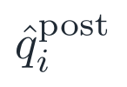

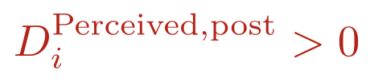
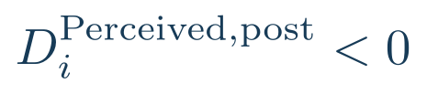
Model
Primary dependent variable
Three core explanatory variables
Initial calibration state
perceived > actual
Post-incentive estimated AI
Actual AI accuracy,
accuracy, corresponding to
corresponding to actual
perceived trustworthiness.
trustworthiness.
perceived < actual
The sign of the pre-incentive gap identifies initial overestimation or underestimation.
15
Notes:
The primary dependent variable is the post-incentive gap between perceived and actual AI trustworthiness. Its sign identifies whether perceived trustworthiness lies above or below actual trustworthiness.
[Sources]
• User-provided source deck, slide 10.

Slide 16
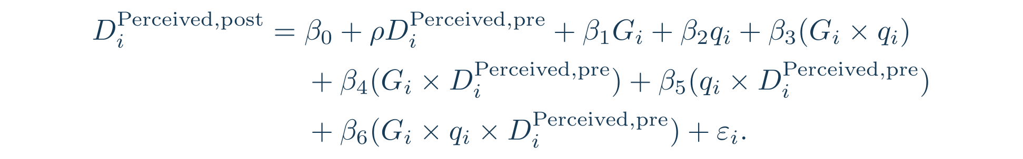




Main Model
Persistence of the pre-incentive gap
Incentive effect. Because the incentive has
three levels, the formal estimate contains
after the incentive.
two between-group comparison coefficients.
Effect of the actual trustworthiness
Whether the incentive effect varies with
actual trustworthiness; this also yields two
level.
interaction coefficients.
The coefficient definitions follow the model specification in the source deck.
16
Notes:
The main model estimates persistence in the pre-incentive gap, the incentive effect, the actual-trustworthiness effect, and their interaction. Because the incentive has three levels, the relevant main and interaction effects are represented by two comparison coefficients each.
[Sources]
• User-provided source deck, slide 11.

Slide 17


Main Model: Key Heterogeneity Tests
Actual trustworthiness heterogeneity
Whether actual AI trustworthiness changes the incentive effect.
Initial calibration heterogeneity
Whether initial overestimation or underestimation changes the incentive effect.
Joint heterogeneity — most important test
Joint effect of incentive level, actual AI trustworthiness, and initial perceived trustworthiness.
Auxiliary outcomes
Attitudinal trust, performance trust, and adoption behaviour are reported separately and do not enter
the calculation of the calibration gap above.
17
Notes:
The model tests heterogeneity by actual AI trustworthiness, initial overestimation or underestimation, and their joint interaction with incentive level. Attitudinal trust, performance trust, and adoption behaviour remain auxiliary outcomes and do not enter the calibration-gap calculation.
[Sources]
• User-provided source deck, slide 11.

Slide 18
Expected Contribution
Contribution to Management Theory
Research on incentive contracting and performance measurement emphasizes potential misalignment between rewarded behaviour and organizational objectives (Kerr, 1975; Baker, 1992). This study further examines whether rewarding AI adoption affects employees’ judgments of AI capability.
The study distinguishes two competing predictions. Expected-utility reasoning predicts changes in AI adoption, whereas motivated reasoning and payoff-based belief distortion predict additional changes in perceived trustworthiness (Kunda, 1990; Jiao, 2020).
The findings will show how AI incentive policies should be evaluated jointly through adoption, capability judgments, and decision quality.
18
Notes:
The expected contribution is to distinguish three explanations for adoption changes: rational payoff responses, capability-judgment shifts, and choices that diverge from participants' own beliefs. This extends research that has mainly treated adoption, purchase, search, or future willingness to pay as outcomes.
[Sources]
• User-provided source deck, slide 12.

Slide 19
Expected Contribution
Contribution to AI Trust Theory
It separately measures actual trustworthiness, perceived trustworthiness, performance trust, and adoption behaviour to identify where economic interests enter the AI trust process (Everett et al., 2026).
It examines whether increased AI adoption arises from changes in economic payoffs, perceived trustworthiness, or trust attitudes.
By comparing perceived trustworthiness with actual trustworthiness, the study determines whether incentives correct an underestimation of AI capability or amplify an overestimation.
18
Notes:
The expected contribution is to distinguish three explanations for adoption changes: rational payoff responses, capability-judgment shifts, and choices that diverge from participants' own beliefs. This extends research that has mainly treated adoption, purchase, search, or future willingness to pay as outcomes.
[Sources]
• User-provided source deck, slide 12.

