Slide 1
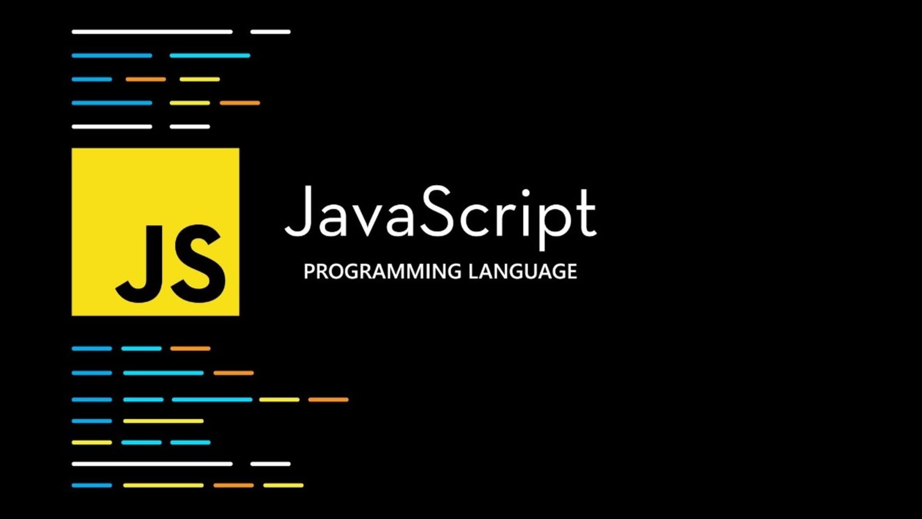
JavaScript
JS
For beginner

Slide 2

JavaScript Types
string
number
boolean
Primitives
null
undefined
JS
symbol
bigint
Complex
object
array
function

Slide 3
JavaScript Types
string
W
JS

Slide 4
JS

Slide 5
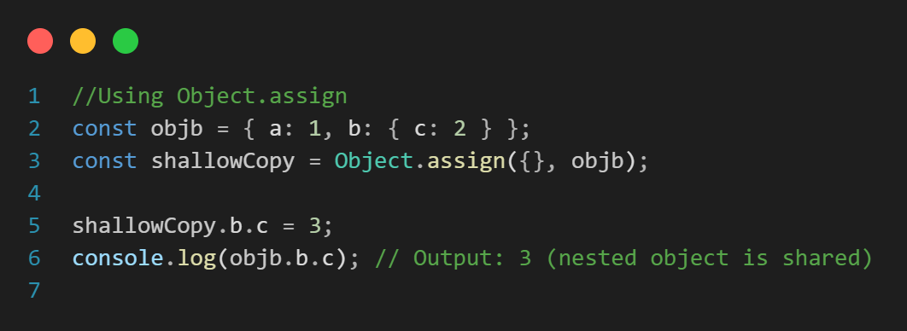
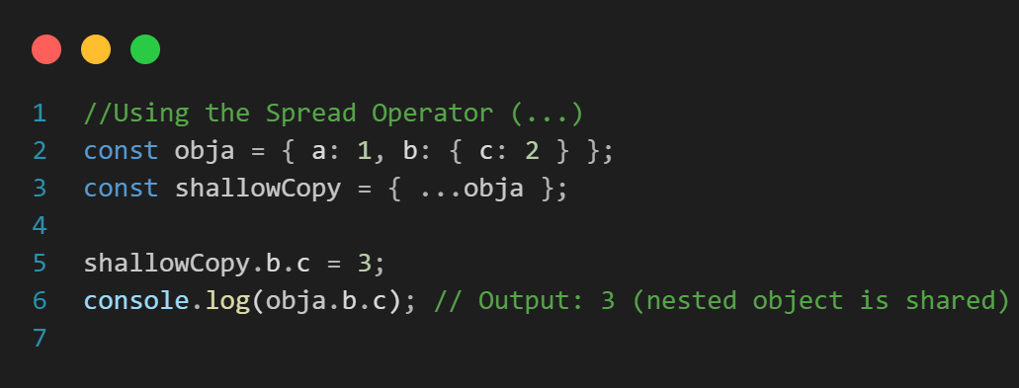
JavaScript Copy
Shallow copy
When your object contains only primitive values, or you do not intend to modify nested objects.
References are copied
Changes to nested objects affect both
JS
Simple and fast

Slide 6
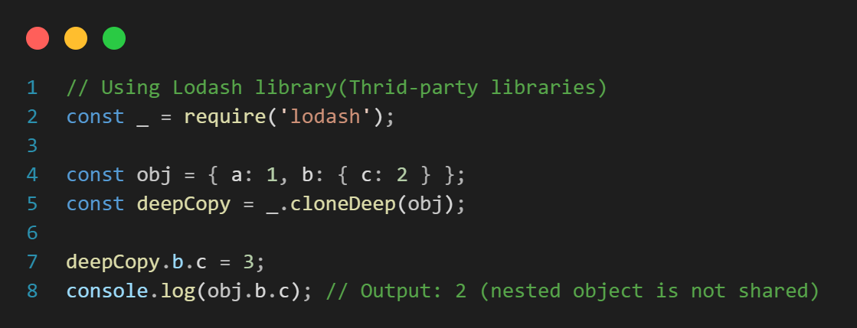
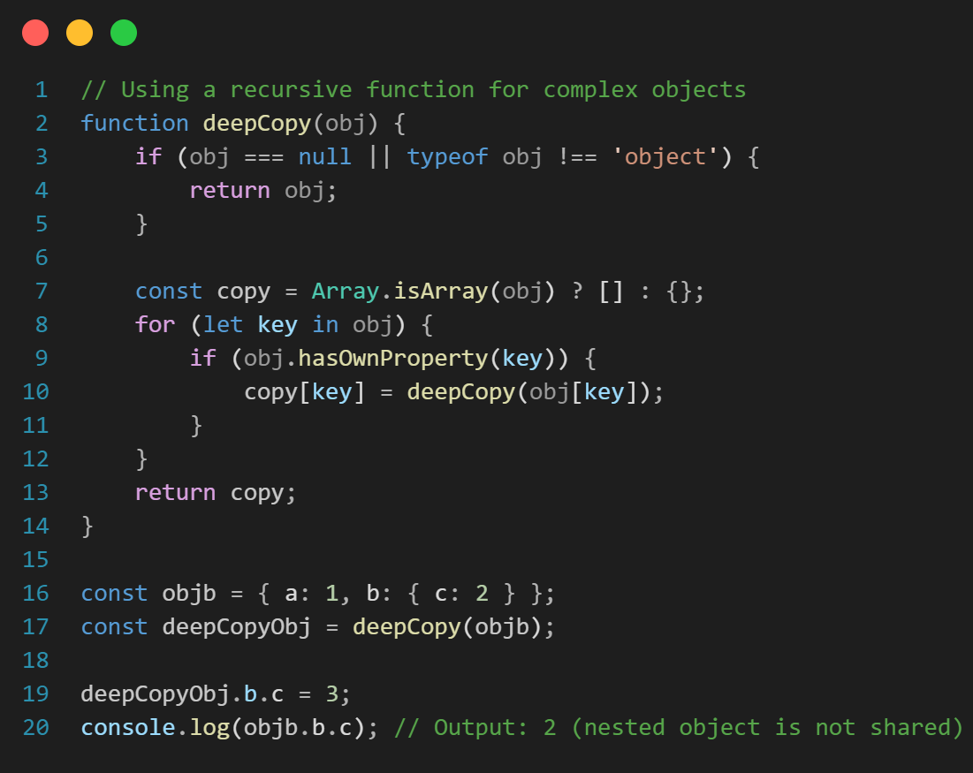
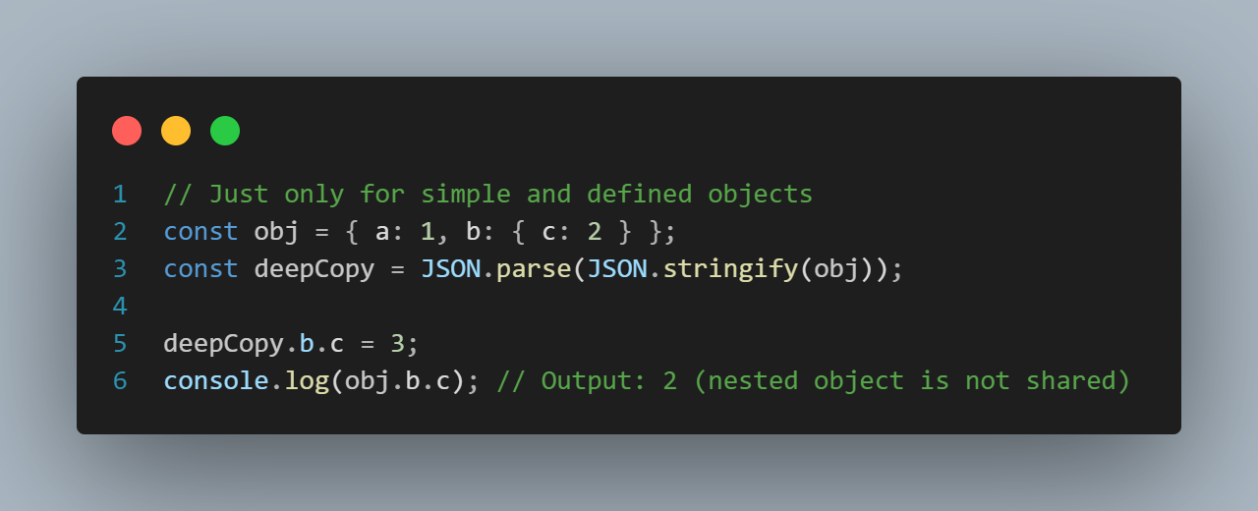
JavaScript Copy
Deep copy
When your object contains nested structures, and you need to ensure complete independence between the copies.
Entire structure is copied
Changes to nested objects are isolated
JS
More complex and time-consuming

Slide 7
JavaScript Polyfill
JS

Slide 8
JavaScript Output
JavaScript Display Possibilities
document.getElementById(DOM_object_Id).innerHTML = message
Writing message into a HTML element
JS
document.write(message)
Writing message into the HTML output
console.log(message)
Writing message into the browser console
window.alert(message)
Writing message into an alert box

Slide 9
JavaScript Event Loop
For enabling non-blocking execution despite being single-threaded.
Call Stack
JS
Task Queue

Slide 10
JS

