Slide 1
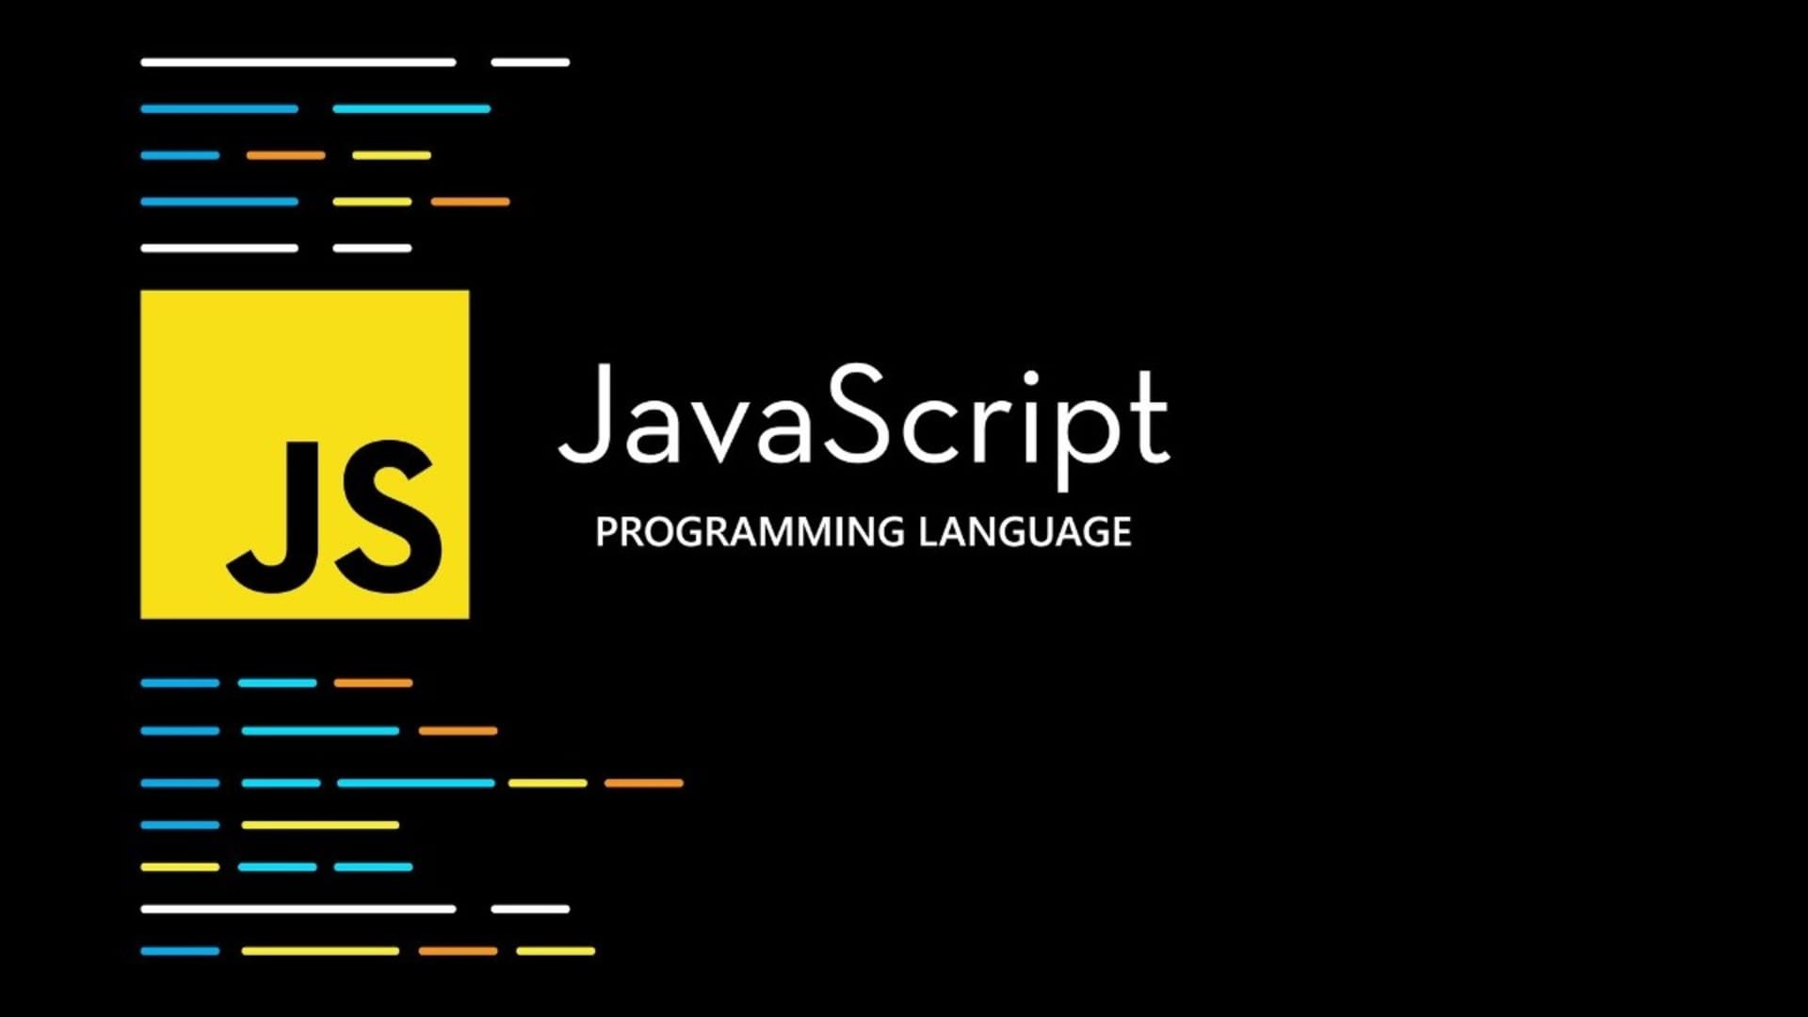
JavaScript
JS
For beginner

Slide 2

JavaScript Variables
Most of the time, a JavaScript application needs to work with information. To store and represent this information in the JavaScript codebase, we use variables. A variable is a container for a value.
JS

Slide 3
JavaScript Variables Keyword
var
W
let
JS
W
const
W

Slide 4
JavaScript Variables Keyword
var
W
let
JS
W
const
W

Slide 5
JavaScript Variables Keyword
var
W
let
JS
W
const
W

Slide 6
JavaScript Data Types
string
number
boolean
JS
Primitives
null
undefined
symbol
Complex
object
bigint
array
function

Slide 7
JavaScript Types
string
W
JS

Slide 8
JS

Slide 9
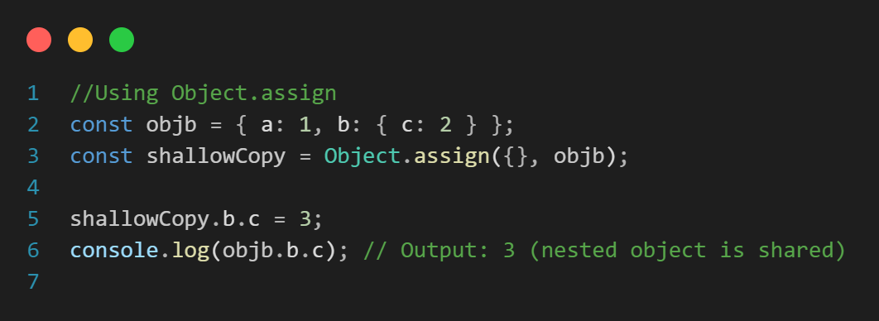
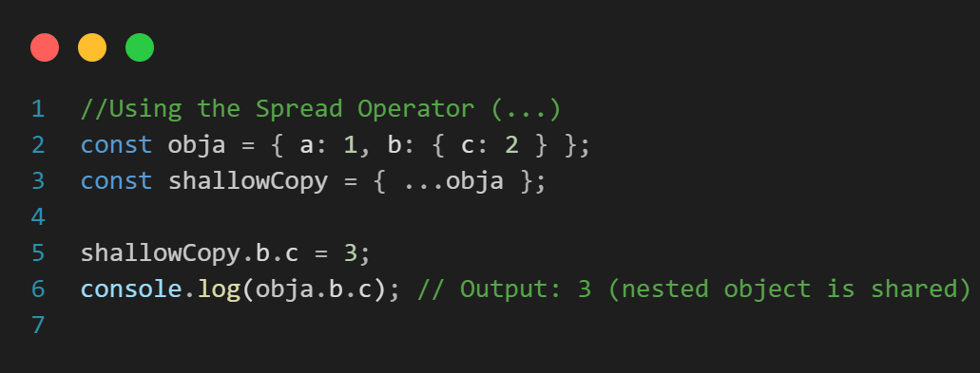
JavaScript Copy
Shallow copy
When your object contains only primitive values, or you do not intend to modify nested objects.
References are copied
Changes to nested objects affect both
JS
Simple and fast

Slide 10
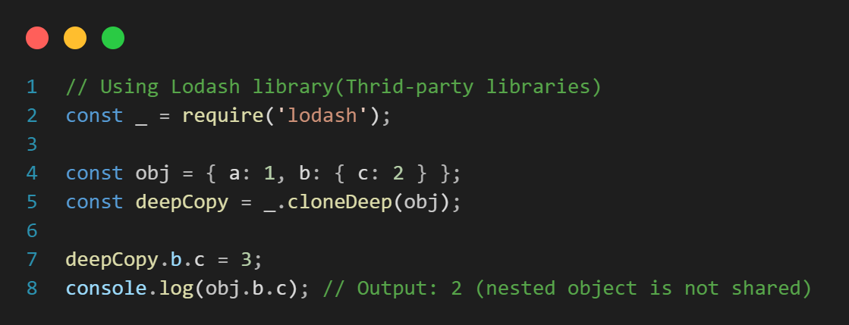
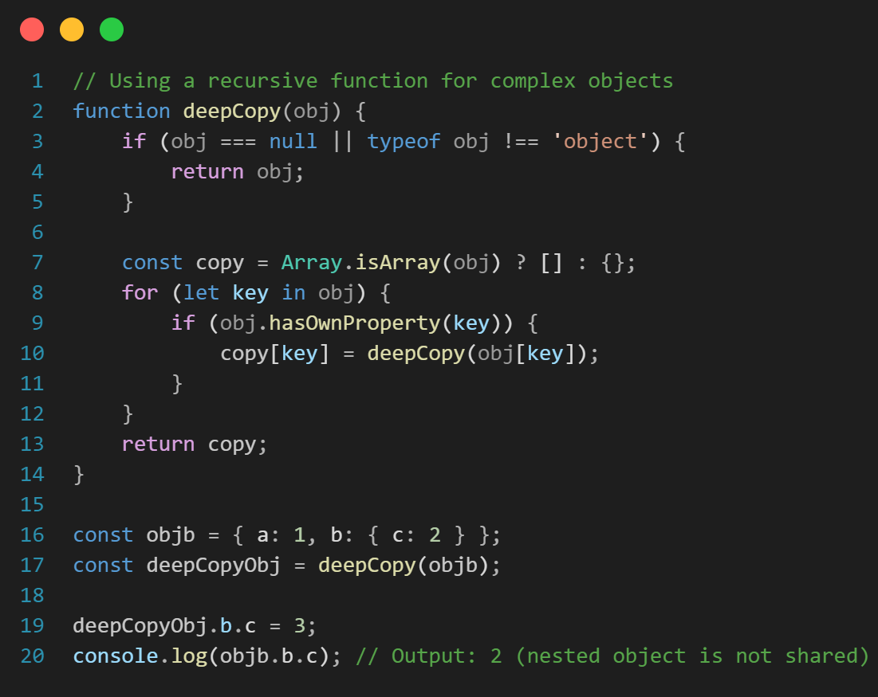
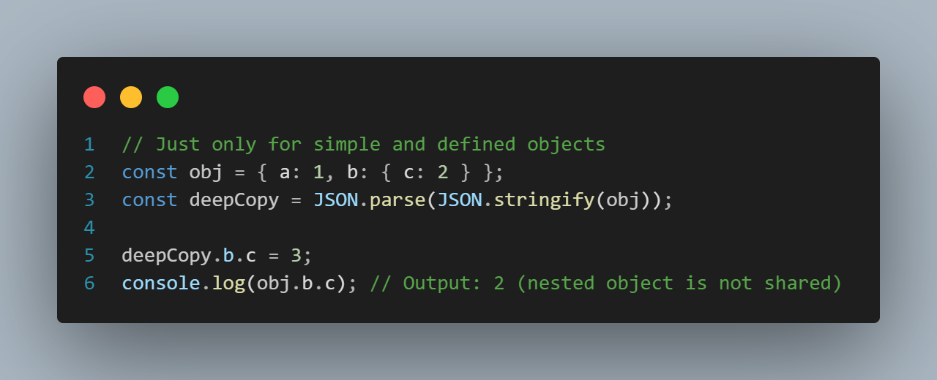
JavaScript Copy
Deep copy
When your object contains nested structures, and you need to ensure complete independence between the copies.
Entire structure is copied
Changes to nested objects are isolated
JS
More complex and time-consuming

Slide 11
JavaScript Polyfill
JS

Slide 12
JavaScript Output
JavaScript Display Possibilities
document.getElementById(DOM_object_Id).innerHTML = message
Writing message into a HTML element
JS
document.write(message)
Writing message into the HTML output
console.log(message)
Writing message into the browser console
window.alert(message)
Writing message into an alert box

Slide 13
JavaScript Event Loop
For enabling non-blocking execution despite being single-threaded.
Call Stack
JS
Task Queue

Slide 14
JS

